Slide 1

The State of Aging in Portland
Part 3 - Race
First page
Portland and comparison cities
City-suburb comparison
Age structure by race
Mapping race and diversity
Blacks
Asians
Native Americans
Hispanics
The largest racial/ethnic group in the city of Portland for persons age 65+ is White non-Hispanic. In general, minority groups have fewer older persons, in part due to recent immigration of younger minority persons.
Portland’s Black community began with settlement in the Albina area, first by railway workers then later by those who came to work in the shipyards during World War II. In the past two decades many Blacks have left the core in Northeast Portland and moved mainly to East Portland. More older Blacks have stayed in the core Northeast Portland area, perhaps due to higher rates of home ownership compared to younger Blacks.
Hispanics in Oregon originally came principally from Mexico and mainly to work in the agricultural industries, but in recent years many have moved to urban occupations. Somewhat like the Black community, Hispanics have shifted eastward from Central Eastside residences.
Portland has a relatively large Asian population. The Asian population is composed of persons from many different national origins, each with its own pattern of location.
Portland’s Native American community is widely distributed across the region, with some local concentrations. Those in the age 70+ group fall off sharply compared to younger age cohorts indicating out migration or, more likely, lower survival rates.
Click here to learn about the nomenclature for this section (e.g., Hispanic vs. Latinx, White vs. white).

Slide 2

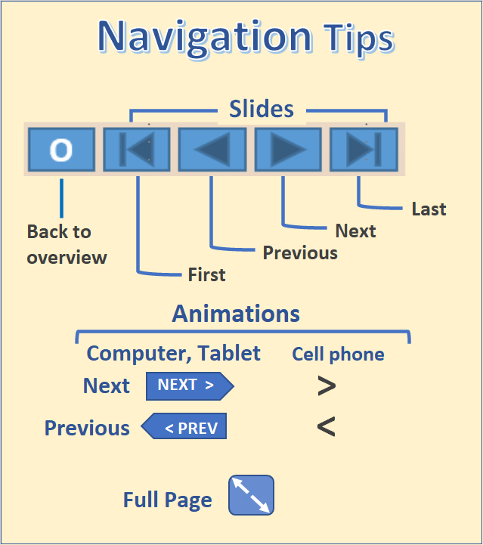
O

Slide 3
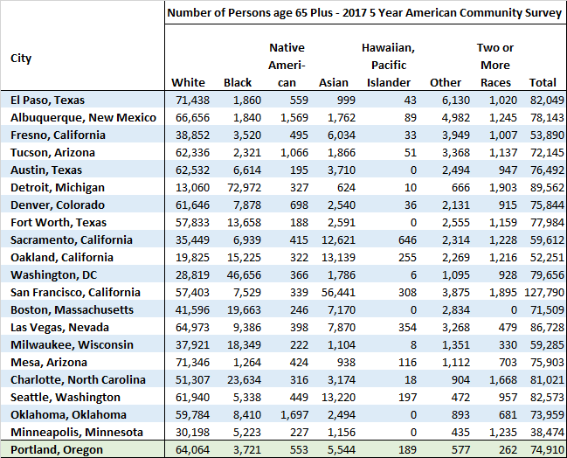
Portland and Comparison Cities
Number of Persons Age 65+ in U.S. Cities Compared to Portland, Ore.
Portland and comparison cities
City-suburb comparison
Age structure by race
Mapping race and diversity
Blacks
Asians
Native Americans
Hispanics
In this table, comparison cities most similar to Portland with respect to race and Hispanic origin are listed from the least similar (El Paso) to the most similar (Minneapolis).
This shows Portland to be a mostly White city, generally similar to Seattle and Minneapolis. Only Mesa, Arizona, has a larger proportion of White non-Hispanics.
Portland lacks the large number of Asians found in San Francisco.
Portland also lacks the large number of Blacks found in Detroit or Washington, DC.
Portland and comparison cities
City-suburb comparison
Age structure by race
Mapping race and diversity
Blacks
Asians
Native Americans
Hispanics
O
Source: 2013-2017 5-year ACS, table B02001
Learn about the American Community Survey (ACS)

Slide 4
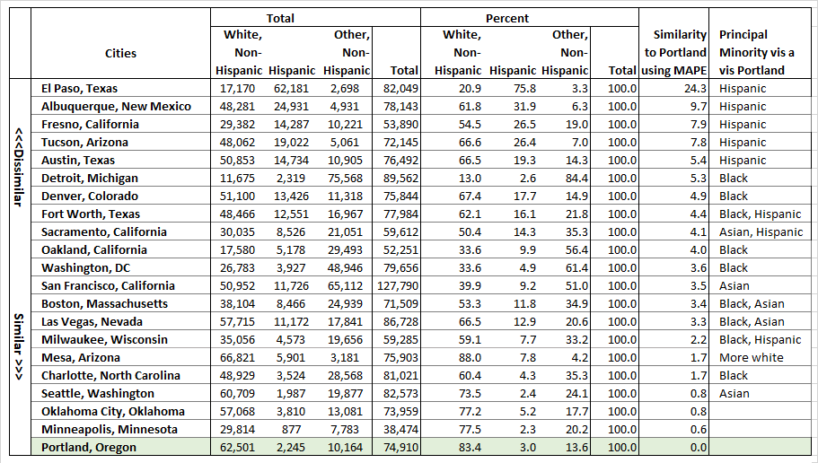
Racial Groups Combined and Hispanic added
Cities are ordered from the most dissimilar (top) to the most similar (bottom) using a MAPE measure (mean absolute percent difference compared to Portland).
MAPE is used to order the cities using percent values for White non-Hispanic, Hispanic, and Other non-Hispanic.
This table adds
Hispanic origin and collapses other race races/ethnicities into:
White non-Hispanic and
Other race non-Hispanic.
The difference in the racial mix in the other cities is due mainly to larger numbers of Hispanics and/or Asians.
.
Source: 2013-2017 5-year ACS, tables B01001, A-I.
O

Slide 5
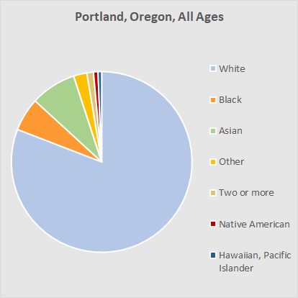
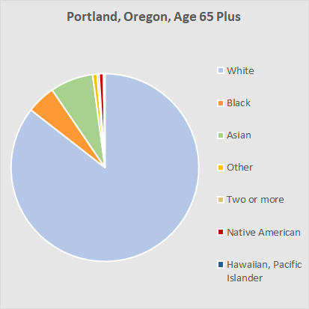
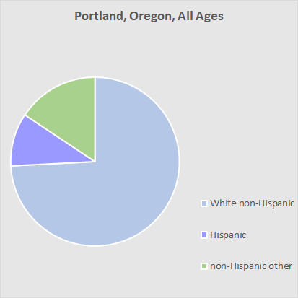
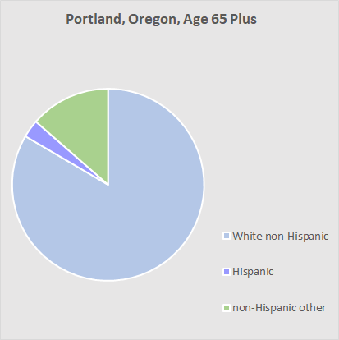
Fewer Minorities in the Older Adult Population
Portland’s population is primarily White, and its age 65+ population is composed of mostly Whites and fewer minorities.
Grouping the city’s population into three groups – White non-Hispanic, Hispanic, and Other non-Hispanic – shows that among those age 65+ there is a much smaller proportion of Hispanics.
Source: 2013-2017 5-year ACS, tables B01001, A-I.
O

Slide 6
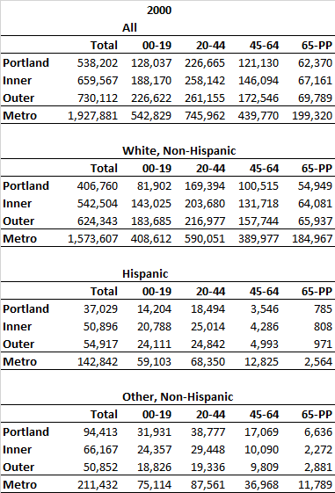
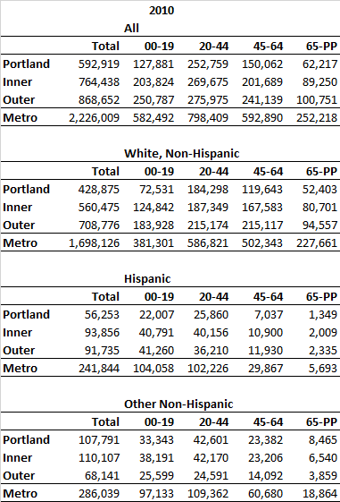
Suburbs and City, by Race and Hispanic Origin
First page
Portland and comparison cities
City-suburb comparison
Age structure by race
Mapping race and diversity
Blacks
Asians
Native Americans
Hispanics
White non-Hispanics comprise the largest proportion of those age 65+:
In 2000 this group was about equally distributed between Portland and its inner and outer suburbs.
By 2010 the numbers shrank slightly in Portland and grew substantially in the suburban areas.
The numbers of age 65+ Hispanics were relatively small in 2000 but increased in all areas and more than doubled in inner and outer areas by 2010.
The Other non-Hispanic group is composed principally of Blacks and Asians. From 2000 to 2010 this group grew by about 27% in the city but by 284% in the inner suburbs.
Source: 2000 and 2010 Decennial Census, SF1, tables 12H and 12I.
Learn about the Decennial Census
O

Slide 7
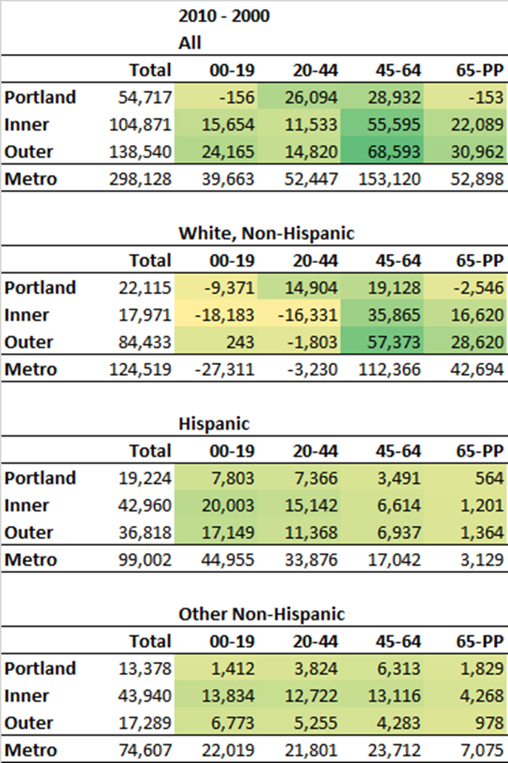
Suburbs and City, Changes by Race and Hispanic Origin
The age 65+ population in the city of Portland actually declined by 153 persons from 2000 to 2010.
However, the numbers in the suburban areas grew by more than 50,000.
Most of the loss of age 65+ population in the city was White non-Hispanic persons.
This loss was mostly offset by modest growth in the numbers of age 65+ Hispanics and Other non-Hispanics.
Source: 2000 and 2010 Decennial Census, SF1, tables 12H and 12I.
O

Slide 8
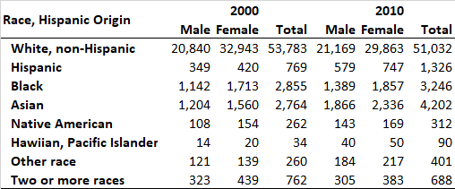
Age Structure by Race for the Age 65+ Population of Portland
First page
Portland and comparison cities
City-suburb comparison
Age structure by race
Mapping race and diversity
Blacks
Asians
Native Americans
Hispanics
This animation shows the numbers for the principal racial and Hispanic origin groups for the age 65+ population in the city of Portland, based on data from the 2000 and 2010 Censuses.
For persons age 65+ the largest group in 2000 and 2010 was White, non-Hispanic; however, the numbers for this group declined slightly over the decade.
There were not a large number of age 65+ Hispanics in 2000 or 2010 but the numbers did nearly double.
The largest minority groups were Black and Asian, with the Asian group showing more growth over the 2000-2010 decade.
Note: The latest 2019 ACS data from the five-year tables are not shown here, as sampling variation for individual ethnic groups makes it difficult to compare with the 2010 Census data.
Source: 2000 and 2010 Decennial Census, SF1, tables P12,A-G.
O

Slide 9
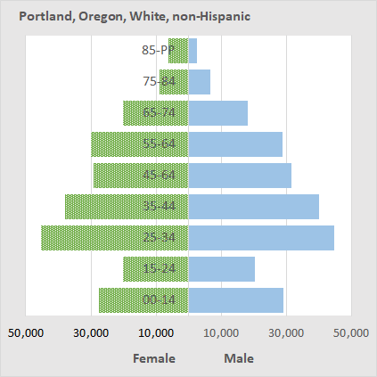
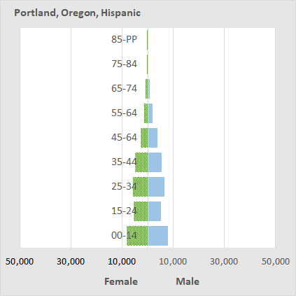
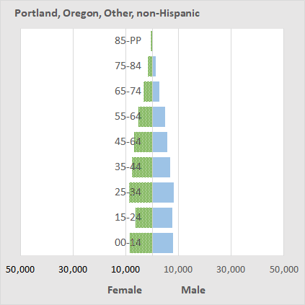
Pyramids, Hispanic & non-Hispanic, Portland
We are shifting here from the use of 2000 and 2010 Census data to data for 2013-2017 from the American Community Survey.
The population pyramid for the city of Portland for White non-Hispanics was characterized by a large young working-age population (age 25-44) and a large pre-retirement population (age 55-64) who will pass age 65 in the next decade.
Portland’s Hispanic population is much smaller than that for White non-Hispanics, and there are relatively few who are age 65+.
The Other non-Hispanic group is composed mainly of Asians, Blacks, and other racial groups who did not check “Hispanic” on the survey form.
This group is more numerous than Hispanics and does include a substantial number of people who are age 65+.
Source: 2013-2017 5-year ACS, table B01001, A-I
O

Slide 10
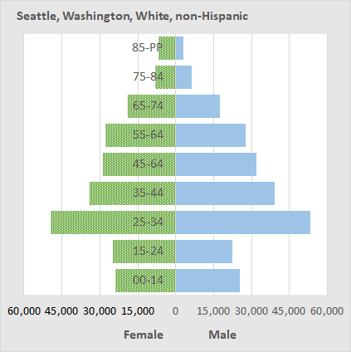
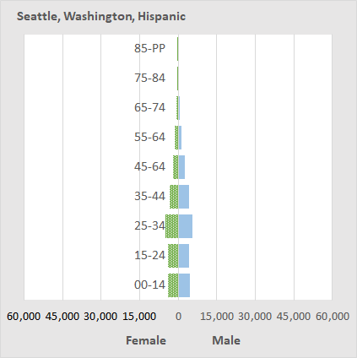
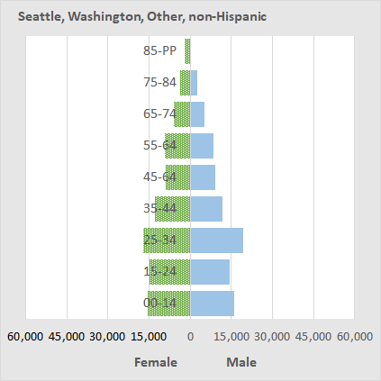
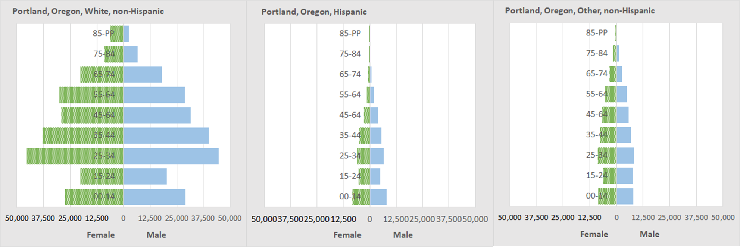
Hispanics &
non-Hispanics –
Seattle & Portland
Seattle and Portland have similar age structures for the three racial/Hispanic groups.
However, Seattle’s Black and Asian populations are larger proportionally than Portland’s.
Portland’s Hispanic population is slightly larger than Seattle’s.
Source: 2013-2017 5-year ACS, table B01001, H-I.
O

Slide 11
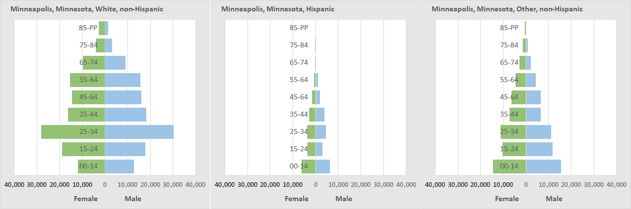
Hispanics &
non-Hispanics in Minneapolis and Portland
Portland has a larger White non-Hispanic population ages 25-74 than Minneapolis.
In Minneapolis the numbers of White non-Hispanics do not decline much from ages 35-65.
The other non-Hispanic population of Minneapolis is larger than Portland’s and includes more Blacks.
Source: 2013-2017 5-year ACS, table B01001, H-I.
Learn more about Minneapolis
O

Slide 12
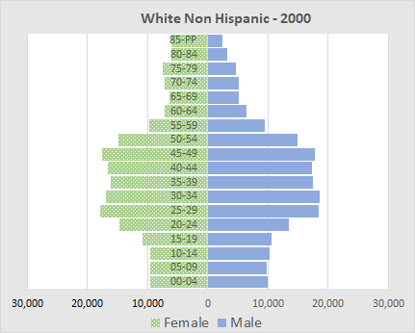
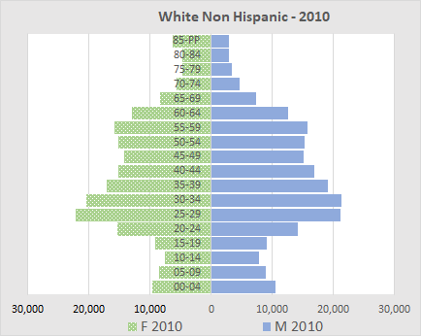
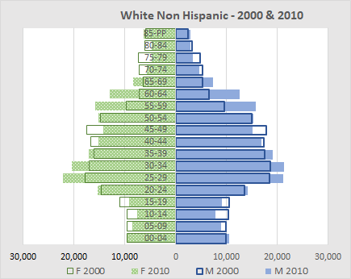
White non-Hispanics – Portland (2000-2010)
The age 65+ White non-Hispanic population of Portland decreased from 53,783 persons in 2000 to 51,032 in 2010 (-2,751).
In this combined population pyramid, population in 2000 is shown with green and blue outlines; the 2010 population is shown with green cross-hatching and solid blue (see legend at bottom of this slide and the next 4).
Note that the 45-54 cohort in 2000 resulted in a large 55-64 cohort in 2010, which in 2020 will be age 65-74 (see if you can see cohort trends over the next 4 slides).
The large cohort moving into retirement age is due in part to the larger numbers of births post World War II and to earlier periods of in-migration of workforce age persons to Portland.
O
Source: 2000 and 2010 Decennial Census, SF1, tables 12A and 12G.

Slide 13
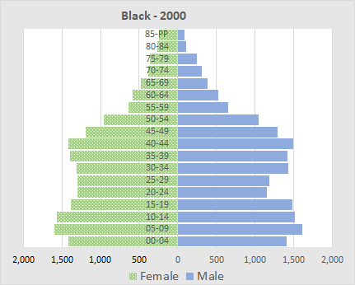
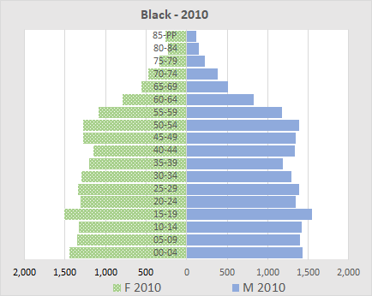
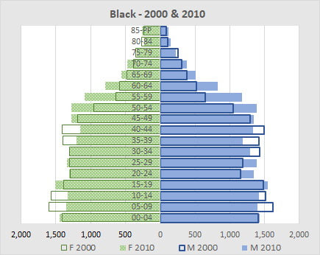
Blacks – Portland (2000-2010)
The age 65+ Black population of Portland increased slightly from 2,855 in 2000 to 3,246 in 2010 (+391).
However, the 45-54 cohort in 2000 resulted in a large 55-64 cohort in 2010, which in 2020 will be age 65-74.
Over the past 20 years there has been outmigration of Blacks from the city due to displacement and more attainable housing price options elsewhere, but this has occurred to a lesser degree for older Black households, many of whom are home-owners.
O
Source: 2000 and 2010 Decennial Census, SF1, table P12B.

Slide 14
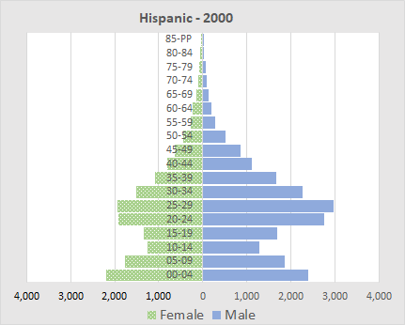
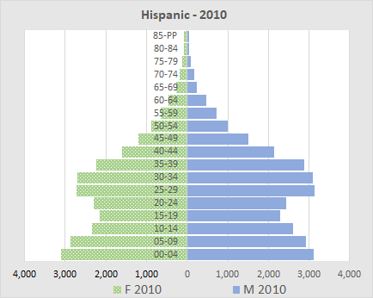
Hispanics – Portland (2000-2010)
Both in 2000 and 2010, the numbers of Hispanics age 65+ were relatively small (769 and 1,326, respectively); however, from 2000 to 2010, the numbers nearly doubled (+557).
In-migration of workforce-age Hispanics over the past two decades will mean a large increase in the numbers of age 65+ Hispanics by 2040.
Note the gender imbalance in the pyramids; for those ages 15-54 there are significantly more males than females (this disparity is more pronounced in 2000 and decreases somewhat by 2010).
O
Source: 2000 and 2010 Decennial Census, SF1, table P12H.
TOC

Slide 15
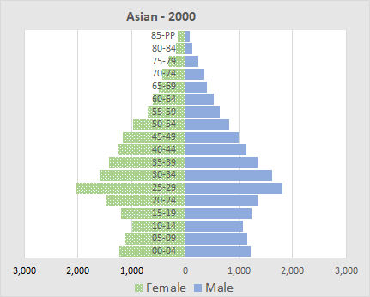
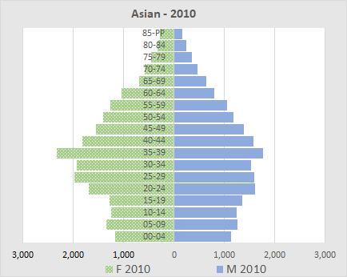
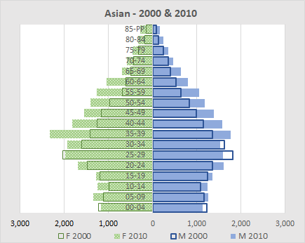
Asians – Portland (2000-2010)
The city of Portland’s age 65+ Asian population grew from 2,764 in 2000 to 4,202 in 2010 (+1,438).
As will be shown in following sections, Portland’s older Asian population is diverse. Based on the 2013-2017 ACS the largest number in Asian sub-populations were Chinese (1,777), followed by Vietnamese (1,570).
Nearly 50% of the Portland Metro Area’s population for these groups live in the city of Portland.
The age structure of the Asian population suggests that there will be steady growth of the age 65+ population.
O
Source: 2000 and 2010 Decennial Census, SF1, table P12D.

Slide 16
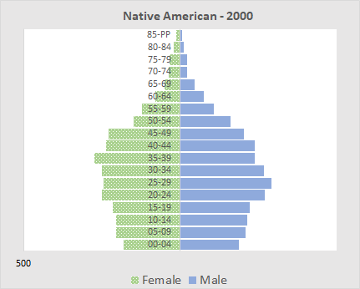
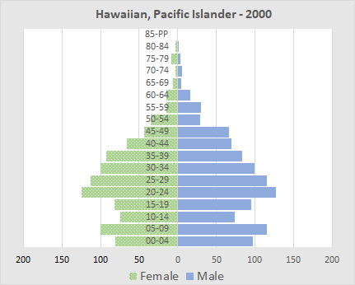
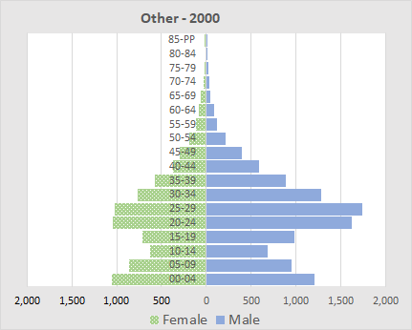
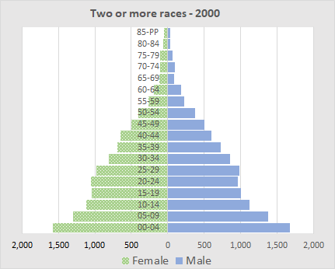
Other Racial Groups – Portland (2000)
Native Americans: The number of older Native Americans in Portland is small. There are substantial numbers in the pre-65 age groups that could foretell growth.
Hawaiians and Pacific Islanders: This is a relatively young population with the numbers falling off sharply over age 50.
Other races: These are mainly persons of Hispanic origin who did not identify with any of the race groups and checked the “other” box. Note the imbalance in males and females for age groups under 50, especially the 20-44 age groups. Often Hispanics select the other race category.
Two or more races. The Census allows the respondent to choose multiple race categories. Larger numbers for the young may be due to increased rates of inter-racial marriage and greater acceptance of the concept of multi-racial.
Source: 2000 and 2010 Decennial Census, SF1, table P12, D-G.
O
Notes:
Dick, I like this slide and want to keep it but wonder, why 2000 rather than 2010, or a combined 2000-2010 pyramid?

Slide 17
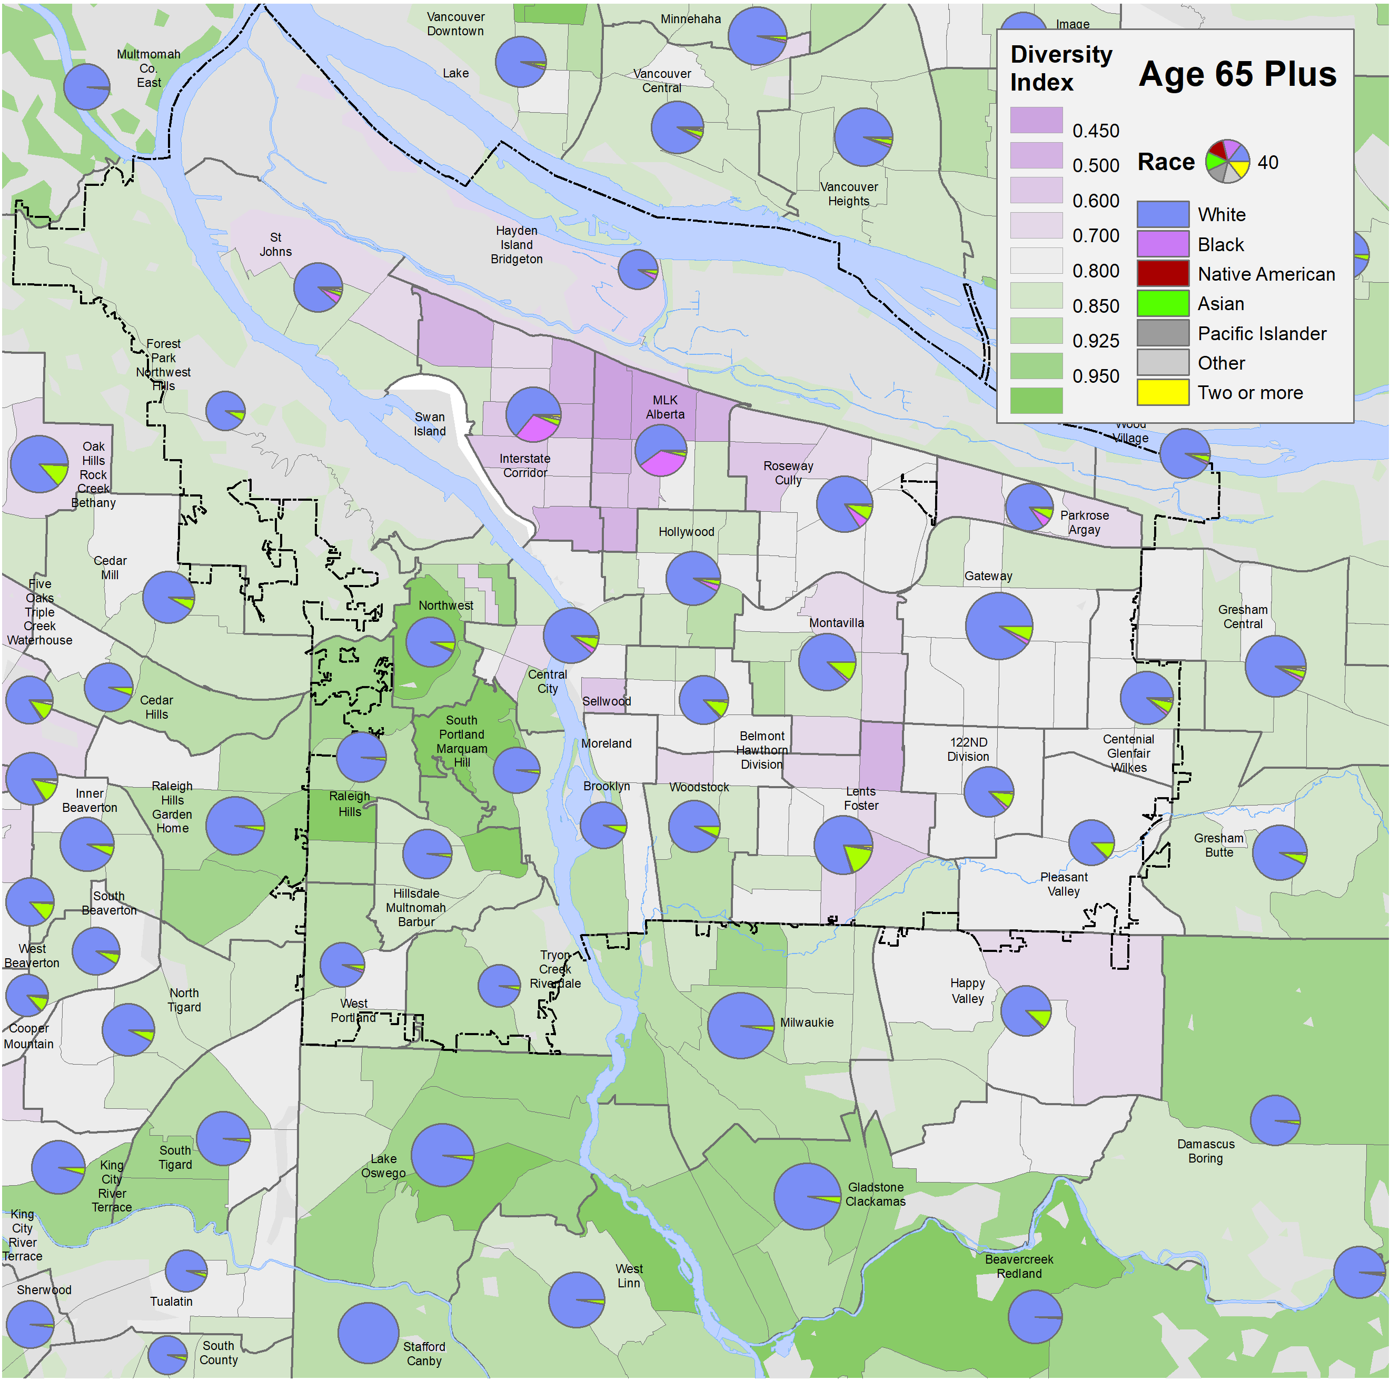
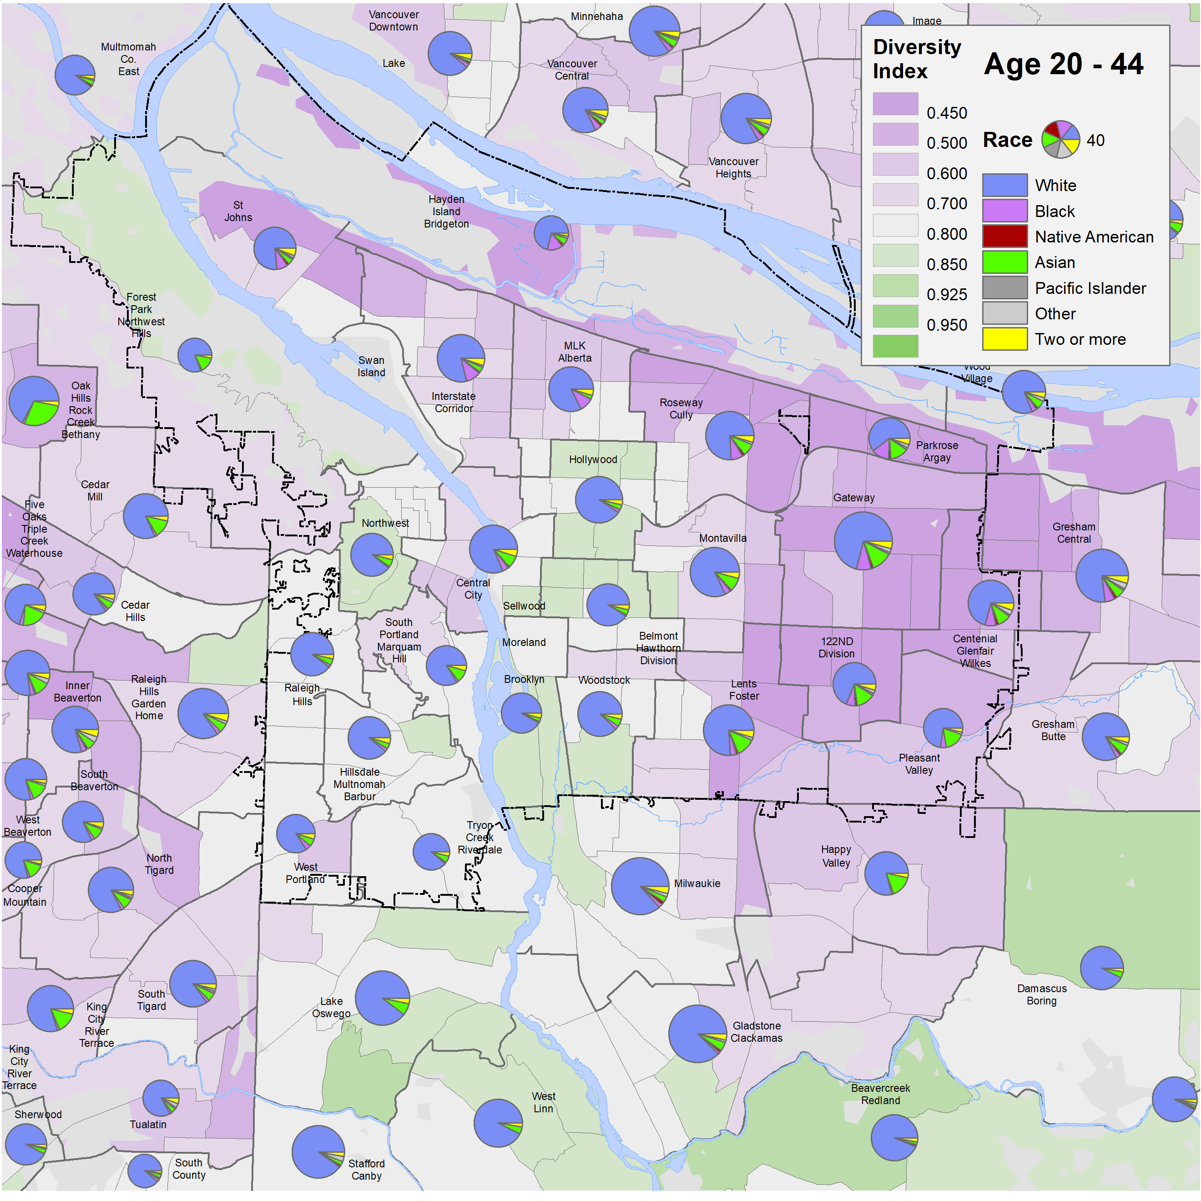
Mapping of Race and Diversity
1,600
Diversity Index: This metric details how similar or diverse a census tract is compared to those within the tract. A lower score here (purples) represents more diversity; a higher score (greens) represents less diversity.
Note: Portland’s city boundary in shown as a dashed black line.
First page
Portland and comparison cities
City-suburb comparison
Age structure by race
Mapping race and diversity
Blacks
Asians
Native Americans
Hispanics
The maps in this slide are based on data from the 2010 Census.
Portland’s age 65+ population is predominately White, except in the northeast (MLK-Alberta, Interstate Corridor, which house much of Portland’s older Black population), and the southeast parts of the city (which house many of Portland’s older Asians; the western suburbs also show more older Asians).
Portland’s population west of the Willamette River is especially lacking in diversity among those age 65+.
By contrast, Portland’s younger working-age (20-44) population is more diverse, particularly in St. Johns, Roseway-Cully and most neighborhoods east of 50th Avenue.
The MLK-Alberta and Interstate Corridor areas have a smaller share of the younger working-age Black population, compared with the older Black population in that area.
Source: 2000 and 2010
Decennial Census, SF1, tables P12, A-G.
O

Slide 18
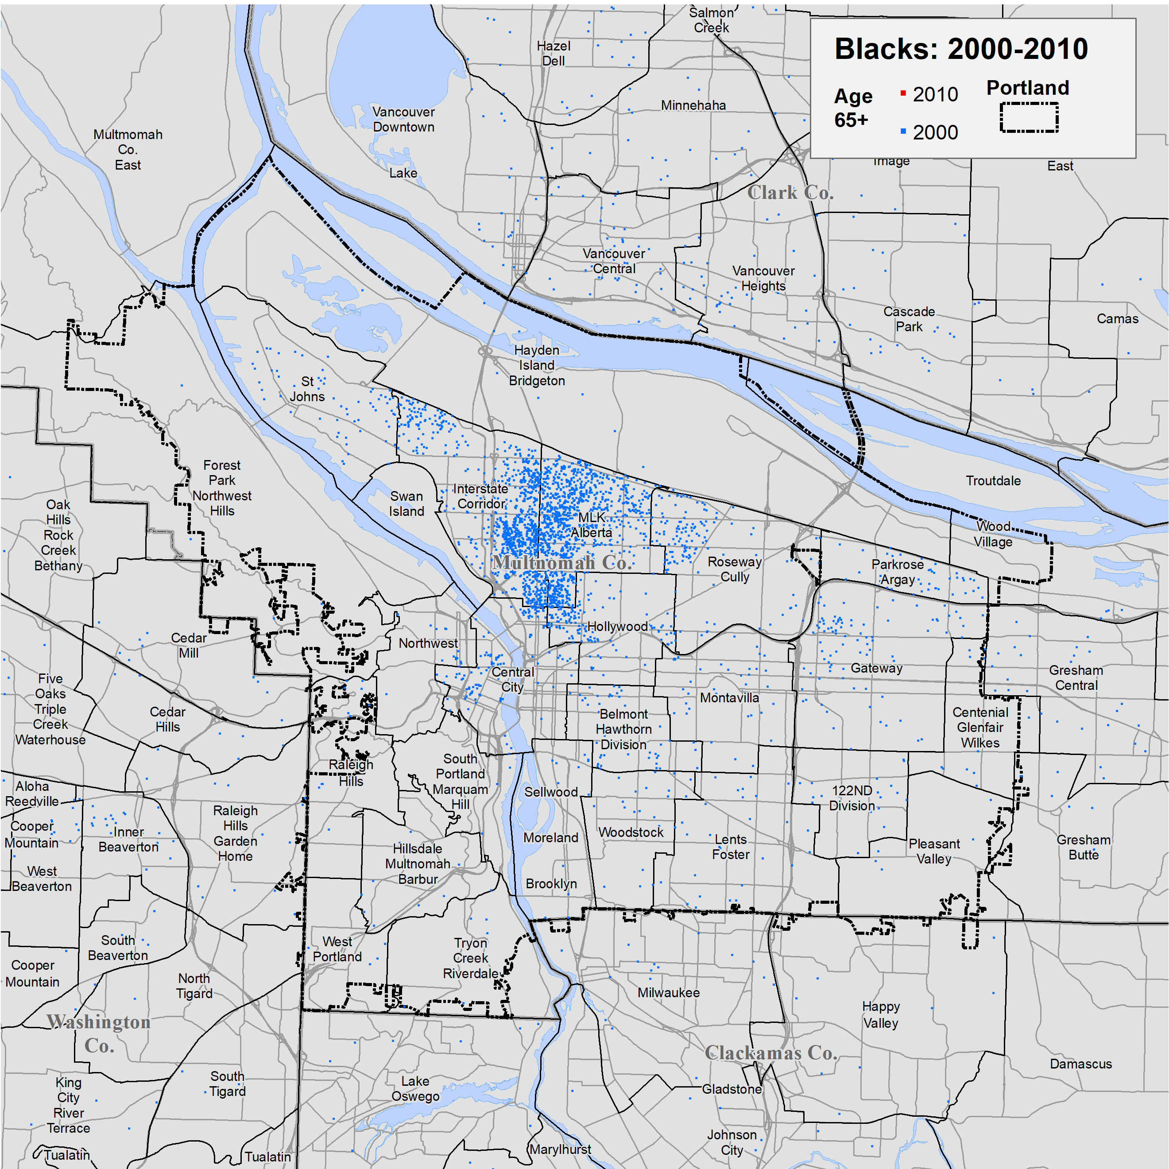
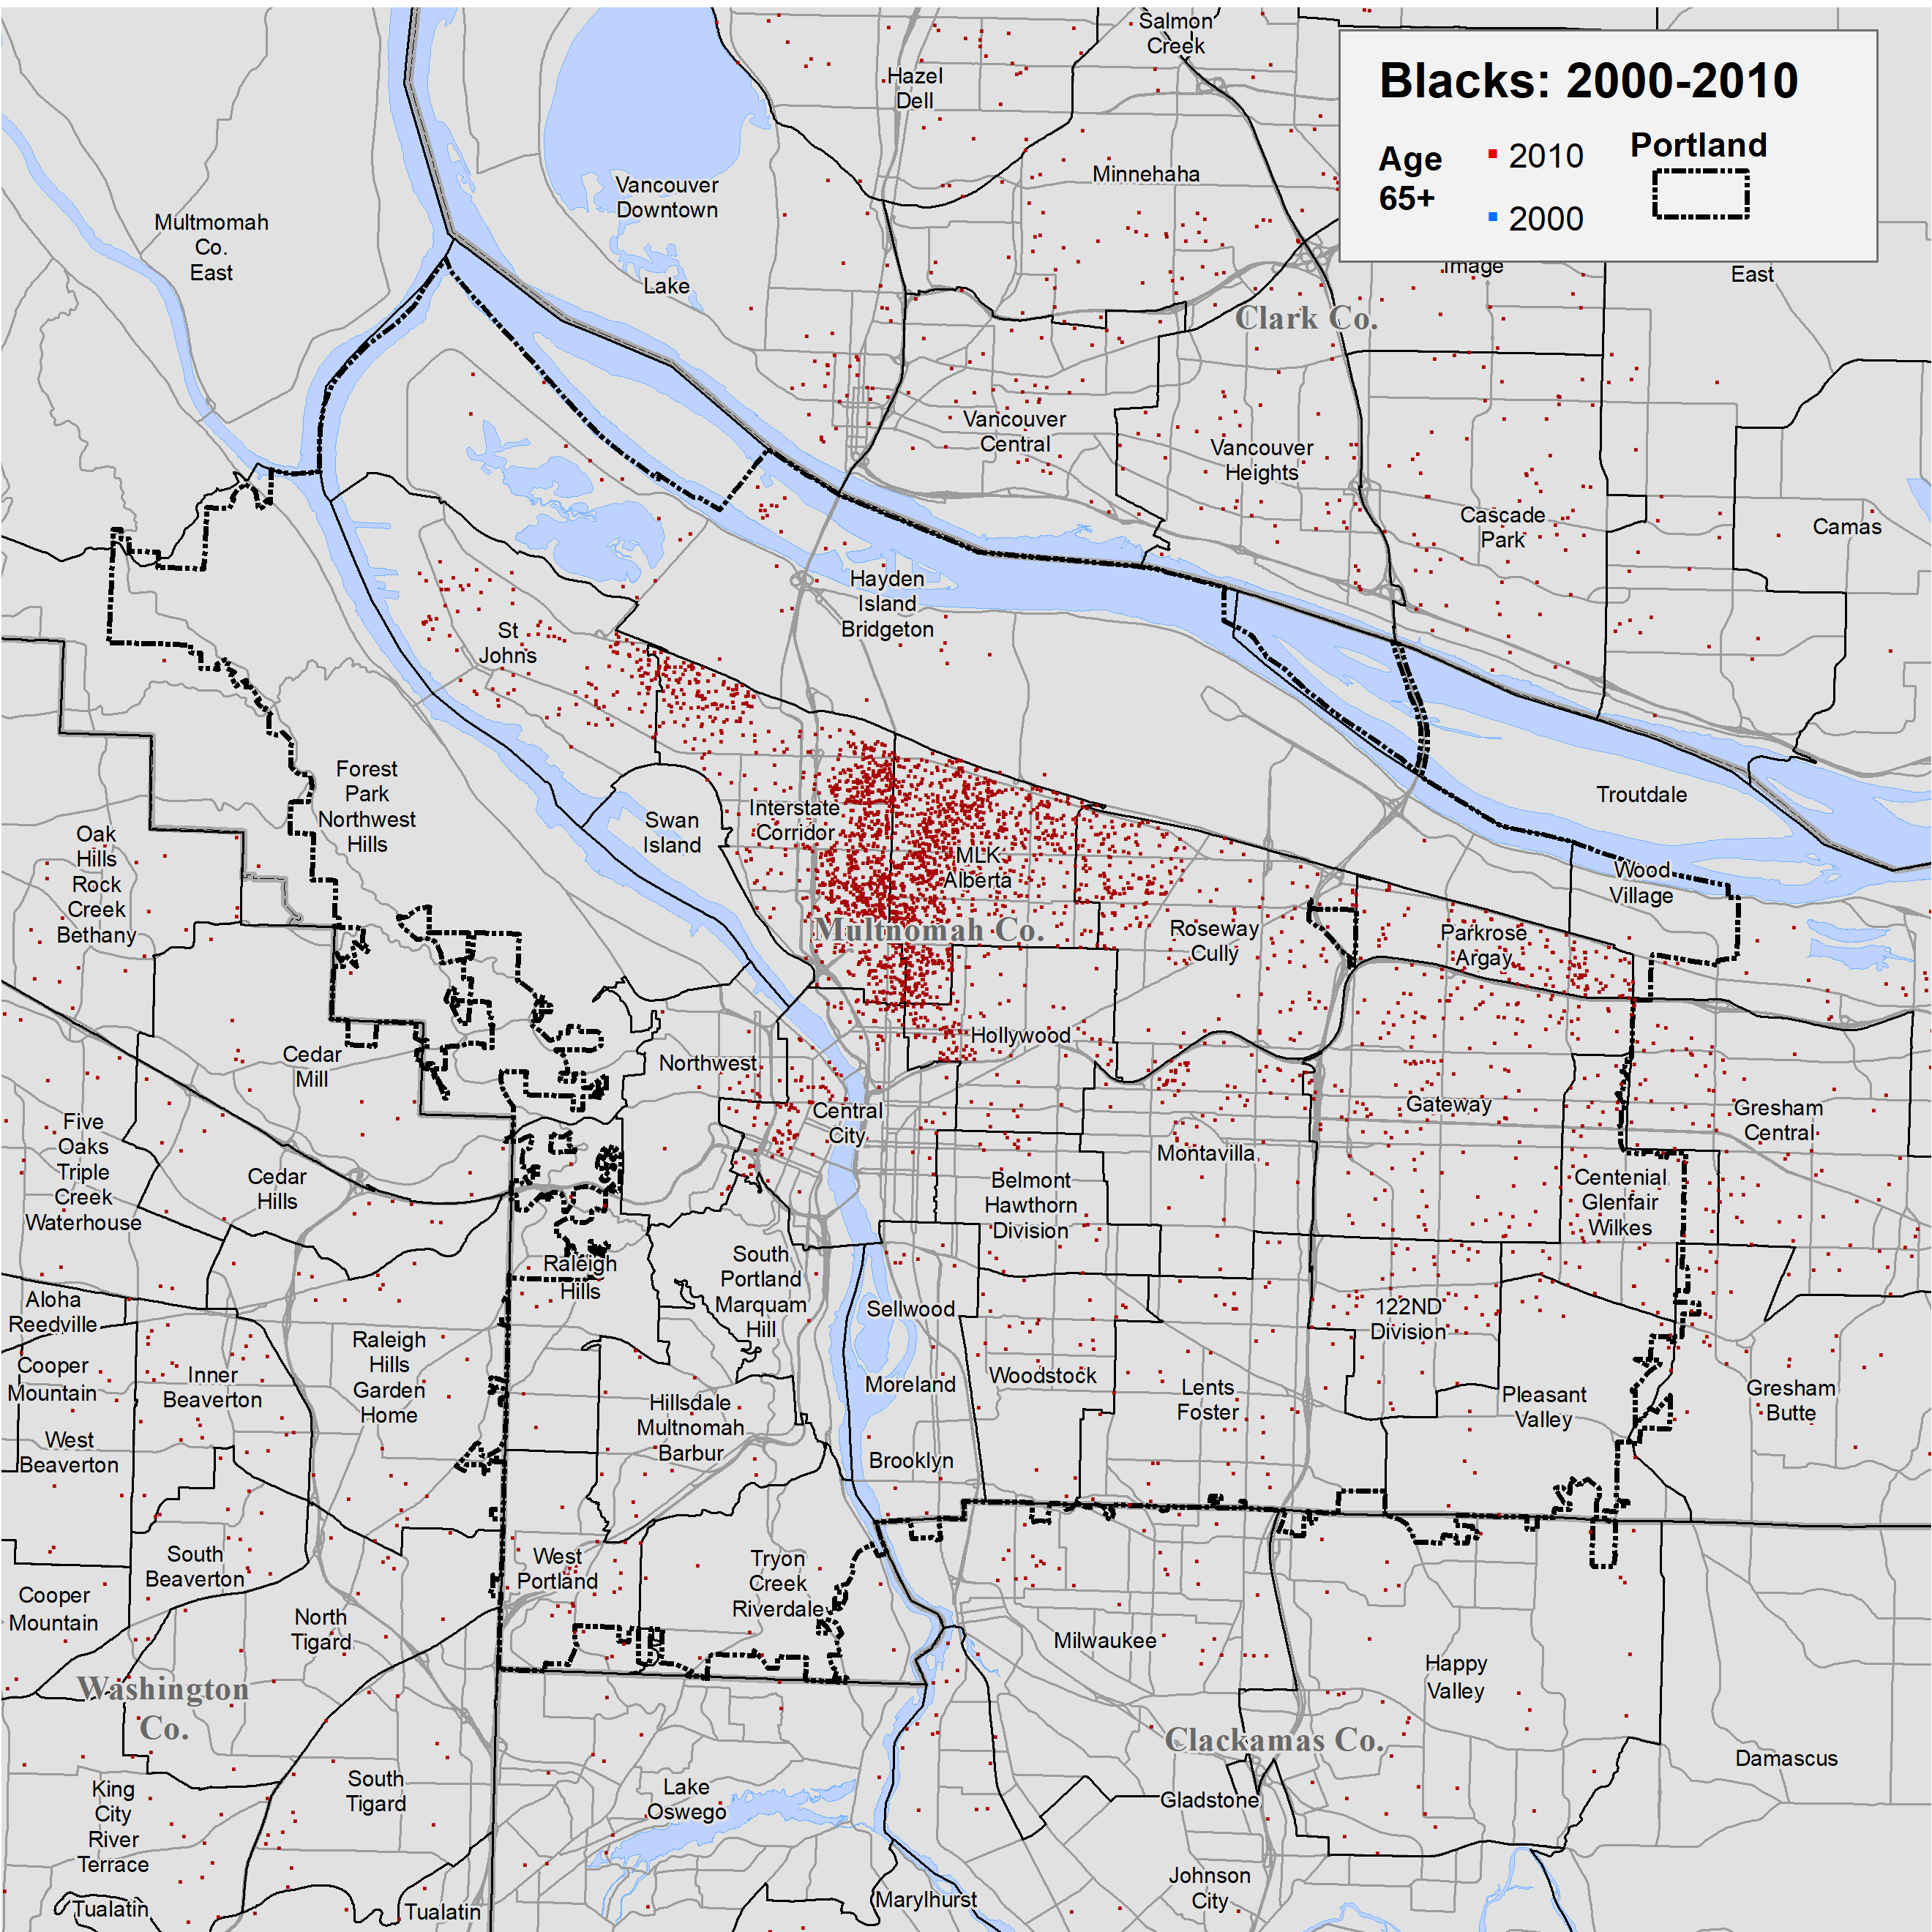
The Changing Location of Portland’s Age 65+ Black Population
First page
Portland and comparison cities
City-suburb comparison
Age structure by race
Mapping race and diversity
Blacks
Asians
Native Americans
Hispanics
In the past 20 years there has been a major shift in Portland’s Black population from the core area in Northeast Portland to the east side of the city, and outside the city to east Multnomah County and suburban counties.
The next two maps show a simulation of the location of Portland’s age 65+ Blacks in 2000 and 2010, based on block-group data from the Census.
In 2000, nearly all older Blacks lived in the Interstate Corridor and MLK Alberta supertract/20-minute neighborhoods.
By 2010, there had been an eastward shift from the core area, diffusing toward Portland’s east side.
O
Source: 2000 and 2010 Decennial Census, SF1, tables P12B.
Notes:
Dick, I removed the TOC from this slide as the natural section break seems to be the previous slide (Mapping of Race and Diversity).

Slide 19
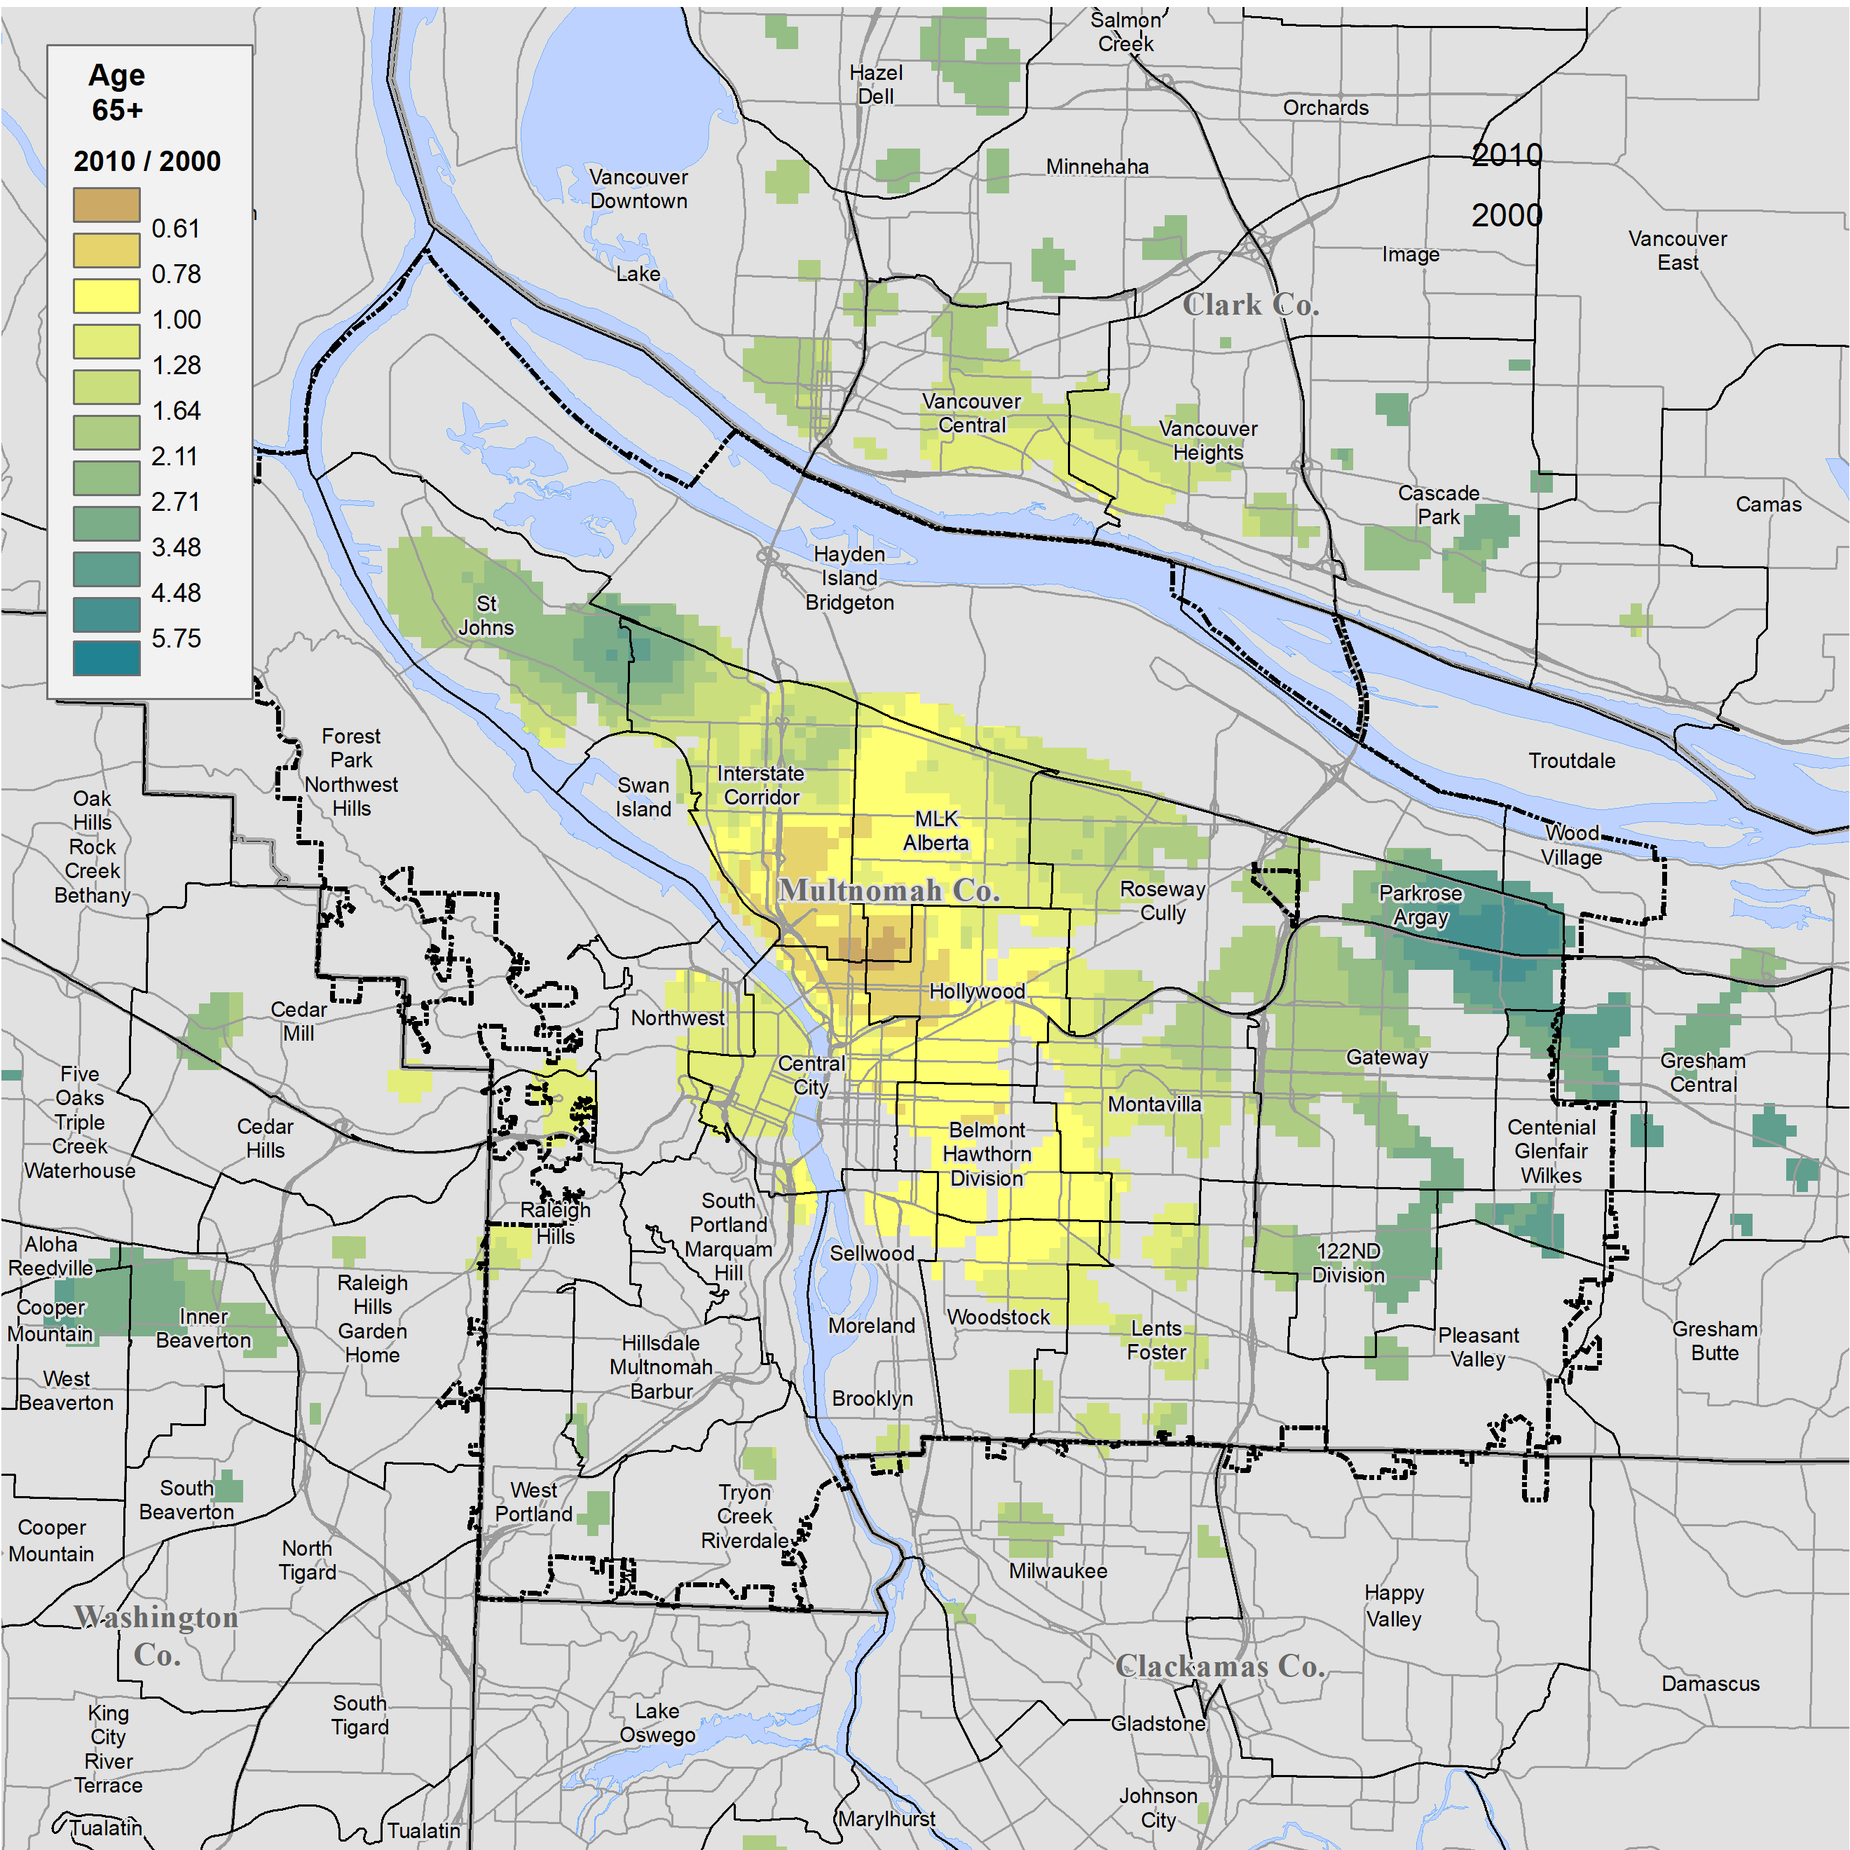
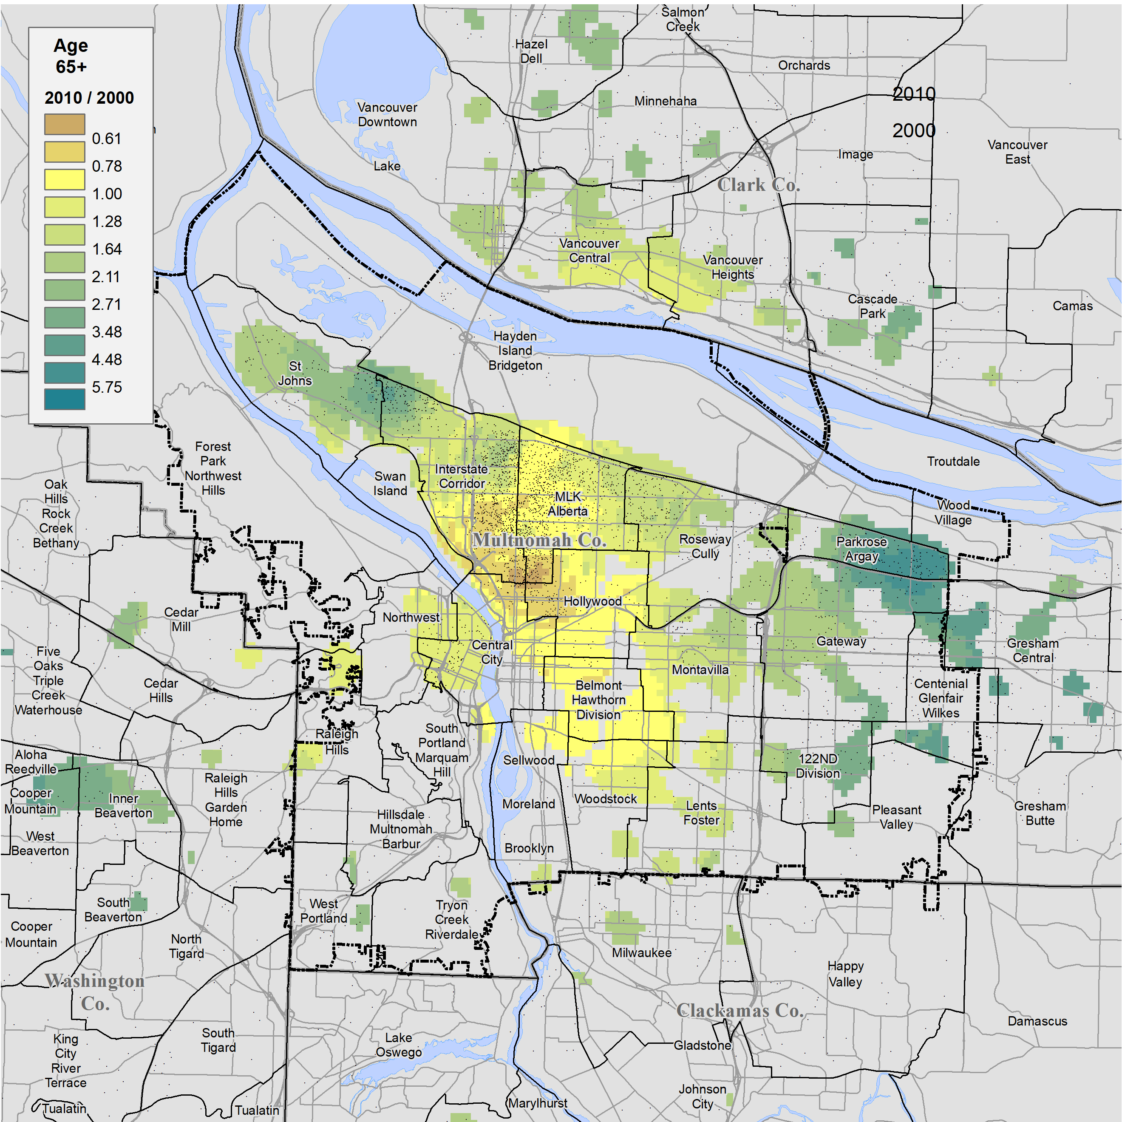
Change Ratios for the Age 65+ Black Population
Using the data from the previous two maps this map shows the degree of change in the age 65+ Black population as a ratio of the 2010 to 2000 population.
The greatest loss of older Blacks was in the Albina core area, where the 2010 number dropped to as little as 61% (brown shadings) of the number in 2000.
By contrast the number grew more than three-fold (green shadings) in the Parkrose-Argay area and along the border of the St Johns and Interstate Corridor supertracts, due in part the constructions of New Columbia.
Superimposing the dot map specifically of Portland’s Black age 65+ population in 2010 shows that the majority still resided close to their 2000 Census location in north and northeast Portland.
O
Source: 2000 and 2010 Decennial Census, SF1, tables P12B.

Slide 20
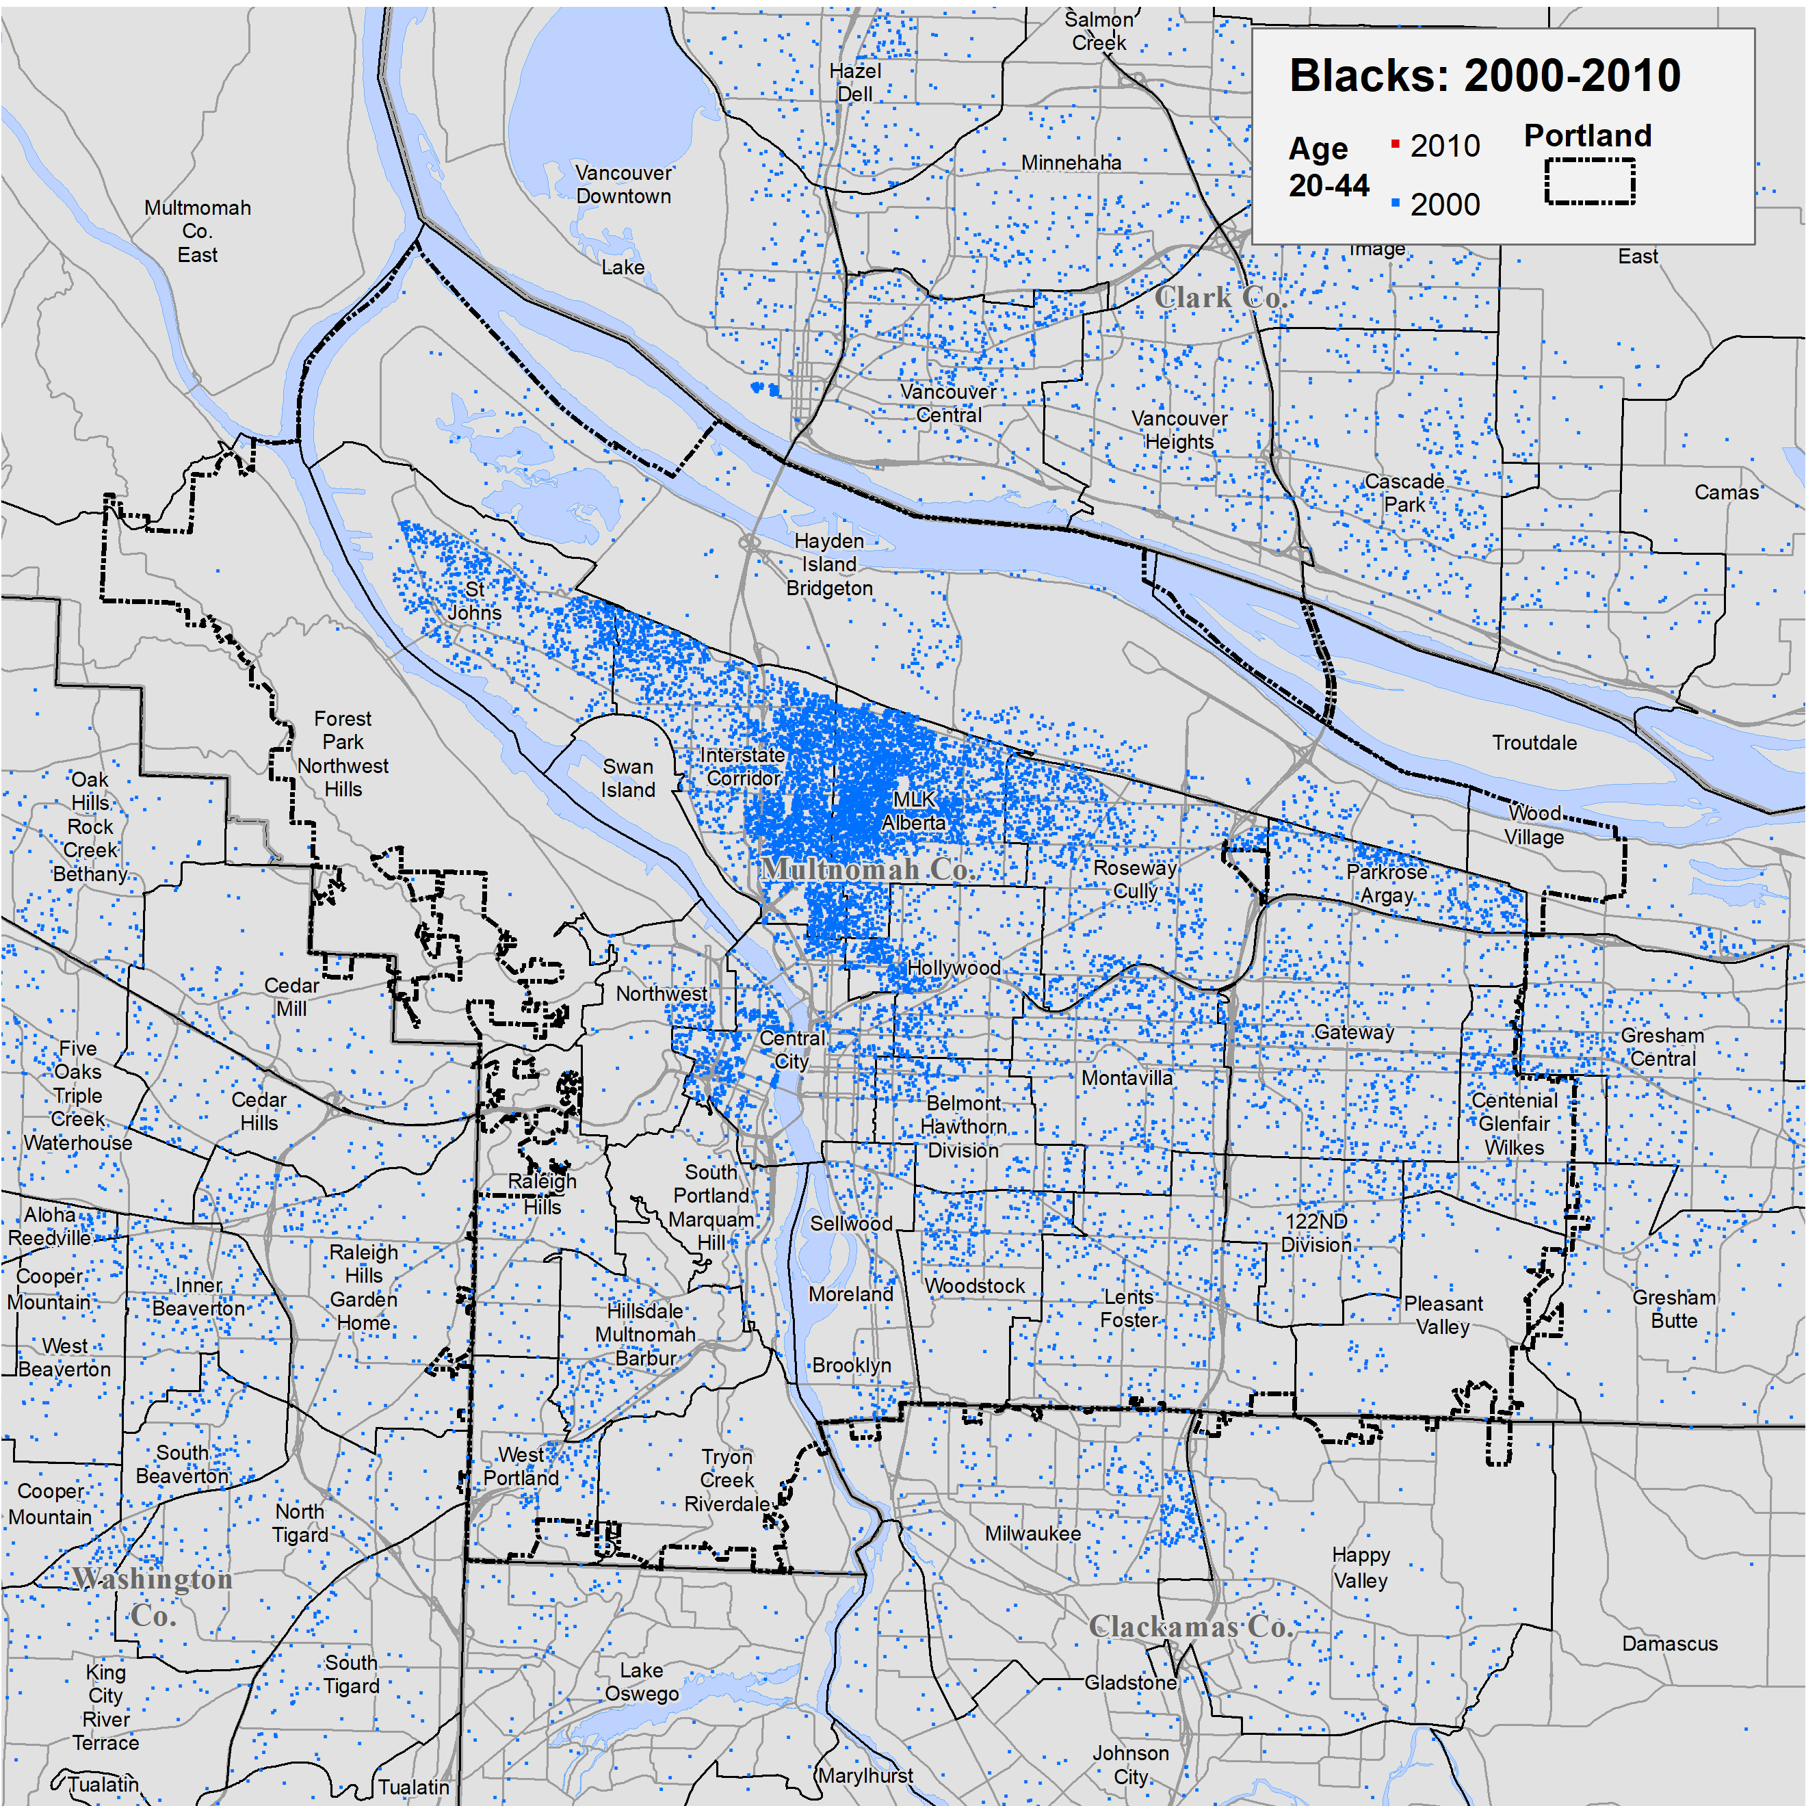
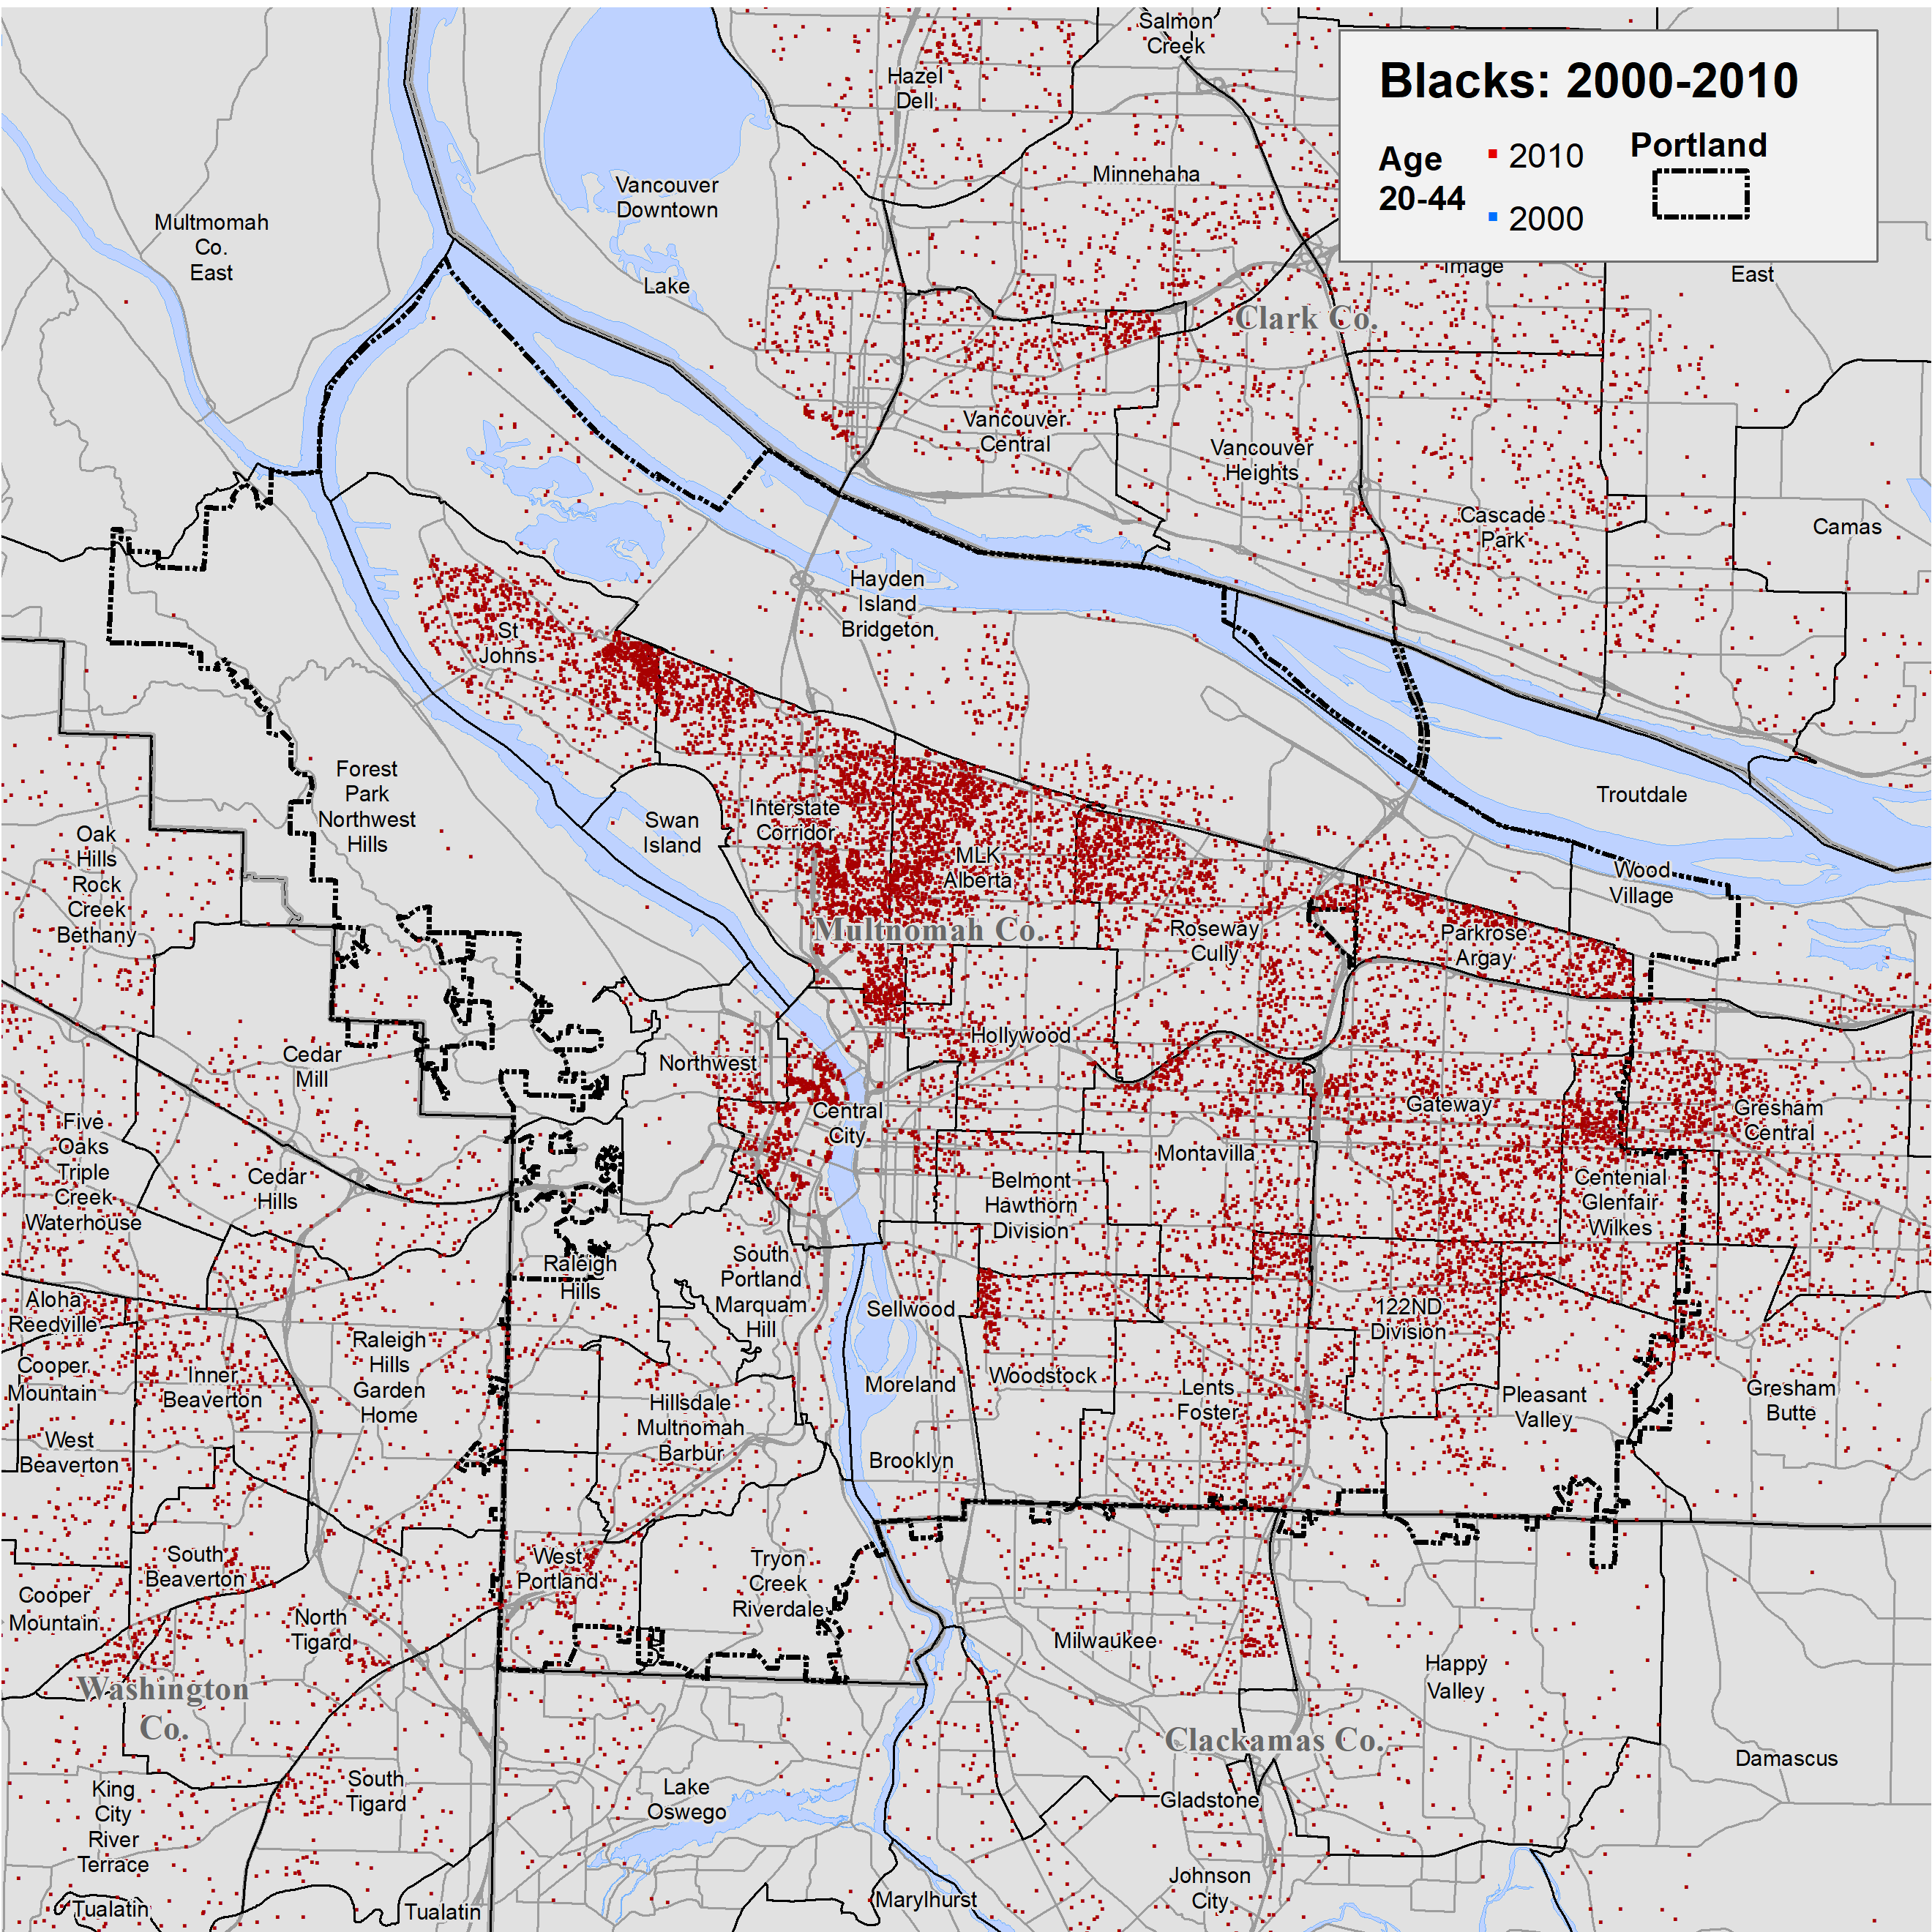
The Changing Location of Portland’s Age 20-44 Black Population
A dot map of the age 20-44 Black population in Portland in 2000 shows that this group was more numerous and distributed more widely than were older Blacks.
By the 2010 Census there was a major redistribution of this group of Blacks to east Multnomah County, Gresham, and to suburbs in Clackamas and Washington Counties and Clark County, Washington.
O
Source: 2000 and 2010 Decennial Census, SF1, tables P12B.

Slide 21
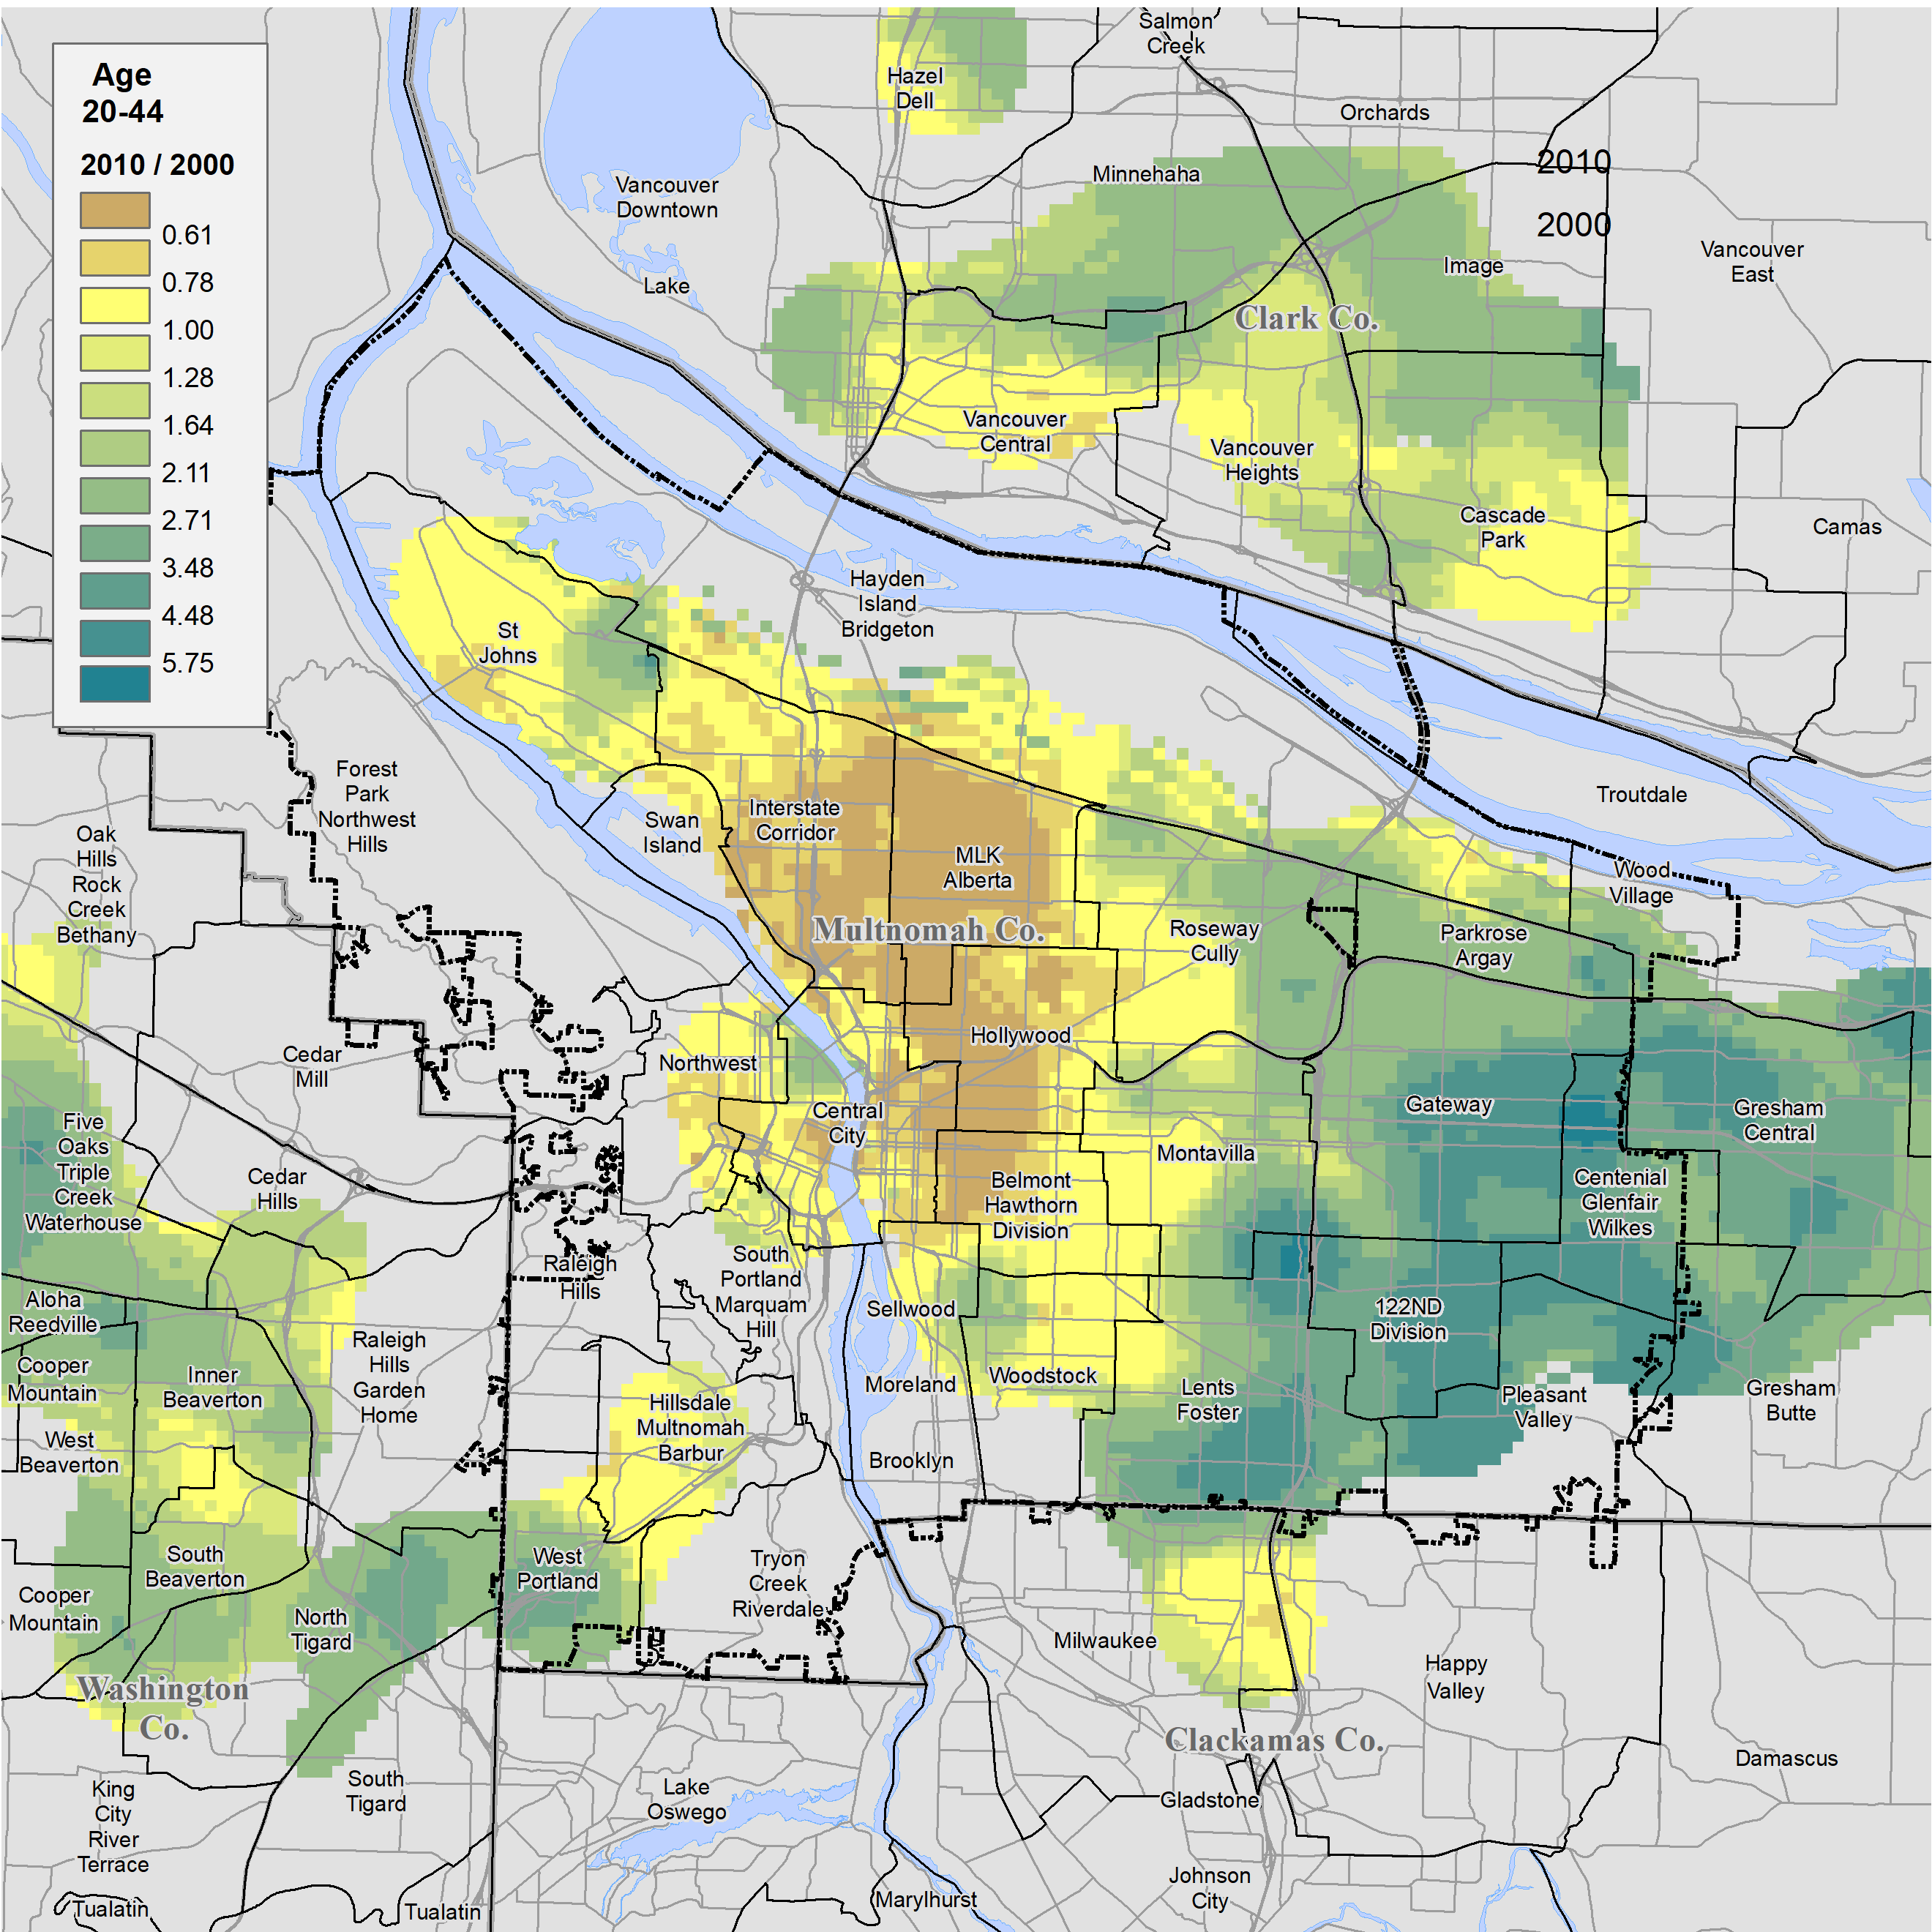
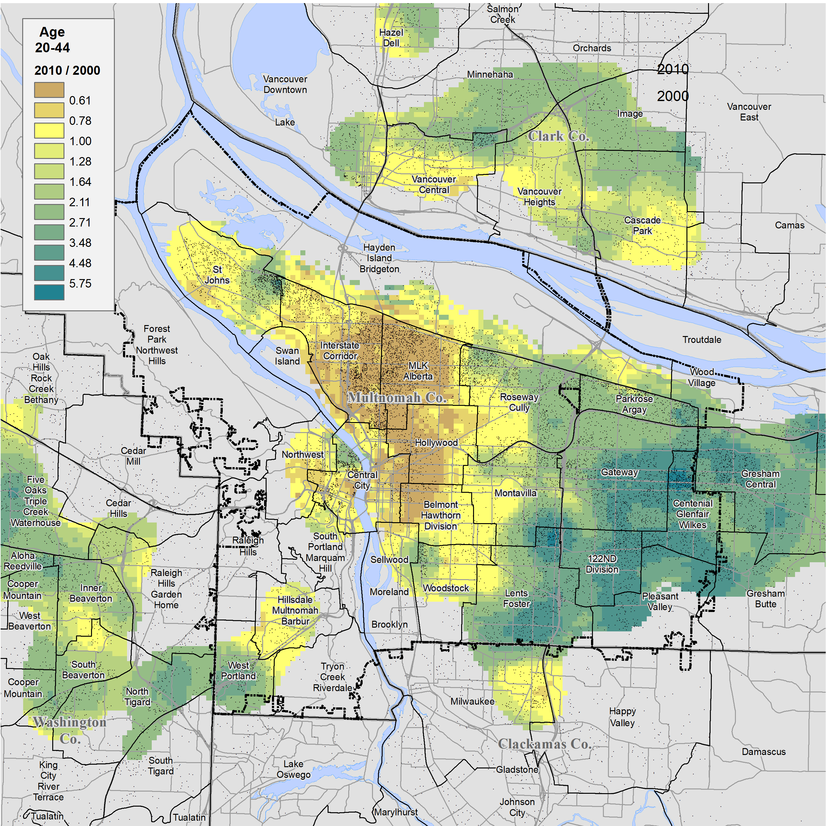
Change Ratios for the Black Age 20-44 Population
This map shows change for the age 20-44 Black population uses the same classes and colors as the map for those age 65+.
The much larger area for this age group shown in brown to yellow reveals the lost population in this younger age cohort.
The broad green area gained Blacks age 20-44.
The magnitude and rate of out-movement from the city core was much greater for Blacks age 20-44 than for those age 65+.
The superimposed dot map of the age 20-44 Black population in 2010, shows that despite the shifts the historic north and northeast Portland, those locations still house many of this group.
O
Source: 2000 and 2010 Decennial Census, SF1, tables P12B.

Slide 22
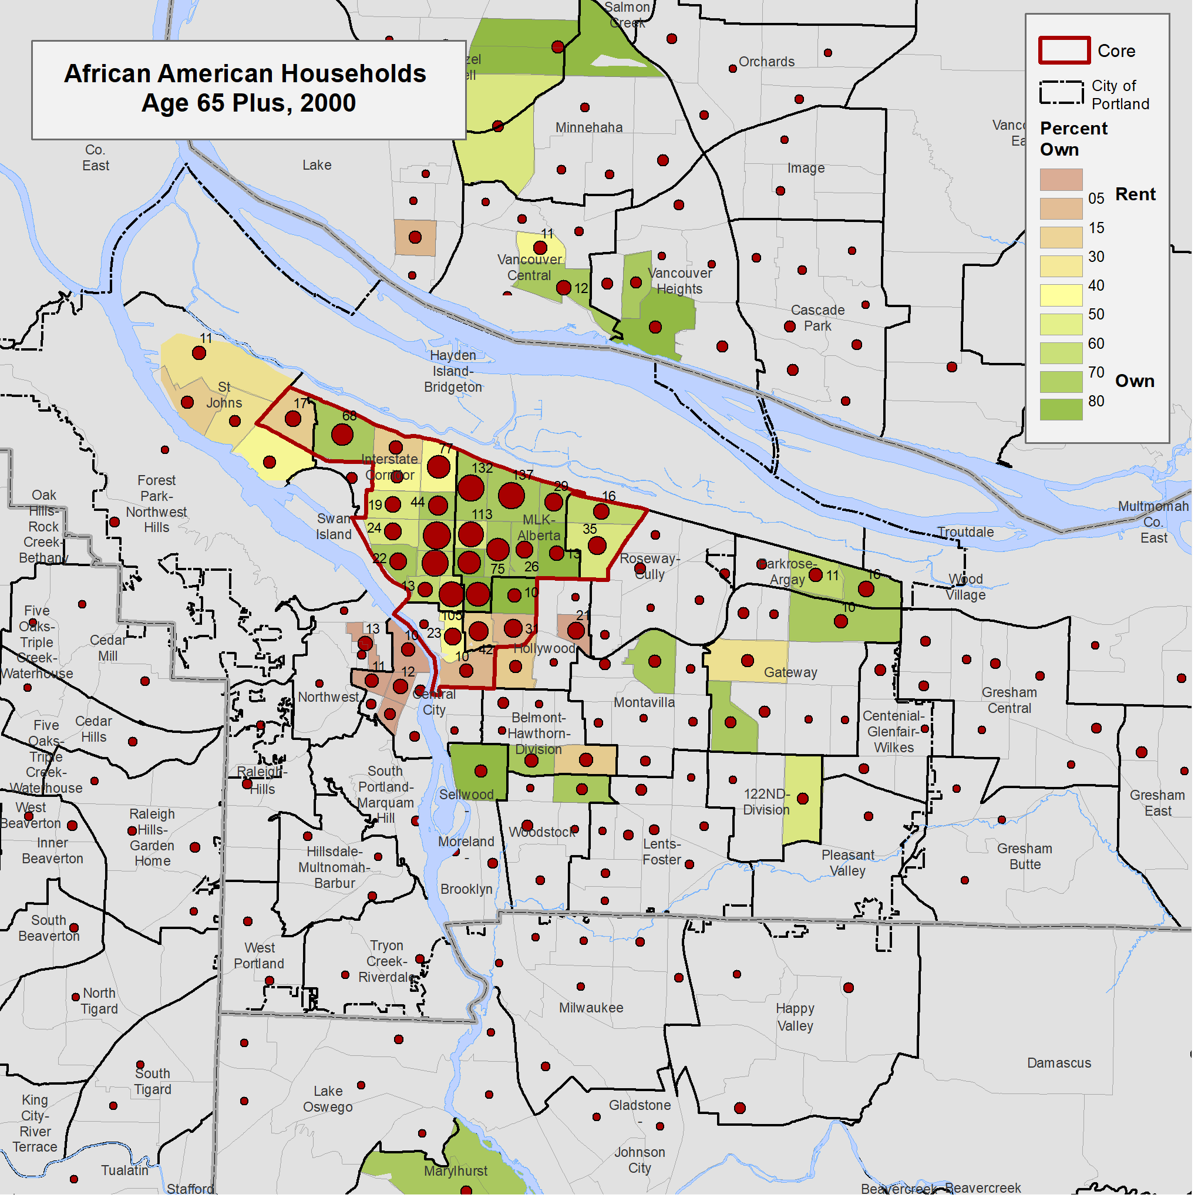
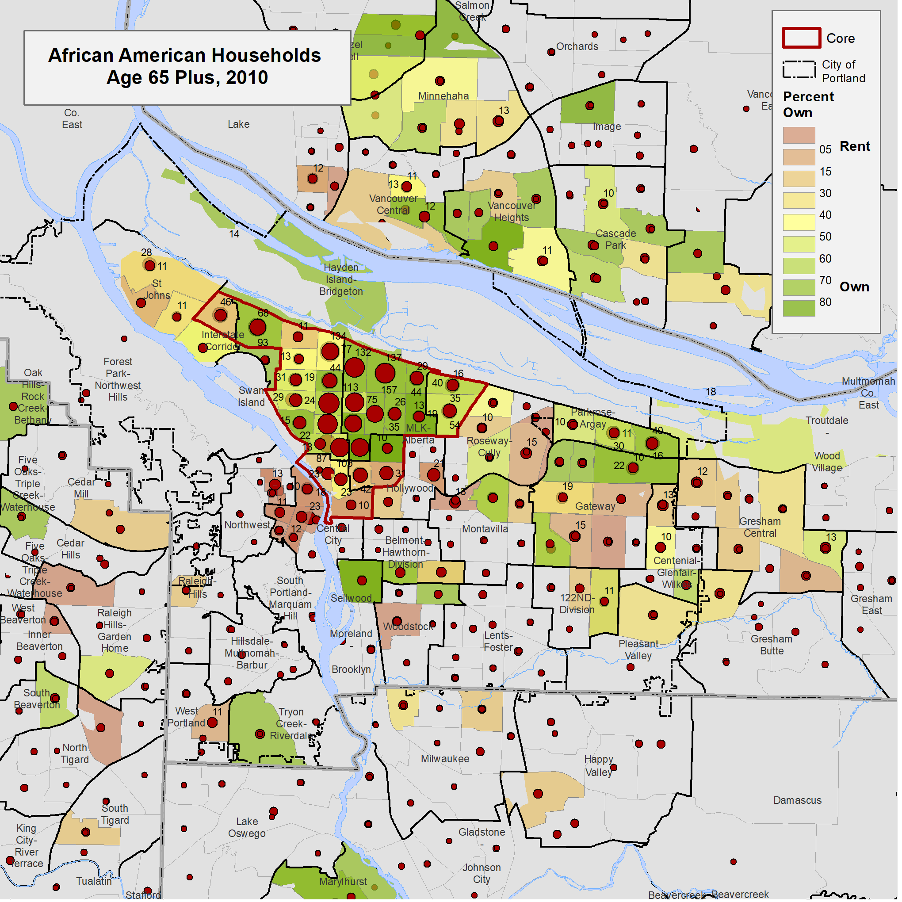
Change in Number of Black Households by Tenure
Black Households,
Age 65+, 2000
Black Households,
Age 65+, 2010
This map shows the number of age 65+ Black households in 2000 superimposed over a map of the proportion who were homeowners and renters (e.g., 80% own, 20% rent = Green).
Green shadings – more owners
Brown shadings – more renters
The size of each red dot is proportional to the number of households (also represented as numbers in certain areas).
The red outlined area is referred to as the core area, Portland’s historic Black community.
View the map animation of the change from 2000 to 2010 for age 65+ Black households. Toggle between the two maps to compare..
A tabulation of owner and renter Black households in the core and non-core areas follows.
Source: 2000 and 2010 Decennial Census, SF1,tables H016B in 2000 and H17B in 2010.
O

Slide 23
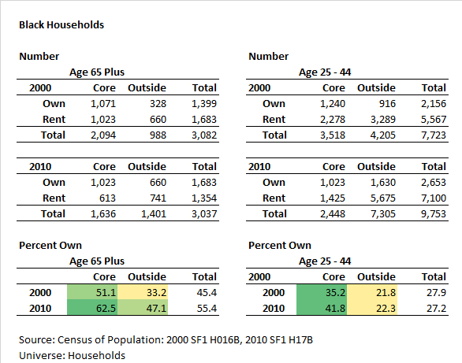
Tabulation of Core and Non-Core Change by owner/renter
Black Households
This table shows the changes in the number of younger and older Blacks households by owner/renter in the core and non-core areas depicted on the previous slide.
For aged 65+ Black households the number in the core area declined from 2,094 in 2000 to 1,636 in 2010 (22%), mostly through the decline in renter households.
For age 25-44 Black households the number in the core area declined 31%, from 3,518 in 2000 to 2,448 in 2010.
For both Black age groups, the proportion of households who owned their residence grew, both inside and outside of the core area.
The smaller loss of age 65+ households in the core is likely due, in part, to the higher proportion who owned their homes (later, we will look at affordability by race and disability).
Source: 2000 and 2010 Decennial Census, SF1,tables H016B in 2000 and H17B in 2010.
O

Slide 24
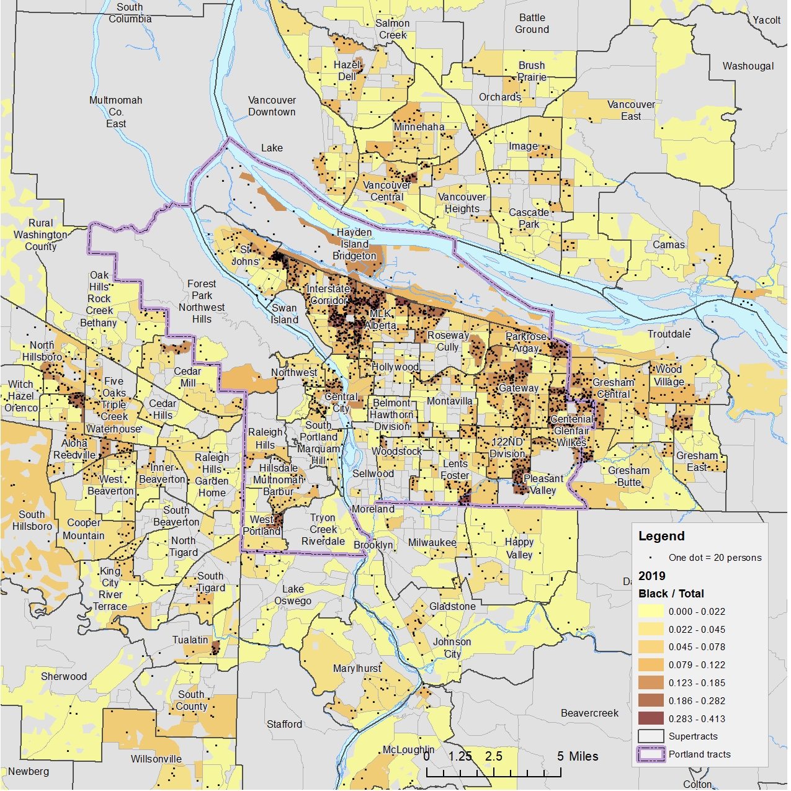
Black Population in 2019 by Block Group
This map shows the distribution of the Black population in the metropolitan region, based on block group data from the 2019 American Community Survey; 1 dot represents 1 Black resident.
The block groups shaded in the darkest brown color have 28.3% or more Black residents, whereas the lightest yellow areas have 0.0-2.2% Black residents.
The largest concentration of the Black population in Portland is still in the historic core area, but over the past 20 years there has been a shift to the eastern edge of the City and into Gresham and surrounding suburbs.
O
Source: 2015-2019 5-year ACS, table P12B.

Slide 25
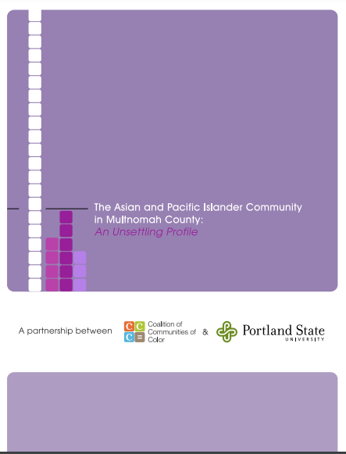
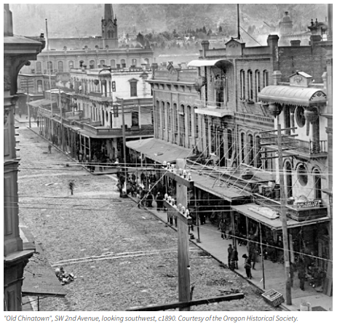


Portland’s Asian Population is Very Diverse
First page
Portland and comparison cities
City-suburb comparison
Age structure by race
Mapping race and diversity
Blacks
Asians
Native Americans
Hispanics
The Asian population of Portland includes culturally diverse groups who settled in Portland at different times.
The Chinese population dates back to the early days of settlement of the Oregon Territory.
The Japanese population in Portland and Oregon began growing prior to WWII.
The Vietnamese population came to Oregon after the end of the Vietnam war in 1975.
Many south Asians from India moved to Oregon to work in technology industries.
The geographical residence patterns of the various Asian groups also are different.
Image credit: Asian Health & Service Center
Image/Source: Coalition of Communities of Color and Portland State University

Slide 26

Principal Asian Subgroups - Portland and Suburbs
The chart to the right lists the numbers of age Asian persons by ethnicity (all ages and age 65+), from the most to least numerous.
The data are tabulated from the American Community Survey, Public Use Microdata and subject to considerable sampling variation.
Data for the city of Portland are for the census tracts that approximate the City boundary.
The largest numbers of age 65+ Asians in Portland are Chinese (excluding those from Taiwan) and Vietnamese.
Portland has a larger share of those age 65+ – as compared to all ages – in the 7-county Portland Metro area for the following subgroups with 100+ elders: Chinese (47.9%), Vietnamese (54.3%), Laotian (69.3%), and Asian Indian (15.9%).
Several other Asian ethnic groups in the Portland Metropolitan area reside mainly outside of the city (e.g., Koreans, Filipinos).
O
Source: 2017 ACS, 5-year data, Public Use Microdata Sample.

Slide 27


Mapping of Asians Aged 65+
Notes:
(1) The red circles are proportional to the size of the population in 2010
(2) the changes in the Asian population from 2000-2010 are displayed from yellow (less change) to purple (more change).
The largest concentration of Asians aged 65+ in Portland is in the southeaster corner of the City, which is also the area of greatest growth for Asians aged 65+.
The second map shows the percentage of Asians aged 65+ in 2010, as well as a bar chart of the Asian population by age.
Note that Asians aged 65+ are a relatively small part of the total Asian population (up to approximately 15% of the population).
Source: 2010 Decennial Census, SF1, table P12D.
The data here are mapped to census tract aggregations called supertracts
O

Slide 28

Asian Subgroups and Diversity (All Ages)
Note the Asian diversity index here represents a scale from most diverse (yellow) to least diverse (green) within the Asian subgroups.
The pie graphs on this map show the number of Asians (area of the pie; bigger = more) and the share for the various Asian subgroups (pie slice).
For many Portland neighborhoods the Chinese population (in light blue) are the most numerous.
However, in many northeast and southeast neighborhoods Vietnamese (in light green) predominate the subgroup composition.
Southern Asians (e.g., those from India, Pakistan) reside mainly outside of the city, except for the Centennial-Glenfair-Wilkes, Forest Park, and Hillsdale-Multnomah-Barbur supertracts.
The most diverse areas with respect to the Asian mix (in yellow) are outside of the City in Clackamas, Clark, and Washington Counties.
Source: 2010 Decennial Census, SF1, table PCT5.
O

Slide 29

Native Americans, by Tribe in Portland
First page
Portland and comparison cities
City-suburb comparison
Age structure by race
Mapping race and diversity
Blacks
Asians
Native Americans
Hispanics
This table shows the number of Native Americans enumerated in the city of Portland in the 2010 Census by tribal affiliation.
The total number of Native Americans was less than 1% of Portland’s 2010 population (5,779 of 583,776).
100 or more respondents identified American Indian (7 different tribes) and Alaska Native tribe (1 tribe).
A large number of Native Americans did not provide a tribal affiliation in their response to the Census.
Source: 2010 Decennial Census, table PCT1.
O

Slide 30






Native Americans, Distribution
The Native American Population is widely distributed across the Portland Metropolitan Area, with a number of local concentrations.
The age 65+ Native American population is distributed in a similar way to that for all ages (blue density shading), but the numbers are not great, due in part to reduced longevity (see Dankovchick et al., 2015).
Here is a zoomed in view of the northeast side of the City. Note that there are several localized concentrations some of which are associated with apartment developments.
However, the numbers in the age 65+ Native American population are not sufficiently numerous to find this association.
On this map the bar charts show the numbers of Native Americans by 10-year age groups over a density map of the numbers of Native Americans of all ages.
There are no striking variations from one supertract to another. The red and an orange bars showing the age 65+ population are not very prominent.
Sources:
2010 Decennial Census, table P12C.
Multifamily housing map: Metro Multifamily Database, 2010.
O

Slide 31




Native American, Age/Sex
The population pyramids for Native Americans in the Portland Metropolitan Area has a broad bulge from age 25 to 54.
The numbers of children and youth are greater for the older age groups suggesting the larger numbers of parents in their thirties and forties.
The city of Portland’s pyramid has a bulge for the 20-34 age group suggesting that there is in-migration of younger Native American households in this age range similar to that for other migrants to Portland.
The numbers in the age 70+ group fall off sharply from the younger age cohorts indicating out migration or, more likely, lower survival rates (see Dankovchick et al., 2015).
The pyramid for the Inner Suburbs is similar to that for the Metropolitan Area.
The pyramid for the outer suburbs suggests older households with middle school and high school aged children.
O
Source: 2010 Decennial Census, table P121C.

Slide 32



Dot Distribution Map of Hispanics by Age
These dot maps show the location of Hispanics by broad age group according to 2000 and 2010 Census data; the first map shows the distribution of Hispanics from the 2000 Census.
From 2000 to 2010 the number of Hispanic households in Portland grew from 9,307 to 14,857.
Large concentrations of Hispanics in the Portland Metro area can be found throughout, including in Multnomah, Washington, Clackamas, and Clark Counties.
In the city of Portland, the largest concentrations of Hispanics in 2010 were in Portland’s east and southeast neighborhoods.
In 2010, the largest numbers of Hispanic households identified as White, with the next largest group identifying as Some Other Race alone.
There are relatively few Hispanics age 65+, but there are substantial numbers in the 50-64 age group who will pass age 65 in the next two decades.
First page
Portland and comparison cities
City-suburb comparison
Age structure by race
Mapping race and diversity
Blacks
Asians
Native Americans
Hispanics
O
Source: 2000 and 2010 Decennial Census, table B12A – B12G.

Slide 33


Age 65+ Hispanic Population
The number of age 65+ Hispanics is relatively small, but given the numbers in younger age groups, the potential for growth in the next two decades is considerable.
The growth in the age 65+ Hispanic population from 2000 to 2010 occurred broadly across the Portland Metropolitan Area (toggle between 2000 and 2010 maps to compare).
O
Source: 2000 and 2010 Decennial Census, SF1, tables P012H, P12H.

Slide 34


Growth of the Age 65+ Hispanic Population
The number of age 65+ Latinx population is relatively small but given the numbers in younger age groups, the potential for growth in the next two decades is considerable.
The growth in the age 65+ Hispanic population from 2000 to 2010 occurred broadly across the Portland Metropolitan Area.
However, the numbers have remained stagnant or even declined in the inner core.
For the 35–49-year age group there has been substantial decline in the inner northeast and southeast neighborhoods but strong growth in the east and southeast neighborhoods.
O
Source: 2000 and 2010
Decennial Census, SF1, tables P012H, P12H.

Slide 35




Income by Race and Hispanic Origin
This slide shows income quintile groups (i.e., income divided into five equal parts) for the Portland Metropolitan Area.
The city of Portland has the largest share of the lowest income groups for all groups, but non-Whites in particular.
The inner suburbs show a more equitable distribution except for Blacks, where nearly half are in the lowest income quintile.
Income distribution in the outer suburbs is the most equitable; 40% of Blacks are in the middle-income quintile.
Source: 2017 ACS, 5-year data, Public Use Microdata Sample.
O

Slide 36
End of Race Section
The following slides in this module provide additional analyses on Minneapolis as a comparison city to Portland, emphasizing race and Hispanic origin.
O
Source: Final_PPT_Links\R3_RaceHispanicOrigin_12_akd_drl5.pptx

Slide 37
State of Aging in Portland
Comparison Cities
Minneapolis - Portland
O

Slide 38




Comparing Portland and Minneapolis
City Share of Metropolitan Area by Race
One of the measures that we decided to use at the outset was the comparison of Portland to 20 other cities of comparable size, using the 10 ranked below and 10 ranked above using 2010 populations.
Minneapolis fell just off our list (too small) but we decided to include it as we suspected that it would prove similar to Portland using varied measures and because the two cities have adopted some of the same strategies to ensure equity.
The Minneapolis- St. Paul-Bloomington Metropolitan Area with a population of 3.57 million is somewhat larger than the Portland-Vancouver-Hillsboro Metropolitan area with a population of 2.45 million (based on the 2019 American Community Survey).
Both Portland and Minneapolis are principally White cities. The two largest cities in the Minneapolis-St. Paul-Bloomington Metro area are Minneapolis with a population of 420,000, and St. Paul with 305,000 compared to the city of Portland with 645,000.
The three cities all have substantial share of the regional minority populations but, except for Blacks in Portland, have less than half of the various minority groups as a share of their metropolitan areas.
City Share of Metropolitan Area by Race
O
Back to main report on race/Hispanic
Source: 2019 ACS 5-Year data. table B02001.

Slide 39




Age and Race
These charts show the population by 5-year age cohorts for Portland and Minneapolis from the 2000 (years 1996-2000) and 2019 (years 2015-2019) ACS.
The population pyramids are generally similar but note that the numbers in Portland have grown more for the 35-44 age group and Minneapolis has a larger age 15-24 age group.
The profiles by race also are similar for the two cities except that Minneapolis has a larger Black population. The Black population in Minneapolis has grown more over the past 9 years while Portland has lost Black population to its suburbs.
Not shown on these graphs, Minneapolis has a large population of Somalian immigrants; 33,000 of the 81,000 Blacks in Minneapolis are from Sub-Saharan Africa.
Back to main report on race/Hispanic
Sources:
-5-year ACS data 1996-2000
-5-year ACS data 2015-2019
O

Slide 40




Economic Comparisons
Minneapolis has more lower income households and Portland more with higher incomes.
By contrast, housing values are higher in Portland and
Rent is more expensive more expensive in Portland.
At all age levels, especially for older households a higher percent of Minneapolitans have incomes below the poverty level than Portlanders.
Sources: Economic and Housing Profiles for Minneapolis and Portland, DP3 and DP4.
O
Back to main report on race/Hispanic
Notes:
Dick, source data needed for this slide.

Slide 41


Race by Community for Minneapolis and Portland
Minneapolis has a larger proportion of Blacks compare to its twin, St. Paul, which has a larger Asian population. The Black population in the Minneapolis, St. Paul, Bloomington Metropolitan Area is widely spread across the many smaller surrounding communities, such as Brooklyn Center.
The Black population of Minneapolis began to grow after the Civil War and with the movement of Blacks to the North during the Second World War. There has been some growth in the past decade.
Portland’s smaller Black population is more concentrated in the city of Portland with some recent shift to nearby suburbs, such as Gresham.
O
Back to main report on race/Hispanic

Slide 42

A More Detailed Look
This map shows the distribution of the Black population in the inner counties of the Minneapolis, St. Paul, Bloomington Metro area.
The map is based on census block group data from the 2019 American Community Survey with one dot representing one Black Resident.
The block groups shaded in the darkest brown color are 61% or more Black. There are a number of such concentrations outside of the central city.
The map for the Portland area was constructed in the same manor using the 2019 ACS data.
The largest concentrations of Blacks in Portland are still in the historic core areas, but over the past twenty years there has been a shift to the eastern edge of the City and into Gresham.
Some of the block groups show that 28% or more of the residents are Black, although the concentrations are less dense than in Minneapolis and the color shadings are shifted downwards.
O
Back to main report on race/Hispanic

Slide 43




Gentrification in Portland
This map shows the change by census tract in the combined ranking of percent in managerial, technical, and professional employment and the percent with a college degree or higher, following the work of David Ley.
From 1990 to 2000 there was a loss in the MLK-Alberta supertracts in the black core area. There also was a decline in the Hollywood and Belmont-Hawthorn-Division supertracts which impacted mainly White households.
From 2000 to 2010 the gain continued in the MKL-Alberta supertract but spread west to the Interstate Corridor and St Johns supertracts impacting, in part, Black households.
The earlier gentrification in the Belmont-Hawthorn-Division supertracts spread south to the Woodstock and Lents-Foster supertracts.
Gentrification played a role in the eastward shift in Portland’s Black population, particularly for those in rental housing.
One dot represents one Black person age 65+ in 2010.
One dot represents one Black person age 65+ in 2010.
O
Back to main report on race/Hispanic

Slide 44



Gentrification in Minneapolis-St. Paul
The Center for Urban and Regional Affairs at the University of Minnesota has carried out studies on gentrification in the Twin Cities.
This map shows census tracts judged to be vulnerable to gentrification. Those in orange gentrified, those in yellow did not.
Here the distribution of the Black population is shown with 1 dot representing 20 persons. Those areas with many blacks are more likely to be vulnerable to gentrification.
The study found that gentrifying tracts were whiter than those that did not but that many tracts that gentrified had large shares of people with color.
An interesting conclusion was that there was little change in the percentage of Blacks, Asians, and Hispanics between the neighborhoods that gentrified and those that did not.
O
Back to main report on race/Hispanic
Source: Center for Urban and Regional Affairs, the University of Minnesota, The Diversity of Gentrification, 2019.

Slide 45
End of Portland Minneapolis Comparison
O
Back to main report on race/Hispanic
Source: Final_PPT_Links\R3_RaceHispanicOrigin_12_akd_drl5.pptx

Slide 46
The State of Aging in Portland
Information on Data Sources
and Geographies
Background for study
The Decennial Census
The American Community Survey (ACS)
Supertracts
The American Housing Survey (AHS)
20 Comparison cities
Geography issues
Portland’s Inner and outer suburbs
The ACS Public Use Microsample
Nomenclature for race and ethnicity
Census group quarters
O

Slide 47

About The State of Aging in Portland Report and Navigating the Findings
O
O
O
O
O
O
O
O
O
O
O
O
O
O
O
O
O
O
This presentation includes seven sections developed as part of a study for the City of Portland by the Institute on Aging at Portland State University (PSU), Portland, Ore. The study, titled The State of Aging in Portland, was undertaken to provide guidance to local government and members of the broad and informal “aging network” of service providers, advocates, and others in Portland and the region so that that they can better understand, and address trends related to Portland and the region’s population aging.
Funding source: The City of Portland, Community Health and Access program.
Project staff included:
Alan DeLaTorre, PhD, Adjunct Faculty, Institute on Aging, PSU; team leader and analytical perspectives; aland@pdx.edu (he now serves as the City of Portland’s Age-friendly City program manager and can be contacted at Alan.DeLaTorre@portlandoregon.gov)
D. Richard Lycan, PhD, Professor Emeritus and Senior Research Associate, Institute on Aging, PSU; volunteer, analyst of demographic data, mapping, and creator of PowerPoints; lycand@pdx.edu
Margaret B. Neal, PhD, Professor Emerita of Urban Studies and Planning and former Director of the Institute on Aging (2003-2017); analyzed age-related differences and similarities in responses to the City’s survey on livability, the 2019 Portland Insights Survey; nealm@pdx.edu
Paula Carder, PhD, Director of the Institute on Aging; project oversight; carderp@pdx.edu.
Additional support was received from faculty at PSU’s Institute on Aging and Population Research Center, and staff from the City of Portland, Metro, Multnomah County, and Home Forward.
We encourage viewers to make full use of our work, including maps and charts, in their research. Content is best viewed using the web-based iSpring modules (see navigation tips below). Content, such as maps and charts, may be best accessed from downloaded PowerPoint files as they will have the highest resolution for viewing and reuse.
Individual pages of this report may be cited as:
DeLaTorre, A., Lycan, D. R., & Neal, M. B. (2021). State of Aging in Portland. Institute on Aging, Portland State University, slide no. #. Retrieved from: https://soaportland.cupa.pdx.edu/.
Software used in this study:
From Office 365 Excel for analysis and building tables and charts and PowerPoint for slide creation.
From Environmental Research Institute ArcMap 10.4 for geospatial analysis and mapping.
From iSpring eLearning Software iSpring Converter Pro 10 to transform PowerPoint to HTML5.
From IBM SPSS statistics for data analysis
Menu

Slide 48
The Decennial Census
O
O
Variables
2010 Census
Household: Household size, home ownership, families
Demographic: Age, race, Hispanic origin, gender, marital status
2000 and earlier: Above, plus additional socioeconomic variables.
Issues with Census data
The latest 2010 data are 10 years old. Results of the 2020 census should be available in September 2021.
The tables in the State of Aging report should be updated when the 2020 data become available.
Only the data listed under Household and Demographic are available but there are hundreds of cross-tabulation tables.
How Census was Used for this Study
At the census block level to determine age and race of seniors housing and to assess demographic changes.
At the census tract level to map age, race, and group quarters residents.
For the city of Portland to get exact counts by age, race, housing type, and group quarters residents.
Access the Census data at: https://data.census.gov/cedsci/
U.S. Census Bureau: https://www.census.gov/programs-surveys/decennial-census.html
Frequency of Data
Collection: Every 10 years
Release: Data Release Schedule
Geographic Levels
Nation, State, County, City, Census Tract and Census Block
Description
The U.S. Census counts every resident in the United States at 10-year intervals, as mandated by the Constitution. It provides a snapshot of each person living in the country on April 1 of the year in which the Census is conducted.
The data collected by the decennial census affect the number of seats a state has in the U.S. House of Representatives and are used to distribute funding and allocate resources across localities and communities.
The 2010 Census reported data on age and sex distributions, race, Hispanic or Latino origin, household relationship and type, the group quarters population, and housing occupancy and tenure (whether the housing occupant owns or rents).
O
O
O
O
O
O
O
O
O
O
O
O
O
O
O
O
Source: Demographic Research Group, Weldon Cooper Center for Public Service,
University of Virginia:
https://demographics.coopercenter.org/guide-to-publicly-available-demographic-data
Menu

Slide 49
The American Community Survey (ACS), Summary Tables
O
O
U.S. Census Bureau, www.census.gov/programs-surveys/acs/
Frequency of Data
Collection: ongoing
Release: Data Release Schedule
Geographic Levels
Nation, State, County, City, Census Tract and Census Block Group
Description
The American Community Survey (ACS) is an ongoing survey that covers a sample of nearly 3.5 million addresses across the U.S. The data are released at 1- or 5- year intervals (the 3-year data product has been discontinued).
The survey provides current data and allows a choice between single-year and multi-year estimates, depending on research needs with respect to currency, reliability and level of geography. The data help local agencies and individuals – in both government, business, non-profits etc. – to better understand their communities and the workforce. The ACS provides information on a variety of subjects, including demographics, economics, housing and social situations/
Variables
Demographic: Age, sex, group quarters population, race, Hispanic or Latino Origin, race, relationship, total population
Economic: Class of worker, commuting to work, employment status, Supplemental Nutrition Assistance Program (SNAP), health insurance coverage, income and earnings, industry and occupation, poverty, work status
Housing: Computer ownership & internet access, house heating fuel, occupancy/vacancy status, occupants per room, owner monthly costs, plumbing facilities, rent statistics, rooms, bedrooms, telephone service available, tenure, units in structure, value of home, vehicles available, year householder moved into unit, year structure built
Social: Ancestry, citizenship status, disability status, educational attainment, fertility, field of degree, grandparents as caregivers, language, marital history, marital status, place of birth, school enrollment, residence one year ago/migration, veterans, year of entry.
Issues with Use of ACS
Substantial sampling error, especially for small geographies such as census tracts
Sample size approximately 2.4% per year, about 12% for five-year data
How ACS was Used for this Study
Socioeconomic data about the city of Portland
Census tract data for analysis and mapping
Aggregation of tract data to supertracts (see next slide)
Access the ACS data at: https://data.census.gov/cedsci/
Back to Housing
O
O
O
O
O
O
O
O
O
O
O
O
O
O
O
O
Source: Demographic Research Group, Weldon Cooper Center for Public Service, University of Virginia:
https://demographics.coopercenter.org/guide-to-publicly-available-demographic-data
Menu

Slide 50



Supertracts
O
O
Supertracts (see red brown) are were created by aggregating 6-8 adjacent census tracts (see grey boundaries).
The supertracts emulated the city of Portland’s 20-minute neighborhoods extended to the seven-county Portland Metropolitan Area.
Portland’s 20-minute neighborhoods were designed to have access to commercial services and amenities as a pedestrian, cyclist, or on transit.
The supertracts also reduced the amount of sampling variability in the data from the American Community Survey. For example, The Lake Oswego supertract (see purple) is the aggregation of 8 census tracts.
The ACS table for the Lake Oswego tracts shows the Estimate (EST) and Measure of Error (MOE) for the number of persons with an ambulatory difficulty. The MOE is the +/- value for the 90% confidence level.
The coefficient of variation (CV) is the ratio of MOE/EST. Values from 0.00 to 0.12 can be considered as good reliability, from .12 to.40 as fair, and over .40 as poor reliable.
All of the tract CV values are greater than 0.40 (poor reliability) but aggregated to supertracts the CV is 0.259 (fair reliability).
In addition, supertracts have recognizable neighborhood names and help to link the data to the viewer’s knowledge of the City.
.
O
O
O
O
O
O
O
O
O
O
O
O
O
O
O
O
8
Menu

Slide 51
The American Housing Survey (AHS)
O
O
The American Housing Survey (AHS) is sponsored by the Department of Housing and Urban Development (HUD) and conducted by the U.S. Census Bureau. The survey has been the most comprehensive national housing survey in the United States since its inception in 1973.
The AHS is a longitudinal housing unit survey conducted biennially in odd-numbered years, with samples redrawn in 1985 and 2015.
It provides up-to-date information about the size, composition, quality and cost of housing in the United States and major metropolitan areas and measures changes in our housing stock as it ages.
Returning to the same housing units every other year to gather data until a new sample of housing units is drawn, the AHS allows users the unique opportunity to analyze housing and household changes over time.
The survey’s principal coverage is of the 15 largest metropolitan areas in the United States. Portland is not one of the top 15 but data are available for 2019, 2015, and 2011.
The AHS has a relatively small sample size, 117,422 units for the nation and only about 3,000 per metropolitan area. Many of the fields for the Portland data are suppressed due to insufficient sample size.
The wide range of core housing topics covered in the ACS include but are not limited to the following:
size and composition of the nation's housing inventory
vacancies
owners and renters
physical conditions of housing units
equipment breakdowns
characteristics of occupants
housing and neighborhood quality
mortgages and other housing costs
fuel usage
home improvements
persons eligible for and beneficiaries of assisted housing
characteristics of recent movers
home values.
How AHS was Used
We mainly used the national data from the AHS, as much of the Portland data were suppressed due to small sample size.
Access the AHS: Data available as a public use sample or created using the ACS Table Maker.
Back to Housing
O
O
O
O
O
O
O
O
O
O
O
O
O
O
Menu

Slide 52






Comparison Cities
O
O
When we discuss our city, Portland, we often speculate about how it is similar or differs from our neighbor to the north, Seattle. We decided to extend the comparison of Portland with other cities about the same size.
However, members of the team also wanted to include Austin, Oakland, and Minneapolis, cities that readers might be familiar with, or cities often compared to Portland.
Here is a list of the 20 comparison cities, 10 larger and 10 smaller, ordered by their population.
As an example of how we used the comparisons, here is a chart that shows, for each of the comparison cities and Portland, the city’s proportion of the metropolitan area population.
Portland is in the middle of the pack, compared to the Portland – Vancouver – Hillsboro Metropolitan Statistical Area (MSA).
By comparison, El Paso contains over 80% of the population in the El Paso MSA and Oakland only about 10% of the San Francisco – Oakland – Berkeley MSA.21
O
O
O
O
O
O
O
O
O
O
O
O
O
O
O
O
Menu
Use to go back to the page you were reading or to go to the table of contents for Population.

Slide 53





Geography Issues
O
O
O
O
O
O
O
O
O
O
O
O
O
O
O
O
O
O
Data in the Census and the American Community Survey are reported for the city of Portland, outlined by the dashed dark red line.
We also use data for the 143 census tracts that approximate the city of Portland, referred to in the study as Portland Tracts.
The Portland Tracts are a reasonably good match to the City boundary. The red dots are in the City but outside of the Portland tracts, and the green dots are in the Portland tracts but outside of the City.
Overall, the Portland Tracts undercount the total population by 1% and overcount the age 65+ population by 0.2%.
One of the cases where we use the Portland Tracts definition of the city is in comparing the city to its inner and outer suburbs.
Here the city boundary is in red, the Portland Tracts in dark brown, the inner suburbs in light brown, and the outer suburbs in yellow.
The city and its inner and outer suburbs each have approximately 1/3 of the Portland-Hillsboro-Vancouver MSA population.
See the “About” report on City, Inner, Outer for more details.
Menu

Slide 54



The City and its Inner and Outer Suburbs
O
O
O
O
O
O
O
O
O
O
O
O
O
O
O
O
O
O
We created inner (see light brown) and outer (see yellow) suburbs zones around the city of Portland (see dark brown), with approximately the same population in each of the three zones.
In the case of this three-region geography, the city of Portland is defined as the collection of 143 census tracts that approximate the City.
One of the reason for this delineation is that much of the detail reported in the Census and the American Community Survey is for census tracts.
However, when we use supertract data, the delineation between the inner and outer suburbs is slightly different.
The tracts marked in a blue X are included in the inner suburbs, and those with the red X are excluded.
The city is the same for tracts and supertracts, but the inner and outer definitions are different.
There is a similar problem when we attempt to aggregate Public Use Microsample Areas (PUMAs) into city, inner, and outer suburbs.
The city of Portland is composed of five PUMAs, and these five PUMAs comprise the 143 census tracts.
However, the inner suburbs have a slightly different delineation with supertracts.
The lavender blue PUMAs are excluded from the outer suburbs, as they extend well beyond the Portland MSA. PUMA 4100500 includes Clatsop and Lincoln Counties.
We use the Public Use Microsample to create a number of custom tables and need to use the PUMA base regions.
4
3
1
5
2
Menu

Slide 55

ACS Public Use Microdata
O
O
The Census Bureau’s American Community Survey (ACS) Public Use Microdata Sample (PUMS) files enable data users to create custom estimates and tables, free of charge, that are not available through ACS pre-tabulated data products. The ACS PUMS files are a set of records from individual people or housing units, with disclosure protection enabled so that individuals or housing units cannot be identified.
The Census Bureau produces ACS 1-year and 5-year PUMS files. These files are accessible using the microdata access tool on data.census.gov and the Census Bureau's FTP site.
Another good source of PUMS data and ideas for using them is IPUMS USA at the University of Minnesota.
Only selected geographic areas are identified in the ACS PUMS, including Region, Division, State, and Public Use Microdata Areas (PUMAs). Of these, PUMAs are the most detailed geographic areas available.
Four PUMAs (red outline) approximate the city of Portland (black dashed line).
How we used the ACS/PUMs data.
We used the ACS/PUMs data for the seven county Portland MSA to create many custom tables that were not published as ACS summary tables.
Data for the five PUMAs shown in yellow on the map were used to create custom tables for the city of Portland.
O
O
O
O
O
O
O
O
O
O
O
O
O
O
O
O
Menu

Slide 56
Nomenclature for State of Aging in Portland Section on Race
56
O
O
O
O
The researchers working on the State of Aging in Portland project recognize the complicated, evolving nature of language that pertains to race, ethnicity, and Hispanic origin.
The source data for most of this section come from the United States Census Bureau which has led to the creation of many graphs, charts, and labels that use the conventions adopted in the Decennial Censuses and the American Community Survey, including the use of:
Blacks, rather than African Americans
Hispanics, rather than Latino, Latina, Latinx, or Latine persons
Asians, Hawaiians, and Pacific Islanders, rather than Asians and Pacific Islanders
We have diverted from U.S. Census Bureau conventions for the following:
We use Native Americans, rather than America Indians, but do refer to American Indian and Alaska Native tribes on a single slide produced from census data.
We capitalize White, rather than leaving it as a lowercase “w” in following the lead of the National Association of Black Journalist (NABJ; Reference: NABJ Style guide). NABJ recommended that “whenever a color is used to appropriately describe race then it should be capitalized, including White and Brown.”
O
O
O
O
O
O
O
O
O
O
O
O
O
O
O
O
Menu

Slide 57
Group Quarters
O
O
Group quarters in this study
The main types of group quarters for older persons as referenced in this report are:
Adult family homes
Nursing homes
Residential care facilities
All of the above are licensed by the State of Oregon, and we make use of licensing data to generate statistics and maps.
Housing for older persons that are not group quarters
Assisted living units are classified as housing units as they provide for privacy and access to the outside as noted under housing unit to the left.
Independent living facilities are classified by the Census as housing units, not group quarters.
O
O
O
O
O
O
O
O
O
O
O
O
O
O
O
O
Housing Units
Planners generally use the Census Bureau’s definitions of housing units, households, and population in households.
A housing unit is any single-family residential structure (like a house or a manufactured home) or any distinct unit in a multi-unit building where the unit provides privacy for the occupants, and the unit has access to the outside, and occupants can come-and-go as they wish (not a custodial facility), and occupancy is independent of any institutional affiliation.
A household is a set of people living together in a housing unit. A nice feature of this definition is that the number of households always equals the number of occupied housing units.
Group Quarters
There are residential situations that do not meet all of the four criteria listed above for housing units. The Census Bureau refers to these other residential situations as group quarters.
A group quarters facility is one that houses multiple, unrelated people, where occupants do not have privacy, or there is controlled access to entering/leaving, or it’s a facility that houses only an institutional or service-receiving population.
In the decennial census, group quarters statistics also include makeshift shelters, or places without shelter, where homeless people are found to sleep.
Source for above, Local Planning Handbook, Metropolitan Council, St. Paul, MN.
Census Bureau on Group Quarters.
Menu

Slide 58
End of Section on Data Sources and Geographies

