Slide 1


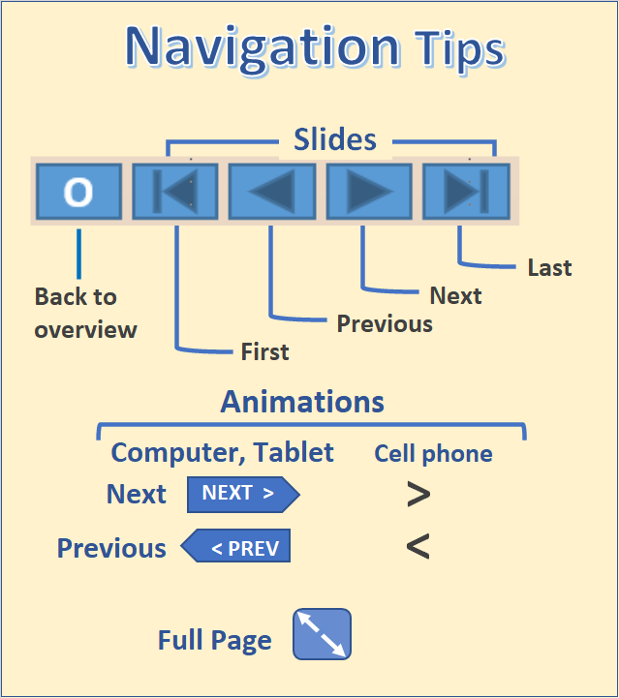
The State of Aging In Portland
Table of Contents
First page
Portland and comparison cities
Migration and characteristics of movers
Population and households
The Metroscope model
An alternative population forecast
Comparing the two forecasts
Part 1 - Population

Slide 2
Summary – Population
2
People age 65+ are the most rapidly growing segment of Portland’s population. The largest number of persons age 65+ are those aging in place in Portland’s single-family owner-occupied homes but there also is a component of less affluent households in multifamily housing.
We begin this section by comparing Portland with 20 comparison cities. In terms of growth rates and proportion of population that is older Portland is in the middle of the group.
Migration is analyzed from three perspectives. In terms of the flow of older population into and out of the City the net is a near wash with gains from the rest of the U.S. and losses to its suburbs. We look at net migration to various zoning categories. Where multifamily zoned areas attract older populations, it often is to independent living developments whereas multi-use zoned areas tends to attract a pre-retirement age population.
The American Housing Survey allows us to look nationally at movements between such characteristics as owner and renter status, but the data for Portland is largely suppressed due to small sample size.
Because we look at population projections for Portland and because the projections are done for persons and households, we look at the range of different households for older persons. Over the life course most older households shrink in size and many of the age 65+ households are one person households with unique housing needs.
Finally, we look at two population projections for Portland. Metroscope, which is used by Portland Metro, uses an urban simulation model to explore the possible effects of various policy choices on urban land development. We make use of medium 2035 implementation of the model. It does not directly forecast population by age, but population by age of householder can be derived.
We developed an alternative model for projecting age and sex for the census tracts in the Portland Metro area using the Hamilton-Perry methods. Its forecasts for the geographical distribution of population is very different from the Metroscope model. The difference is large for the 65+ population.
O

Slide 3
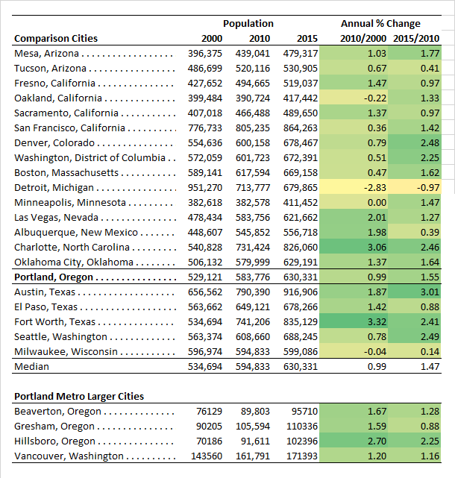
Portland a Mid-sized City
3
The city of Portland has some interesting company among U.S. mid-sized cities. Boston and Detroit only have slightly more population than Portland but are part of much larger metropolitan areas.
We selected 10 cities larger than Portland and 10 cities smaller as comparison cities.
Not surprisingly Portland is close to the median size for the 20 comparison cities.
From 2000 to 2010 Portland grew at an annual rate of 0.99% but from 2010 to 2015, after the recession, growth was at a 1.55% annual rate, both close to the median for the 20 comparison cities.
With respect to growth rates Portland again is similar to its comparison cities, not growing as rapidly as Charlotte but not suffering population losses as did Detroit and Milwaukee.
Notes: Changes in population may include expansions through annexation. The 2015 figures assume constant growth during the 2013-2017 sample for the ACS.
Sources: Decennial Census 2000 table P001, 2010 table P1, ACS 2017 5-year table B01003.
Learn about the Decennial Census
O

Slide 4
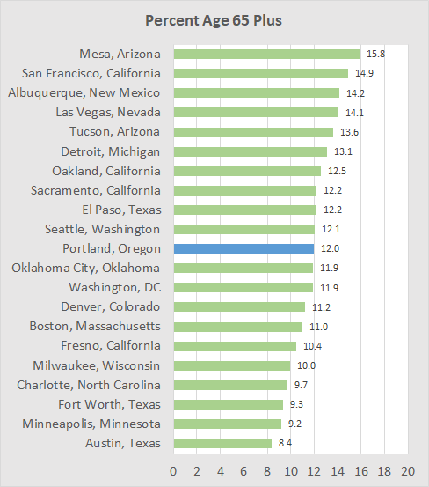
Approximately 12% of Portland’s Residents were Age 65+ (2015)
4
About 12% of the city of Portland’s population was age 65+ in 2015.
The proportion age 65+ in Portland was nearly the same as the median for the 20 comparison cities (12.0%).
It was considerably lower than the percent in Mesa, Arizona (a Phoenix suburb), but much higher than in Austin Texas.
We also show the percent age 65+ for the larger cities in the Portland metropolitan area. Portland’s percentage is lower than the local comparison areas except for Hillsboro.
Source: ACS 2017 5-year table B01003.
Note: The 2015 figures assume constant growth during the 2013-2017 sample for the ACS.
O

Slide 5
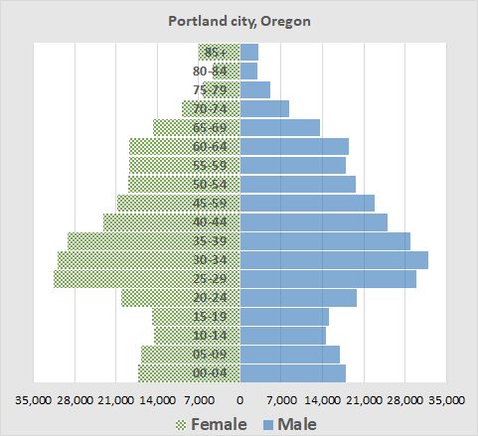
The City’s Age Structure
5
The population pyramid for Portland in 2015 reflects:
The aging post WWII baby boomers
Recent in-migration of working age households
Earlier periods of strong in-migration
Modest resurgence in the number of young children
Gender imbalance for the oldest age groups
Growth in the age 65+ population will be driven by the large number of boomers approaching age 65 and the younger cohorts reflecting earlier periods of strong workforce age in-migration.
Source: ACS 2017 5-year table S0101. Data are for 2013-2017 with mid-year of 2015.
Learn about the American Community Survey (ACS)
O

Slide 6
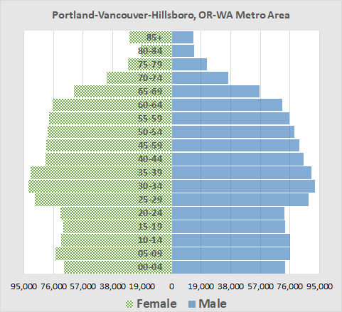
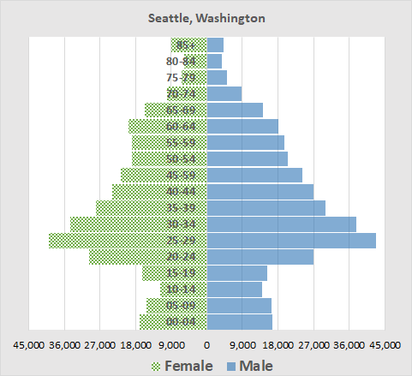
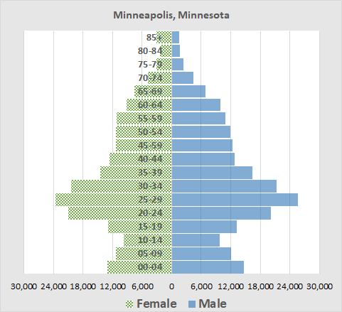
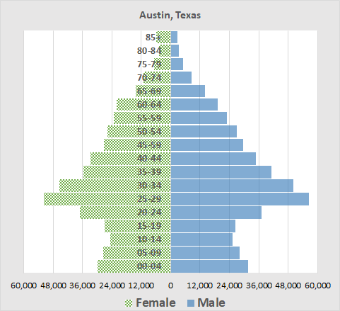
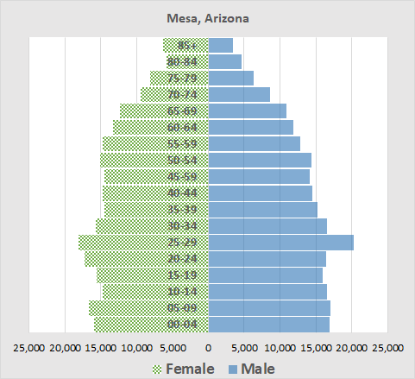

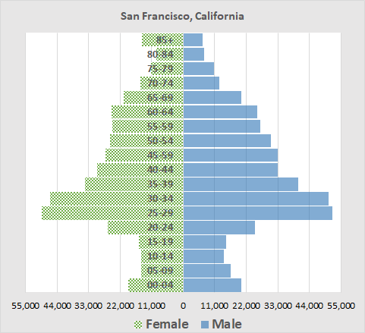
How Does Portland’s Age Structure Compare?
6
The Portland Metropolitan Area has larger cohorts moving up to old age than does the City.
The pyramids for Portland and Seattle are similar, except for the larger 25-29 cohort in Seattle.
The pyramid for Minneapolis also is similar.
Austin lacks the large number of baby boomers.
Mesa, a Phoenix suburb, has years of to-be-older folks.
San Francisco has large number of recently in-migrated young working age households.
Source: ACS 2017 5-year table S0101. Data are for 2013-2017 with mid-year of 2015.
O

Slide 7
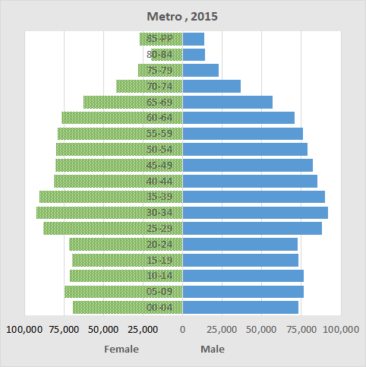
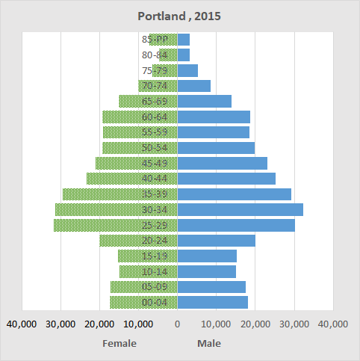
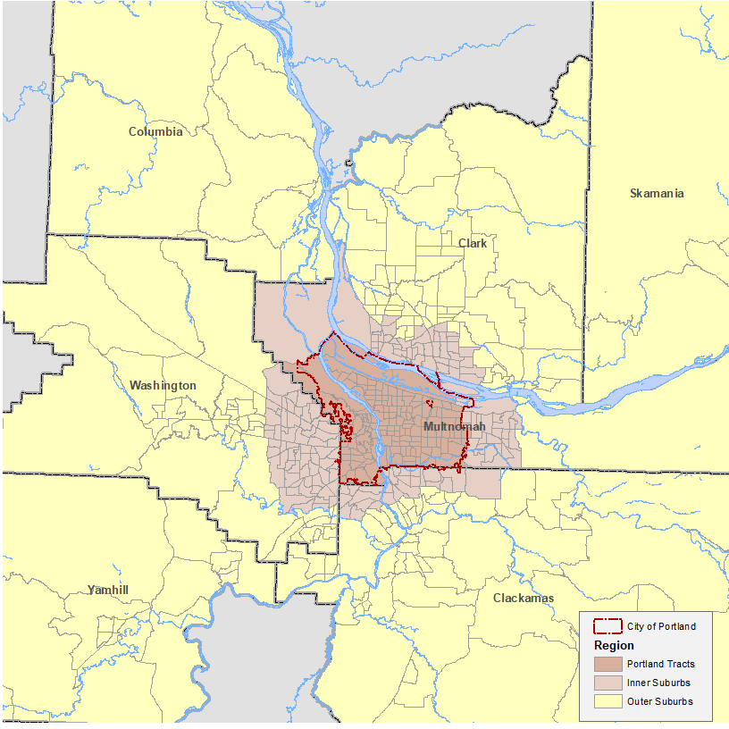
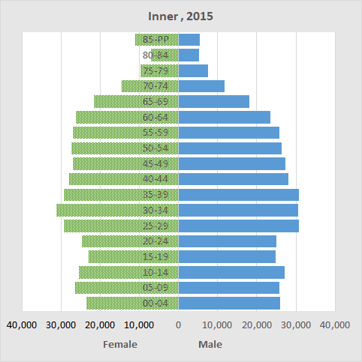
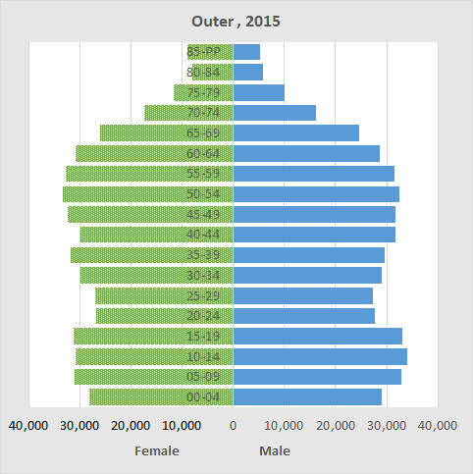
Portland Compared to its Suburbs
7
The data for these population pyramids are from the 2013-2017 American Community Survey.
Compared to the 7-county Portland Metropolitan area, a larger share of the City’s population is in the 20-44 working age group.
The City’s share of the age 50+ population is less than that for its inner and outer suburbs.
Learn about the definition of City, inner, and outer.
O
Source: ACS 2017 5-year table S0101. Data are for 2013-2017 with mid-year of 2015.

Slide 8
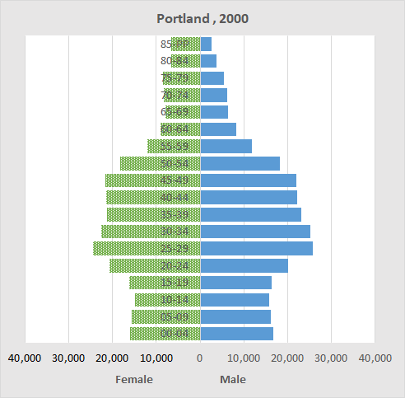
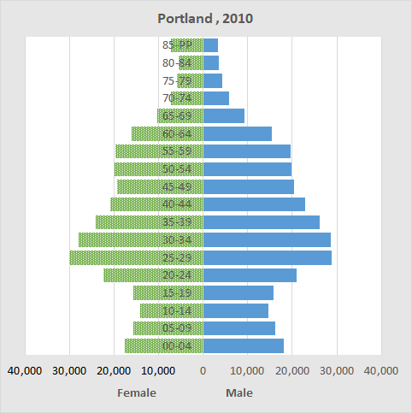
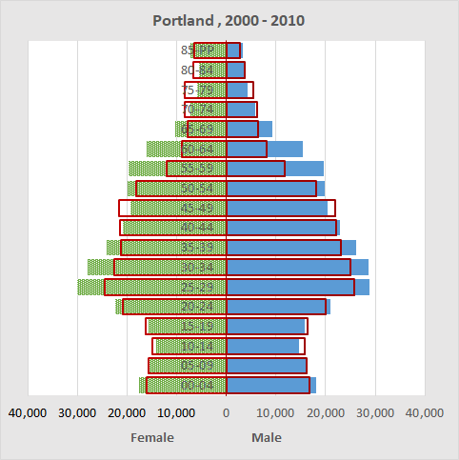
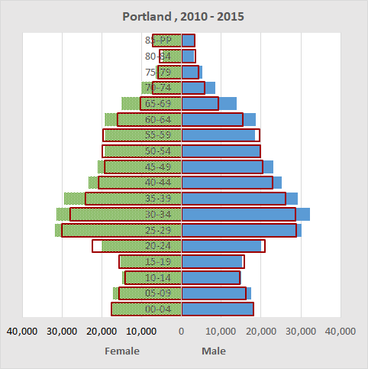


Changes: 2000-2015
8
Sources: Decennial Census 2000 and 2010 table P-12, ACS 2017 5-year table S0101.
Tracking the City from 2000-2015, one can see the growth of the working age population resulting from in-migration.
The bottom pair of pyramid charts shows the change by 5-year age group.
For the 2000-2010 comparison compare the red line to the chart bar two bars up.
For the 2010-2015 comparison compare the red line with the chart bar immediately above.
If you make this comparison for the 2000-2010 you will see how the aging of the baby boomer population results in growth of the 65+ age groups.
O

Slide 9
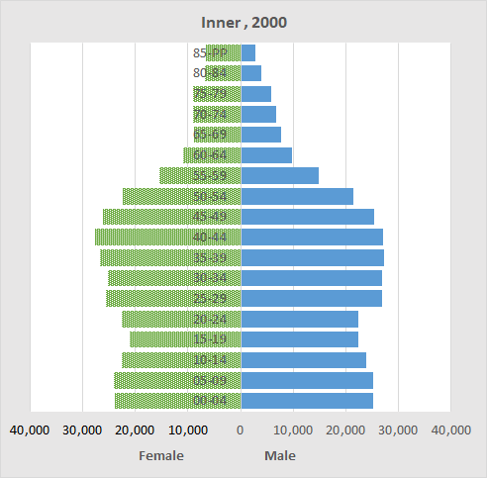
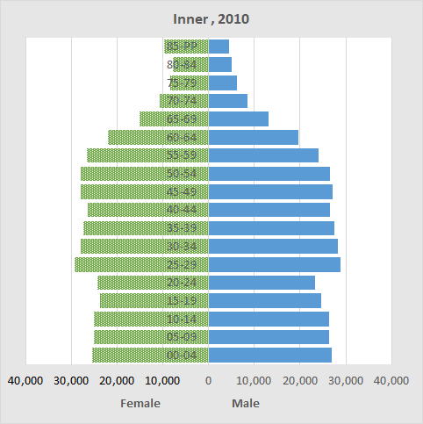
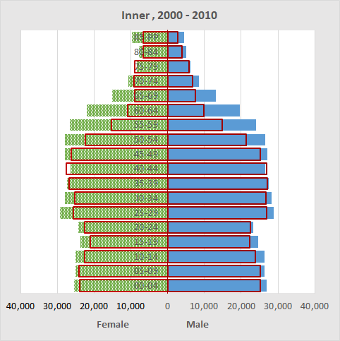
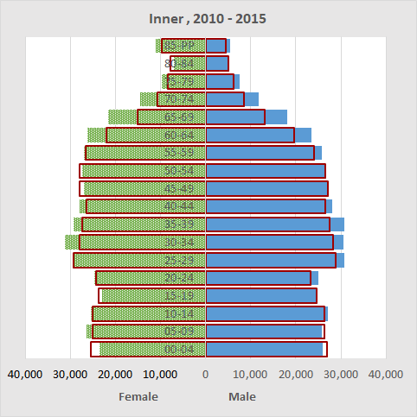
Changes: Inner Suburbs
9
Sources: Decennial Census 2000 and 2010 table P-12, ACS 2017 5-year table S0101.
Portland’s inner suburbs have a bulge due mainly to earlier periods of in-migration, much of that coming from city to suburb moves.
In the 2015 pyramid chart the large 50-59 age and following cohorts foretell substantial future growth of the age 65+ population.
The bottom two charts overlay 2000 and 2010 patterns (Census to Census) and 2010-2015 patterns (Census to ACS).
O

Slide 10
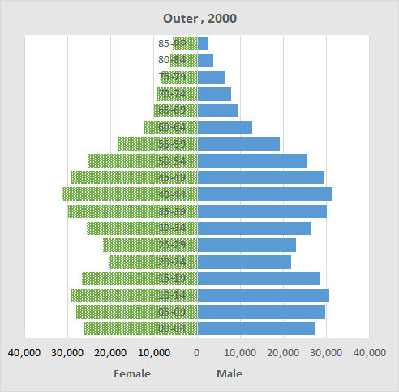
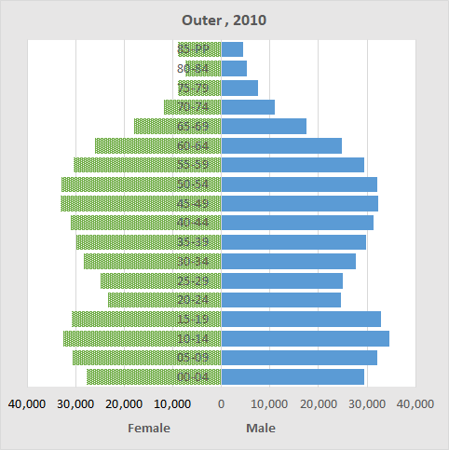
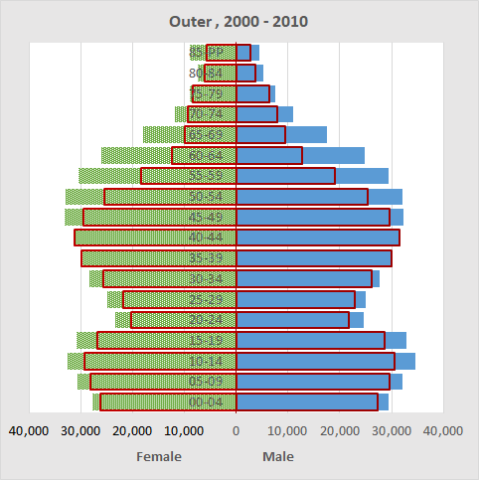
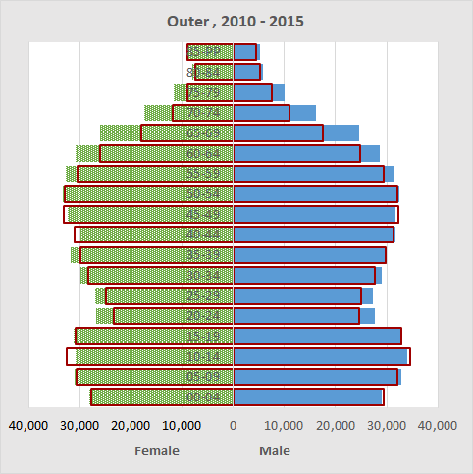
Changes: Outer Suburbs
10
Sources: Decennial Census 2000 and 2010 table P-12, ACS 2017 5-year table S0101.
Portland’s outer suburbs will experience growth in the age 65+ population due to aging in place of a large pre-retirement age population.
Some of the growth is due to in-migration from the City and outside of the metropolitan area.
The bottom two charts overlay 2000 and 2010 patterns (Census to Census) and 2010-2015 patterns (Census to ACS).
O

Slide 11
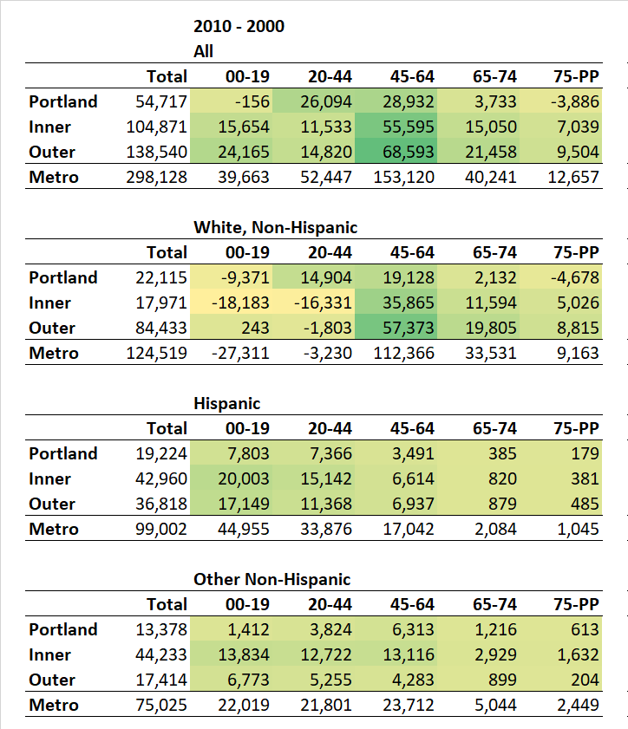
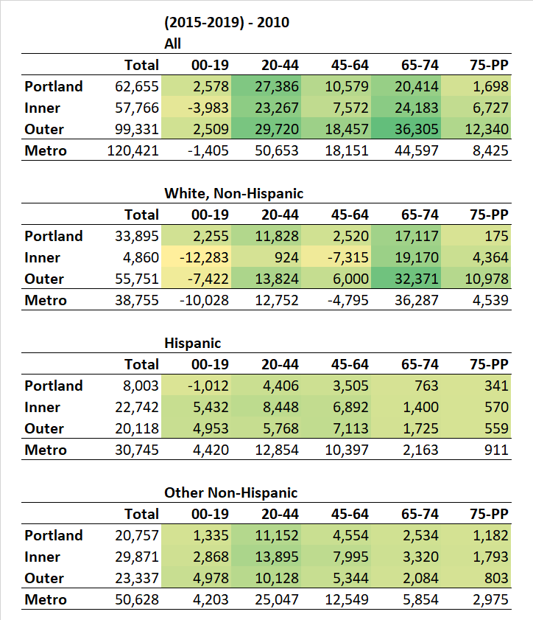
Changing Population of Older People
11
From 2000 to 2010, Portland’s population increased from 529,131 to 583,776, an annual rate of growth of 0.99%. From 2010 to 2015, after the great recession, growth increased to an annual growth rate of 1.55%. This growth was driven by the large number of boomers (born from 1946-1964) approaching and surpassing age 65, and the younger cohorts reflecting earlier periods of strong workforce age in-migration. Compared to the seven-county Portland Metropolitan area, a larger share of the City’s population is in the 20-44 working age group.
As displayed in the table to the right (source: U.S. Census, 2000 & 2010), patterns of growth and decline among different age groups, races, and geographic locations are observable from 2000-2010. The city of Portland lost population at both ends of the age spectrum (those 0-19 and 75 and older) while Portland’s inner and outer suburbs gained population across all age categories, with particularly strong growth of middle-aged individuals aged 45-64; the inner and outer suburbs have grown due to in-migration from this group from outside the metropolitan area and from city-to-suburb moves.
Did these trends continue after 2010? The latest reasonably stable data we have is from the five-year 2015-2018 American Community Survey, based on responses from 46,072 persons in Portland. These data suggest that more baby boomers aged past 65 and that the number 65-74 have increased for white non-Hispanics. The numbers for Portland showing change for age 75 plus white non-Hispanics and for age 65 plus Hispanics are too small to assess due to small sample size. We need to await results from the 2020 census to better assess these changes.
Significant
Not significant
See definition of Portland and its inner and outer suburbs.
O

Slide 12
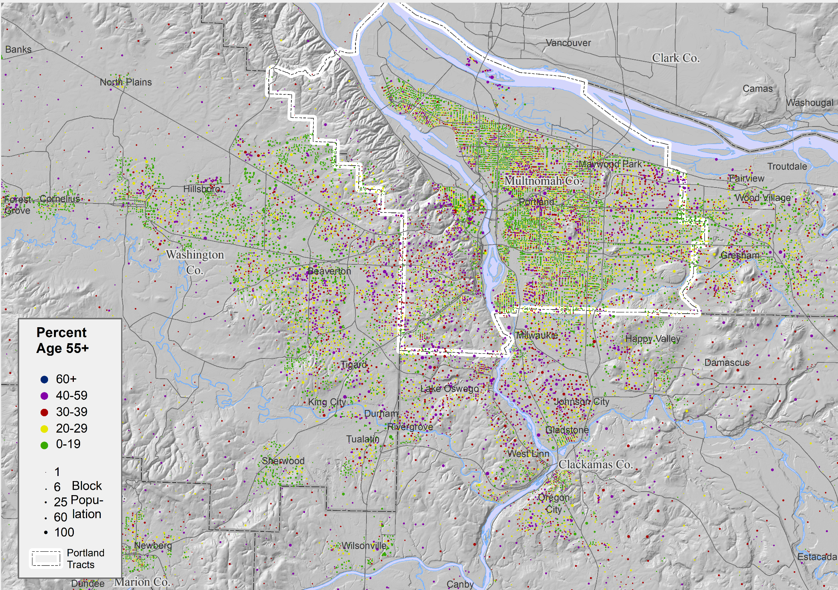
Where Older People Live
12
The color of the dots represents the percent of the block’s 2010 population that was age 55+:
Green: Less than 20%
Yellow: 20-29%
Red: 30-39%
Purple: 40% and over
The green dot areas are unlikely to have a large population of older persons by 2035.
The yellow dot areas are mainly single-family housing and are likely to gain a substantial older population through future aging in place.
Many of the areas where 50% or more of the 2010 population was age 65+ are outside of the City (e.g., King City, Beaverton, Claremont, Wilsonville).
Claremont
Portland
O
Source: Decennial Census 2010 table P12.

Slide 13
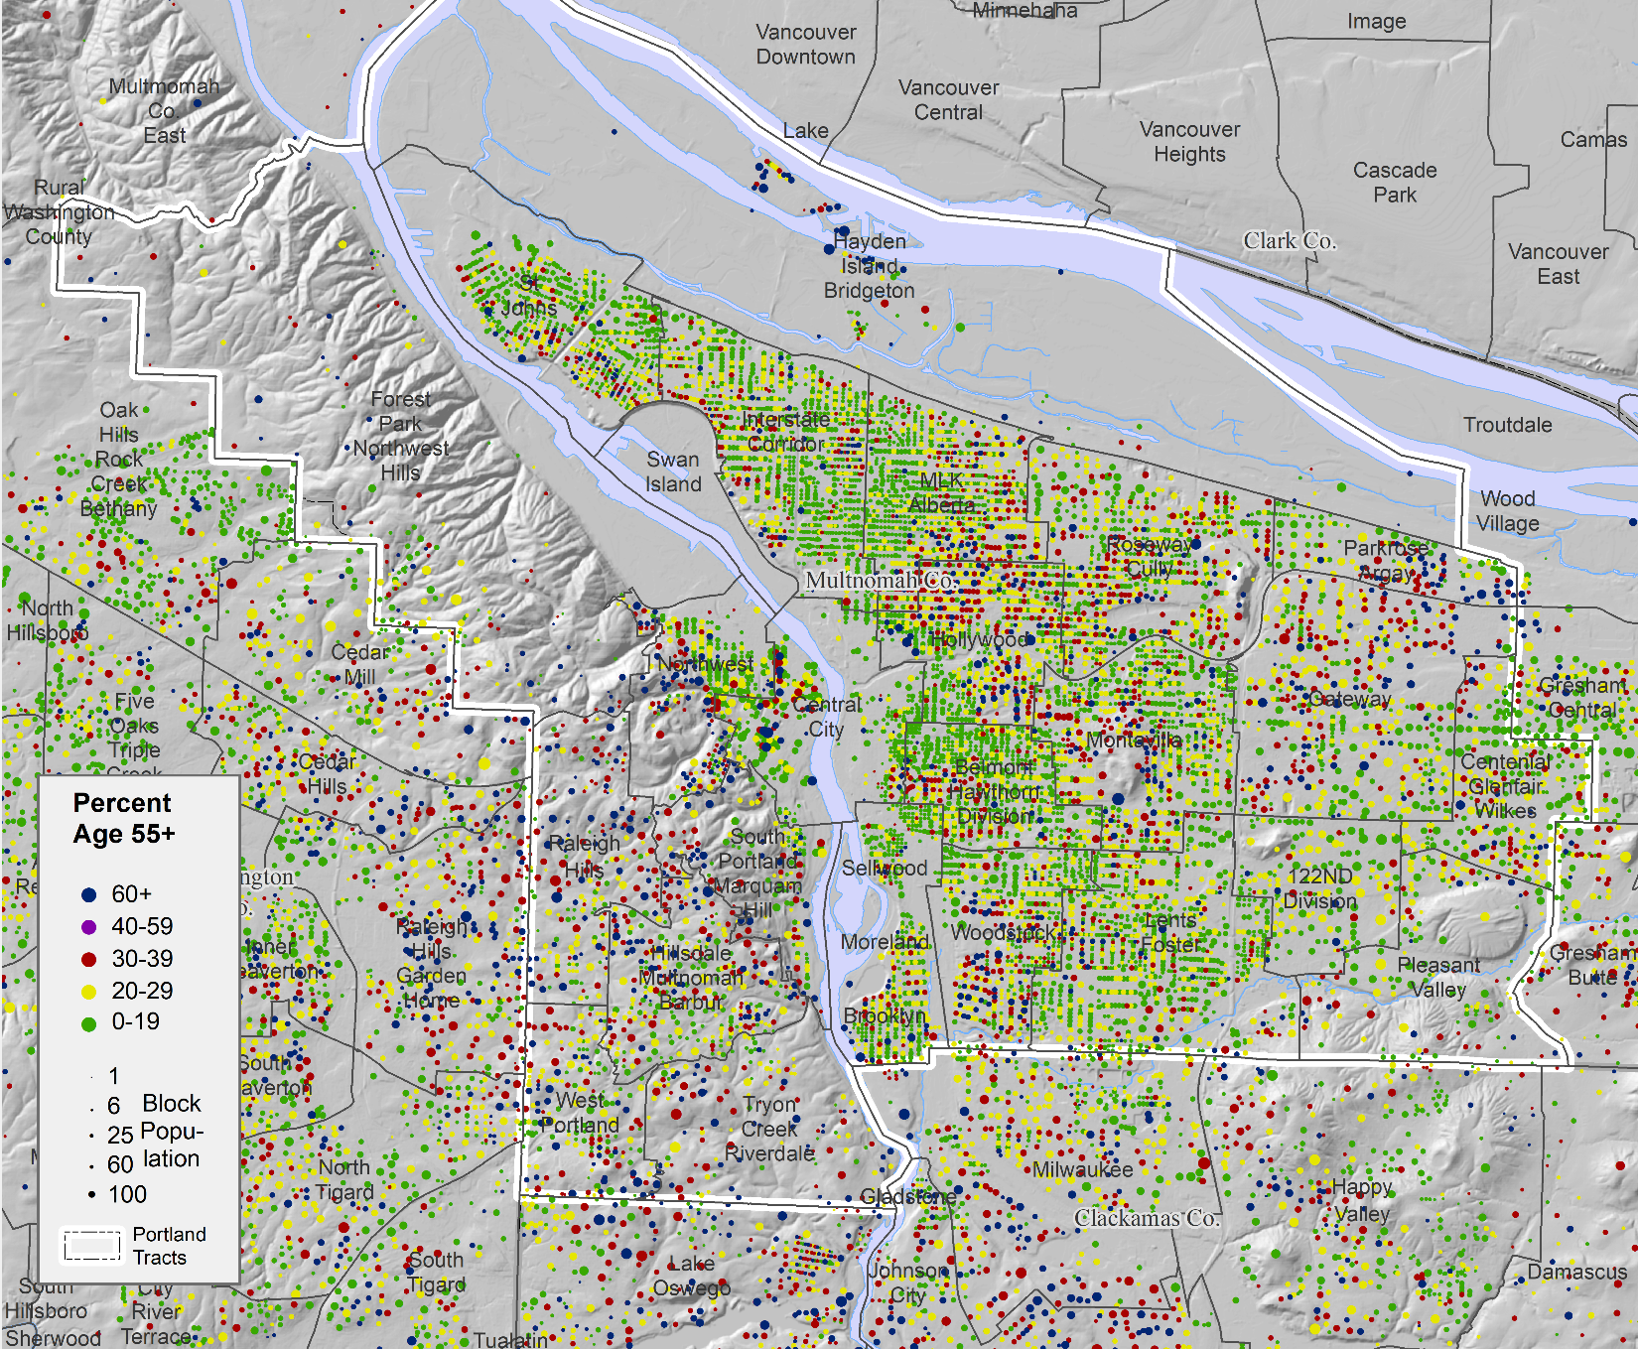
Zoomed in to City
13
This is the same map as the previous one but zoomed in on the city of Portland.
The named geographies, e.g., Interstate Corridor, are similar to Portland’s 20-minute neighborhoods extended to cover the metropolitan areas.
As on the previous map the green dot blocks have a mainly younger population and are unlikely to have a large age 65+ population by 2035.
The yellow and red dot blocks are single family housing with multi-family intermixed and are likely to have a growing age 65+ population mainly through aging in place.
The purple blocks include a few blocks of mainly single-family housing but consist mainly of apartments and condos.
Areas of major concentrations of older adults include the Central City, other blocks to the west of the Willamette, the east side of the Parkrose-Argay neighborhood and the Gateway, Montavilla, and Woodstock neighborhoods.
O
Source: Decennial Census 2010 table P12.

Slide 14
Views of Migration
14
For older populations, the two demographic components that most bring about change are survival rates and migration. Over the span of 25-years, births had no effect on the age structure of the 65+ population.
Migration can be directly assessed by determining where a person lived in an earlier time period and comparing it with the current residence. One source of such data is the American Community Survey which asks where a person resided a year ago. These data are tabulated into county-to-county flows by the Census Bureau. For confidentiality reasons flows for cities are not published so we need to use flows for Multnomah County as a near proxy. We will see that many more working age persons are moving to Portland than away but for the age 65+ population the considerable flow of older migrants to Multnomah County is offset by losses to Clackamas and Washington Counties.
We also can compute imputed migration be comparing the numbers in an age group, say 30-44, with the We need to subtract the number expected to die using mortality rates to estimate the number of migrants.
Table of Contents
First page
Portland and comparison cities
Migration and characteristics of movers
Population and households
The Metroscope model
An alternative population forecast
Comparing the two forecasts
O

Slide 15
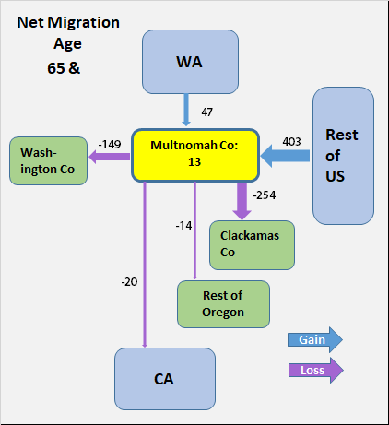
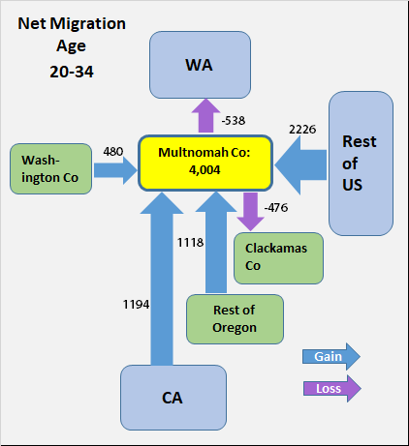

Direct Measures of Migration
15
We are able to view gross migration, i.e., the separate in and out migration flows, for U.S. counties.
One of the questions in the American Community survey is where did you live a year ago? To protect confidentiality the residence only is pinned down to the county level. This means we can’t find migration figures for the City of Portland, but we can for Multnomah County of which about 5/6 is in the City.
For the age 65+ population here are the reported county to county changes of county of residence for 2012-2017. The big Oregon flow is from California to SW Oregon (in-flow = 1,365; outflow = 707).
However, for the age 65+ population in and out flows balance and the net flow of migrants for Multnomah County is +13, near zero. The county gains from the rest of the U.S. and loses to adjoining counties.
By contrast, the net flows for Multnomah County for the 20-34 age group was +4,004.
Our findings are consistent with what William Frye at the Brookings Institution found in a national study. Quoting Frye: In states where senior populations will grow fastest over the next 35-years, aging in place rather than migration will drive this growth. In Georgia, for instance, the senior population will increase by more than 40% from 2010 to 2020 due to the aging of existing residents, versus less than 3% due to migration.
As we saw in the flow diagram for Multnomah County (displayed again, here), it nets out to near zero in age 65+ migrants and thus the growth of its older population will occur mainly through aging in place.
Source for table and charts: U.S Census Bureau, County to County Migration Flows, 2013-2017.
Frye, William H., Mapping the Growth of Older America: Seniors and Boomers in the Early 21st Century, The Brookings Institution, May 2007.
Unfortunately, all of these numbers have large sampling errors.
O

Slide 16
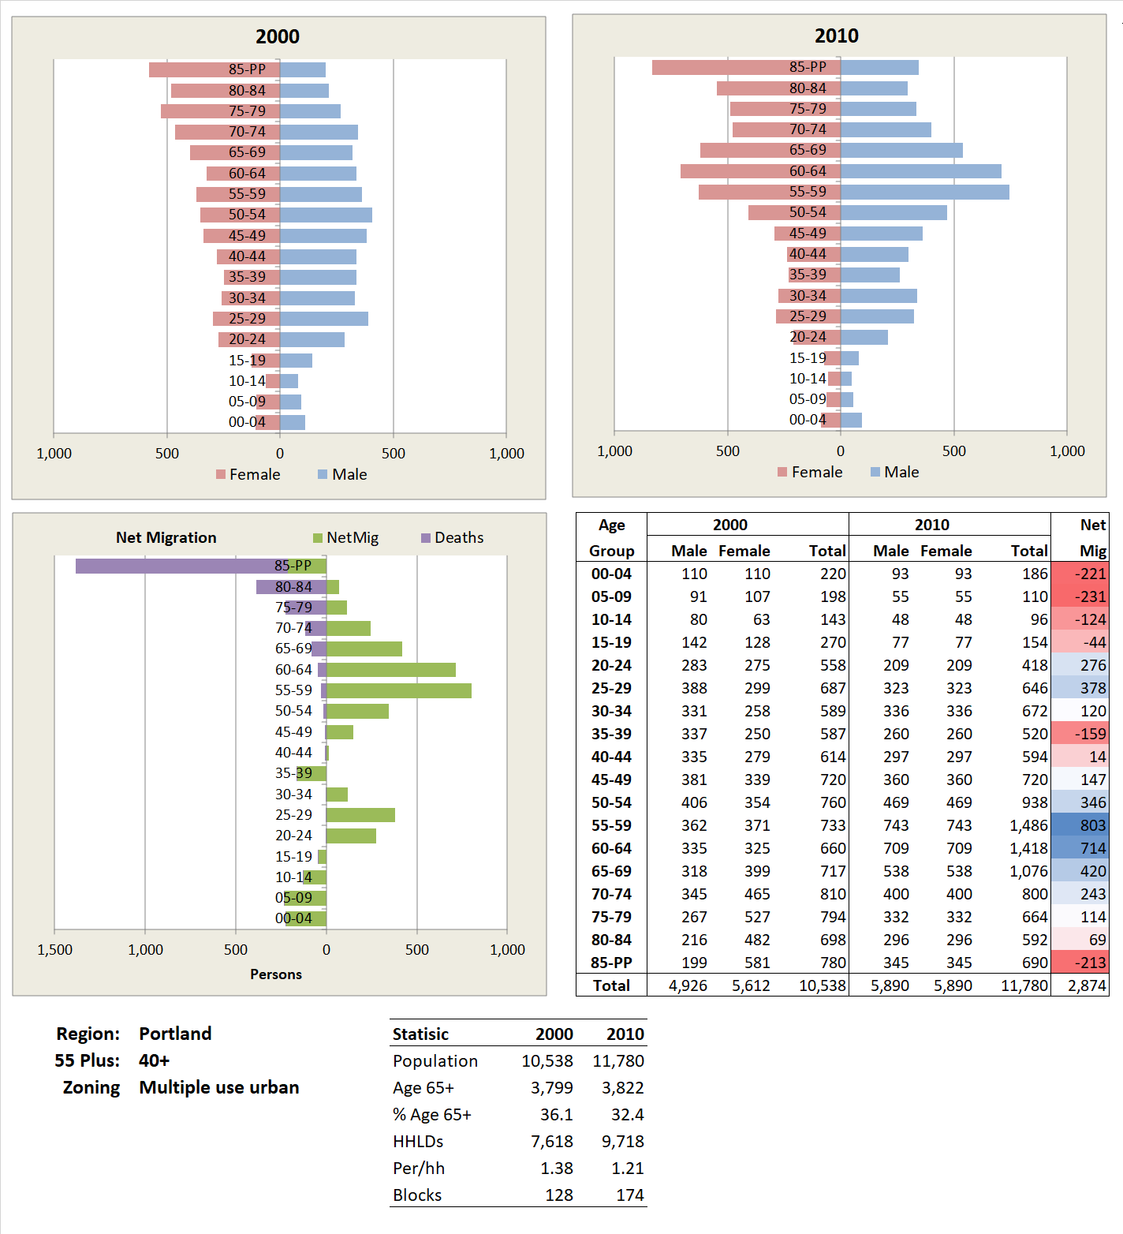
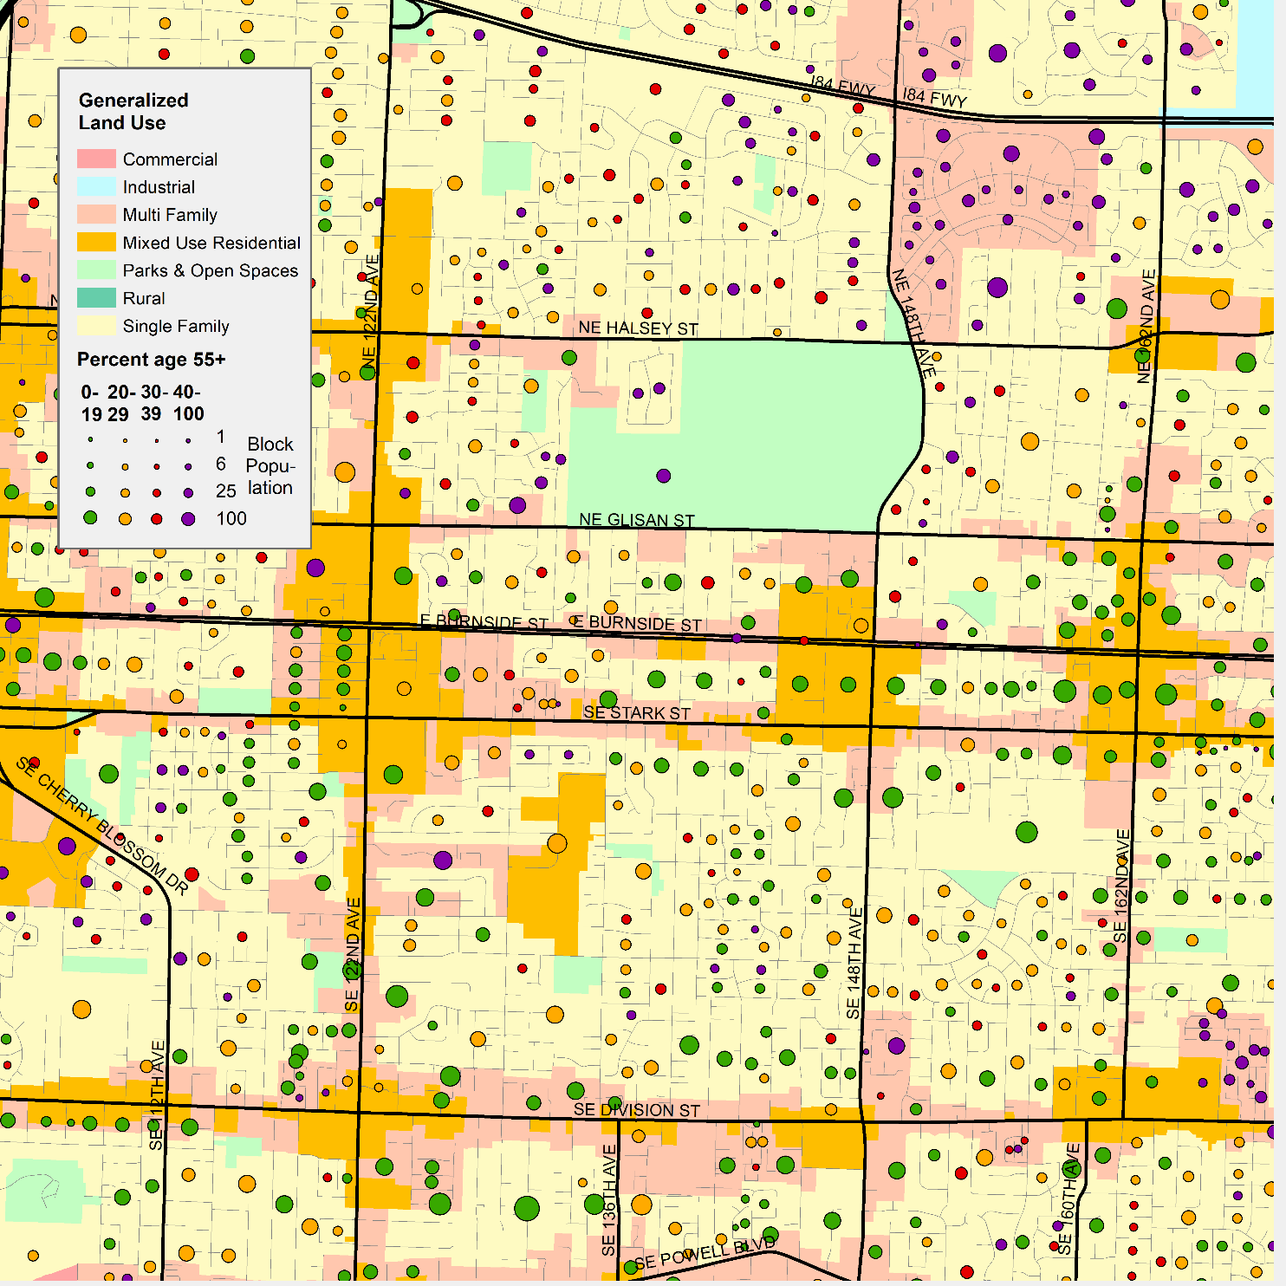
Seniors, Land Use, and Net Migration
16
Using GIS tools, we compared the 2000 and 2010 populations at the census block level with the blocks classified by zoning class.
On this map the small circles represent census blocks. The area of the block represents the population of the block. The color shade of the block represents the proportion of the 2010 population, from yellow with 0-19% to purple with 40% or more. The area shadings represent generalized zoning.
We estimate age specific net migration for: single family residential in light yellow, multifamily residential in light red, and multiple use urban in in dark yellow.
Here is an example for multiple use urban for those blocks where 40% or more of the 2010 population is age 55+.
It shows strong in-migration for ages 50-74 and modest in-migration for ages 20-34.
In-migration is a net of in- and out-migration, calculated by comparing a 5-year age cohort from the 2000 to the 2010 census figure (e.g., comparing 587 age 35-39 in 2000, to 720 age 45-49 in 2000).
We make an adjustment for the number in the cohort who may have died during the 10-year period. We use U.S. Social Security Administration survival rates for this calculation. The numbers surviving may be low in high income and education areas and high in low education low-income areas.
O
Sources: Decennial Census 2000 and 2010 table P12.

Slide 17
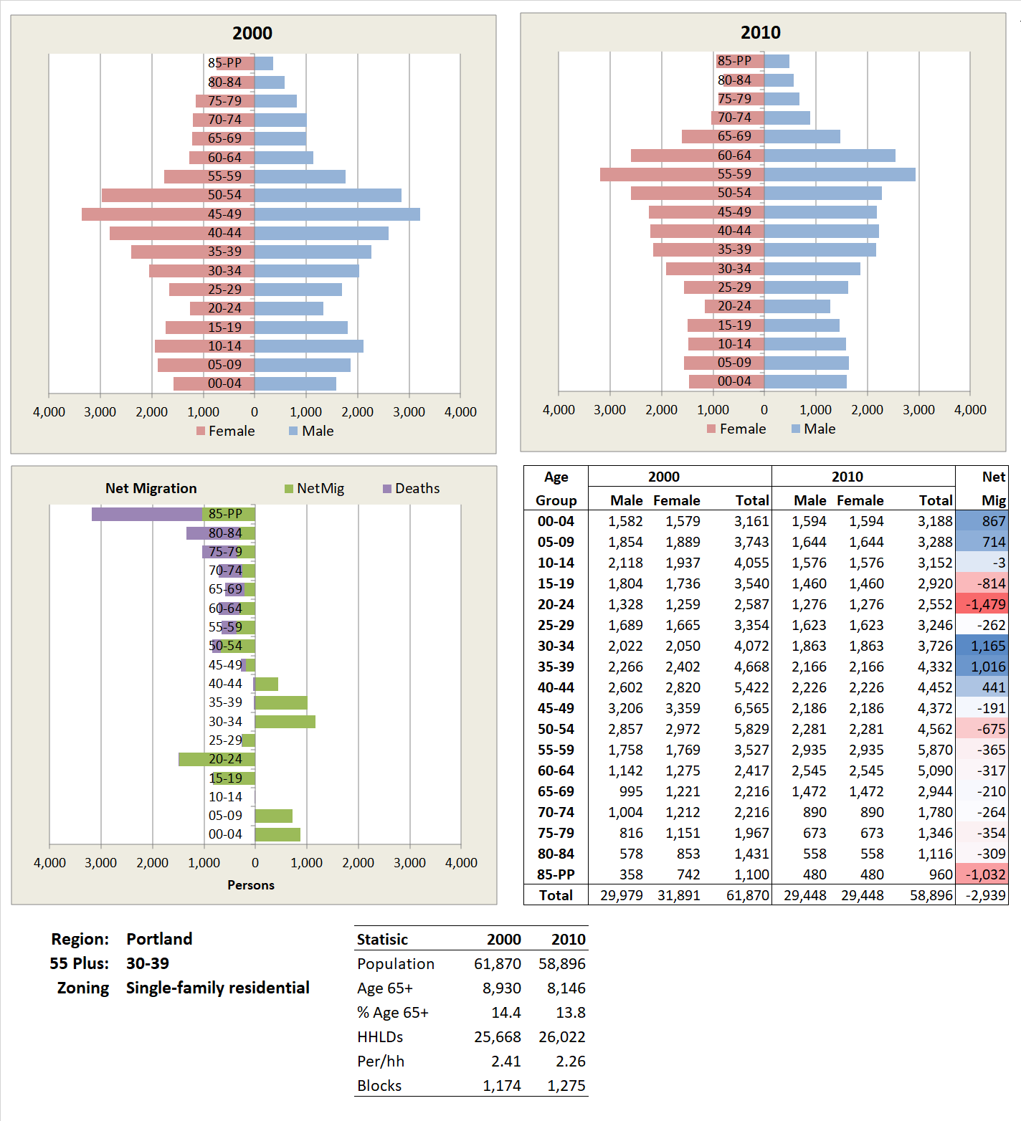
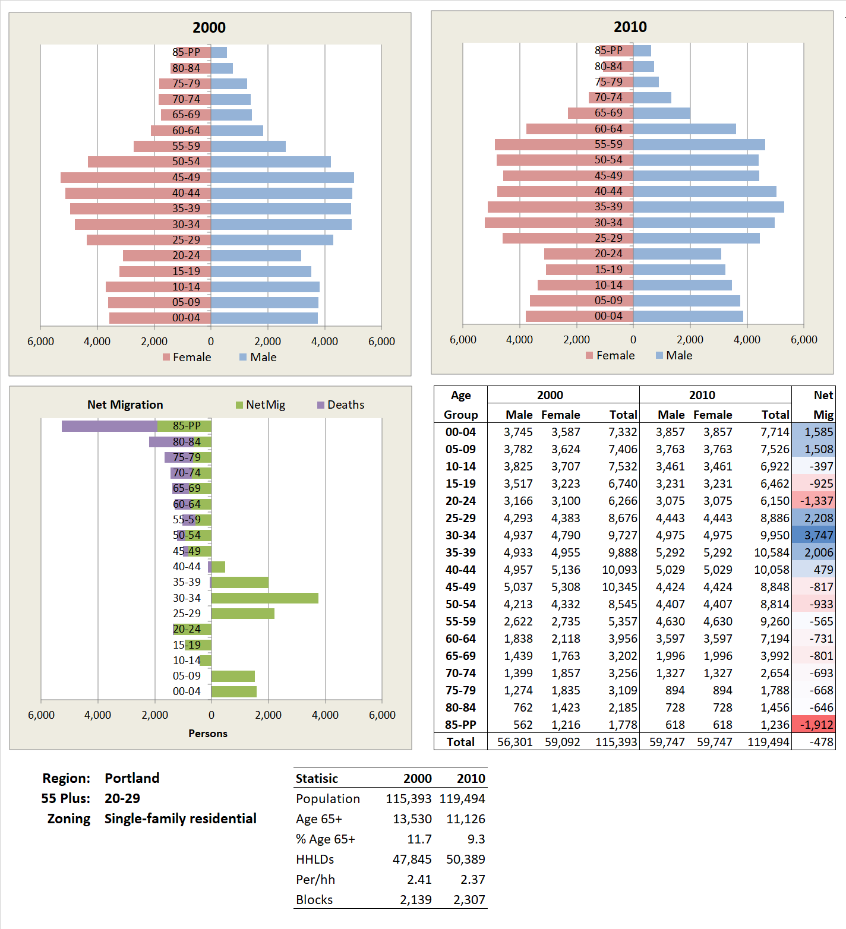
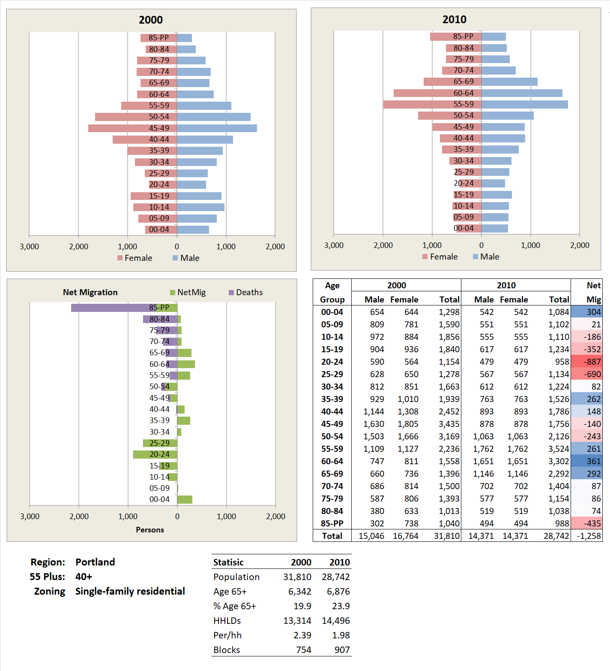
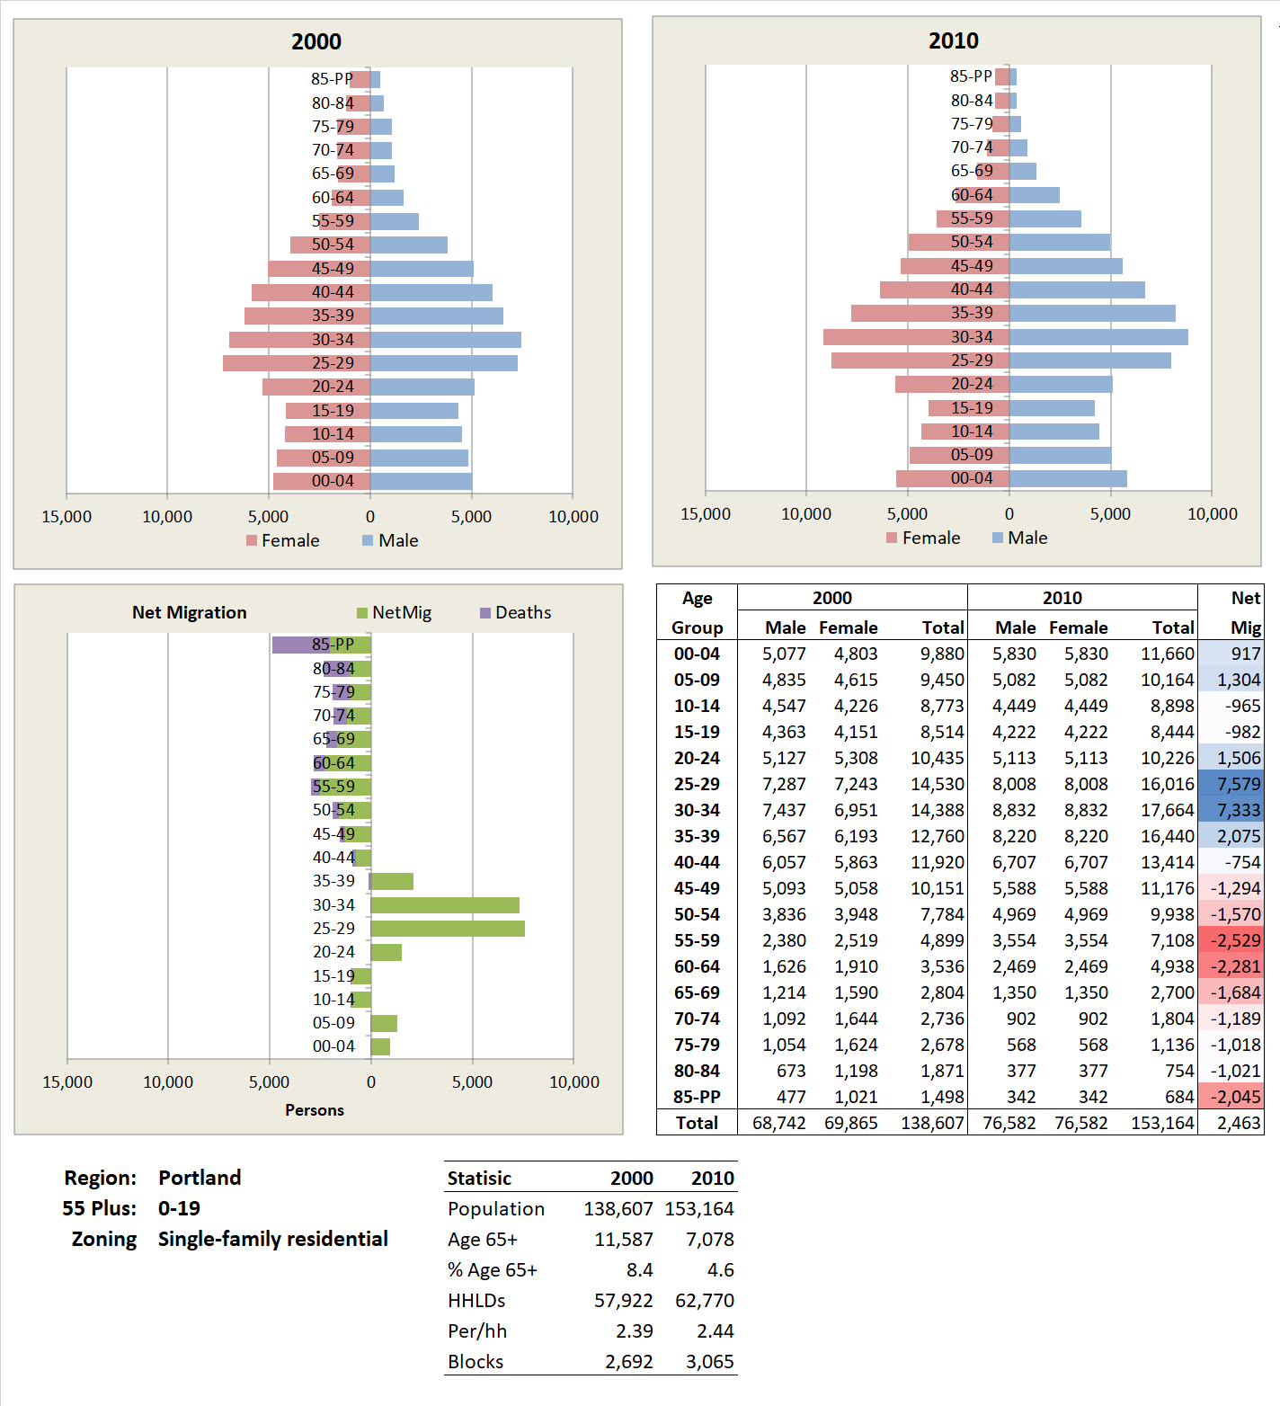
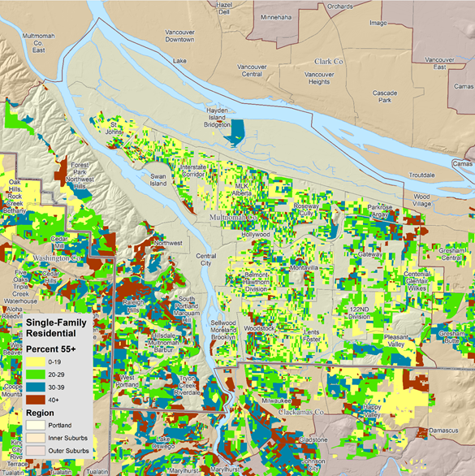
Net Migration for Single Family Residential Zoning
17
This map shows parcels zoned single family residential color-coded by the percent of the 2010 population that was age 55+.
The first chart shows the summary for census blocks with 0-19% of the population age 55+.
The next shows the summary for census blocks with 20-29% of the population age 55+.
We see a major shift toward older households as we move to the 30-39% age 55+ group.
For those blocks where more than 40% of the population is age 55+ we begin to see net in-migration of older persons.
In summary, for areas zoned single family residential in Portland we see a shift from in-migration of young households where there are few age 55+ (yellow on map) to in-migration of older households and outmigration of younger households where more that 40% of the block population is age a 55+ (dark red on map).
Net migration is positive for persons in their 20’s and 30’s with modest outmigration of older persons, particularly in their 50’s.
Where 40% or more of the population is age 55 plus we begin to see net in-migration of pre-retirement age older people accompanied by the loss of people in the 20’s.
Net migration for the 20-29% group is similar to the last except that there is loss of young adults and the greatest outmigration is for those 85 and older.
Net migration is positive for 20-44 age persons with loss of age 15-24 persons. The net outmigration of the 50 and older is less.
Sources: Decennial Census 2000 and 2010 table P12. Zoning from Metro RLIS 2010.
O

Slide 18
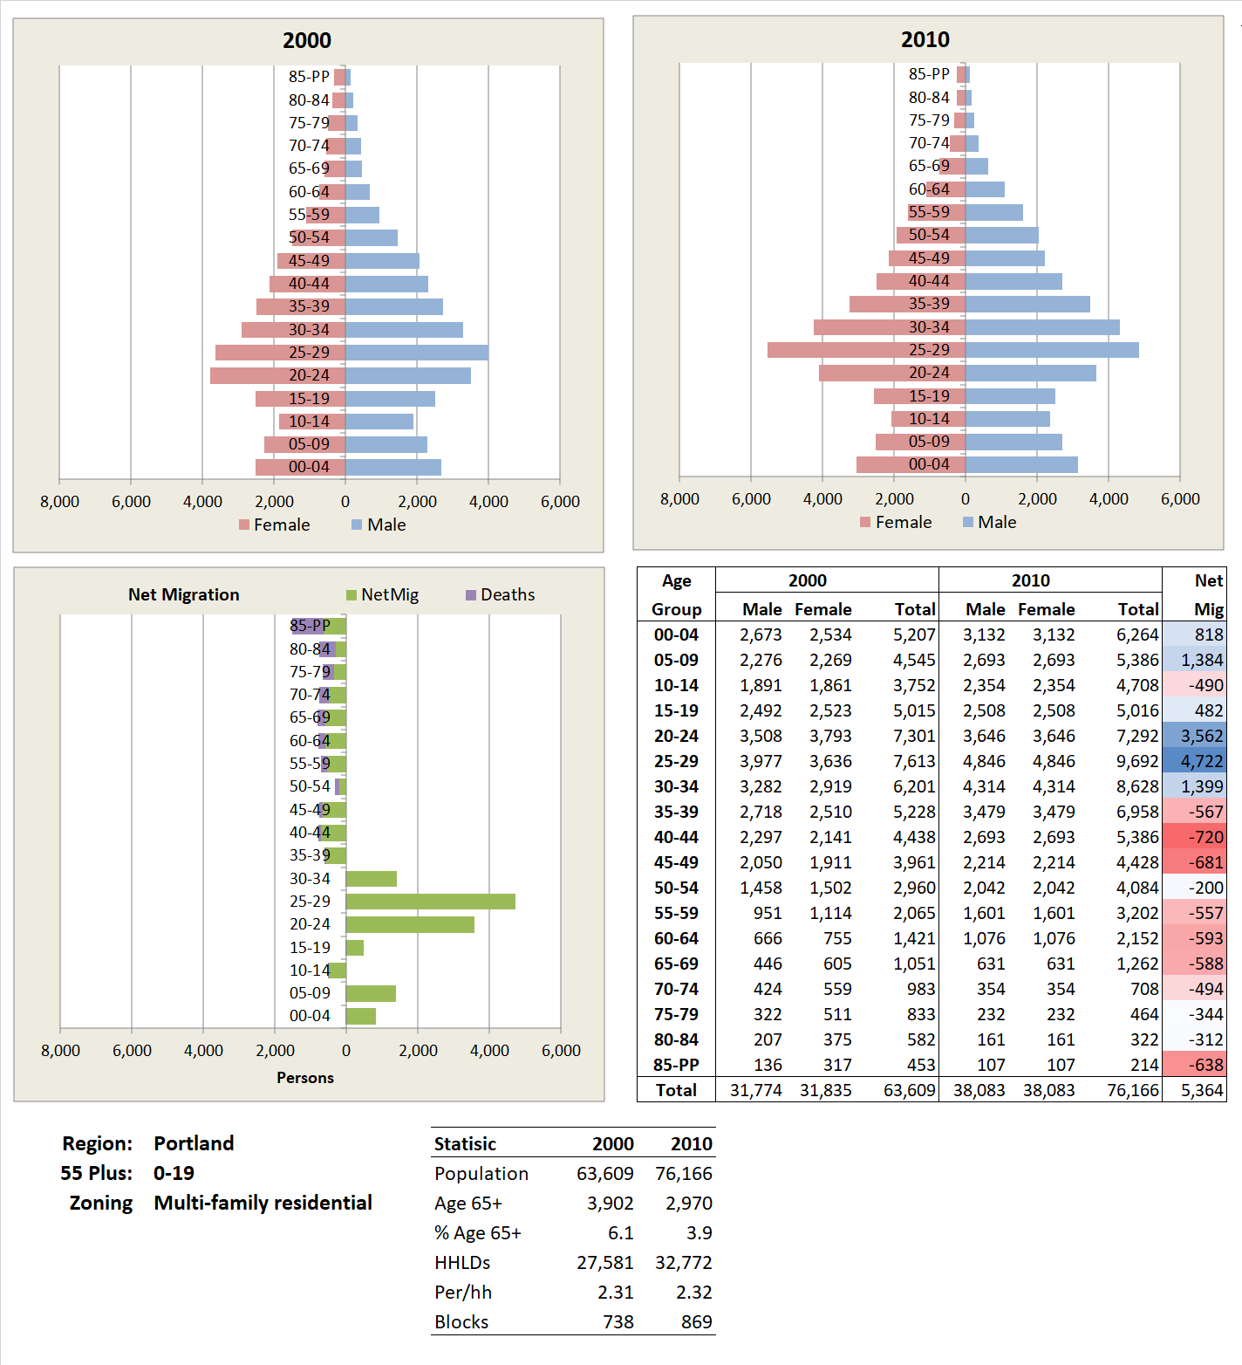
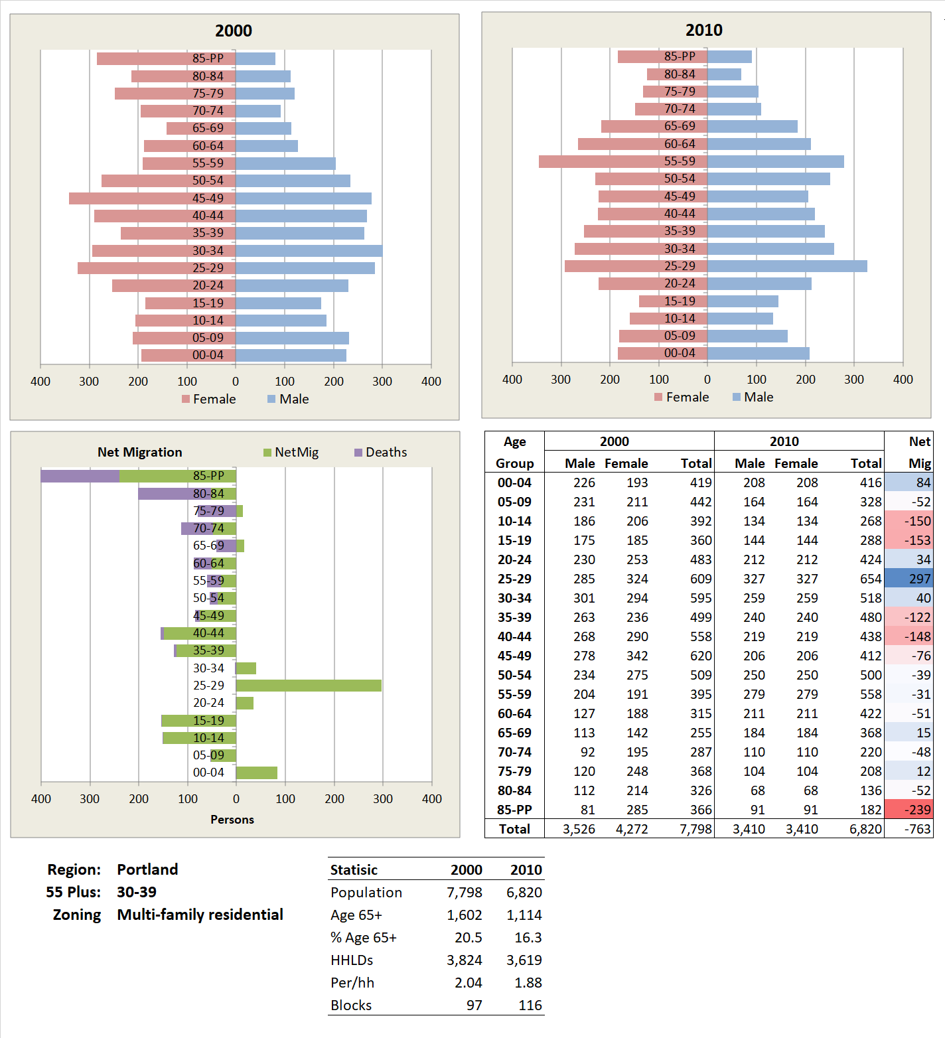
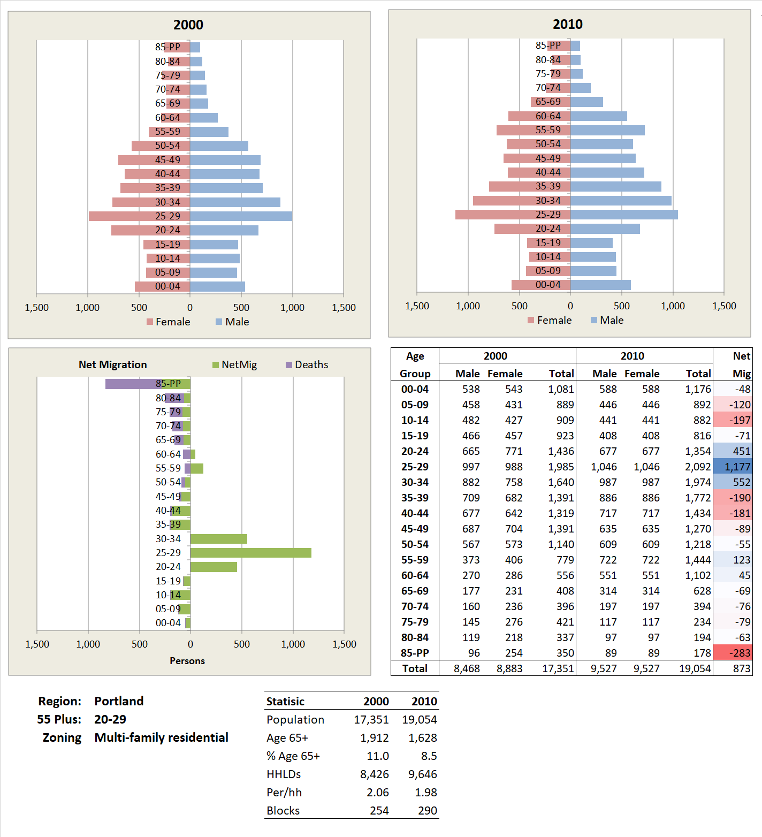
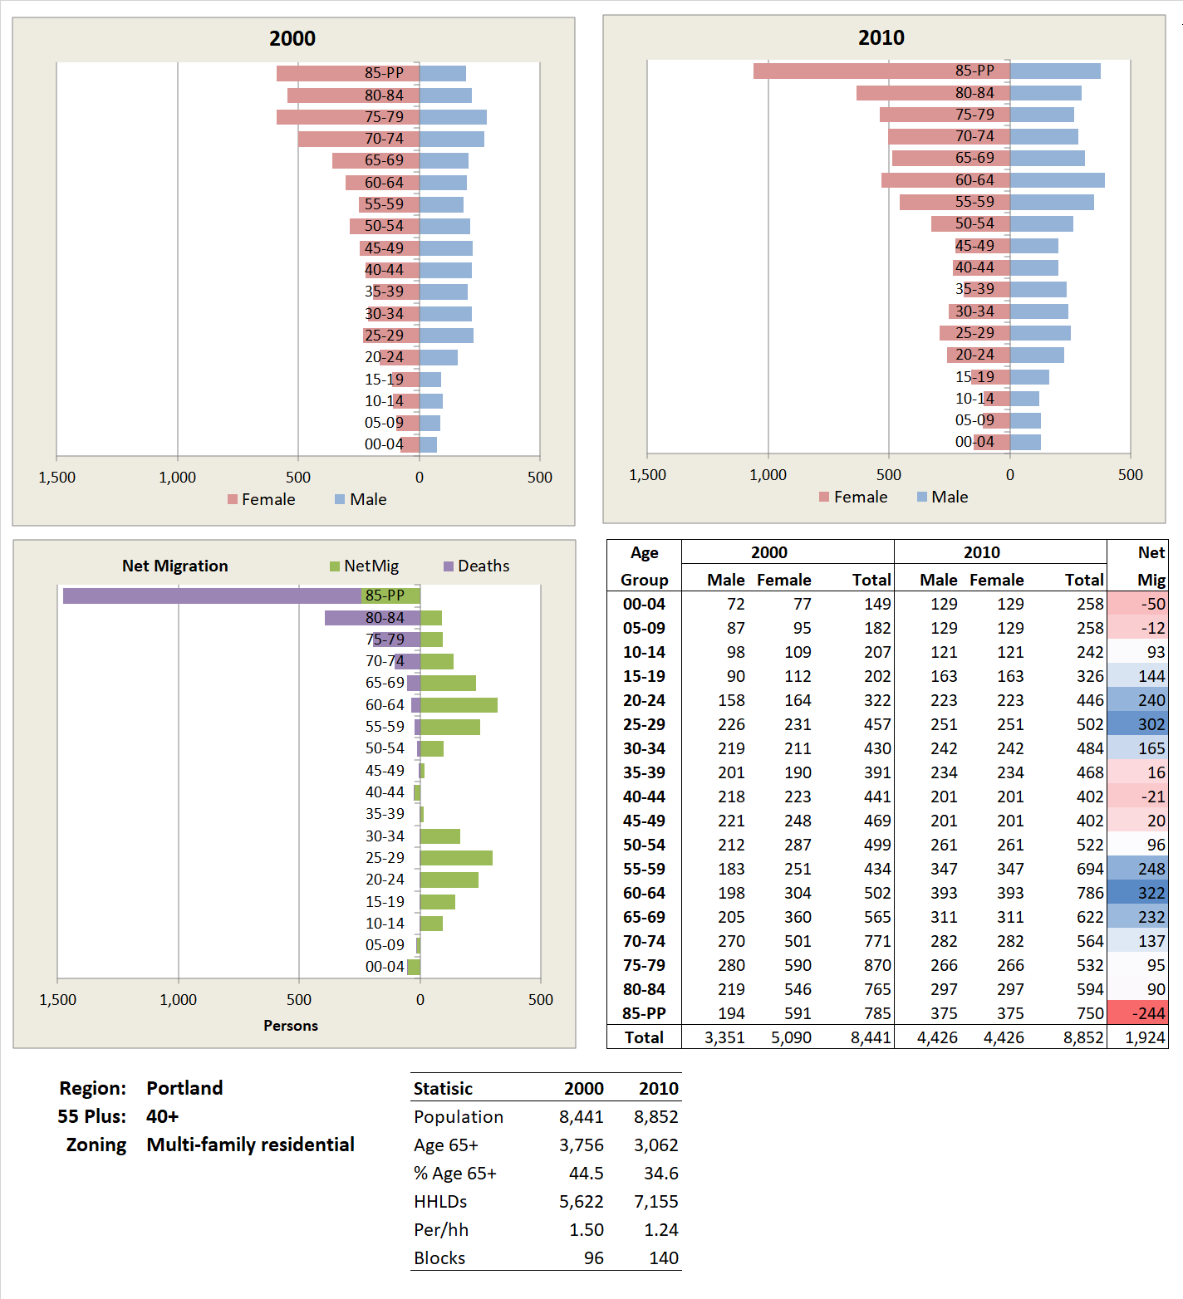
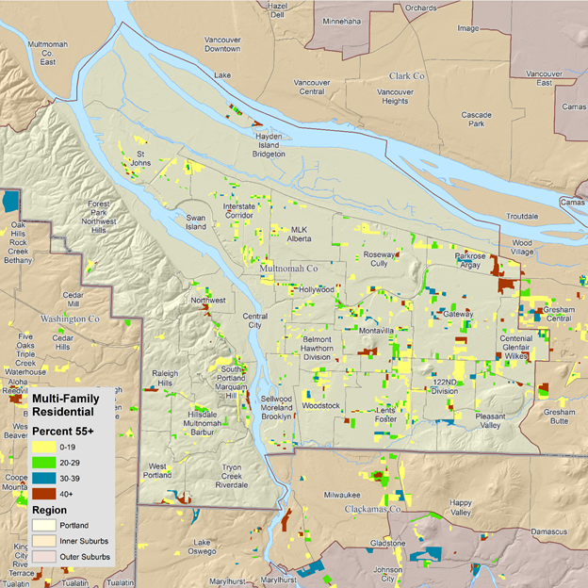
Net Migration for Multifamily Residential Zoning
18
This map shows parcels zoned multifamily residential color-coded by the percent of the 2010 population that was age 55+.
Net migration for those areas where 0-19% of the block population is similar to that for single-family residential; however, the population is only about half of single-family residential for the same percent of those age the 55+.
For the 20-29% age 55+ class, the profile is similar to that for single family.
The numbers in the 30-39% age 55+ class are small and the results somewhat erratic.
For those blocks zoned multifamily residential with 40% or more of the population age 55+, we can see a major shift to a bimodal distribution of younger and older households cohabiting these units.
The dark red areas on the map are the only multifamily zoned blocks that appear to have substantial net in-migration of older persons between 2000 and 2010. (Note: Most of the large independent living developments are outside of the city of Portland.)
In spite of being base on only around 100 blocks we see a clear patten of net in-migration of younger and older households.
There is net in-migration of persons in their 20’s and 30’s and modest out-migration of persons age 35 plus.
Net in-migrants for the 20-29% class are about ten years older than for the 0-19 class. Net migration for children flips from positive to negative.
The age 25-29 age group shows net in-migration at the expense of nearly all other age groups. Since the statistics only are based on about 100 blocks the results are erratic.
Sources: Decennial Census 2000 and 2010 table P12. Zoning from Metro RLIS 2010.
O

Slide 19
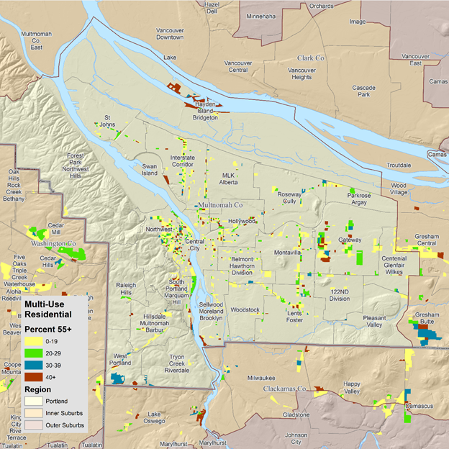
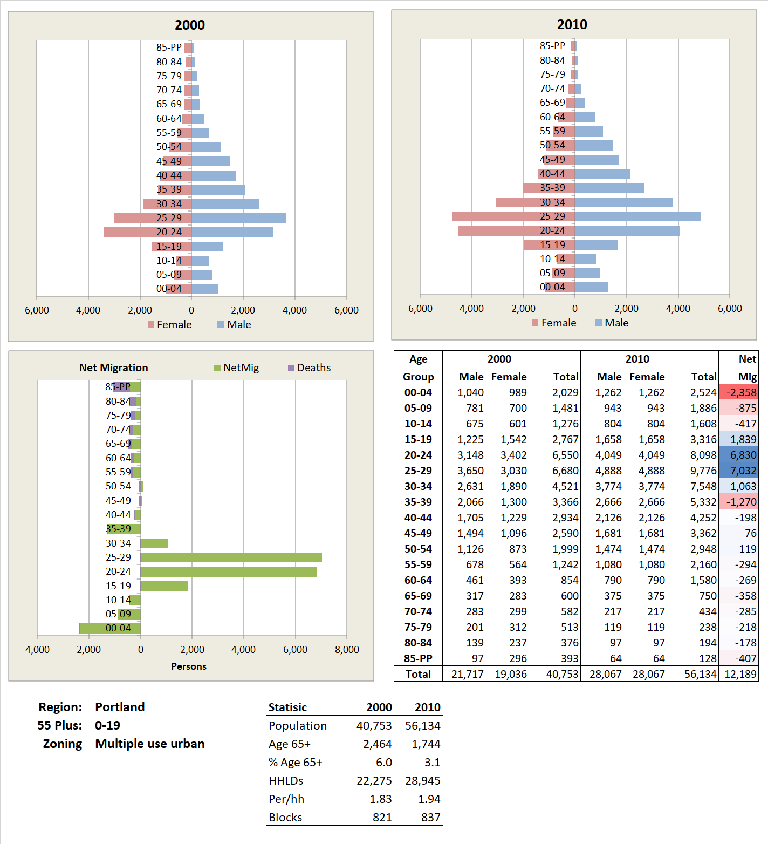
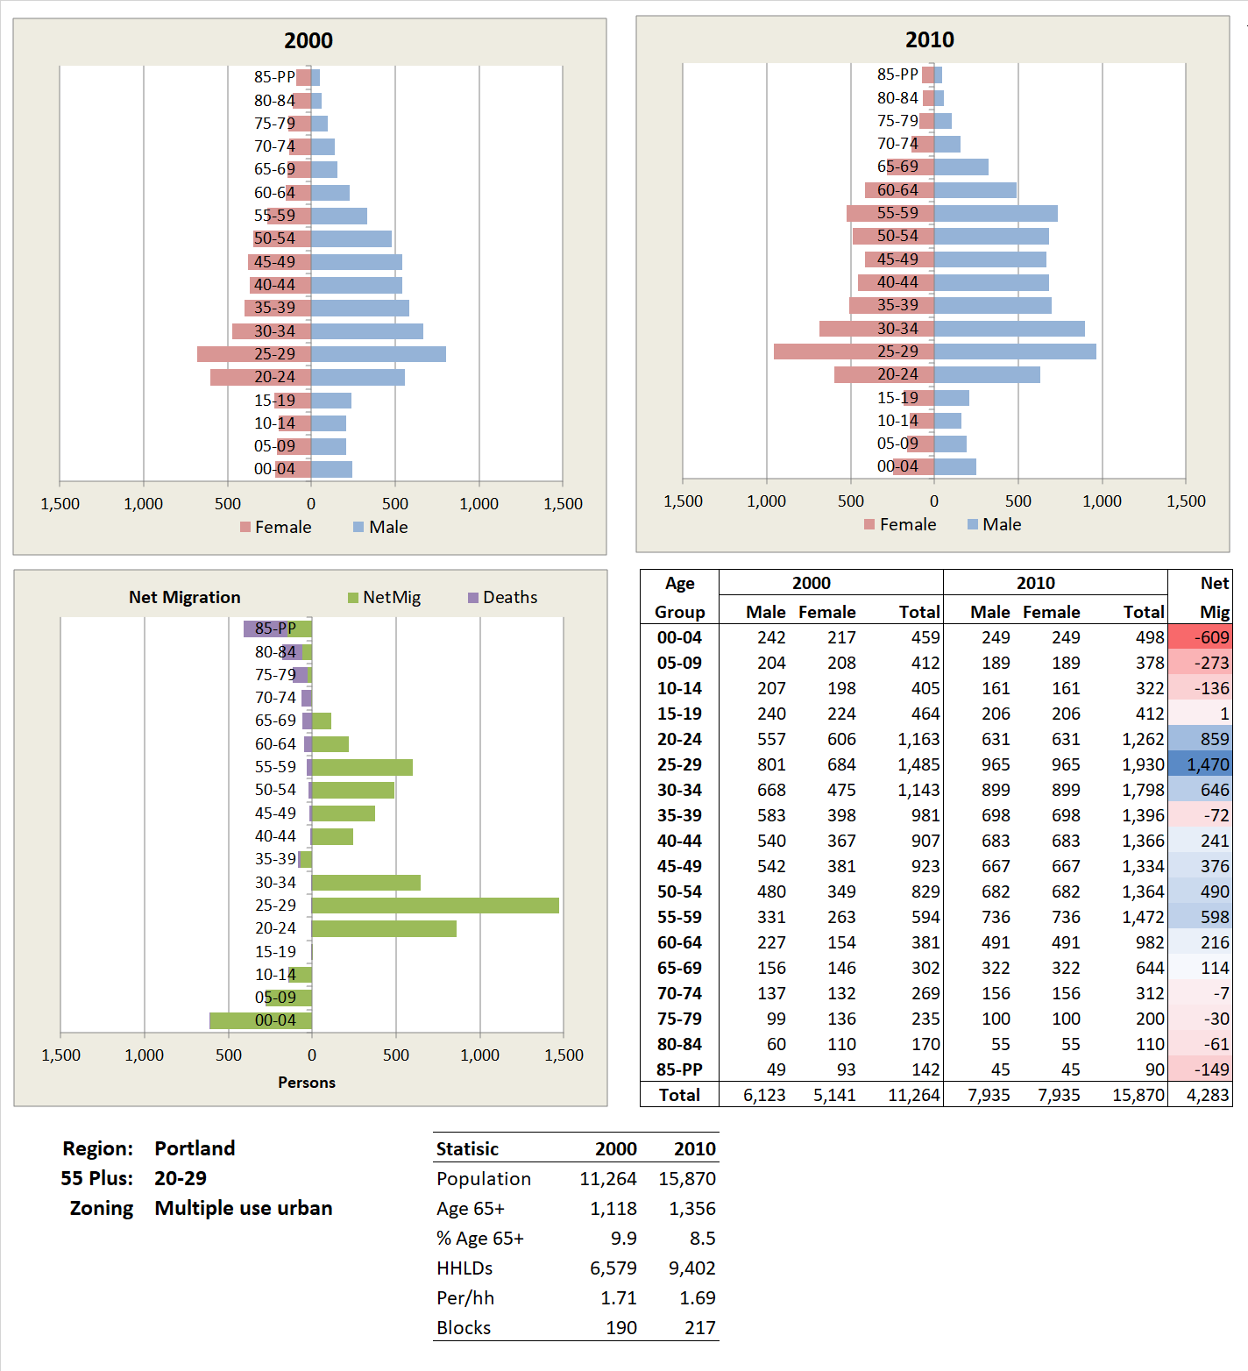
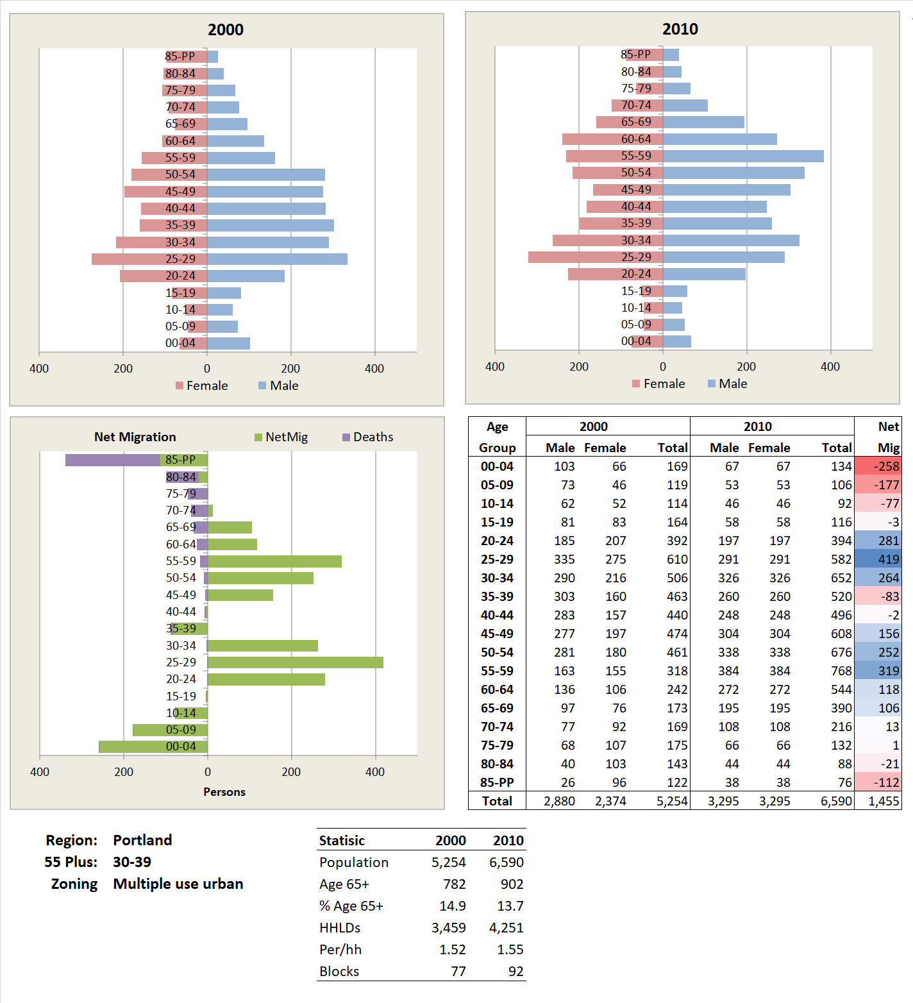
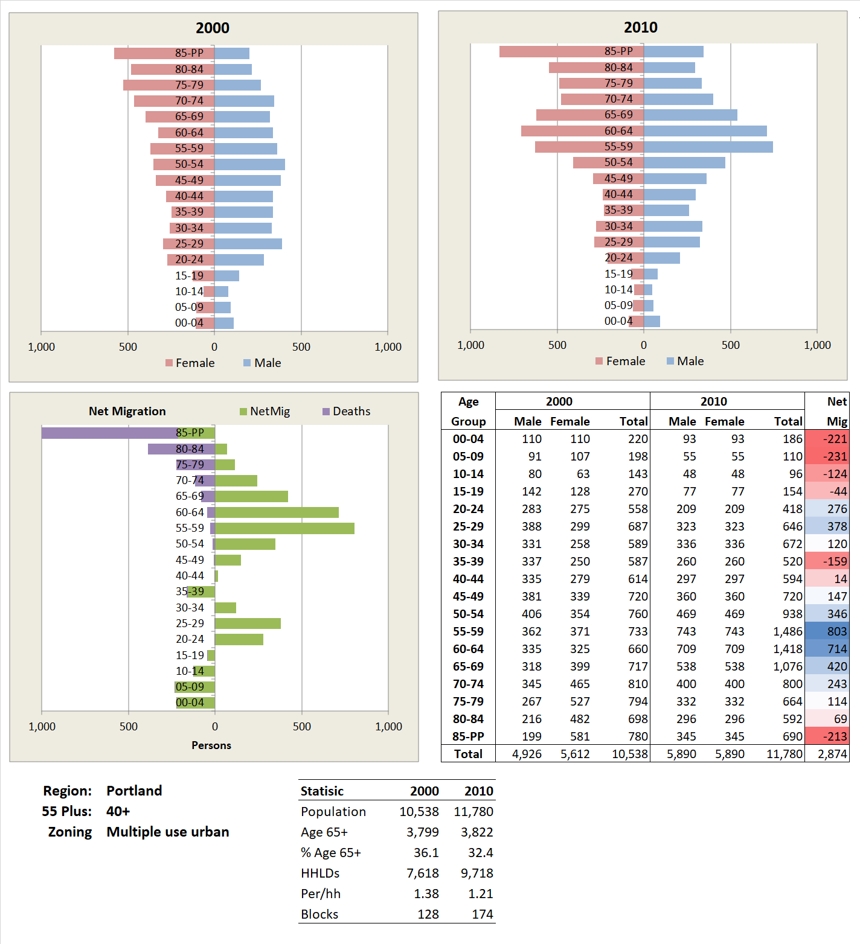
Net Migration for Multi Use Urban Zoning
19
Multi- (or mixed-) use urban buildings commonly combine ground level retail with residential use on the upper floors. Multi-use structures may provide neighborhood shopping and services for residents.
Multi-use residential zoned blocks where there are few age 65+ are largely the domain of younger households.
When we shift to blocks with 20-29% age 55+, we see a major shift in in-migration to include the in-migration of persons in their 40’s and 50’s.
The profile for the 30-39% group is similar to that for the 20-29% age 55+ class.
Again, progressing to the 40% of age 55+ class, there is mixed old-young net in-migration, but the older age group is larger and older.
While there is not much in-migration of age 65+ persons, those in-migrants in their 50’s are likely to age in place and to result in future large concentrations of older persons in multi-use zoned residential areas.
Multi-Use Urban
Multi-Use Urban
For the 20-29% class we see a major shift to include mixed net in-migration of a younger group in their 20’s and 30’s and an older group in their 40’s and 50’s. There is out-migration of children.
Multi use residential zoned blocks with 0-19% age 55 plus house a population of young household with young children. There is strong in-migration of persons in their 20’s and some outmigration of young children.
Both the population pyramids and the net migration chars show substantial net-migration of persons in their 50-s and sixties and some, but less in-migration of younger persons.
The profile for the 430-39% group is similar to that for the 20-29% group but with greater in and out magnitudes.
O
Sources: Decennial Census 2000 and 2010 table P12. Zoning from Metro RLIS 2010.

Slide 20

Population and Portland’s Comprehensive Plan
Metro describes the results of the Metroscope model not as a forecast per se, but as illustrating the likely consequences of varying land use policies.
We show some results of a medium growth forecast by the Metroscope 2035 projections and make use of the age, income, and household size data to turn the forecast of housing units into a population forecast. The data are not those approved by Metro Council but are illustrative of the reworking of the Metroscope model. Metro has more recently published its 2040 forecast and we expect to update our results with this more recent forecast.
For comparison, we also present the results of a forecast by age for Portland Supertracts, using a Hamilton-Perry trend model which is based on cohort trends between the 2000 and 2010 Census. Metroscope and the Hamilton-Perry model show quite different results for the City. This is due in part to Metroscope’s use of detailed local information on possibilities for land development. However, because it is mainly workforce driven it may not track the likely housing choices of older households over the 2010-2035 period of this forecast.
Under Oregon land use planning law cities and counties are required to develop coordinated population forecasts. However, there is an exception for the areas inside the urban growth boundaries in the Portland Metro Area where Metro is responsible.
One results of this arrangement is that there is no official population forecast for the city of Portland such as exists for Bend, Medford, or Salem. Many public and private organizations need population forecasts by age, particularly where they are making long-term capital investments. For older people this would include ventures such as building affordable housing and long-term care facilities.
20
The 2035 Comprehensive Plan for the City of Portland is not rooted in meeting the needs of a forecast 2035 population but, rather, stresses goals and strategies for meeting the needs of a growing and more diverse population.
Most of the analysis of demand and supply for housing is found in the 2011 report Household Demand and Supply Projections which leans heavily on Metro’s regional 2035 forecast.
In this report the City argues for using households as a basis for planning rather than population because of the one-to-one relationship between households and housing units.
The City summarized key findings arising from the Metroscope model:
A 2035 forecast of between 344,800 and 376,300 households compared to the baseline of 240,000 households in 2005.
The City of Portland’s share of all households will decline from 28% in 2005 to 22% in 2035.
The housing type in highest demand will shift in favor of multifamily housing units.
Land capacity, governed by current zoning and opportunities for redevelopment, will be sufficient to meet housing needs.
Higher growth is expected in the Central Business subarea and the demand will shift from rental to owner housing.
Higher income households will increase as a percentage, but the percentage of middle-income household will decline.
O

Slide 21




Housing and Household Type by Age, City of Portland
21
This sequence of view walks you from younger working age households, to pre-retirement, to older households.
For householders age 35-59, 58% are married couples residing in single-family owner-occupied housing.
For the age 75+ householders the proportion falls to 54%, with a growing percentage of persons living alone in single- and multi-family housing.
More age 75+ households are found in multi-family developments with 20+ units, perhaps because larger developments tend to have elevators.
The takeaway is that there is a progression of household types and related housing types as age progresses into the cohorts age 65-74 and older.
Source: 2017 American Community Survey, 5-year data, Public Use Microsample. Shows survey data from 2013-2017.
O

Slide 22

Population Projections
22
Oregon counties are required to produce population forecasts in part to ensure an adequate supply of buildable land. Since 2015, such forecasts have been provided by the Population Research Center (PRC) at Portland State University.
However, there is an exemption for the area inside of the urban growth boundary in Clackamas, Washington, and Multnomah Counties. For these counties, Metro produces forecasts within the growth boundary and PRC produces forecasts for areas outside of the boundary.
Metro produces growth forecasts using and urban simulation model, Metroscope, that was developed locally. We make use of their census tract level residential forecast for 2035.
Metroscope is largely employment driven. Workers need housing and Metroscope estimates housing demand and supply and generates needed housing across the region.
It does not produce a population forecast per se but based on relationships between housing type and socioeconomic profiles one can convert projections of households to population.
We have some reservations about the ability of Metroscope to forecast the future location of older households, in part due to the strong workforce orientation of Metroscope and because it does not track age cohorts through time.
Table of Contents
First page
Portland and comparison cities
Migration and characteristics of movers
Population and households
The Metroscope model
An alternative population forecast
Comparing the two forecasts
For comparison purposes we provide an alternative population forecast, using the Hamilton-Perry method, based solely on trends in the age data between the 2000 and 2010 Census. (Note: For more information on the Hamilton-Perry method, see slide 28.)
We use the abbreviation of MSC for the Metroscope forecast and HP for Hamilton-Perry.
O

Slide 23


Comparison of Population Forecasts for the Metro Area
23
Here are six population forecasts for the 7-county Portland Metropolitan Area. All are for the population in households, or adjusted to population in households, and exclude persons in group quarters.
Two of the forecasts are higher and in close correspondence in their 2025 value:
The sum of the Hamilton-Perry forecast for the supertracts in the Metro area.
A cohort component model by Metro in 2009.
The four other forecasts are lower and are in close agreement:
Hamilton-Perry forecasts based on:
The sum of forecasts for the City and its inner and outer suburbs.
The Metropolitan area as a whole.
A cohort component forecast by Metro in 2016.
The Metroscope urban simulation model.
The city of Portland is comprised of the 143 census tracts that approximate the city.
Click here to see the selected tracts.
O

Slide 24

Metroscope Forecast by Region, Type, and Tenure
24
The is the Metroscope forecast by City, Inner, and Outer. It is for population by age of householder for 5 broad age groups.
For the Metro Area the largest age group in 2010, the 25-44, are forecast to decline slightly but in the City, they are forecast to grow by 34,888, mainly due to the growth of 58,287 in apartments (renter multifamily).
The largest population growth for the Metro Area is for householders age 65+. The age 65+ population in the City is forecast to nearly double from 2010 to 2035 but growth in the suburbs, particularly the outer suburbs is greater.
The models forecasts that in the City the numbers of persons in age 65+ households will more than double.
However, the numbers in apartments and condos are forecast to grow even more rapidly.
O

Slide 25




Metroscope 2035 Forecast by Age Group, Portland
25
This slide is a graphic display of the data for Portland.
Age 25-44. For Portland, forecasts that the number living in apartments will increase considerably and the number in single-family owner-occupied housing will decrease. Only in the outer suburbs does the number in single-family owner-occupied hold its own.
Age 45-54. For Portland the numbers in apartments and condominiums will grow and the number in single-family owner-occupied will slightly decline. Only in the outer suburbs is there a significant increase in the numbers in single-family owner-occupied.
Age 55-65. In Portland An increase in the numbers in condominiums is forecast. The number in single-family owner-occupied will hold steady in Portland and grow in the suburbs.
Age 65+. For Portland, the number in single family housing will grow significantly, mainly through ageing in place. Substantial growth in the numbers of households in apartments and condominiums is forecast. Most of the growth for this group will be in the inner and outer suburbs in single-family owner-occupied housing, also through aging in place.
Source: UGR Medium Forecast, Scenario 1462. 2010 Household Forecast by 2010 Census tracts and HIA categories and housing type This information is DRAFT and UNREVIEWED by any local jurisdictions and is only to be used for research purposes.
Metro has produced a subsequent forecast for 2035 which we have in hand but have not had time to extract results. These data will be replaced with the 2040 forecast when we complete the query tool, later this year.
O

Slide 26

Change by Income Group - Higher Income
26
The Metroscope forecast suggests very different housing futures for lower and higher income households.
The eight income groups provided by the Metroscope forecast were divided as equitably as possible for each age group to higher and lower income groups.
For the higher income City households age 25-64, slightly fewer continue to reside in single-family owner-occupied housing in 2035, with some shift to apartments and condos. This reversal is forecast to be greater in Portland than in its suburbs.
For the age 65+ population in higher income households in the City and its suburbs most are forecast to reside in single-family owner-occupied housing in 2010 and 2035 with a modest shift to condo housing for those in the City.
O

Slide 27

Change by Income Group - Lower Income
27
For age 25-44 lower income households Metroscope forecasts a shift from single-family owner-occupied to apartments and condos, especially for younger age groups. Also, many fewer in this age group are forecast to live in rental single-family housing.
This trend is more pronounced in the City.
For age 65+ households most reside in single-family owner-occupied in 2010 and are forecast to in 2035.
However, large increases in the number living in apartments and condos also is forecast, particularly for the City.
Clearly most of the shift of older households to apartments and condos is forecast to occur for lower income households. Skip back to the previous slide to compare.
This same analysis was attempted at the census tract and supertract levels of geography, but the results appeared unstable.
O

Slide 28






Map of Tract Level Metroscope Forecast
28
These maps show the results of a Metroscope Medium forecast for 2035 for census tracts. The four maps use the same classes and color schemes. Green colored areas are forecast to have fewer persons for the population associated with the age of the householder. Shades of beige to brown show growth.
Age 25-44. Growth is forecast for the west, downtown, and inner east sides of Portland and for outer suburbs.
Age 45-54. A generally similar pattern to the age 20-44 is shown.
Age 55-64. Similar growth in the outer suburbs but more growth in the City.
Age 65+. Growth everywhere in the Metro Area but compressed at upper end of the legend.
Different class intervals and colors. In Portland it shows growth in the Southeast and in a north-south corridor from Interstate down through Hillsdale-Multnomah-Barbur supertracts. Growth is slower in the inner suburbs.
O

Slide 29
An Alternative Forecast: Hamilton-Perry Model
29
Table of Contents
First page
Portland and comparison cities
Migration and characteristics of movers
Population and households
The Metroscope model
An alternative population forecast
Comparing the two forecasts
A second population forecast is provided here using a simplified version of the cohort-component model known as the Hamilton-Perry model. We use it as a simple trend model to compare with the Metroscope forecast.
The cohort-component model starts with a beginning population by age and sex and forecasts subsequent populations by adding births, and net migrants, and subtracting deaths. The Hamilton-Perry model does not require estimates of births, deaths, and migration but extrapolates trends from age/sex data for two points in time. It requires little judgement on the part of the modeler.
For this model we use age/sex data for census tracts as reported in the 2000 and 2010 censuses. We use data for persons residing in households and exclude those in group quarters such as nursing homes, prisons, and college dormitories. Group quarters populations are driven by other factors than the local housing market. (Note: While not explicitly stated, it appears that the Metroscope model also excludes the group quarters population.)
Metroscope and Hamilton-Perry operate on slightly different currency. Metroscope provides a forecast of households by age and Hamilton-Perry provides a forecast of persons by age. Specifically for the age 65+ population, Metroscope forecasts the number of persons living in households where the householder is age 65+ and the Hamilton-Perry model forecasts the number of persons age 65+.
A weakness of the Hamilton-Perry model as applied here is that it is based on the 2000-2010 population data. This period includes the Great Recession, but not the recovery, since which has experienced a boom in multi-family housing construction in the City. Also, after 2010 there was an influx of younger households moving to the City.
However, the Hamilton-Perry model should perform well for the age 65+ population as many of them were in their 40’s and 50’s in 2010, the beginning of the forecast period, and most are likely to remain in the same residence through past their 60’s.
If the Hamilton-Perry model were to be run based on the 2020 census data it would include the post-recession experience and might produce different results, but perhaps not for the age 65+ population.
O

Slide 30

The Hamilton-Perry Model
30
This page shows the calculation of the population forecast for the Gresham Central supertract/20-minute neighborhood.
The model is based on persons by age (males and females are aggregated).
The key to the model are the cohort coefficient ratios (CCRs). Larger numbers result in more growth.
The model is based on the trajectory of age cohorts. For example, those age 0-4 in 2000 would become those age 10-14 in 2010 and those 20-24 in 2020.
The ratio 0.950 (reflecting 3,340/3,517) indicates the progression for the 0-4 age group in 2000 to the 10-14 age group in 2010, suggesting modest shrinkage in this age cohort.
The forecast steps by 10 years. The light blue values are interpolated.
The key calculation is the multiplication of 2010 value multiplied by the CCR (e.g., 3,188 * 1.021 = 3,256).
Rather than using a birthrate to calculate births the model uses the ratios of age 0-4 to birth age population and the birth age population to bring births into the model, although since we are interested in older persons this does not affect our result.
Similarly, no mortality rates are assumed as mortality and net migration are combined in the cohort coefficient ratio.
O
Notes:
Overall, this is a great step-by-step overview!
I made an adjustment to the 5th bullet as the number is the equation (3,430) looks like it should have been 3,340.
I made changes to the animations (when things appear), please review for accuracy.
There are some extra “clicks” in the animations that don’t do anything. It’s not a big deal, but idf it is easy to fix it might be worthwhile to eliminate them.

Slide 31

Cohort Change Ratios (CCR)
31
Here are the cohort change ratios for the city of Portland and its inner and outer suburbs.
The numbers shown here are the ratio of persons in a 5-year age group as a proportion the save 5-year age group 10 years later, as discussed on the previous slide.
Those values above one imply growth from one 5-year age group to the same cohort ten years later.
The blue line for the City is well above zero from the 20-24/10-14 to 35-39/25-29 cohort ratios.
For cohort ratios beyond the 40-44/30-44 ratio growth turns negative for the City.
The dotted red line is the survival rate from one 5-year age group to the same group five years later. After about age 40 the CCR for Portland drops below the survival rate implying net out-migration.
For persons approximately aged 70+ the light blue and green lines for the inner and outer suburbs are slightly above the dotted red line suggesting net in-migration.
From the Hamilton Perry Model forecast.
O

Slide 32

Sample Forecast
32
This page shows an example of the Hamilton-Perry type forecast for the Gresham Central supertract.
This tract has a large older population due to the concentration of nursing and residential care facilities and adult foster homes.
The population pyramids show the 2000 and 2010 population by age and sex.
The bar chart shows only the age 55+, 5-year age groups.
The tables show the forecast by 5-year age group in numbers and percentage. It suggests, for example, that the age 85+ population will nearly triple from 2000 to 2040.
It shows that the age 65-69 age cohort will reach a maximum of 4.33% of the population and then decline to 4.02% in 2040.
By comparison, the age 85+ population is at its maximum of 2.59% in 2040 at the end of the forecast period.
O

Slide 33




The Alternative Hamilton-Perry Model Forecast
33
This forecast was made for the supertracts in the seven-county metropolitan area and aggregated into City of Portland the inner and outer suburbs. Portland here is represented by the collection of census tracts that comprise the City.
The bar chart shows the growth of the age 55+ population.
For the City nearly all of the 5-year age groups age 55+ are projected to grow at a modest rate.
For the City the numbers age 85+ grow substantially from 9,273 in 2010 to a forecast 13,108 in 2040.
In the inner suburbs growth of the age 55+ population in is forecast to be more rapid than in the City. The age 85+ population grows from 13,036 in 2010 to a forecast of 34,955 in 2040.
The large numbers of households who moved to the inner suburbs in their 30’s and 40’s are forecast to age in place and result in a much larger growth of the age 55+ population than in the City. The number 85+ in 2010 was 11,717 forecast to grow to 43,226 in 2040, more than tripling.
O

Slide 34

Recap of Hamilton-Perry Model Forecast
34
These tables and charts are simplified to show only the beginning of the forecast with 2010 census data and the Hamilton-Perry forecast for 2040.
Except for age 65+ population, only modest population growth is forecast for the City.
For all age groups the largest amount of population growth is forecast for the outer suburbs.
Generally, growth of population in the inner suburbs is intermediate to that in the City and the outer suburbs.
O

Slide 35




Hamilton-Perry Forecast by Supertract
35
Here are the forecasts by the Hamilton-Perry model. The darker areas indicate a forecast of more growth for the age group. The green shades indicate a loss forecast.
For the age 25-44 population Hamilton-Perry forecasts a loss of population in the central core and growth in the suburban areas. This is based on trends observed from the 2000 to 2010 Census.
As we progress from the 25-44 age group to the age 55-64 age group growth is generally wide-spread.
For age 65+ all supertracts are forecast to grow in population. However, the greatest growth is in suburban areas, not in the City. This is due to the aging in place of the population that settled in the suburbs some 20 years ago that now are moving into retirement age.
The main areas of the City showing higher growth are the Pleasant Valley and Forest Park-Northwest Hills supertracts.
The crest of the baby boomers came earlier to the City being experienced now more that in 2035.
O

Slide 36
Metroscope Versus Hamilton-Perry Forecasts
36
Metroscope: Metro’s forecasting model
A complicated urban simulation model.
Provides socio-economic detail: households by age, income, housing type and tenure, and presence of children.
Only forecasts target date 25-years in the future.
Hamilton-Perry: An abbreviated cohort component model
Requires only age-sex detail from two censuses and no assumptions about birth and death rates.
Extrapolates 2000-2010 cohort trends.
Provides age/sex detail by age group for each 5-year period.
Should be updated when 2020 census data become available.
Supertracts were used as the geography for the forecast.
Why do we care?
The results of the two forecasts are very different.
For the age 65+ population The Metroscope 2035 forecast for the City is much higher than that from the Hamilton-Perry forecast. The Hamilton-Perry forecast suggest more growth of the age 65+ population in areas of present concentration of retirement and pre-retirement age population. Metroscope suggests more growth of the age 65+ population in areas with new apartment and condominium development.
Local organizations depend on population forecasts as a basis for their organizational planning, particularly those such as libraries, prisons, and schools that need to consider long term capital investments.
Table of Contents
First page
Portland and comparison cities
Migration and characteristics of movers
Population and households
The Metroscope model
An alternative population forecast
Comparing the two forecasts
We suggest that the City needs a mid- to long-term population forecast, based on an enhanced Metroscope forecast or one by an independent demographer.
The Metroscope model is largely workforce oriented and does not contain mechanisms to simulate the numbers and location of the City’s growing older population.
O

Slide 37


Adjusting the Metroscope Forecast
37
The Metroscope data by age of householder is available for the beginning year of 2010 as well as the 2035 forecast year.
The data show 2010 Metroscope figures next to those for the 2010 census, as well as the ratio of Metroscope to Census. The red color shading show where Metroscope is higher than the Census value and the blue where Metroscope is lower than the Census value.
We use these ratios to adjust 2035 Metroscope values and then compare the adjusted Metroscope values to the Hamilton-Perry forecast.
The last column labeled HSC/HP is the log of the ratio of the adjusted Metroscope forecast to the Hamilton-Perry forecast. Red values show Metroscope to be higher, blue lower.
Note that the adjusted Metroscope forecast for the age 65+ is considerably higher than the Hamilton-Perry forecast.
O

Slide 38

“Apples and Pears”
38
Metroscope and Hamilton-Perry models provide forecasts using different measures.
Both provide a forecast for persons living in households, excluding those in group quarters such as nursing homes, long term care, prisons, and college dormitories.
In the Metroscope forecast, population is determined by multiplying a forecast of households by household size.
The Hamilton-Perry forecast is for the number of persons by age.
The Metroscope forecast is for the number of persons by age of householder.
These charts compare the number of households by age of householder and the number of persons by age, using data from the 2010 census.
There is a strong relationship between the two for the age 65+ population for the City and the inner and outer suburbs.
The relationship holds up well for other age groups except the under 25 householders.
This is reasonably strong support for comparing Metroscope and Hamilton-Perry forecasts.
It does not test whether Metroscope’s household size figures are correct, and we don’t have the Census data to verify this.
O

Slide 39

Adjusted Metroscope and Hamilton-Perry Forecasts
39
These charts compare the population forecasts by age group with the Metroscope forecast expressed as persons by age of householder.
For all ages the adjusted Metroscope forecast is higher for the City and lower for the inner and outer suburbs.
For the age 20-44 age group the adjusted Metroscope is considerably higher for the City and lower for the outer suburbs.
For the 45-54 and 55-65 age groups the two forecasts are reasonably close.
For the 65+ age group the adjusted Metroscope forecast is much higher for the City and slightly higher for the inner and outer suburbs.
O

Slide 40




Hamilton-Perry and Metroscope, All Ages
40
When we compare the supertract growth rates for the Hamilton-Perry (HP) and Metroscope (MS) models we see that there is a near zero correlation between the two.
We are mainly concerned with the forecasts for the city of Portland, here defined as the collection of census tracts that approximate the City and shown with a dashed outline.
Hamilton-Perry forecasts most of the growth in the City to occur in its east side supertracts and in some west side tracts.
Metroscope, by contrast, forecasts strong growth for all west-side supertracts and for supertracts in the inner east side and north Portland.
The map of the difference between the two forecasts shows Metroscope forecasting more growth in the west, central, and northern areas of the City and Hamilton-Perry forecasting more growth on the outer east side.
Essentially the Metroscope model reverses some of the trends of the 2000-2010 period on which the Hamilton-Perry model is based due to anticipated redevelopment, infill, and densification.
R² = 0.06
The values charted here are the logarithms of the 2035/2010 ratios for the Metroscope and Hamilton Perry forecasts. An R² of 1 would indicate a perfect correlation, 0 no correlation.
O

Slide 41




Hamilton-Perry and Metroscope, Ages 25-44
41
When we compare the supertract growth rates of the 25-44 population using Hamilton-Perry and Metroscope models we see that there is a near zero correlation between the two.
We are mainly concerned with the forecasts for the city where there is a near inversion between the Metroscope and Hamilton-Perry forecasts.
Metroscope forecasts substantial growth in the age 25-44 population in and around the central city whereas in the same areas Hamilton-Perry forecasts moderate losses.
The Hamilton-Perry model forecasts more growth for Portland’s east side than does Metroscope.
For the most part the Hamilton-Perry model forecasts more growth of the age 25-44 populations in Washington and Clark Counties, although the story is mixed in Clackamas County.
R² = 0.01
O

Slide 42




Hamilton-Perry and Metroscope, Age 65+
42
As was the case for the previous examples there is little relationship to the growth forecasts for the population age 65+ in supertracts between the two.
We are mainly concerned here about the forecast for Portland. Except for the outer southeast supertracts, 122nd and Division and Pleasant Valley, more growth for the age 65+ population is forecast for the City by the Metroscope model than by the Hamilton-Perry trend forecast.
In particular, supertracts in the arc extending from Hillsdale-Multnomah-Barbur to Interstate Corridor are forecast to grow the age 65+ population more in the Metroscope forecast when compared to the Hamilton-Perry forecast.
This likely is due to the Metroscope model forecasting more growth of condo and apartment housing and less of single-family housing and assigning older households to these types.
In Clark and Washington Counties the two forecasts are generally similar, but they are quite different in Clackamas County. The Metroscope modelers anticipated new growth areas whereas Hamilton-Perry extrapolated from current growth areas.
R² = 0.10
O

Slide 43

Housing and Metroscope Forecast, Ages 25-44
43
The background colors on this map show the supertracts for which the Metroscope forecast is higher or lower than the Hamilton-Perry forecast along with bar charts that show Metroscope’s forecast of changes in housing units for this age group.
Note that in the central portion of the City, in red and orange shades, Metroscope forecasts a large increase in the number of apartments (RentMult) and to a less extent condos (OwnMult).
In many areas, but particularly in and around the Central City there is a major loss forecast for single family rental housing. Since this is an important housing resource for lower income younger households it presumably would push them into apartment housing.
Most of the supertracts that show growth in single family owner occupied (OwnSingle) are outside of the City.
In the green and blue areas on the map the Hamilton-Perry forecast is higher. This is mainly because Metroscope forecasts lower growth for these areas due to lesser housing growth, sometimes loss of single-family housing, and Hamilton-Perry extrapolates higher historical trends.
O

Slide 44

Housing and Metroscope Forecast, Age 65+
44
Metroscope evaluates housing differently for the age 65+ population than for the age 25-44 population.
In several City supertracts the number of older persons grows, perhaps reflecting a gain from younger households more than new construction.
In the Central City and Interstate Corridor supertracts there is growth in the number of age 65+ persons living in apartments and condos, likely facilitated in part by a loss of single-family rental housing for seniors.
Many supertracts in the City show relatively little loss or gain in housing units; see West Portland, Tryon Creek-Riverdale, and Pleasant Valley. For most of these Hamilton-Perry forecasts higher growth suggesting that Metroscope may not account well for the aging in place senior population.
Throughout most of the City there is growth in the numbers of age 65+ living in apartments and condos.
O

Slide 45

Are Some of the Trends Forecast by Metroscope Happening?
45
Is there contemporary evidence for the changes in housing type and tenure that are forecast in Metroscope?
The numbers here are from the one-year ACS data and have considerable sampling error, but the 2010-2019 change values in blue are significant at the 90% confidence level.
Single-year data from the American Community Survey suggest that a slightly declining share (see LQ column) of Portland’s households live in single-family owner-occupied housing. The numbers grew significantly by 15,816 but only at a rate of 0.988 of overall housing growth.
By contrast the numbers in 20+ unit condos grew by 3,266 at a rate 1.529 times the overall growth rate of housing and for apartment developments with 20+ units by 14,616 at 1.221 times the overall housing growth rate.
Some of these changes may reflect the recovery from the 2008 recession and may not persist over the next 25-years. Also, they reflect housing for all ages and may or may not characterize housing changes for older households.
Source: American Community Survey one year data, 2010 and 2019, table B25032.
O

Slide 46
End of Population Section
46
Table of Contents
First page
Portland and comparison cities
Migration and characteristics of movers
Population and households
The Metroscope model
An alternative population forecast
Comparing the two forecasts
O
Source: Final_PPT\R1_PortlandsPopulation_22_drl5_akd2_6.27.21.pptx

Slide 47

The State of Aging in Portland
Information on Data Sources
and Geographies
Background for study
The Decennial Census
The American Community Survey (ACS)
Supertracts
The American Housing Survey (AHS)
20 Comparison cities
Geography issues
Portland’s Inner and outer suburbs
The ACS Public Use Microsample
Nomenclature for race and ethnicity
Census group quarters
O

Slide 48

About The State of Aging in Portland Report and Navigating the Findings
O
O
O
O
O
O
O
O
O
O
O
O
O
O
O
O
O
O
This presentation includes seven sections developed as part of a study for the City of Portland by the Institute on Aging at Portland State University (PSU), Portland, Ore. The study, titled The State of Aging in Portland, was undertaken to provide guidance to local government and members of the broad and informal “aging network” of service providers, advocates, and others in Portland and the region so that that they can better understand, and address trends related to Portland and the region’s population aging.
Funding source: The City of Portland, Community Health and Access program.
Project staff included:
Alan DeLaTorre, PhD, Adjunct Faculty, Institute on Aging, PSU; team leader and analytical perspectives; aland@pdx.edu (he now serves as the City of Portland’s Age-friendly City program manager and can be contacted at Alan.DeLaTorre@portlandoregon.gov)
D. Richard Lycan, PhD, Professor Emeritus and Senior Research Associate, Institute on Aging, PSU; volunteer, analyst of demographic data, mapping, and creator of PowerPoints; lycand@pdx.edu
Margaret B. Neal, PhD, Professor Emerita of Urban Studies and Planning and former Director of the Institute on Aging (2003-2017); analyzed age-related differences and similarities in responses to the City’s survey on livability, the 2019 Portland Insights Survey; nealm@pdx.edu
Paula Carder, PhD, Director of the Institute on Aging; project oversight; carderp@pdx.edu.
Additional support was received from faculty at PSU’s Institute on Aging and Population Research Center, and staff from the City of Portland, Metro, Multnomah County, and Home Forward.
We encourage viewers to make full use of our work, including maps and charts, in their research. Content is best viewed using the web-based iSpring modules (see navigation tips below). Content, such as maps and charts, may be best accessed from downloaded PowerPoint files as they will have the highest resolution for viewing and reuse.
Individual pages of this report may be cited as:
DeLaTorre, A., Lycan, D. R., & Neal, M. B. (2021). State of Aging in Portland. Institute on Aging, Portland State University, slide no. #. Retrieved from: https://soaportland.cupa.pdx.edu/.
Software used in this study:
From Office 365 Excel for analysis and building tables and charts and PowerPoint for slide creation.
From Environmental Research Institute ArcMap 10.4 for geospatial analysis and mapping.
From iSpring eLearning Software iSpring Converter Pro 10 to transform PowerPoint to HTML5.
From IBM SPSS statistics for data analysis
Menu

Slide 49
The Decennial Census
O
O
Variables
2010 Census
Household: Household size, home ownership, families
Demographic: Age, race, Hispanic origin, gender, marital status
2000 and earlier: Above, plus additional socioeconomic variables.
Issues with Census data
The latest 2010 data are 10 years old. Results of the 2020 census should be available in September 2021.
The tables in the State of Aging report should be updated when the 2020 data become available.
Only the data listed under Household and Demographic are available but there are hundreds of cross-tabulation tables.
How Census was Used for this Study
At the census block level to determine age and race of seniors housing and to assess demographic changes.
At the census tract level to map age, race, and group quarters residents.
For the city of Portland to get exact counts by age, race, housing type, and group quarters residents.
Access the Census data at: https://data.census.gov/cedsci/
U.S. Census Bureau: https://www.census.gov/programs-surveys/decennial-census.html
Frequency of Data
Collection: Every 10 years
Release: Data Release Schedule
Geographic Levels
Nation, State, County, City, Census Tract and Census Block
Description
The U.S. Census counts every resident in the United States at 10-year intervals, as mandated by the Constitution. It provides a snapshot of each person living in the country on April 1 of the year in which the Census is conducted.
The data collected by the decennial census affect the number of seats a state has in the U.S. House of Representatives and are used to distribute funding and allocate resources across localities and communities.
The 2010 Census reported data on age and sex distributions, race, Hispanic or Latino origin, household relationship and type, the group quarters population, and housing occupancy and tenure (whether the housing occupant owns or rents).
O
O
O
O
O
O
O
O
O
O
O
O
O
O
O
O
Source: Demographic Research Group, Weldon Cooper Center for Public Service,
University of Virginia:
https://demographics.coopercenter.org/guide-to-publicly-available-demographic-data
Menu

Slide 50
The American Community Survey (ACS), Summary Tables
O
O
U.S. Census Bureau, www.census.gov/programs-surveys/acs/
Frequency of Data
Collection: ongoing
Release: Data Release Schedule
Geographic Levels
Nation, State, County, City, Census Tract and Census Block Group
Description
The American Community Survey (ACS) is an ongoing survey that covers a sample of nearly 3.5 million addresses across the U.S. The data are released at 1- or 5- year intervals (the 3-year data product has been discontinued).
The survey provides current data and allows a choice between single-year and multi-year estimates, depending on research needs with respect to currency, reliability and level of geography. The data help local agencies and individuals – in both government, business, non-profits etc. – to better understand their communities and the workforce. The ACS provides information on a variety of subjects, including demographics, economics, housing and social situations/
Variables
Demographic: Age, sex, group quarters population, race, Hispanic or Latino Origin, race, relationship, total population
Economic: Class of worker, commuting to work, employment status, Supplemental Nutrition Assistance Program (SNAP), health insurance coverage, income and earnings, industry and occupation, poverty, work status
Housing: Computer ownership & internet access, house heating fuel, occupancy/vacancy status, occupants per room, owner monthly costs, plumbing facilities, rent statistics, rooms, bedrooms, telephone service available, tenure, units in structure, value of home, vehicles available, year householder moved into unit, year structure built
Social: Ancestry, citizenship status, disability status, educational attainment, fertility, field of degree, grandparents as caregivers, language, marital history, marital status, place of birth, school enrollment, residence one year ago/migration, veterans, year of entry.
Issues with Use of ACS
Substantial sampling error, especially for small geographies such as census tracts
Sample size approximately 2.4% per year, about 12% for five-year data
How ACS was Used for this Study
Socioeconomic data about the city of Portland
Census tract data for analysis and mapping
Aggregation of tract data to supertracts (see next slide)
Access the ACS data at: https://data.census.gov/cedsci/
Back to Housing
O
O
O
O
O
O
O
O
O
O
O
O
O
O
O
O
Source: Demographic Research Group, Weldon Cooper Center for Public Service, University of Virginia:
https://demographics.coopercenter.org/guide-to-publicly-available-demographic-data
Menu

Slide 51



Supertracts
O
O
Supertracts (see red brown) are were created by aggregating 6-8 adjacent census tracts (see grey boundaries).
The supertracts emulated the city of Portland’s 20-minute neighborhoods extended to the seven-county Portland Metropolitan Area.
Portland’s 20-minute neighborhoods were designed to have access to commercial services and amenities as a pedestrian, cyclist, or on transit.
The supertracts also reduced the amount of sampling variability in the data from the American Community Survey. For example, The Lake Oswego supertract (see purple) is the aggregation of 8 census tracts.
The ACS table for the Lake Oswego tracts shows the Estimate (EST) and Measure of Error (MOE) for the number of persons with an ambulatory difficulty. The MOE is the +/- value for the 90% confidence level.
The coefficient of variation (CV) is the ratio of MOE/EST. Values from 0.00 to 0.12 can be considered as good reliability, from .12 to.40 as fair, and over .40 as poor reliable.
All of the tract CV values are greater than 0.40 (poor reliability) but aggregated to supertracts the CV is 0.259 (fair reliability).
In addition, supertracts have recognizable neighborhood names and help to link the data to the viewer’s knowledge of the City.
.
O
O
O
O
O
O
O
O
O
O
O
O
O
O
O
O
8
Menu

Slide 52
The American Housing Survey (AHS)
O
O
The American Housing Survey (AHS) is sponsored by the Department of Housing and Urban Development (HUD) and conducted by the U.S. Census Bureau. The survey has been the most comprehensive national housing survey in the United States since its inception in 1973.
The AHS is a longitudinal housing unit survey conducted biennially in odd-numbered years, with samples redrawn in 1985 and 2015.
It provides up-to-date information about the size, composition, quality and cost of housing in the United States and major metropolitan areas and measures changes in our housing stock as it ages.
Returning to the same housing units every other year to gather data until a new sample of housing units is drawn, the AHS allows users the unique opportunity to analyze housing and household changes over time.
The survey’s principal coverage is of the 15 largest metropolitan areas in the United States. Portland is not one of the top 15 but data are available for 2019, 2015, and 2011.
The AHS has a relatively small sample size, 117,422 units for the nation and only about 3,000 per metropolitan area. Many of the fields for the Portland data are suppressed due to insufficient sample size.
The wide range of core housing topics covered in the ACS include but are not limited to the following:
size and composition of the nation's housing inventory
vacancies
owners and renters
physical conditions of housing units
equipment breakdowns
characteristics of occupants
housing and neighborhood quality
mortgages and other housing costs
fuel usage
home improvements
persons eligible for and beneficiaries of assisted housing
characteristics of recent movers
home values.
How AHS was Used
We mainly used the national data from the AHS, as much of the Portland data were suppressed due to small sample size.
Access the AHS: Data available as a public use sample or created using the ACS Table Maker.
Back to Housing
O
O
O
O
O
O
O
O
O
O
O
O
O
O
Menu

Slide 53






Comparison Cities
O
O
When we discuss our city, Portland, we often speculate about how it is similar or differs from our neighbor to the north, Seattle. We decided to extend the comparison of Portland with other cities about the same size.
However, members of the team also wanted to include Austin, Oakland, and Minneapolis, cities that readers might be familiar with, or cities often compared to Portland.
Here is a list of the 20 comparison cities, 10 larger and 10 smaller, ordered by their population.
As an example of how we used the comparisons, here is a chart that shows, for each of the comparison cities and Portland, the city’s proportion of the metropolitan area population.
Portland is in the middle of the pack, compared to the Portland – Vancouver – Hillsboro Metropolitan Statistical Area (MSA).
By comparison, El Paso contains over 80% of the population in the El Paso MSA and Oakland only about 10% of the San Francisco – Oakland – Berkeley MSA.21
O
O
O
O
O
O
O
O
O
O
O
O
O
O
O
O
Menu
Use to go back to the page you were reading or to go to the table of contents for Population.

Slide 54





Geography Issues
O
O
O
O
O
O
O
O
O
O
O
O
O
O
O
O
O
O
Data in the Census and the American Community Survey are reported for the city of Portland, outlined by the dashed dark red line.
We also use data for the 143 census tracts that approximate the city of Portland, referred to in the study as Portland Tracts.
The Portland Tracts are a reasonably good match to the City boundary. The red dots are in the City but outside of the Portland tracts, and the green dots are in the Portland tracts but outside of the City.
Overall, the Portland Tracts undercount the total population by 1% and overcount the age 65+ population by 0.2%.
One of the cases where we use the Portland Tracts definition of the city is in comparing the city to its inner and outer suburbs.
Here the city boundary is in red, the Portland Tracts in dark brown, the inner suburbs in light brown, and the outer suburbs in yellow.
The city and its inner and outer suburbs each have approximately 1/3 of the Portland-Hillsboro-Vancouver MSA population.
See the “About” report on City, Inner, Outer for more details.
Menu

Slide 55



The City and its Inner and Outer Suburbs
O
O
O
O
O
O
O
O
O
O
O
O
O
O
O
O
O
O
We created inner (see light brown) and outer (see yellow) suburbs zones around the city of Portland (see dark brown), with approximately the same population in each of the three zones.
In the case of this three-region geography, the city of Portland is defined as the collection of 143 census tracts that approximate the City.
One of the reason for this delineation is that much of the detail reported in the Census and the American Community Survey is for census tracts.
However, when we use supertract data, the delineation between the inner and outer suburbs is slightly different.
The tracts marked in a blue X are included in the inner suburbs, and those with the red X are excluded.
The city is the same for tracts and supertracts, but the inner and outer definitions are different.
There is a similar problem when we attempt to aggregate Public Use Microsample Areas (PUMAs) into city, inner, and outer suburbs.
The city of Portland is composed of five PUMAs, and these five PUMAs comprise the 143 census tracts.
However, the inner suburbs have a slightly different delineation with supertracts.
The lavender blue PUMAs are excluded from the outer suburbs, as they extend well beyond the Portland MSA. PUMA 4100500 includes Clatsop and Lincoln Counties.
We use the Public Use Microsample to create a number of custom tables and need to use the PUMA base regions.
4
3
1
5
2
Menu

Slide 56

ACS Public Use Microdata
O
O
The Census Bureau’s American Community Survey (ACS) Public Use Microdata Sample (PUMS) files enable data users to create custom estimates and tables, free of charge, that are not available through ACS pre-tabulated data products. The ACS PUMS files are a set of records from individual people or housing units, with disclosure protection enabled so that individuals or housing units cannot be identified.
The Census Bureau produces ACS 1-year and 5-year PUMS files. These files are accessible using the microdata access tool on data.census.gov and the Census Bureau's FTP site.
Another good source of PUMS data and ideas for using them is IPUMS USA at the University of Minnesota.
Only selected geographic areas are identified in the ACS PUMS, including Region, Division, State, and Public Use Microdata Areas (PUMAs). Of these, PUMAs are the most detailed geographic areas available.
Four PUMAs (red outline) approximate the city of Portland (black dashed line).
How we used the ACS/PUMs data.
We used the ACS/PUMs data for the seven county Portland MSA to create many custom tables that were not published as ACS summary tables.
Data for the five PUMAs shown in yellow on the map were used to create custom tables for the city of Portland.
O
O
O
O
O
O
O
O
O
O
O
O
O
O
O
O
Menu

Slide 57
Nomenclature for State of Aging in Portland Section on Race
57
O
O
O
O
The researchers working on the State of Aging in Portland project recognize the complicated, evolving nature of language that pertains to race, ethnicity, and Hispanic origin.
The source data for most of this section come from the United States Census Bureau which has led to the creation of many graphs, charts, and labels that use the conventions adopted in the Decennial Censuses and the American Community Survey, including the use of:
Blacks, rather than African Americans
Hispanics, rather than Latino, Latina, Latinx, or Latine persons
Asians, Hawaiians, and Pacific Islanders, rather than Asians and Pacific Islanders
We have diverted from U.S. Census Bureau conventions for the following:
We use Native Americans, rather than America Indians, but do refer to American Indian and Alaska Native tribes on a single slide produced from census data.
We capitalize White, rather than leaving it as a lowercase “w” in following the lead of the National Association of Black Journalist (NABJ; Reference: NABJ Style guide). NABJ recommended that “whenever a color is used to appropriately describe race then it should be capitalized, including White and Brown.”
O
O
O
O
O
O
O
O
O
O
O
O
O
O
O
O
Menu

Slide 58
Group Quarters
O
O
Group quarters in this study
The main types of group quarters for older persons as referenced in this report are:
Adult family homes
Nursing homes
Residential care facilities
All of the above are licensed by the State of Oregon, and we make use of licensing data to generate statistics and maps.
Housing for older persons that are not group quarters
Assisted living units are classified as housing units as they provide for privacy and access to the outside as noted under housing unit to the left.
Independent living facilities are classified by the Census as housing units, not group quarters.
O
O
O
O
O
O
O
O
O
O
O
O
O
O
O
O
Housing Units
Planners generally use the Census Bureau’s definitions of housing units, households, and population in households.
A housing unit is any single-family residential structure (like a house or a manufactured home) or any distinct unit in a multi-unit building where the unit provides privacy for the occupants, and the unit has access to the outside, and occupants can come-and-go as they wish (not a custodial facility), and occupancy is independent of any institutional affiliation.
A household is a set of people living together in a housing unit. A nice feature of this definition is that the number of households always equals the number of occupied housing units.
Group Quarters
There are residential situations that do not meet all of the four criteria listed above for housing units. The Census Bureau refers to these other residential situations as group quarters.
A group quarters facility is one that houses multiple, unrelated people, where occupants do not have privacy, or there is controlled access to entering/leaving, or it’s a facility that houses only an institutional or service-receiving population.
In the decennial census, group quarters statistics also include makeshift shelters, or places without shelter, where homeless people are found to sleep.
Source for above, Local Planning Handbook, Metropolitan Council, St. Paul, MN.
Census Bureau on Group Quarters.
Menu

Slide 59
End of Section on Data Sources and Geographies

