Slide 1

The State of Aging in Portland
Part 5 - Livability in Portland by Age
Findings from the City’s 2019 Survey of Residents

Slide 2
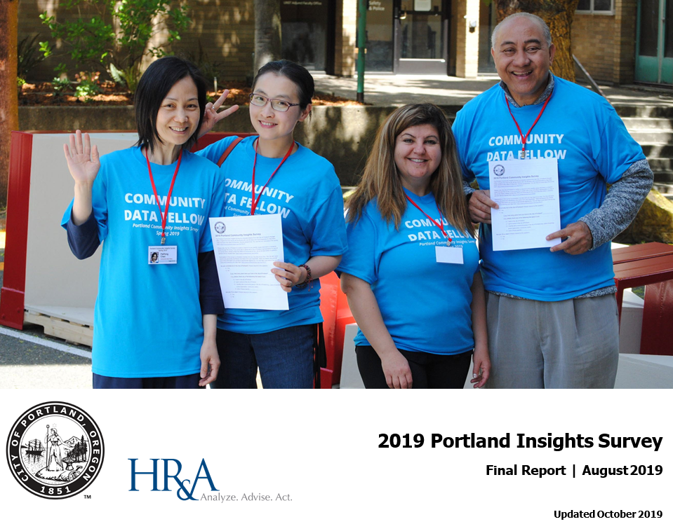
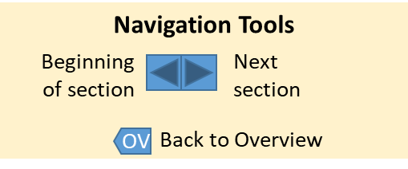

Introduction
2
This presentation is based on the City of Portland’s 2019 Portland Insights Survey and specifically examines the age-related findings. The general findings from the study were analyzed by the City and can be found, along with a detailed description of the study’s methodology, at: https://www.portlandoregon.gov/cbo/79177
In the study, 30 quantitative questions were asked. The findings presented here include data only from respondents age 20 and over and who were residents of the city (n < 7,645, depending on the question).
Although every attempt was made by the City to include all residents of the city in the study, including special outreach to traditionally under-represented groups, the respondents do not necessary comprise a representative sample. Individuals who held strong beliefs, positive or negative, may have been more likely to respond to the survey. Thus, caution should be used in interpreting the results.
Summary of Key Findings
Portland as a Place
Portland as Opportunity
Safety Issues
Services and Environment
Disaster Preparation
Navigation Tools
Beginning of section
Next
section
Back to Overview

Slide 3
Introduction (cont.)
3
Because older adults and females were over-represented among the respondents, we weighted the results by age and gender (using data from 2017 American Communities Survey Public Use Microdata. (It should be noted that people with higher incomes also were overrepresented, but no weighting by income was applied.)
Similarities and differences in responses by age of respondents are presented and then further examined by four key variables: income, race/ethnicity, gender, and rent/own status.
To facilitate the comparisons and because of limited subsample sizes, the data for these four variables are di- or tri-chotomized, as follows:
  Income:
    Below $75,000 and $75,000 or above based on the 2017 5-Year American Communities Survey Public Use Microdata based on responses from 2013 to 2017.
  Race/ethnicity (click here to learn about the nomenclature for race and ethnicity in this section):
    Black, Indigenous, People of Color (“BIPOC”) compared with White non-Hispanic respondents (“W n-H”).
  Gender (click here to learn about the nomenclature for race and gender in this section):
    “Male”, “Female”, and “Other.” This third group includes respondents who identify, for example, as non-binary, transgender, questioning, and Two Spirit. It is important to note that the number of respondents in this group is small (< 194) and thus subject to greater sampling error. However, in preliminary examinations of the data, the group’s responses often appeared to differ from those of males and females and we felt it was important to explore this further.
  Tenure: Respondents who “Rent” compared to those who “Own” their residences.

Slide 4
Introduction (cont.)
4
For each survey question, the responses of people are compared by age either in five age groups (20-29, 30-44, 45-59, 60-74 and 75+) or four (20-29, 30-44, 45-49 and 60+). (After the specific age comparison and the age by income comparison, the 60-74 and 75+ groups are combined due to relatively low numbers of respondents in the age 75+ group).
The data are then analyzed comparing the responses of people in each age group by income, race/ethnicity, gender identity, and rent/own status.
The subsample of respondents who did not identify as male or female is relatively small (n < 194), but because of consistent variations in their responses compared to those of male and female respondents, these findings are presented.
The survey questions are grouped in five general categories related to Portland’s livability which comprise the sections of this presentation:
  Portland as a Place
  Opportunity
  Safety
  Services and Environment
  Disaster Preparedness
Clicking the blue arrows near the bottom left of each page allows one to return to the beginning of a section or skip to the next section. Clicking the white arrows at the bottom left allows one to advance to the next point or return to the previous point.
A Summary of Key Findings is provided on the next few slides, followed by the detailed five sections.

Slide 5
Summary of Key Findings - General
5
Age was related to the responses in a majority of survey items but in varying ways.
  Sometimes there was little difference by age group. For example, respondents in each age group were very dissatisfied with the City’s response to homelessness.
  In other cases, the responses of older and younger adults diverged. For example, older persons were more dissatisfied with the condition of streets, sidewalks, and public spaces and with new construction in their neighborhoods. Alternatively, with respect to protection by police from violent crime and from property crime, satisfaction levels, while low, increased with age.
  Respondents age 75+ often held the most positive views, occasionally in tandem with the youngest age group (20-29).
Generally, age group differences or similarities remained consistent in the sub-analyses by income, race/ethnicity, gender identity and rent/own status.
More often than not, in addition to respondents’ age, responses also differed by respondents’ household income, race/ethnicity, gender identity, and rent/own status.
  In general, respondents with lower incomes, who were members of a minority group, who did not identify as male or female, and/or who rented rather than owned their residence had less positive views.

Slide 6
Summary of Key Findings – Portland as a Place
6
Feelings about Portland as a place were mixed.
  The majority of respondents did not feel positive about the future of the city, were not satisfied with Portland as a place to raise children, and did not feel that it was easy to get needed information from the City.
  Alternatively, the majority of respondents were satisfied with Portland as a place to live, as a place to work or go to school, and as a place to be part of a community.
Satisfaction/positive views either generally declined with age or remained consistent across age groups.
Go to Portland as a Place section

Slide 7
Summary of Key Findings – Portland as Opportunity
7
Overall, the majority of survey respondents did not see Portland as a place for opportunity with respect to:
  racial equity
  finding a job with sufficient income
  keeping one’s home, and
  influencing City decisions.
The exception was access to education and training.
For most but not all items, agreement/satisfaction declined with age.
Go to Portland as Opportunity section

Slide 8
Summary of Key Findings – Safety Issues
8
Most respondents in all age groups felt safe walking during the day or night in their neighborhoods
Most respondents in all age groups also felt safe walking during the day in the central city but not at night.
For these four items, there were minimal differences by age.
Alternatively, most respondents were not satisfied with police protection from either violent crime or property crime, although satisfaction generally increased with age.
Go to Safety Issues section

Slide 9
Summary of Key Findings – Services and Environment
9
Satisfaction was mixed with respect to City services and the city’s environment.
  The majority of respondents in each age group were satisfied with:
    the reliability of their daily commute
    the quality of residential garbage, recycling, and composting services
    water quality of Portland’s rivers and streams
    the safety of parks and natural areas and
    the cleanliness of parks and natural areas.
  The majority of respondents were dissatisfied, however, with respect to:
    the City’s response to homelessness
    construction in the neighborhood
    the cleanliness and physical condition of streets and roads
    commute traffic and safety
    and the value of the City utility (sewer and water) bill.
For features where negative reactions predominated, those negative feelings generally increased with age. For features viewed positively, reactions generally became more positive with age.
Go to Services and Environment section

Slide 10
Summary of Key Findings – Disaster Preparedness
10
Most respondents did not feel prepared for a natural disaster, such as an earthquake.
  Well under half of respondents in any age group, and fewer than 20% of those age 20-29, said they felt prepared.
  Older respondents reported more preparedness than younger respondents.
Go to Disaster Preparedness section

Slide 11
Portland as a Place
11
Summary of Key Findings
Portland as a Place
Portland as Opportunity
Safety Issues
Services and Environment
Disaster Preparation
Survey items concerning satisfaction with Portland as a place are grouped in this section, including Portland as a place:
  In the future
  To live
  To raise children
  To work or go to school
  To be part of a community
  To get information from the City
Section summary

Slide 12
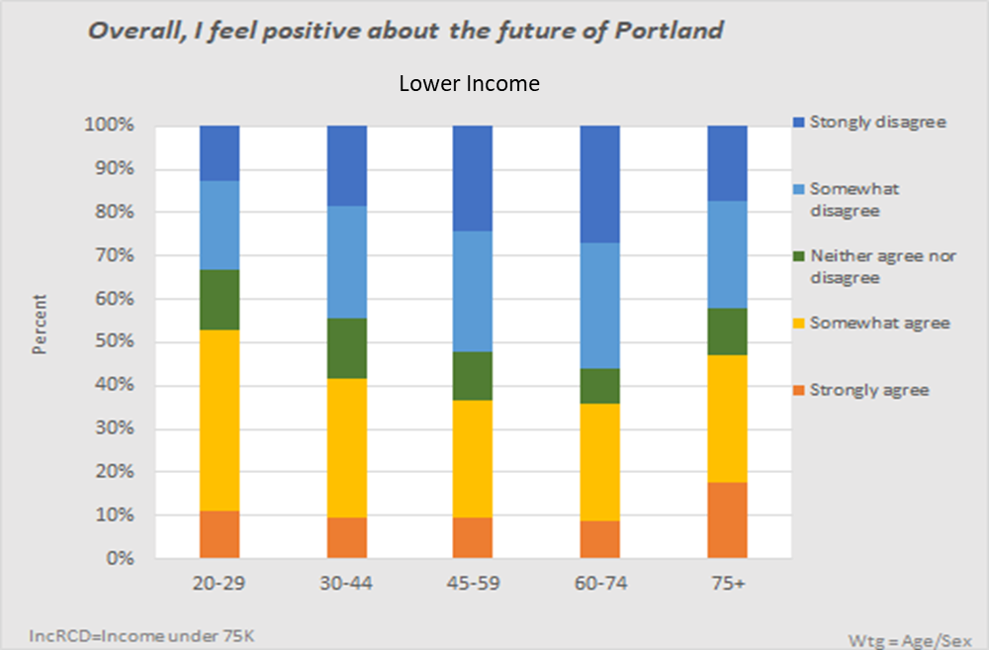
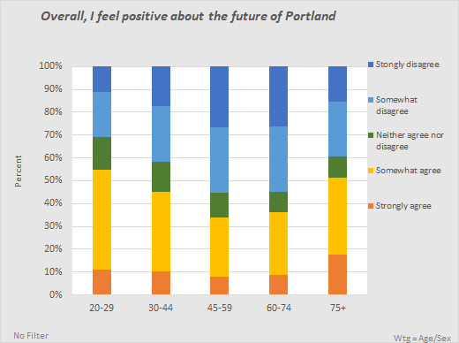
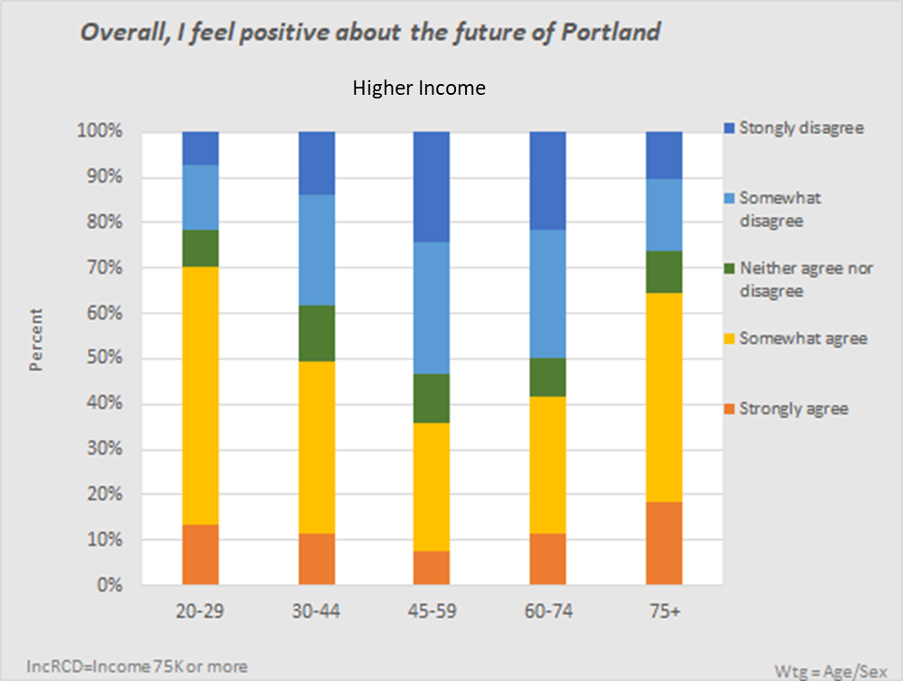
Feelings about Portland’s Future
12
Less than half of respondents age 30-74 felt positive about the future of Portland (see bottom left chart).
Responses varied by age. In only two age groups – the under 30 and the 75+ – did half or more of the respondents strongly or somewhat agree that they felt positive about Portland’s future.
Those with incomes of $75,000+ (chart on the bottom right) felt more positive than those with incomes below $75,000 (top right chart). This was especially true for the youngest and the oldest respondents.

Slide 13
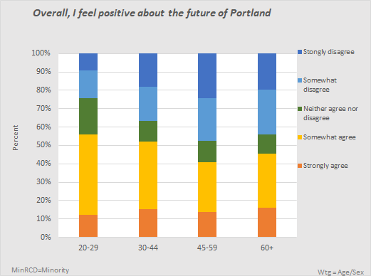
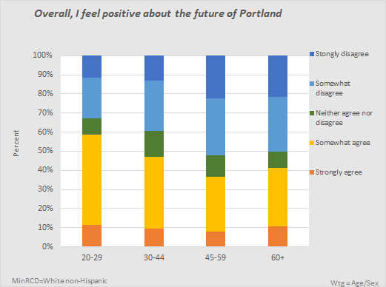
Feelings about Portland’s Future (cont.)
13
The pattern of responses was similar by race/ethnicity across the age groups, although White non-Hispanic respondents over age 29 tended to be a bit less optimistic about Portland’s future than were BIPOC respondents.
BIPOC
W n-H

Slide 14
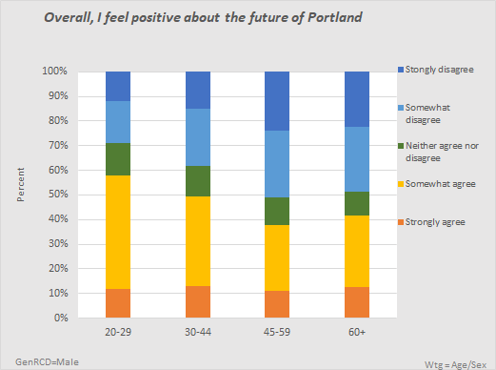
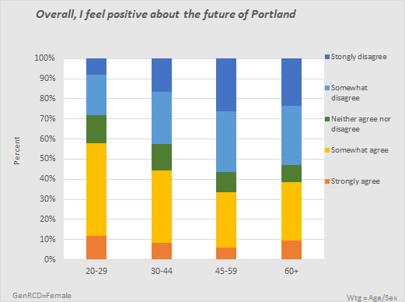
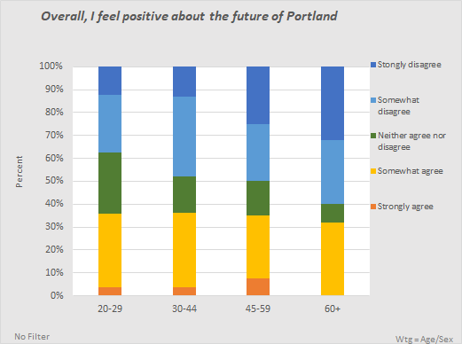
Feelings about Portland’s Future (cont.)
14
Respondents who did not identify as male or female (“other,” meaning non-binary or non-conforming, in the remainder of this presentation – see note in Introduction), especially older adults, felt much less positive about the future of Portland.
Male
Female
Other

Slide 15
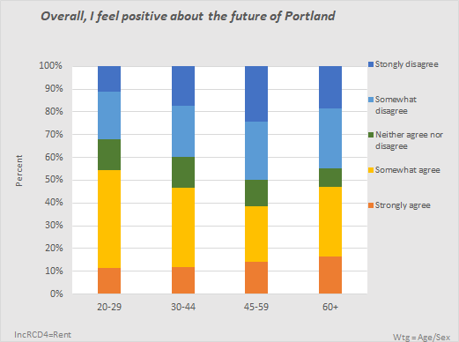
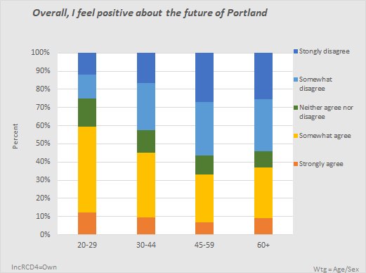
Feelings about Portland’s Future (cont.)
15
In this sample of Portland residents, owners outnumbered renters 2 to 1 (owners = 4,834; renters = 2,374; another 322 did not respond or responded “other”).
Younger respondents generally felt more positive about Portland’s future than did older respondents, with respondents in the youngest age group (20-29), among both renters and owners, being the most optimistic. Young (20-29) owners felt the most positive, and older (60+) owners the least positive.
Rent
Own

Slide 16
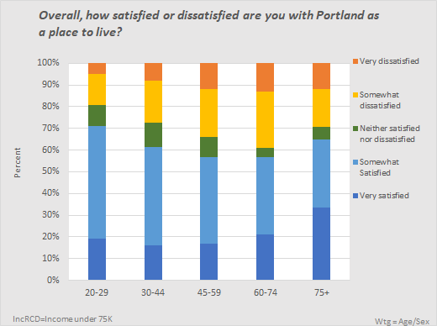
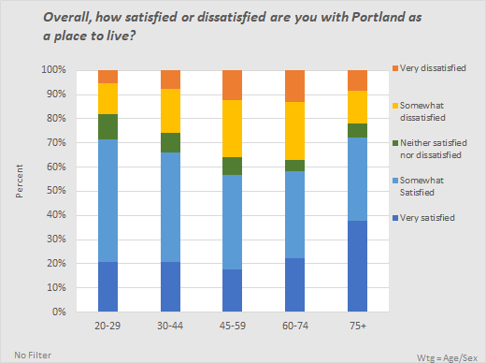
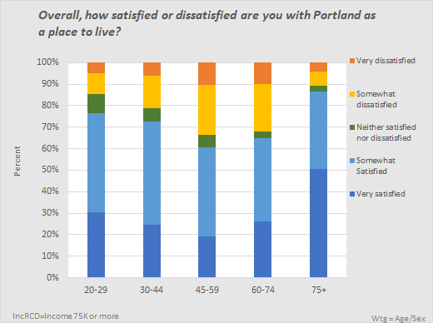
Satisfaction with Portland as a Place to Live
16
Lower Income
Generally, respondents felt satisfied with Portland as a place to live, although this was true for even more of those in the youngest and oldest age groups, and especially among those with higher incomes.
Higher Income

Slide 17
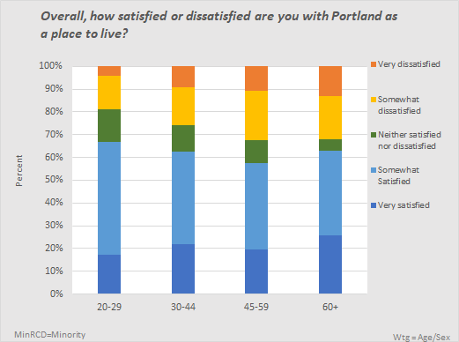
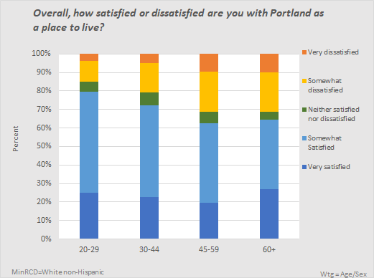
Satisfaction with Portland as a Place to Live (cont.)
17
Satisfaction generally decreased with age.
White non-Hispanics were more likely to be satisfied than other racial groups.
BIPOC
W n-H

Slide 18
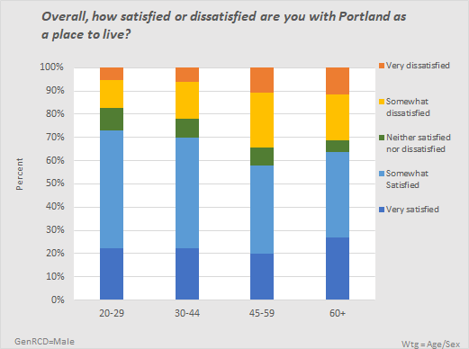
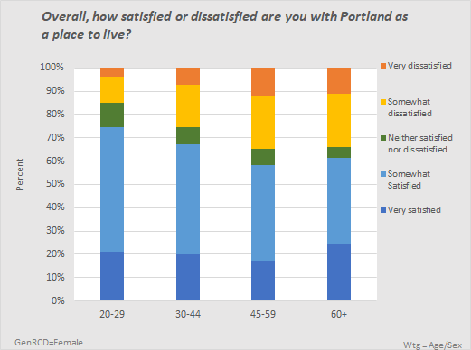
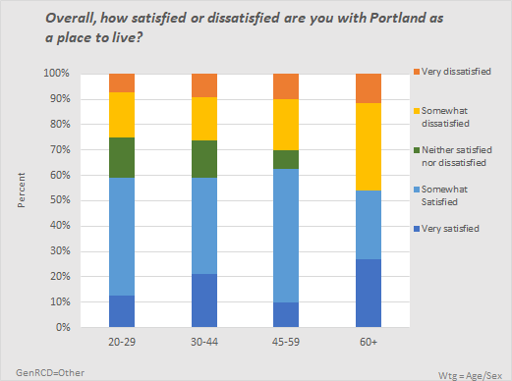
Satisfaction with Portland as a Place to Live (cont.)
18
When looking at the four age groups by gender identity, males’ and females’ responses did not differ greatly, but among other respondents, there was less satisfaction with Portland as a place to live for all age groups except those 45-59, with those 60+ least likely to be somewhat or very satisfied.
Male
Female
Other

Slide 19
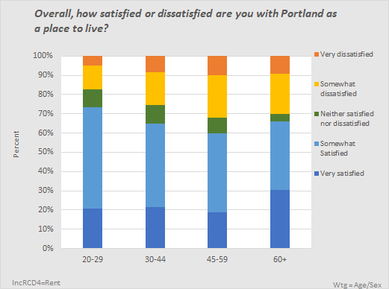
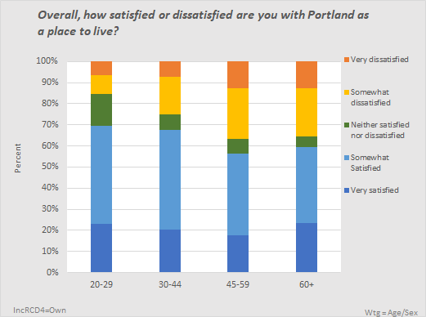
Satisfaction with Portland as a Place to Live (cont.)
19
The majority of respondents in all age groups were satisfied with Portland as a place to live, owners and renters alike. Among both renters and owners, those age 20-29 were most likely to be satisfied.
Rent
Own

Slide 20
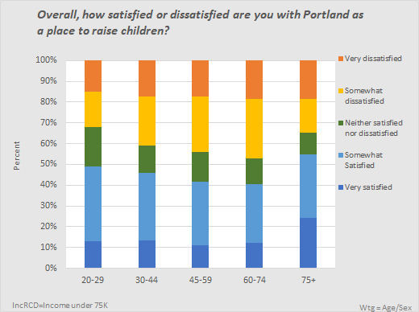
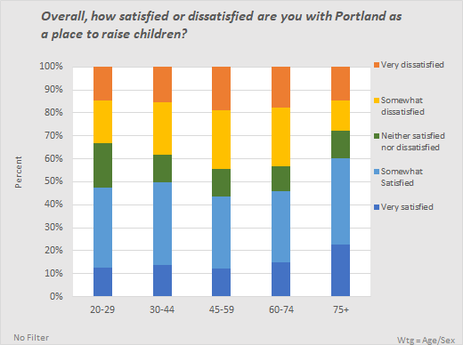
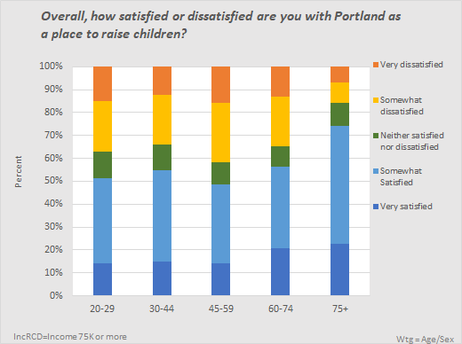
Satisfaction with Portland as a Place to Raise Children
20
Lower Income
There was little variation by age, except those who responded in the 75+ age group were most likely to be satisfied with Portland as a place to raise children.
Respondents with higher incomes in all age groups were more likely to be satisfied.
(Note that several older respondents indicated the question was not applicable.)
Higher Income

Slide 21
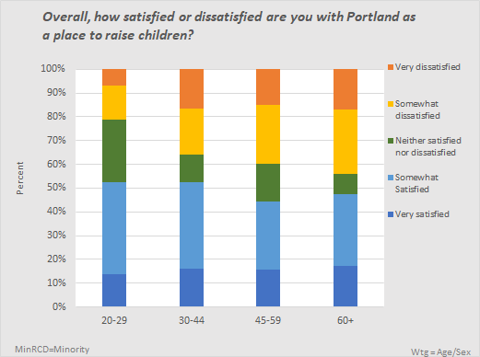
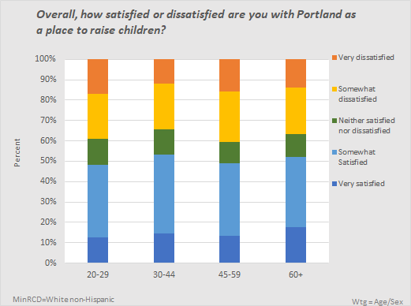
Satisfaction with Portland as a Place to Raise Children (cont.)
21
The pattern of responses did not differ greatly by race/ethnicity.
BIPOC
W n-H

Slide 22
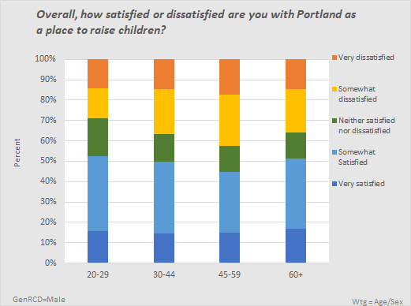
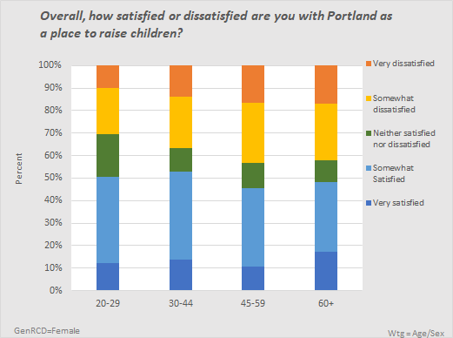
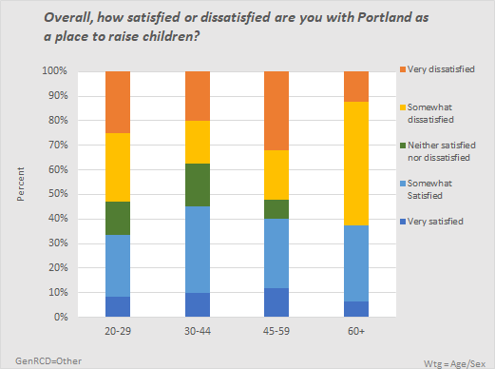

Satisfaction with Portland as a Place to Raise Children (cont.)
22
Although male and female respondents’ views did not differ greatly, other respondents in all age groups, but especially those who were 60+ and responded, were considerably less satisfied with Portland as a place to raise children.
Female
Other

Slide 23
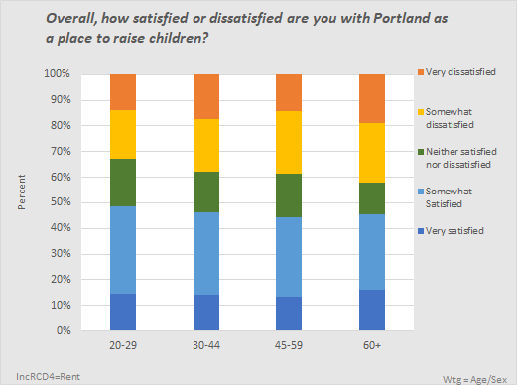
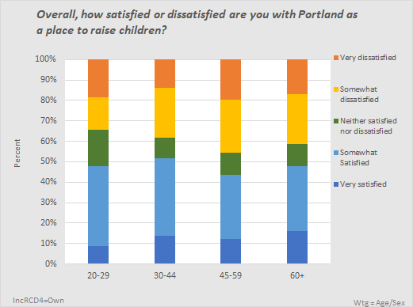
Satisfaction with Portland as a Place to Raise Children (cont.)
23
Renters’ and owners’ views did not differ greatly, nor were there major differences by age and rent/own status.
Rent
Own

Slide 24
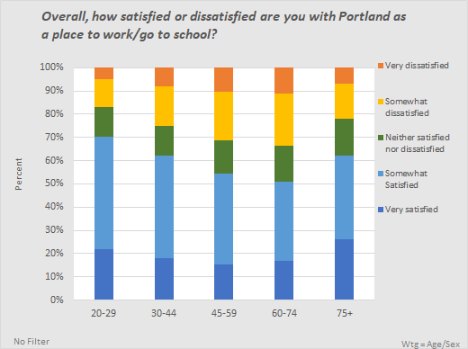
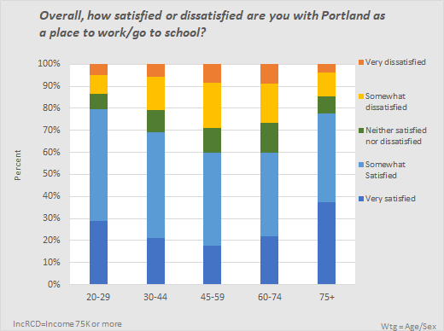
Satisfaction with Portland as a Place to
Work/Go to School
24
Lower Income
The majority of respondents felt satisfied with Portland as a place to work or go to school.
Those in the youngest group were more likely to be satisfied, with satisfaction decreasing by age until the age 75+ group.
People with higher incomes were considerably more likely to be satisfied.
Higher Income

Slide 25
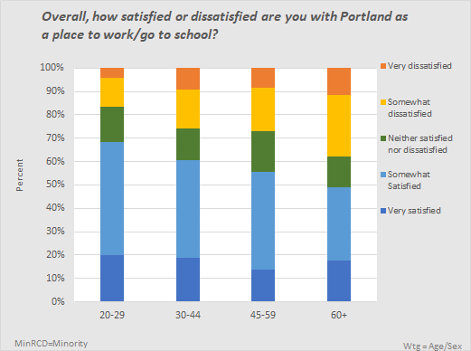
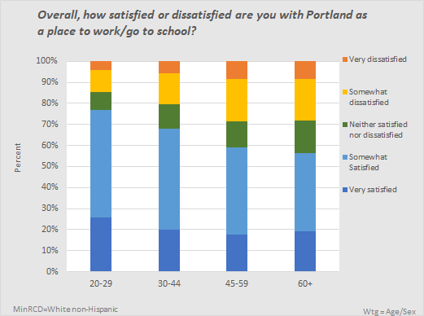
Satisfaction with Portland as a Place to Work/Go to School (cont.)
25
White non-Hispanics were more likely to be satisfied with Portland as a place to work or go to school than Black, Indigenous, and People of Color.
BIPOC
W n-H

Slide 26
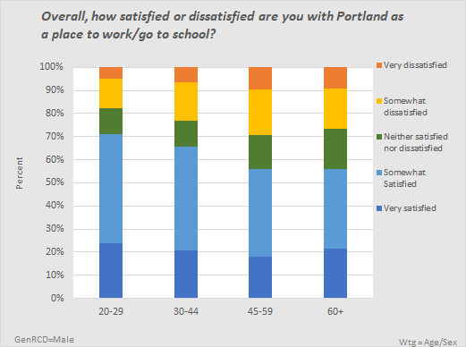
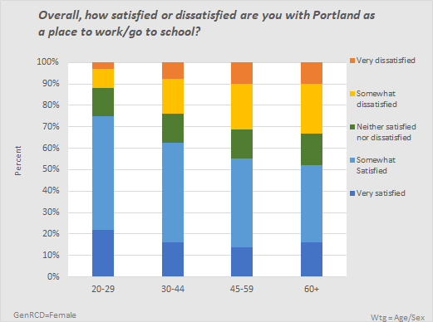
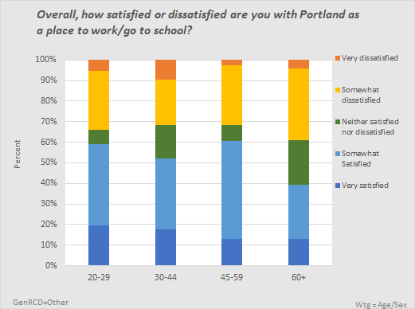
Satisfaction with Portland as a Place to Work/Go to School (cont.)
26
Among respondents who identified as male or female, those in the youngest age group reported the most satisfaction.
Other respondents’ patterns of responses differed, with people age 45-59 most likely to be somewhat or very satisfied and those age 60+ least satisfied.
Female
Other

Slide 27
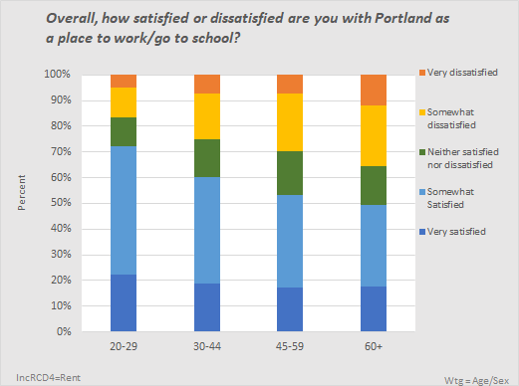
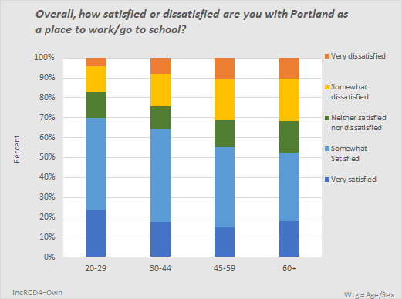
Satisfaction with Portland as a Place to Work/Go to School (cont.)
27
The pattern of responses by age was similar for renters compared to owners. In both groups, those age 20-29 were most satisfied with Portland as a place to work or go to school.
Rent
Own

Slide 28
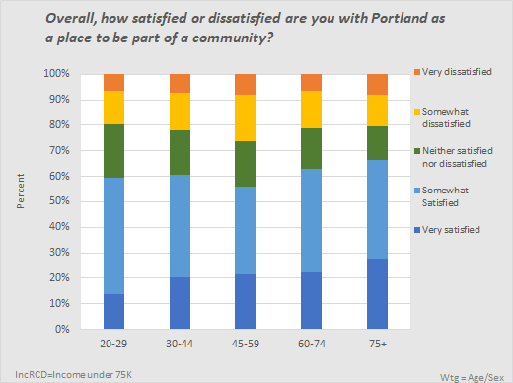
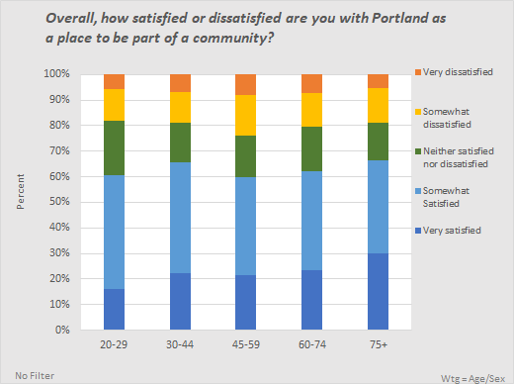
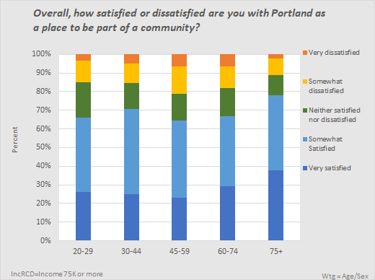
Satisfaction with Portland as a Place to be Part of a Community
28
Lower Income
60% or more respondents in each age group were somewhat or very satisfied with Portland as a place to be part of a community.
There was little difference by age.
Respondents with higher incomes were more satisfied.
Higher Income

Slide 29
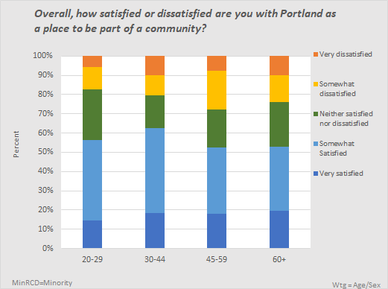
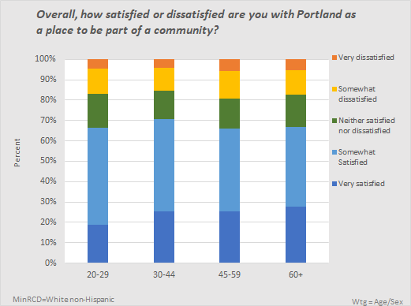
Satisfaction with Portland as a Place to be Part of a Community (cont.)
29
Satisfaction levels, while still above 50% for all age groups, were 10 or more percentage points lower among BIPOC respondents than among White non-Hispanics.
BIPOC
W n-H

Slide 30
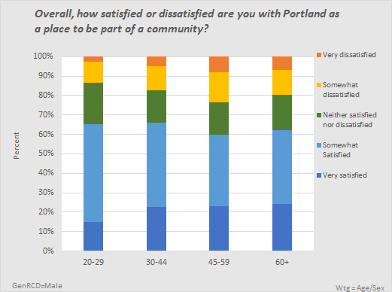
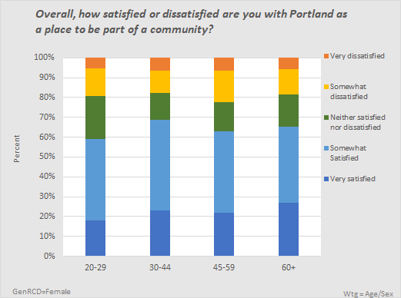
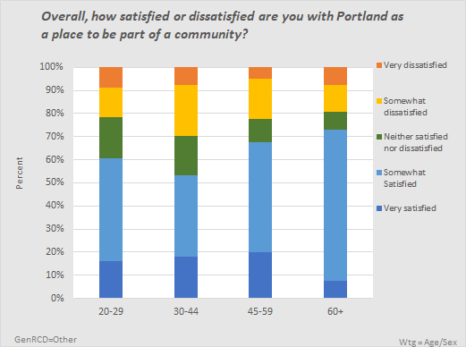
Satisfaction with Portland as a Place to be Part of a Community (cont.)
30
Respondents identifying as male or female in the different age groups responded similarly, but other respondents age 30-44 were less likely to be satisfied, and those age 45 and older more likely to be satisfied, although only “somewhat” satisfied.
Male
Female
Other

Slide 31
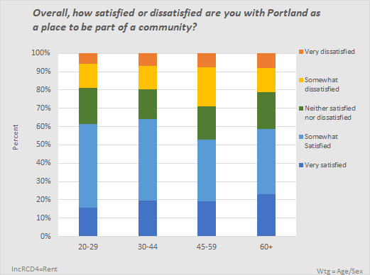

Satisfaction with Portland as a Place to be Part of a Community (cont.)
31
There was little difference between the youngest and oldest renters’ and owners’ views with respect to Portland as a place to be part of a community, but owners age 45-59 were more satisfied than renters in this age group.
Rent
Own

Slide 32



Ease of Getting Information Needed from the City
32
Lower Income
Around 40% of respondents, regardless of age, agreed that they could easily get the information they need from the City.
Income level did not significantly differentiate between respondents.
Higher Income

Slide 33


Ease of Getting Information Needed from the City (cont.)
33
Under half of all respondents in each age group among both BIPOC and White non-Hispanic respondents agreed that it was easy to get needed information from the city.
BIPOC respondents age 30 and over were somewhat more likely to strongly disagree than younger BIPOC respondents and than White non-Hispanic respondents.
BIPOC
W n-H

Slide 34



Ease of Getting Information Needed from the City (cont.)
34
Respondents who did not identify as male or female were more likely to disagree and less likely to agree that it was easy to get the information they needed from the City.
Female
Other

Slide 35


Ease of Getting Information Needed from the City (cont.)
35
There was little difference between renters’ and owners’ views by age with respect to the ease of getting information they need from the City.
Rent
Own

Slide 36
Portland as Opportunity
36
Summary of Key Findings
Portland as a Place
Portland as Opportunity
Safety Issues
Services and Environment
Disaster Preparation
Survey items concerning Portland as a place of opportunity are grouped in this section, including:
  Portland’s progress toward racial equity
  Access to jobs that pay sufficiently
  Access to education and training
  Worry about losing home due to cost/access to affordable housing
  Power to influence City decisions
Section summary

Slide 37



Progress Where a Person’s Outcomes are Not Based on their Race
37
Lower Income
Less than half of all respondents, in any age group, agreed that progress is being made on becoming a city where a person’s outcomes are not based on their race.
There was not much difference by age, except those 75+ were more likely to agree and less likely to disagree.
Income did not differentiate the groups significantly, except those age 75+ with higher incomes were most likely to agree and least likely to disagree.
Higher Income

Slide 38


Progress Where a Person’s Outcomes are Not Based on their Race (cont.)
38
The pattern of responses did not differ greatly by age and minority status. Only around 40% of respondents in the four age groups in the two race/ethnicity groups agreed with this statement.
BIPOC respondents in the two middle age groups were more likely to agree than White non-Hispanic respondents in those age groups.
BIPOC
W n-H

Slide 39



39
Progress Where a Person’s Outcomes are Not Based on their Race (cont.)
For this question, we examined in greater detail the responses of BIPOC respondents.
The numbers of people age 60+, in particular, are quite small, so caution must be used in interpreting the results (Black 60+ n=18; Asian 60+ n = 36; Hispanic 60+ n = 9).
Across all age groups, agreement was lowest among Blacks and then Hispanic residents. Disagreement was strongest among Blacks and increased with age.
Asian
Hispanic
Black

Slide 40



40
Progress Where a Person’s Outcomes are Not Based on their Race (cont.)
Respondents who identified as male were somewhat more likely to feel progress was being made than were those who identified as females.
Other respondents younger than 60 felt much more negatively about this, however, while those age 60+ were considerably more positive in their views.
Female
Other

Slide 41
40
Progress Where a Person’s Outcomes are Not Based on their Race (cont.)
Respondents who identified as male were somewhat more likely to feel progress was being made than were those who identified as females.
Other respondents younger than 60 felt much more negatively about this, however, while those age 60+ were considerably more positive in their views.
Female
Other

Slide 42


41
Progress Where a Person’s Outcomes are Not Based on their Race (cont.)
Renters’ and owners’ views did not differ greatly by age with respect to whether progress was being made on becoming a city where a person’s outcomes are not based on their race.
Rent
Own

Slide 43



Can Find a Job Paying Enough to Support Self and Family
42
Lower Income
Fewer than half of the respondents in each age group except those age 30-44 agreed that they could find a job paying enough to support themselves and their family.
Respondents with higher incomes were much more likely to agree that they could find a job paying enough than were those with lower incomes.
It should be noted that among the respondents to this question, in the age 75+ group there were only 36 respondents.
Higher Income

Slide 44


Can Find a Job Paying Enough to Support Self and Family (cont.)
43
White non-Hispanics age 20-29, 30-44 and 45-59 were more likely to feel that they could find a job paying enough to support themselves and their family than were BIPOC respondents.
BIPOC respondents in the youngest and oldest age groups, and White non-Hispanic respondents age 60+, were the groups least likely to agree they could find a job with sufficient pay.
BIPOC
W n-H

Slide 45



Can Find a Job Paying Enough to Support Self and Family (cont.)
44
Respondents who identified as male were more like to feel that they could find a job paying enough to support themselves and their family than were females across all age groups.
Other respondents were least likely to agree and most likely to strongly disagree across all age groups.
Female
Other

Slide 46


Can Find a Job Paying Enough to Support Self and Family (cont.)
45
Renters in all age groups were much less likely to feel that they could find a job paying enough than were owners.
Agreement decreased with age for both renters and owners but was particularly marked among renters.
Just over 20% of renters age 60+ felt they could find a job paying enough, compared to over 45% of owners in this age group.
Rent
Own

Slide 47



Have Access to Educational and Training Opportunities
46
Lower Income
Over half of those in each age group agreed that they have access to educational and training opportunities, with respondents in the youngest group most likely to agree.
Respondents with higher incomes were much more likely to agree than those with lower incomes, regardless of age.
Higher Income

Slide 48


Have Access to Educational and Training Opportunities (cont.)
47
Among both racial/ethnic groups, the youngest respondents were most likely to agree that they had access to educational and training opportunities to get a better job.
White non-Hispanics felt more positively than did respondents of color.
BIPOC
W n-H

Slide 49





Have Access to Educational and Training Opportunities (cont.)
48
Taking a more detailed look by race, the age-related pattern of responses was similar for all racial groups except Blacks, with younger adults, and in some cases, older adults, most likely to agree that they have access to educational and training opportunities.
Among Blacks, however, fewer than half of younger and older adults somewhat or strongly agreed that they had such opportunities.
Hispanic
White
Black
Asian
Other

Slide 50



Have Access to Educational and Training Opportunities (cont.)
49
Over half of the male and female respondents in all age groups agreed that they had access to educational and training opportunities.
Non-binary or non-conforming respondents, regardless of age, were considerably less likely to agree.
Female
Other

Slide 51


Have Access to Educational and Training Opportunities (cont.)
50
Across all age groups, owners were much more likely than renters to agree that they had access to educational and training opportunities.
The age group reporting the most agreement among both renters and owners was the 20-29 age group.
Rent
Own

Slide 52



Are Worried about Losing Home Due to Cost
51
Lower Income
About ½ of youngest respondents and almost 40% or more of all other respondents were worried about losing their home due to cost.
Among lower income respondents (incomes below $75,000), however, over half of respondents in every age category were worried, and over 60% of those age 30-44 and 45-59.
Higher Income

Slide 53


Are Worried about Losing Home Due to Cost (cont.)
52
Losing one’s home due to cost was a concern for half or more of all minority respondents and more so for those age 60+.
Concern levels were lower among White non-Hispanic respondents, except among those age 20-29, although at least one third of respondents in each age group were worried.
BIPOC
W n-H

Slide 54



Are Worried about Losing Home Due to Cost (cont.)
53
From one third to one half of both male and female respondents were worried about losing their home due to cost, with females age 45+ more worried than their male counterparts.
Respondents who did not identify as male or female were much more likely to be worried, with well over half in each age group expressing concern. In this group, concern was greatest among those age 20-29 (almost 70%) and those 60+ (over 60%).
Female
Other

Slide 55


Are Worried about Losing Home Due to Cost (cont.)
54
Renters were much more concerned about losing their home due to cost than were owners. From over half to almost three quarters of renters were worried about losing their home due to cost, with concern greatest among those age 30 and over.
There was considerable concern among owners, as well, especially in the youngest and oldest age groups, with over one third in each group agreeing that they were worried about losing their home due to cost.
Rent
Own

Slide 56



Have Power to Influence City Decisions
55
Lower Income
Only around one fifth or less of respondents, across all ages, agreed that they had the power to influence City decisions about issues important to them.
Many respondents very strongly disagreed that they have power to influence City decisions, although respondents age 30 and over were more likely to disagree than were those age 20-29. Disagreement increased with age until the 75+ age group.
There were few differences by income.
Higher Income

Slide 57


Have Power to Influence City Decisions (cont.)
56
Response patterns were similar by age between Black, Indigenous, and People of Color and White non-Hispanic respondents.
Respondents in the youngest age group felt more empowered than did older respondents.
BIPOC
W n-H

Slide 58



Have Power to Influence City Decisions (cont.)
57
Respondents who did not identify as male or female felt much less power to influence City decisions than did male or female respondents, and these feelings increased with age.
Female
Other

Slide 59


Have Power to Influence City Decisions (cont.)
58
Owners in all but the youngest age group felt less powerful than renters.
Rent
Own

Slide 60
Safety Issues
59
Summary of Key Findings
Portland as a Place
Portland as Opportunity
Safety Issues
Services and Environment
Disaster Preparation
Survey items concerning safety issues in Portland are grouped in this section, including respondents’ feelings with respect to:
  Safety walking
    during the day in their neighborhood
    at night in their neighborhood
    during the day in the central city
    at night in the central city
  Protection by police
    from violent crime
    from property crime
Section summary

Slide 61



Feel Safe Walking During the Day in their Neighborhood
60
Lower Income
Safety walking during the day in their neighborhood was of little concern to the vast majority (over 80%) of respondents
Those in the youngest and oldest age groups were most likely to agree they felt safe walking in their neighborhood during the day.
Greater percentages of those with higher incomes felt safe.
Higher Income

Slide 62


Feel Safe Walking During the Day in their Neighborhood (cont.)
61
White non-Hispanic respondents were even more likely to feel safe walking during the day in their neighborhood, especially those age 20-29.
BIPOC
W n-H

Slide 63



Feel Safe Walking During the Day in their Neighborhood (cont.)
62
The vast majority of all respondents, regardless of their gender identity, somewhat or strongly agreed that they felt safe walking during the day in their neighborhood.
Female
Other

Slide 64


Feel Safe Walking During the Day in their Neighborhood (cont.)
63
Although nearly all renters and owners felt safe walking during the day in their neighborhood, somewhat more young renters agreed that they felt safe than did young owners.
Rent
Own

Slide 65



Feel Safe Walking at Night in their Neighborhood
64
Lower Income
Although more than half of each age group agreed or strongly agreed that they felt safe walking in their neighborhood at night, respondents age 20-29 were less likely to do so than the other age groups.
Respondents with higher incomes were considerably more likely to feel safe walking in their neighborhood at night than those in the lower income group.
Higher Income

Slide 66


Feel Safe Walking at Night in their Neighborhood (cont.)
65
White non-Hispanics in all age groups were considerably more likely to feel safe walking at night in their neighborhood than were other respondents.
Respondents in minority groups and age 20-29 were the least likely to feel safe walking at night in their neighborhood.
BIPOC
W n-H

Slide 67



Feel Safe Walking at Night in their Neighborhood (cont.)
66
Male respondents in all age groups were considerably more likely to feel safe walking at night in their neighborhood than were females and those who identified as neither male nor female.
Female
Other

Slide 68


Feel Safe Walking at Night in their Neighborhood (cont.)
67
Younger owners were the group least likely to feel safe walking in their neighborhood at night compared to owners in other age groups and to renters of all ages.
Rent
Own

Slide 69



Feel Safe Walking During the Day in the Central City
68
Lower Income
At the time of this survey (2019), the majority of all age groups agreed that they felt safe walking during the day in the central city.
The youngest and oldest groups were most likely to agree, and this did not differ significantly by income, except for the 75+, where even more of those with higher incomes felt safe walking in the central city during the day.
Higher Income

Slide 70


Feel Safe Walking During the Day in the Central City (cont.)
69
At the time of this survey, the majority of both White non-Hispanics and BIPOC respondents somewhat or strongly agreed that they felt safe walking during the day in the central city.
Younger White non-Hispanic respondents, however, were most likely to feel safe walking in the central city during the day.
BIPOC
W n-H

Slide 71



Feel Safe Walking During the Day in the Central City (cont.)
70
At the time of the survey, the majority of respondents, regardless of their gender identity, somewhat or strongly agreed that they felt safe walking during the day in the central city.
Males in the two youngest age groups and respondents who identified as neither male nor female of all ages were most likely to report feeling safe walking during the day in the central city.
Female
Other

Slide 72


Feel Safe Walking During the Day in the Central City (cont.)
71
Renters were more likely to feel safe walking during the day in the central city than were owners, especially renters age 20-29.
Rent
Own

Slide 73



Feel Safe Walking at Night in the Central City
72
Lower Income
At the time of this survey, even before the pandemic and protests for racial justice, a majority of Portlanders, regardless of age, did not feel safe walking at night in the central city.
Among older respondents, those with higher incomes were more likely to feel safe walking in the central city than were those with lower incomes.
Higher Income

Slide 74


Feel Safe Walking at Night in the Central City (cont.)
73
The pattern of responses was similar between Black, Indigenous, and People of Color and White non-Hispanics, with the majority reporting not feeling safe walking at night in the central city.
BIPOC

Slide 75



Feel Safe Walking at Night in the Central City (cont.)
74
Respondents who identified as female were less likely to feel safe walking at night in the central city than were males or other respondents.
Female
Other

Slide 76


Feel Safe Walking at Night in the Central City (cont.)
75
Although the majority of both renters and owners did not feel safe walking at night in the central city, renters in all age groups were somewhat more likely to agree that they felt safe walking at night in the central city.
Rent
Own

Slide 77



Satisfied with Ability of Police to Protect From Violent Crime
76
Lower Income
Fewer than half of respondents in all age groups were satisfied with the ability of police to protect them from violent crime, although satisfaction increased with age.
Proportionately more younger adults were very or somewhat dissatisfied than were older adults, especially those 75+.
Respondents with higher incomes were more likely to be satisfied than were those with lower incomes.
Higher Income

Slide 78


Satisfied with Ability of Police to Protect From Violent Crime (cont.)
77
Younger members of minority groups were less likely to be satisfied with the ability of police to protect from violent crime than were older minority respondents and White non-Hispanic respondents.
BIPOC

Slide 79



Satisfied with Ability of Police to Protect From Violent Crime (cont.)
78
Regardless of age, respondents who did not identify as male or female were much more likely to be very or somewhat dissatisfied with the ability of the police to protect them from violent crime.
This was especially the case for those age 20-29.
Female
Other

Slide 80


Satisfied with Ability of Police to Protect From Violent Crime (cont.)
79
Renters’ and owners’ responses were similar, although owners in the youngest age group were more likely to be dissatisfied with the ability of police to protect them from violent crime.
Rent
Own

Slide 81



Satisfied with Ability of Police to Address Property Crime
80
Lower Income
Satisfaction with the ability of police to address property crime was low (20-30%), regardless of age.
A majority of all age groups were somewhat or very dissatisfied, with the three middle age groups the most likely to be dissatisfied.
There was little difference between the responses of those with lower versus higher incomes, except respondents age 20-29 with lower incomes were somewhat less likely to be dissatisfied than were their peers in the higher income group.
Higher Income

Slide 82


Satisfied with Ability of Police to Address Property Crime (cont.)
81
White non-Hispanics in all age groups were less satisfied than were minority respondents with the ability of police to address property crime.
BIPOC
W n-H

Slide 83



Satisfied with Ability of Police to Address Property Crime (cont.)
82
Respondents in all age groups who identified as a gender other than male or female were least likely to be satisfied with the ability of policy to address property crime.
Female
Other

Slide 84


Satisfied with Ability of Police to Address Property Crime (cont.)
83
Although the majority of both renters and owners in all age groups were dissatisfied with the ability of police to address property crime, owners were more likely to be dissatisfied than were renters.
Own
Rent

Slide 85
Services and Environment
84
Summary of Key Findings
Portland as a Place
Portland as Opportunity
Safety Issues
Services and Environment
Disaster Preparation
Survey items concerning satisfaction with services and environmental issues in Portland are grouped in this section, including respondents’ satisfaction with:
  Homelessness
  Construction in the neighborhood
  Cleanliness of streets, sidewalks, public spaces
  Physical condition of roads
  Commute
    Reliability
    Traffic/crowding
    Safety
  Garbage, recycling, and composting services
  Utility bill (water and sewer)
  Water quality of rivers and streams
  Parks
    Safety
    Cleanliness
Section Summary

Slide 86



Satisfaction with City’s Response to Homelessness
85
Lower Income
There was widespread dissatisfaction across all age groups with the City’s response to homelessness, with at least 60% of respondents in each age group stating they were very dissatisfied and most others somewhat dissatisfied.
There were even higher levels of dissatisfaction among those with higher incomes.
Higher Income

Slide 87


Satisfaction with City’s Response to Homelessness (cont.)
86
There was even greater dissatisfaction with the City’s response to homelessness among White non-Hispanic respondents than among minority respondents.
Minority respondents age 20-29 were somewhat less unhappy with the City’s response to homelessness than were older minority respondents.
BIPOC

Slide 88



Satisfaction with City’s Response to Homelessness (cont.)
87
Respondents who were age 60+ and identified as neither male nor female were those most likely to be very or somewhat dissatisfied.
Female
Other

Slide 89


Satisfaction with City’s Response to Homelessness (cont.)
88
The vast majority of both renters and owners were very dissatisfied with the City’s response to homelessness.
Dissatisfaction was greater among owners, particularly those age 30 and above.
Rent

Slide 90



Feel Construction of New Houses or Buildings has Made Neighborhood a Better Place to Live
89
Lower Income
Fewer than 40% of respondents in any age group agreed that construction of new houses or buildings had made the neighborhood a better place to live.
Negative feelings about the impact of construction on the neighborhood generally increased with age.
Nearly half or more of respondents age 45+ disagreed somewhat or strongly that new construction had made their neighborhood a better place to live.
Respondents with incomes lower than $75,000 were much more likely to feel negatively about new construction, especially older respondents.
Higher Income

Slide 91


Feel Construction of New Houses/Buildings Made the Neighborhood a Better Place to Live (cont.)
90
Among both minority and White non-Hispanic respondents, those age 45 and over were more likely to disagree that construction had made the neighborhood a better place to live than those under 45.
BIPOC
W n-H

Slide 92



Feel Construction of New Houses/Buildings Made the Neighborhood a Better Place to Live (cont.)
91
Non-binary or non-conforming respondents and female respondents, especially, and particularly those age 60+, were more likely to disagree that construction had made their neighborhood a better place than were males.
Male
Female
Other

Slide 93


Feel Construction of New Houses/Buildings Made the Neighborhood a Better Place to Live (cont.)
92
The two youngest groups of renters were much less likely than younger owners to agree that construction of new houses or buildings had made their neighborhood a better place to live.
Regardless of age, only about 30% of renters agreed that construction of new houses or buildings had made their neighborhood a better place to live.
Among owners, disagreement increased significantly with age; although nearly half of owners age 20-29 agreed, less than one quarter of those age 60+ did so.
Rent
Own

Slide 94



Satisfaction with Cleanliness of Streets, Sidewalks, Other Public Spaces
93
Lower Income
There were high levels of dissatisfaction with the cleanliness of streets, sidewalks and other public spaces among all age groups, with those age 45-59 most likely to be dissatisfied.
Respondents with higher incomes were more likely to be dissatisfied than those with household incomes below $75,000.
Higher Income

Slide 95


Satisfaction with Cleanliness of Streets, Sidewalks, Other Public Spaces (cont.)
94
White non-Hispanic respondents of all ages were more likely to be very or somewhat dissatisfied with the cleanliness of streets, sidewalks and other public spaces than BIPOC respondents.
Respondents age 45-59 were least satisfied, regardless of minority/non-minority status.
BIPOC
W n-H

Slide 96



Satisfaction with Cleanliness of Streets, Sidewalks, Other Public Spaces (cont.)
95
Dissatisfaction with the cleanliness of streets, sidewalks and other public spaces was expressed by the majority of respondents, regardless of their gender identity.
Respondents age 45+ were most likely to be dissatisfied.
Dissatisfaction was somewhat less likely among respondents who did not identify as male or female.
Male
Female
Other

Slide 97


Satisfaction with Cleanliness of Streets, Sidewalks, Other Public Spaces (cont.)
96
Owners in all age groups were less satisfied with the cleanliness of streets, sidewalks and other public spaces than renters.
The 45-59 age group was most dissatisfied among both renters and owners.
Rent

Slide 98



Satisfaction with the Condition of Roads (Potholes, Smoothness)
97
Lower Income
Dissatisfaction with the condition of roads was very high, regardless of age and income.
Dissatisfaction was greatest among the older age groups and respondents with higher incomes.
Higher Income

Slide 99


Satisfaction with the Condition of Roads (Potholes, Smoothness) (cont.)
98
The majority of both minority and White non-Hispanic respondents were dissatisfied with the condition of roads. Somewhat higher proportions of minority respondents were satisfied, however.
BIPOC
W n-H

Slide 100



Satisfaction with the Condition of Roads (Potholes, Smoothness) (cont.)
99
Respondents did not differ greatly by gender identity, although non-binary, non-conforming respondents age 60+ were somewhat less likely to be dissatisfied with road conditions than were male or female respondents.
Female
Other

Slide 101


Satisfaction with the Condition of Roads (Potholes, Smoothness) (cont.)
100
Dissatisfaction increased with age among both renters and owners, although owners were more likely to be dissatisfied than renters.
Rent
Own

Slide 102



Satisfaction with the Reliability (Length and Predictability) of the Daily Commute
101
Satisfaction with the reliability (length and predictability) of the daily commute was below 50% for all groups except the youngest and decreased with age.
Responses did not differ greatly by respondents’ household incomes, except those age 75+ in the higher income group were more likely to be dissatisfied.

Slide 103


Satisfaction with the Reliability (Length and Predictability) of Daily Commute (cont.)
102
Satisfaction with the reliability of their daily commute generally decreased with age for both BIPOC and White non-Hispanic respondents.
BIPOC

Slide 104



Satisfaction with the Reliability (Length and Predictability) of Daily Commute (cont.)
103
Satisfaction with the reliability of the daily commute decreased with age regardless of gender identity.
Dissatisfaction was greatest among non-binary/non-conforming respondents.
Male
Female
Other

Slide 105


Satisfaction with the Reliability (Length and Predictability) of Daily Commute (cont.)
104
Satisfaction with commute reliability generally decreased with age for both renters and owners, although owners were less satisfied than were renters.
Rent
Own

Slide 106



Satisfaction with Traffic or Crowding on the Daily Commute
105
Lower Income
The majority of respondents in all age groups were dissatisfied with traffic or crowding on their daily commute, compared with the previous year, and dissatisfaction increased with age.
Responses did not differ greatly by respondents’ incomes.
Higher Income

Slide 107


Satisfaction with Traffic or Crowding on the Daily Commute (cont.)
106
Responses concerning satisfaction with traffic or crowding on the daily commute did not vary greatly by race/ethnicity, although younger BIPOC respondents were somewhat more likely to be dissatisfied than were younger White non-Hispanics.
BIPOC
W n-H

Slide 108



Satisfaction with Traffic or Crowding on the Daily Commute (cont.)
107
Dissatisfaction with traffic or crowding on the daily commute generally increased with age, regardless of gender identity, but was higher among respondents age 30-59 who did not identify as male or female.
Male
Female
Other

Slide 109


Satisfaction with Traffic or Crowding on the Daily Commute (cont.)
108
The majority of both renters and owners were dissatisfied with traffic or crowding on their daily commute.
Dissatisfaction increased with age, particularly for owners.
Rent
Own

Slide 110



Satisfaction with Safety of Daily Commute
109
Lower Income
Less than half of the respondents in any age group were satisfied with the safety of their daily commute, and satisfaction generally declined with age.
Respondents with lower incomes, especially those in the older age groups, were more likely to be dissatisfied.
Higher Income

Slide 111


Satisfaction with Safety of Daily Commute (cont.)
110
There was little difference between minority and White non-Hispanic respondents’ levels of satisfaction with the safety of their daily commute, although again, satisfaction declined with age.
BIPOC
W n-H

Slide 112



Satisfaction with Safety of Daily Commute (cont.)
111
There was little difference by gender identity with respect to the safety of respondents’ daily commutes, although again, satisfaction generally decreased with age.
Male
Female
Other

Slide 113


Satisfaction with Safety of Daily Commute (cont.)
112
Satisfaction with the safety of their daily commute decreased with age for both renters and owners.
Owners in the youngest age group (20-29) were the most satisfied group, with over half reporting they were somewhat or very satisfied, while owners age 60+ were the group expressing the least satisfaction.
Rent

Slide 114



Satisfaction with Quality of Garbage, Recycling, and Composting Services at Residence
113
Lower Income
The majority of respondents of all ages were satisfied with the quality of residential garbage, recycling, and composting services, although satisfaction increased with respondents’ age.
Higher income respondents expressed greater levels of satisfaction than did respondents with lower incomes.
Higher Income

Slide 115


Satisfaction with Quality of Garbage, Recycling, and Composting Services at Residence (cont.)
114
White non-Hispanic respondents were much more likely to be satisfied with the quality of the garbage, recycling, and composting services at their residence than were minority respondents.
BIPOC
W n-H

Slide 116



Satisfaction with Quality of Garbage, Recycling, and Composting Services at Residence (cont.)
Other
115
Satisfaction generally increased with age for all gender groups, although respondents who identified as neither male nor female were less likely to be satisfied, except for those age 60+.
Female
Other

Slide 117


Satisfaction with Quality of Garbage, Recycling, and Composting Services at Residence (cont.)
116
Owners were generally more satisfied than renters with the quality of the garbage, recycling, and composting services at their residence.
Rent

Slide 118



Satisfaction with Value of City Utility Bill
117
Lower Income
40% or fewer respondents in each age group were satisfied with the value of their utility bill.
Satisfaction decreased with age, except for the 75+ group.
The age-related pattern of responses was similar for the two income groups, but respondents with higher incomes were more satisfied than those with lower incomes.
Higher Income

Slide 119


Satisfaction with Value of City Utility Bill (cont.)
118
Satisfaction levels with the value of their City utility bill were similar between minority and White non-Hispanic respondents age 30+ but were lower among minority respondents age 20-29 than White non-Hispanic respondents in the same age group.
BIPOC
W n-H

Slide 120



Satisfaction with Value of City Utility Bill (cont.)
119
Regardless of gender identity, dissatisfaction with the value of the City utility bill increased with age.
The highest levels of dissatisfaction were among those age 60+ who identified as neither male nor female.
Younger males age 20-29 were more likely to be satisfied than were younger females or respondents who identified as neither male nor female in this age group.
Female
Other

Slide 121


Satisfaction with Value of City Utility Bill (cont.)
120
Satisfaction with the value of the City utility bill generally decreased with age among both renters and owners.
Rent

Slide 122



Satisfaction with Water Quality of Portland’s Rivers and Streams
121
Lower Income
More than half of respondents in each age group were very or somewhat satisfied with the water quality of Portland’s rivers and streams, and satisfaction increased with age.
Satisfaction levels were higher among those with higher incomes.
Higher Income

Slide 123


Satisfaction with Water Quality of Portland’s Rivers and Streams (cont.)
122
Respondents’ levels of satisfaction with the water quality of Portland’s rivers and streams did not differ greatly by minority status but did increase with age for both groups.
BIPOC
W n-H

Slide 124



Satisfaction with Water Quality of Portland’s Rivers and Streams (cont.)
123
Respondents who identified as neither male nor female were considerably less satisfied than males and females, with fewer than half in each age group reporting that they were very or somewhat satisfied with the water quality of Portland’s rivers and streams.
In all three gender identity groups, those age 20-29 had the lowest levels of satisfaction.
Female
Other

Slide 125


Satisfaction with Water Quality of Portland’s Rivers and Streams (cont.)
124
Across all age groups, owners tended to be more satisfied than renters.
Satisfaction increased marginally by age among both renters and owners.
Rent

Slide 126



Satisfaction with Safety of Parks and Natural Areas Visited
125
Lower Income
The majority of respondents in all age groups reported satisfaction with the safety of the parks and natural areas that they visited.
Those age 45-59 had somewhat lower levels of satisfaction.
Income level did not appear to affect satisfaction levels.
Higher Income

Slide 127


Satisfaction with Safety of Parks and Natural Areas Visited (cont.)
126
Satisfaction with the safety of parks and natural areas visited was greater among White non-Hispanic respondents in all age groups.
BIPOC
W n-H

Slide 128



Satisfaction with Safety of Parks and Natural Areas Visited (cont.)
127
Satisfaction levels with the safety of parks and natural areas visited levels were highest in all age groups among respondents who did not identify as male or female.
Female

Slide 129


Satisfaction with Safety of Parks and Natural Areas Visited (cont.)
128
Satisfaction with the safety of parks and natural areas visited dropped somewhat with age for renters and for owners except for owners age 60+.
More renters than owners tended to be very satisfied with the safety of parks.
Rent

Slide 130



Satisfaction with Cleanliness of Parks and Natural Areas Visited
129
Lower Income
The majority of respondents in all age groups reported satisfaction with the cleanliness of the parks and natural areas that they visited.
Those age 45-59 had lower levels of satisfaction with the cleanliness of the parks and natural areas and the youngest and oldest groups the highest levels.
Income level did not greatly affect satisfaction levels.
Higher Income

Slide 131


Satisfaction with Cleanliness of Parks and Natural Areas Visited (cont.)
130
White non-Hispanic respondents in the youngest and oldest age groups had somewhat higher levels of satisfaction with the cleanliness of the parks and natural areas they visited than did minority respondents in those age groups.
BIPOC
W n-H

Slide 132



131
Satisfaction with Cleanliness of Parks and Natural Areas Visited (cont.)
Satisfaction with the cleanliness of the parks and natural areas visited was lowest among those age 45-59 in all three gender identity groups and was lowest for non-binary/non-conforming respondents age 45+.
Female
Other

Slide 133


132
Satisfaction with Cleanliness of Parks and Natural Areas Visited (cont.)
The majority of renters and owners in all age groups were satisfied with the cleanliness of parks and natural areas, although somewhat fewer respondents age 45-59 were very or somewhat satisfied.
Renters expressed more satisfaction than owners across all ages.
Rent
Own

Slide 134
Disaster Preparedness
133
Summary of Key Findings
Portland as a Place
Portland as Opportunity
Safety Issues
Services and Environment
Disaster Preparation
Findings concerning respondents’ feelings of their own preparedness for a natural disaster, such as an earthquake, are presented in this section.
Section summary

Slide 135



Feel Prepared for a Natural Disaster, such as an Earthquake
134
Lower Income
Feelings of preparedness for a natural disaster generally increased with age, but well under half of respondents in any age group felt prepared.
Fewer than 20% of those age 20-29 felt prepared.
Those with lower incomes in all age groups were less likely to agree that they felt prepared than those with incomes of $75,000 or above.
Higher Income

Slide 136


Feel Prepared for a Natural Disaster, such as an Earthquake (cont.)
135
Feelings of personal preparedness increased with age among both BIPOC and White non-Hispanic respondents.
White non-Hispanics in the 60+ age group were those most likely to at least somewhat agree that they felt prepared.
BIPOC
W n-H

Slide 137



Feel Prepared for a Natural Disaster, such as an Earthquake (cont.)
136
Feelings of personal preparedness for a natural disaster generally increased with age for male, female, and other respondents alike.
Non-binary, non-conforming respondents were less likely to feel prepared than were male or female respondents, except for those age 60+, who were evenly split between somewhat agreeing they felt prepared and strongly disagreeing that they felt prepared for a natural disaster.
Female
Other

Slide 138


Feel Prepared for a Natural Disaster, such as an Earthquake (cont.)
137
Feelings of preparedness increased with age among both renters and owners, but owners in all age groups felt more prepared than did renters.
Rent
Own

Slide 139
End of Livability in Portland by Age
138
Summary of Key Findings
Portland as a Place
Portland as Opportunity
Safety Issues
Services and Environment
Disaster Preparation
Findings from the City’s 2019 Survey of Residents
PowerPoint file: .
Liv Charts_6.25.21_L.pptx

Slide 140
Nomenclature for State of Aging in Portland Section on Livability
139
The researchers working on the State of Aging in Portland project recognize the complicated, evolving nature of language that pertains to race, ethnicity, Hispanic origin, and gender.
We have used the term Black, Indigenous, People of Color (“BIPOC”) in this section to dichotomize the race variable and compare with White non-Hispanic respondents (“W n-H”). Although we feel it is important to understand and report the experiences of specific racial and ethnic groups – as in the section on race and age – we were limited by the available data and chose BIPOC to best organize our findings for the reader.
We capitalize White, rather than leaving it as a lowercase “w” in following the lead of the National Association of Black Journalist (NABJ; Reference: NABJ Style guide). NABJ recommended that “whenever a color is used to appropriately describe race then it should be capitalized, including White and Brown.
We have used three gender categories in this section – “male”, “female”, and “other” – to trichotomize the variable. Although we feel it is important to understand the experiences of people with all gender identities, and the term “other” is far from adequate, we were limited by the available data and chose the term to best organize our findings for the reader. It is important to note that the “other” category includes respondents who identify, for example, as non-binary, transgender, questioning, and Two Spirit.
Back to Introduction

