Slide 1
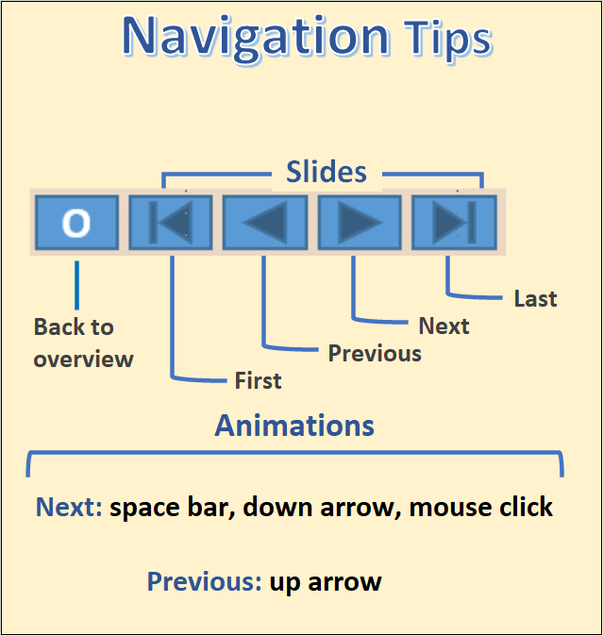

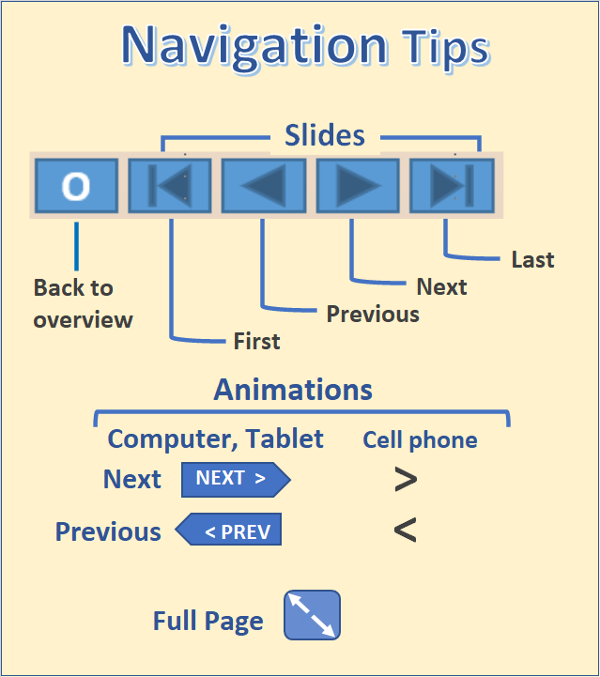
The State of Aging in Portland
1
Part 4.3 – Later in Life Housing Transitions
Table of Contents
Beginning
Types of facilities
Group quarters
Skilled nursing
Residential care
Adult foster homes
Assisted living
Recap of care facilities
Retirement facilities
Maps and tables
While most older households prefer to remain in their long-term residence for as long as their health and financial circumstances permit, some by choice or changes in their personal circumstance, relocate to some other choice of housing. This might be a choice to downsize to an apartment or a condominium, to take advantage of an affordable housing opportunity, or by necessity moving to a more supportive environment such as assisted living or some other type of long-term care facility.
While the total numbers in these care facilities is relatively small, 2460 in care facilities and an additional 1,692 in assisted living, many older persons spend at least some time in one of these types of facilities.
The types of developments to be covered in this section include the following.
The group quarters population:
  Nursing homes
  Residential care facilities
  Adult foster homes
Other housing for older people:
  Assisted living
  Independent living, (age
qualified residences)

Slide 2
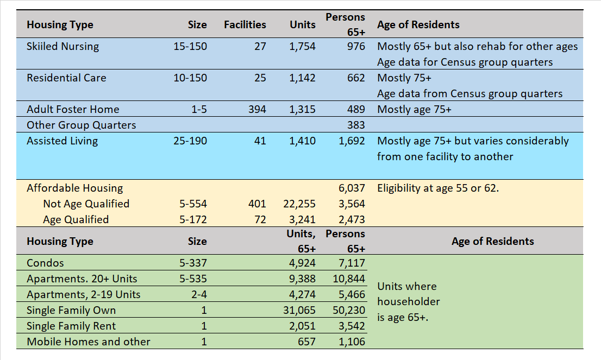
Later in Life Housing Transitions
2
This table lists the various types of housing that house many older persons and to which they may move from their pre-retirement housing.
We have very specific data for some of these housing types where there is a licensing requirement including:
  Skilled nursing
  Residential care
  Assisted living
  Adult foster homes
There are other types of housing that are favored by older households who want to downsize, reduce housing costs, or want the social amenities of independent living:
  Condos – Some condominium developments have attracted pre-retirement age older persons.
  Affordable housing – Some affordable housing developments reserve units or entire developments for older persons.
  Independent living – The senior housing market has been building age-restricted multifamily housing developments to attract the aging baby boomers. We don’t show estimates for independent living as there is no licensing requirement.
Note: Data on this table may differ from Census figures that follow because: (1) the 2010 Census was not precise in identifying and classifying group quarters; and (2) these numbers are based, in part, on more recent and more accurate licensing data.
O

Slide 3
Differentiating Between the Types of Care Facilities
3
By comparison, assisted living facilities must have private apartments, ranging from a studio to one or two bedrooms
Most residents in residential care facilities are able to receive support from Medicaid whereas most of those in assisted living facilities are not and are private pay residents.
Adult foster homes are single-family residences that offer 24-hour care in a home-like setting. They are licensed by the state of Oregon and can house up to five residents (most house the maximum of five). Most residents are able to draw support from Medicaid.
The group quarters population is separately counted by the Census and are not part of the population of households. The group quarters population is divided into institutional and non-institutional components.
For older persons nursing facilities are the main component of the institutional population.
Among the non-institutional population most older persons are in another category that includes residential care and adult foster homes but also many younger persons.
Those residing in assisted living are viewed as being in households and are not included in the group quarters population.
Table of Contents
Beginning
Types of facilities
Group quarters
Skilled nursing
Residential care
Adult foster homes
Assisted living
Recap of care facilities
Retirement facilities
Maps and tables
Nursing homes, residential care, adult family homes, and assisted living all are licensed by the state of Oregon and need to meet certain criteria.
Nursing homes, also called skilled nursing facilities, provide a wide range of health and personal care services. Their services focus on medical care more than most assisted living facilities. These services typically include nursing care, 24-hour supervision, three meals a day, and assistance with everyday activities.
Assisted living and residential care facilities provide housing and supportive services to six or more people. Residential care and assisted living facilities’ services are similar but licensed separately by the Department of Human Services. For example, they both provide meals, laundry, housekeeping, social activities, medication administration and personal care assistance.
Residential care facilities offer shared and private rooms. These facilities are not required to provide private bathrooms or kitchenettes.
O

Slide 4
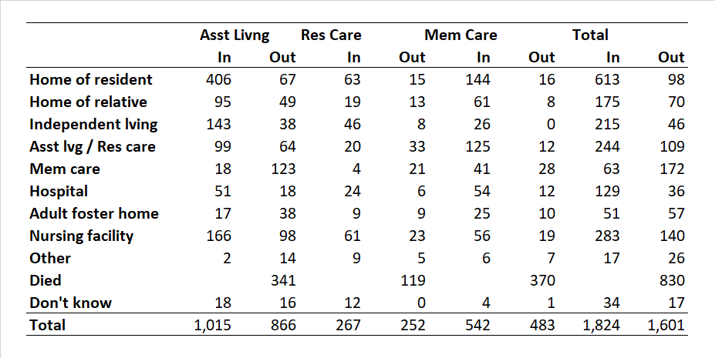
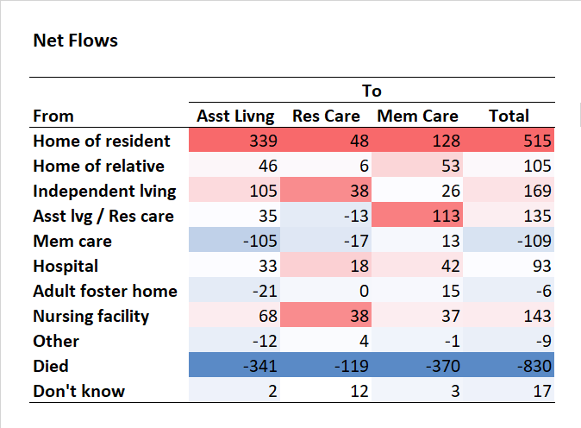
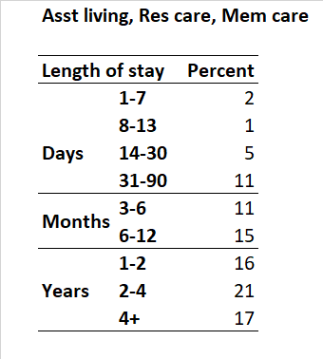
Interrelationships
4
In later life older persons often cycle through various levels of care in residential care, memory care, and assisted living.
This table shows the in and out movements for these three types of facilities, based on 2017 survey data collected by Portland State University. For example, it shows 166 moves from assisted living to a nursing facility and 97 moves from a nursing facility to assisted living.
Most persons in assisted living came from their previous home but for those in memory care there was a net gain of 128 moving from their prior home but about as many, a net of 113, moving from assisted living or residential care.
The largest flow was a loss of 370 persons from death in the memory care facilities.
The length of stay in these three types of facilities varies from several years in an assisted living facility or a few months in an assisted living facility and then a move to a memory care facility.
Source: 2018 Community-Based Care, Resident and Community Characteristics Report on Assisted Living, Residential Care, Memory Care. Paula Carder et al, Institute on Aging, Portland State University, 2018.
O

Slide 5
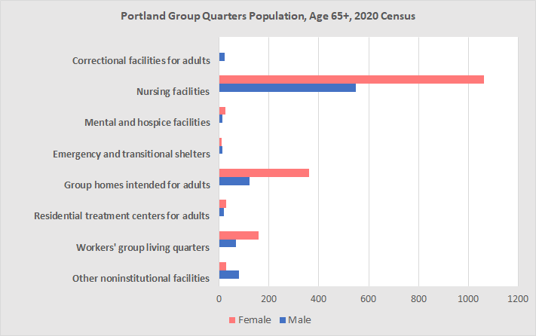
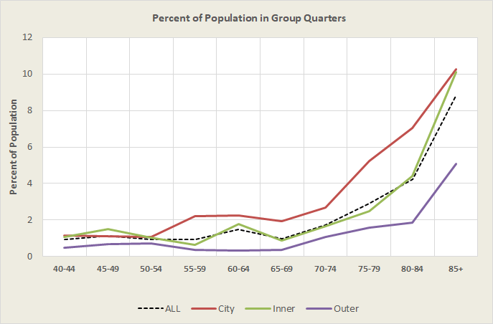
Group Quarters
5
Portland Group Quarters Population, Age 65+, 2010 Census
Group quarters are places where people live or stay in a group living arrangement. These places are owned or managed by an entity or organization that provides residents with housing and/or services.
The largest group of age 65+ persons residing in group quarters were the 1,610 persons age 65+ counted in nursing facilities, followed by 485 in group homes (for adults).
Nursing homes and groups quarters populations were predominately female, rising as high as 74.6% in group homes for adults.
In 2010, about 4.5% of the age 65+ population in Portland resided in group quarters. Data from the 2018 American Community Survey suggests that the percentage had dropped to 3.8%, but the growing numbers of very old persons in Portland will cause the total to rise.
The proportion of the age 65+ population in Portland living in group quarters is higher than in its inner and outer suburbs, mainly because it has a larger share of these facilities.
As the population of the inner and outer suburbs grows and as services expand, generally, the numbers of beds in nursing homes and long-term care facilities is likely to grow in these areas.
An important reason for looking at the Census group quarters population is that we have detailed age information at the tract and block levels.
Table of Contents
Beginning
Types of facilities
Group quarters
Skilled nursing
Residential care
Adult foster homes
Assisted living
Recap of care facilities
Retirement facilities
Maps and tables
O
Source: 2010 Decennial Census, SF1, table PCT-38.

Slide 6
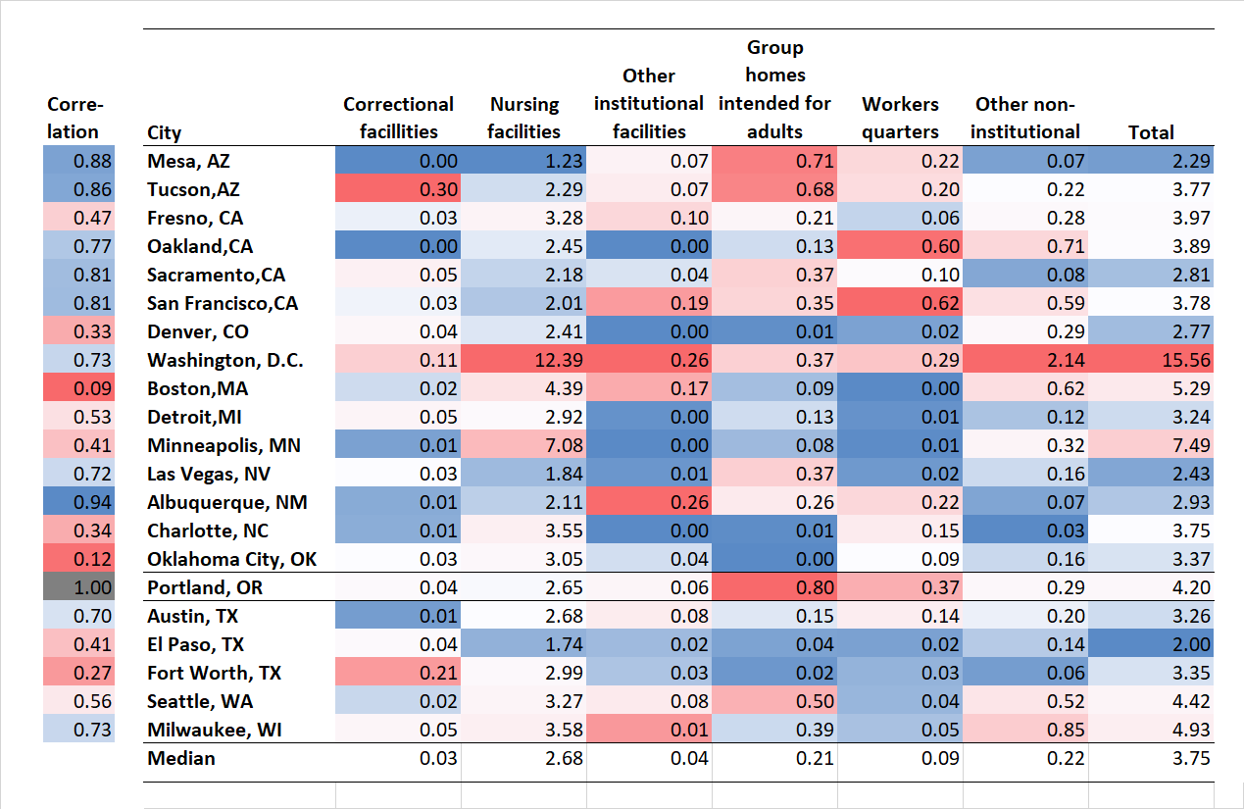
Group Quarters and Comparison Cities
6
This table shows the number in various types of group quarters as a percentage of the age 65+ population. High percentages for each column are in red, low in blue.
The largest share of the group quarters population in the comparison cities is in nursing facilities with a median percentage of 2.68%; at 2.65%, Portland is close to the median.
For Portland, the next largest percent in group quarters is for group homes for adults at 0.80% of the age 65+ population compared to the median of 0.21% for the comparison cities and similar to Tucson and Mesa.
Correlating the ranked values for each type of group quarters facility, weighting each equally, Portland is most similar to Albuquerque, Mesa, and Tucson (darker blues) and least similar to Boston, Oklahoma City, and Fort Worth (darker reds).
Source: 2010 Decennial Census, SF1, table PCT-38.
O

Slide 7
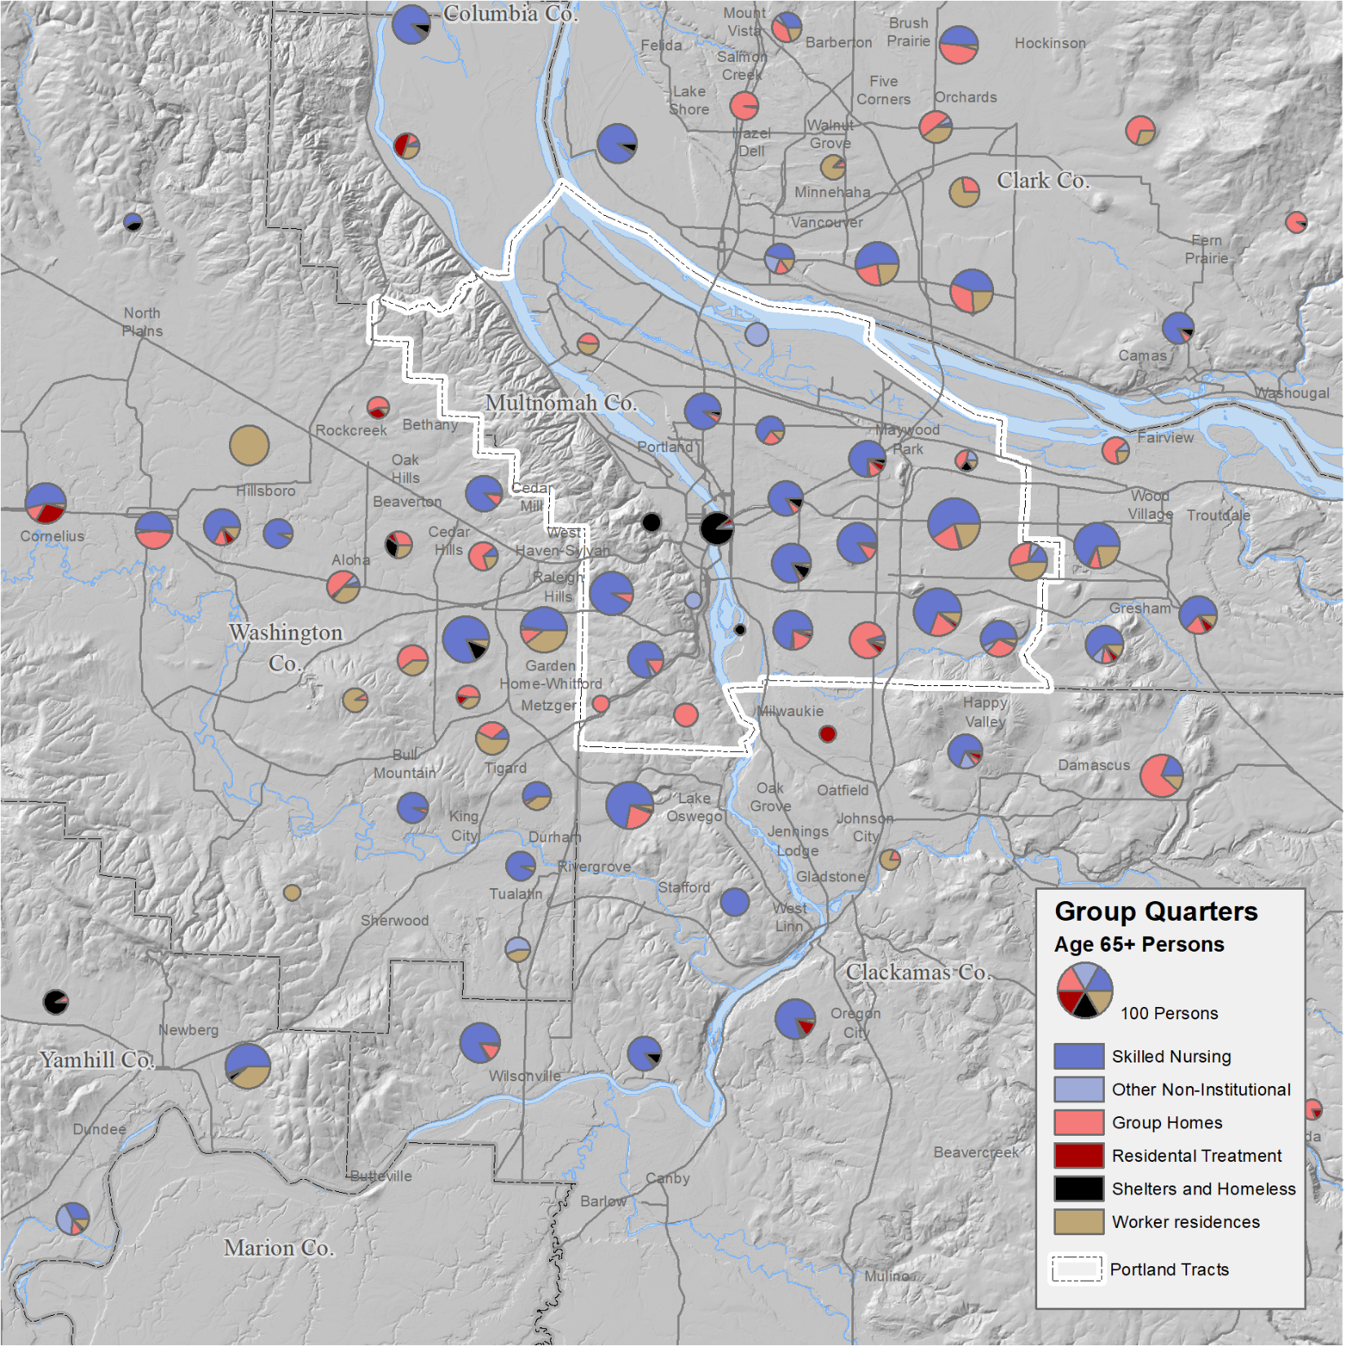
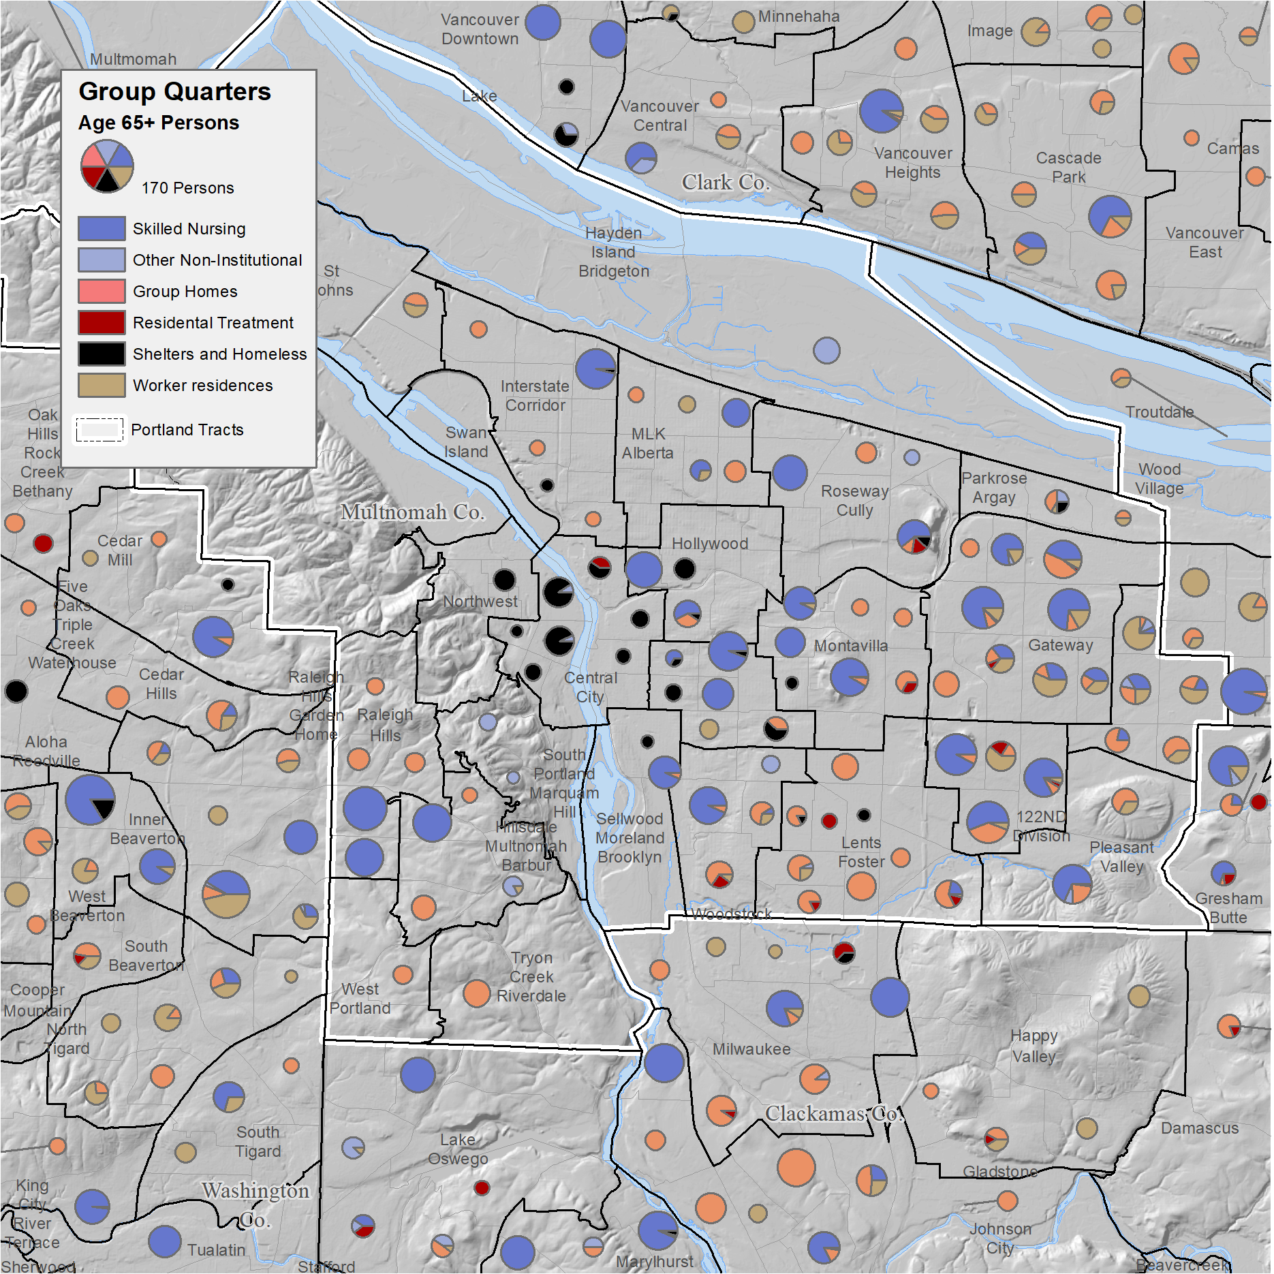
Mapping of Group Quarters Types
7
This map shows the number of group quarters in each supertract (learn more about supertracts). The area of the pie represents the number of persons in group quarters.
Throughout the Portland Metropolitan area nursing homes and group homes are the most common type of group quarters residence.
On Portland’s east side and in suburban areas worker residences also are common (think older priests and nuns).
The Central City area has the largest number of older homeless and older persons in shelters.
When we zoom in to the census tract level, we see some additional patterns.
Some tracts have mainly nursing homes, such as those in Montavilla.
The tracts in Lents-Foster have mainly group homes.
The tracts on Portland’s east side, abutting Gresham, are more mixed.
The tracts in the Central City supertract mainly have older persons who are homeless or in shelters.
O
Source: 2010 Decennial Census, SF1, table PCT-38.

Slide 8
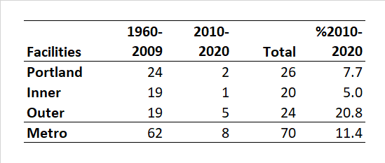
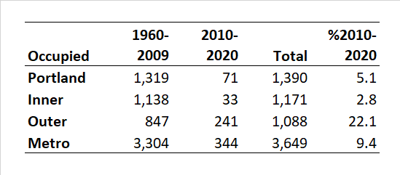
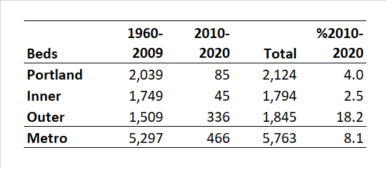
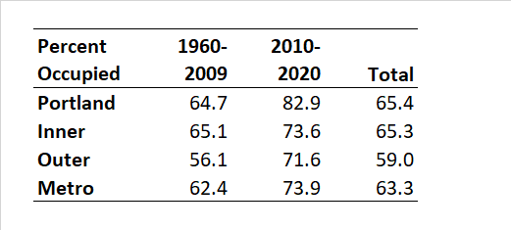
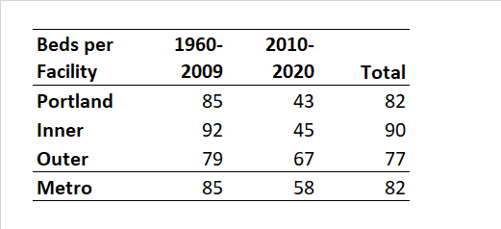
Skilled Nursing Facilities
Date certified for Medicare
8
Nursing homes, which are skilled nursing facilities, provide a wide range of health and personal care services. Their services focus on medical care more than most assisted living facilities. These services typically include nursing care, 24-hour supervision, three meals a day, and assistance with everyday activities. Rehabilitation services – e.g., physical, occupational, and speech therapy – are also available.
Some people stay at a nursing home for a short time after being in the hospital. After they recover, they go home. However, most nursing home residents live there permanently because they have ongoing physical or cognitive conditions that require consistent care and supervision.
As of November 2010, there were 70 skilled nursing homes in the Portland Metropolitan Area, 26 of which were in the city of Portland.
Portland has had the largest number of occupied skilled nursing beds since 1960; however, the outer suburbs witnessed the most growth in total beds since 2010, a 18.2% growth from 2010-2020.
Note: The 1,319 occupied beds shown here at the end of 2009 (certified for Medicare), is less than the 2,160 persons of all ages, counted in the 2010 Census who were living in skilled nursing facilities, of which 1,610 were age 65+ (those data are not displayed).
In the city of Portland, the average size of a skilled nursing facility was 82 beds, the same as the average for the metropolitan area.
The city of Portland’s occupancy rate of 65.4%, higher than the inner and outer suburbs.
There has been little change in the number of skilled nursing facilities or count of beds in Portland in the last decade.
Table of Contents
Beginning
Types of facilities
Group quarters
Skilled nursing
Residential care
Adult foster homes
Assisted living
Recap of care facilities
Retirement facilities
Maps and tables
Descriptions of skilled nursing facilities from National Institute on Aging, U.S. Department of Health and Human services. https://www.nia.nih.gov/ health/residential-facilities-assisted-living-and-nursing-homes.
Data from the Centers for Medicare and Medicaid Services.
O

Slide 9
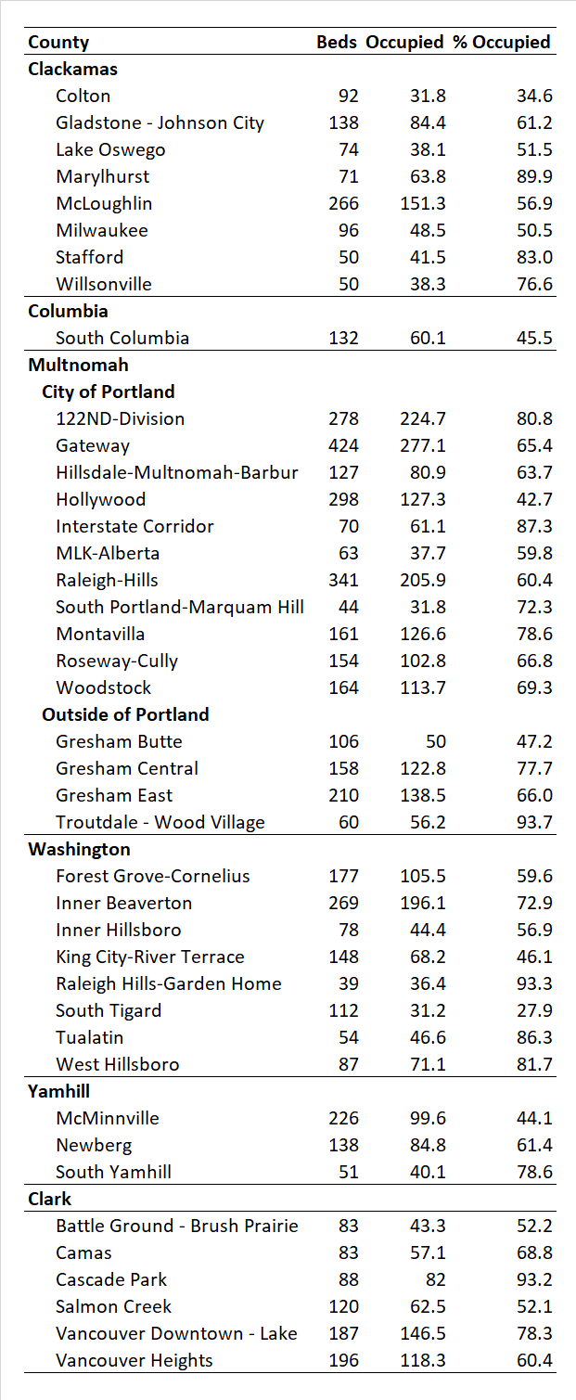
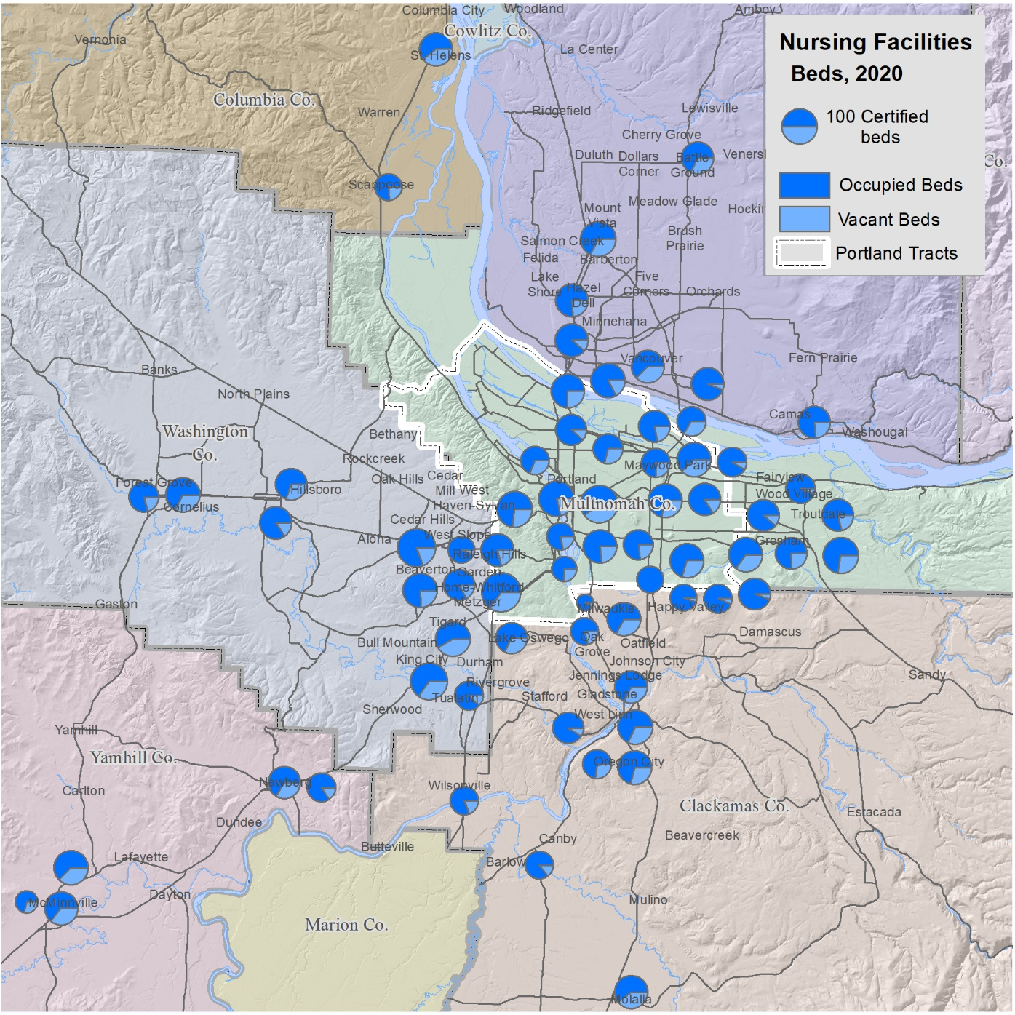
Location of Skilled Nursing Facilities
9
Skilled nursing facilities are widely distributed across the Portland Metropolitan Area, but the largest concentration is in the city of Portland.
The area of the pie chart is equal to the number of licensed beds and the darker shade shows the average number utilized.
The Portland supertracts contain the largest numbers of beds with 424 in the Gateway District and 341 in Raleigh Hills.
Source: 2019 Licensing data from the Oregon Department of Human Services
O

Slide 10
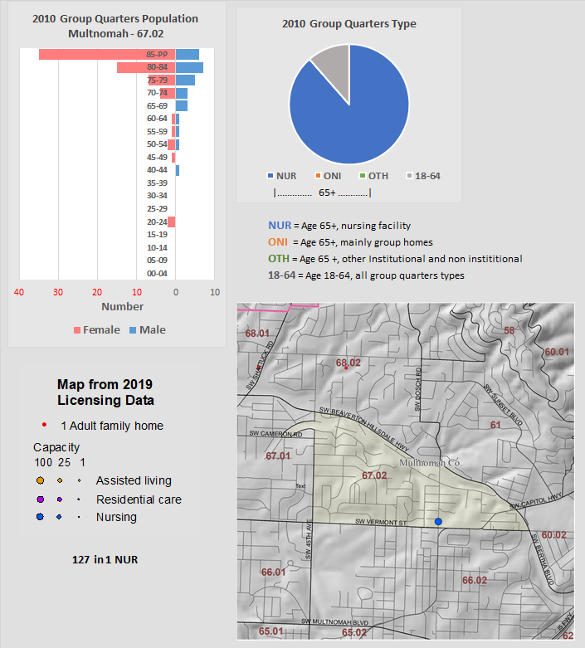
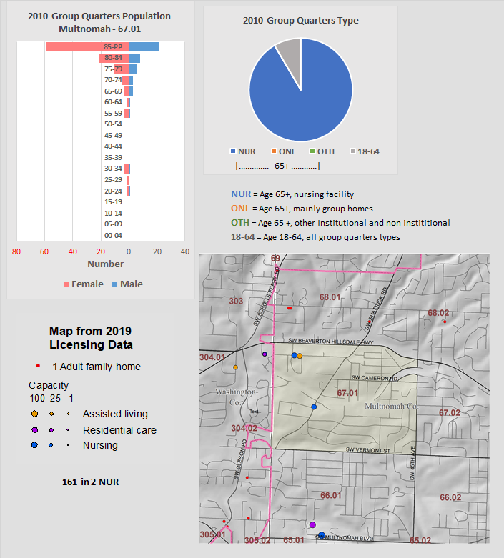
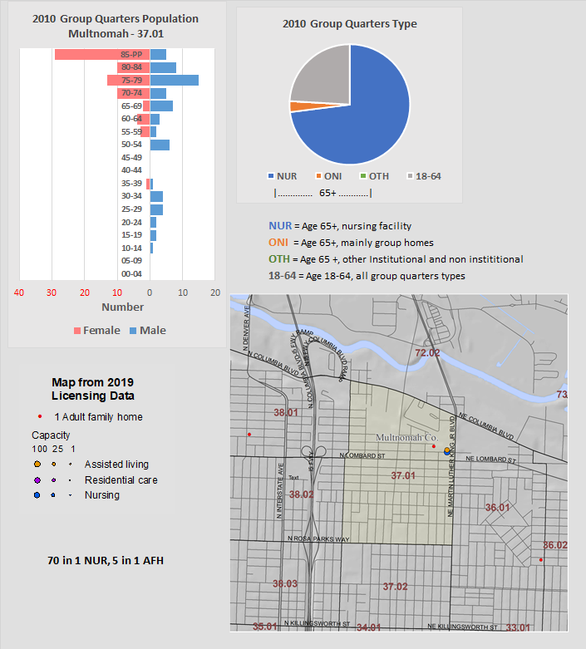
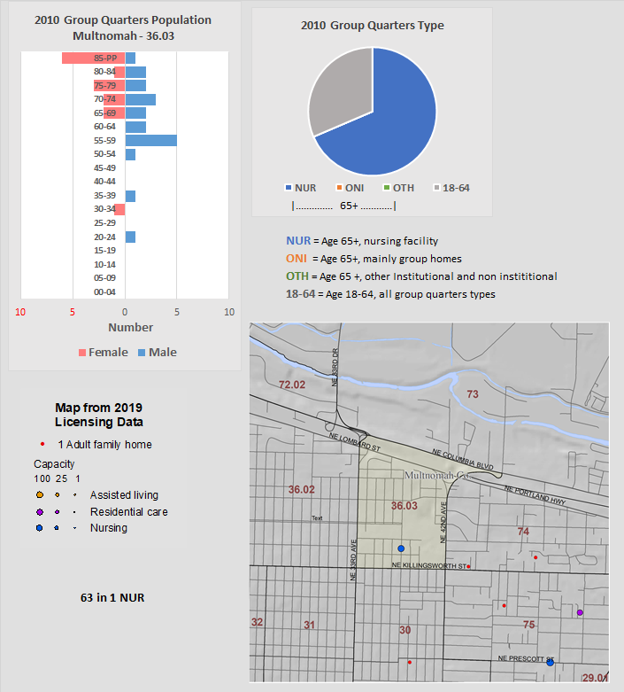
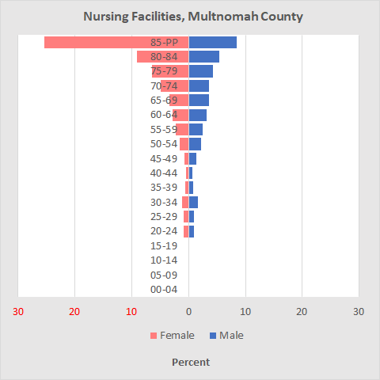
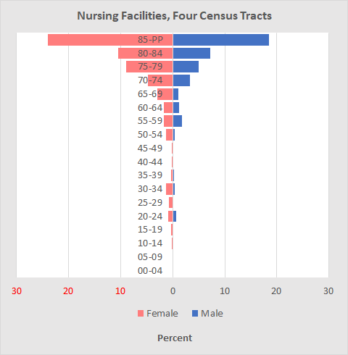
Age / Sex for Selected Nursing Facilities – Licensing Data
10
Four census tracts were selected in which nearly all of the care facilities were nursing facilities (blue dots), based on data from the 2010 Decennial Census (tracts: 67.02, 67.01, 37.01, 36.03). Assisted living facilities are shown on in two of the tracts as orange dots (tracts: 67.01 & 37.01), but are not included in the population.
The first three tracts look much like the previously viewed pyramid for nursing facilities in Multnomah County, but the last (tract 36.03), departs from this ideal, showing more males and younger persons but suggesting unique characteristics of individual nursing facilities.
Here are the population pyramids for nursing facilities from the group quarters summary for Multnomah County and for the four census tracts.
Both population pyramids have 60% females and data from the county for the tracts showed 25% under age 65. Group quarters data for the county may include some residential care facilities with more older persons.
Sources: Facilities in 2019 from Oregon Department of Human Services, age data from the Decennial Census, ST1, table P43
O

Slide 11
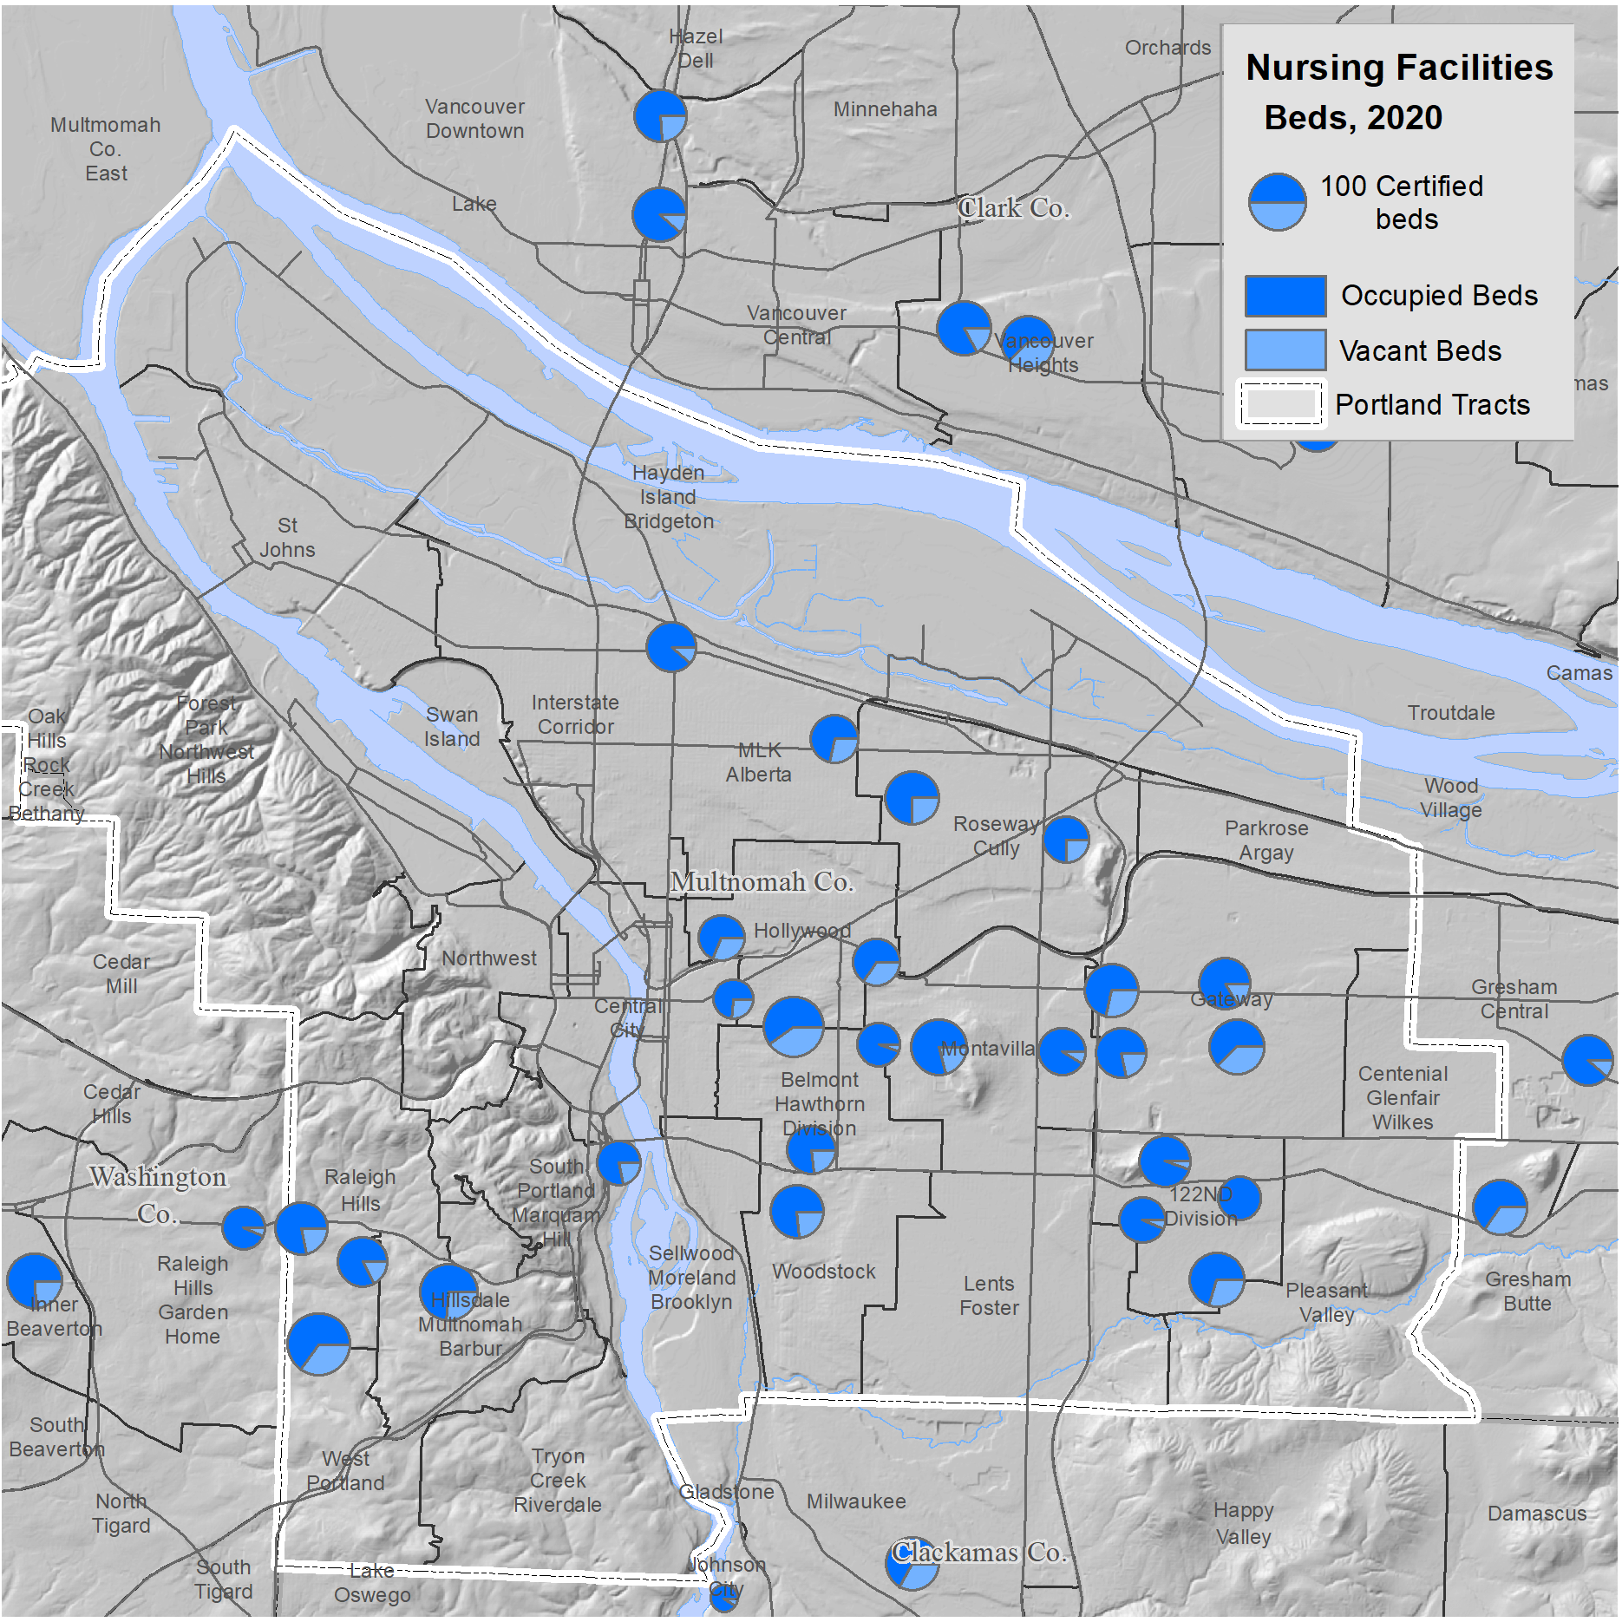
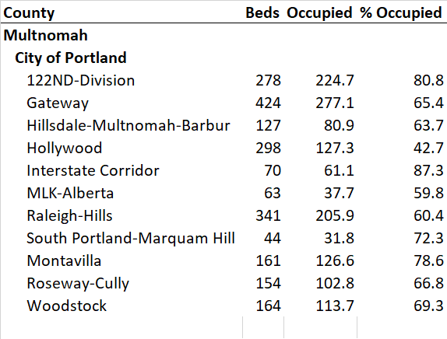
Zoomed in to Portland
11
A closer look at the location of skilled nursing facilities in Portland shows that they are widely distributed.
However, a number of Portland supertracts, for example St Johns, Lents-Foster, Glenfair-Wilkes, and Pleasant Valley, have none.
O
Source: Facilities in 2019 from Oregon Department of Human Services

Slide 12
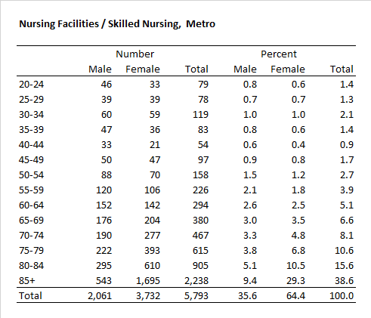
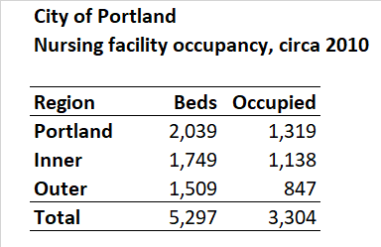
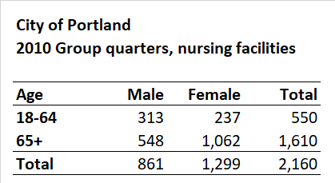
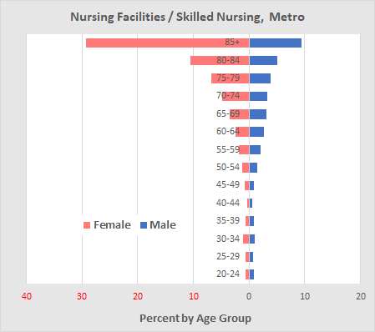
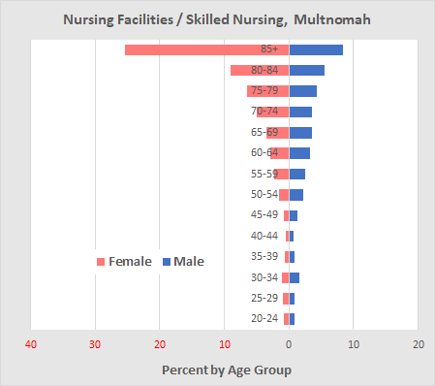
Age of Nursing Facility Residents – More Details
12
For the Portland Metropolitan Area in 2010 69% of the males and 85% of the females in nursing homes were age 65+, averaging 80% for both sexes.
The figures for Multnomah County are similar.
These age data are only available down to the county level, so we do not have separate figures for the city of Portland.
Licensing data indicates that there were about 2,039 beds in nursing facilities that became Medicaid approved before 2011; we estimated that 1,319 were occupied.
The number from the 2010 Census was 2,160 persons, much higher than the estimated occupancy from licensing data.
In the following pages we will attempt to estimate the age structure of nursing homes using Census group quarters age data and facility type from licensing data.
Sources: Decennial Census, SF1, table P43 and 2019 licensing data from Oregon Department of Human Services.
O
Notes:
Portland licensing data from from Nursing_Super_Reg.xls

Slide 13
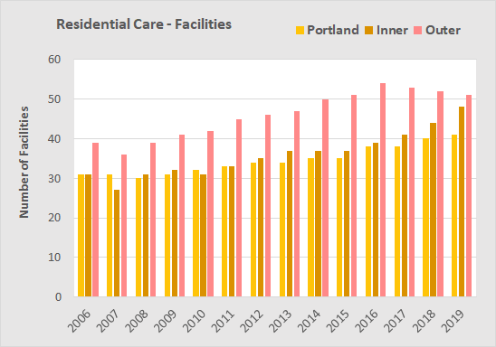
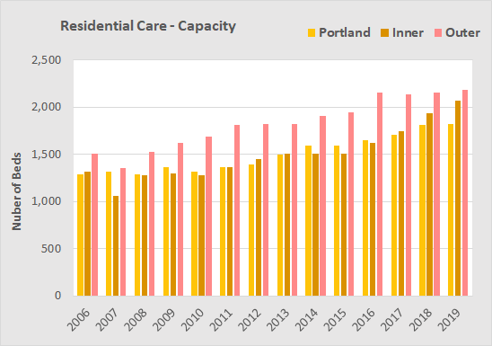
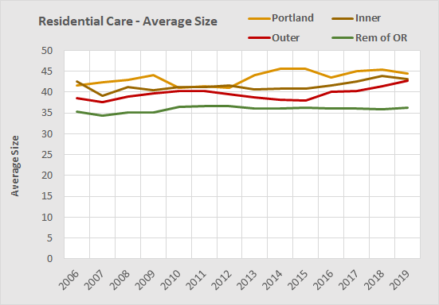
Residential Care Facilities
13
Assisted living and residential care facilities provide housing and supportive services to six or more people. Residential care and assisted living facilities’ services are similar, but licensed separately by the Department of Human Services (e.g., both provide meals, laundry, housekeeping, social activities, medication administration and personal care assistance).
Residential care facilities offer shared and private rooms. These facilities are not required to provide private bathrooms or kitchenettes. By comparison assisted living facilities must have private apartments, ranging from a studio to one or two bedrooms.
Residential care facilities must have a registered nurse on staff or contract. However, the nurse does not have to be there 24 hours a day.
In the city of Portland there were 41 residential care facilities in 2019, an increase from 32 from 2009.
The capacity of Portland facilities in 2019 was 1,822 beds up from 1,366 in 2009.
The growth in residential care facilities in Portland grew by 33%, about the same rate as the state as a whole.
Table of Contents
Beginning
Types of facilities
Group quarters
Skilled nursing
Residential care
Adult foster homes
Assisted living
Recap of care facilities
Retirement facilities
Maps and tables
Outer suburbs, as shown here, exclude those from Clark and Skamania Counties in Washington state.
The average size of a residential care facility in Portland was 44.4 beds in 2010, up slightly from 44.1 in 2009.
The growth of capacity in residential care facilities in Portland was slower than in its inner and outer suburbs due both to slower growth in number of facilities and in average size.
Descriptions of residential care facilities from the Oregon Aging & Disability Resource Connection, https://adrcoforegon.org /consite/explore-assisted-living-and-residential-care.php.
Facilities licensing data provided to Portland State University by the Oregon Department of Human Services.
O

Slide 14
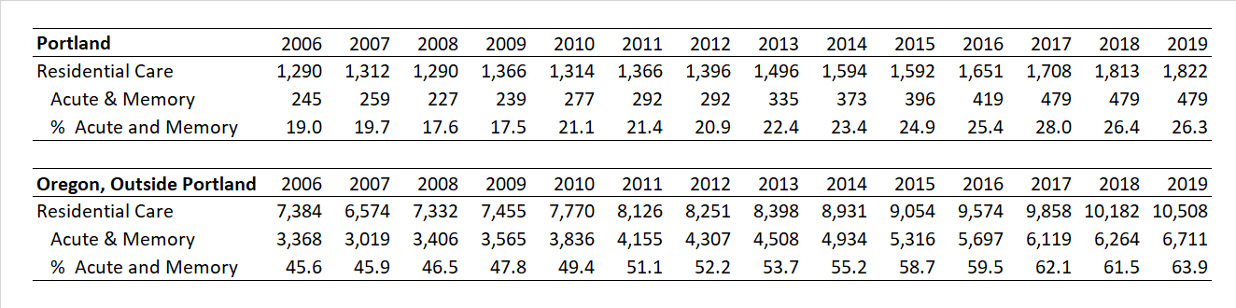
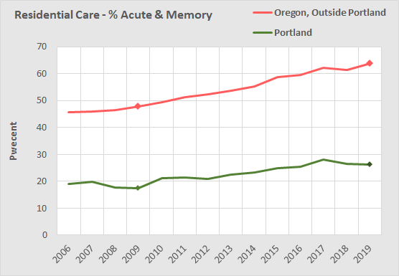
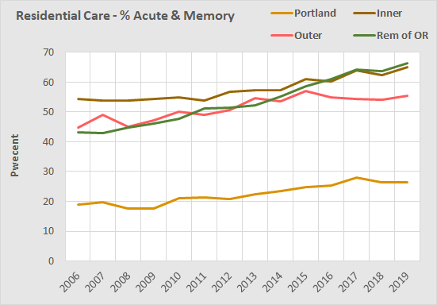
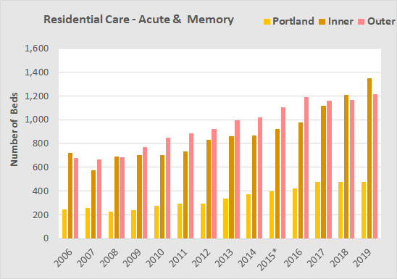
Residential Care Services
14
For the state of Oregon, the most rapid growth in residential care has been in the capacity for providing acute and memory care.
In Oregon (outside the Portland Metropolitan Area), facilities licensed for acute and memory care grew more rapidly than in Portland.
Note: Portland started with a smaller base for growth compared to its inner and outer suburbs.
In recent years, the majority of residential care facilities are licensed for both acute and memory care and the proportion offering memory care has grown.
Source: 2019 licensing data from the Oregon Department of Human Services
O

Slide 15
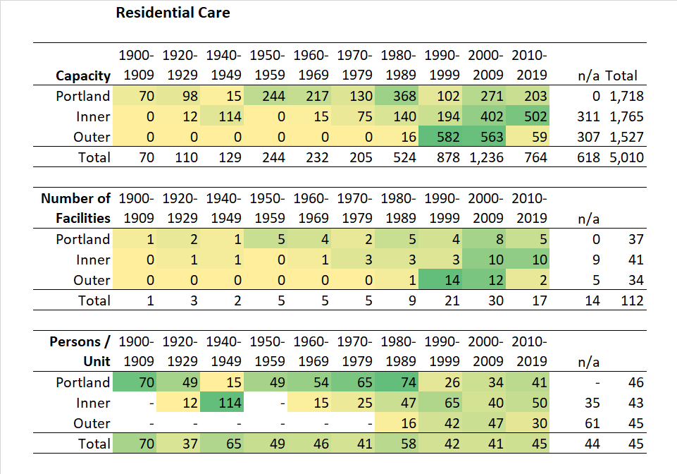
Year Built
15
Most of the residential care facilities also are listed in the Metro Multifamily Housing Database, which provides the date the facility was constructed for most facilities. The n/a column indicates no date provided.
Construction began earlier in the City than in the suburbs. In the City 33% of the residential care capacity was built after 1990 whereas in the outer suburbs 78% of the capacity was built after 1990.
Over time the average capacity of a residential care facility has averaged 45 persons per facility and has not varied much between the City and suburbs.
The average capacity of residential care facilities at 45-per-facility is smaller than that for assisted living facilities at 78-per-facility.
Sources: 2019 licensing data from the Oregon Department of Human Services and 2018 Metro Multifamily Housing Database
O

Slide 16
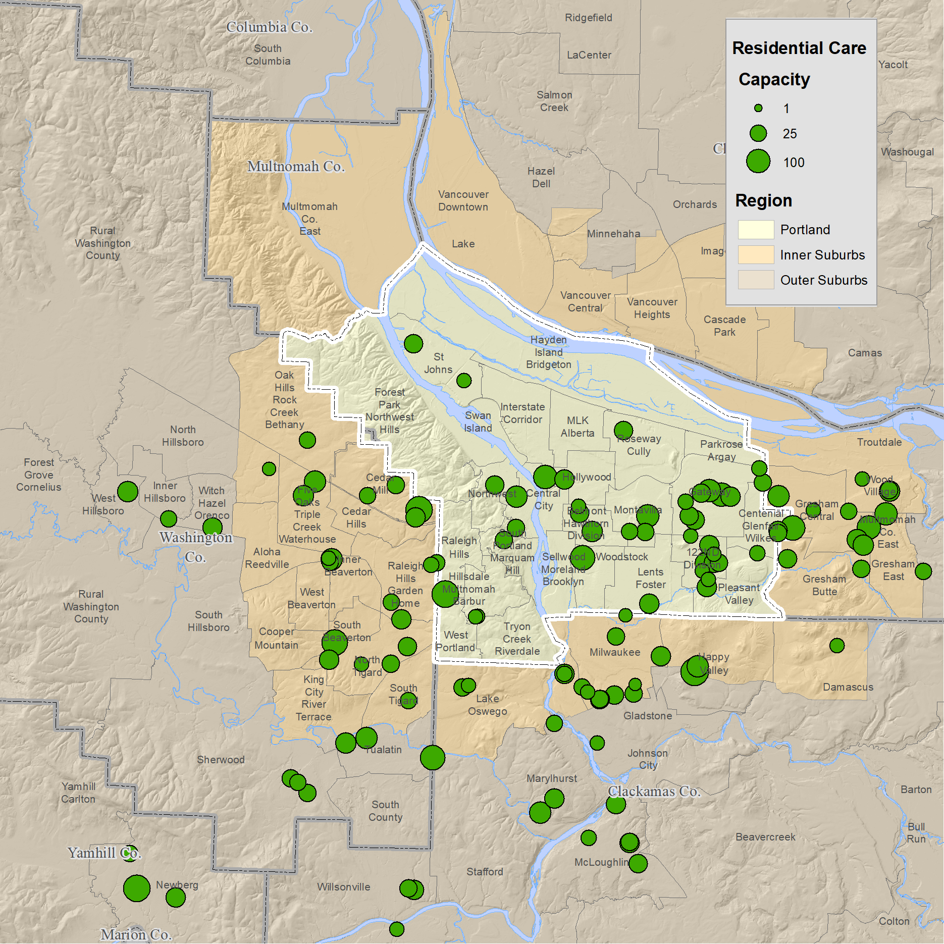
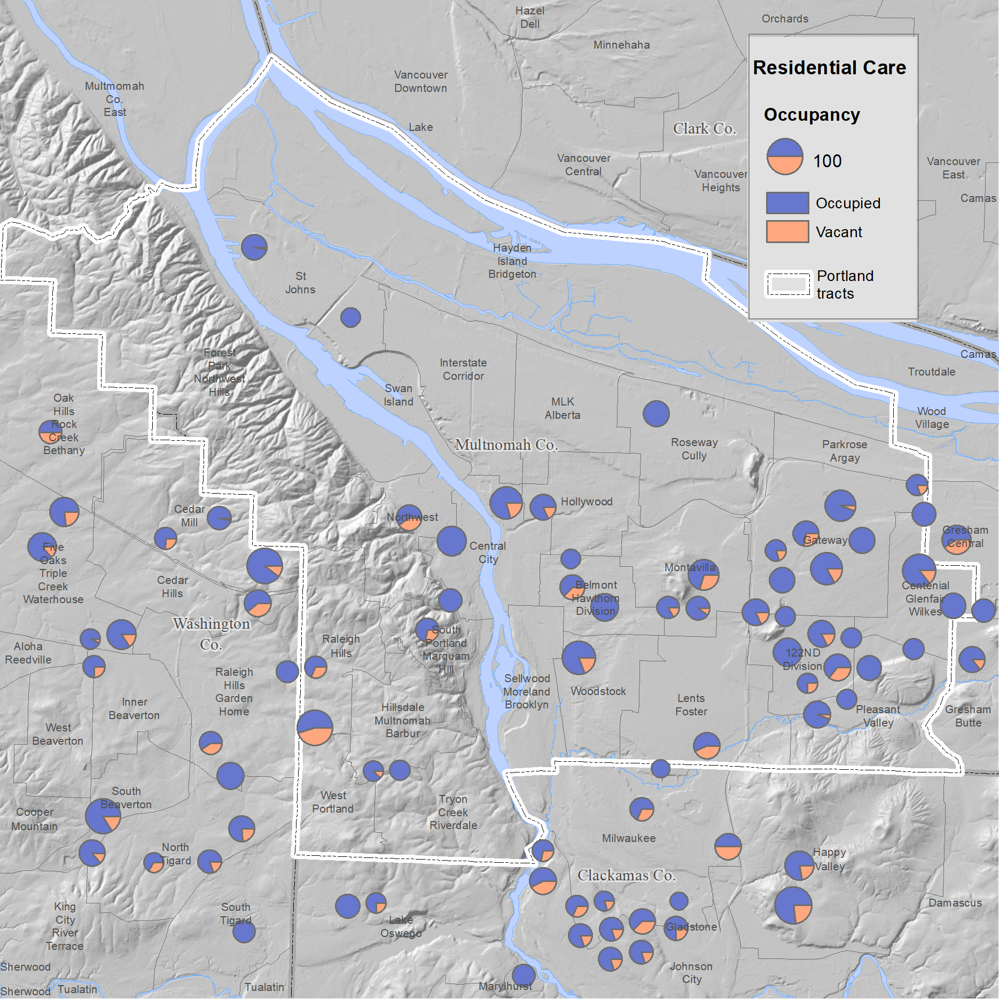
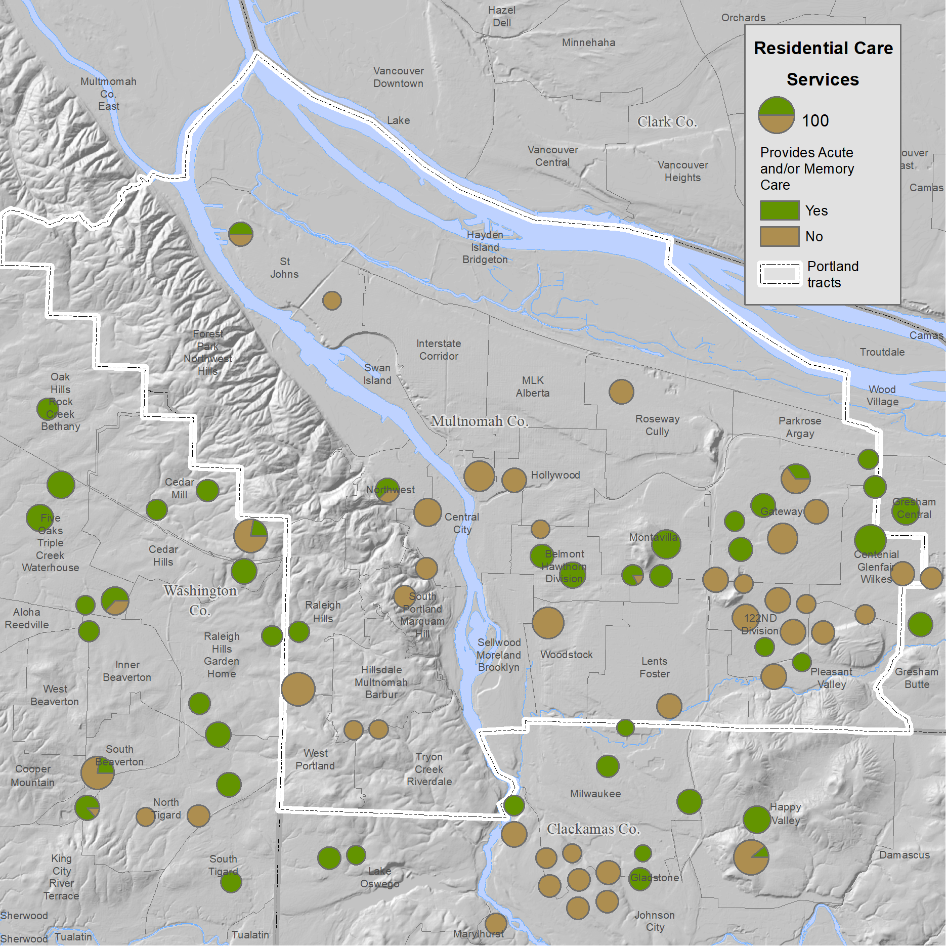
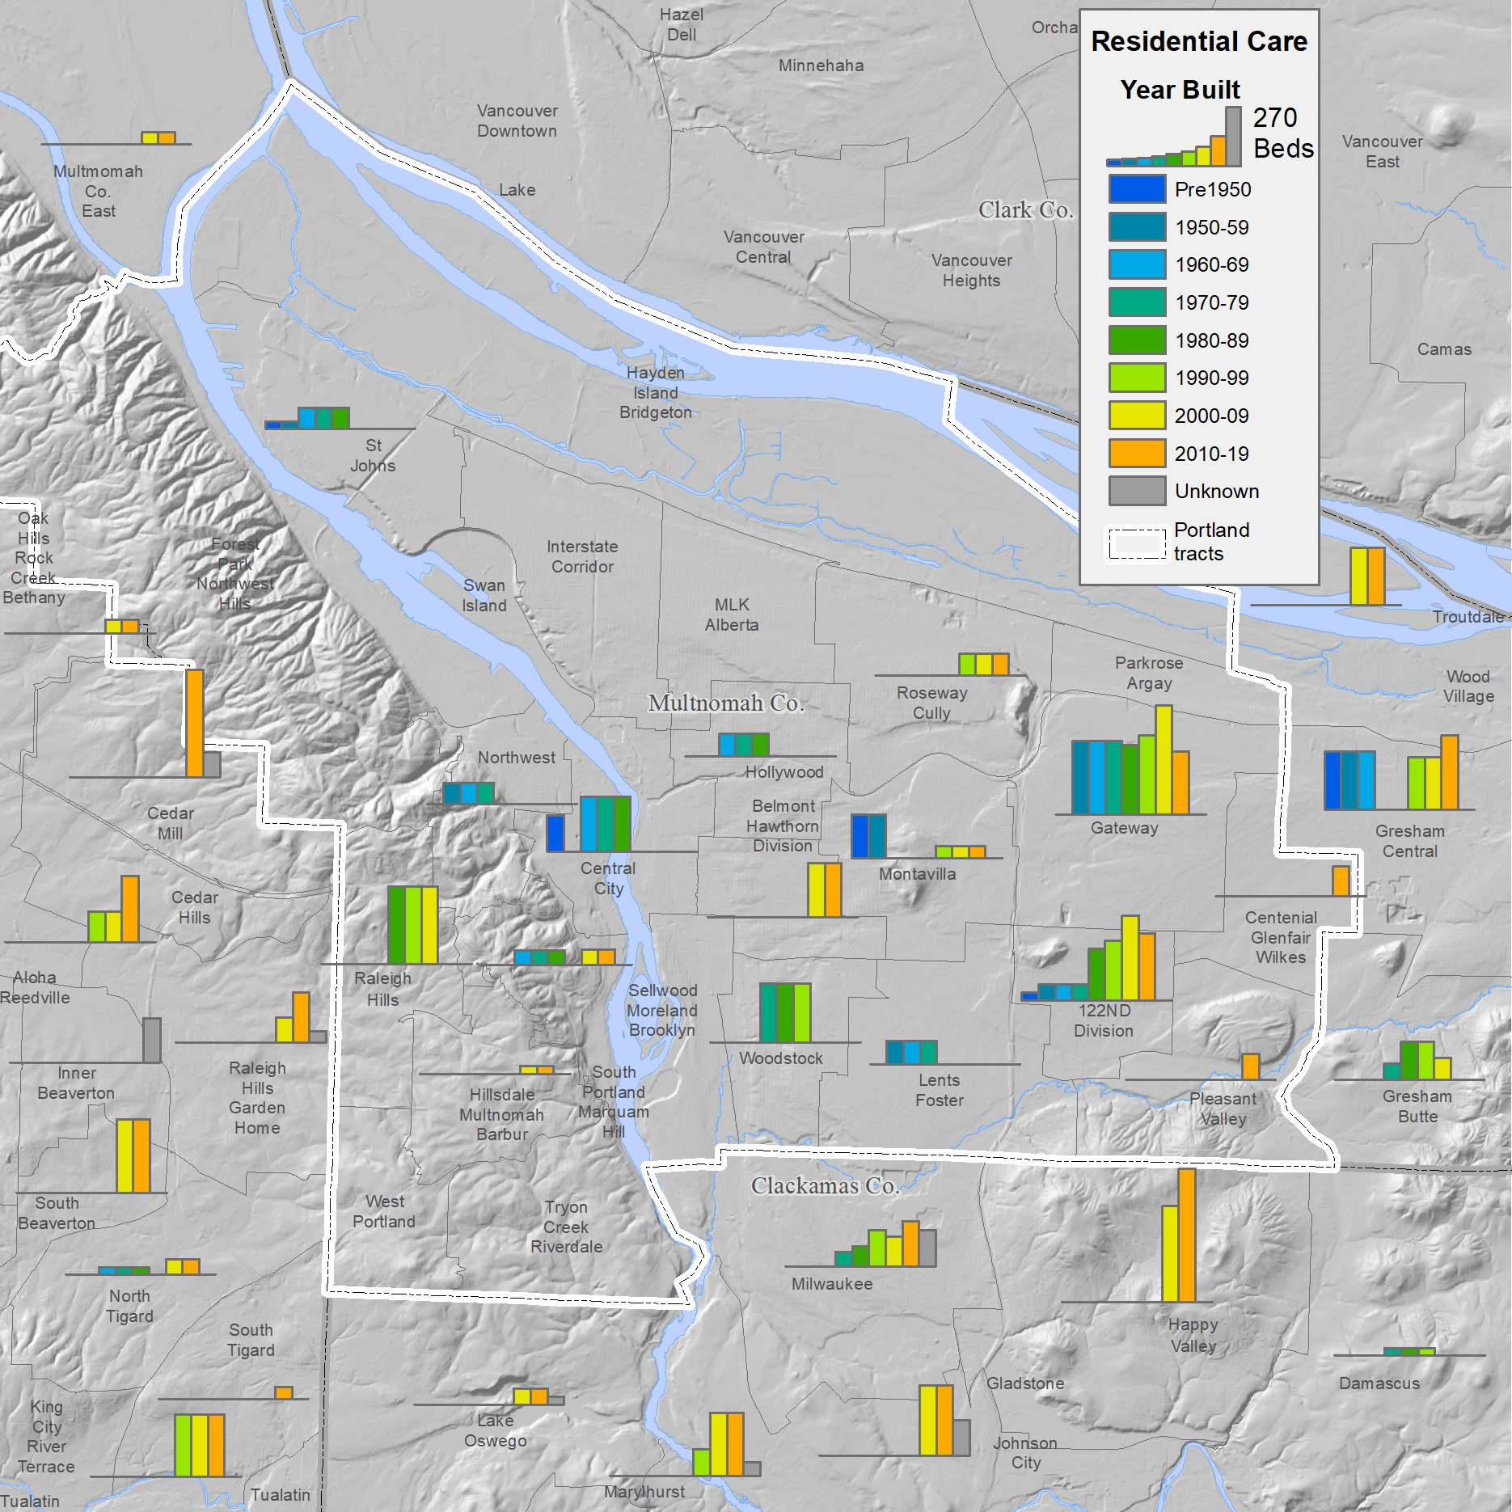
Mapping of Residential Care Facilities
16
Residential care facilities are widely distributed throughout the Portland Metropolitan Area; however, there are concentrations in the Gateway and 122nd and Division neighborhoods.
The level of occupancy varies considerably from one facility to the next and there is no discernable regional pattern.
Many residential care facilities provide acute or memory care, but many in Gateway and most in the 122 and Division neighborhoods do not.
Some Portland residential care facilities were built before 1990 (e.g., central city, Hollywood), but the latest surge of growth was in the 122nd and Division neighborhood.
Most of the facilities outside Portland, in Washington and Clackamas Counties, were built after 1990.
Sources: 2019 licensing data from the Oregon Department of Human Services and 2018 Metro Multifamily Housing Database
O

Slide 17
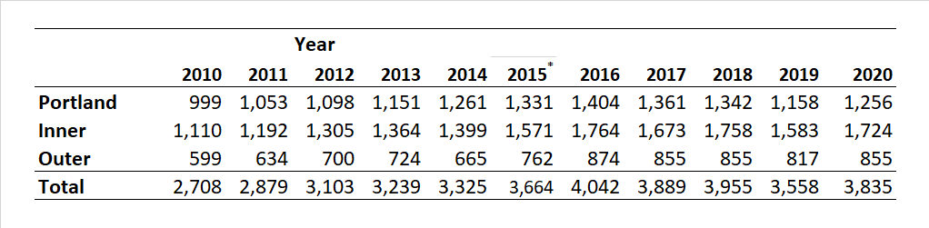
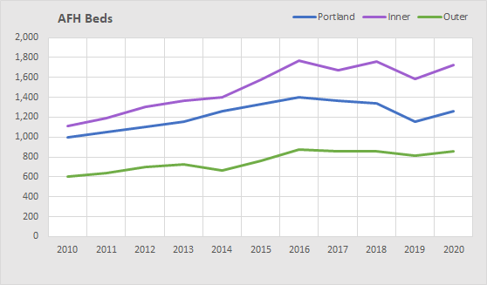
Adult Foster Homes
17
When older people or adults with physical disabilities are no longer able to care for themselves in their own homes, adult foster care may be an option. Adult foster homes are single-family residences that offer 24-hour care in a home-like setting.
Adult foster homes are licensed by the State of Oregon and can house up to five residents (most house the maximum of five).
The number of adult foster homes in the Portland Metropolitan Area (Oregon only, not including Washington state counties) grew from 2,708 in 2010, to 4,042 in 2016, then declined to 3,558 in 2019 due to stricter state requirements.
The largest number of beds were in Portland’s inner suburbs followed by the City of Portland.
Table of Contents
Beginning
Types of facilities
Group quarters
Skilled nursing
Residential care
Adult foster homes
Assisted living
Recap of care facilities
Retirement facilities
Maps and tables
*Values for 2015 were not available and are interpolated
*
O
Source: 2019 licensing data from the Oregon Department of Human Services

Slide 18
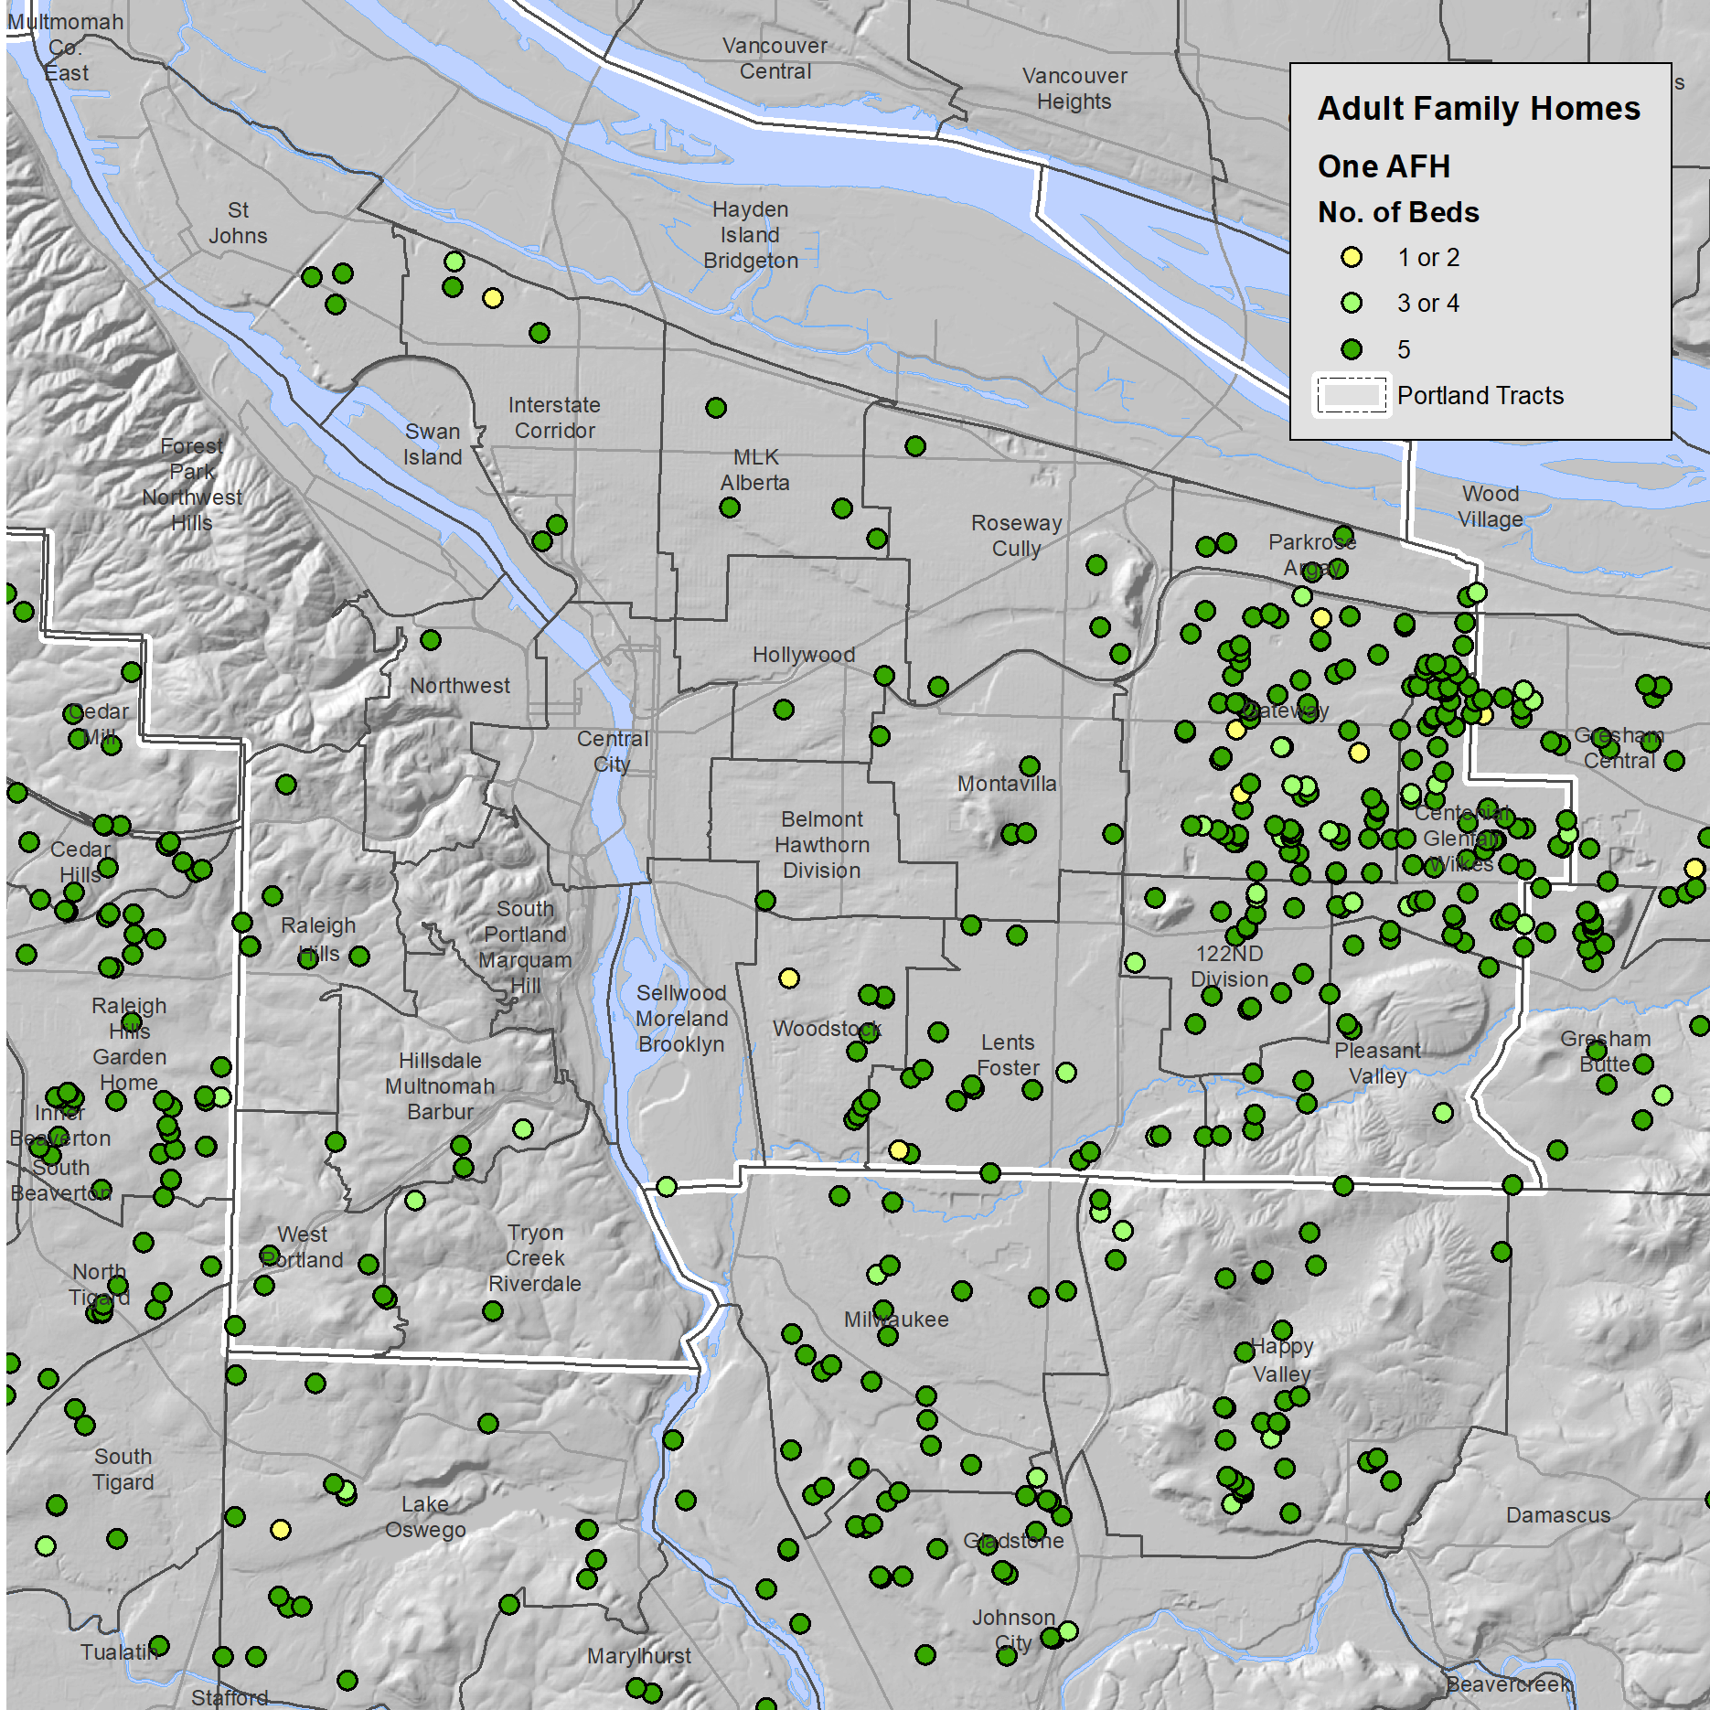
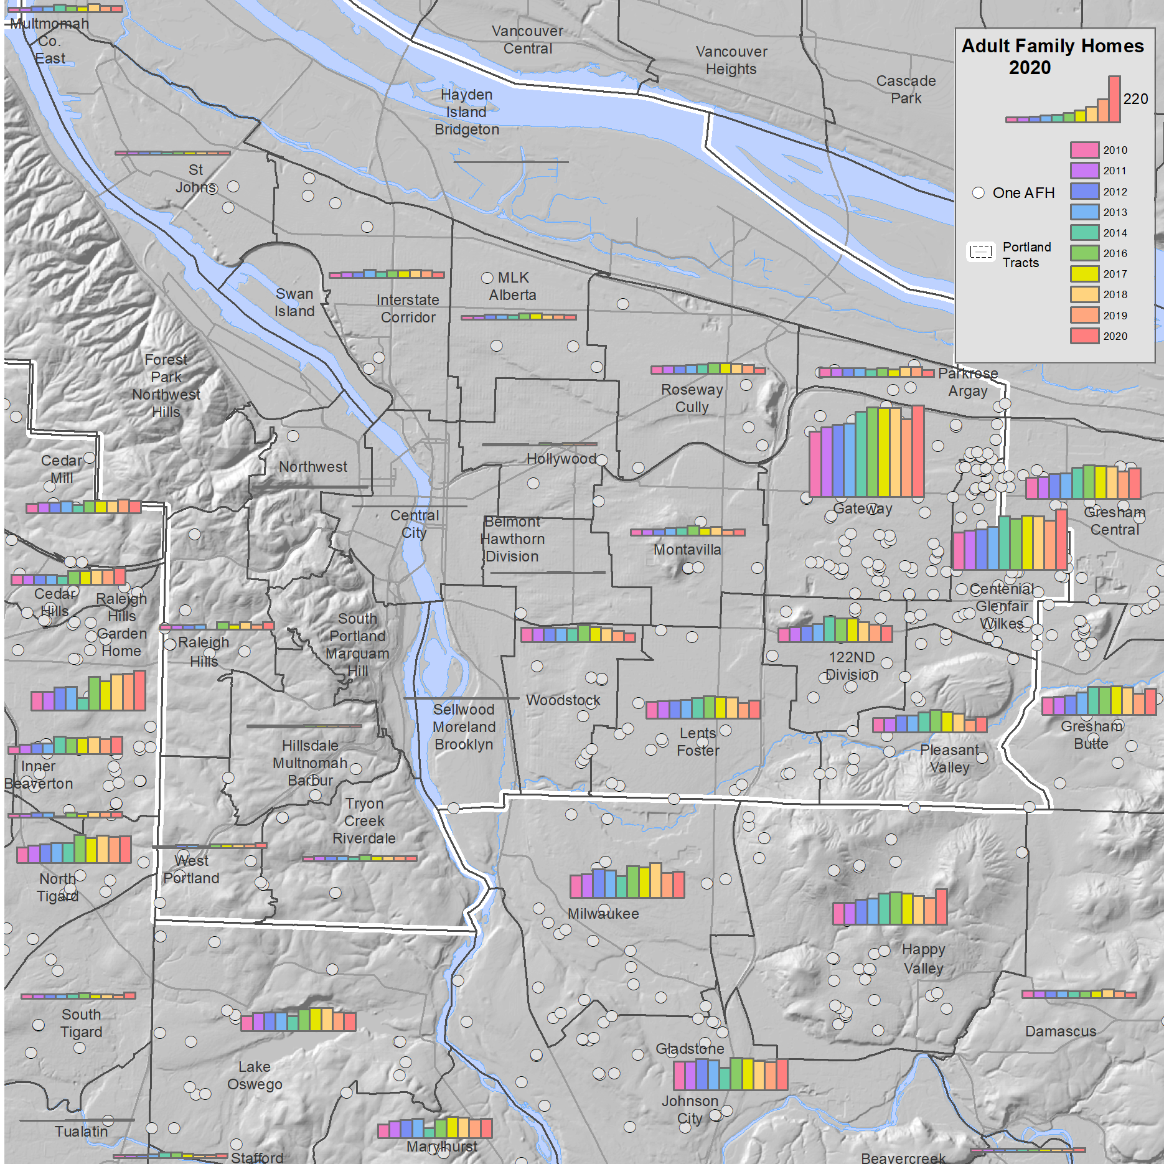
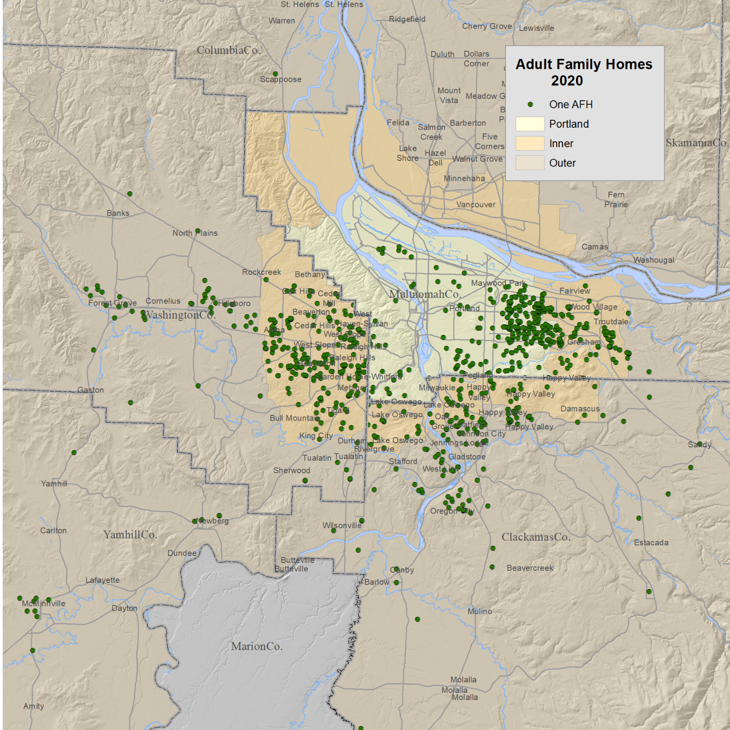
Maps of Adult
Family Homes
18
Adult family homes are found in all parts of the Metropolitan Area but there is a strong concentration on Portland’s east side and in nearby Gresham.
Zoomed in to the City we see the east side concentration and also the paucity of this type of residence in the north and central eastside of Portland, and west of the Willamette River. The majority house the limit of five persons (dark green dots).
A bar chart shows the changing numbers over time with the location of 2020 facilities in gray dots.
The Gateway neighborhood has the largest number of this type of housing and the numbers have grown over the decade.
The post 2016 decline can be seen in several of the charts, such as in Woodstock and the 122nd and Division neighborhoods.
Sources: 2019 licensing data from the Oregon Department of Human Services and 2018 Metro Multifamily Housing Database
O

Slide 19
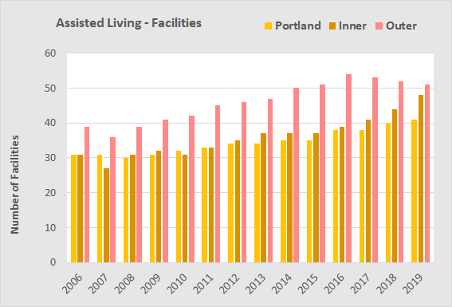
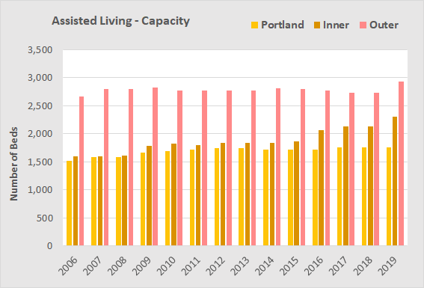

Assisted Living Facilities
19
Assisted Living Facility means a building, complex, or distinct part thereof, consisting of fully, self-contained, individual living units where six or more seniors and/or adult individuals with disabilities may reside in homelike surroundings. Assisted living units must have:
  Private units or apartments with a minimum of 220 sq. ft. of living area.
  Kitchenette, with sink, refrigerator and cooking appliance.
  A wheelchair-accessible bathroom with shower in each unit.
Residential care facilities are similar, but typically have:
  Shared or private rooms.
  Individual or common bathrooms.
The city of Portland has seen slow but steady increases in the number of assisted living facilities since 2008.
For this time period, the number of assisted living facilities in Portland grew by 5%, as compared to 30% in its inner suburbs.
The capacity of Portland facilities in 2019 was 1,756 beds, up from 1,665 in 2009.
The average size of an assisted living facility in Portland was just under 80 persons, larger than that in residential care facilities.
Table of Contents
Beginning
Types of facilities
Group quarters
Skilled nursing
Residential care
Adult foster homes
Assisted living
Recap of care facilities
Retirement facilities
Maps and tables
Source: 2019 licensing data from the Oregon Department of Human Services.
O

Slide 20

Year Built
20
Most of the assisted living facilities also are listed in the Metro Multifamily Housing Database, which provides the date the facility was constructed for most facilities. The n/a column indicates no date provided.
Assisted living facilities often are co-located with independent living facilities and recently with memory care facilities.
Most of the capacity in assisted living in the Portland Metro area was built after about 1980. Of the 22 facilities in Portland, four were built before 1980.
Over time the average capacity of an assisted living unit has ranged from 45 to 180 units.
The average capacity of assisted living facilities at 78-per-facility is larger than that of residential care facilities at 45-per-facility.
Sources: 2019 licensing data from the Oregon Department of Human Services and 2018 Metro Multifamily Housing Database
O

Slide 21



Mapping of Assisted Living Facilities
21
Most assisted living facilities were built after 1990 with exceptions in the Belmont-Hawthorn-Division, Gateway, Raleigh Hills, and St. Johns neighborhoods.
The neighborhoods with the largest number of facilities added after 2010 have mostly been outside of the City such as in the Cedar Mill, Gresham Central, Milwaukee, and Marylhurst neighborhoods.
The greatest growth in Portland’s assisted living was in the Gateway neighborhood after 1990.
This map shows assisted living vacancies for the city and some of the inner suburbs in 2019.
Growth in the region’s assisted living has occurred across the city and inner and outer suburbs, as seen in this map from 2019 data.
Sources: 2019 licensing data from the Oregon Department of Human Services and 2018 Metro Multifamily Housing Database
O

Slide 22



Recap of Care Facilities
22
Adding up the number of persons in licensed care facilities suggest that in 2019 in the city of Portland there were about 21,889 persons in these care facilities. Not all, but most, of these persons were age 65+.
This population was housed in 1,103 licensed facilities, of which 809 were adult family homes with residency capped at 5 persons.
We computed the number of persons in licensed facilities as a percent of the 2020 forecasted population.
Overall, the percent of the age 65+ population in Portland living in one of these types of facilities was 8.4%. As a percent of the age 75+ it was 23.8%.
In some of Portland’s neighborhoods the percent of the age 65+ resident population was as high as 19.5% in the Gateway neighborhood, 40.7% as a percent of the age 75+ population.
The bar chart in the upper right shows care facilities as a percent of the 2020 forecasted population by number of neighborhoods (using Hamilton-Perry forecast).
Table of Contents
Beginning
Types of facilities
Group quarters
Skilled nursing
Residential care
Adult foster homes
Assisted living
Recap of care facilities
Retirement facilities
Maps and tables
% of 2020 Population
O

Slide 23




Neighborhood View
23
The Gateway neighborhood had the largest licensed capacity for all four types of facilities.
A regional view illustrates the concentration of facilities on Portland’s east side, extending into Gresham.
Zoomed into the City this concentration is confirmed but also noticeable is the relative lack of facilities of all types in north Portland neighborhoods and the Lents-Foster neighborhood.
When we aggregate the numbers by neighborhood, we see some differences. The bold black numbers are the total number of facilities.
The large cluster in the Gateway neighborhood is about equally divided among the four types.
Other neighborhoods have a predominance of one facility type, such as residential care in the Central City or adult family homes in the Parkrose-Argay neighborhood.
O

Slide 24





A Walk-through of Retirement Facilities
24
We select units built through 2010 from the 2018 Metro Multifamily Housing Database (apartments, condominiums, and retirement facilities).
Although our principal interest is in retirement facilities, we are also interested in understanding the many late-in-life moves of older adults to apartments and condominiums.
This map shows retirement facilities.
Here we add proportional circles shows the size of the units and the areas where the map symbols overlap.
Some are affordable housing and offer reduced rents to persons age 62+ with lower incomes and to persons with disabilities.
We have estimated the number of independent living units by subtracting the number of units in licensed facilities at the same location; this map shows the combined proportions of licensed and independent living facilities.
Sources: 2019 licensing data from the Oregon Department of Human Services and 2018 Metro Multifamily Housing Database
O

Slide 25
Retirement Housing
251
Table of Contents
Beginning
Types of facilities
Group quarters
Skilled nursing
Residential care
Adult foster homes
Assisted living
Recap of care facilities
Retirement facilities
Maps and tables
The following pages contain information on assisted living, independent living, and market rate housing with large numbers of persons age 65+.
Assisted living facilities are licensed by the State of Oregon so we can locate them and know the number of licensed units.
Independent living facilities are not licensed and are more difficult to identify. Also, many facilities include assisted living, memory care, and independent living units.
We also provide examples of census blocks with multi-family and condominium housing that house large numbers of older persons.
O

Slide 26





Selection of Multifamily Units with Many Older Persons
26
In Metro’s 2018 Multifamily Housing database there were 98,958 apartments, condominiums, and retirement developments in the city of Portland.
We selected those on census blocks where 40% or more of the 2010 population was age 55+ (11,766 in the city of Portland).
In the city only 7.5% of the apartment units are included in the selection, but 14.6% of the condominium units, and 53.7% of the retirement units are included.
In apartments, the older population typically is housed along with younger households. Condominiums and retirement housing developments tend to have fewer younger households.
Sources: 2018 Metro Multifamily Housing Database and Decennial Census, SF1, Table P12
O

Slide 27
Examples of Census Blocks with Many Older Persons
27
Table of Contents
Beginning
Types of facilities
Group quarters
Skilled nursing
Residential care
Adult foster homes
Assisted living
Recap of care facilities
Retirement facilities
Maps and tables
Some parts of the City contain housing that is largely populated by older persons, such as at the one of which Terwilliger Plaza is located.
The information on the following pages is largely anecdotal but provides snapshots of the social demography of parts of Portland that have concentrations of older people.
O

Slide 28


Maps and Tables
28
This page shows an example of the mapping and charting of multifamily housing developments, which are only mapped and analyzed where 40% or more the population is age 55+ (Dahlke Manor is used to illustrate).
On the map the proportion of the 2010 census population is shown by color shading. The block on which Dahlke Manor is located has from 40-59% age 55+.
The demographic data are from the 2010 census:
  Age/Sex
  Race/Hispanic
  Own/Rent
  Household type
  Group quarters (none on this block)
The demographic data are for the census block, not the individual facility. Thus, if there is more than one multifamily development or single-family homes, they are included in the block total.
Data from the 2019 Metro Multifamily Housing database indicate there are 115 units in Dahlke Manor and that it was built in 1971. The 2018 Metro Affordable Housing database indicates that it is affordable housing, and the sponsor is Home Forward.
The data on the apartment developments and other housing are from Metro’s Multifamily Housing and Affordable Housing databases and the Regional Land Information System (RLIS).
O

Slide 29





Hollywood
29
Sixteen Twenty Broadway - Condominiums
The Hollywood District is an area which has a number of multifamily housing developments that have attracted an older population.
Dahlke Manor is a public housing development managed by Home Forward. The residents are age 55+ or have a disability. Nearly all of the households are one person.
Grace Peck Terrace is similar to Dahlke Manor but has more households that are younger.
A condominium development, unnamed in Metro’s database, is a market rate development with a mix of younger and older households. The predominate household type is one-person female households.
Sixteen Twenty Broadway is a condominium similar to the previous unnamed development but has more husband-and-wife households.
The Fontaine shares a block with the Lloyd Manor. Both are condominiums and have a young/old mix.
The developments on this page illustrate the younger age mix in the affordable housing developments and the young/old age mix in market rate apartments and condominiums.
The two senior housing developments in the Hollywood neighborhood, Holiday Park Plaza and Weidler Commons, will be discussed separately.
O

Slide 30



Terwilliger Plaza
30
Terwilliger Plaza is one of the largest retirement facilities in Portland.
Metro classifies the older part of the development as a retirement facility and the newer part as an apartment.
There are a number of other multifamily developments on the block as well as several single-family dwelling units.
In spite of the mixed nature of the developments on the block it appears that households begin to move into this facility in their 60’s.
The age 65+ households on the block include some husband-and-wife families but more single person households, predominately female.
O

Slide 31






Summerplace
31
The far northeast corner of Portland includes the Summerplace development and nearby condominium developments.
The Winsor Place condominium development includes units in three Windsor Place developments. The block also includes 81 single family structures, all in the red shaded area.
The households on this block range from pre-retirement to age 85+ and have an approximately equal mix of husband and wife and single person households.
The blocks in this area also contain the Argay Downs and Fremont Village Park condominiums. Both blocks include a number of single-family homes which is reflected in the younger population residing.
Here are additional details about the Summerplace and Parkrose Chateau developments.
O

Slide 32








Market Rate
Retirement Housing
32
Four examples:
  Hawthorne Village: Memory care and assisted living
  Sellwood Landing: Assisted living
  St. Andrews: Memory care
  Laurelhurst Village: Assisted living and memory care
Salient characteristics of retirement housing
  The most numerous cohort for all four examples is age 85+.
  There are relatively few residents younger than age 65.
  The scattering of persons younger than age 65 is mainly a result of the embedded single-family units.
  The most frequent household type is female living alone.
  Nearly all residents are white non-Hispanics, with few minorities.
O

Slide 33











Market Rate Apartments
33
It was difficult to select apartment developments in Portland where 40% or more of the population on the block was age 55+ and where all the multifamily housing was apartment type, not condominium or retirement.
Selected examples are:
  Southpark Square: Young/old mix, few minorities
  Hollywood East and Hollywood Towne
  Emerald East and Gateway Towers: Four multifamily developments on block, wide range of ages.
  Harbor Court and the Mews at North Harbor: Young/old mix, many husband-wife households.
Only Southpark Square is a singular development on a census blocks. The other examples confound the census data for two or more developments and a mix of apartment and condominium units.
Most of the apartment developments that passed the 40% age 55+ on the block were affordable housing and a discussion of this housing type follows.
O

Slide 34
34
Table of Contents
Beginning
Types of facilities
Group quarters
Skilled nursing
Residential care
Adult foster homes
Assisted living
Recap of care facilities
Retirement facilities
Maps and tables
The State of Aging in Portland
End of Section 4.3 – Housing
Later in Life Housing Transitions
O
Source: Final_PPT_Links\R7_2_Late_In_Life_Housing_7_akd_drl.pptx

Slide 35

The State of Aging in Portland
Information on Data Sources
and Geographies
Background for study
The Decennial Census
The American Community Survey (ACS)
Supertracts
The American Housing Survey (AHS)
20 Comparison cities
Geography issues
Portland’s Inner and outer suburbs
The ACS Public Use Microsample
Nomenclature for race and ethnicity
Census group quarters
O

Slide 36

About The State of Aging in Portland Report and Navigating the Findings
O
O
O
O
O
O
O
O
O
O
O
O
O
O
O
O
O
O
This presentation includes seven sections developed as part of a study for the City of Portland by the Institute on Aging at Portland State University (PSU), Portland, Ore. The study, titled The State of Aging in Portland, was undertaken to provide guidance to local government and members of the broad and informal “aging network” of service providers, advocates, and others in Portland and the region so that that they can better understand, and address trends related to Portland and the region’s population aging.
Funding source: The City of Portland, Community Health and Access program.
Project staff included:
  Alan DeLaTorre, PhD, Adjunct Faculty, Institute on Aging, PSU; team leader and analytical perspectives; aland@pdx.edu (he now serves as the City of Portland’s Age-friendly City program manager and can be contacted at Alan.DeLaTorre@portlandoregon.gov)
  D. Richard Lycan, PhD, Professor Emeritus and Senior Research Associate, Institute on Aging, PSU; volunteer, analyst of demographic data, mapping, and creator of PowerPoints; lycand@pdx.edu
  Margaret B. Neal, PhD, Professor Emerita of Urban Studies and Planning and former Director of the Institute on Aging (2003-2017); analyzed age-related differences and similarities in responses to the City’s survey on livability, the 2019 Portland Insights Survey; nealm@pdx.edu
  Paula Carder, PhD, Director of the Institute on Aging; project oversight; carderp@pdx.edu.
Additional support was received from faculty at PSU’s Institute on Aging and Population Research Center, and staff from the City of Portland, Metro, Multnomah County, and Home Forward.
We encourage viewers to make full use of our work, including maps and charts, in their research. Content is best viewed using the web-based iSpring modules (see navigation tips below). Content, such as maps and charts, may be best accessed from downloaded PowerPoint files as they will have the highest resolution for viewing and reuse.
Individual pages of this report may be cited as:
  DeLaTorre, A., Lycan, D. R., & Neal, M. B. (2021). State of Aging in Portland. Institute on Aging, Portland State University, slide no. #. Retrieved from: https://soaportland.cupa.pdx.edu/.
Software used in this study:
  From Office 365 Excel for analysis and building tables and charts and PowerPoint for slide creation.
  From Environmental Research Institute ArcMap 10.4 for geospatial analysis and mapping.
  From iSpring eLearning Software iSpring Converter Pro 10 to transform PowerPoint to HTML5.
  From IBM SPSS statistics for data analysis
Menu

Slide 37
The Decennial Census
O
O
Variables
2010 Census
  Household: Household size, home ownership, families
  Demographic: Age, race, Hispanic origin, gender, marital status
2000 and earlier: Above, plus additional socioeconomic variables.
Issues with Census data
  The latest 2010 data are 10 years old. Results of the 2020 census should be available in September 2021.
  The tables in the State of Aging report should be updated when the 2020 data become available.
  Only the data listed under Household and Demographic are available but there are hundreds of cross-tabulation tables.
How Census was Used for this Study
  At the census block level to determine age and race of seniors housing and to assess demographic changes.
  At the census tract level to map age, race, and group quarters residents.
  For the city of Portland to get exact counts by age, race, housing type, and group quarters residents.
Access the Census data at: https://data.census.gov/cedsci/
U.S. Census Bureau: https://www.census.gov/programs-surveys/decennial-census.html
Frequency of Data
Collection: Every 10 years
Release: Data Release Schedule
Geographic Levels
Nation, State, County, City, Census Tract and Census Block
Description
The U.S. Census counts every resident in the United States at 10-year intervals, as mandated by the Constitution. It provides a snapshot of each person living in the country on April 1 of the year in which the Census is conducted.
The data collected by the decennial census affect the number of seats a state has in the U.S. House of Representatives and are used to distribute funding and allocate resources across localities and communities.
The 2010 Census reported data on age and sex distributions, race, Hispanic or Latino origin, household relationship and type, the group quarters population, and housing occupancy and tenure (whether the housing occupant owns or rents).
O
O
O
O
O
O
O
O
O
O
O
O
O
O
O
O
Source: Demographic Research Group, Weldon Cooper Center for Public Service,
University of Virginia:
https://demographics.coopercenter.org/guide-to-publicly-available-demographic-data
Menu

Slide 38
The American Community Survey (ACS), Summary Tables
O
O
U.S. Census Bureau, www.census.gov/programs-surveys/acs/
Frequency of Data
Collection: ongoing
Release: Data Release Schedule
Geographic Levels
Nation, State, County, City, Census Tract and Census Block Group
Description
The American Community Survey (ACS) is an ongoing survey that covers a sample of nearly 3.5 million addresses across the U.S. The data are released at 1- or 5- year intervals (the 3-year data product has been discontinued).
The survey provides current data and allows a choice between single-year and multi-year estimates, depending on research needs with respect to currency, reliability and level of geography. The data help local agencies and individuals – in both government, business, non-profits etc. – to better understand their communities and the workforce. The ACS provides information on a variety of subjects, including demographics, economics, housing and social situations/
Variables
Demographic: Age, sex, group quarters population, race, Hispanic or Latino Origin, race, relationship, total population
Economic: Class of worker, commuting to work, employment status, Supplemental Nutrition Assistance Program (SNAP), health insurance coverage, income and earnings, industry and occupation, poverty, work status
Housing: Computer ownership & internet access, house heating fuel, occupancy/vacancy status, occupants per room, owner monthly costs, plumbing facilities, rent statistics, rooms, bedrooms, telephone service available, tenure, units in structure, value of home, vehicles available, year householder moved into unit, year structure built
Social: Ancestry, citizenship status, disability status, educational attainment, fertility, field of degree, grandparents as caregivers, language, marital history, marital status, place of birth, school enrollment, residence one year ago/migration, veterans, year of entry.
Issues with Use of ACS
Substantial sampling error, especially for small geographies such as census tracts
Sample size approximately 2.4% per year, about 12% for five-year data
How ACS was Used for this Study
Socioeconomic data about the city of Portland
Census tract data for analysis and mapping
Aggregation of tract data to supertracts (see next slide)
Access the ACS data at: https://data.census.gov/cedsci/
Back to Housing
O
O
O
O
O
O
O
O
O
O
O
O
O
O
O
O
Source: Demographic Research Group, Weldon Cooper Center for Public Service, University of Virginia:
https://demographics.coopercenter.org/guide-to-publicly-available-demographic-data
Menu

Slide 39



Supertracts
O
O
Supertracts (see red brown) are were created by aggregating 6-8 adjacent census tracts (see grey boundaries).
The supertracts emulated the city of Portland’s 20-minute neighborhoods extended to the seven-county Portland Metropolitan Area.
Portland’s 20-minute neighborhoods were designed to have access to commercial services and amenities as a pedestrian, cyclist, or on transit.
The supertracts also reduced the amount of sampling variability in the data from the American Community Survey. For example, The Lake Oswego supertract (see purple) is the aggregation of 8 census tracts.
The ACS table for the Lake Oswego tracts shows the Estimate (EST) and Measure of Error (MOE) for the number of persons with an ambulatory difficulty. The MOE is the +/- value for the 90% confidence level.
The coefficient of variation (CV) is the ratio of MOE/EST. Values from 0.00 to 0.12 can be considered as good reliability, from .12 to.40 as fair, and over .40 as poor reliable.
All of the tract CV values are greater than 0.40 (poor reliability) but aggregated to supertracts the CV is 0.259 (fair reliability).
In addition, supertracts have recognizable neighborhood names and help to link the data to the viewer’s knowledge of the City.
.
O
O
O
O
O
O
O
O
O
O
O
O
O
O
O
O
8
Menu

Slide 40
The American Housing Survey (AHS)
O
O
The American Housing Survey (AHS) is sponsored by the Department of Housing and Urban Development (HUD) and conducted by the U.S. Census Bureau. The survey has been the most comprehensive national housing survey in the United States since its inception in 1973.
The AHS is a longitudinal housing unit survey conducted biennially in odd-numbered years, with samples redrawn in 1985 and 2015.
It provides up-to-date information about the size, composition, quality and cost of housing in the United States and major metropolitan areas and measures changes in our housing stock as it ages.
Returning to the same housing units every other year to gather data until a new sample of housing units is drawn, the AHS allows users the unique opportunity to analyze housing and household changes over time.
The survey’s principal coverage is of the 15 largest metropolitan areas in the United States. Portland is not one of the top 15 but data are available for 2019, 2015, and 2011.
The AHS has a relatively small sample size, 117,422 units for the nation and only about 3,000 per metropolitan area. Many of the fields for the Portland data are suppressed due to insufficient sample size.
The wide range of core housing topics covered in the ACS include but are not limited to the following:
  size and composition of the nation's housing inventory
  vacancies
  owners and renters
  physical conditions of housing units
  equipment breakdowns
  characteristics of occupants
  housing and neighborhood quality
  mortgages and other housing costs
  fuel usage
  home improvements
  persons eligible for and beneficiaries of assisted housing
  characteristics of recent movers
  home values.
How AHS was Used
  We mainly used the national data from the AHS, as much of the Portland data were suppressed due to small sample size.
Access the AHS: Data available as a public use sample or created using the ACS Table Maker.
Back to Housing
O
O
O
O
O
O
O
O
O
O
O
O
O
O
Menu

Slide 41






Comparison Cities
O
O
When we discuss our city, Portland, we often speculate about how it is similar or differs from our neighbor to the north, Seattle. We decided to extend the comparison of Portland with other cities about the same size.
However, members of the team also wanted to include Austin, Oakland, and Minneapolis, cities that readers might be familiar with, or cities often compared to Portland.
Here is a list of the 20 comparison cities, 10 larger and 10 smaller, ordered by their population.
As an example of how we used the comparisons, here is a chart that shows, for each of the comparison cities and Portland, the city’s proportion of the metropolitan area population.
Portland is in the middle of the pack, compared to the Portland – Vancouver – Hillsboro Metropolitan Statistical Area (MSA).
By comparison, El Paso contains over 80% of the population in the El Paso MSA and Oakland only about 10% of the San Francisco – Oakland – Berkeley MSA.21
O
O
O
O
O
O
O
O
O
O
O
O
O
O
O
O
Menu
Use to go back to the page you were reading or to go to the table of contents for Population.

Slide 42





Geography Issues
O
O
O
O
O
O
O
O
O
O
O
O
O
O
O
O
O
O
Data in the Census and the American Community Survey are reported for the city of Portland, outlined by the dashed dark red line.
We also use data for the 143 census tracts that approximate the city of Portland, referred to in the study as Portland Tracts.
The Portland Tracts are a reasonably good match to the City boundary. The red dots are in the City but outside of the Portland tracts, and the green dots are in the Portland tracts but outside of the City.
Overall, the Portland Tracts undercount the total population by 1% and overcount the age 65+ population by 0.2%.
One of the cases where we use the Portland Tracts definition of the city is in comparing the city to its inner and outer suburbs.
Here the city boundary is in red, the Portland Tracts in dark brown, the inner suburbs in light brown, and the outer suburbs in yellow.
The city and its inner and outer suburbs each have approximately 1/3 of the Portland-Hillsboro-Vancouver MSA population.
See the “About” report on City, Inner, Outer for more details.
Menu

Slide 43



The City and its Inner and Outer Suburbs
O
O
O
O
O
O
O
O
O
O
O
O
O
O
O
O
O
O
We created inner (see light brown) and outer (see yellow) suburbs zones around the city of Portland (see dark brown), with approximately the same population in each of the three zones.
In the case of this three-region geography, the city of Portland is defined as the collection of 143 census tracts that approximate the City.
One of the reason for this delineation is that much of the detail reported in the Census and the American Community Survey is for census tracts.
However, when we use supertract data, the delineation between the inner and outer suburbs is slightly different.
  The tracts marked in a blue X are included in the inner suburbs, and those with the red X are excluded.
  The city is the same for tracts and supertracts, but the inner and outer definitions are different.
There is a similar problem when we attempt to aggregate Public Use Microsample Areas (PUMAs) into city, inner, and outer suburbs.
  The city of Portland is composed of five PUMAs, and these five PUMAs comprise the 143 census tracts.
  However, the inner suburbs have a slightly different delineation with supertracts.
The lavender blue PUMAs are excluded from the outer suburbs, as they extend well beyond the Portland MSA. PUMA 4100500 includes Clatsop and Lincoln Counties.
We use the Public Use Microsample to create a number of custom tables and need to use the PUMA base regions.
4
3
1
5
2
Menu

Slide 44

ACS Public Use Microdata
O
O
The Census Bureau’s American Community Survey (ACS) Public Use Microdata Sample (PUMS) files enable data users to create custom estimates and tables, free of charge, that are not available through ACS pre-tabulated data products. The ACS PUMS files are a set of records from individual people or housing units, with disclosure protection enabled so that individuals or housing units cannot be identified.
The Census Bureau produces ACS 1-year and 5-year PUMS files. These files are accessible using the microdata access tool on data.census.gov and the Census Bureau's FTP site.
Another good source of PUMS data and ideas for using them is IPUMS USA at the University of Minnesota.
Only selected geographic areas are identified in the ACS PUMS, including Region, Division, State, and Public Use Microdata Areas (PUMAs). Of these, PUMAs are the most detailed geographic areas available.
Four PUMAs (red outline) approximate the city of Portland (black dashed line).
How we used the ACS/PUMs data.
  We used the ACS/PUMs data for the seven county Portland MSA to create many custom tables that were not published as ACS summary tables.
  Data for the five PUMAs shown in yellow on the map were used to create custom tables for the city of Portland.
O
O
O
O
O
O
O
O
O
O
O
O
O
O
O
O
Menu

Slide 45
Nomenclature for State of Aging in Portland Section on Race
45
O
O
O
O
The researchers working on the State of Aging in Portland project recognize the complicated, evolving nature of language that pertains to race, ethnicity, and Hispanic origin.
The source data for most of this section come from the United States Census Bureau which has led to the creation of many graphs, charts, and labels that use the conventions adopted in the Decennial Censuses and the American Community Survey, including the use of:
  Blacks, rather than African Americans
  Hispanics, rather than Latino, Latina, Latinx, or Latine persons
  Asians, Hawaiians, and Pacific Islanders, rather than Asians and Pacific Islanders
We have diverted from U.S. Census Bureau conventions for the following:
  We use Native Americans, rather than America Indians, but do refer to American Indian and Alaska Native tribes on a single slide produced from census data.
  We capitalize White, rather than leaving it as a lowercase “w” in following the lead of the National Association of Black Journalist (NABJ; Reference: NABJ Style guide). NABJ recommended that “whenever a color is used to appropriately describe race then it should be capitalized, including White and Brown.”
O
O
O
O
O
O
O
O
O
O
O
O
O
O
O
O
Menu

Slide 46
Group Quarters
O
O
Group quarters in this study
The main types of group quarters for older persons as referenced in this report are:
  Adult family homes
  Nursing homes
  Residential care facilities
All of the above are licensed by the State of Oregon, and we make use of licensing data to generate statistics and maps.
Housing for older persons that are not group quarters
Assisted living units are classified as housing units as they provide for privacy and access to the outside as noted under housing unit to the left.
Independent living facilities are classified by the Census as housing units, not group quarters.
O
O
O
O
O
O
O
O
O
O
O
O
O
O
O
O
Housing Units
Planners generally use the Census Bureau’s definitions of housing units, households, and population in households.
A housing unit is any single-family residential structure (like a house or a manufactured home) or any distinct unit in a multi-unit building where the unit provides privacy for the occupants, and the unit has access to the outside, and occupants can come-and-go as they wish (not a custodial facility), and occupancy is independent of any institutional affiliation.
A household is a set of people living together in a housing unit. A nice feature of this definition is that the number of households always equals the number of occupied housing units.
Group Quarters
There are residential situations that do not meet all of the four criteria listed above for housing units. The Census Bureau refers to these other residential situations as group quarters.
A group quarters facility is one that houses multiple, unrelated people, where occupants do not have privacy, or there is controlled access to entering/leaving, or it’s a facility that houses only an institutional or service-receiving population.
In the decennial census, group quarters statistics also include makeshift shelters, or places without shelter, where homeless people are found to sleep.
Source for above, Local Planning Handbook, Metropolitan Council, St. Paul, MN.
Census Bureau on Group Quarters.
Menu

Slide 47
End of Section on Data Sources and Geographies

