Slide 1
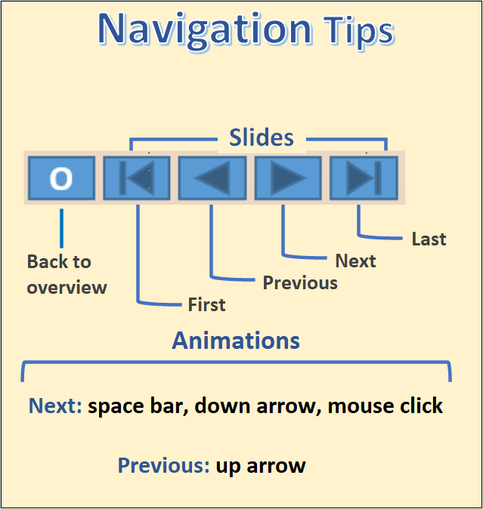

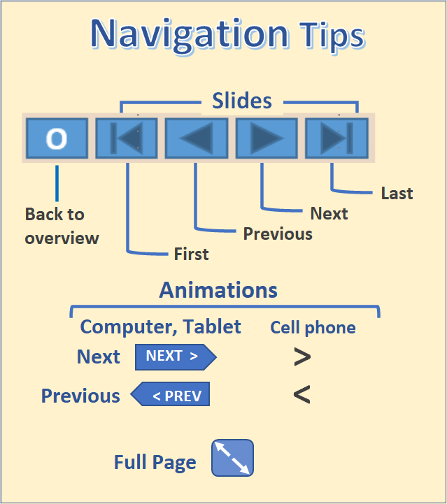
The State of Aging in Portland
Part 4.1 - Housing, Households, and Families
The largest number of older persons in Portland live in owner-occupied single -family housing and have lived in the same house for at least twenty years. Many reside in gentrifying neighborhoods and have incomes that typically are less than half of the younger well-to-do households moving in.
A smaller number of older persons live in rental housing, mainly apartments. They either have not had the resources or chosen not to purchase a home. Most of these older households are rent burdened, paying more than 35% of their income on rent.
.
The data from the public use micro sample of the American Community Survey (ACS) allow us to explore in detail how older people in Portland are housed but only for the city as a whole. We can use the census tract data from the ACS to map some aspects of how seniors are housed, but these maps are subject to considerable sampling error.
We make use of the data from the 2000 and 2010 Censuses to look at senior housing in more geographical detail. The tables and maps should be updated when data from the 2020 Census become available.
Separate modules cover affordable housing, where age often is a criterion for admission, and late in life housing transitions such as nursing homes, residential care facilities, adult family homes, and assisted living all of which mainly house persons age 74 and older.
Table of contents
Comparison cities
Charts from ACS public use microdata
Tables from ACS public use microdata
Mapping of housing data
Net migration and zoning
A brief look at affordable housing and care facilities
Data sources and Methods

Slide 2
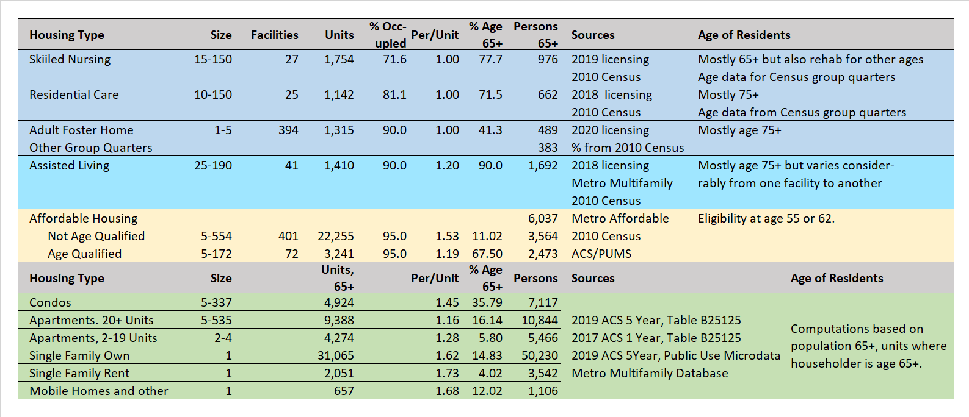
How Older People in Portland Are Housed
The largest number (50,230) of older people in Portland reside in single-family owner-occupied housing. Many of these are married couple families but many also are one person households.
The next largest number reside in apartments that in developments with 20+ units (10,844, after subtracting those in affordable housing).
Condominiums house 7,714 persons age 65+. Many of these households moved to a condominium at a younger age and aged in place. Many of these are one person households.
A surprisingly large number (6,037) of the Age 65+ in Portland reside in affordable housing.
Of those in affordable housing 3,564 are in developments that don’t have an age qualification and 2,437 in the less numerous units that have one.
A total of 2,510 reside in nursing homes, residential care facilities, adult foster homes, and other group quarters. 1,692 reside in assisted living. Not shown here are the numbers in independent living facilities which are not licensed by the state or US.
Sources: In table above.
O

Slide 3
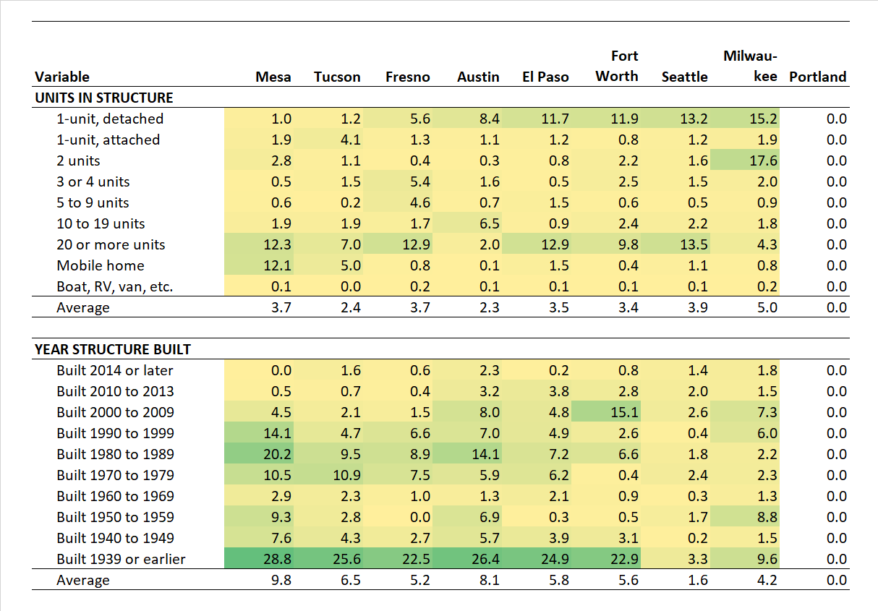
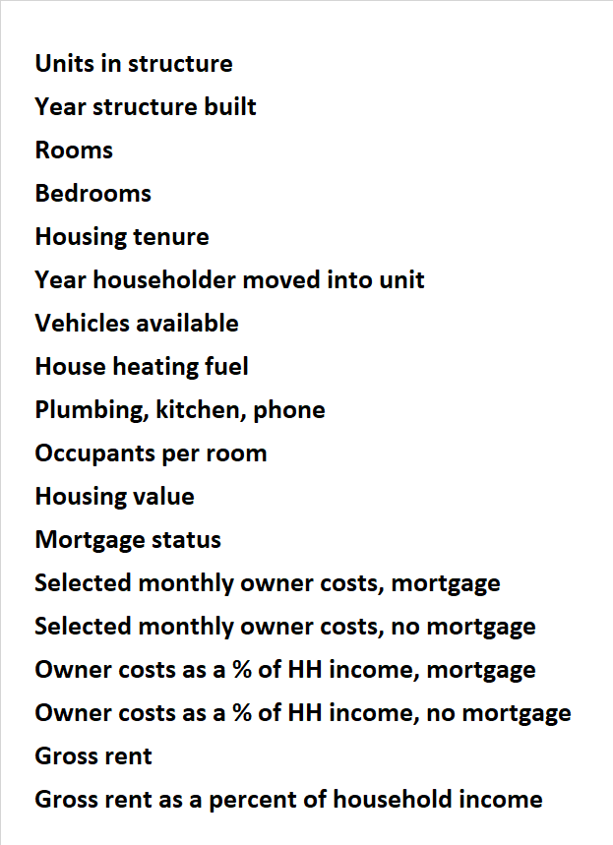
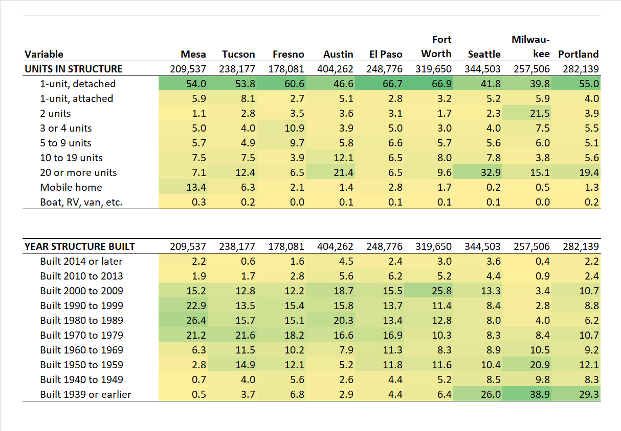
Comparison Cities, Method
3
Table of contents
Beginning
Comparison cities
Charts from ACS public use microdata
Tables from ACS public use microdata
Mapping of housing data
Net migration and zoning
A brief look at affordable housing and care facilities
Data sources and Methods
The variables included in the 2018 5-year American Community Survey Housing Profile were used to find which of the 20 comparison cities were similar to Portland and which were different.
Here are sample values for two variables, units in structure and year structure built, for Portland and eight comparison cities.
The absolute value of the difference between the value for each city and Portland was calculated.
The average of the absolute values for each subcategory was calculated and used to compare the cities with Portland, the MAPE or mean absolute percentage error.
This process was completed for the 18 variables shown on the original view, and the results were averaged for each comparison city.
Examples for cities
The values are highlighted by a green (high) to yellow (low) color shading.
Source: 2018 American Community Survey, 5-year data, table DP-04.
O

Slide 4
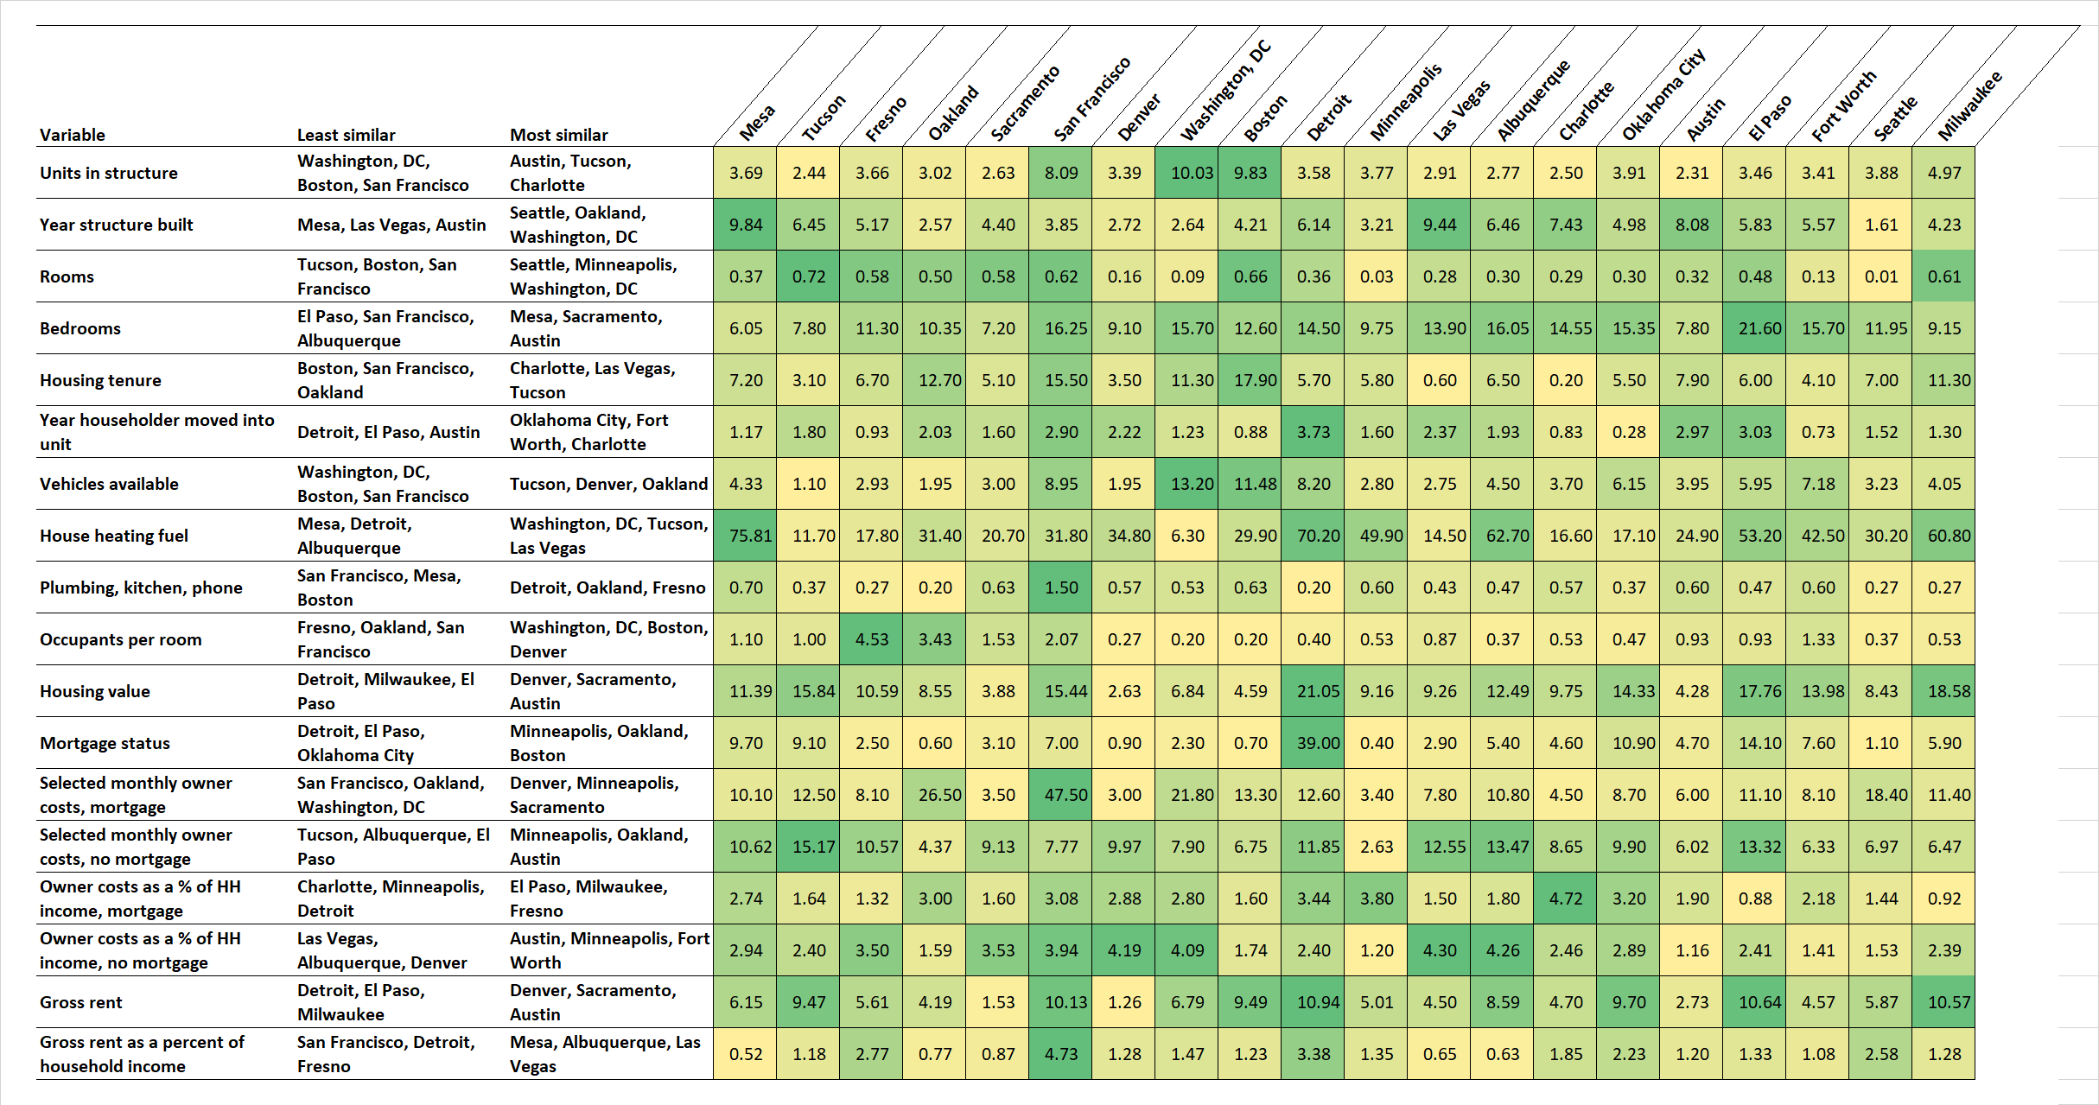
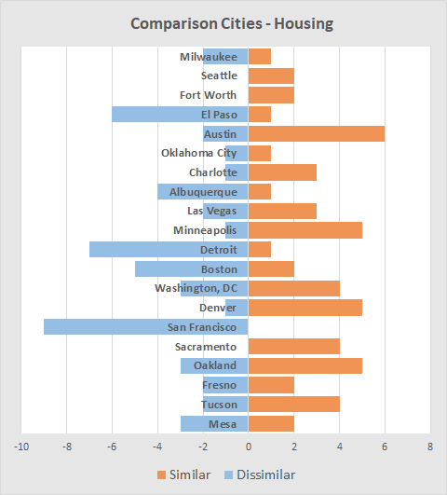
Comparison Cities, Results
4
Here are the results of the MAPE calculations for the 20 cities and 18 variables.
Similar (yellow, low score) or dissimilar (green, high score) depends on the measure compared.
For example, on vehicles available, Portland is similar to Tucson, scored as 1.10, but on the same measure dissimilar to Washington, D.C., scored as 13.20.
This chart shows the average of the individual MAPE values.
Portland is frequently similar to Austin, Minneapolis, and Denver.
Portland is frequently dissimilar to San Francisco, Detroit, and El Paso.
Source: 2018 American Community Survey, 5-year data, table DP-04.
O

Slide 5
Housing and Age from the ACS Public Use Micro Sample
5
Table of contents
Beginning
Comparison cities
Charts from ACS public use microdata
Tables from ACS public use microdata
Mapping of housing data
Net migration and zoning
A brief look at affordable housing and care facilities
Data sources and Methods
The next series of slides examines type and tenure for housing by race and Hispanic origin, income, and for city-suburb differences.
The Public Use Microdata Sample (PUMS) from the 2017 American Community Survey contains responses for 31,245 persons in the city of Portland, of which 4,496 were for persons age 65+.
There are over 200 variables describing individuals, their housing, and their households.
Click here to learn more about the American Community Survey.
O

Slide 6
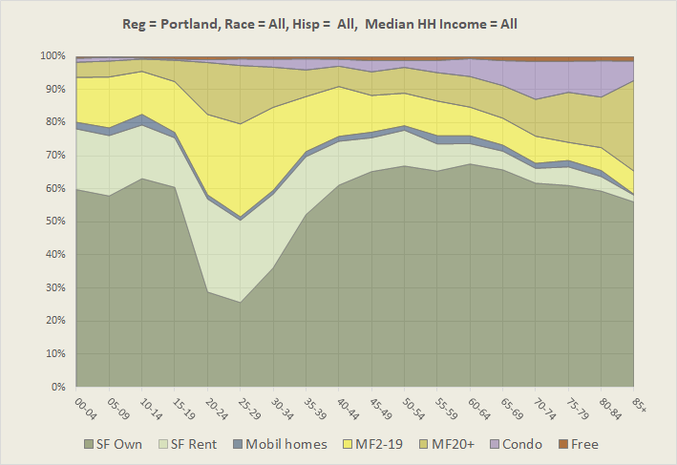
Housing, Young to Old
6
This chart shows how age influences the mode of housing. The ACS provides more detail, but to reduce sampling variability we collapse housing into the following groups (excluding group quarters such as nursing homes):
  SF Own – Single-family owner-occupied
  SF Rent – Single-family renter-occupied
  Mobile homes – Mobile homes, boats, other
  MF2-19 – Multifamily housing, duplex to 19 units
  MF20+ – Multifamily 20+ units
  Condo – Condominiums, multi-family owned
  Free – Not owned and not paying rent
The data are for the city of Portland and are for the number of persons in different types of housing.
For persons in their 20’s, the largest percentage reside in apartments (light and dark yellow) and rental single-family housing (light green).
The share living in owner-occupied single-family housing grows until about age 60 (darker green) and then begins to decline.
After about age 50, the number in condos grows.
Relatively few older persons live in rental single-family housing.
After age 70 the share in larger apartment developments (MF20+) grows. Many of these are senior residences such as age-restricted housing or income-qualified housing.
Source: Public Use Microdata Sample, American Community Survey, 5-year data, 2013-2017.
O

Slide 7
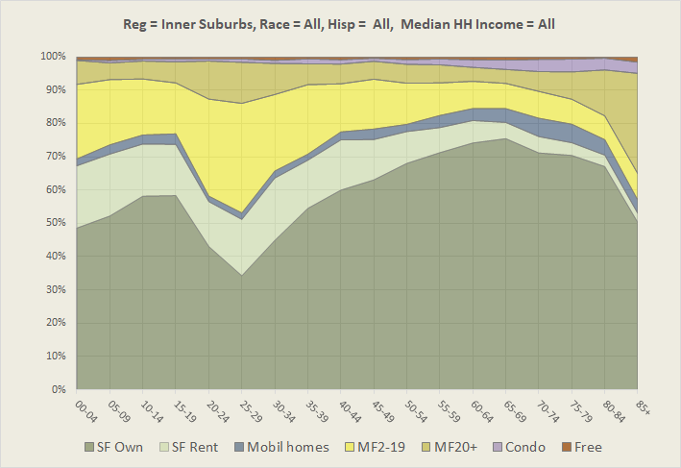
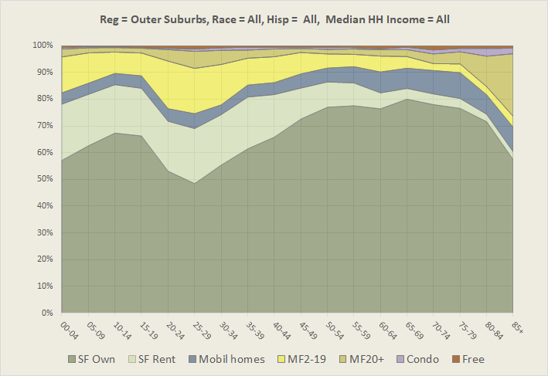
Housing: City-Suburb Differences
7
This series of slides compares the city of Portland with its inner and outer suburbs.
Step through the city, and the inner and outer suburbs, and make your own observations.
Single-family, owner-occupied housing (SF Own)
  A larger proportion of younger and older households own a single-family home in the suburbs.
  Home ownership peaks later in life in the suburbs.
Multifamily renter housing (MF2-19 and MF 20+)
  The proportion in this type of housing declines as one moves outward from the city.
  After about age 60 the proportion in multifamily housing declines as one moves outward from the city.
Condominiums (Condo)
  A later in life shift to condos is much more common in the city than in its suburbs.
Mobile homes (Mobile homes)
  Few in the city but many in the outer suburbs.
Source: Public Use Microdata Sample, American Community Survey, 5-year data, 2013-2017.
O

Slide 8
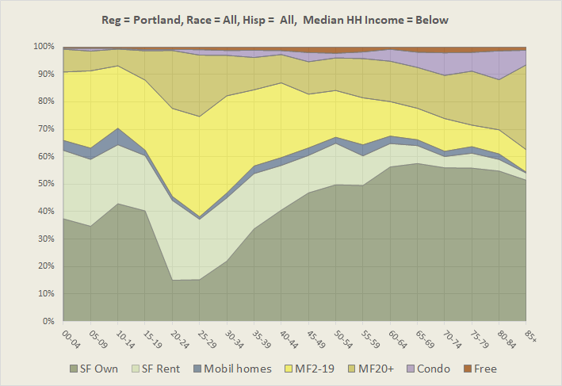
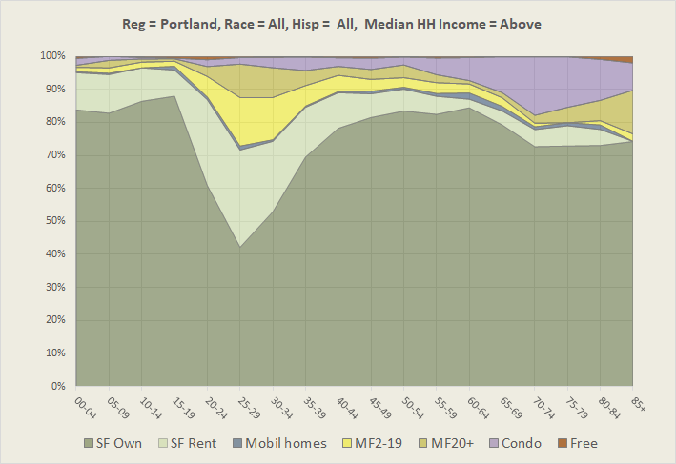
Rich and Poor
8
The trajectory of housing type and tenure varies greatly between more and less affluent households. This slide is for all income groups in Portland.
The next two slides are for Portland households whose median household income was above or below the Portland Metropolitan area median of $80,000.
Home ownership – Higher income households are much more likely to be single-family home-owners than those with lower incomes. For higher income households it peaks at the 60-65 age group at 84%, whereas for lower income households it peaks at age 65-69 at 58%.
Renters – A much larger proportion of lower income households age 65+ are renters compared to higher income households. Many of the renters at retirement are long-term renters.
Condominiums – The later-in-life shift to condominiums is more a characteristic of higher income households.
Source: Public Use Microdata Sample, American Community Survey, 5-year data, 2013-2017.
O

Slide 9
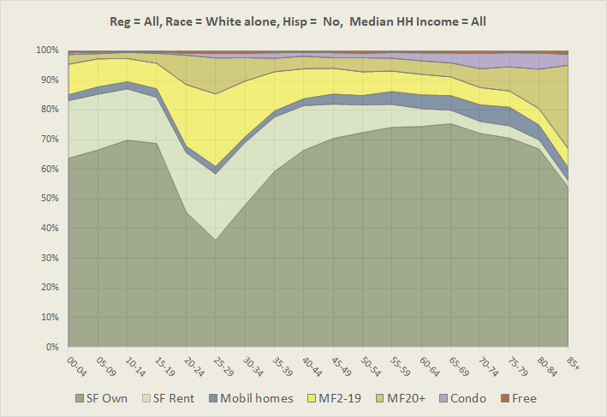
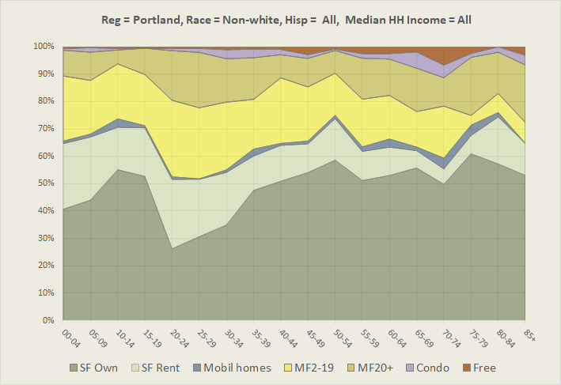
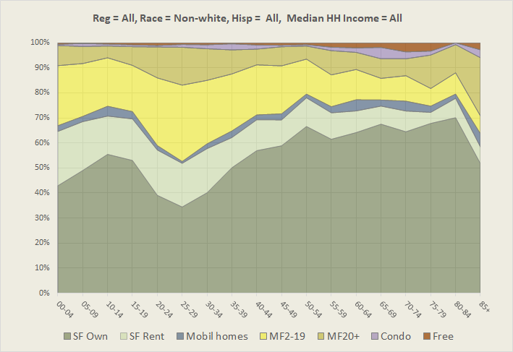
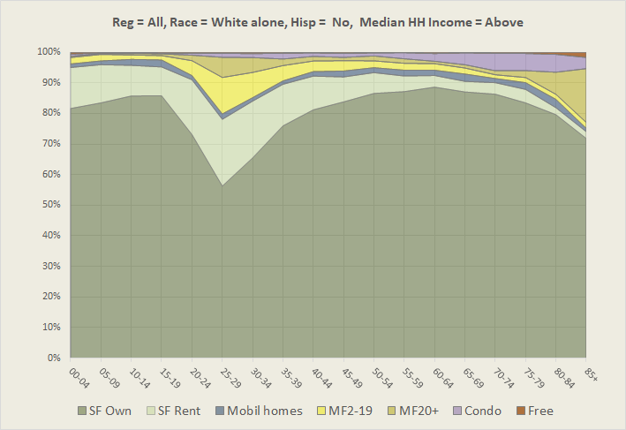
Race and Hispanic Origin
9
The trajectory of housing type and tenure for non-Hispanic White persons is similar to that for all persons, reflecting the predominance of White non-Hispanics in Portland’s population.
Not surprisingly, the chart for White non-Hispanics has some similarity to that for higher income Portlanders.
The chart for non-Whites, including Hispanics, shows large variations between adjacent age groups, suggesting those numbers were influenced by sampling variation.
The same chart for the seven-county metropolitan area appears more stable.
We can compare it with the chart for non-Hispanic Whites alone for the metropolitan area.
For the metro area the main difference between these two charts is the higher proportion of the White non-Hispanic population achieving home ownership and the smaller percentage living in rental housing, single family homes, or apartments.
Source: Public Use Microdata Sample, American Community Survey, 5-year data, 2013-2017.
O

Slide 10
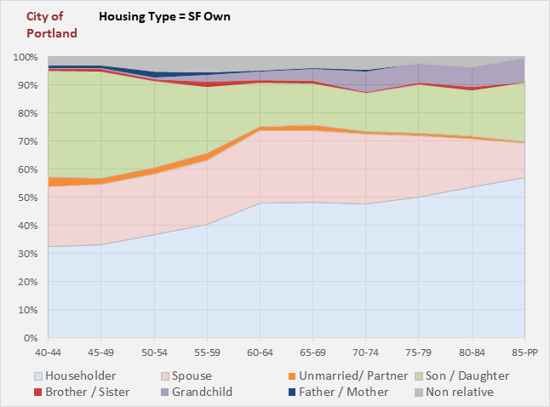
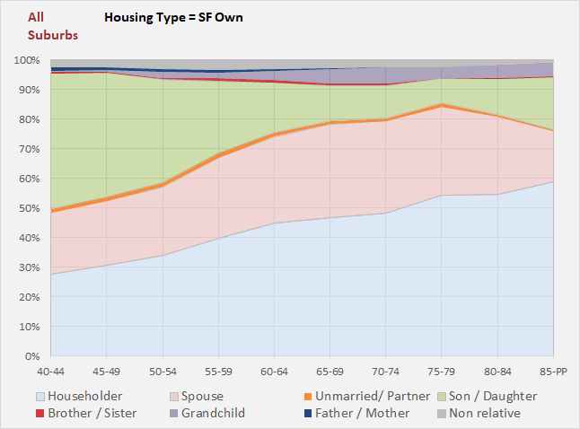
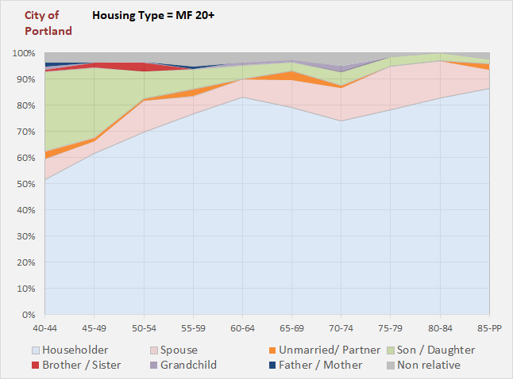
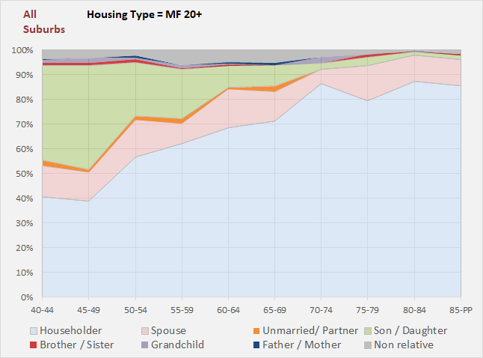
Housing Type and Tenure
10
For most of the housing/tenure types there are minor differences between city and suburb, or this cannot be differentiated due to sample size limitations.
Single-family housing in the city of Portland has more grandchildren and other related persons than in the suburbs.
Larger apartment developments (20+ units) in the city have fewer children and spouses than those in the suburbs.
In both the city and its suburbs, the majority of the units house only the householder, but in the city, this peaks for the 60-64-year age group and in the suburbs for the 70-74 age group (data are not displayed).
Source: American Community Survey, 5-year data, 2013-2017. Public Use Microdata Sample.
O

Slide 11
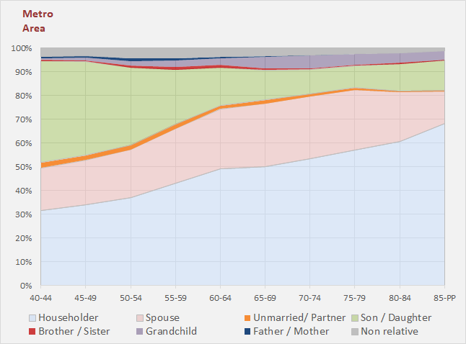

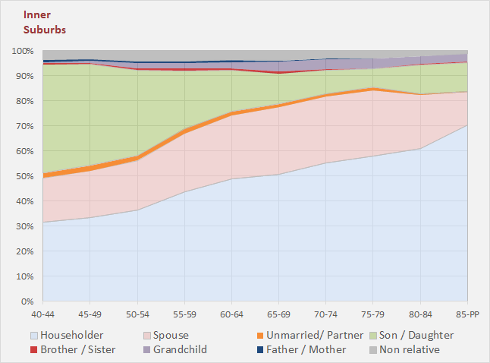
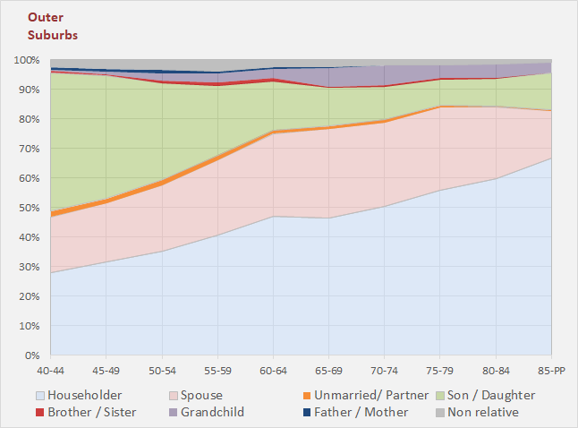
Relationships
11
The Portland Metro Area:
  The intergenerational dimensions are shown by the top four layers: non-relative, father/mother, grandchild, brother/sister.
  For ages 70-74, 6.5% of the Metro Area’s households house a grandchild.
  The proportion of the households that include a spouse rises to 30.1% by the age 65-69 cohort and then declines, due mainly to mortality.
City-Suburb variations:
  While there are minor differences between Portland and its inner and outer suburbs, the differences are less than those by other variables such as race and income.
  The main differences are that the suburbs have more children present from age 40-44 to 60-64 and more spouses from age 65-69.
Source: American Community Survey, 5-year data, 2013-2017. Public Use Microdata Sample.
O

Slide 12
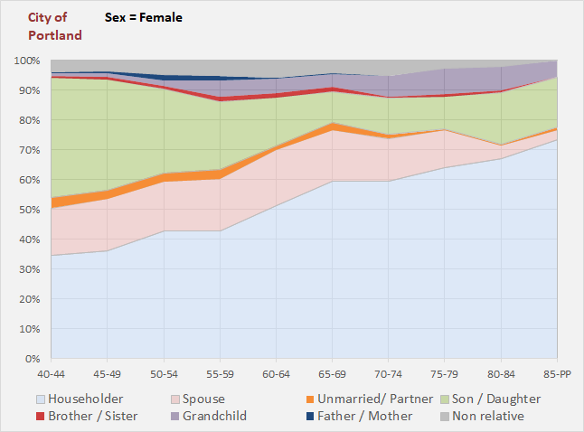
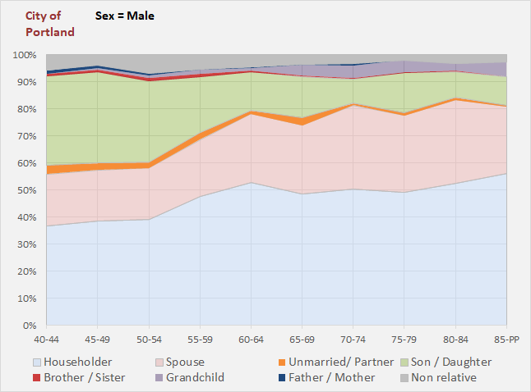
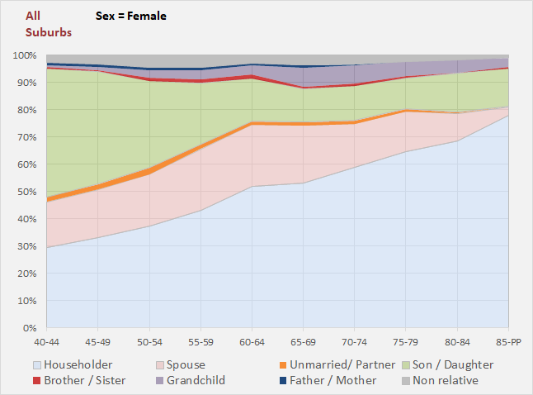
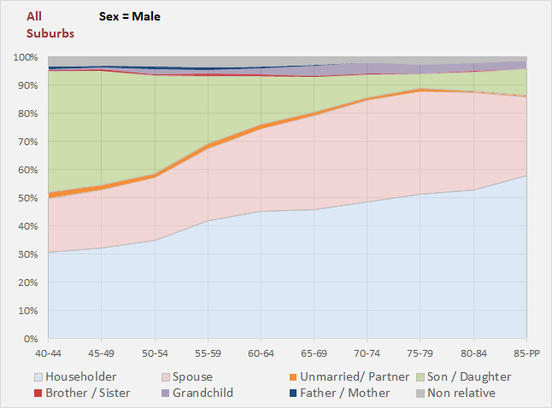
Gender
12
The composition of male and female householders varies.
  The householder or reference person is the person who fills out the Census or ACS survey form.
  For the city of Portland, female households are more likely to include a grandchild and less likely to include a spouse (toggle back and forth to see female-male differences).
  Portland and its suburbs are generally similar with respect to how male and female households compare.
Source: American Community Survey, 5-year data, 2013-2017. Public Use Microdata Sample.
O

Slide 13
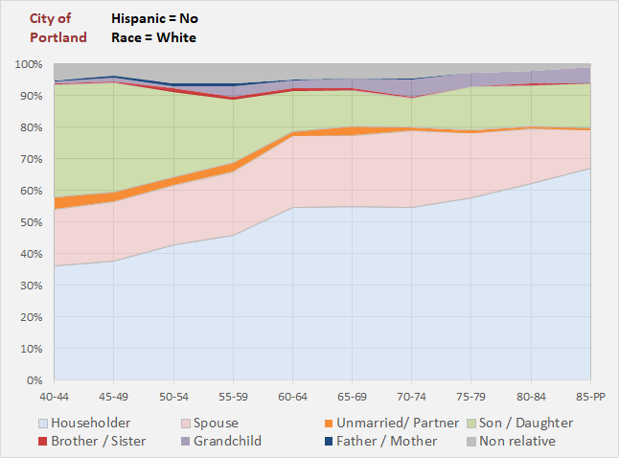
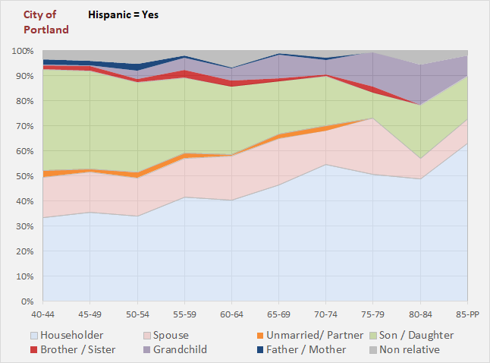
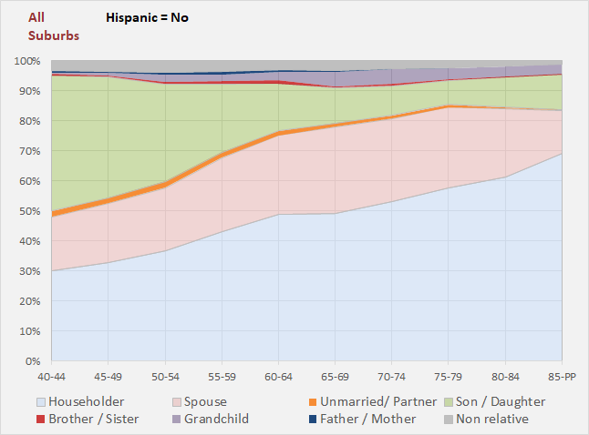
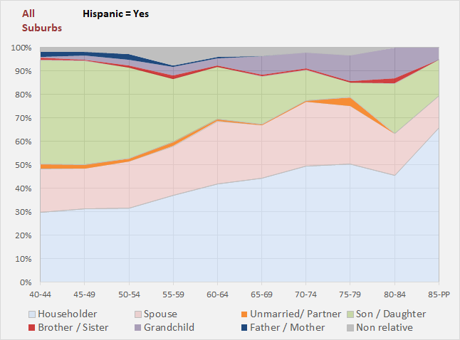
Hispanic Origin
13
Hispanics are the largest minority group in the Metro Area and in the city of Portland.
Fewer Hispanics than non-Hispanic householders are age 65 and older.
Older Hispanic householders are more likely to live with grandchildren, siblings, and parents.
The family composition of city and suburban households is similar across races.
Source: American Community Survey, 5-year data, 2013-2017. Public Use Microdata Sample.
O

Slide 14
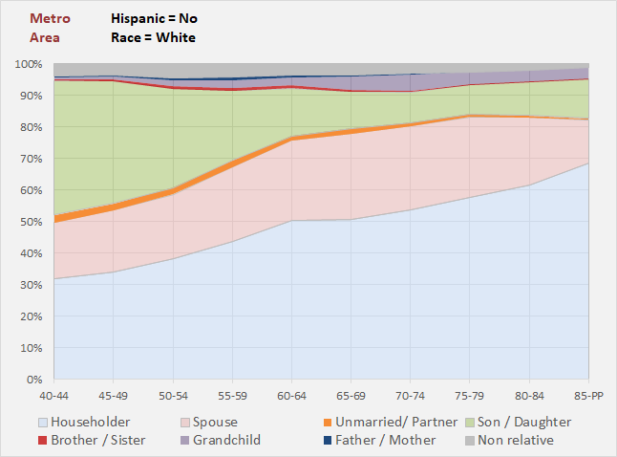
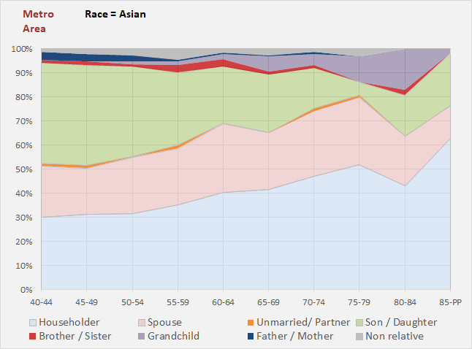
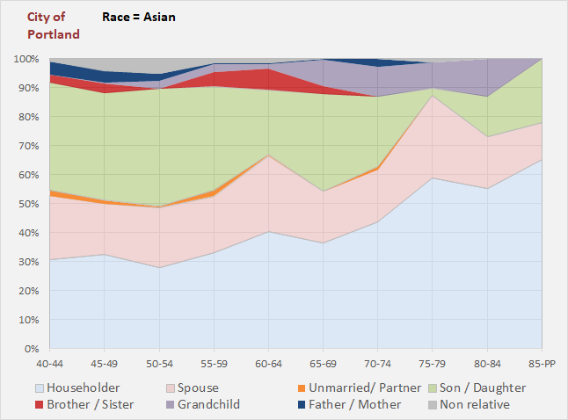
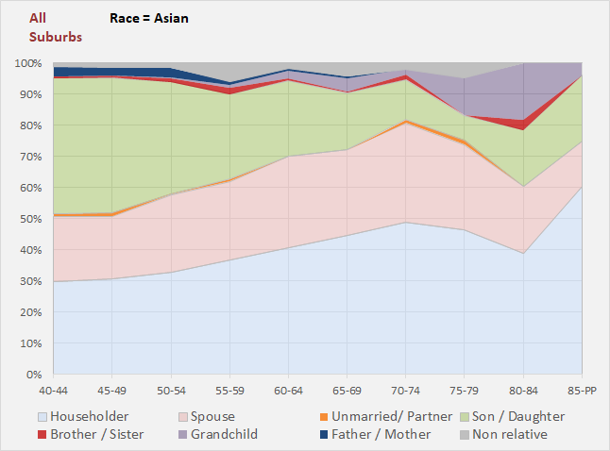
Asians
14
In the Metro area, White non-Hispanic households contain less grandchildren, parents, and siblings than do older Asian households.
In the city of Portland, intergenerational Asian households appear to be more common than in its suburban areas.
Source: American Community Survey, 5-year data, 2013-2017. Public Use Microdata Sample.
O

Slide 15
Tabular Presentations of Data on Housing from the ACS Public Use Microdata
15
Table of contents
Beginning
Comparison cities
Charts from ACS public use microdata
Tables from ACS public use microdata
Mapping of housing data
Net migration and zoning
A brief look at affordable housing and care facilities
The following tables overlap the previous chart-style representations of housing characteristics by age, race, income, household, family type, and mover status.
Click here to read about Public Use Microdata.
O

Slide 16
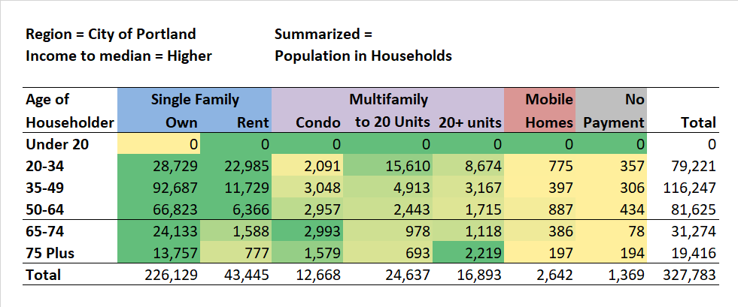
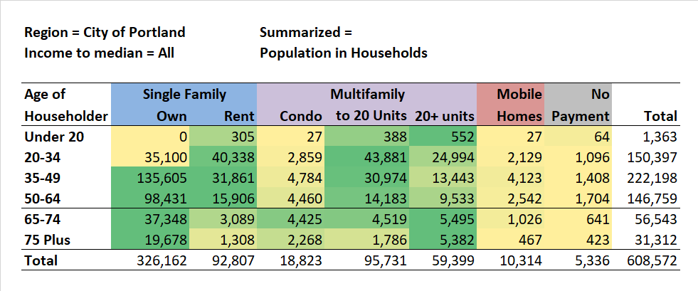
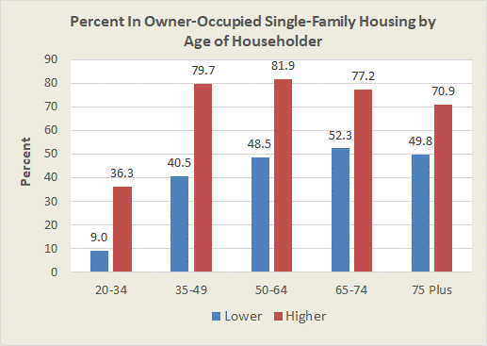
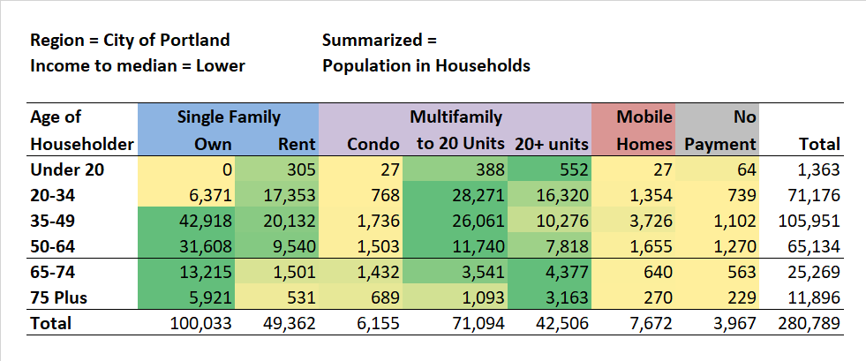
Housing Units and Age of Householder
16
This table shows a tabulation of housing types by age and units in structure by age of householder for the city of Portland.
For the 35-49 age group and older the largest number of Portland’s residents lived in single-family, owner-occupied (SFO) housing units.
However, the percentages for lower and higher income older households were quite different. For higher income age 65-74 households 77.2% lived in single-family owner-occupied whereas for lower income households the figure was 53.1%.
Lower income households in the 50-64 age groups were much more likely than higher income households to live in apartments and this persists into the 65-74 and 75+ age groups.
Residence in condos is much more common for higher income older households.
These data help in understanding the differing housing needs of older persons and the way in which they vary between lower and higher income older households
Source: American Community Survey, 5-year data, 2013-2017. Public Use Microdata Sample.
Median income applied for each age group
O

Slide 17
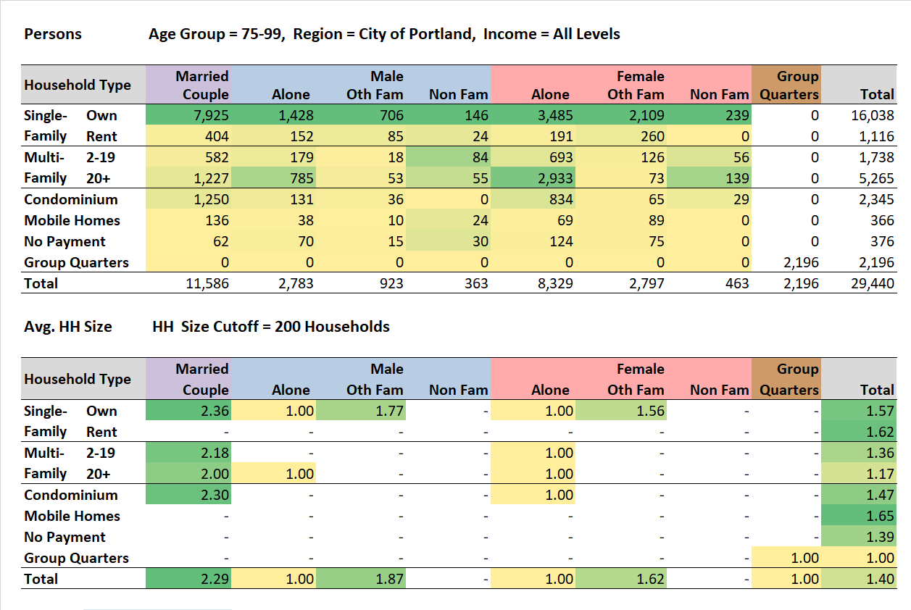
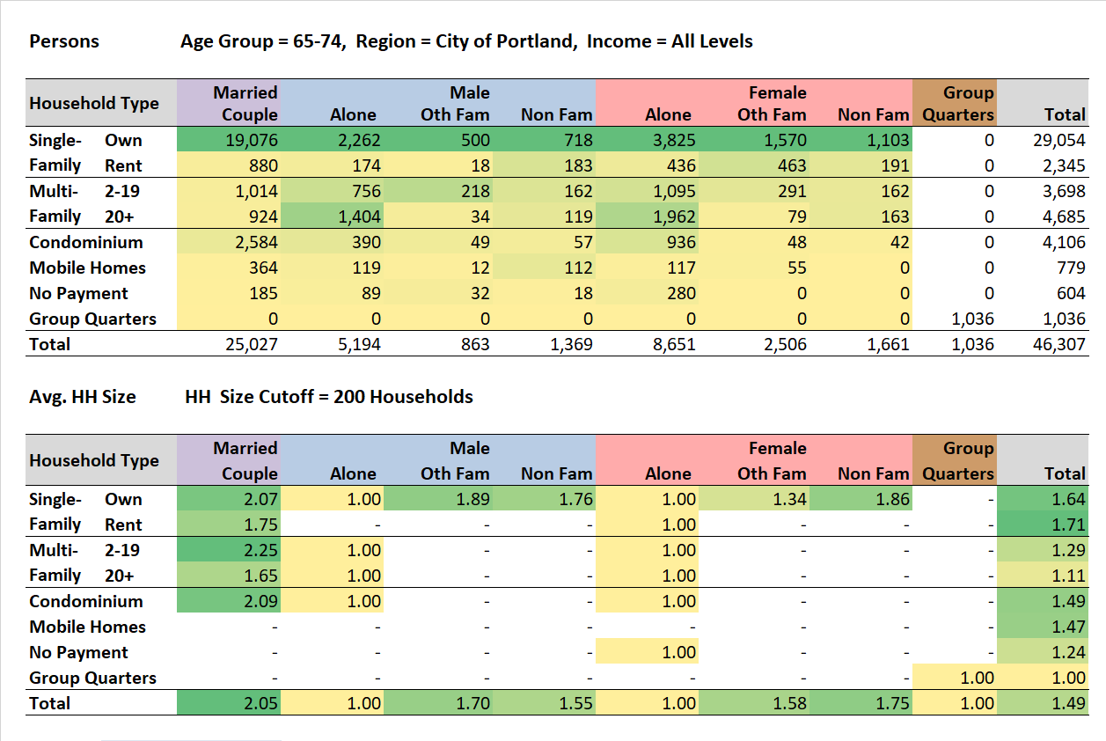
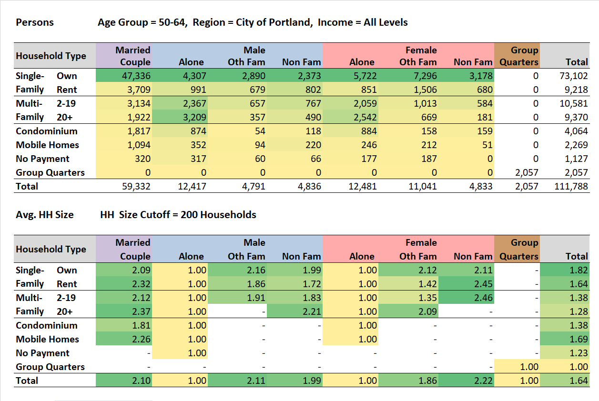
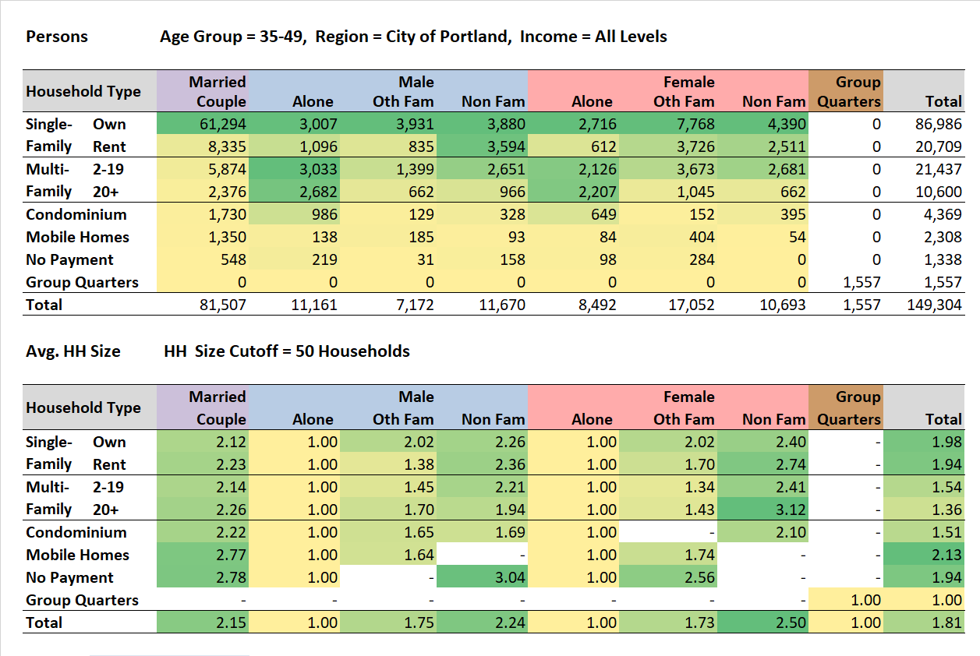
Housing and Family Type by Age, City of Portland
17
This sequence of view walks you from younger working-age households, to pre-retirement, to older households.
For householders age 35-49, 41% (61,294/149,304) are married couples residing in single-family owner-occupied housing.
For the age 75-99 householders, the percent falls to 29% (2,940/29,440, with a growing percentage of persons living alone in single- and multi-family housing.
More age 75-99 households are found in multi-family developments with 20+ units, perhaps because more larger developments have elevators.
The takeaway is that there is a progression of household type and related housing type as the householder’s age progresses into 65-74 age groups and older.
Note: Some household sizes for groups that logically are 2+, such as married couples, are less than 2 due to sampling error.
Source: American Community Survey, 5-year data, 2013-2017. Public Use Microdata Sample.
O

Slide 18
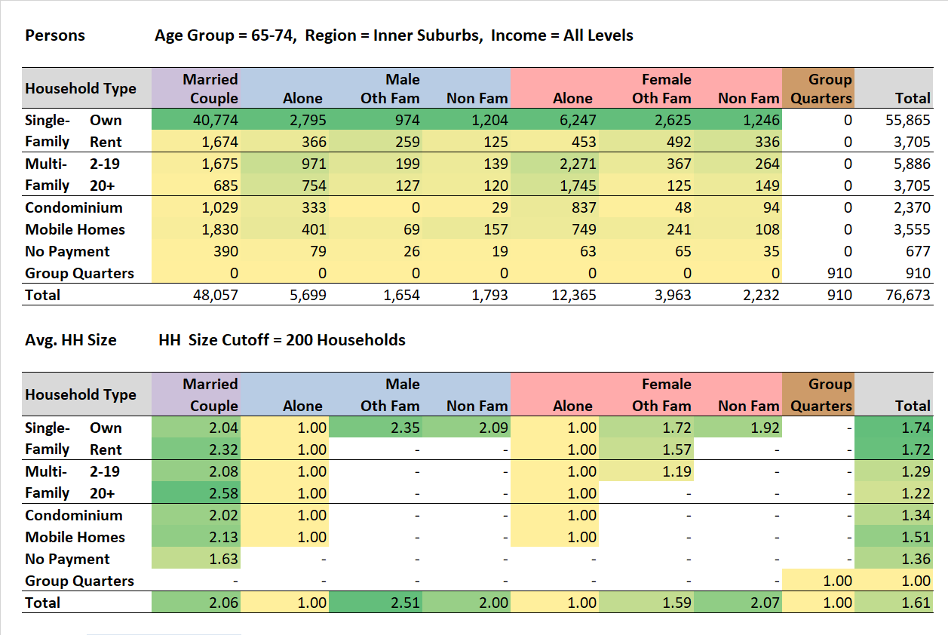
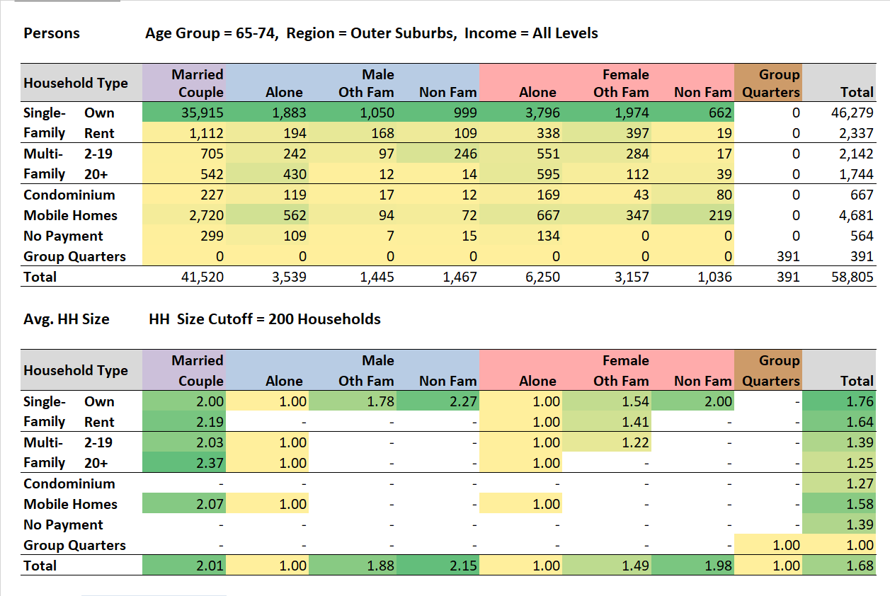
Housing and Family Type, City and Suburb
18
The differentiation of household type and housing type is much more pronounced in the city and decreases as one moves to the inner and outer suburbs.
Here are the Portland data.
In the inner suburbs, the proportion that are married couples living in owner-occupied single-family housing increases. The number of males in multi-family housing declines.
In the outer suburbs, 79% of households 65-74 age group are married couples living in single-family owner-occupied housing.
Source: American Community Survey, 5-year data, 2013-2017. Public Use Microdata Sample.
O

Slide 19
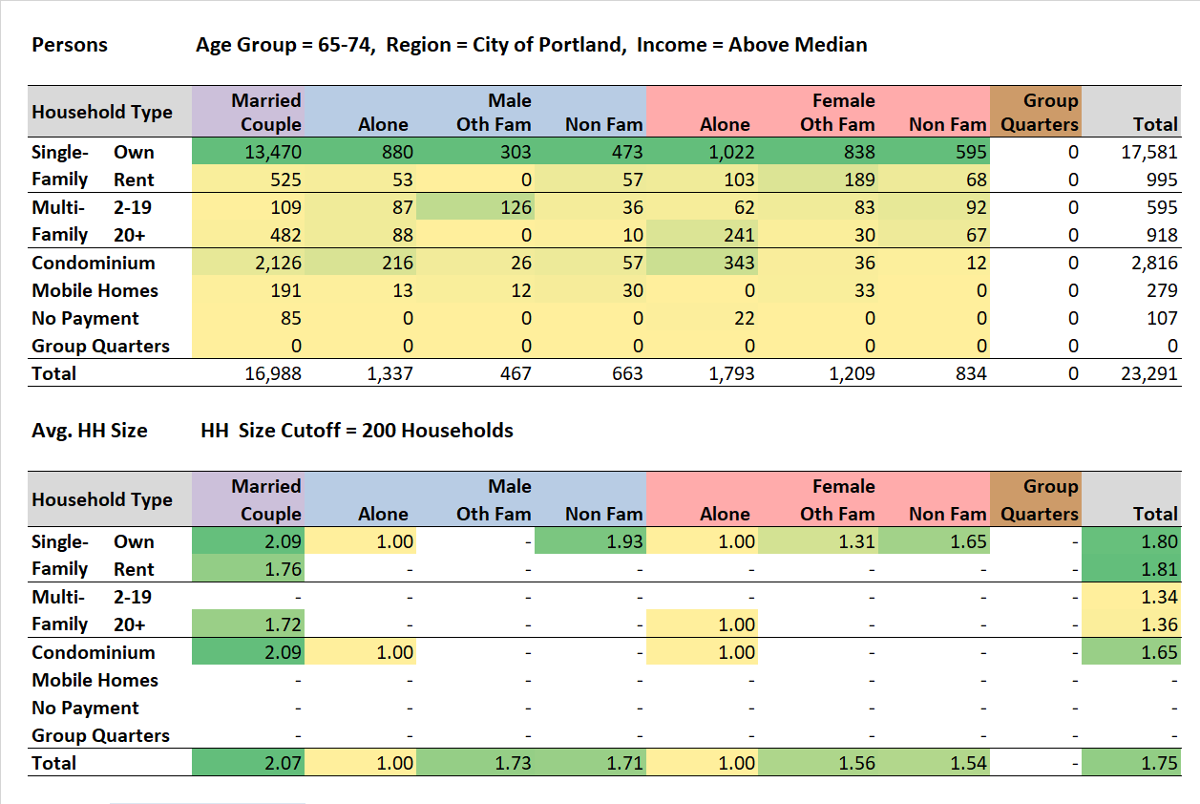
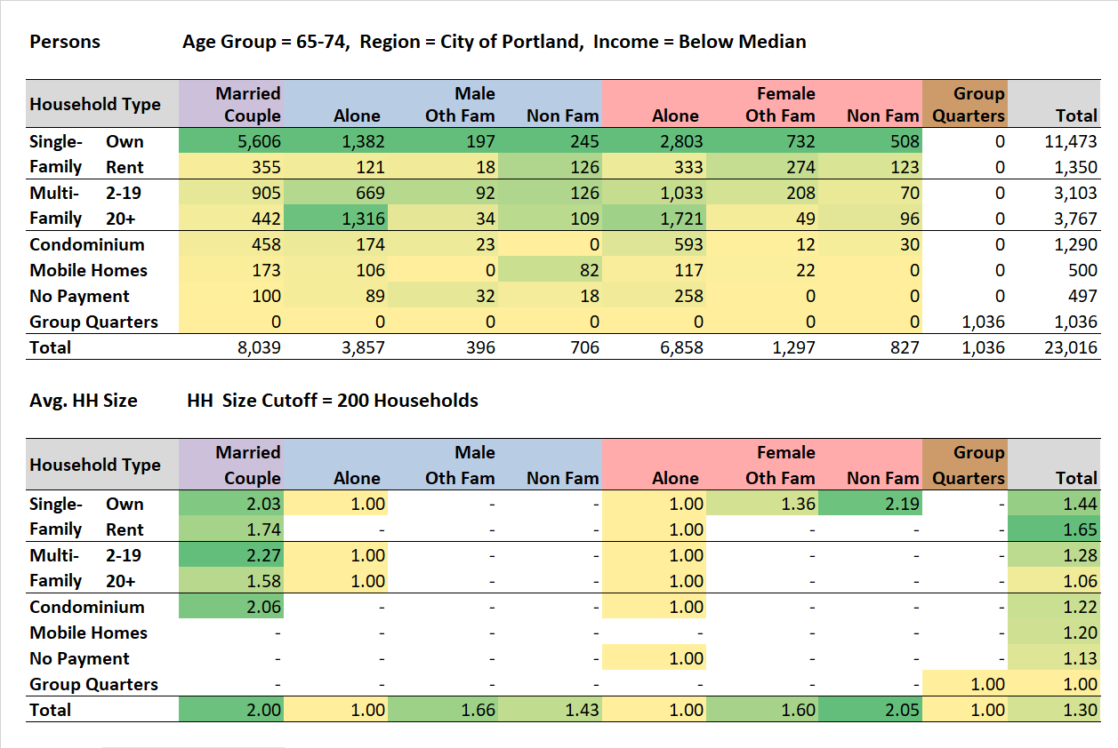
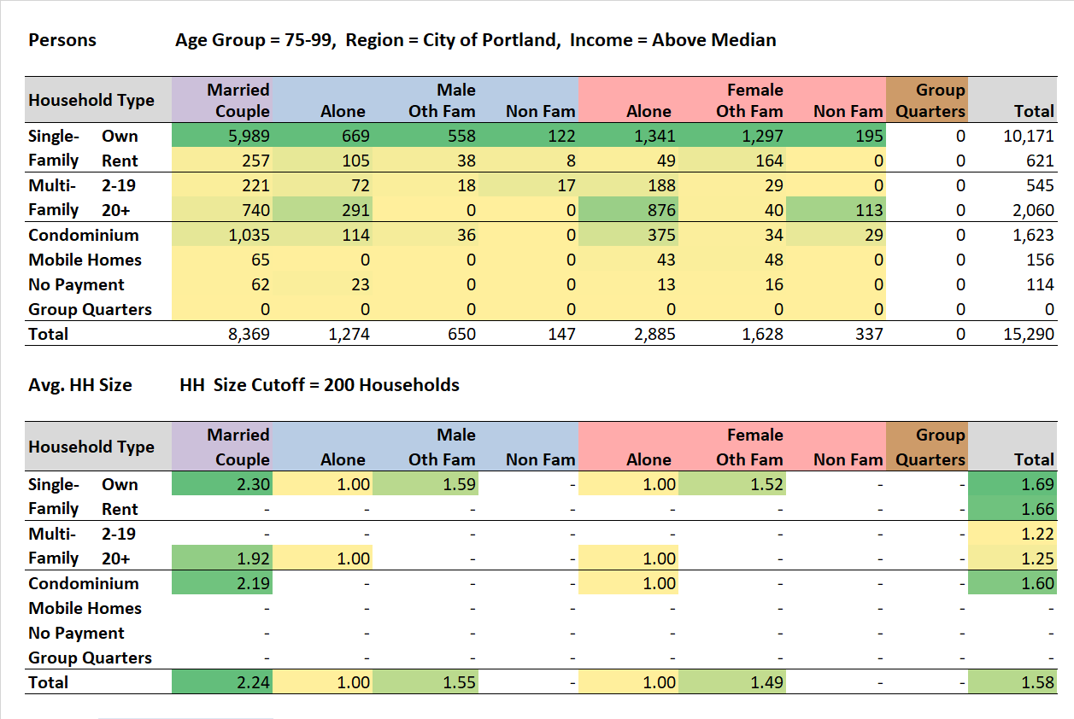
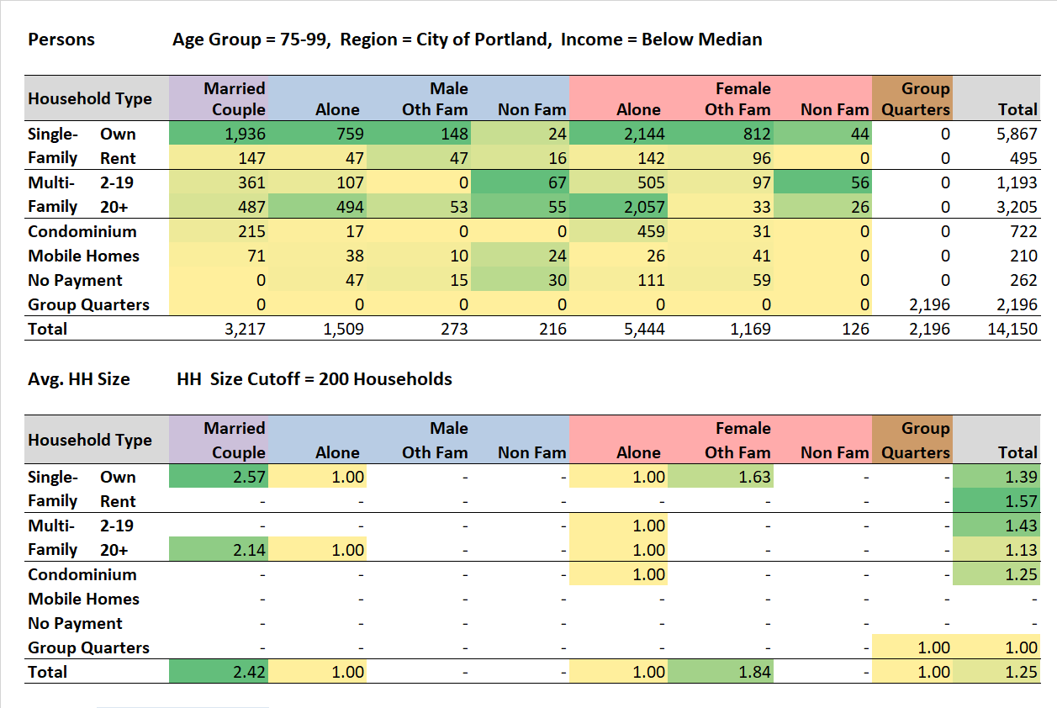
Housing and Family Type, Income
19
For age 65-74 households living in the city, higher income households are most likely to reside in single-family owner-occupied housing, followed by condominiums.
For the same ages, by contrast, many lower income households live in rental multi-family housing, with the largest number living alone.
By the 75-99 age group, the proportion in multi-family housing declines, particularly for males, perhaps due in part to mortality.
On the previous slides note the relatively small household sizes for older households, particularly the large proportion of one-person households.
Notes: Some household sizes for groups that logically are 2+, such as married couples, are less than 2 due to sampling error. No payment households are residing without ownership or payment of rent.
Source: American Community Survey, 5-year data, 2013-2017. Public Use Microdata Sample.
Median income applied for each age group
O

Slide 20












One-Person Households, Age, Income, and Length of Residence
20
These data are for the city of Portland and focus on one-person households in multi-family housing, beginning with apartments in developments with smaller developments with 2-19 units.
Note that for lower income one-person households age 50+, males and females, there are a substantial number of persons who have resided in their present housing for five or more years. This group may never have owned their home or went from owning to renting.
The same is true for larger multi-family housing developments, 20+ units, but the numbers of males age 50-64 residing for 5+ years appears proportionally larger.
Condominiums are most common for lower income older one-person female households, many of whom may be the surviving spouse of previously married-couple condo occupants.
Source: American Community Survey, 5-year data, 2013-2017. Public Use Microdata Sample.
Median income applied for each age group
O
Notes:
The slides drop off on the right a little bit. I was going to fix, but there are multiple layers and I didn’t want to mess anything up!
The second bullet doesn’t seem correct to me.
There ae lots of males, low income, who resided under 1 and 2-4 years in the 50-64 age group. It would be helpful to have the red box appear with the bullet point. Also, why is the 35-49 age group included in the box, since the narrative talks about the 50+?
I don’t understand why the male red box is highlighted yet again after the male, then the female boxes appear.
The narrative says the charts begin with the Multi-family 20+ units, but that is not the case. I think the narrative would be correct if the charts appear in the order stated in the narrative.
Aren’t condos more common for older women alone than men, regardless of income?

Slide 21







Married-Couple Households, Age, Income, and Length of Residence
21
Older residents of smaller developments with 2-19 units are more often lower income (1,231 vs 402).
For age 65+ living in smaller apartment developments the largest number have lived at the same location for 20+ years.
In larger apartment developments with 20+ units there are more high than low income older residents.
Not very many older households live in single-family renter housing, the numbers declining with age.
In single-family owner-occupied housing few of the families have resided for less than 10 years.
Source: American Community Survey, 5-year data, 2013-2017. Public Use Microdata Sample.
Median income applied for each age group
O

Slide 22








Housing Characteristics of Movers
22
The data in these tables are from the 2019 American Housing Survey. They show national data, tabulated mainly from households in metropolitan areas, and data specifically for the Portland Metropolitan Area.
The first table shows reasons, nationally, for moving for owner and renter households. For the 65+ households, the two reasons that stand out are the desire to live closer to children and other, for renters and owners. The second table shows data for households age 65+ for Portland, but these are mainly suppressed.
This table shows how housing costs changed for owners and renters moving from various types of housing. For younger owner and renter households, costs were more likely to increase for moves to all types of housing. For older households it was a mixed bag, with some older households noting increases and others decreases. Portland data for older households are largely suppressed and not shown here.
These tables show change in housing tenure, first with national data. It may seem counterintuitive that there are more shifts from owner to renter up through age 64, but note that the shifts from renter to owner are larger. The Portland data are largely suppressed.
The final two tables show shifts between different types of structures. The proportion of owners moving to apartments declines with age. Renters moving are about equally likely to move to another apartment or to a house. Most Portland data are suppressed.
'.' Represents not applicable or no cases in sample
'S' Represents estimates that did not meet publication standards or withheld to avoid disclosure
Source: American Housing Authority online table creator, https://www.census.gov/programs-surveys/ahs/data/interactive/ahstablecreator.html
O

Slide 23
Mapping of Housing Data
23
Table of contents
Beginning
Comparison cities
Charts from ACS public use microdata
Tables from ACS public use microdata
Mapping of housing data
Net migration and zoning
A brief look at affordable housing and care facilities
Data sources and Methods
The next slides show a variety of maps based mainly on data from the American Community Survey and the 2010 Census.
Data from the American Community Survey (ACS) are particularly useful because there were over 200 survey items asked of each household, and the most recent data is for the 2015-2019 period.
The ACS contains responses for 31,245 persons in the city of Portland, of which 4,496 were for persons age 65+. However, if the age 65+ were spread over the 177 census tracts in the city that would amount to about 25 age 65+ per census tract, a relatively small sample when one further filters it by such measures as home ownership, race, and income.
For some maps we aggregate the tract data into larger geographies which we call supertracts (in Portland, these are called twenty-minute neighborhoods).
Data from the 2000 and 2010 censuses are particularly useful because they are a full enumeration and not subject to sampling error. They are available for census tracts and even down to the block level.
Only seven questions, however, were asked of the respondent, referred to as the householder by the Census:
  How many people live here?
  Relationship to the respondent?
  Age of each?
  Sex of each?
  Race of each?
  Whether Hispanic?
  Is this housing unit owned or rented?
Despite the small number of questions, hundreds of tables are produced showing such cross tabulations as age, race, and household relationships, such as grandchild.
O

Slide 24

Housing Type and Tenure - Map
24
This map is based on census tract data from the American Community Survey 5-year data for 2014-2018. The tables are based on a relatively small sample, so the tract level data reflect in part sampling error. The dotted black line indicates the city’s border.
The color shadings show the percentage of the population who were age 65+. The highest percentages within the city are in SW Portland, the central city area and east of the I-405 freeway.
The pie symbols show the proportion of the housing units by tenure (own, rent) and units in structure where the householder is age 65+. These data are aggregated from census tracts to supertracts to reduce sampling variation.
The light blue sector of the pies shows the proportion in single family housing. In most of Portland’s supertracts, older households live in single-family housing, and may be mostly aging in place.
However, in and around the downtown core, the majority of older persons are housed in large apartment and condominium developments.
Source: Type and tenure - American Community Survey, 5-year data 2014-2018, table B25033; Age - Census of Population, 2010, table P12.
O

Slide 25


Short-term / Long-term Residents
25
This map shows the percentage of the age 65+ households that are homeowners. At the census tract level there is considerable sampling variation, so the data were aggregated into Portland’s twenty-minute neighborhoods.
With the exception of the areas surrounding the central city, most of the homeowners have lived in the same residence since 1990, approximately 26 year. Thus, those homeowners are likely aging in place.
When we look at the map of age 65+ renters, we see that the majority have lived in their residence only since 2010, approximately five years.
Renters are more susceptible to changes in the housing market and are more able to respond to live events, such as a job change, than are homeowners.
Renters, as discussed in the section on income and wealth, tend to accumulate less wealth during their life course.
Source: Tenure by age – American Community Survey, 5-year data 2014-2018, table B25011; Year moved in – 2018 American Community Survey, 5-year data 2014-2018, table B25038.
O

Slide 26

Cost Burden for Renters
26
The color shading on this map shows the percent of age 65+ renter households who are spending 35% or more of their income on rent. It is based on American Community Survey data and is subject to considerable sampling variation.
The pie chart symbols show the same data aggregated into twenty-minute neighborhoods.
In Portland only the Woodstock neighborhood shows the majority of renters age 65+ spending 25% or less of their income on rent.
In the Gateway neighborhood 70% of age 65+ renters are spending 35 or more percent of their income on rent.
Source: American Community Survey, 5-year data, 2014-2018, table B25070
O

Slide 27




Household Type and Tenure for Age 65+ Households
27
Compared to its suburbs Portland has the smallest percentage of single-family owner households and the largest number of married couple households.
Also, the largest percentage of rental non-family households. The largest number for this group are females living alone.
Portland also has the largest percentage of persons in group quarters, although the largest number are in the outer suburbs. Those in group quarters are about evenly divided between institutions such as nursing homes and others in the non-institutional category, such as group homes.
The final set of graphs show trends from the city vs. inner vs. outer suburb.
Family households include married couples, the most common, and other households with related individuals, for example a mother and child with no husband present.
Non-family households are composed of un-related individuals. Two older unrelated persons for example, or, most common for older households, one person living alone.
Source: American Community Survey, 5-year data, 2014-2018, table B25011
O

Slide 28


Households Age 65+ by Tenure and Type
28
Bi-variate maps, like this one, convey a lot of information but can be confusing.
If we zoom out and look at the Portland Metropolitan Area, we see that the city of Portland is mostly green, indicating a predominance of older non-family and renter households.
The outer suburbs are mainly pink-purple, indicating a predominance of older owner- occupied family households.
Portland’s inner suburbs share these household type – tenure relationships for their age 65+ households.
If we zoom in to Portland, we see a geographically more diverse mix of family/non-family and owner/renter older households.
Parts of the west side, the inner east side, and far southeast corner show older households that are owners and family or mixed, toward renters or non-family.
Source: American Community Survey, 5-year data, 2014-2018, table B25011
O
Notes:
I don’t fully understand the last bullet point.

Slide 29


Another View for Household Types for Those Age 65+
29
The background map in shades of brown shows the proportion of households that are age 65+.
On the pie charts, the light blue area represents family households in owner-occupied housing, mainly married- couple families. The share in this class is greater outside of the city.
The darker red-brown shade represents age 65+ non-family households in rental single-family housing. The largest number in this group are one-person female households.
Zooming into the city we see that the mix of housing tenure and household types varies greatly by neighborhood.
In the Central City neighborhood, by far the largest number are non-family households in rental housing.
In only a few neighborhoods does the share in owner-occupied family housing, mainly married couples, approach 50%.
The share in the purple section of the pie mainly reflects the location of group quarters (e.g., nursing homes).
Source: American Community Survey, 5-year data, 2014-2018 table B25011
O

Slide 30




Maps of the Main Household Types for Age 65+
30
Husband and wife homeowner households are much more numerous in Portland’s inner and outer suburbs, except for that part of Portland to the west of the Willamette River, based on block group data from the 2010 census.
There are relatively few husband-and-wife renter households in the city or elsewhere in the Portland Metro area.
For male owner and renter householders living alone or with family, the numbers are small compared to owner husband and wife households.
For female owner and renter householders living alone or with family, the city houses many of these households, but they also are common in the established suburban areas.
Source: American Community Survey, 5-year data, 2014-2018 table B25011
O
Notes:
On the charts for male and female owner and renter householders, the title is “Age 65 Plus, Other Male” or “Other Female” – why “other”? - MBN

Slide 31




Grandchildren by Race and Hispanic Origin
31
This series of maps shows the proportion of households that include a grandchild, mapped by census block group. The same classes and colors are used for all maps in the series.
Here are descriptions and maps by race and Hispanic origin:
  White non-Hispanic: Relatively few include a grandchild.
  Hispanic: More Hispanic than White households include a grandchild, with the highest numbers in the MLK-Alberta and Interstate Corridor neighborhoods.
  Asian: Relatively few Asian households include a grandchild.
  Black: A larger proportion of Black households include a grandchild, with the highest proportions in the historic Black neighborhoods where the Black population is older.
Source. 2010 Decennial Census, Summary File 1, Table P29, Household Type by relationship.
O

Slide 32




Parents of Householder by Race and Hispanic Origin
32
This series of maps shows the proportion of households that include a parent of the householder, mapped by census block group. The same classes and colors are used for all maps.
Here are descriptions and maps by race and Hispanic origin:
  White non-Hispanic: Relatively few include a parent of the householder.
  Hispanic: More Hispanic than White non-Hispanic households include a householder’s parent, with the highest numbers in the MLK-Alberta and Interstate Corridor neighborhoods.
  Black: A very high proportion of some Black households – compared with Hispanics and White non-Hispanics – include a parent of the householder.
  Asian: A substantial proportion of Asian households include a parent of the householder, spread broadly across the metropolitan area.
Source. 2010 Decennial Census, Summary File 1, table P29, Household Type by Relationship.
O

Slide 33
Net Migration and Zoning
33
Table of contents
Beginning
Comparison cities
Charts from ACS public use microdata
Tables from ACS public use microdata
Mapping of housing data
Net migration and zoning
A brief look at affordable housing and care facilities
Data sources and Methods
The next four slides show estimates of the net migration by age for various land use types.
Net migration is determined by comparing the numbers in a 2000 cohort to the same cohort ten years later, for example, comparing the number of persons age 55-59 in 2000 and those 65-69 in 2010, adjusting for losses due to mortality.
This analysis is done using block-level data, where the block has been classified by its general zoning class (e.g., single-family residential, multifamily residential, mixed-use).
O

Slide 34


Seniors, Land Use, and Net Migration
34
Using GIS tools, we compare 2000 and 2010 populations at the census block level with the blocks classified by zoning class.
On this map the small circles represent census blocks. The area of the circle represents the population of the block. The color shade of the block represents the proportion of the 2010 population from green, with 0-19%, to purple, with 40% or more.
The area shadings represent generalized land uses (e.g., commercial, single family). We estimate age-specific net migration for: single family residential in light yellow, multifamily residential in light red, and mixed use residential in orange.
Here is an example for multiple use (i.e., mixed use) for those blocks where 40% or more of the 2010 population is age 55+.
It shows strong in-migration for ages 50-74 and modest in-migration for ages 20-34.
In-migration is a net of in-and-out migration. It is calculated by comparing a 5-year age cohort from the 2000 to the 2010 census figure, for example the 587 who were 35-39 in 2000, to the 720 who were age 45-49 in 2000.
We adjust for the number in the cohort who may have died during the 10-year period using U.S. Social Security Administration survival rates.
Source: Age data - 2000 and 2010 Decennial Census, Table P12
Land use designations - 2010 RLIS, Portland Metro
O

Slide 35





Net Migration for Single Family Residential Zoning
35
This map shows parcels zoned single family residential, color-coded by the percent of the 2010 population that was age 55+.
The first chart of this series shows the summary for census blocks with 0-19% of the population age 55+.
The next shows the summary for census blocks with 20-29% of the population age 55+.
We see a major shift toward older households as we move to the 30-39% age 55+ group.
For those blocks where more than 40% of the population is age 55+ we begin to see net in-migration of older persons.
In summary, for areas zoned single family residential in Portland we see a shift from in-migration of young households where there are few age 55+ (yellow on map) to in-migration of older households and outmigration of younger households where more than 40% of the block population is age 55+ (dark red on map).
Net migration is positive for persons in their 20’s and 30’s with modest outmigration of older persons, particularly in their 50’s.
Where 40% or more of the population is age 55 plus we begin to see net in-migration of pre-retirement age older people accompanied by the loss of people in the 20’s.
Net migration for the 20-29 percent group is similar to the last except that there is loss of young adults and the greatest outmigration is for those 85 and older.
Net migration is positive for 20-44 age persons with loss of age 15-24 persons. The net outmigration of the 50 and older is less.
Source: Age data - 2000 and 2010 Decennial Census, Table P12
Land use designations - 2010 RLIS, Portland Metro
O

Slide 36





Net Migration for Multifamily Residential Zoning
36
This map shows those areas zoned for multifamily residential, color coded for the percent age 55+.
Net migration for those areas where 0-19% of the block population is 55+ is similar to that for single-family residential but has a population about half that of single-family residential for the same percent 55+ class.
For the 20-29% age 55+ class the profile is similar.
The numbers in the 30-39% age 55+ class are small, and the results somewhat erratic.
For those blocks zoned multifamily residential with 40% or more of the population age 55+ we see a major shift to a bimodal distribution of younger and older households cohabiting these units.
The dark red areas on the map are the only multifamily zoned blocks that appear to have substantial net in-migration of older persons. Most of the large independent living developments are outside of the city of Portland.
There is net in-migration of persons in their 20’s and 30’s and modest out-migration of persons age 35 plus.
Net in-migrants for the 20-29 percent class are about ten years older than for the 0-19 class. Net migration for children flips from positive to negative.
The age 25-29 age group shows net in-migration at the expense of nearly all other age groups. Since the statistics only are based on about 100 blocks the results are erratic.
In spite of being based on only around 100 blocks, we see a clear patten of net in-migration of younger and older households.
Source: Age data - 2000 and 2010 Decennial Census, Table P12
Land use designations - 2010 RLIS, Portland Metro
O

Slide 37





Net Migration for Multi-Use Urban Zoning
37
Multi- (or mixed) use urban buildings commonly combine ground-level retail with residential use on the upper floors. The multi-use structures of the neighborhood may provide shopping and services for the residents.
Multi-use residential zoned blocks where there are few age 55+ (0-19%) are largely the domain of younger households.
When we shift to blocks with 20-29% age 55+, we see a major shift in in-migration to include in-migration of persons in their 40’s and 50’s.
The profile for the 30-39% group is similar to that for the 20-29% age 55+ class.
Again, progressing to the 40% class there is a mix of old and young net in-migration, but the older age group has more incoming migrants.
While there is not much in-migration of age 65+ persons, those in-migrants in their 50’s are likely to age in place and to result in future large concentrations of older persons in multi-use residentially zoned areas.
Multi-Use Urban
Multi-Use Urban
Multi use residential zoned blocks with 0-19 percent age 55 plus house a population of young households with young children. There is strong in-migration of persons in their 20’s and some outmigration of young children.
For the 20-29 percent class we see a major shift to include mixed net in-migration of a younger group in their 20’s and 30’s and an older group in their 40’s and 50’s. There is out-migration of children.
The profile for the 30-39 percent group is similar to that for the 20-29 percent group but with greater in and out magnitudes.
Both the population pyramids and the net migration charts show substantial net-migration of persons in their 50’s and 60’s and some, but less, in-migration of younger persons.
Source: Age data - 2000 and 2010 Decennial Census, Table P12
Land use designations - 2010 RLIS, Portland Metro
O

Slide 38
Affordable Housing and Late-in-Life Housing Transitions
38
In the course of developing this section on housing for older persons we explored two types of specialized housing that often house older people. Two lengthy sections were developed, to which links are provided below.
  Affordable Housing – There were approximately 25.676 housing units in 2018, mostly apartments, in Portland that were available at below market rates for those who qualify through low income or disability status. The age qualification for these units often is age 55, and so these units often house substantial numbers of older persons, although the numbers of very old are not great. Click here to learn more.
  Late-in-Life Housing Transitions – While most older people prefer to stay in their residence as long as they can, often at some point their health dictates that they move to a location that provides more care. The main types of such facilities include assisted living, nursing homes, residential care facilities, and adult family homes. Click here to learn more.
The next two slides provide a brief insight into care facilities and affordable housing.
Table of contents
Beginning
Comparison cities
Charts from ACS public use microdata
Tables from ACS public use microdata
Mapping of housing data
Net migration and zoning
A brief look at affordable housing and care facilities
Data sources and Methods
O

Slide 39




Care Facilities
39
The chart here shows the distribution by supertract of the four types of care facilities which generally house the oldest population. All combine housing with various levels of support services. See the section on late-in-life housing transitions for more information.
The Gateway neighborhood had the largest licensed capacity for all four types of facilities.
A regional view illustrates the concentration of facilities on Portland’s east side, extending into Gresham.
Zooming into the city, this concentration is confirmed, but also noticeable is the relative lack of facilities of all types in north Portland and the Lents-Foster neighborhood.
When we aggregate the numbers of all types of facilities by neighborhood, we see some differences. The bold black numbers are the total number of facilities.
The large cluster in the Gateway neighborhood is about equally divided among the four types.
Other neighborhoods have concentrations of one type, such as residential care in the Central City.
Source: State of Oregon licensing data.
O

Slide 40


Affordable Housing for Older Persons
40
Affordable housing units in Portland often have an age requirement of 55 or 62, and as a result, many have a substantial population of older people. See the report on Affordable Housing for more detail.
These data are from Metro’s 2018 Affordable Housing Database. We show these data because many of these housing units house older persons. The area of the circles is relative to the number of housing units
Affordable housing is concentrated in the Central City, North Portland, and Interstate Corridor supertracts.
Affordable housing designated for seniors is concentrated in the Central City and Northwest supertracts.
The delineation of senior housing was done by noting comments in the 2018 Metro Affordable Housing database and by checking web listings for the individual developments and sponsor sites.
For senior affordable housing, only multifamily buildings with 5+ units in the city of Portland are shown.
Source: 2017 Affordable Housing Database, Portland Metro.
O
Notes:
Dick, this needs to be updated from the new About file.
Does "North Portland" comprise several supertracts? I noticed this inconsistency earlier, too. We should probably name the specific supertract(s). - MBN

Slide 41
End of Section on Housing, Households, and Families
41
Table of contents
Beginning
Comparison cities
Charts from ACS public use microdata
Tables from ACS public use microdata
Mapping of housing data
Net migration and zoning
A brief look at affordable housing and care facilities
Data sources and Methods
O

Slide 42
The State of Aging in Portland
Information on Data Sources
and Geographies
Background for study
The Decennial Census
The American Community Survey (ACS)
Supertracts
The American Housing Survey (AHS)
20 Comparison cities
Geography issues
Portland’s Inner and outer suburbs
The ACS Public Use Microsample
Nomenclature for race and ethnicity
Census group quarters
O

Slide 43

About The State of Aging in Portland Report and Navigating the Findings
O
O
O
O
O
O
O
O
O
O
O
O
O
O
O
O
O
O
This presentation includes seven sections developed as part of a study for the City of Portland by the Institute on Aging at Portland State University (PSU), Portland, Ore. The study, titled The State of Aging in Portland, was undertaken to provide guidance to local government and members of the broad and informal “aging network” of service providers, advocates, and others in Portland and the region so that that they can better understand, and address trends related to Portland and the region’s population aging.
Funding source: The City of Portland, Community Health and Access program.
Project staff included:
  Alan DeLaTorre, PhD, Adjunct Faculty, Institute on Aging, PSU; team leader and analytical perspectives; aland@pdx.edu (he now serves as the City of Portland’s Age-friendly City program manager and can be contacted at Alan.DeLaTorre@portlandoregon.gov)
  D. Richard Lycan, PhD, Professor Emeritus and Senior Research Associate, Institute on Aging, PSU; volunteer, analyst of demographic data, mapping, and creator of PowerPoints; lycand@pdx.edu
  Margaret B. Neal, PhD, Professor Emerita of Urban Studies and Planning and former Director of the Institute on Aging (2003-2017); analyzed age-related differences and similarities in responses to the City’s survey on livability, the 2019 Portland Insights Survey; nealm@pdx.edu
  Paula Carder, PhD, Director of the Institute on Aging; project oversight; carderp@pdx.edu.
Additional support was received from faculty at PSU’s Institute on Aging and Population Research Center, and staff from the City of Portland, Metro, Multnomah County, and Home Forward.
We encourage viewers to make full use of our work, including maps and charts, in their research. Content is best viewed using the web-based iSpring modules (see navigation tips below). Content, such as maps and charts, may be best accessed from downloaded PowerPoint files as they will have the highest resolution for viewing and reuse.
Individual pages of this report may be cited as:
  DeLaTorre, A., Lycan, D. R., & Neal, M. B. (2021). State of Aging in Portland. Institute on Aging, Portland State University, slide no. #. Retrieved from: https://soaportland.cupa.pdx.edu/.
Software used in this study:
  From Office 365 Excel for analysis and building tables and charts and PowerPoint for slide creation.
  From Environmental Research Institute ArcMap 10.4 for geospatial analysis and mapping.
  From iSpring eLearning Software iSpring Converter Pro 10 to transform PowerPoint to HTML5.
  From IBM SPSS statistics for data analysis
Menu

Slide 44
The Decennial Census
O
O
Variables
2010 Census
  Household: Household size, home ownership, families
  Demographic: Age, race, Hispanic origin, gender, marital status
2000 and earlier: Above, plus additional socioeconomic variables.
Issues with Census data
  The latest 2010 data are 10 years old. Results of the 2020 census should be available in September 2021.
  The tables in the State of Aging report should be updated when the 2020 data become available.
  Only the data listed under Household and Demographic are available but there are hundreds of cross-tabulation tables.
How Census was Used for this Study
  At the census block level to determine age and race of seniors housing and to assess demographic changes.
  At the census tract level to map age, race, and group quarters residents.
  For the city of Portland to get exact counts by age, race, housing type, and group quarters residents.
Access the Census data at: https://data.census.gov/cedsci/
U.S. Census Bureau: https://www.census.gov/programs-surveys/decennial-census.html
Frequency of Data
Collection: Every 10 years
Release: Data Release Schedule
Geographic Levels
Nation, State, County, City, Census Tract and Census Block
Description
The U.S. Census counts every resident in the United States at 10-year intervals, as mandated by the Constitution. It provides a snapshot of each person living in the country on April 1 of the year in which the Census is conducted.
The data collected by the decennial census affect the number of seats a state has in the U.S. House of Representatives and are used to distribute funding and allocate resources across localities and communities.
The 2010 Census reported data on age and sex distributions, race, Hispanic or Latino origin, household relationship and type, the group quarters population, and housing occupancy and tenure (whether the housing occupant owns or rents).
O
O
O
O
O
O
O
O
O
O
O
O
O
O
O
O
Source: Demographic Research Group, Weldon Cooper Center for Public Service,
University of Virginia:
https://demographics.coopercenter.org/guide-to-publicly-available-demographic-data
Menu

Slide 45
The American Community Survey (ACS), Summary Tables
O
O
U.S. Census Bureau, www.census.gov/programs-surveys/acs/
Frequency of Data
Collection: ongoing
Release: Data Release Schedule
Geographic Levels
Nation, State, County, City, Census Tract and Census Block Group
Description
The American Community Survey (ACS) is an ongoing survey that covers a sample of nearly 3.5 million addresses across the U.S. The data are released at 1- or 5- year intervals (the 3-year data product has been discontinued).
The survey provides current data and allows a choice between single-year and multi-year estimates, depending on research needs with respect to currency, reliability and level of geography. The data help local agencies and individuals – in both government, business, non-profits etc. – to better understand their communities and the workforce. The ACS provides information on a variety of subjects, including demographics, economics, housing and social situations/
Variables
Demographic: Age, sex, group quarters population, race, Hispanic or Latino Origin, race, relationship, total population
Economic: Class of worker, commuting to work, employment status, Supplemental Nutrition Assistance Program (SNAP), health insurance coverage, income and earnings, industry and occupation, poverty, work status
Housing: Computer ownership & internet access, house heating fuel, occupancy/vacancy status, occupants per room, owner monthly costs, plumbing facilities, rent statistics, rooms, bedrooms, telephone service available, tenure, units in structure, value of home, vehicles available, year householder moved into unit, year structure built
Social: Ancestry, citizenship status, disability status, educational attainment, fertility, field of degree, grandparents as caregivers, language, marital history, marital status, place of birth, school enrollment, residence one year ago/migration, veterans, year of entry.
Issues with Use of ACS
Substantial sampling error, especially for small geographies such as census tracts
Sample size approximately 2.4% per year, about 12% for five-year data
How ACS was Used for this Study
Socioeconomic data about the city of Portland
Census tract data for analysis and mapping
Aggregation of tract data to supertracts (see next slide)
Access the ACS data at: https://data.census.gov/cedsci/
Back to Housing
O
O
O
O
O
O
O
O
O
O
O
O
O
O
O
O
Source: Demographic Research Group, Weldon Cooper Center for Public Service, University of Virginia:
https://demographics.coopercenter.org/guide-to-publicly-available-demographic-data
Menu

Slide 46



Supertracts
O
O
Supertracts (see red brown) are were created by aggregating 6-8 adjacent census tracts (see grey boundaries).
The supertracts emulated the city of Portland’s 20-minute neighborhoods extended to the seven-county Portland Metropolitan Area.
Portland’s 20-minute neighborhoods were designed to have access to commercial services and amenities as a pedestrian, cyclist, or on transit.
The supertracts also reduced the amount of sampling variability in the data from the American Community Survey. For example, The Lake Oswego supertract (see purple) is the aggregation of 8 census tracts.
The ACS table for the Lake Oswego tracts shows the Estimate (EST) and Measure of Error (MOE) for the number of persons with an ambulatory difficulty. The MOE is the +/- value for the 90% confidence level.
The coefficient of variation (CV) is the ratio of MOE/EST. Values from 0.00 to 0.12 can be considered as good reliability, from .12 to.40 as fair, and over .40 as poor reliable.
All of the tract CV values are greater than 0.40 (poor reliability) but aggregated to supertracts the CV is 0.259 (fair reliability).
In addition, supertracts have recognizable neighborhood names and help to link the data to the viewer’s knowledge of the City.
.
O
O
O
O
O
O
O
O
O
O
O
O
O
O
O
O
8
Menu

Slide 47
The American Housing Survey (AHS)
O
O
The American Housing Survey (AHS) is sponsored by the Department of Housing and Urban Development (HUD) and conducted by the U.S. Census Bureau. The survey has been the most comprehensive national housing survey in the United States since its inception in 1973.
The AHS is a longitudinal housing unit survey conducted biennially in odd-numbered years, with samples redrawn in 1985 and 2015.
It provides up-to-date information about the size, composition, quality and cost of housing in the United States and major metropolitan areas and measures changes in our housing stock as it ages.
Returning to the same housing units every other year to gather data until a new sample of housing units is drawn, the AHS allows users the unique opportunity to analyze housing and household changes over time.
The survey’s principal coverage is of the 15 largest metropolitan areas in the United States. Portland is not one of the top 15 but data are available for 2019, 2015, and 2011.
The AHS has a relatively small sample size, 117,422 units for the nation and only about 3,000 per metropolitan area. Many of the fields for the Portland data are suppressed due to insufficient sample size.
The wide range of core housing topics covered in the ACS include but are not limited to the following:
  size and composition of the nation's housing inventory
  vacancies
  owners and renters
  physical conditions of housing units
  equipment breakdowns
  characteristics of occupants
  housing and neighborhood quality
  mortgages and other housing costs
  fuel usage
  home improvements
  persons eligible for and beneficiaries of assisted housing
  characteristics of recent movers
  home values.
How AHS was Used
  We mainly used the national data from the AHS, as much of the Portland data were suppressed due to small sample size.
Access the AHS: Data available as a public use sample or created using the ACS Table Maker.
Back to Housing
O
O
O
O
O
O
O
O
O
O
O
O
O
O
Menu

Slide 48






Comparison Cities
O
O
When we discuss our city, Portland, we often speculate about how it is similar or differs from our neighbor to the north, Seattle. We decided to extend the comparison of Portland with other cities about the same size.
However, members of the team also wanted to include Austin, Oakland, and Minneapolis, cities that readers might be familiar with, or cities often compared to Portland.
Here is a list of the 20 comparison cities, 10 larger and 10 smaller, ordered by their population.
As an example of how we used the comparisons, here is a chart that shows, for each of the comparison cities and Portland, the city’s proportion of the metropolitan area population.
Portland is in the middle of the pack, compared to the Portland – Vancouver – Hillsboro Metropolitan Statistical Area (MSA).
By comparison, El Paso contains over 80% of the population in the El Paso MSA and Oakland only about 10% of the San Francisco – Oakland – Berkeley MSA.21
O
O
O
O
O
O
O
O
O
O
O
O
O
O
O
O
Menu
Use to go back to the page you were reading or to go to the table of contents for Population.

Slide 49




Geography Issues
O
O
O
O
O
O
O
O
O
O
O
O
O
O
O
O
O
O
Data in the Census and the American Community Survey are reported for the city of Portland, outlined by the dashed dark red line.
We also use data for the 143 census tracts that approximate the city of Portland, referred to in the study as Portland Tracts.
The Portland Tracts are a reasonably good match to the City boundary. The red dots are in the City but outside of the Portland tracts, and the green dots are in the Portland tracts but outside of the City.
Overall, the Portland Tracts undercount the total population by 1% and overcount the age 65+ population by 0.2%.
One of the cases where we use the Portland Tracts definition of the city is in comparing the city to its inner and outer suburbs.
Here the city boundary is in red, the Portland Tracts in dark brown, the inner suburbs in light brown, and the outer suburbs in yellow.
The city and its inner and outer suburbs each have approximately 1/3 of the Portland-Hillsboro-Vancouver MSA population.
See the “About” report on City, Inner, Outer for more details.
Menu

Slide 50



The City and its Inner and Outer Suburbs
O
O
O
O
O
O
O
O
O
O
O
O
O
O
O
O
O
O
We created inner (see light brown) and outer (see yellow) suburbs zones around the city of Portland (see dark brown), with approximately the same population in each of the three zones.
In the case of this three-region geography, the city of Portland is defined as the collection of 143 census tracts that approximate the City.
One of the reason for this delineation is that much of the detail reported in the Census and the American Community Survey is for census tracts.
However, when we use supertract data, the delineation between the inner and outer suburbs is slightly different.
  The tracts marked in a blue X are included in the inner suburbs, and those with the red X are excluded.
  The city is the same for tracts and supertracts, but the inner and outer definitions are different.
There is a similar problem when we attempt to aggregate Public Use Microsample Areas (PUMAs) into city, inner, and outer suburbs.
  The city of Portland is composed of five PUMAs, and these five PUMAs comprise the 143 census tracts.
  However, the inner suburbs have a slightly different delineation with supertracts.
The lavender blue PUMAs are excluded from the outer suburbs, as they extend well beyond the Portland MSA. PUMA 4100500 includes Clatsop and Lincoln Counties.
We use the Public Use Microsample to create a number of custom tables and need to use the PUMA base regions.
4
3
1
5
2
Menu

Slide 51

ACS Public Use Microdata
O
O
The Census Bureau’s American Community Survey (ACS) Public Use Microdata Sample (PUMS) files enable data users to create custom estimates and tables, free of charge, that are not available through ACS pre-tabulated data products. The ACS PUMS files are a set of records from individual people or housing units, with disclosure protection enabled so that individuals or housing units cannot be identified.
The Census Bureau produces ACS 1-year and 5-year PUMS files. These files are accessible using the microdata access tool on data.census.gov and the Census Bureau's FTP site.
Another good source of PUMS data and ideas for using them is IPUMS USA at the University of Minnesota.
Only selected geographic areas are identified in the ACS PUMS, including Region, Division, State, and Public Use Microdata Areas (PUMAs). Of these, PUMAs are the most detailed geographic areas available.
Four PUMAs (red outline) approximate the city of Portland (black dashed line).
How we used the ACS/PUMs data.
  We used the ACS/PUMs data for the seven county Portland MSA to create many custom tables that were not published as ACS summary tables.
  Data for the five PUMAs shown in yellow on the map were used to create custom tables for the city of Portland.
O
O
O
O
O
O
O
O
O
O
O
O
O
O
O
O
Menu

Slide 52
Nomenclature for State of Aging in Portland Section on Race
52
O
O
O
O
The researchers working on the State of Aging in Portland project recognize the complicated, evolving nature of language that pertains to race, ethnicity, and Hispanic origin.
The source data for most of this section come from the United States Census Bureau which has led to the creation of many graphs, charts, and labels that use the conventions adopted in the Decennial Censuses and the American Community Survey, including the use of:
  Blacks, rather than African Americans
  Hispanics, rather than Latino, Latina, Latinx, or Latine persons
  Asians, Hawaiians, and Pacific Islanders, rather than Asians and Pacific Islanders
We have diverted from U.S. Census Bureau conventions for the following:
  We use Native Americans, rather than America Indians, but do refer to American Indian and Alaska Native tribes on a single slide produced from census data.
  We capitalize White, rather than leaving it as a lowercase “w” in following the lead of the National Association of Black Journalist (NABJ; Reference: NABJ Style guide). NABJ recommended that “whenever a color is used to appropriately describe race then it should be capitalized, including White and Brown.”
O
O
O
O
O
O
O
O
O
O
O
O
O
O
O
O
Menu

Slide 53
Group Quarters
O
O
Group quarters in this study
The main types of group quarters for older persons as referenced in this report are:
  Adult family homes
  Nursing homes
  Residential care facilities
All of the above are licensed by the State of Oregon, and we make use of licensing data to generate statistics and maps.
Housing for older persons that are not group quarters
Assisted living units are classified as housing units as they provide for privacy and access to the outside as noted under housing unit to the left.
Independent living facilities are classified by the Census as housing units, not group quarters.
O
O
O
O
O
O
O
O
O
O
O
O
O
O
O
O
Housing Units
Planners generally use the Census Bureau’s definitions of housing units, households, and population in households.
A housing unit is any single-family residential structure (like a house or a manufactured home) or any distinct unit in a multi-unit building where the unit provides privacy for the occupants, and the unit has access to the outside, and occupants can come-and-go as they wish (not a custodial facility), and occupancy is independent of any institutional affiliation.
A household is a set of people living together in a housing unit. A nice feature of this definition is that the number of households always equals the number of occupied housing units.
Group Quarters
There are residential situations that do not meet all of the four criteria listed above for housing units. The Census Bureau refers to these other residential situations as group quarters.
A group quarters facility is one that houses multiple, unrelated people, where occupants do not have privacy, or there is controlled access to entering/leaving, or it’s a facility that houses only an institutional or service-receiving population.
In the decennial census, group quarters statistics also include makeshift shelters, or places without shelter, where homeless people are found to sleep.
Source for above, Local Planning Handbook, Metropolitan Council, St. Paul, MN.
Census Bureau on Group Quarters.
Menu

Slide 54
End of Section on Data Sources and Geographies

