Slide 1
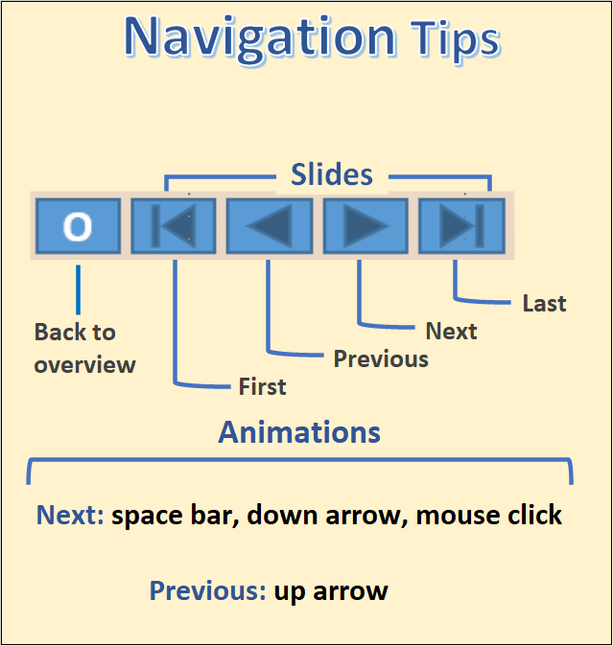

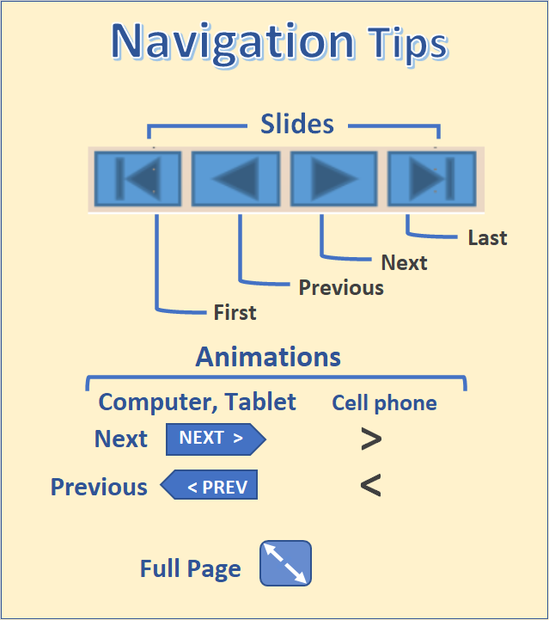
The Atlas of Older
1
Part 3 – Disabilities
Table of Contents
What is a disability?
Disability by socioeconomic measures
Comparison cities
Housing type and tenure
City-Suburb
Mapping of disability
Health insurance
Hispanics and Blacks
A disability is any condition of the body or mind that makes it more difficult for the person with the condition to do certain activities and interact with the world around them (Centers for Disease Control and Prevention, 2020).
This section explores disability, mainly for older adults in the city of Portland, with respect to variables such as income, education, and other household characteristics. Disability-related comparisons are also presented to other cities of the same approximate size and comparing the city of Portland to its suburbs. Maps highlight the geographical distribution of disabilities in Portland Metropolitan area.

Slide 2
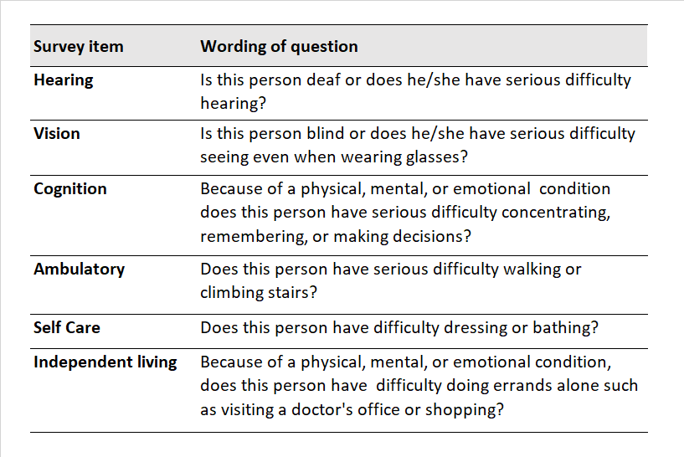
Measuring Disability
2
The American Community Survey (ACS) asks the respondent in each household about six possible impairments for each person in the household (2017, U.S. Census Bureau).
ACS data can be accessed in published tables cross-tabulated by age, household type, and other socioeconomic measures.
Data are available at the Census block group level of geography (1,421 in the seven county Portland-Hillsboro-Vancouver Metropolitan Area) or in the Public Use Microsample (PUMs), where one can create special tabulations of interest but only for large areas of at least 100,000 persons.
There are 5 Public Use Microdata Areas (PUMAs) that approximately cover the city of Portland geography.
Disability Questions from the American Community Survey
Table of Contents
What is a disability?
Disability by socioeconomic measures
Comparison cities
Housing type and tenure
City-Suburb
Mapping of disability
Health insurance
Hispanics and Blacks
Source: How Disability Data are Collected from the American Community Survey
O

Slide 3
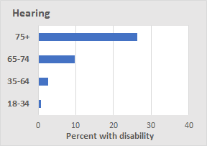
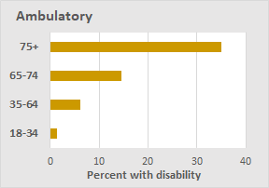
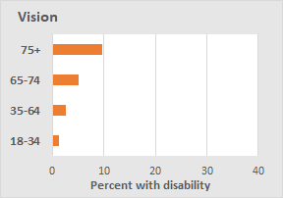
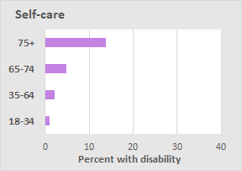
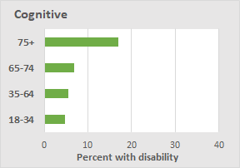
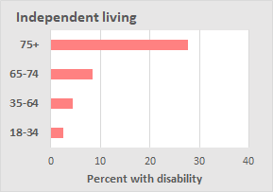
Disabilities Increase with Age, City of Portland
3
Studies show that disability prevalence increases with age, regardless of race, housing tenure, or income (Joint Center for Housing Studies of Harvard University, 2016).
The incidence of reported disability rises with age for all six disability types reported in the American Community Survey, as shown in these data for Portland.
In Portland, the increases in disability prevalence with age are greatest for those with ambulatory, independent living, and hearing disabilities.
The increases are somewhat less for those with cognitive, self-care, and vision disabilities.
Source: 2019 ACS 5-year data, table S1810
Learn about the American Community Survey (ACS)
O

Slide 4
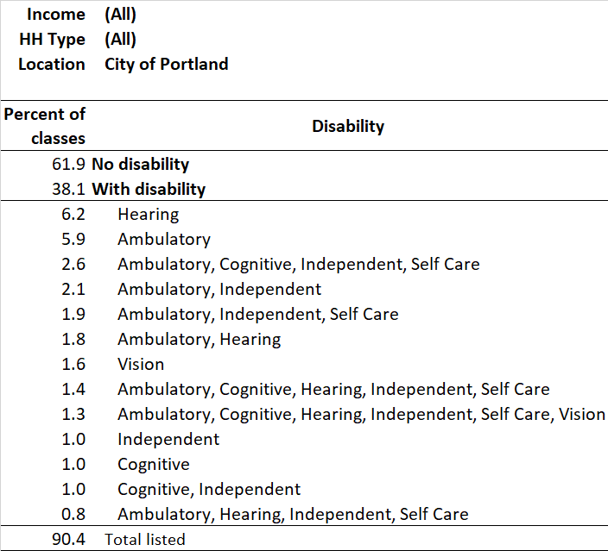
Disability Prevalence among Those Age 65+
4
In a recent ACS survey, 38% of all persons age 65+ living in the city of Portland were reported to have at least 1 disability. About 62% were reported to have no disability.
Notable findings:
  The most common single disabilities reported were a serious hearing issue (6.2%) and a serious ambulatory issue (5.9%)
  1.3% reported having all six disability types.
  11.9% reported having an ambulatory and at least one other disabilities.
Note: Not all combinations of disabilities are shown.
Source: 2013-2017 ACS 5-year data, Public Use Microdata
O

Slide 5
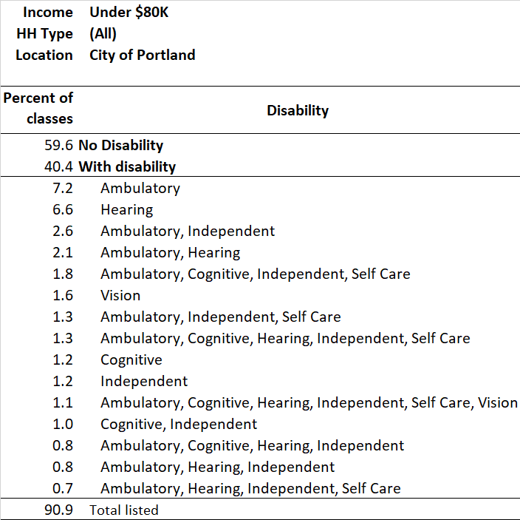
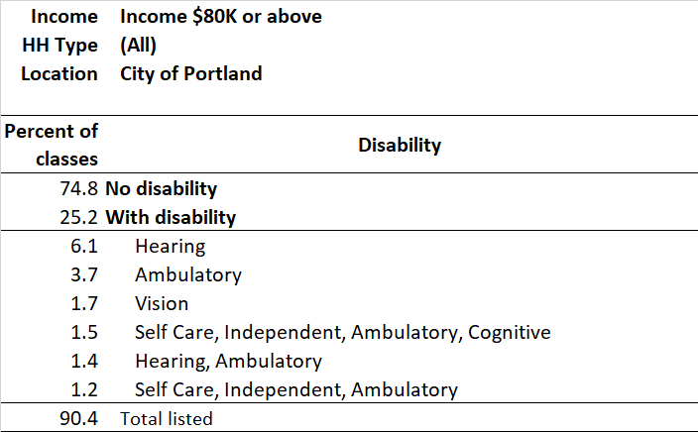
Lower Income Means a Higher Disability Rate for Age 65+
5
Households with incomes under $80,000
  40.4% of persons in Portland households were reported to have a disability.
  For those, ambulatory or some combination with ambulatory difficulty was most common.
  1.1% were reported to have all six types of disability.
Households with incomes $80,000 or more
  25.2% were reported to have a disability, 15.2% less (∆ = difference) than their lower-income counterparts.
  Similar to the lower-income group, ambulatory or some combination with ambulatory difficulty was most common.
15.2 ∆
Source: 2019 ACS 5-year data, table S1810
O

Slide 6
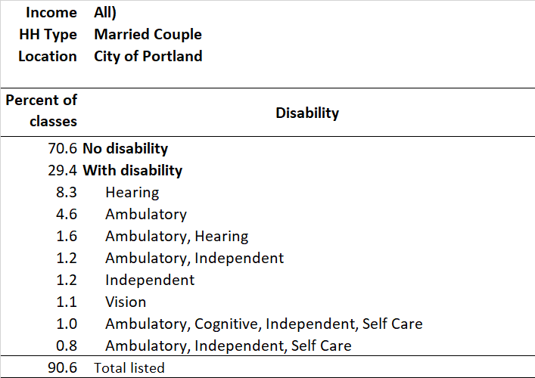
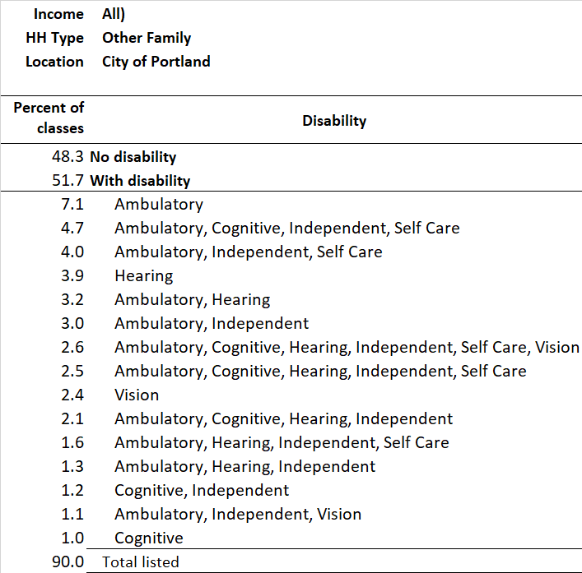
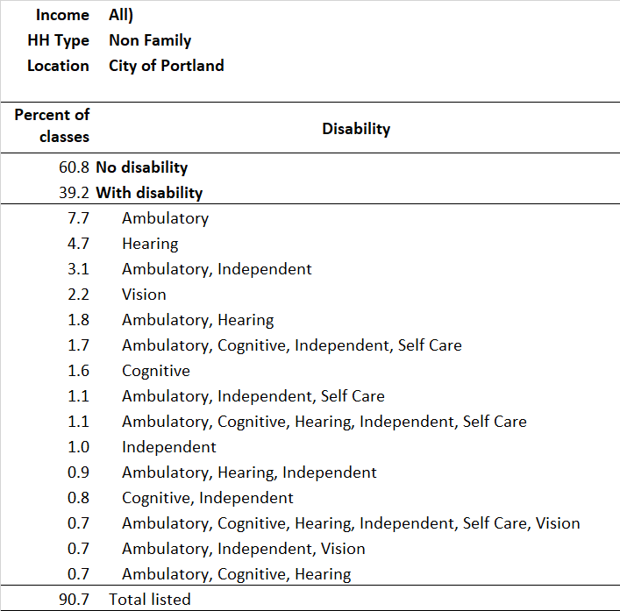
Disability Rates are Lower for Married Couple Older Households
6
This paged compares persons age 65+ in married couple, non-family, and other family households for persons living in the city of Portland.
The highest disability rate in this group (51.7%) is for persons in other-family households. Most have multiple disabilities, with some combination with an ambulatory disability being the most common.
Persons in non-family households have the next highest disability rate (39.2%). The largest number have a single type of disability. For those with multiple disabilities a combination with an ambulatory disability is most common.
Persons in married couple households have the lowest (29.4%) disability rate. The largest number have a single disability but where combined it most often is with an ambulatory disability.
Note: Married-couple households include husband and wife in the households. Since 2000 the Census has collected information on same-sex couples.
Non-family households are those with a collection of unrelated persons living together. For older persons, the most common type is the one-person household.
Other family households are those with related individuals, other than husband and wife, living together. An example might be a divorced female and child.
Source: 2019 ACS 5-year data, table S1810
O

Slide 7
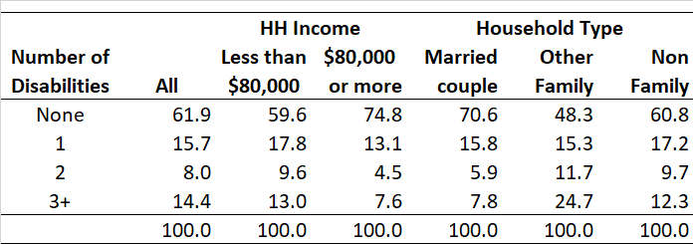
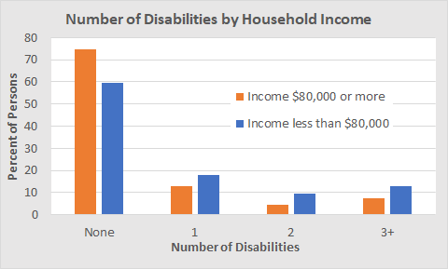
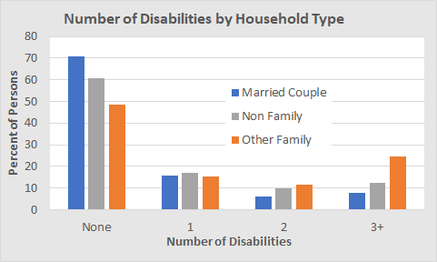
Number of Disabilities by Income and Household Type
7
Although most people younger than age 90 in the U.S. reported good functional health, the need for medical attention increased from ages 70 to 90; the prevalence of multiple chronic diseases or disabilities began increasing in those in the 70s and 80s (Santoni, et al., 2015).
Notes on household types:
  Other family households include related persons, such as a mother and child with no husband present.
  Non-family households are comprised of non-related persons. The most common are one-person households.
  Since the 2000 Census, married couple households include same-sex couples.
More higher income households have no disability, and fewer have three or more.
More married couple households have no disability, and fewer have three or more.
Fewer other family households have no disability, and many more have three or more compared to non-family and married couple households.
O
Source: 2013-2017 ACS 5-year data, Public Use Microdata

Slide 8
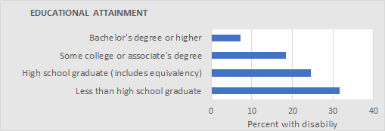
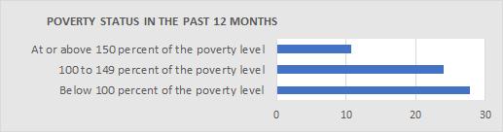
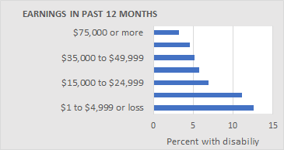
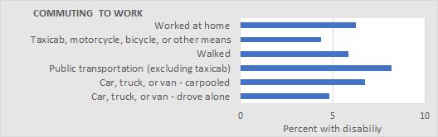
Education, Affluence, and Disability - All Ages
8
Percent with Disability
These tables show how educational attainment, poverty status, and income affect disability rates in the city of Portland.
  Lower educational attainment is correlated to higher disability prevalence.
  Being closer to or below poverty is correlated with higher disability prevalence.
  Lower earnings are correlated with higher disability prevalence.
As for commuting to work one might expect that the walkers would have the lowest disability rates, but those commuting by taxicab, motorcycle, bicycle, or other means had a lower rate.
When looking at specific age groups, rather than all ages, disability rates varied (data not displayed here).
Percent with Disability
Percent with Disability
Percent with Disability
Source: 2018 ACS 5-year data, Table S1811
O

Slide 9
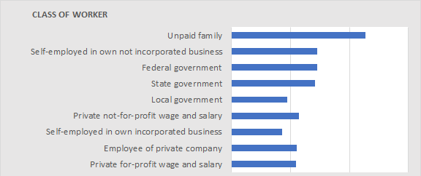
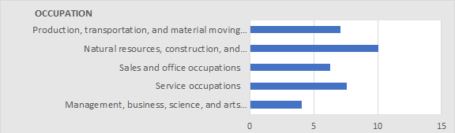
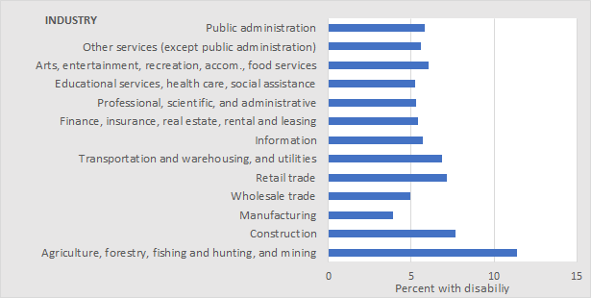
Work and Disability -
All Ages
9
Percent with Disability
Disability rates vary by class of worker and are highest for unpaid family workers in the city of Portland.
  The lowest disability rates are for self-employed workers in their own incorporated business.
  Self-employed workers in businesses that were not incorporated have higher disability rates.
Not surprisingly, the highest disability rates by occupation are for persons working in natural resources, construction, and related occupations; the lowest are for those in management, business, science and the arts.
By industry, the highest disability rates are for those working in agriculture, forestry, fishing and hunting, and mining. The lowest are for those employed in manufacturing.
It should be noted that while many older people may not be in the workforce, their health is impacted by their work history.
Percent with Disability
Percent with Disability
Source: 2018 ACS 5-year data, table S1811
O

Slide 10
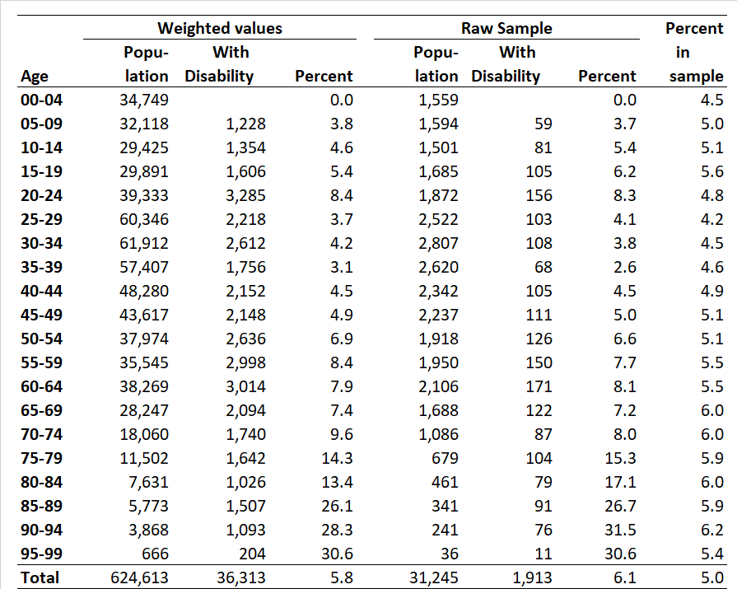
Disability from Public Use Microsample of the American Community Survey
10
The next slides show data tabulated for the city of Portland from the five years of data in the 2013-2017 Public Use Micro Sample of the American Community Survey (ACS/PUMS) for those with a cognitive disability.
The weighted values columns of this table show the tabulation of the numbers of persons reported to have a cognitive disability, up to 30.6% for persons age 95+.
The values in the raw sample columns of the table show the number in the PUMS subset of persons in the interviewed households.
Note that for those age 80+ the numbers in the sample reported to have a cognitive disability are particularly small, suggesting that the proportions disabled in the weighted percentages are subject to large sampling errors.
Source: ACS 2017 5-year data, Public Use Microdata
O

Slide 11
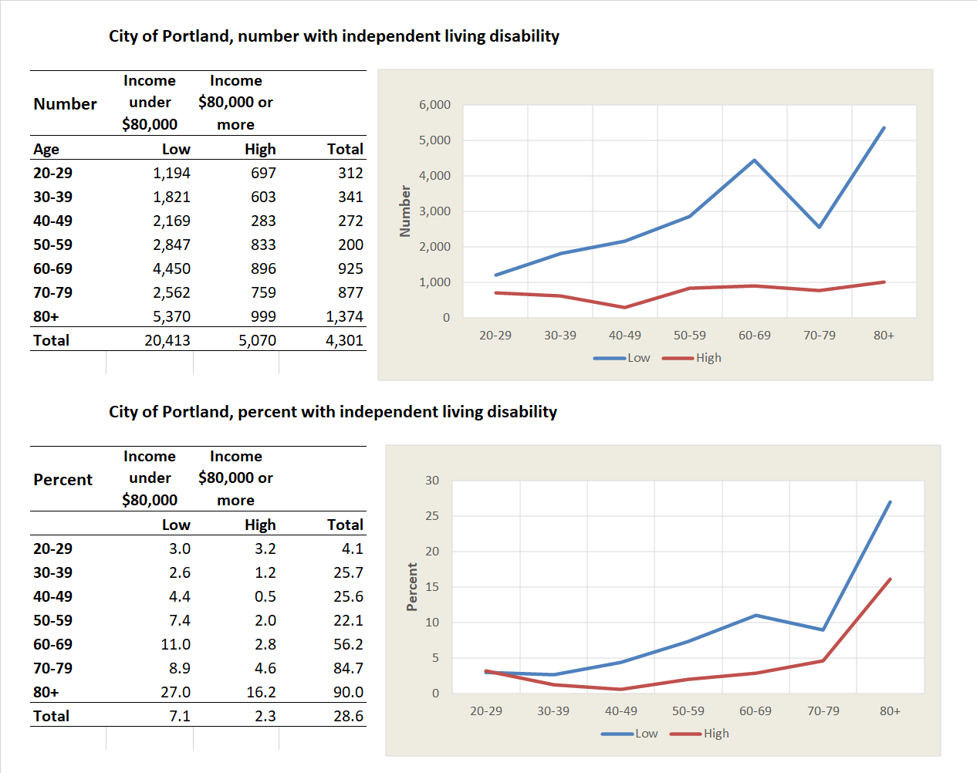
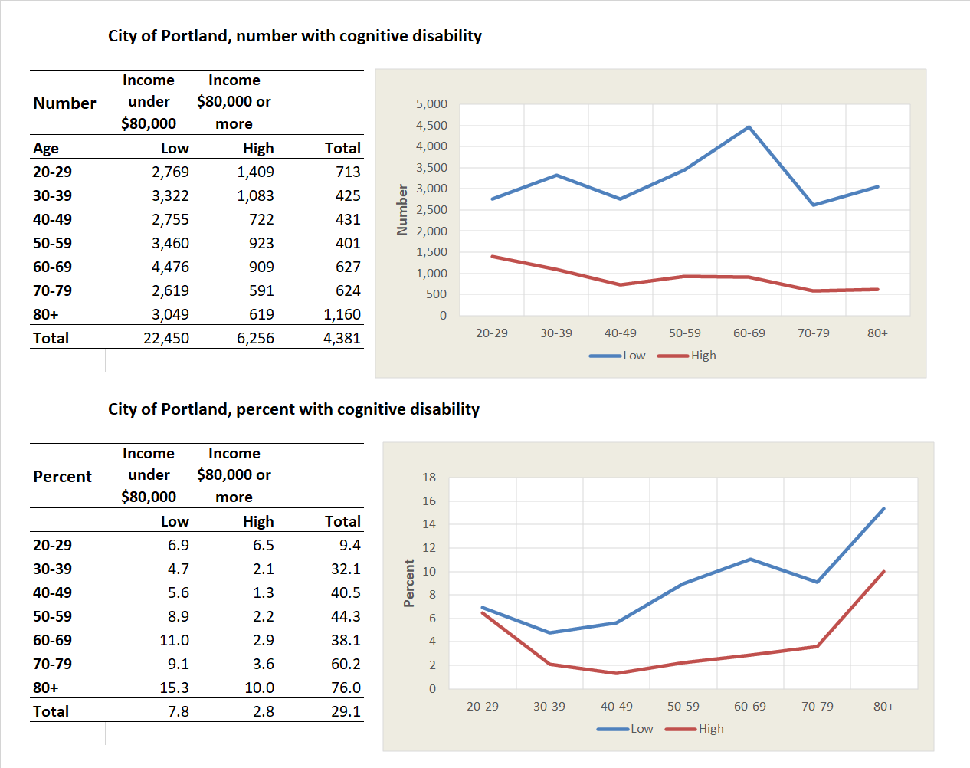
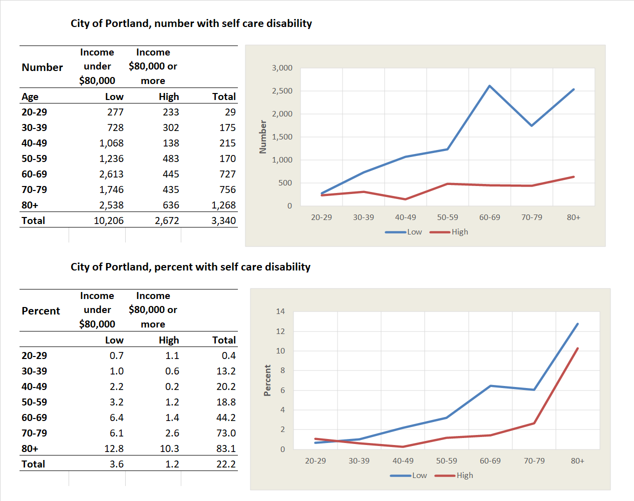
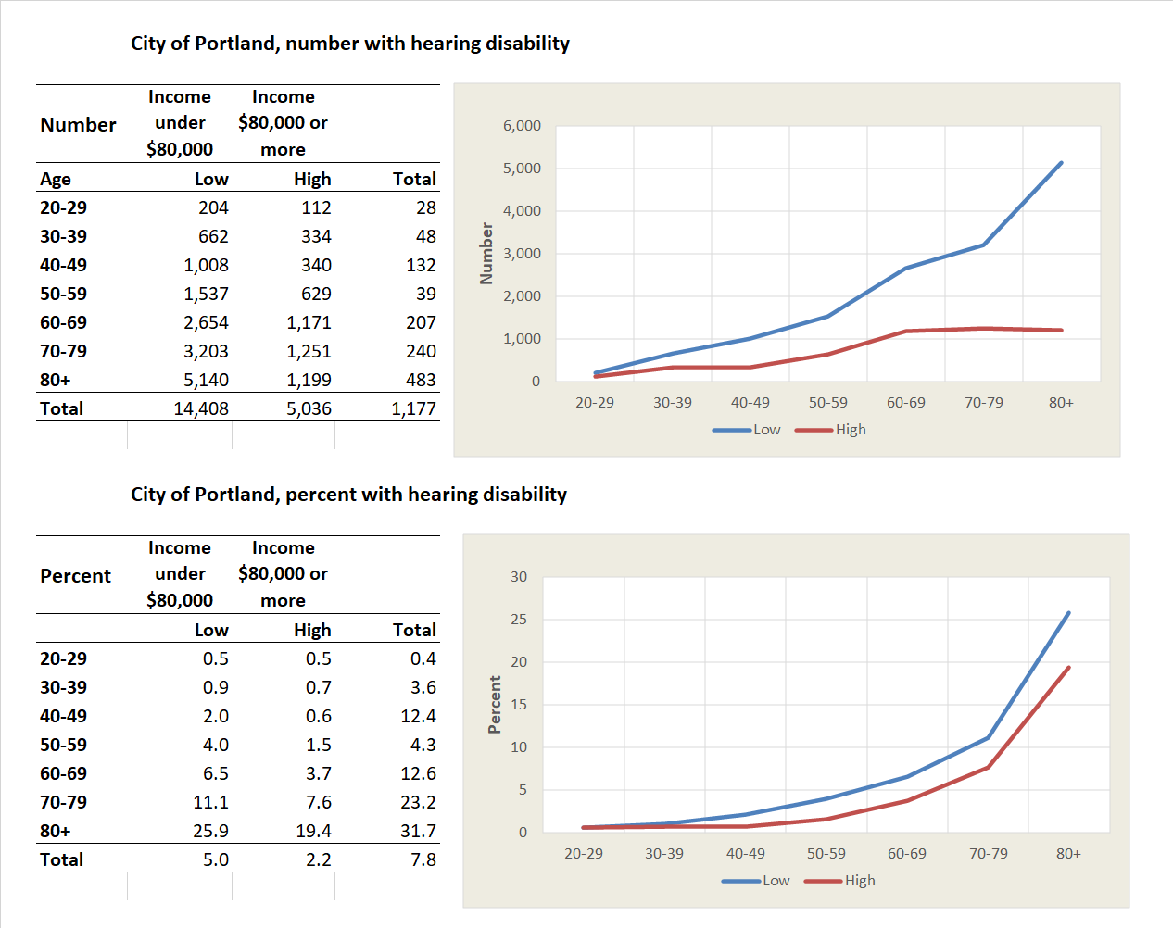
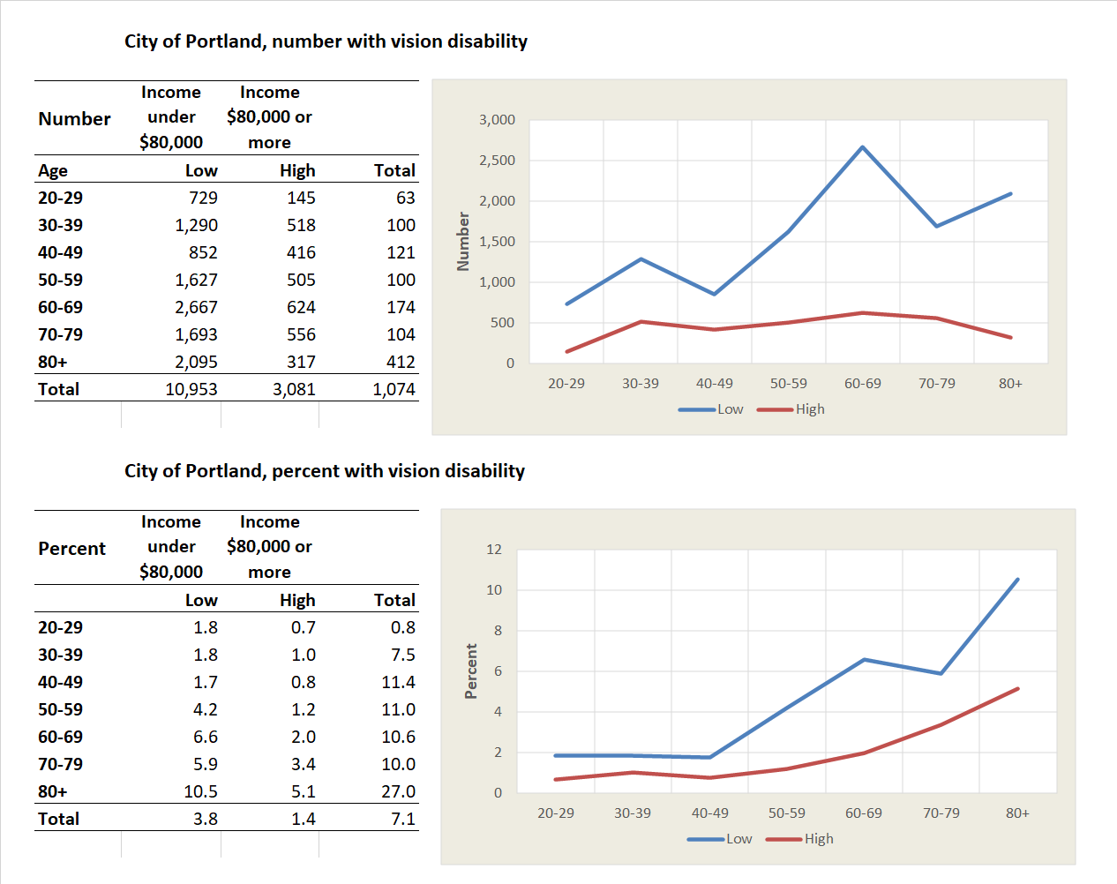

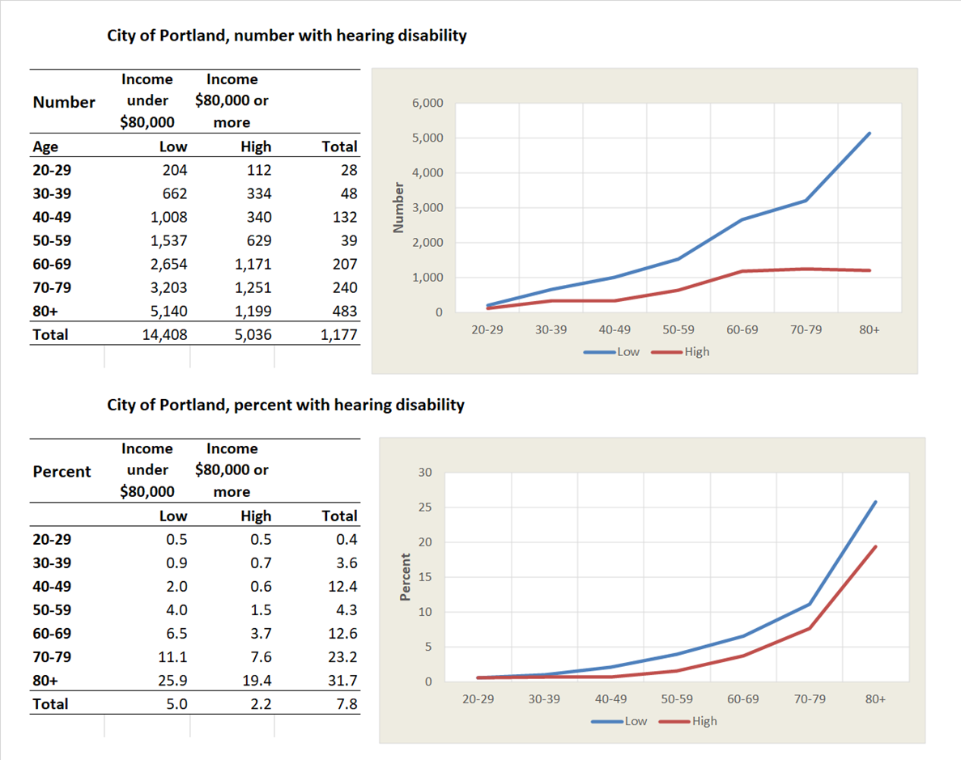
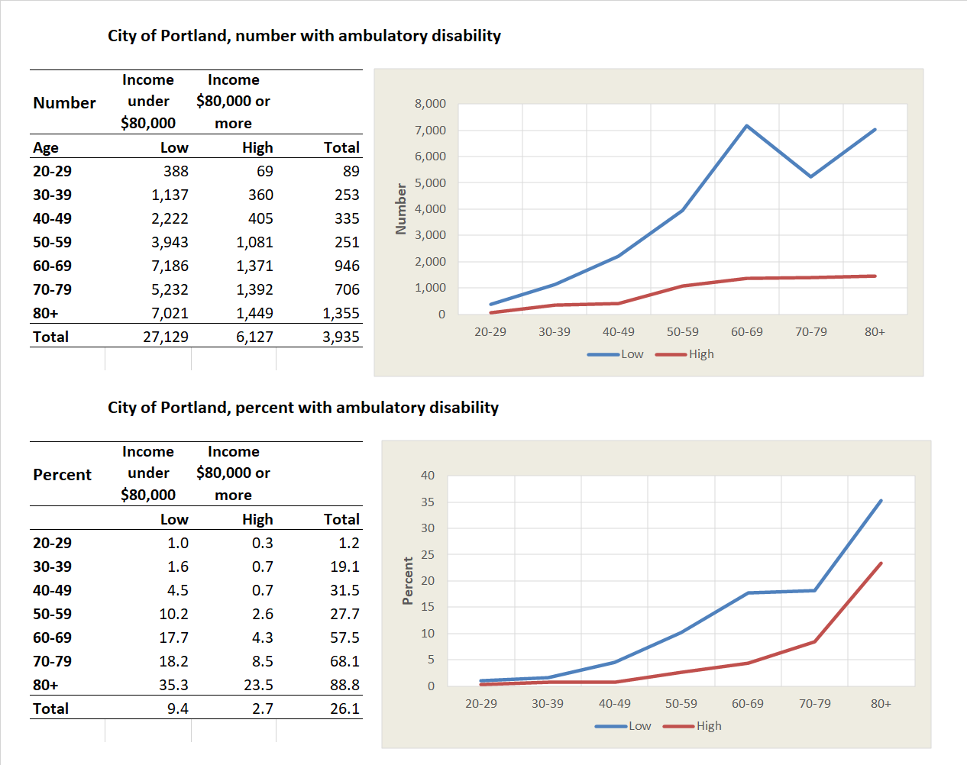
Disability, Income, and Age for the City
11
Ambulatory disability shows the greatest difference in incidence by income, higher by 13.4% for the 60-69 age group with lower incomes.
For the other disabilities, the differences in incidence by income range downward from independent living at 8.2% to hearing at 2.8% .
The two disability types most different in the incidence by age and income are hearing and cognitive. For cognitive disability, the difference in incidence by income is large across all age groups.
For hearing disability, differences in incidence by income are small for all age groups.
The following slides show results for ambulatory, independent living, self-care, cognitive, hearing and vision disabilities. They show values for Portland and its inner and outer suburbs and the variation in disability rates by income and housing type and tenure.
Source: ACS 2017 5-year data, Public Use Microdata
O

Slide 12
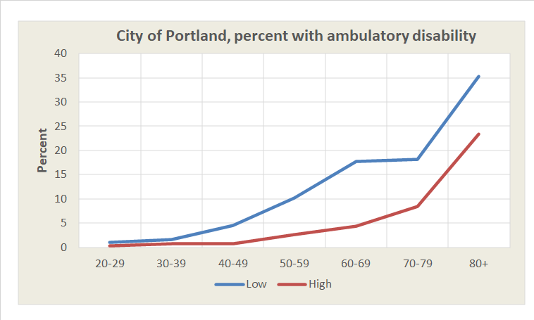
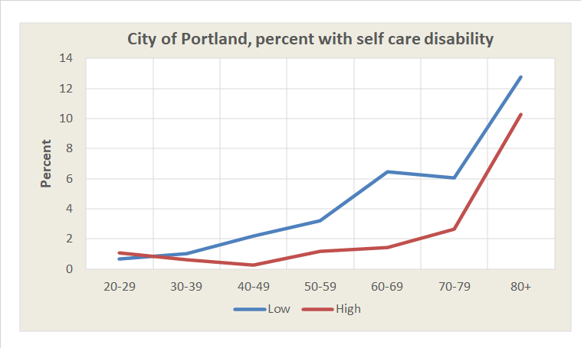
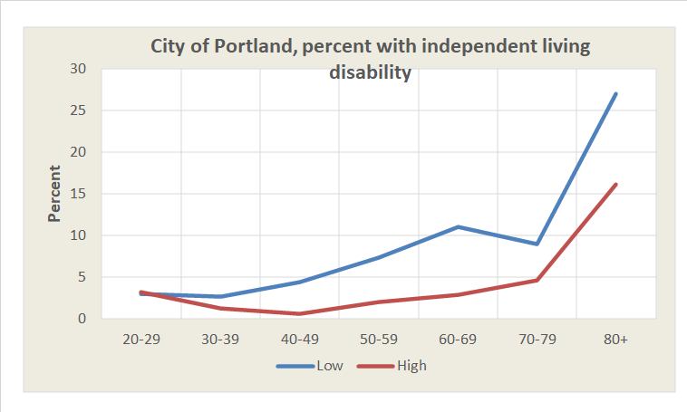
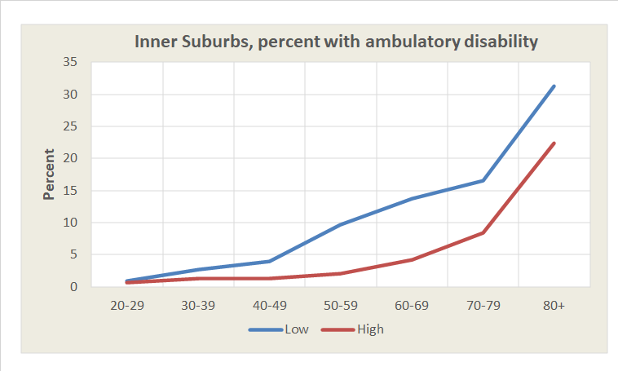
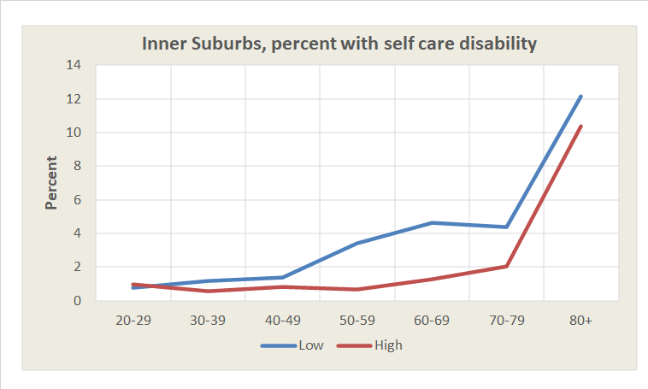
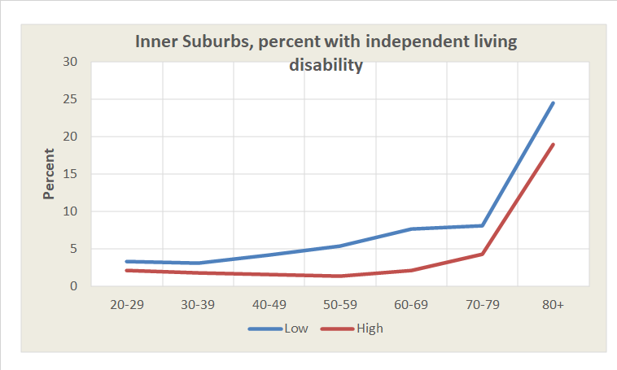
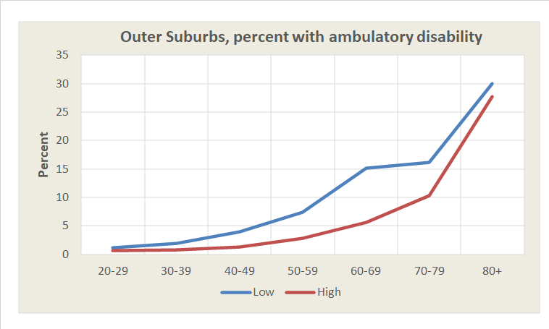
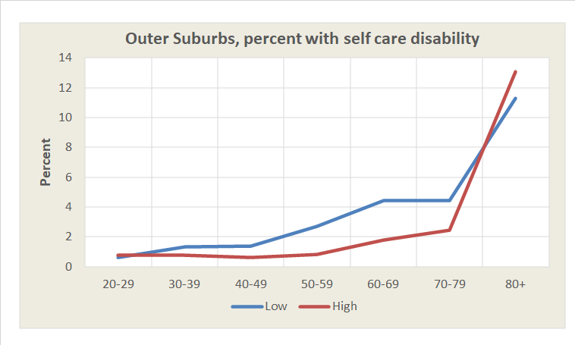
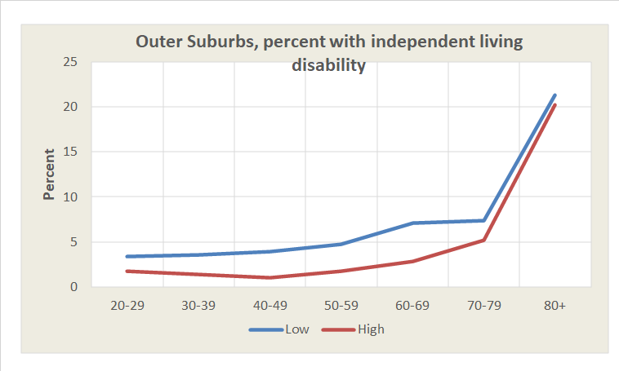
City-Suburb Differences by Income:
Ambulatory, Self-Care, Independent Living Disability
12
The general observable pattern is that all 9 charts share some similarities, including:
  There is a peak in the incidence of disability for the age 60-69 group with low incomes.
  The incidence of disability for lower income persons flattens for the 70-79 age group and steepens for the 80+ age group.
The impact of income on incidence of disability appears to be greater for the older age groups in Portland (top row of charts) compared to those in the inner and outer suburbs.
Source: ACS 2017 5-year data, Public Use Microdata
O

Slide 13
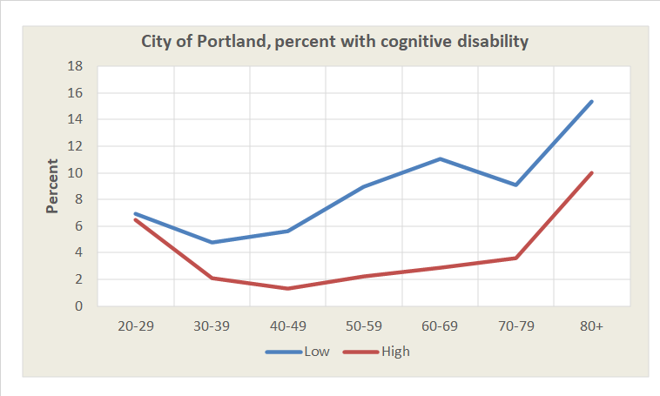
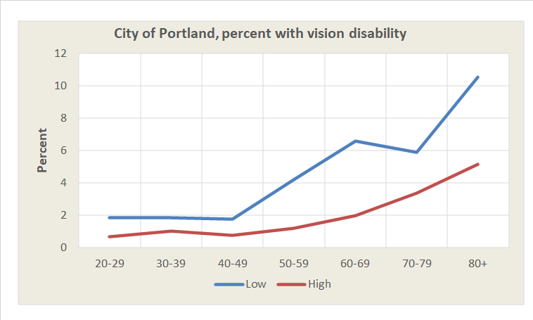
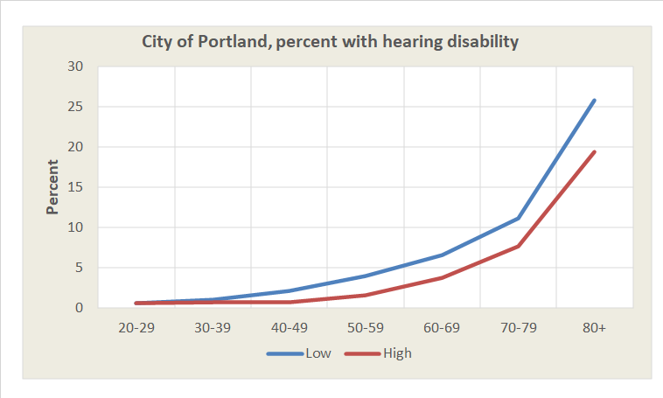
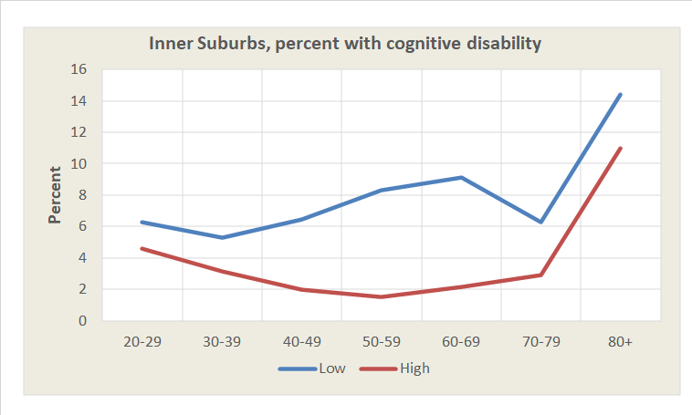
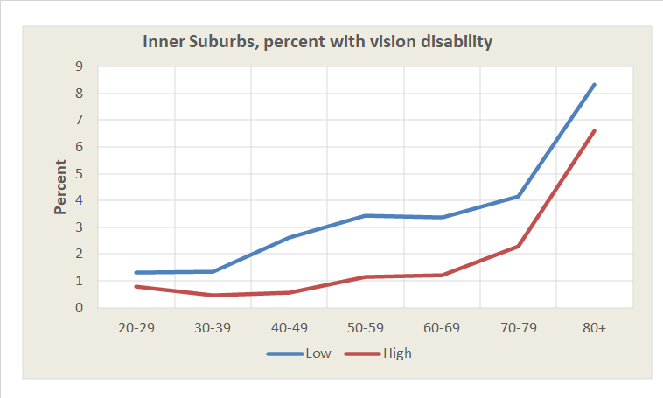
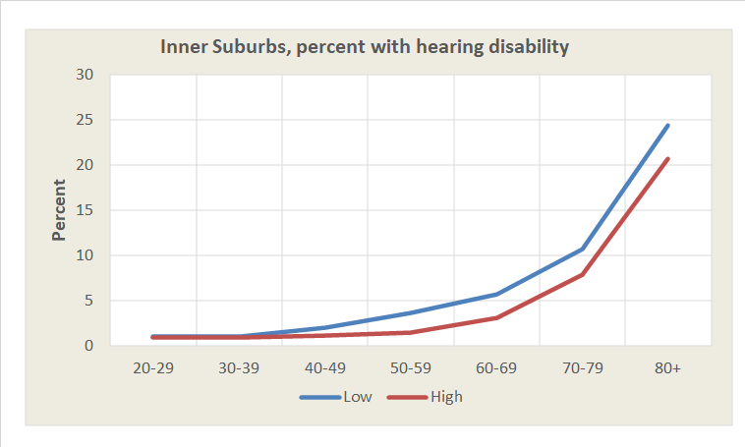
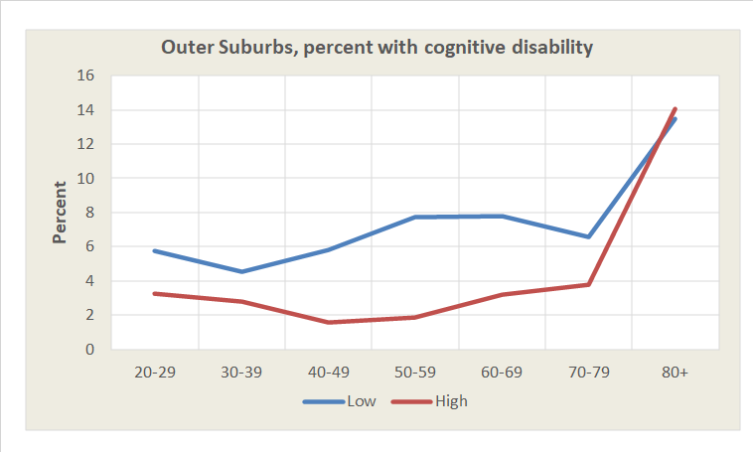
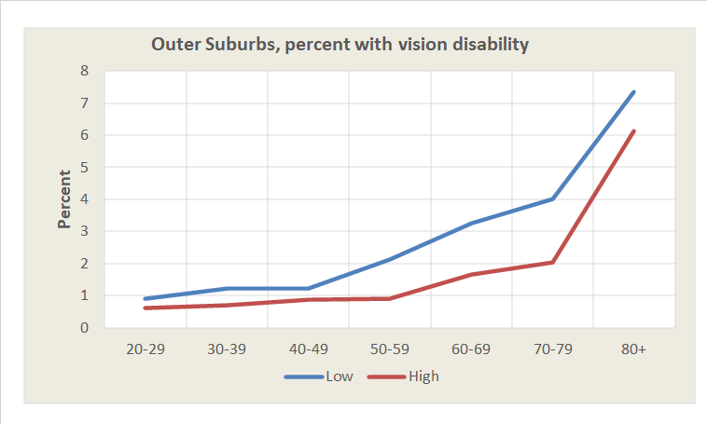

City-Suburb Differences by Income:
Cognitive, Vision, and Hearing Disability
13
The charts for these three types of disability appear to show the same patterns as those for the previous three types.
In general, the differences in percentages with disability by income tend to be greater for those in the city of Portland compared with those in the inner and outer suburbs.
The impact of income on incidence of disability among these categories appears to be most pronounced for cognitive disability (left row of charts) for those in the 40s, 50s and 60s.
Source: ACS 2017 5-year data, Public Use Microdata
O

Slide 14

Calculating City Differences for Disability, Age 65+
14
Average
Table of Contents
What is a disability?
Disability by socioeconomic measures
Comparison cities
Housing type and tenure
City-Suburb
Mapping of disability
Health insurance
Hispanics and Blacks
The averaged MAPE (Mean Absolute Percentage Error), on the top line, was used to rank the difference between Portland and each of the 20 comparison cities.
The values in red on the blue bars are the MAPE values. MAPE is the averaged of the sum of the absolute differences in percent between Portland and the six cities most and least like Portland.
The numbers in black are the detailed disability rates for all age groups by sex, race/Hispanic origin, age, and for those age 65+ by type of disability.
Portland is most similar to Las Vegas, Minneapolis, and Sacramento.
Portland is least similar to Fresno, Charlotte, and Detroit.
Example
O
Source: 2018 ACS five-year data, table S1810

Slide 15

The 20 Comparison Cities by Disability for Aged 65+
15
Here is a summary of the MAPE data on the previous slide but for all 20 comparison cities.
Portland was most like Las Vegas, Minneapolis, and Sacramento.
Portland was least like Fresno, Charlotte, and Detroit.
Disability rates by age, race/Hispanic origin, and sex resulted in high difference measures Detroit and Charlotte and Portland.
Among the disability measures ambulatory, self-care, ambulatory, and independent living differentiated Fresno, Charlotte, and Detroit from Portland.
Source: 2018 ACS five-year data, table S1810
O

Slide 16


Disability by Housing Type and Tenure
16
This series of slides shows disability rates by housing type and tenure.
Results on this slide are for the 7-county Portland Metropolitan Area and the city of Portland.
Broad housing classes shown are:
  GRP – Group quarters, long-term care/nursing homes
  CND – Condominiums
  APT – Rented apartments
  SFR – Single family, rented
  SFO – Single family, owned
The housing mixes are shown for those with:
  a disability
  no disability
Two versions of the chart are shown:
  numbers
  percent of the total
Table of Contents
What is a disability?
Disability by socioeconomic measures
Comparison cities
Housing type and tenure
City-Suburb
Mapping of disability
Health insurance
Hispanics and Blacks
Note: Most assisted living and independent living units are captured in the APT category.
In the following animations refer to the percent with disability for context (upper right chart).
Source: ACS 2017 5-year data, Public Use Microdata
O

Slide 17






Disability by Housing Type and Tenure for the City
17
For persons age 50+ progressing from ambulatory, to independent living, to self-care:
  The proportion of older persons with a disability residing in group quarters grows.
  The proportion in single-family owner-occupied is lowest for people with a self-care disability.
Cognitive disability is high for younger persons as compared to ambulatory, independent living, and self-care.
The numbers for older persons with a cognitive disability increase with age, as does the proportion of people living in group quarters.
For people with hearing and vision disabilities, the number of older persons in single-family housing is higher than for other types of disability.
Source: ACS 2017 5-year data, Public Use Microdata
O

Slide 18












Disability and Housing, City and Metropolitan Area Comparison
18
This set of slides compares the city of Portland and the metropolitan area with respect to housing arrangements for people with each of the six types of disability.
The two upper charts for with disability are the best for comparison.
Do you see any major differences for older persons in the groups age 60+?
Housing type by disability appears to be affected by the opportunities, with more condominiums and apartments existing in the city of Portland, but otherwise, the city and its enclosing metropolitan area are similar.
Source: ACS 2017 5-year data, Public Use Microdata
O

Slide 19






Disability by Housing Type
19
These charts are for the city of Portland and display the number and proportion of people with and without the six disability types.
General trend: People with a disability are more likely to live in an apartment, rather than a single-family home that is owned.
People in the 70s and later with a disability are more likely to live in group quarters than those without a disability.
Those with independent living, self-care, or cognitive disabilities are more likely to live in group quarters beginning in their 60s.
Source: ACS 2017 5-year data, Public Use Microdata
O

Slide 20

Mapping of Disability
20
The next section shows maps of the six types of disabilities reported in the American Community Survey.
All of the maps are for the age 65+ population.
Because we are showing small subgroups (e.g., age 65+, with a disability, in the city) the sampling errors are relatively large.
To partly overcome the problem of sampling variation we group 6-8 of the tracts into supertracts (red-brown borders), which approximate the City of Portland’s 20-minute neighborhoods (e.g., MLK-Alberta, Gateway).
So that the tract and supertract maps may be more easily compared, both use the same class boundaries and color shades.
The city of Portland boundary is shown a black dashed line.
The darker orange shade shows the census tracts and supertracts that best approximate the City.
Table of Contents
What is a disability?
Disability by socioeconomic measures
Comparison cities
Housing type and tenure
City-Suburb
Mapping of disability
Health insurance
Hispanics and Blacks
O

Slide 21




Census Tract or Supertract?
21
These maps show the proportions of residents age 65+ with ambulatory and cognitive disabilities, the most (ambulatory) and least common types of disability (cognitive), by census tract (CT) and for supertracts (ST) aggregations of 6-8 census tracts.
Aggregating the data from census tracts to supertracts reduces the sampling variability for the more and less common disabilities.
However, the aggregation to supertracts helps more for cognitive disability, where the numbers observed in the sample are smaller.
A hint regarding the extent of sampling error on the census tract maps is the large variability between adjacent tracts. Back up and see if you can see this pattern (e.g., Roseway Cully tracts).
Source: ACS 2018 5-year data, Tables B18002 and B18005
O

Slide 22









Metro Area Disability for 65+ Population by Supertract
22
This sequence of maps walks through the 6 types of disability for those age 65+ in the region.
The first map shows the incidence of any disability. High values in Portland’s eastern neighborhoods and St. Johns are common to the various disability types and maps.
A map combining the incidence of disability with a bar chart showing the 6 disability types summarizes the prior maps.
Some key features are:
  There are high values on all or most of the 6 types of disability in Portland’s eastern neighborhoods and St. Johns.
  There is a preponderance of mostly low values in the band of neighborhoods in the inner east side.
  There is an anomaly of high cognitive disability in the Central City neighborhood.
This map of incidence of two or more disabilities confirms the earlier patterns shown. The tracts in brown have a high rate, while those in blue have a low rate.
Source: 2018 ACS 5-year data Tables B18102 - B18107
O

Slide 23



Statistics for Maps
23
These data are compiled from the 2013-2018 ACS data for supertracts and are for persons age 65+ in the 7-county Portland Metropolitan area.
This chart shows the proportion of persons with various disabilities. Note that ambulatory (grey) and cognitive disability (yellow) barely overlap, indicating that nearly all supertracts scored higher in the proportion with ambulatory than cognitive disability.
This table shows various statistics for types of disability for supertracts. Note the ordering is similar for mean and median.
The disability rates for supertracts were correlated. The highest rate of correlation is 0.626 for vision and cognition.
If the census tract-level variables on which the maps are based are highly correlated, then the maps will tend to look similar.
Proportion with Disability
Correlations
Source: 2018 ACS 5-year data, Tables B18102 – B18107
O

Slide 24


Cognitive Disability,
Aged 65+ Population
24
On the census tract-level map, the rates of cognitive disability appear quite variable, likely due in part to the small sample size. However, the Central City, east side tracts, and north Portland appear to show higher rates.
Aggregated to the supertract level it is clearer that the rates of cognitive disability are highest in the Central City and high in the Centennial-Glenfair-Wilkes and 122nd and Division supertracts.
Both maps use the same colors and classes (i.e., color-coded categories that separate the proportions with a disability in the upper-right corner).
The larger variations in the tract-level data are averaged out so the supertract map shows less variability.
Source: 2018 ACS 5-year data, Table B18104
O

Slide 25

Ambulatory Disability,
Aged 65+ Population
25
The city includes many of the census tracts and supertracts that have the highest map class/proportion, i.e., 58.1% or more with an ambulatory disability.
The highest proportions reporting ambulatory disabilities are in the Gateway, 122nd and Division, Lents–Foster, and St. Johns supertracts.
Two supertracts west of the Willamette – Northwest and Tryon Creek-Riverdale – are in the lowest class, i.e., less than 19.6% who reported an ambulatory disability.
Source: 2018 ACS 5-year data, Table B18105
O

Slide 26

Self-Care Disability,
Aged 65+ Population
26
The city contains two of the supertracts, Gateway and 122nd and Division, in the highest map class (i.e., 25.5% or higher) who reported a self-care disability.
A number of the supertracts in the more affluent areas west of the Willamette River and on the inner east side, are in the lowest or next lowest map classes, i.e., 1.8-6.6% and 6.7-10.3%.
Source: 2018 ACS 5-year data, Table B18106
O

Slide 27

Independent Living,
Aged 65+ Population
27
The census tract map shows broad distribution of people reporting an independent living disability, although it is important to account for margins of error when considering these data.
When aggregating to supertracts, several of those with the highest or next-to-highest proportion with an independent living disability – 20.5% or greater – are in the eastern part of the city and region.
Proportions with an independent living disability also are high in the Central City and St. Johns supertracts.
Hillsdale–Multnomah–Barber, West Portland, Tryon Creek–Riverdale, and Hollywood supertracts are in the lowest map class, i.e., 6.6 % or lower who reported an independent living disability.
Source: 2018 ACS 5-year data, Table B18107
O

Slide 28

Vision Disability,
Aged 65+ Population
28
The census tract maps show a somewhat spread-out distribution of people reporting a vision disability, but these data should be compared with the supertracts.
At the supertract level, those reporting vision disabilities age 65+ are also fairly spread out.
However, we can see a discernable pattern of high rates of vision disability in the Interstate Corridor and Central City, and the supertracts in the eastern areas of the city and region. The 122nd and Division supertract shows the highest proportions reporting a vision disability.
Source: 2018 ACS 5-year data, Table B18103
O

Slide 29

Hearing Disability,
Aged 65+ Population
29
A previous slide showed that the spatial distribution of hearing disability is not highly correlated with the other types, the highest being independent living with a correlation of 0.444.
In Portland the highest incidence of hearing disability is in southeast and north Portland supertracts and in the Central City.
The largest cluster of lower rates is in the MLK-Alberta, Roseway-Cully, and Parkrose-Argay neighborhoods.
Rates also are lower in the Belmont-Hawthorn-Division, Selwood-Moreland-Brooklyn, Tryon Creek-Riverside, and Northwest supertracts.
Source: 2018 ACS 5-year data, Table B18103
O

Slide 30

Health Insurance by Age, Disability, and Insurance Status
30
Data are for persons with or without a disability.
Table of Contents
What is a disability?
Disability by socioeconomic measures
Comparison cities
Housing type and tenure
City-Suburb
Mapping of disability
Health insurance
Hispanics and Blacks
This chart shows health insurance coverage by age for those with or without a reported disability.
Data for the city of Portland show that 36.1% of persons age 65+ reported a disability.
99.4% of all those age 65+ were covered by health insurance – public, private, or both – whether they reported a disability or not.
By contrast, 10.4% of the age 19-64 population reported having a disability. 92.5% of those with a disability had health insurance and 90.7% of those with no disability had health insurance.
For those with no disability, private health insurance provided coverage for most of those age 19-64 (85.8%), compared to 62.3% of those age 65+.
Source: ACS 2018 5-year data, Table B18135
O

Slide 31


Private Health Insurance, Age 65+
31
The previous slide showed that nearly all of the age 65+ population were covered by public health insurance (98.9%) and many also carried additional private coverage (52.8%).
The following pair of maps use the same class intervals/proportions (see upper right-hand corner) to show the proportion of the age 65+ population covered by private health insurance for those with no disability and for those with a disability.
Private health insurance is more common for those with no disability than for those with, although the range among supertracts is considerable.
The following Portland supertracts stand out for their low levels of coverage: Lents-Foster, Pleasant Valley, Centennial-Glenfair-Wilkes and Central City.
Source: ACS 2018 5-year data, Table B18135
O

Slide 32




Mapping Disability for Black and Hispanic Populations
32
Mapping disability rates for older non-White populations presents a problem due to small sample size.
The first maps on this slide display the numbers of Black residents by block (U.S. Census, 2010) for all ages, then for those age 65+.
The next two maps show the same data rendered as dot maps, with one dot per person (1st all ages, 2nd age 65+).
Observe that many of the supertracts show only a few dots for Blacks age 65+, providing a poor basis for estimating the proportion with any or some particular type of disability.
Good
Not good
Notes:
The numbers of Blacks age 65+ enumerated in the 2010 census for each block were randomly scattered within the block using ESRI’s ArcMap area to random point tool.
Disability data are not collected in the decennial census.
O

Slide 33



Mapping Disability for Blacks Aged 65+ by Supertract
33
This series of maps shows the proportion of Blacks with any disability in shades of red.
The following 3 maps are parsed by the number of Blacks age 65+ in the supertract, with the first starting with more than 10 Black individuals, then more than 50, then more than 100.
The 1st map, showing areas with 10 or more Blacks age 65+ shows a high disability rate for the Hollywood neighborhood and a low rate for Montavilla. Back up to see this.
However, as we filter out blocks with too few Blacks, those areas are dropped off the map.
What we can say with a high degree of certainty is that older Blacks in the historically Black neighborhoods have a high rate of disability.
Source: 2018 ACS 5-year data, Table B18001B
O

Slide 34





Mapping Disability for Hispanics Aged 65+ by Supertract
34
This series of maps was constructed in the same way as the previous series for Blacks age 65+ on the previous slide.
Walk through the series to see what can be best substantiated.
Because there are more Hispanics than Blacks in the Portland Metropolitan Area, the disability rate for more supertracts can be substantiated.
Several Portland supertracts show high disability rates for Hispanics compared to suburban areas, but rates also are high in some suburban areas (e.g., Gresham Central, Vancouver Heights, Witch Hazel-Orenco).
The highest observed rates are in the city of Portland were Lents–Foster and Sellwood–Moreland supertracts.
Note: As discussed in the Race section, the Hispanic non-White population age 65+ is more dispersed than the Black population, even before controlling for disability.
Source: 2018 ACS 5-year data, Table B18001I
O

Slide 35

End of Section on Disability
35
Table of Contents
Back to beginning
What is a disability?
Disability by socioeconomic measures
Comparison cities
Housing type and tenure
City-Suburb
Mapping of disability
Health insurance
Hispanics and Blacks
O
Souce: Final_PPT_Links\R8_Disability_8_6.27.27_DRL5_AKD3.pptx

Slide 36
The State of Aging in Portland
Information on Data Sources
and Geographies
Background for study
The Decennial Census
The American Community Survey (ACS)
Supertracts
The American Housing Survey (AHS)
20 Comparison cities
Geography issues
Portland’s Inner and outer suburbs
The ACS Public Use Microsample
Nomenclature for race and ethnicity
Census group quarters
O

Slide 37

About The State of Aging in Portland Report and Navigating the Findings
O
O
O
O
O
O
O
O
O
O
O
O
O
O
O
O
O
O
This presentation includes seven sections developed as part of a study for the City of Portland by the Institute on Aging at Portland State University (PSU), Portland, Ore. The study, titled The State of Aging in Portland, was undertaken to provide guidance to local government and members of the broad and informal “aging network” of service providers, advocates, and others in Portland and the region so that that they can better understand, and address trends related to Portland and the region’s population aging.
Funding source: The City of Portland, Community Health and Access program.
Project staff included:
  Alan DeLaTorre, PhD, Adjunct Faculty, Institute on Aging, PSU; team leader and analytical perspectives; aland@pdx.edu (he now serves as the City of Portland’s Age-friendly City program manager and can be contacted at Alan.DeLaTorre@portlandoregon.gov)
  D. Richard Lycan, PhD, Professor Emeritus and Senior Research Associate, Institute on Aging, PSU; volunteer, analyst of demographic data, mapping, and creator of PowerPoints; lycand@pdx.edu
  Margaret B. Neal, PhD, Professor Emerita of Urban Studies and Planning and former Director of the Institute on Aging (2003-2017); analyzed age-related differences and similarities in responses to the City’s survey on livability, the 2019 Portland Insights Survey; nealm@pdx.edu
  Paula Carder, PhD, Director of the Institute on Aging; project oversight; carderp@pdx.edu.
Additional support was received from faculty at PSU’s Institute on Aging and Population Research Center, and staff from the City of Portland, Metro, Multnomah County, and Home Forward.
We encourage viewers to make full use of our work, including maps and charts, in their research. Content is best viewed using the web-based iSpring modules (see navigation tips below). Content, such as maps and charts, may be best accessed from downloaded PowerPoint files as they will have the highest resolution for viewing and reuse.
Individual pages of this report may be cited as:
  DeLaTorre, A., Lycan, D. R., & Neal, M. B. (2021). State of Aging in Portland. Institute on Aging, Portland State University, slide no. #. Retrieved from: https://soaportland.cupa.pdx.edu/.
Software used in this study:
  From Office 365 Excel for analysis and building tables and charts and PowerPoint for slide creation.
  From Environmental Research Institute ArcMap 10.4 for geospatial analysis and mapping.
  From iSpring eLearning Software iSpring Converter Pro 10 to transform PowerPoint to HTML5.
  From IBM SPSS statistics for data analysis
Menu

Slide 38
The Decennial Census
O
O
Variables
2010 Census
  Household: Household size, home ownership, families
  Demographic: Age, race, Hispanic origin, gender, marital status
2000 and earlier: Above, plus additional socioeconomic variables.
Issues with Census data
  The latest 2010 data are 10 years old. Results of the 2020 census should be available in September 2021.
  The tables in the State of Aging report should be updated when the 2020 data become available.
  Only the data listed under Household and Demographic are available but there are hundreds of cross-tabulation tables.
How Census was Used for this Study
  At the census block level to determine age and race of seniors housing and to assess demographic changes.
  At the census tract level to map age, race, and group quarters residents.
  For the city of Portland to get exact counts by age, race, housing type, and group quarters residents.
Access the Census data at: https://data.census.gov/cedsci/
U.S. Census Bureau: https://www.census.gov/programs-surveys/decennial-census.html
Frequency of Data
Collection: Every 10 years
Release: Data Release Schedule
Geographic Levels
Nation, State, County, City, Census Tract and Census Block
Description
The U.S. Census counts every resident in the United States at 10-year intervals, as mandated by the Constitution. It provides a snapshot of each person living in the country on April 1 of the year in which the Census is conducted.
The data collected by the decennial census affect the number of seats a state has in the U.S. House of Representatives and are used to distribute funding and allocate resources across localities and communities.
The 2010 Census reported data on age and sex distributions, race, Hispanic or Latino origin, household relationship and type, the group quarters population, and housing occupancy and tenure (whether the housing occupant owns or rents).
O
O
O
O
O
O
O
O
O
O
O
O
O
O
O
O
Source: Demographic Research Group, Weldon Cooper Center for Public Service,
University of Virginia:
https://demographics.coopercenter.org/guide-to-publicly-available-demographic-data
Menu

Slide 39
The American Community Survey (ACS), Summary Tables
O
O
U.S. Census Bureau, www.census.gov/programs-surveys/acs/
Frequency of Data
Collection: ongoing
Release: Data Release Schedule
Geographic Levels
Nation, State, County, City, Census Tract and Census Block Group
Description
The American Community Survey (ACS) is an ongoing survey that covers a sample of nearly 3.5 million addresses across the U.S. The data are released at 1- or 5- year intervals (the 3-year data product has been discontinued).
The survey provides current data and allows a choice between single-year and multi-year estimates, depending on research needs with respect to currency, reliability and level of geography. The data help local agencies and individuals – in both government, business, non-profits etc. – to better understand their communities and the workforce. The ACS provides information on a variety of subjects, including demographics, economics, housing and social situations/
Variables
Demographic: Age, sex, group quarters population, race, Hispanic or Latino Origin, race, relationship, total population
Economic: Class of worker, commuting to work, employment status, Supplemental Nutrition Assistance Program (SNAP), health insurance coverage, income and earnings, industry and occupation, poverty, work status
Housing: Computer ownership & internet access, house heating fuel, occupancy/vacancy status, occupants per room, owner monthly costs, plumbing facilities, rent statistics, rooms, bedrooms, telephone service available, tenure, units in structure, value of home, vehicles available, year householder moved into unit, year structure built
Social: Ancestry, citizenship status, disability status, educational attainment, fertility, field of degree, grandparents as caregivers, language, marital history, marital status, place of birth, school enrollment, residence one year ago/migration, veterans, year of entry.
Issues with Use of ACS
Substantial sampling error, especially for small geographies such as census tracts
Sample size approximately 2.4% per year, about 12% for five-year data
How ACS was Used for this Study
Socioeconomic data about the city of Portland
Census tract data for analysis and mapping
Aggregation of tract data to supertracts (see next slide)
Access the ACS data at: https://data.census.gov/cedsci/
Back to Housing
O
O
O
O
O
O
O
O
O
O
O
O
O
O
O
O
Source: Demographic Research Group, Weldon Cooper Center for Public Service, University of Virginia:
https://demographics.coopercenter.org/guide-to-publicly-available-demographic-data
Menu

Slide 40



Supertracts
O
O
Supertracts (see red brown) are were created by aggregating 6-8 adjacent census tracts (see grey boundaries).
The supertracts emulated the city of Portland’s 20-minute neighborhoods extended to the seven-county Portland Metropolitan Area.
Portland’s 20-minute neighborhoods were designed to have access to commercial services and amenities as a pedestrian, cyclist, or on transit.
The supertracts also reduced the amount of sampling variability in the data from the American Community Survey. For example, The Lake Oswego supertract (see purple) is the aggregation of 8 census tracts.
The ACS table for the Lake Oswego tracts shows the Estimate (EST) and Measure of Error (MOE) for the number of persons with an ambulatory difficulty. The MOE is the +/- value for the 90% confidence level.
The coefficient of variation (CV) is the ratio of MOE/EST. Values from 0.00 to 0.12 can be considered as good reliability, from .12 to.40 as fair, and over .40 as poor reliable.
All of the tract CV values are greater than 0.40 (poor reliability) but aggregated to supertracts the CV is 0.259 (fair reliability).
In addition, supertracts have recognizable neighborhood names and help to link the data to the viewer’s knowledge of the City.
.
O
O
O
O
O
O
O
O
O
O
O
O
O
O
O
O
8
Menu

Slide 41
The American Housing Survey (AHS)
O
O
The American Housing Survey (AHS) is sponsored by the Department of Housing and Urban Development (HUD) and conducted by the U.S. Census Bureau. The survey has been the most comprehensive national housing survey in the United States since its inception in 1973.
The AHS is a longitudinal housing unit survey conducted biennially in odd-numbered years, with samples redrawn in 1985 and 2015.
It provides up-to-date information about the size, composition, quality and cost of housing in the United States and major metropolitan areas and measures changes in our housing stock as it ages.
Returning to the same housing units every other year to gather data until a new sample of housing units is drawn, the AHS allows users the unique opportunity to analyze housing and household changes over time.
The survey’s principal coverage is of the 15 largest metropolitan areas in the United States. Portland is not one of the top 15 but data are available for 2019, 2015, and 2011.
The AHS has a relatively small sample size, 117,422 units for the nation and only about 3,000 per metropolitan area. Many of the fields for the Portland data are suppressed due to insufficient sample size.
The wide range of core housing topics covered in the ACS include but are not limited to the following:
  size and composition of the nation's housing inventory
  vacancies
  owners and renters
  physical conditions of housing units
  equipment breakdowns
  characteristics of occupants
  housing and neighborhood quality
  mortgages and other housing costs
  fuel usage
  home improvements
  persons eligible for and beneficiaries of assisted housing
  characteristics of recent movers
  home values.
How AHS was Used
  We mainly used the national data from the AHS, as much of the Portland data were suppressed due to small sample size.
Access the AHS: Data available as a public use sample or created using the ACS Table Maker.
Back to Housing
O
O
O
O
O
O
O
O
O
O
O
O
O
O
Menu

Slide 42






Comparison Cities
O
O
When we discuss our city, Portland, we often speculate about how it is similar or differs from our neighbor to the north, Seattle. We decided to extend the comparison of Portland with other cities about the same size.
However, members of the team also wanted to include Austin, Oakland, and Minneapolis, cities that readers might be familiar with, or cities often compared to Portland.
Here is a list of the 20 comparison cities, 10 larger and 10 smaller, ordered by their population.
As an example of how we used the comparisons, here is a chart that shows, for each of the comparison cities and Portland, the city’s proportion of the metropolitan area population.
Portland is in the middle of the pack, compared to the Portland – Vancouver – Hillsboro Metropolitan Statistical Area (MSA).
By comparison, El Paso contains over 80% of the population in the El Paso MSA and Oakland only about 10% of the San Francisco – Oakland – Berkeley MSA.21
O
O
O
O
O
O
O
O
O
O
O
O
O
O
O
O
Menu
Use to go back to the page you were reading or to go to the table of contents for Population.

Slide 43




Geography Issues
O
O
O
O
O
O
O
O
O
O
O
O
O
O
O
O
O
O
Data in the Census and the American Community Survey are reported for the city of Portland, outlined by the dashed dark red line.
We also use data for the 143 census tracts that approximate the city of Portland, referred to in the study as Portland Tracts.
The Portland Tracts are a reasonably good match to the City boundary. The red dots are in the City but outside of the Portland tracts, and the green dots are in the Portland tracts but outside of the City.
Overall, the Portland Tracts undercount the total population by 1% and overcount the age 65+ population by 0.2%.
One of the cases where we use the Portland Tracts definition of the city is in comparing the city to its inner and outer suburbs.
Here the city boundary is in red, the Portland Tracts in dark brown, the inner suburbs in light brown, and the outer suburbs in yellow.
The city and its inner and outer suburbs each have approximately 1/3 of the Portland-Hillsboro-Vancouver MSA population.
See the “About” report on City, Inner, Outer for more details.
Menu

Slide 44



The City and its Inner and Outer Suburbs
O
O
O
O
O
O
O
O
O
O
O
O
O
O
O
O
O
O
We created inner (see light brown) and outer (see yellow) suburbs zones around the city of Portland (see dark brown), with approximately the same population in each of the three zones.
In the case of this three-region geography, the city of Portland is defined as the collection of 143 census tracts that approximate the City.
One of the reason for this delineation is that much of the detail reported in the Census and the American Community Survey is for census tracts.
However, when we use supertract data, the delineation between the inner and outer suburbs is slightly different.
  The tracts marked in a blue X are included in the inner suburbs, and those with the red X are excluded.
  The city is the same for tracts and supertracts, but the inner and outer definitions are different.
There is a similar problem when we attempt to aggregate Public Use Microsample Areas (PUMAs) into city, inner, and outer suburbs.
  The city of Portland is composed of five PUMAs, and these five PUMAs comprise the 143 census tracts.
  However, the inner suburbs have a slightly different delineation with supertracts.
The lavender blue PUMAs are excluded from the outer suburbs, as they extend well beyond the Portland MSA. PUMA 4100500 includes Clatsop and Lincoln Counties.
We use the Public Use Microsample to create a number of custom tables and need to use the PUMA base regions.
4
3
1
5
2
Menu

Slide 45

ACS Public Use Microdata
O
O
The Census Bureau’s American Community Survey (ACS) Public Use Microdata Sample (PUMS) files enable data users to create custom estimates and tables, free of charge, that are not available through ACS pre-tabulated data products. The ACS PUMS files are a set of records from individual people or housing units, with disclosure protection enabled so that individuals or housing units cannot be identified.
The Census Bureau produces ACS 1-year and 5-year PUMS files. These files are accessible using the microdata access tool on data.census.gov and the Census Bureau's FTP site.
Another good source of PUMS data and ideas for using them is IPUMS USA at the University of Minnesota.
Only selected geographic areas are identified in the ACS PUMS, including Region, Division, State, and Public Use Microdata Areas (PUMAs). Of these, PUMAs are the most detailed geographic areas available.
Four PUMAs (red outline) approximate the city of Portland (black dashed line).
How we used the ACS/PUMs data.
  We used the ACS/PUMs data for the seven county Portland MSA to create many custom tables that were not published as ACS summary tables.
  Data for the five PUMAs shown in yellow on the map were used to create custom tables for the city of Portland.
O
O
O
O
O
O
O
O
O
O
O
O
O
O
O
O
Menu

Slide 46
Nomenclature for State of Aging in Portland Section on Race
46
O
O
O
O
The researchers working on the State of Aging in Portland project recognize the complicated, evolving nature of language that pertains to race, ethnicity, and Hispanic origin.
The source data for most of this section come from the United States Census Bureau which has led to the creation of many graphs, charts, and labels that use the conventions adopted in the Decennial Censuses and the American Community Survey, including the use of:
  Blacks, rather than African Americans
  Hispanics, rather than Latino, Latina, Latinx, or Latine persons
  Asians, Hawaiians, and Pacific Islanders, rather than Asians and Pacific Islanders
We have diverted from U.S. Census Bureau conventions for the following:
  We use Native Americans, rather than America Indians, but do refer to American Indian and Alaska Native tribes on a single slide produced from census data.
  We capitalize White, rather than leaving it as a lowercase “w” in following the lead of the National Association of Black Journalist (NABJ; Reference: NABJ Style guide). NABJ recommended that “whenever a color is used to appropriately describe race then it should be capitalized, including White and Brown.”
O
O
O
O
O
O
O
O
O
O
O
O
O
O
O
O
Menu

Slide 47
Group Quarters
O
O
Group quarters in this study
The main types of group quarters for older persons as referenced in this report are:
  Adult family homes
  Nursing homes
  Residential care facilities
All of the above are licensed by the State of Oregon, and we make use of licensing data to generate statistics and maps.
Housing for older persons that are not group quarters
Assisted living units are classified as housing units as they provide for privacy and access to the outside as noted under housing unit to the left.
Independent living facilities are classified by the Census as housing units, not group quarters.
Source for above, Local Planning Handbook, Metropolitan Council, St. Paul, MN.
Census Bureau on Group Quarters.
O
O
O
O
O
O
O
O
O
O
O
O
O
O
O
O
Housing Units
Planners generally use the Census Bureau’s definitions of housing units, households, and population in households.
A housing unit is any single-family residential structure (like a house or a manufactured home) or any distinct unit in a multi-unit building where the unit provides privacy for the occupants, and the unit has access to the outside, and occupants can come-and-go as they wish (not a custodial facility), and occupancy is independent of any institutional affiliation.
A household is a set of people living together in a housing unit. A nice feature of this definition is that the number of households always equals the number of occupied housing units.
Group Quarters
There are residential situations that do not meet all of the four criteria listed above for housing units. The Census Bureau refers to these other residential situations as group quarters.
A group quarters facility is one that houses multiple, unrelated people, where occupants do not have privacy, or there is controlled access to entering/leaving, or it’s a facility that houses only an institutional or service-receiving population.
In the decennial census, group quarters statistics also include makeshift shelters, or places without shelter, where homeless people are found to sleep.
Menu

Slide 48
End of Section on Data Sources and Geographies

