Slide 1
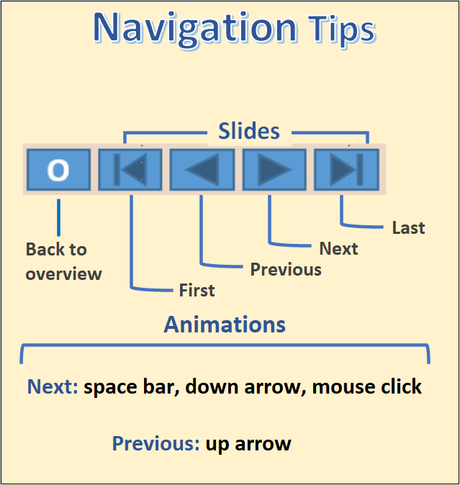

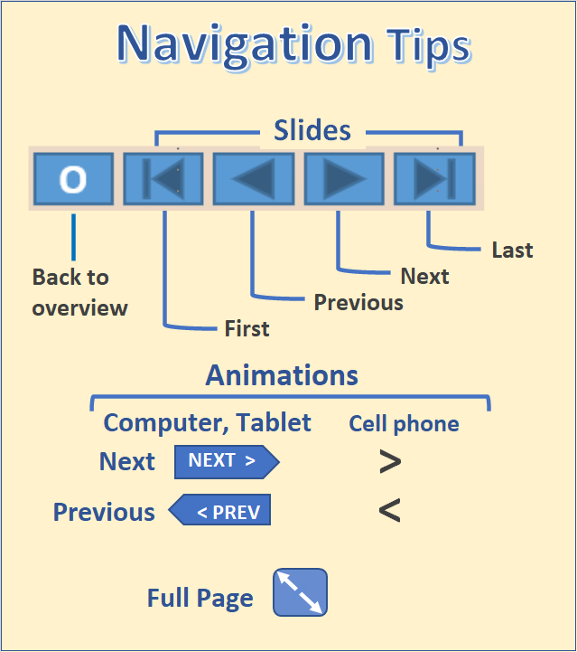
The State of Aging in Portland
Part 4.2 - Affordable Housing Developments for Seniors
1
Overview: Maps and tables
Examples: profiles of selected developments
A classification of senior housing types
Portland Metro’s 2018 Affordable Housing Database lists 21,021 affordable housing units in developments with 5 or more units in the city of Portland, based on a review of the websites for the individual developments.
5,359 of these housing units were restricted by age, income, and disability status. Since disabilities increase with age and are more common for lower income persons, eligibility may occur before the threshold age criteria for a development, usually age 55 or 62.
Whereas market rate assisted living developments are looking at the impending wave of baby boomers, this wave has already crested for residents of affordable housing.
Most of the affordable housing developments have long or closed waiting lists and many more persons are qualified than there are available units.

Slide 2
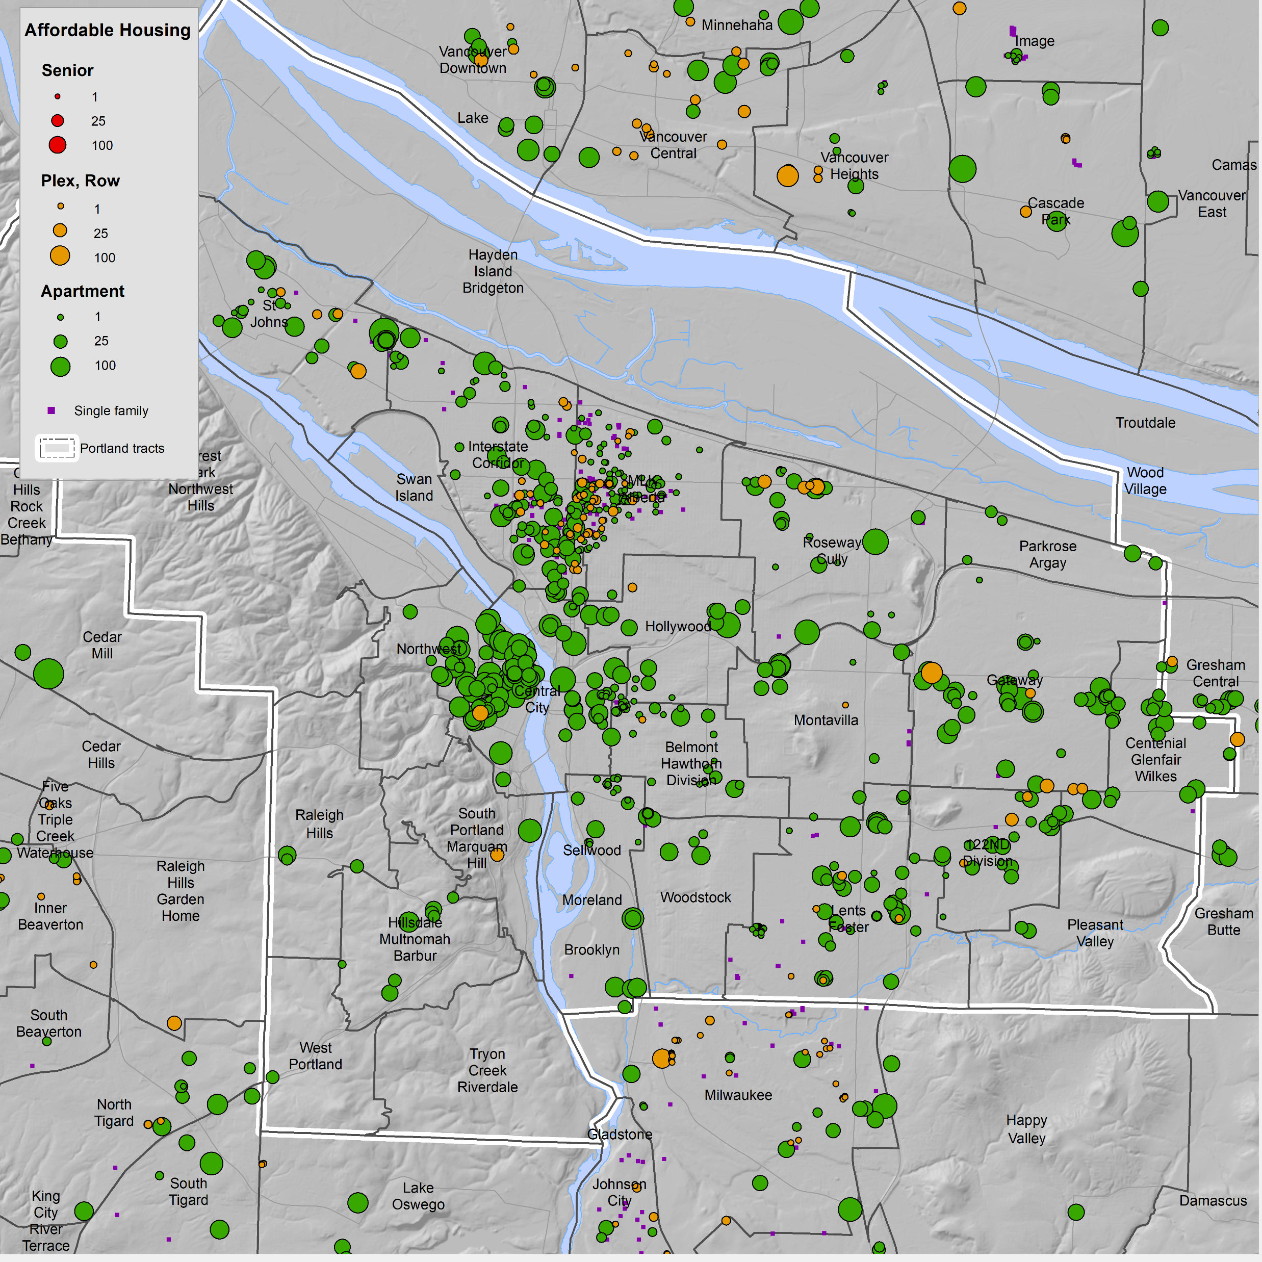
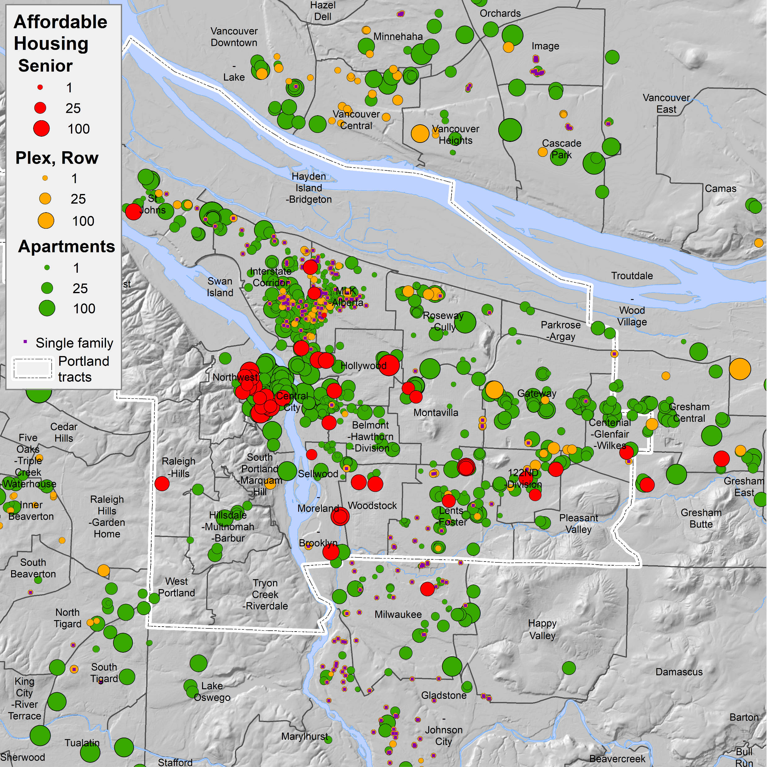
Affordable Housing for Older Persons
2
These data are from Metro’s 2018 Affordable Housing Database. We show these data because many of these housing units house older persons. The areas of the circles is relative to the number of housing units.
Affordable housing is concentrated in the Central City, North Portland, and Interstate Corridor supertracts.
Affordable housing designated for seniors is concentrated in the Central City and Northwest supertracts.
The delineation of senior housing was done by noting comments in the 2018 Metro Affordable Housing database and by checking web listings for the individual developments and sponsor sites.
For senior affordable housing only multifamily with five or more units in the city of Portland are shown.
O
Source: Metro - Affordable Housing Database (2018)

Slide 3
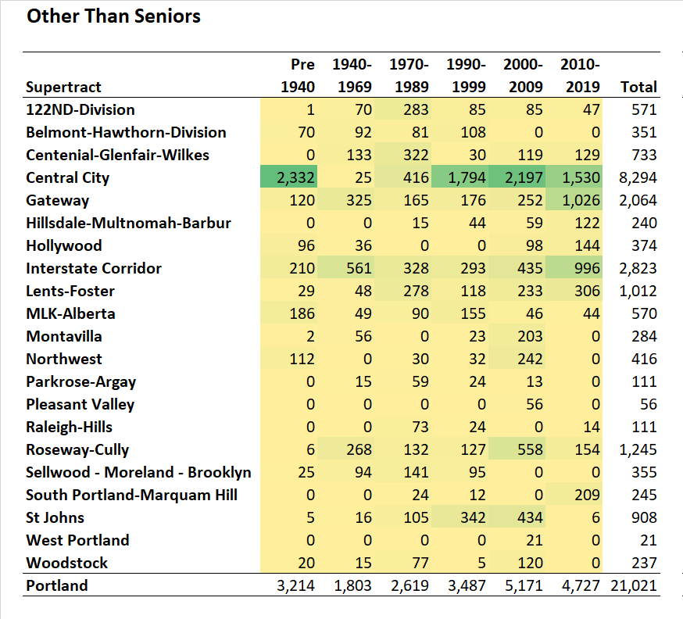
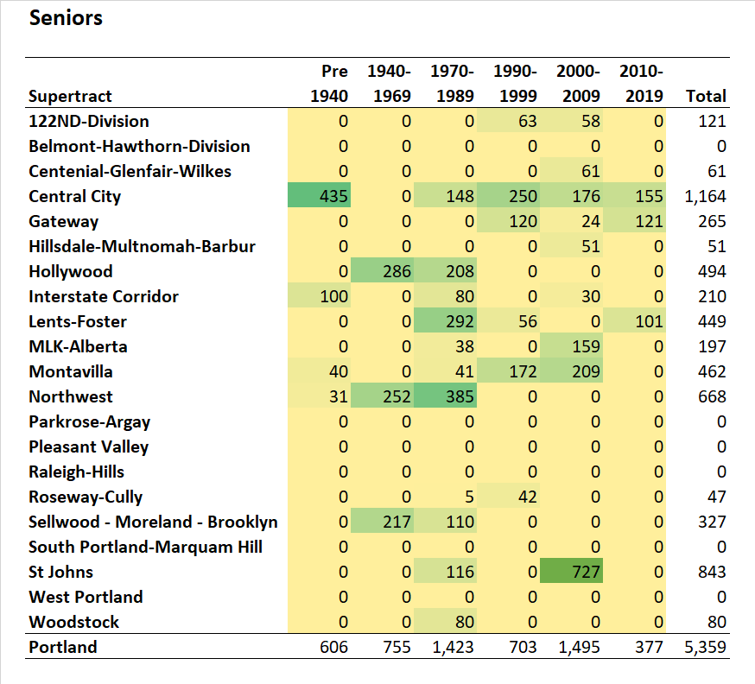
Distribution by Supertract
3
Here are the same data as the previous slide, tabulated by supertract.
Affordable housing for persons other than seniors is highly concentrated in the Central City supertract. The Interstate Corridor, Gateway, Roseway-Cully, and Lents-Foster supertracts also have many units.
A large number of these units have been built since 1990 but there also are many rehabilitated units built before 1940.
With 1,164 units the Central City supertract has the largest number of units for seniors, but the St. Johns area has 843 units.
From 2000 to 2009, 1,495 affordable units for seniors were added; from 2010 to 2019, only 377 units were added.
Source: Metro - Affordable Housing Database (2018)
Learn about supertracts
O

Slide 4
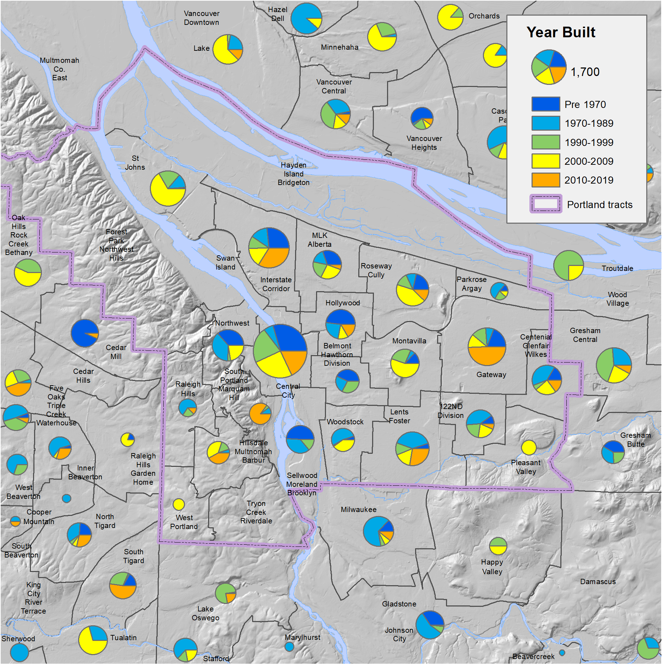
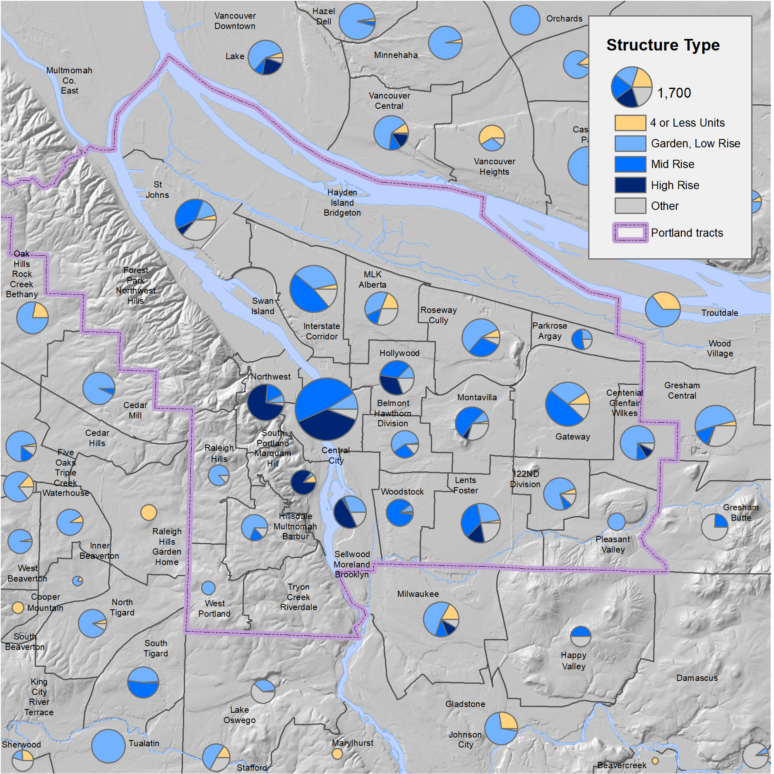
Age and Structure Type of Existing Affordable Housing
4
This first map displays older units (built before 2000) in green and shades of blue; newer units are displayed in yellow and orange (built in 2000 or later).
The Selwood-Moreland-Brooklyn and Northwest supertracts have the highest prevalence of pre-2000 developments, whereas Gateway and St. Johns supertracts – as well as the southwestern corner of city of Portland – have more developments from 2000 and later.
Central City has the largest pie (i.e., the most affordable housing developments), and a somewhat balanced share of pre- and post-2000 developments, like the Interstate Corridor supertract.
Most of the affordable housing units are multifamily. Not surprisingly, those in the Central City and Northwest supertracts are high-rise and mid-rise buildings, whereas those in less central locations are a mix of mid-rise and low-rise.
O

Slide 5
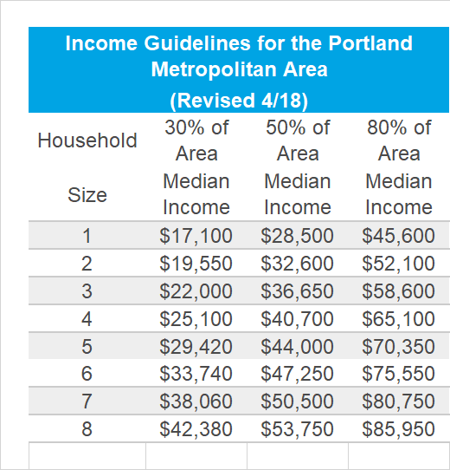
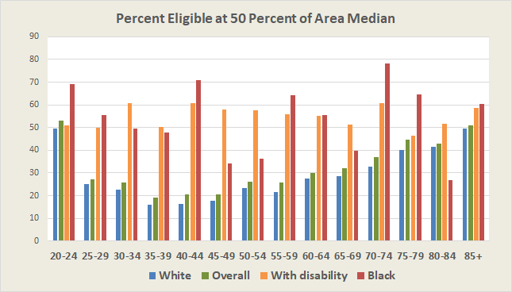
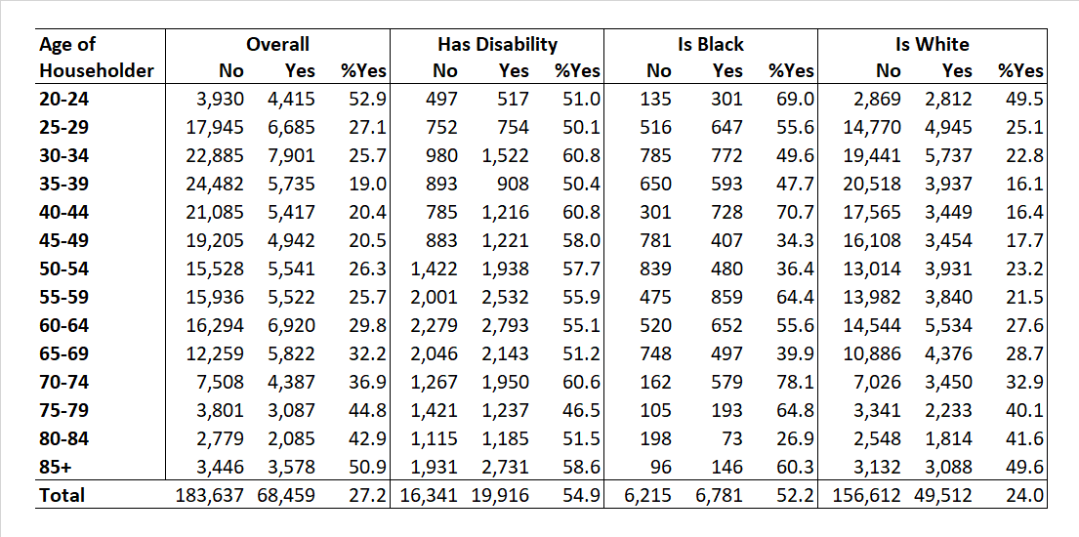
Access to Affordable Housing
5
Access to affordable housing from Home Forward and other housing providers, such as the Portland Housing Bureau, is based on income and household size.
We use the 50% of area median income criteria and data from the public use microsample of the 2018 American Community Survey to show the numbers of households entitled to apply.
Overall, for households in the city of Portland the proportion eligible to apply rises sharply after age 75 to over 40%.
For those householders with a disability for most age groups, over half would be eligible to apply.
The percent eligible for Black householders is much higher than for White householders, due to lower incomes for Black householders.
The 68,459 households eligible to apply for affordable housing is more than double the 26,527 units available in Portland.
Here are the same data in chart form.
Percent Eligible at 50% of Area Median Income
Source: American Community Survey, 5-year Data 2014-2018, Public Use Microsample.
Income guidelines from Home Forward.
O
Learn about the Public Use Microdata for the American Community Survey.

Slide 6
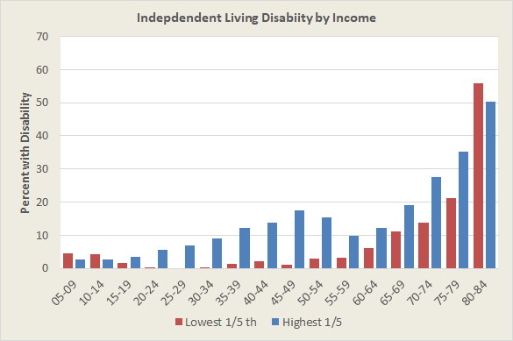
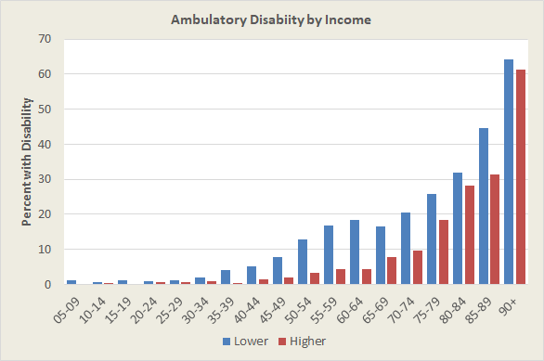
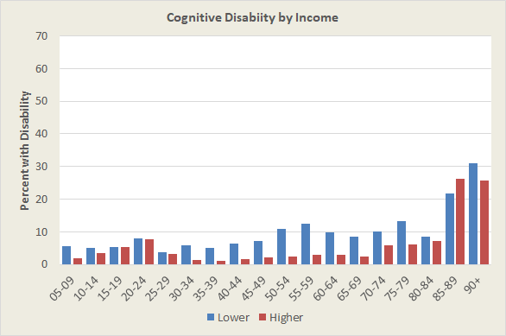
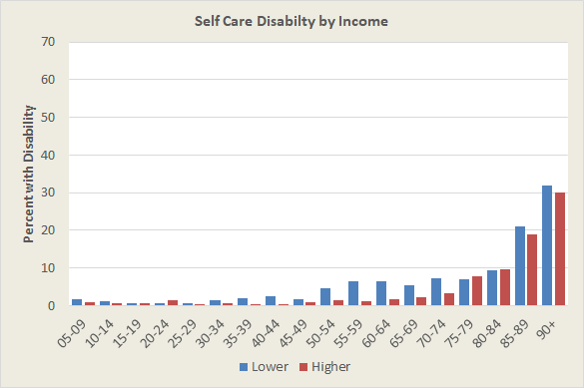
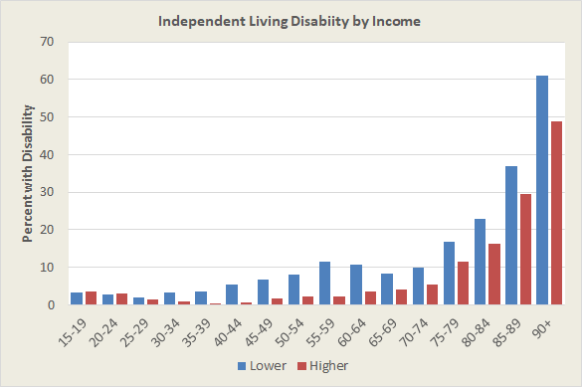
Income and Disability
6
Persons in lower income households are more likely to have a disability that qualifies them to apply for affordable housing.
The following slides compare city of Portland households, above and below the median income, for the Portland Metropolitan Area:
  Self care
  Ambulatory
  Cognitive
  Independent living
A common thread to the four types of disabilities above is that from about age 45 to 75, persons in households with incomes below the median have more disabilities than persons in households with incomes above the median. Generally, disability rates tend to equalize after age 80 as biological factors dominate.
This slide compares the percent with an independent living disability for households with incomes in the highest and lowest quintiles. The sample is somewhat thin but the increased spread from highest to lowest income is no doubt larger.
Because low income and disability affect the ability to secure affordable housing, some persons will be able to apply before the common threshold ages of 55 or 62.
Source: American Community Survey, 5-year Data 2014-2018, Public Use Microsample.
O

Slide 7
Affordable Housing for Seniors, Examples
7
Beginning
Overview: Maps and tables
Examples: profiles of selected developments
A classification of senior housing types
The following slides show examples of 20 affordable housing developments that are age restricted or are otherwise purposed for seniors.
Some of the things that you may wish to look for as your view these examples are:
  Age distribution – Residents move into affordable housing developments at different ages. Most require that applicants be age 55 or 62 or have a disability. Since lower income older persons are more likely to have a disability, many can apply before the minimum age. Other residents have aged in place in their long-term residence and move to affordable seniors housing in their 70’s or 80’s.
  Gender balance – Because women tend to live longer than men their numbers past age 75 are greater than males. However, some developments attract mainly males or females.
  Household type – The most common household type is the one- person household, predominately female. Some developments attract husband-wife households, depending in part on the types of housing offered.
  Race and ethnicity – Older minority households are more likely than white non-Hispanics to meet the income qualifications of the developments and thus are present in larger numbers than in market rate senior housing. Some ethnic groups, such as Hispanics, are younger and present in smaller numbers.
  Inadequate supply – There are many more low-income households that are eligible to apply for affordable housing units than there are units available. Waiting lists are often long or closed.
O

Slide 8
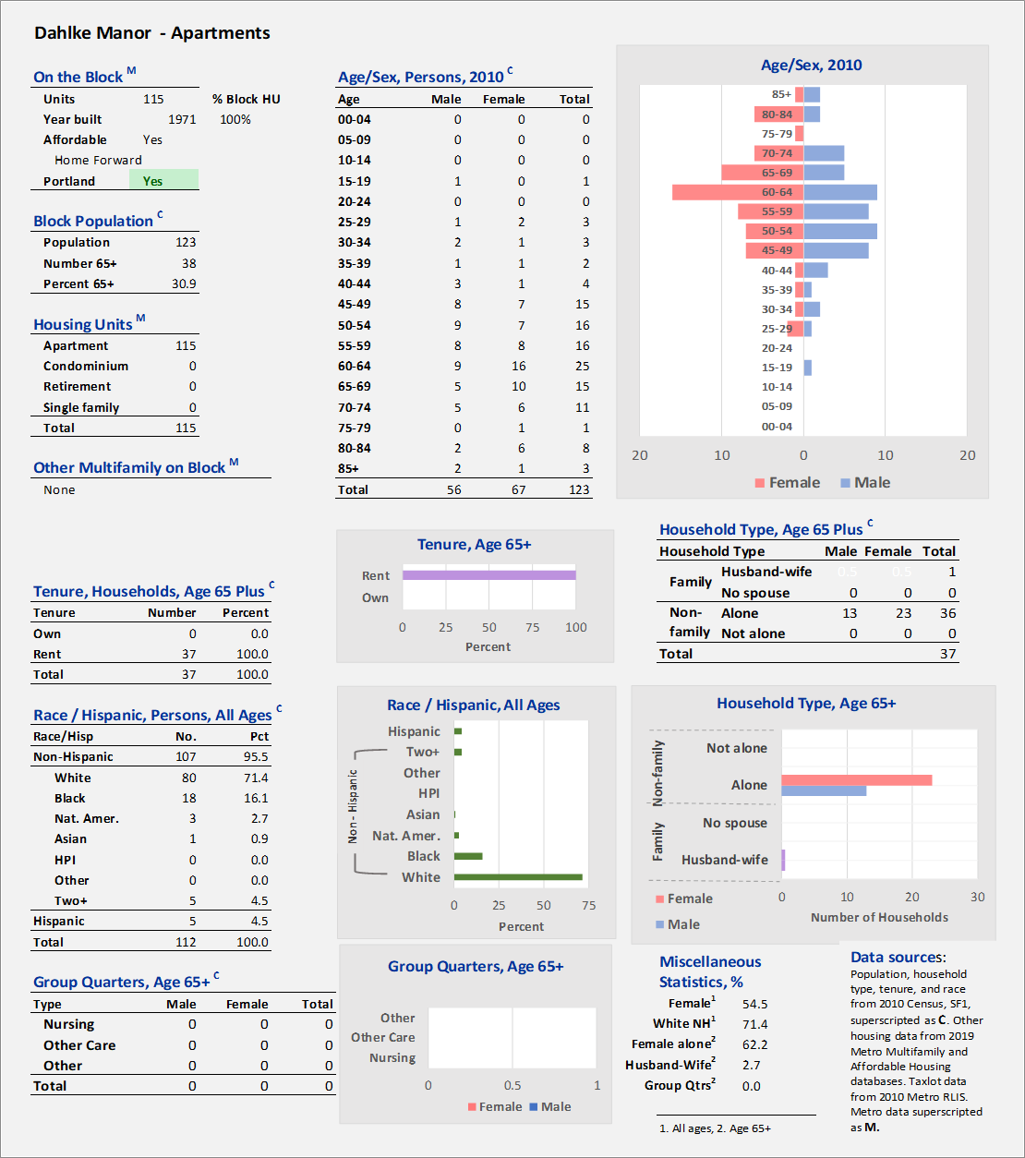
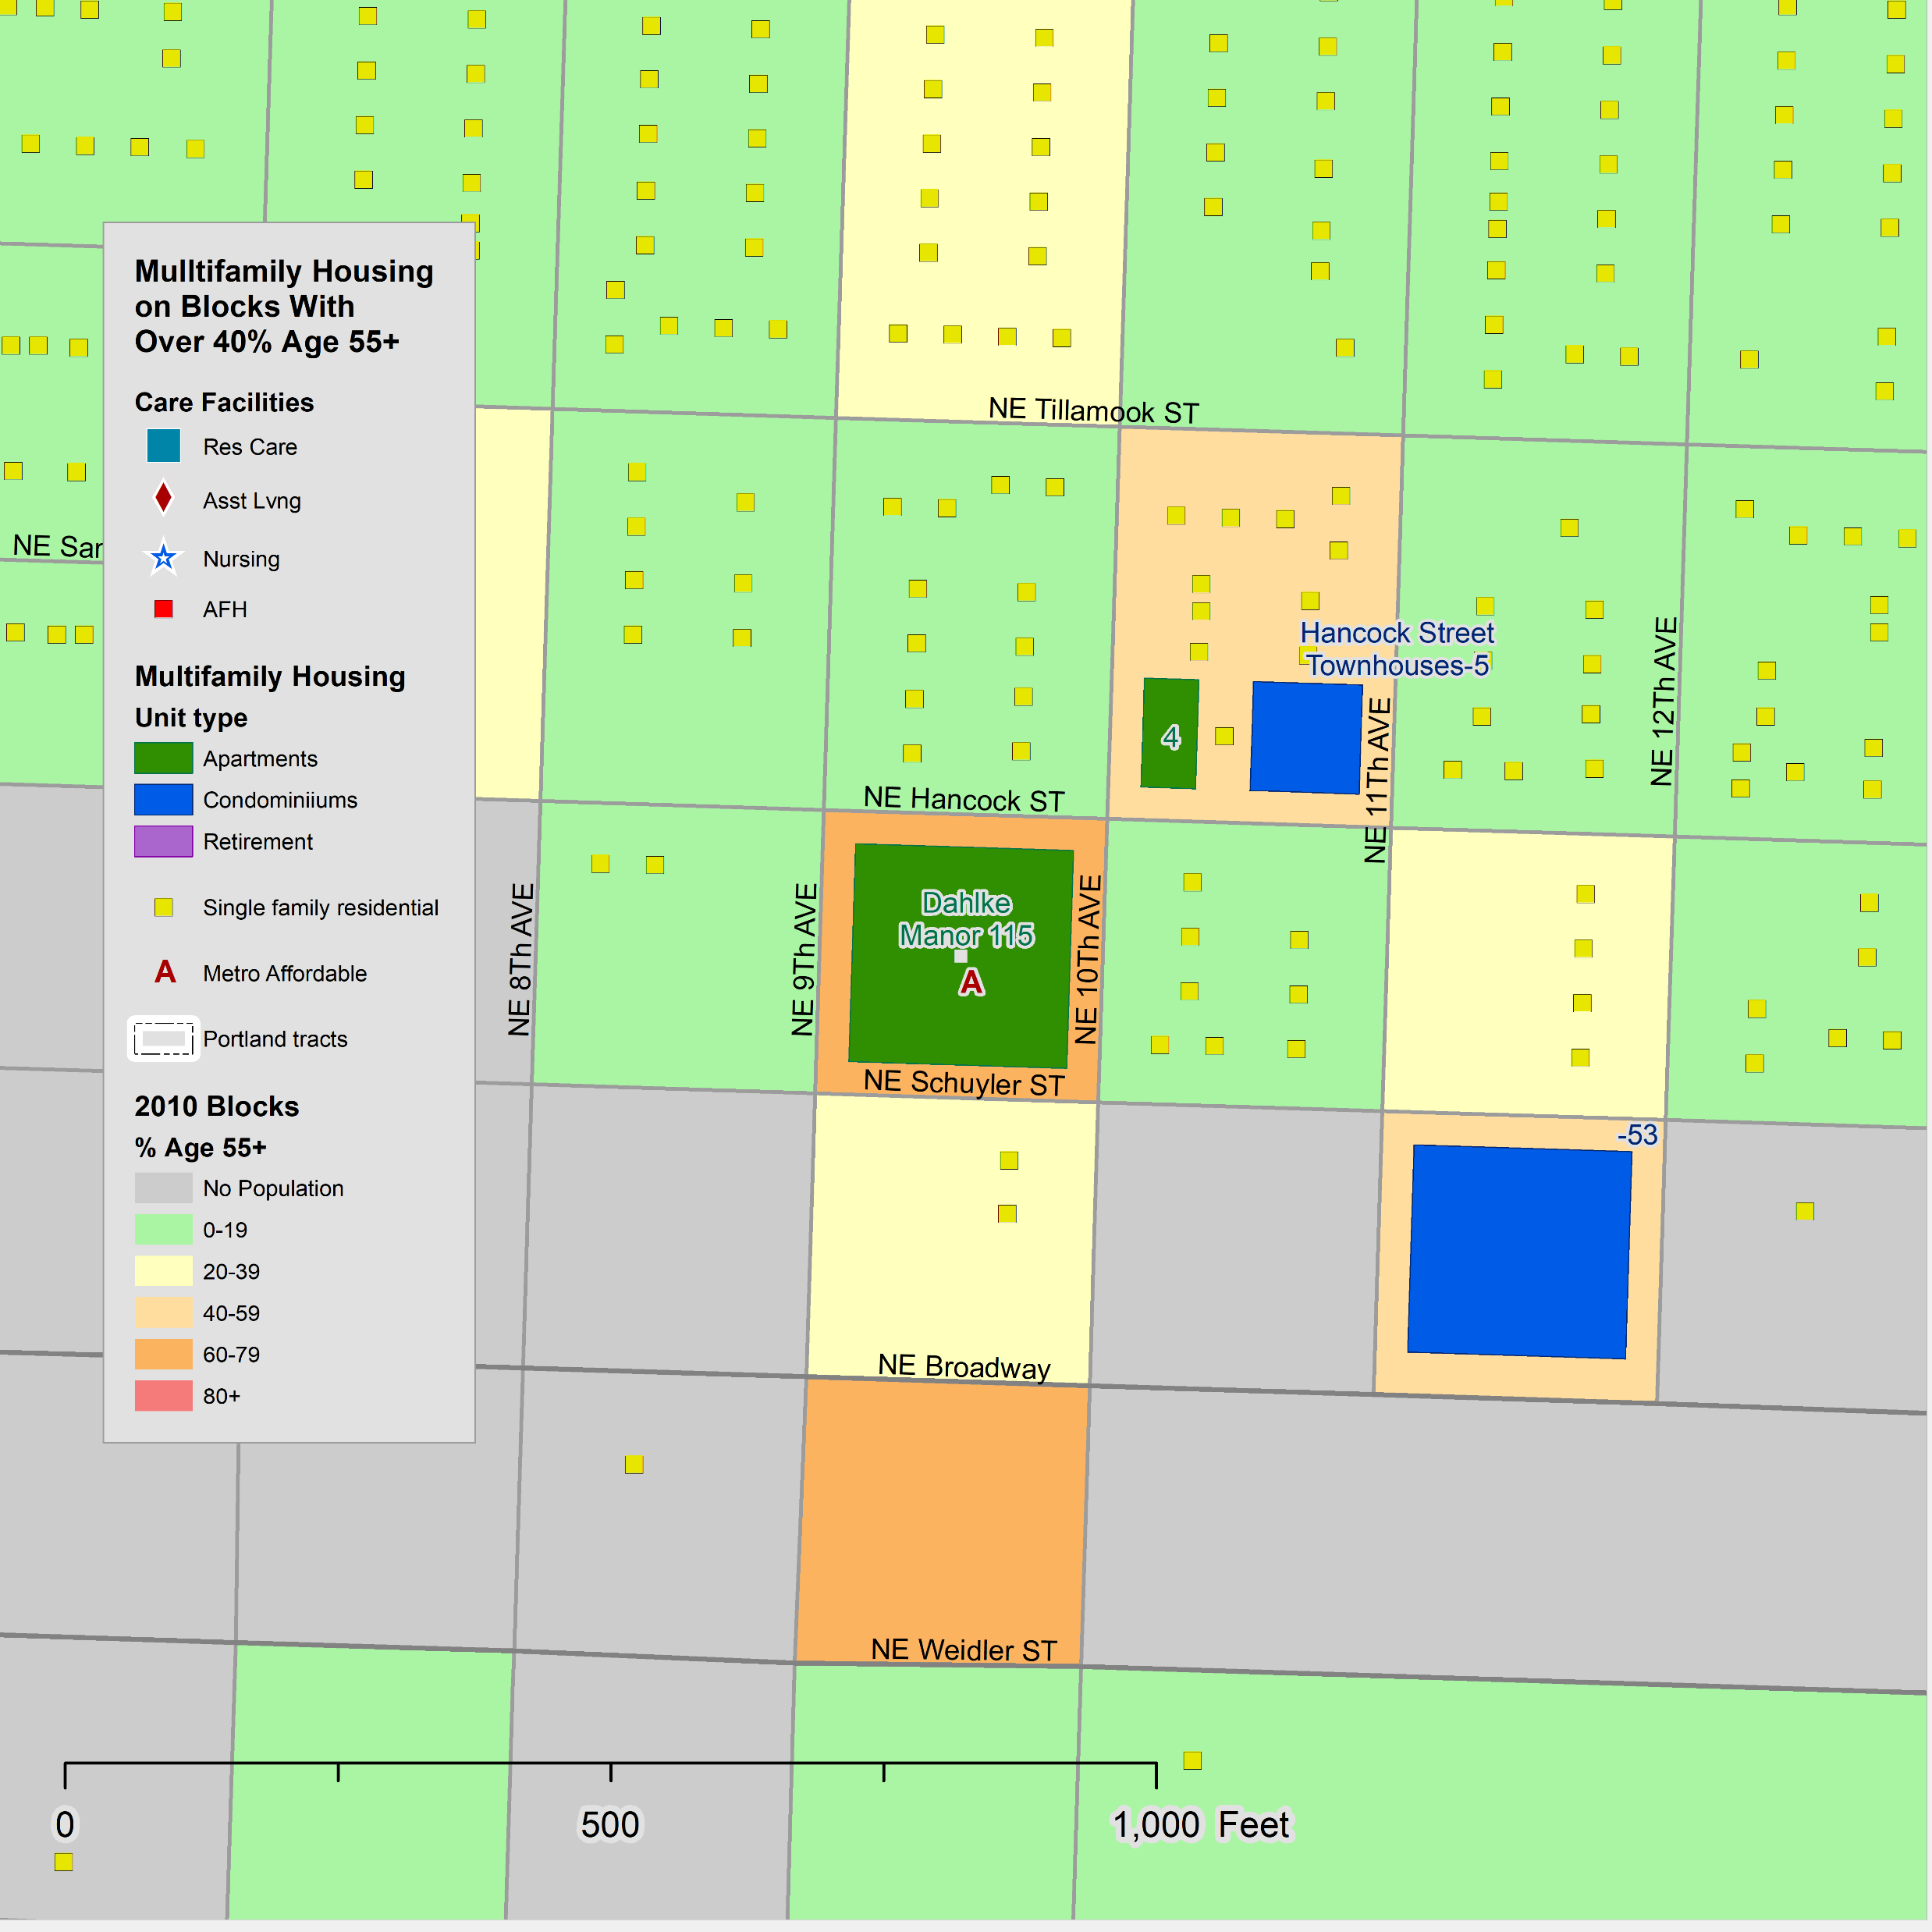
Maps and Tables for Affordable Housing
8
This page shows an example of the mapping and charting of affordable housing developments. Dahlke Manor is used to illustrate.
On the map the proportion of the 2010 census population is shown by color shading. The block on which Dahlke Manor is located has from 40-59% age 55+.
Multifamily developments are only mapped and analyzed where 40% or more the population is age 55+
The demographic data are from the 2010 census.
  Age/Sex
  Race/Hispanic
  Own/Rent
  Household type
  Group quarters (none on this block)
The demographic data are for the census block, not the individual facility. Thus, if there is more than one multifamily development or single-family homes, they are included in the block total.
Data from the 2019 Metro Multifamily Housing database indicate there are 115 units in Dahlke Manor and that it was built in 1971. The 2018 Metro Affordable Housing database indicates that it is affordable housing, and the sponsor is Home Forward.
The data on the apartment developments and other housing are from Metro’s Multifamily Housing and Affordable Housing databases and the Regional Land Information System (RLIS).
Caveats:
Data from the 2010 census were used for several of the tables and charts because they are published at the block level and are based on a complete count, not a sample.
If the comings and goings of residents has reached an equilibrium, the 2010 data should still be representative. If admission policies have changed since 2010 these changes will not be reflected in the tables and charts.
Data are for the census block where the apartment development is located. If there is no other housing on the block it represents the population of the housing development.
It may be useful to repeat these analyses when the 2020 census data becomes available in 2021.
O

Slide 9
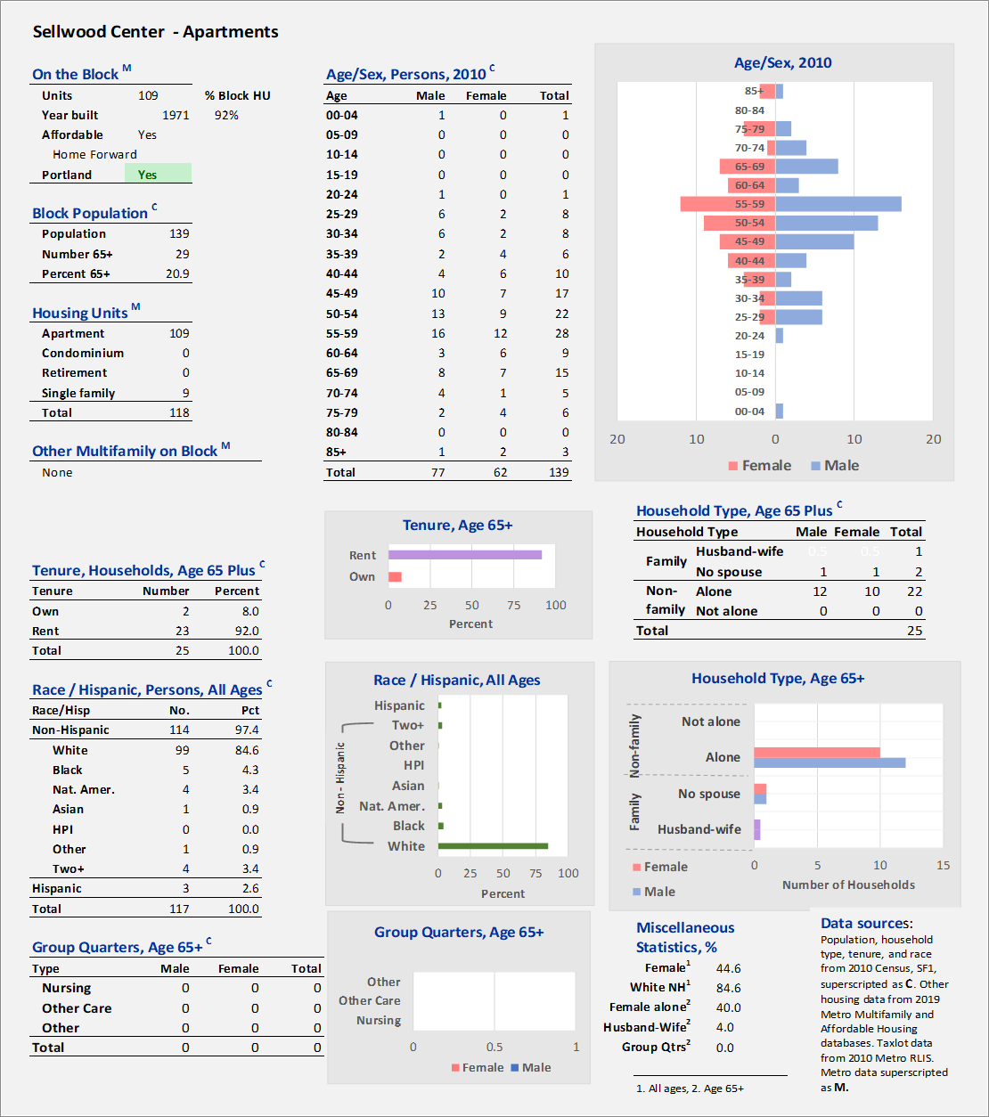
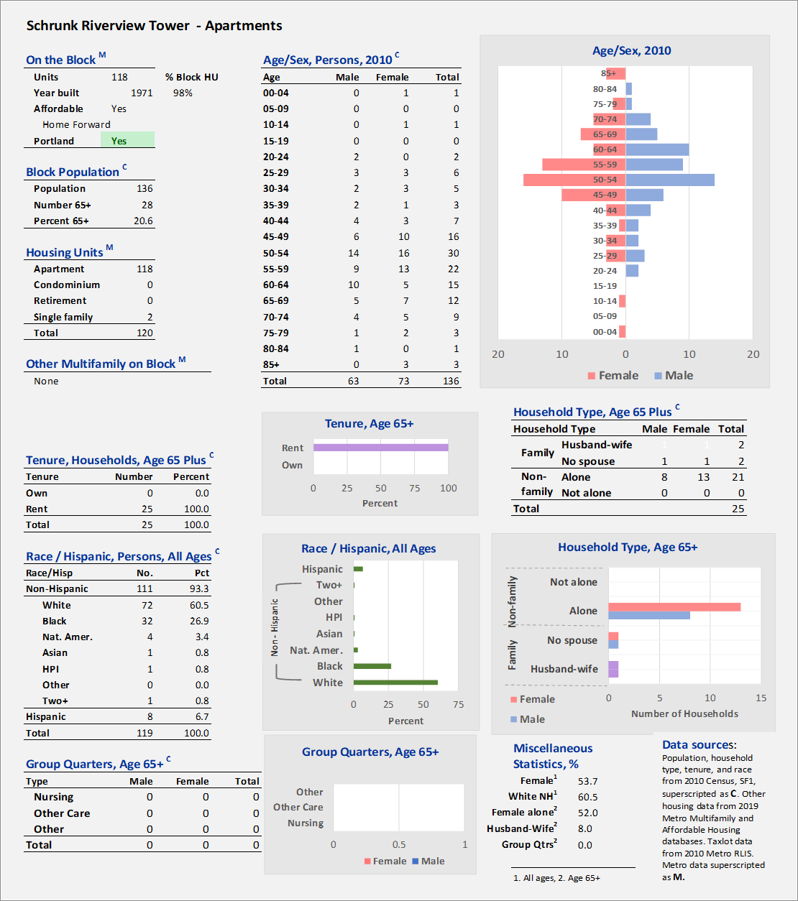
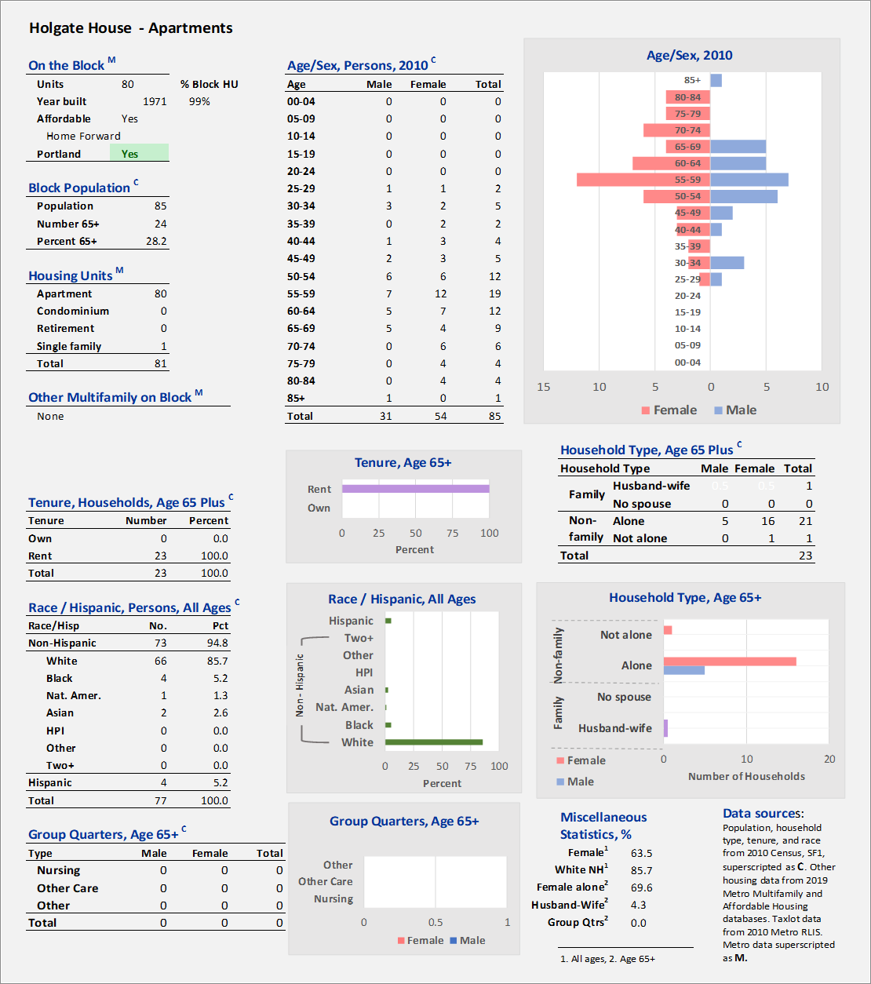
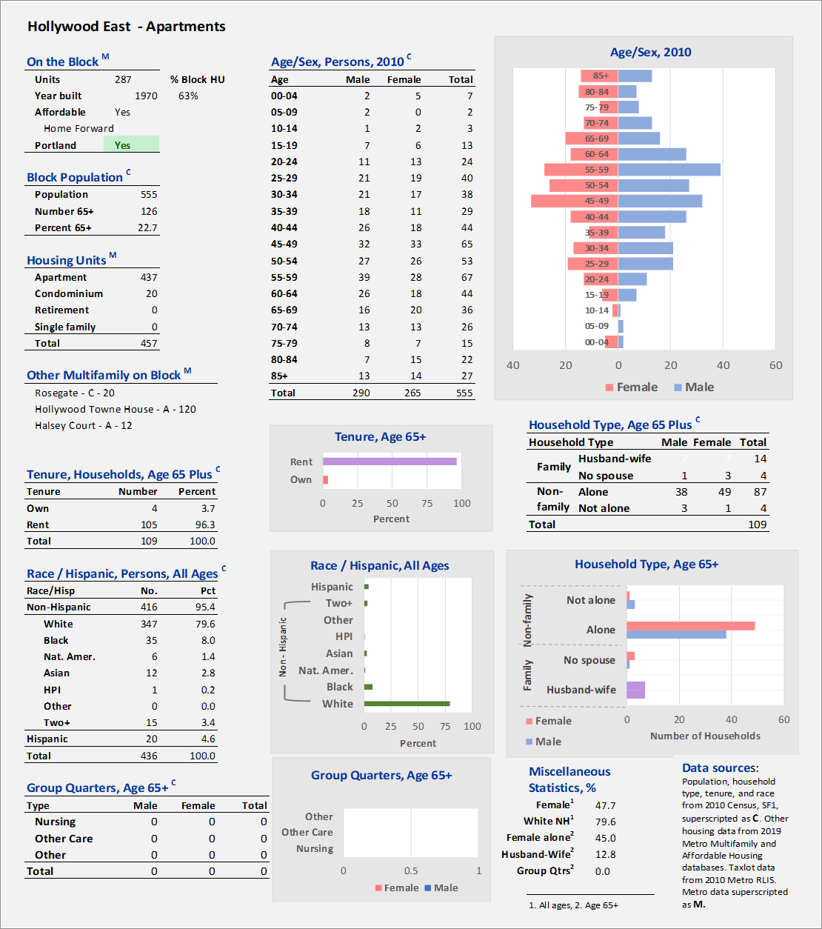
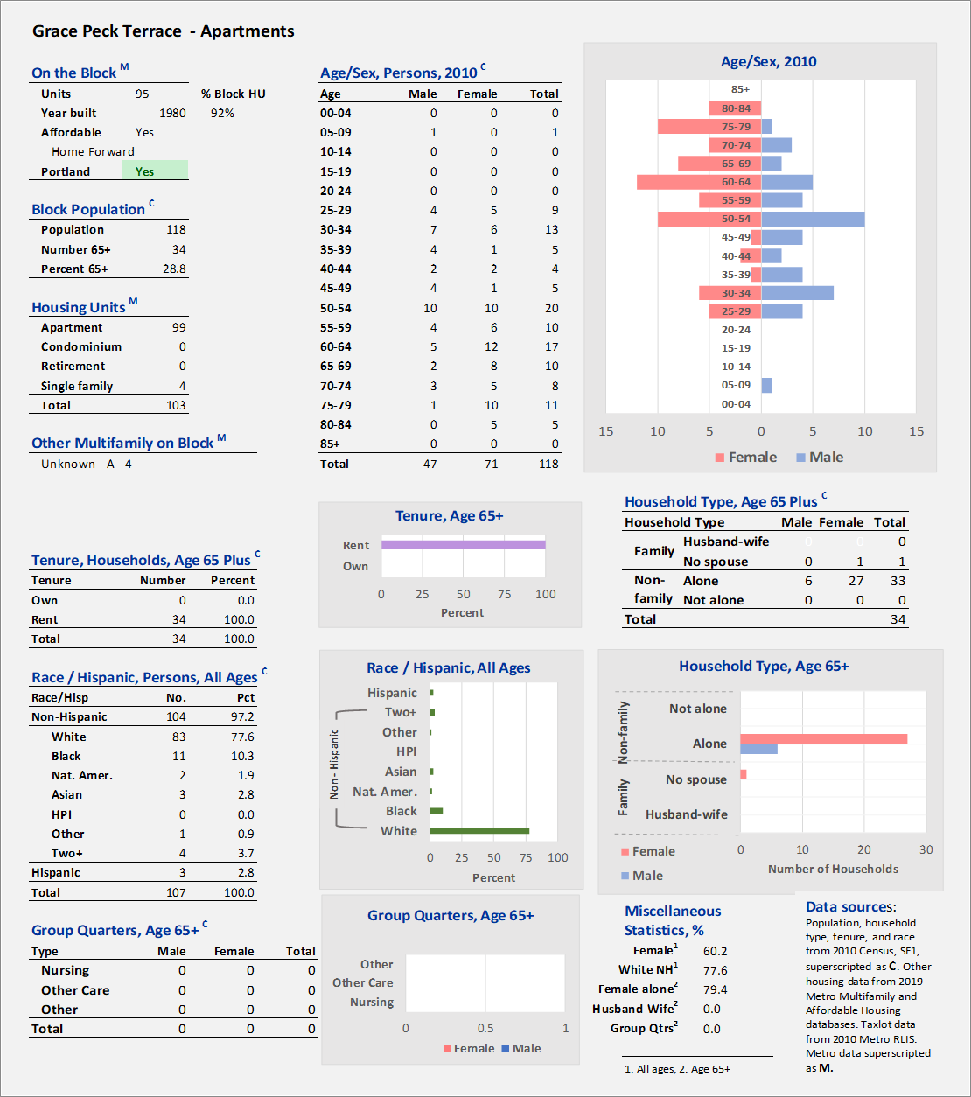
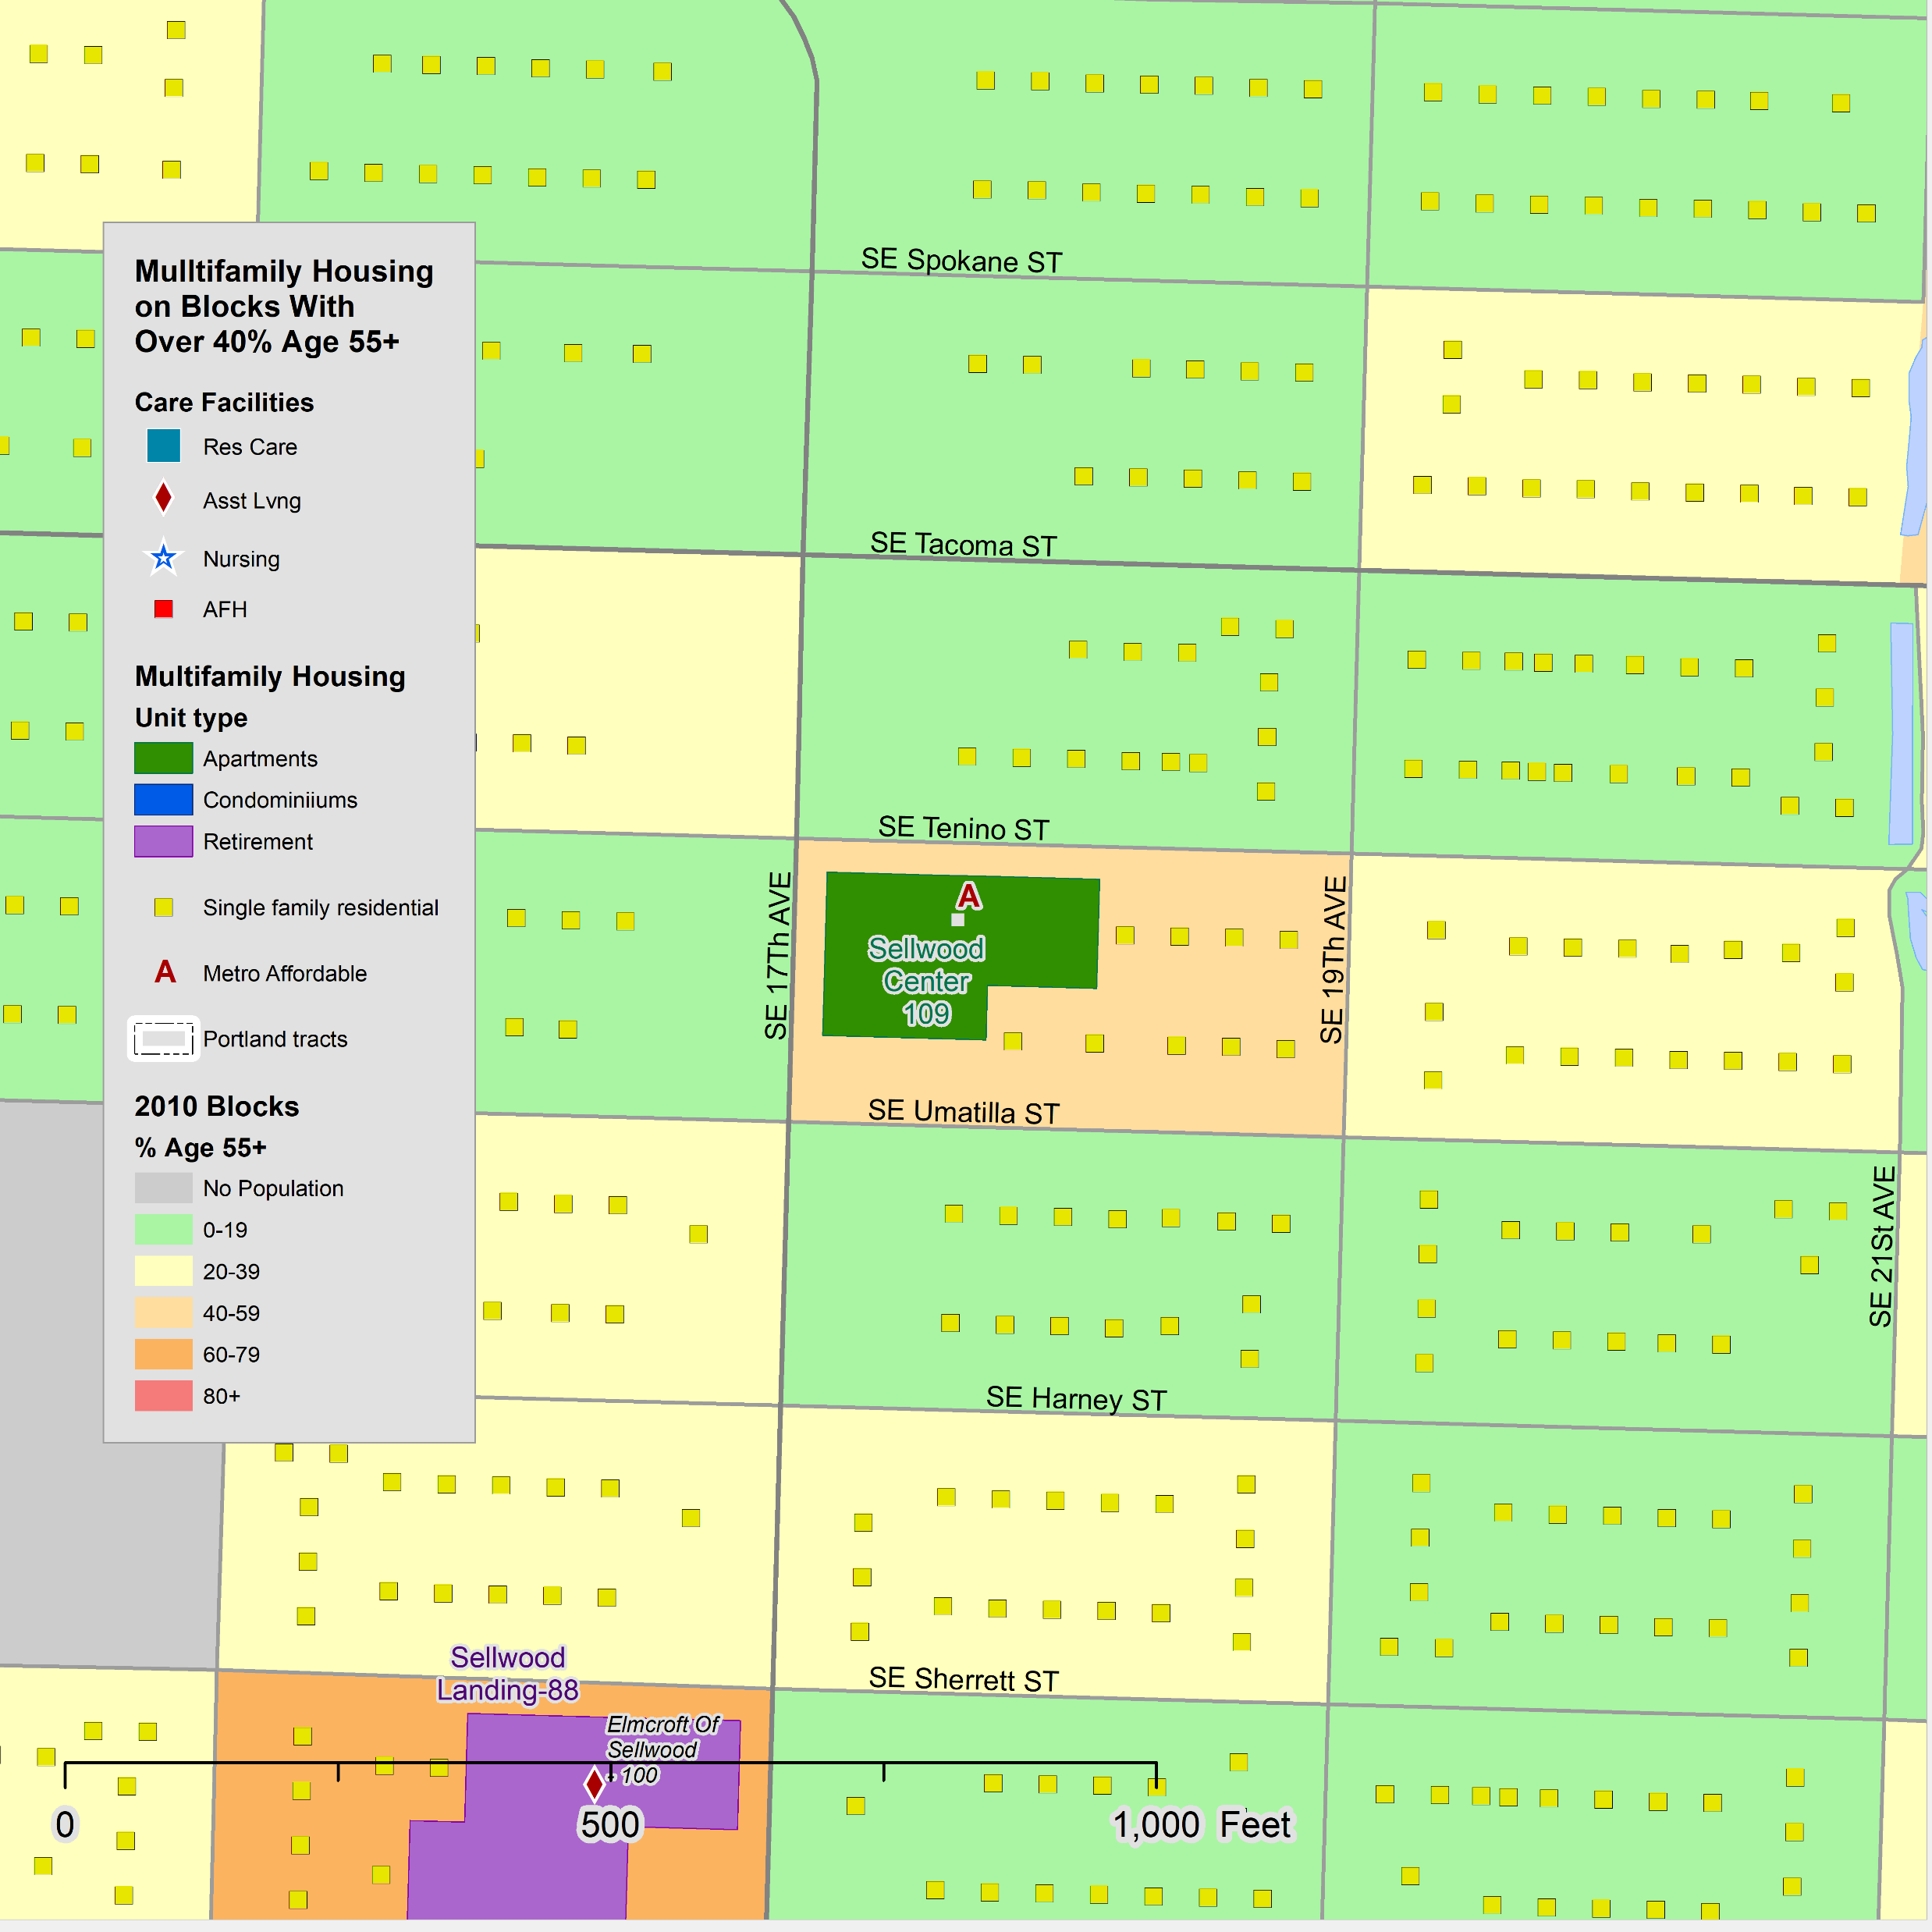
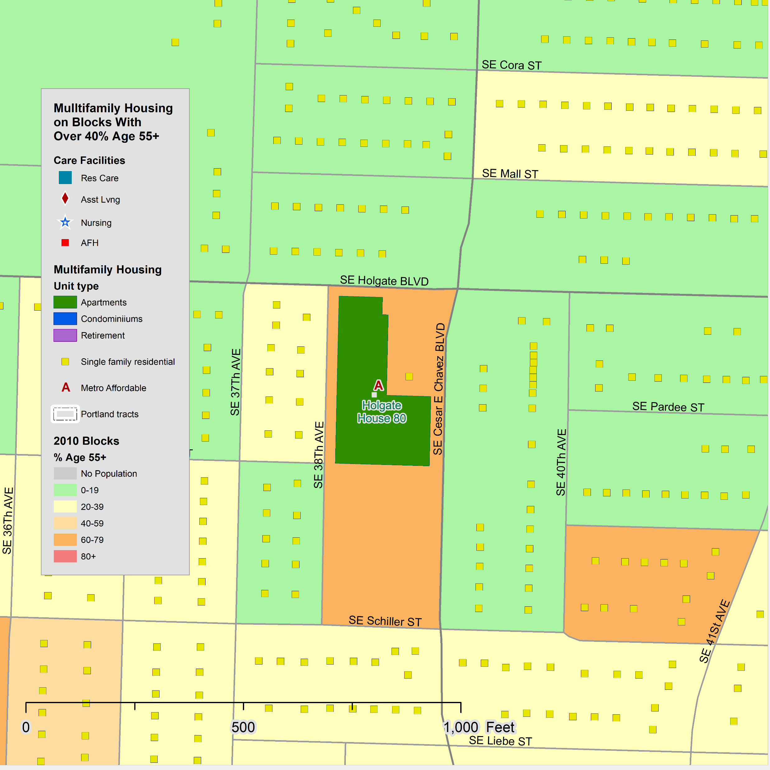
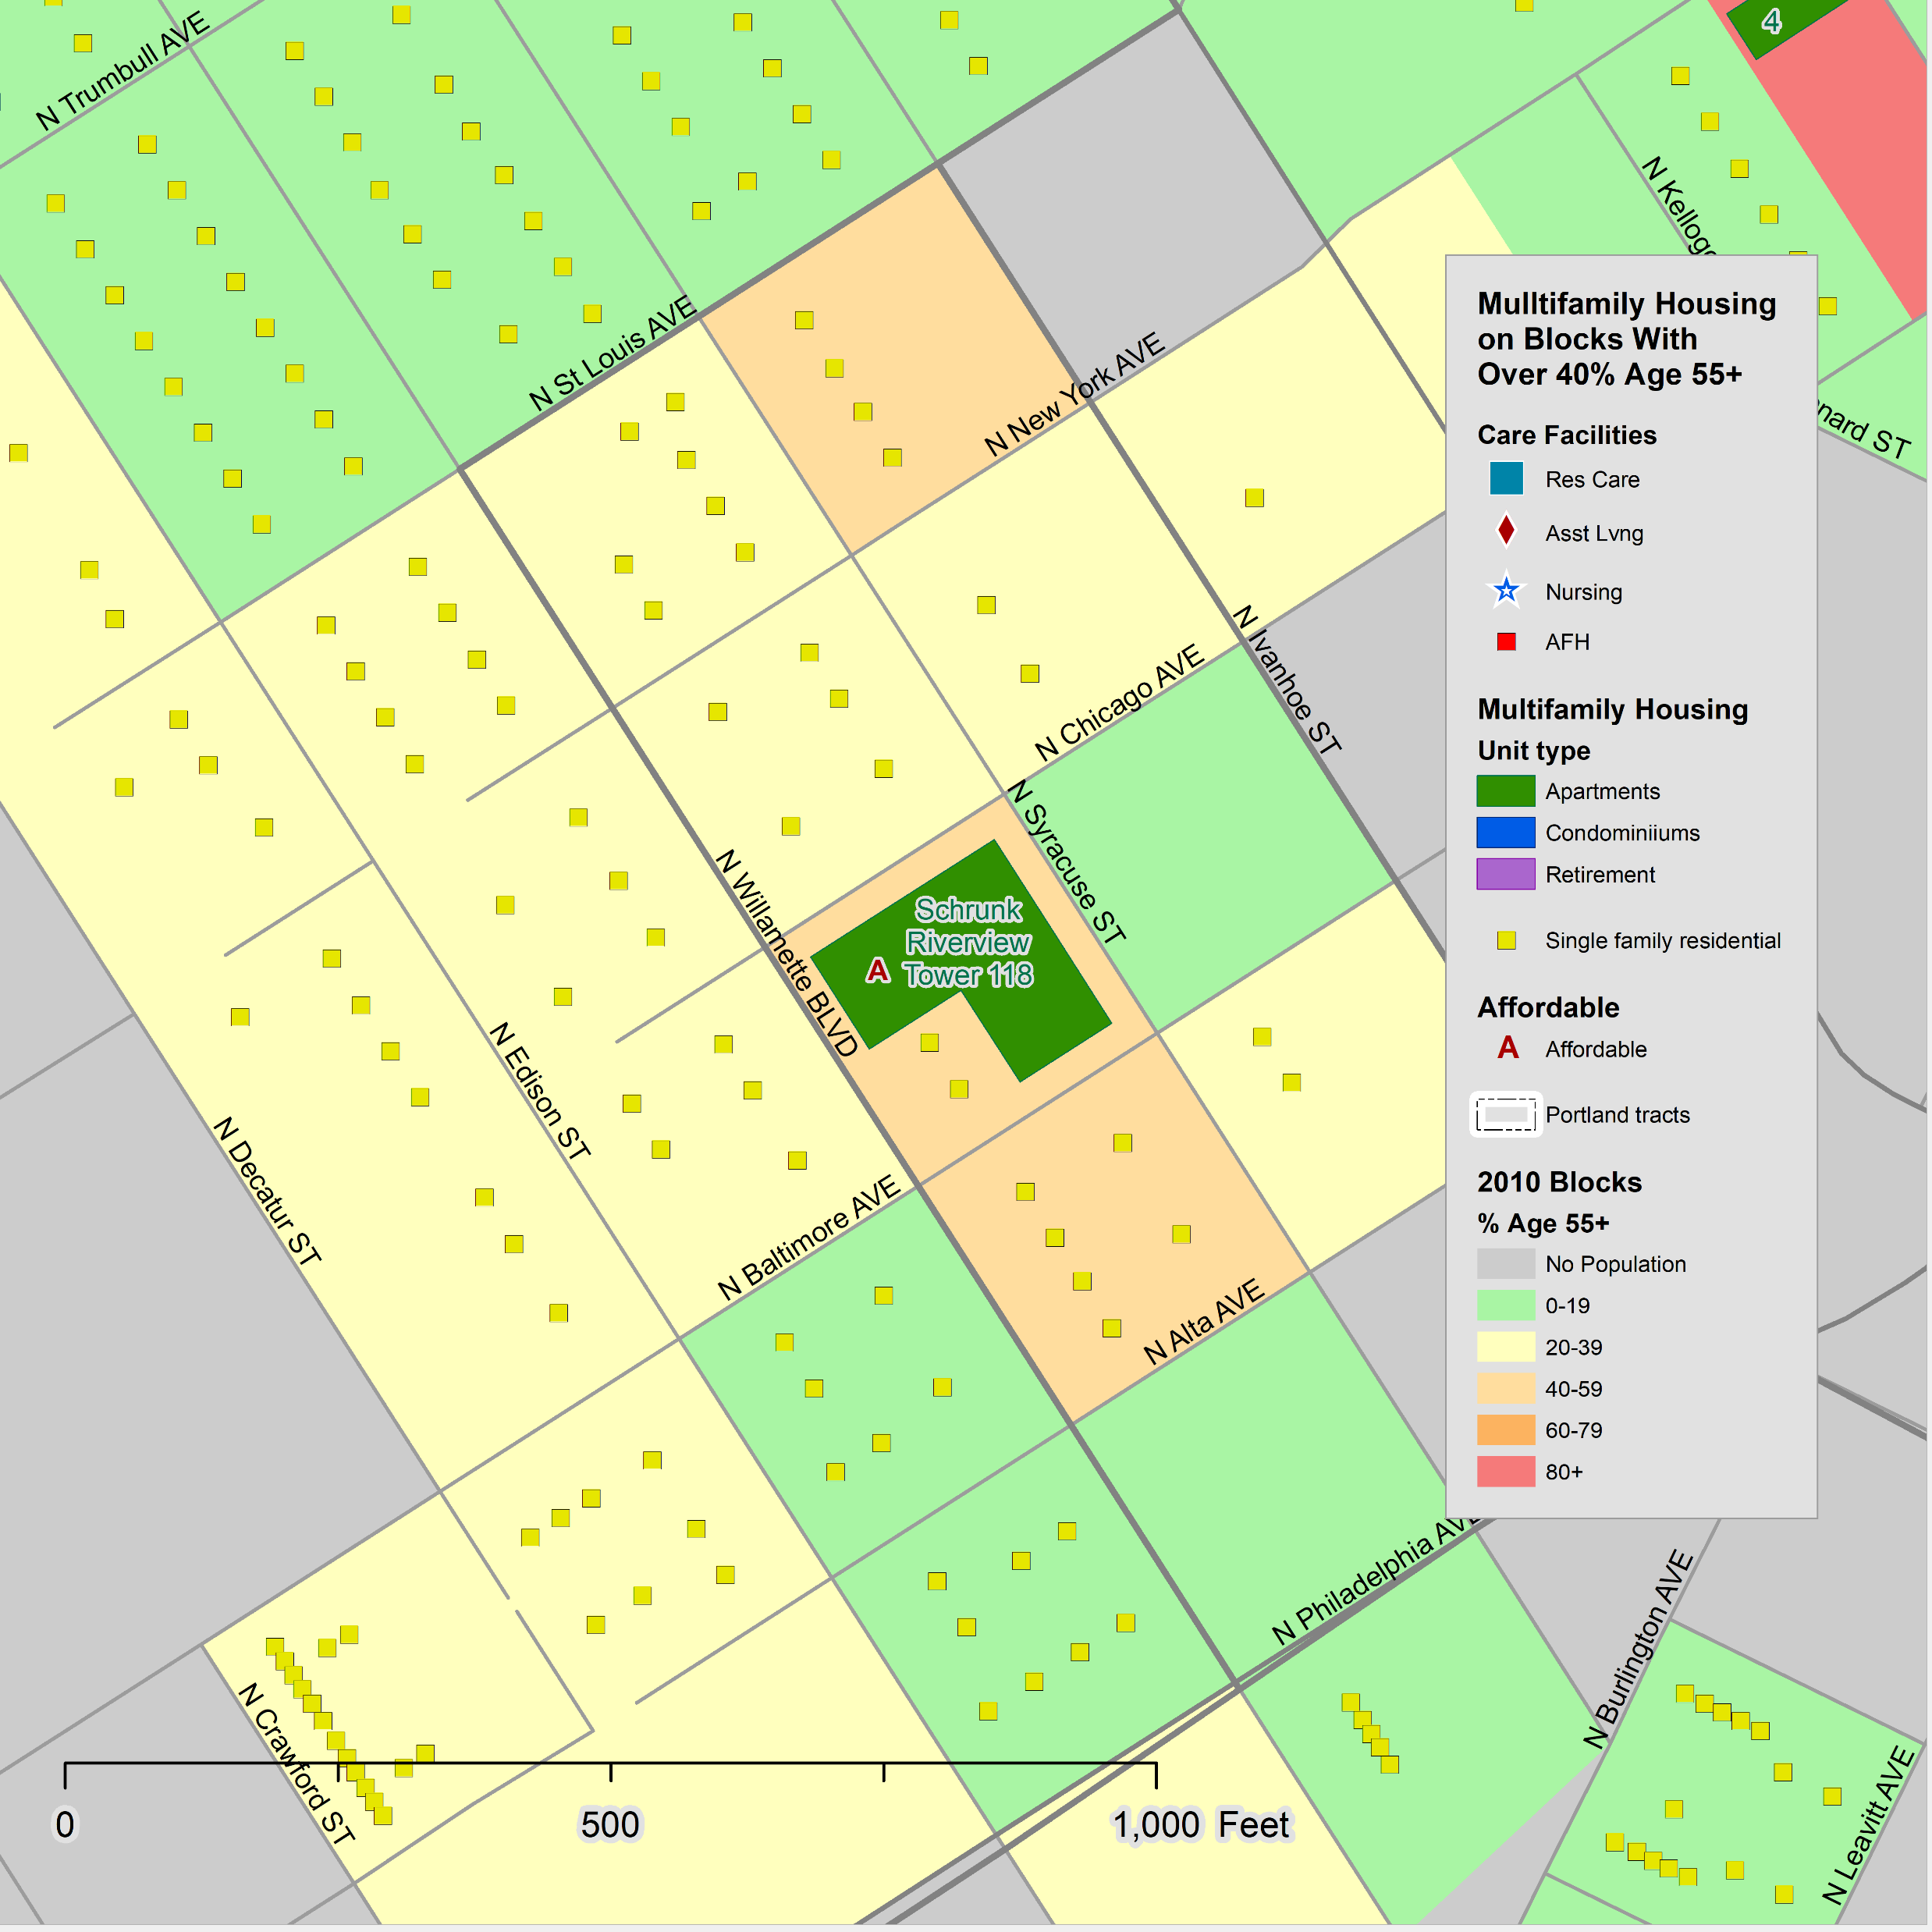
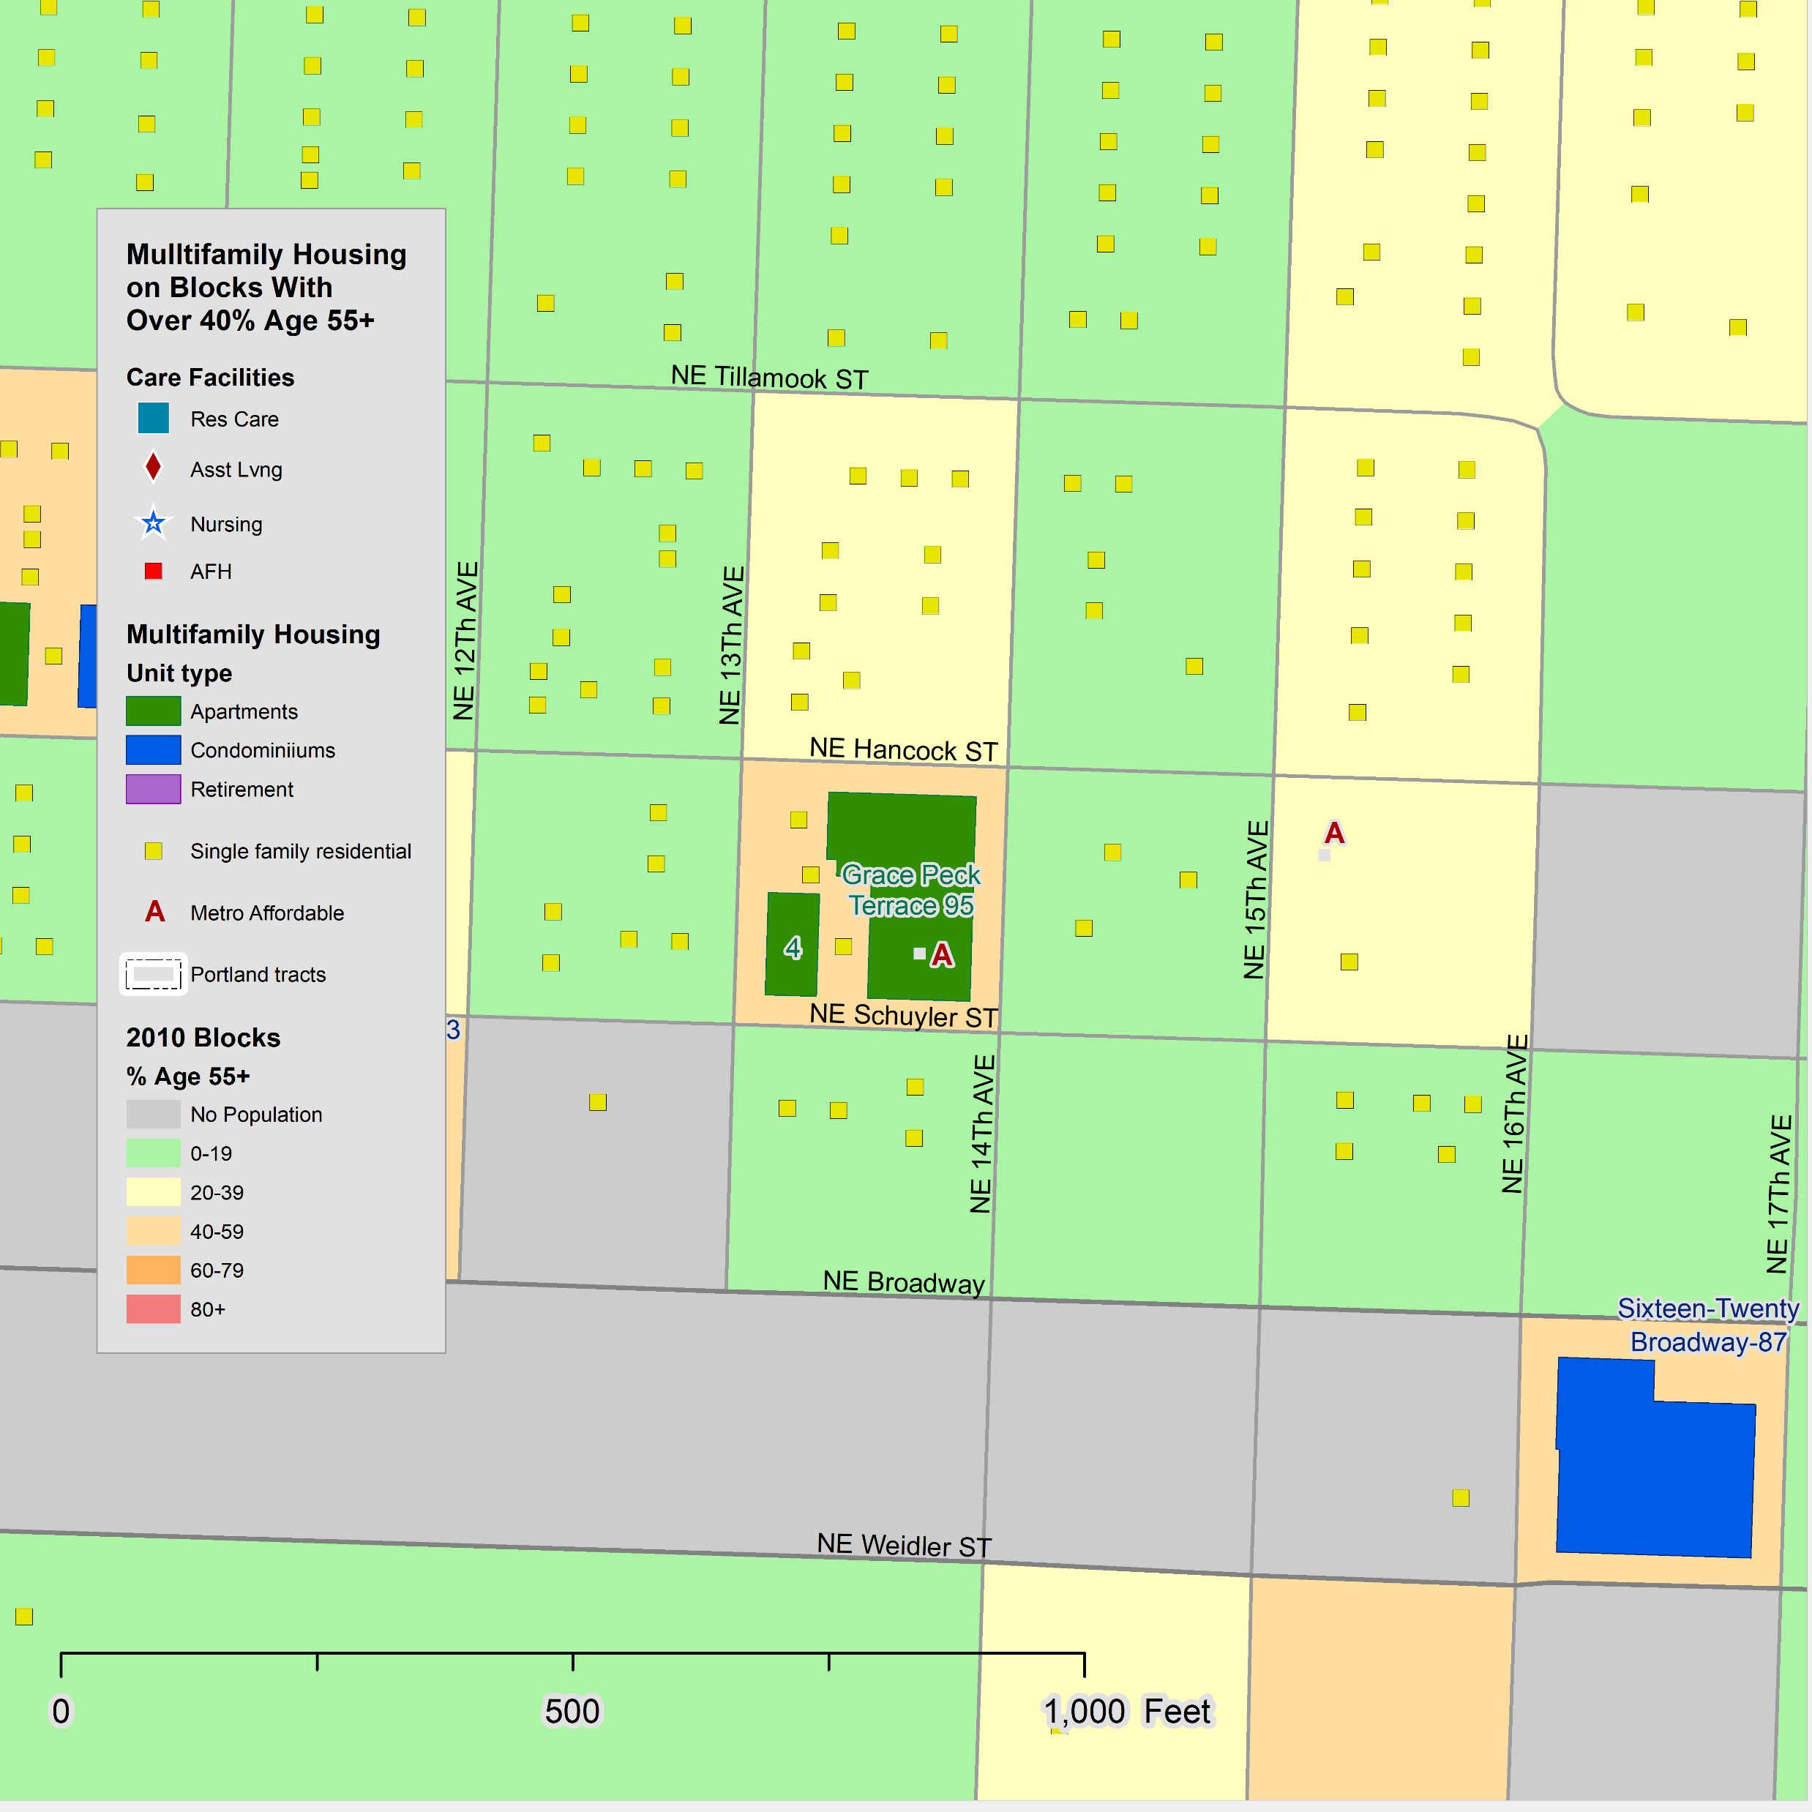
Examples, Home Forward
9
Home Forward is a public housing authority and the largest provider of affordable housing in Oregon, with 1,980 units of public housing and 9,390 Section 8 rent assistance vouchers in Multnomah, County. Covered on this report are apartments with five or more units.
Some of the units are reserved for seniors and persons with disabilities. All have an income limitation, usually 50% or 80% of the area median income.
The first four examples show developments where the modal age is the 55-59 age group with some younger and few very old.
  Sellwood Center - mainly white non-Hispanic
  Shrunk Riverview Tower - black residents
  Holgate House - mainly white non-Hispanic
  Dahlke Manor - minorities
The last two have a more mixed population with younger family households and some very old.
  Grace Peck Terrace – a few husband-wife households
  Sellwood Center
O

Slide 10
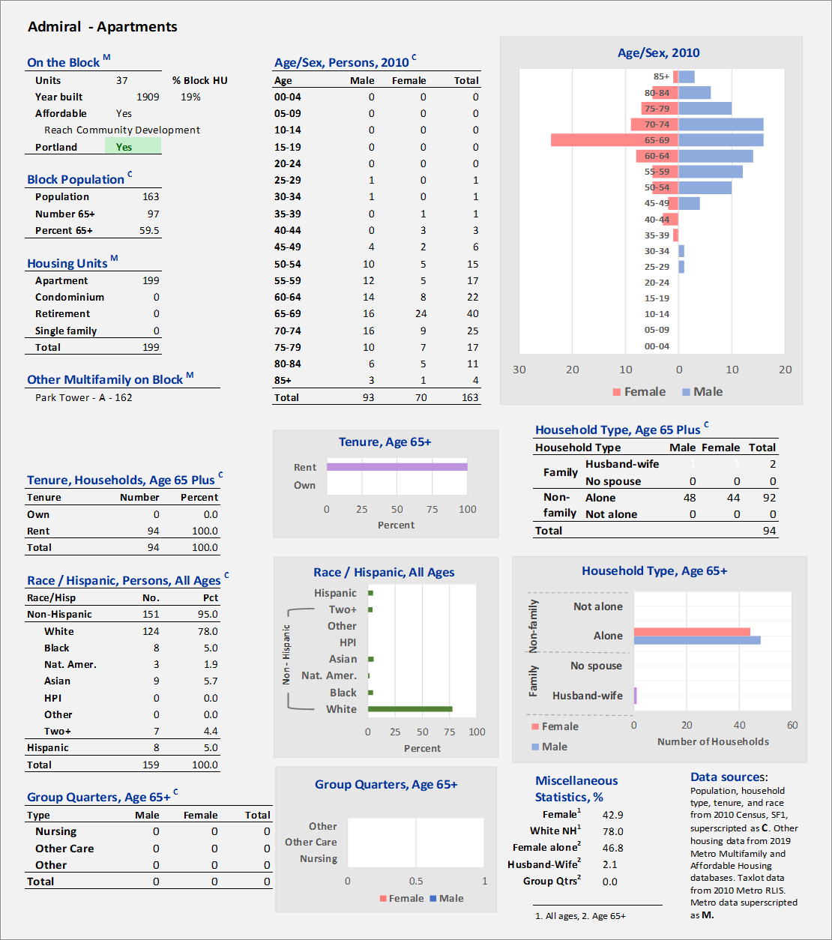
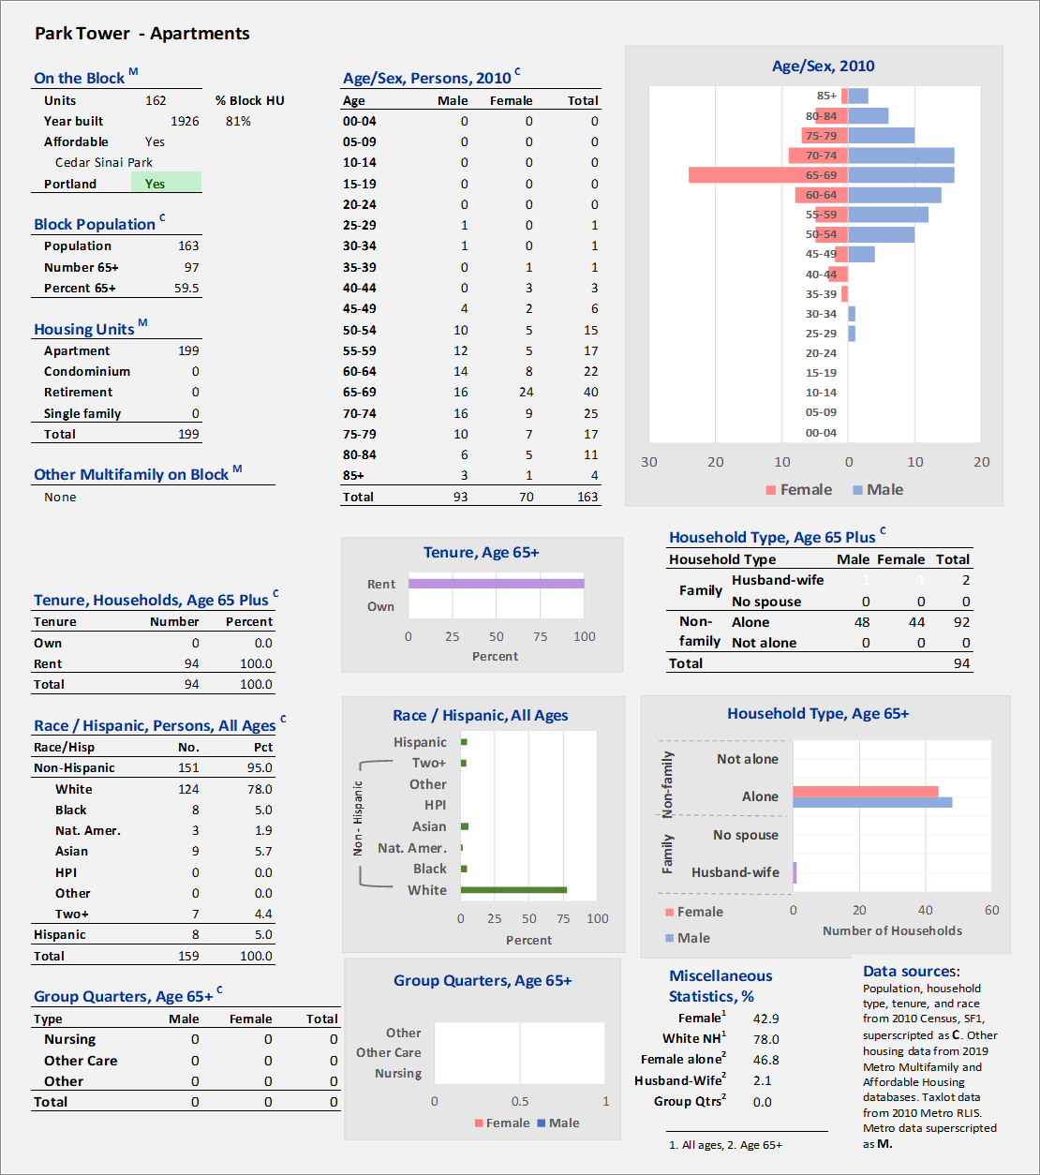
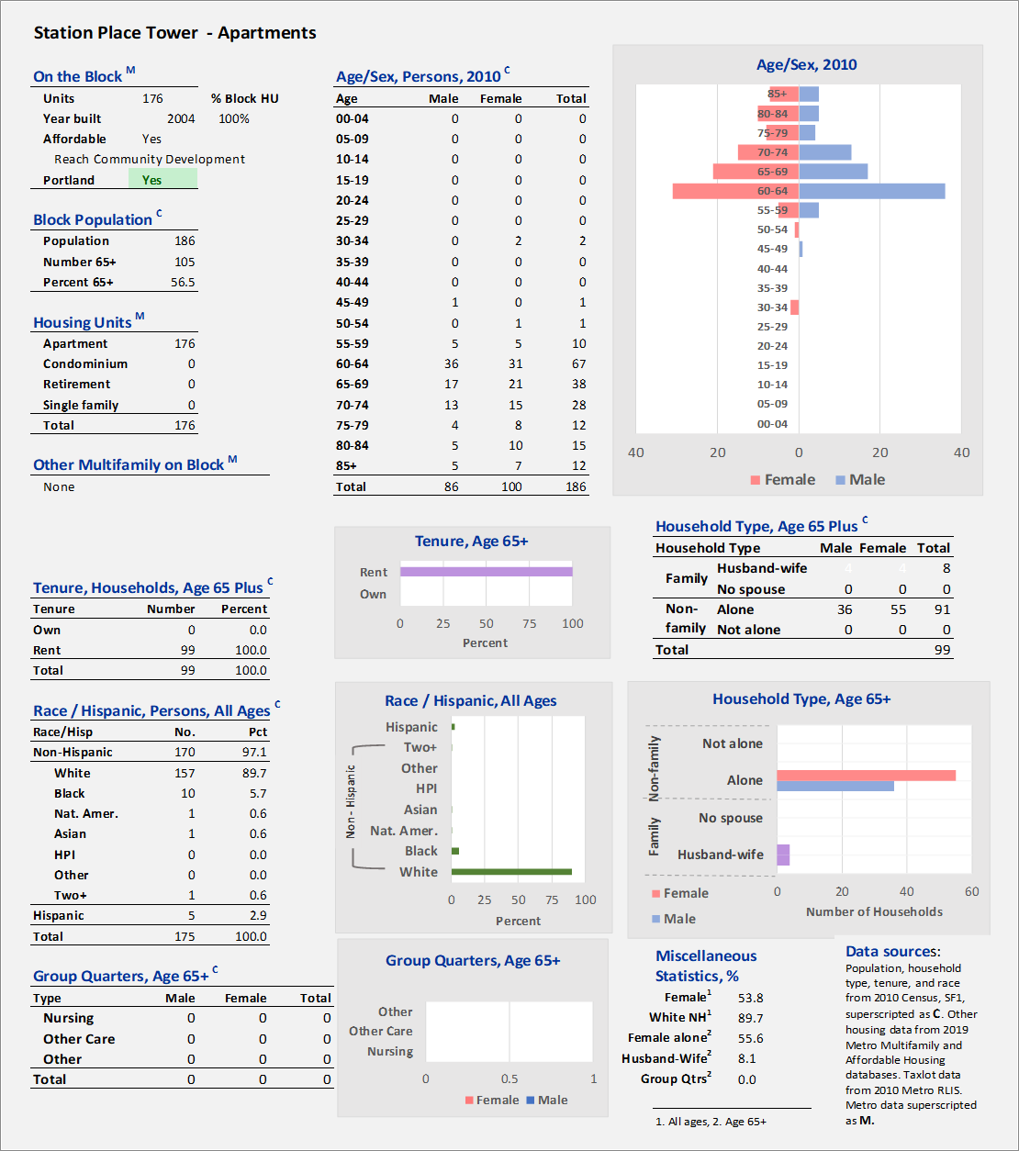
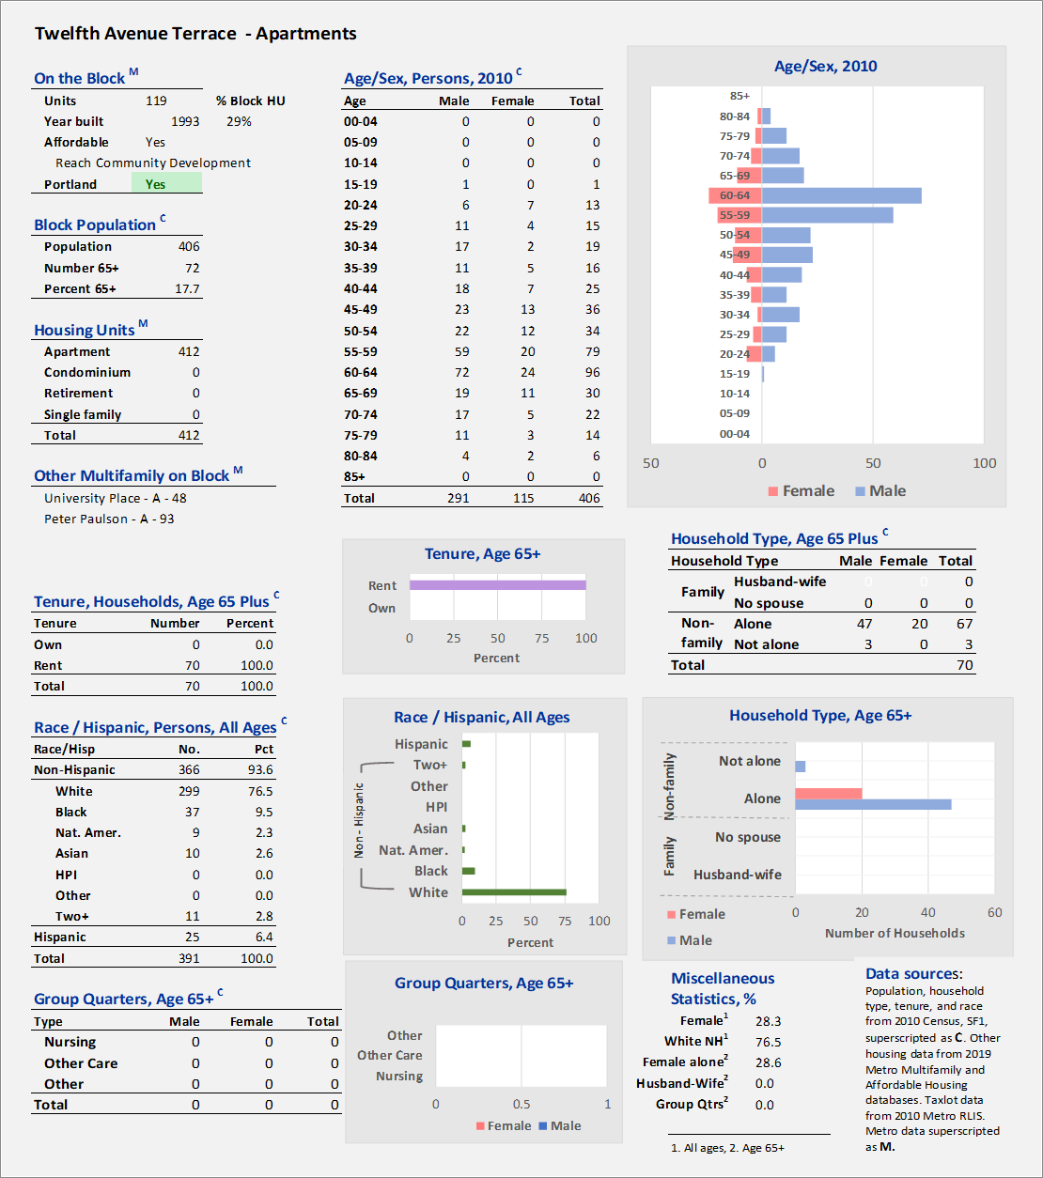
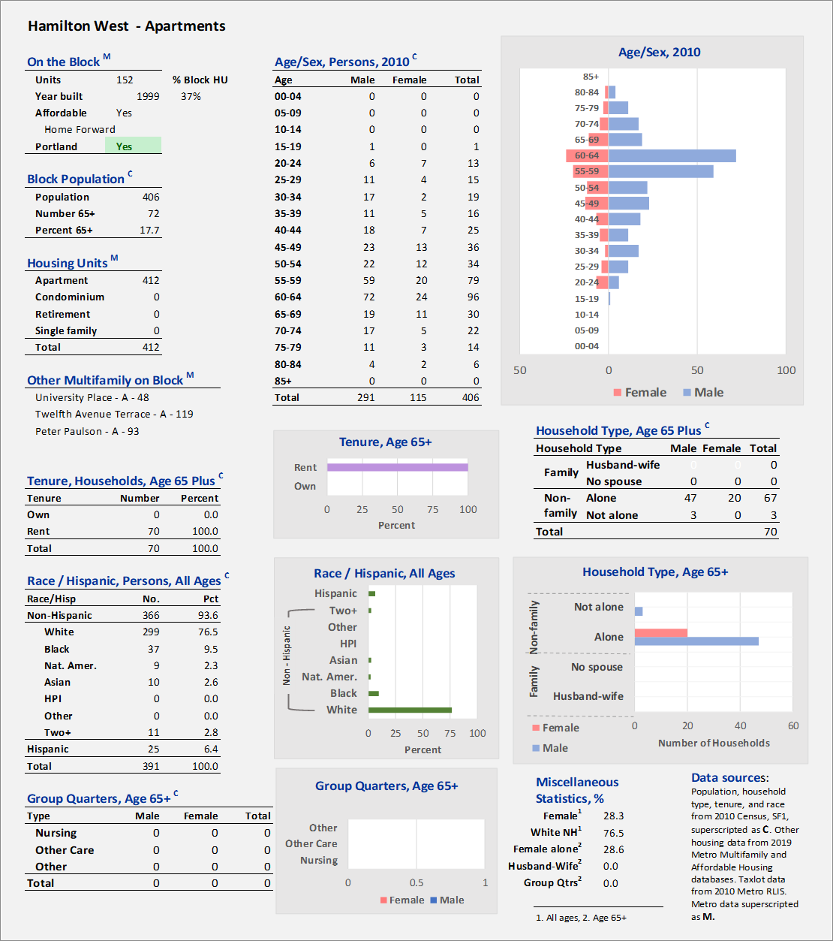
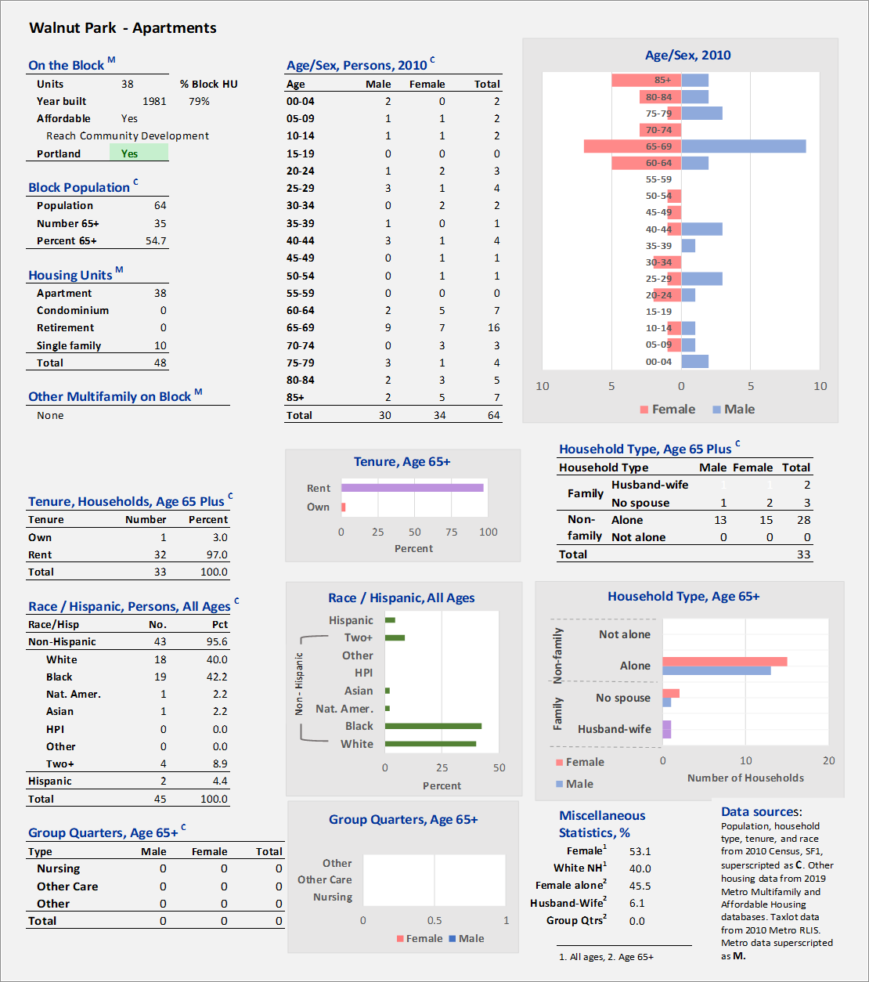
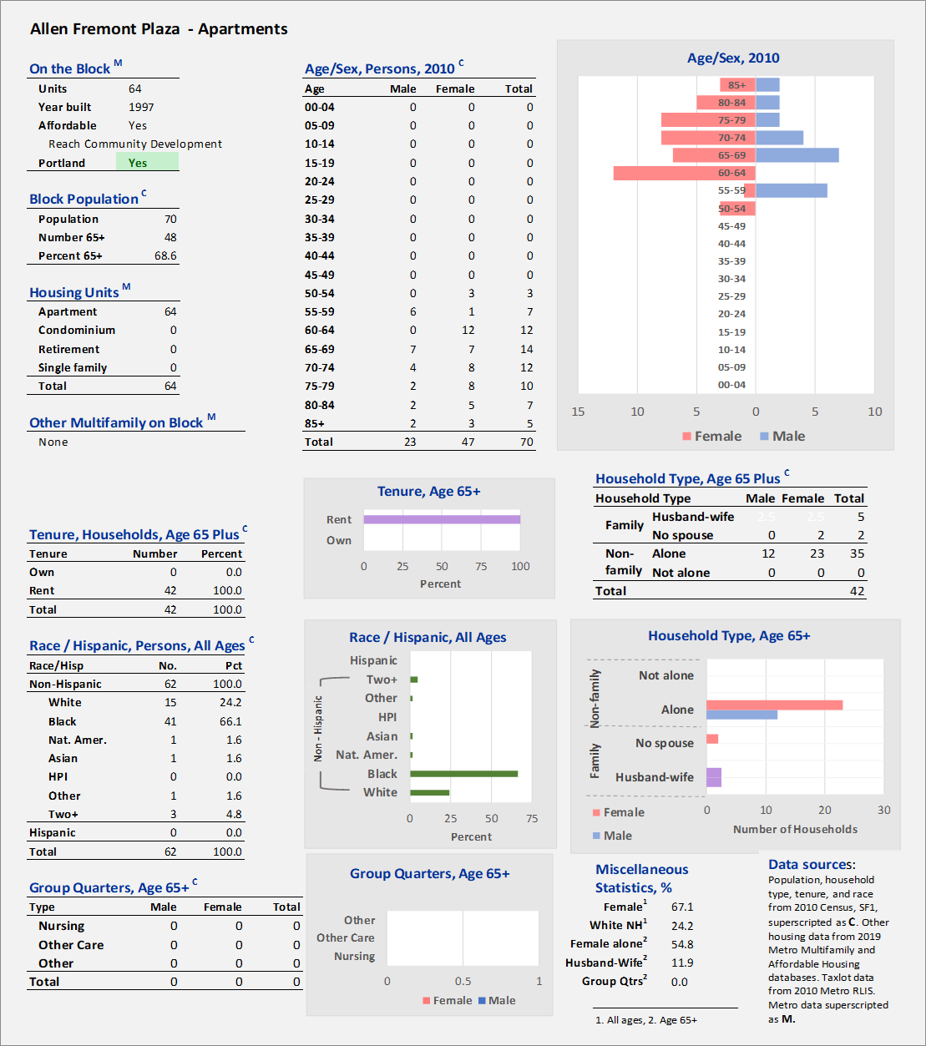
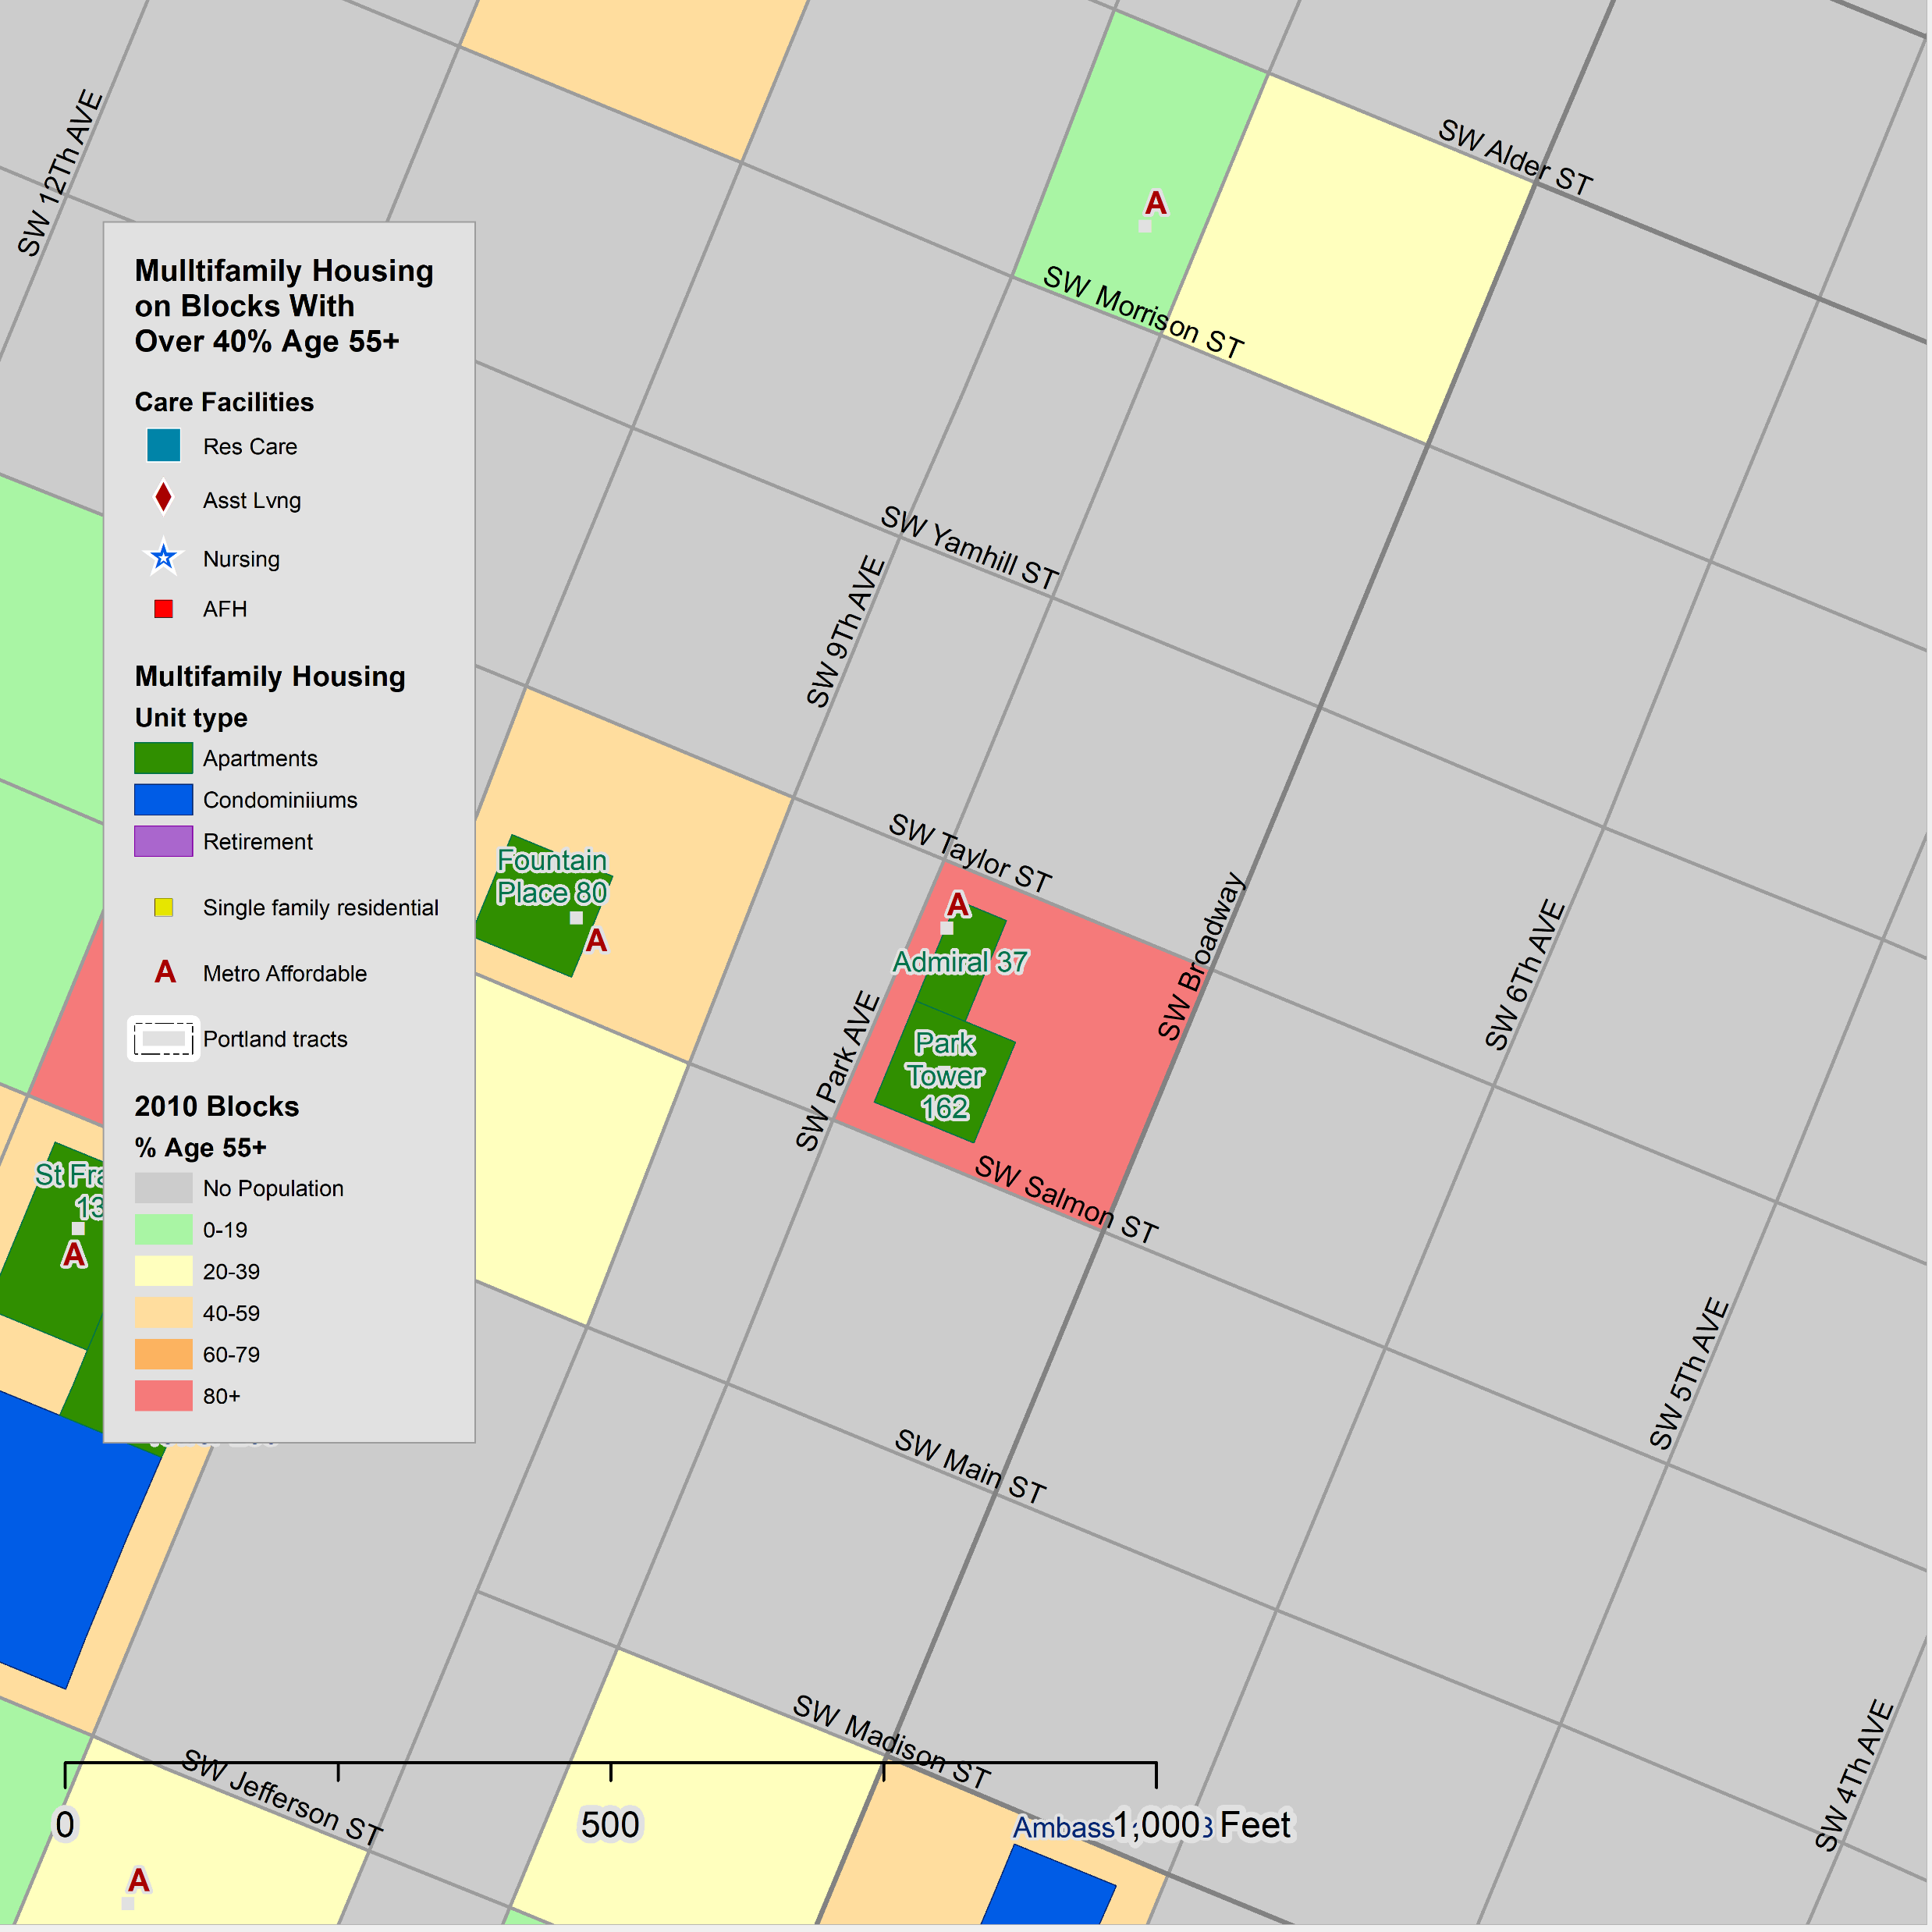
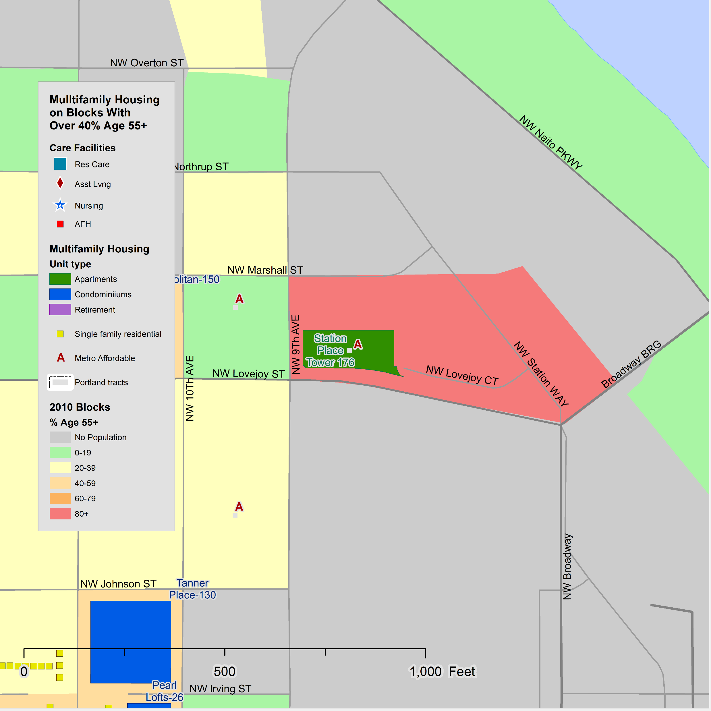
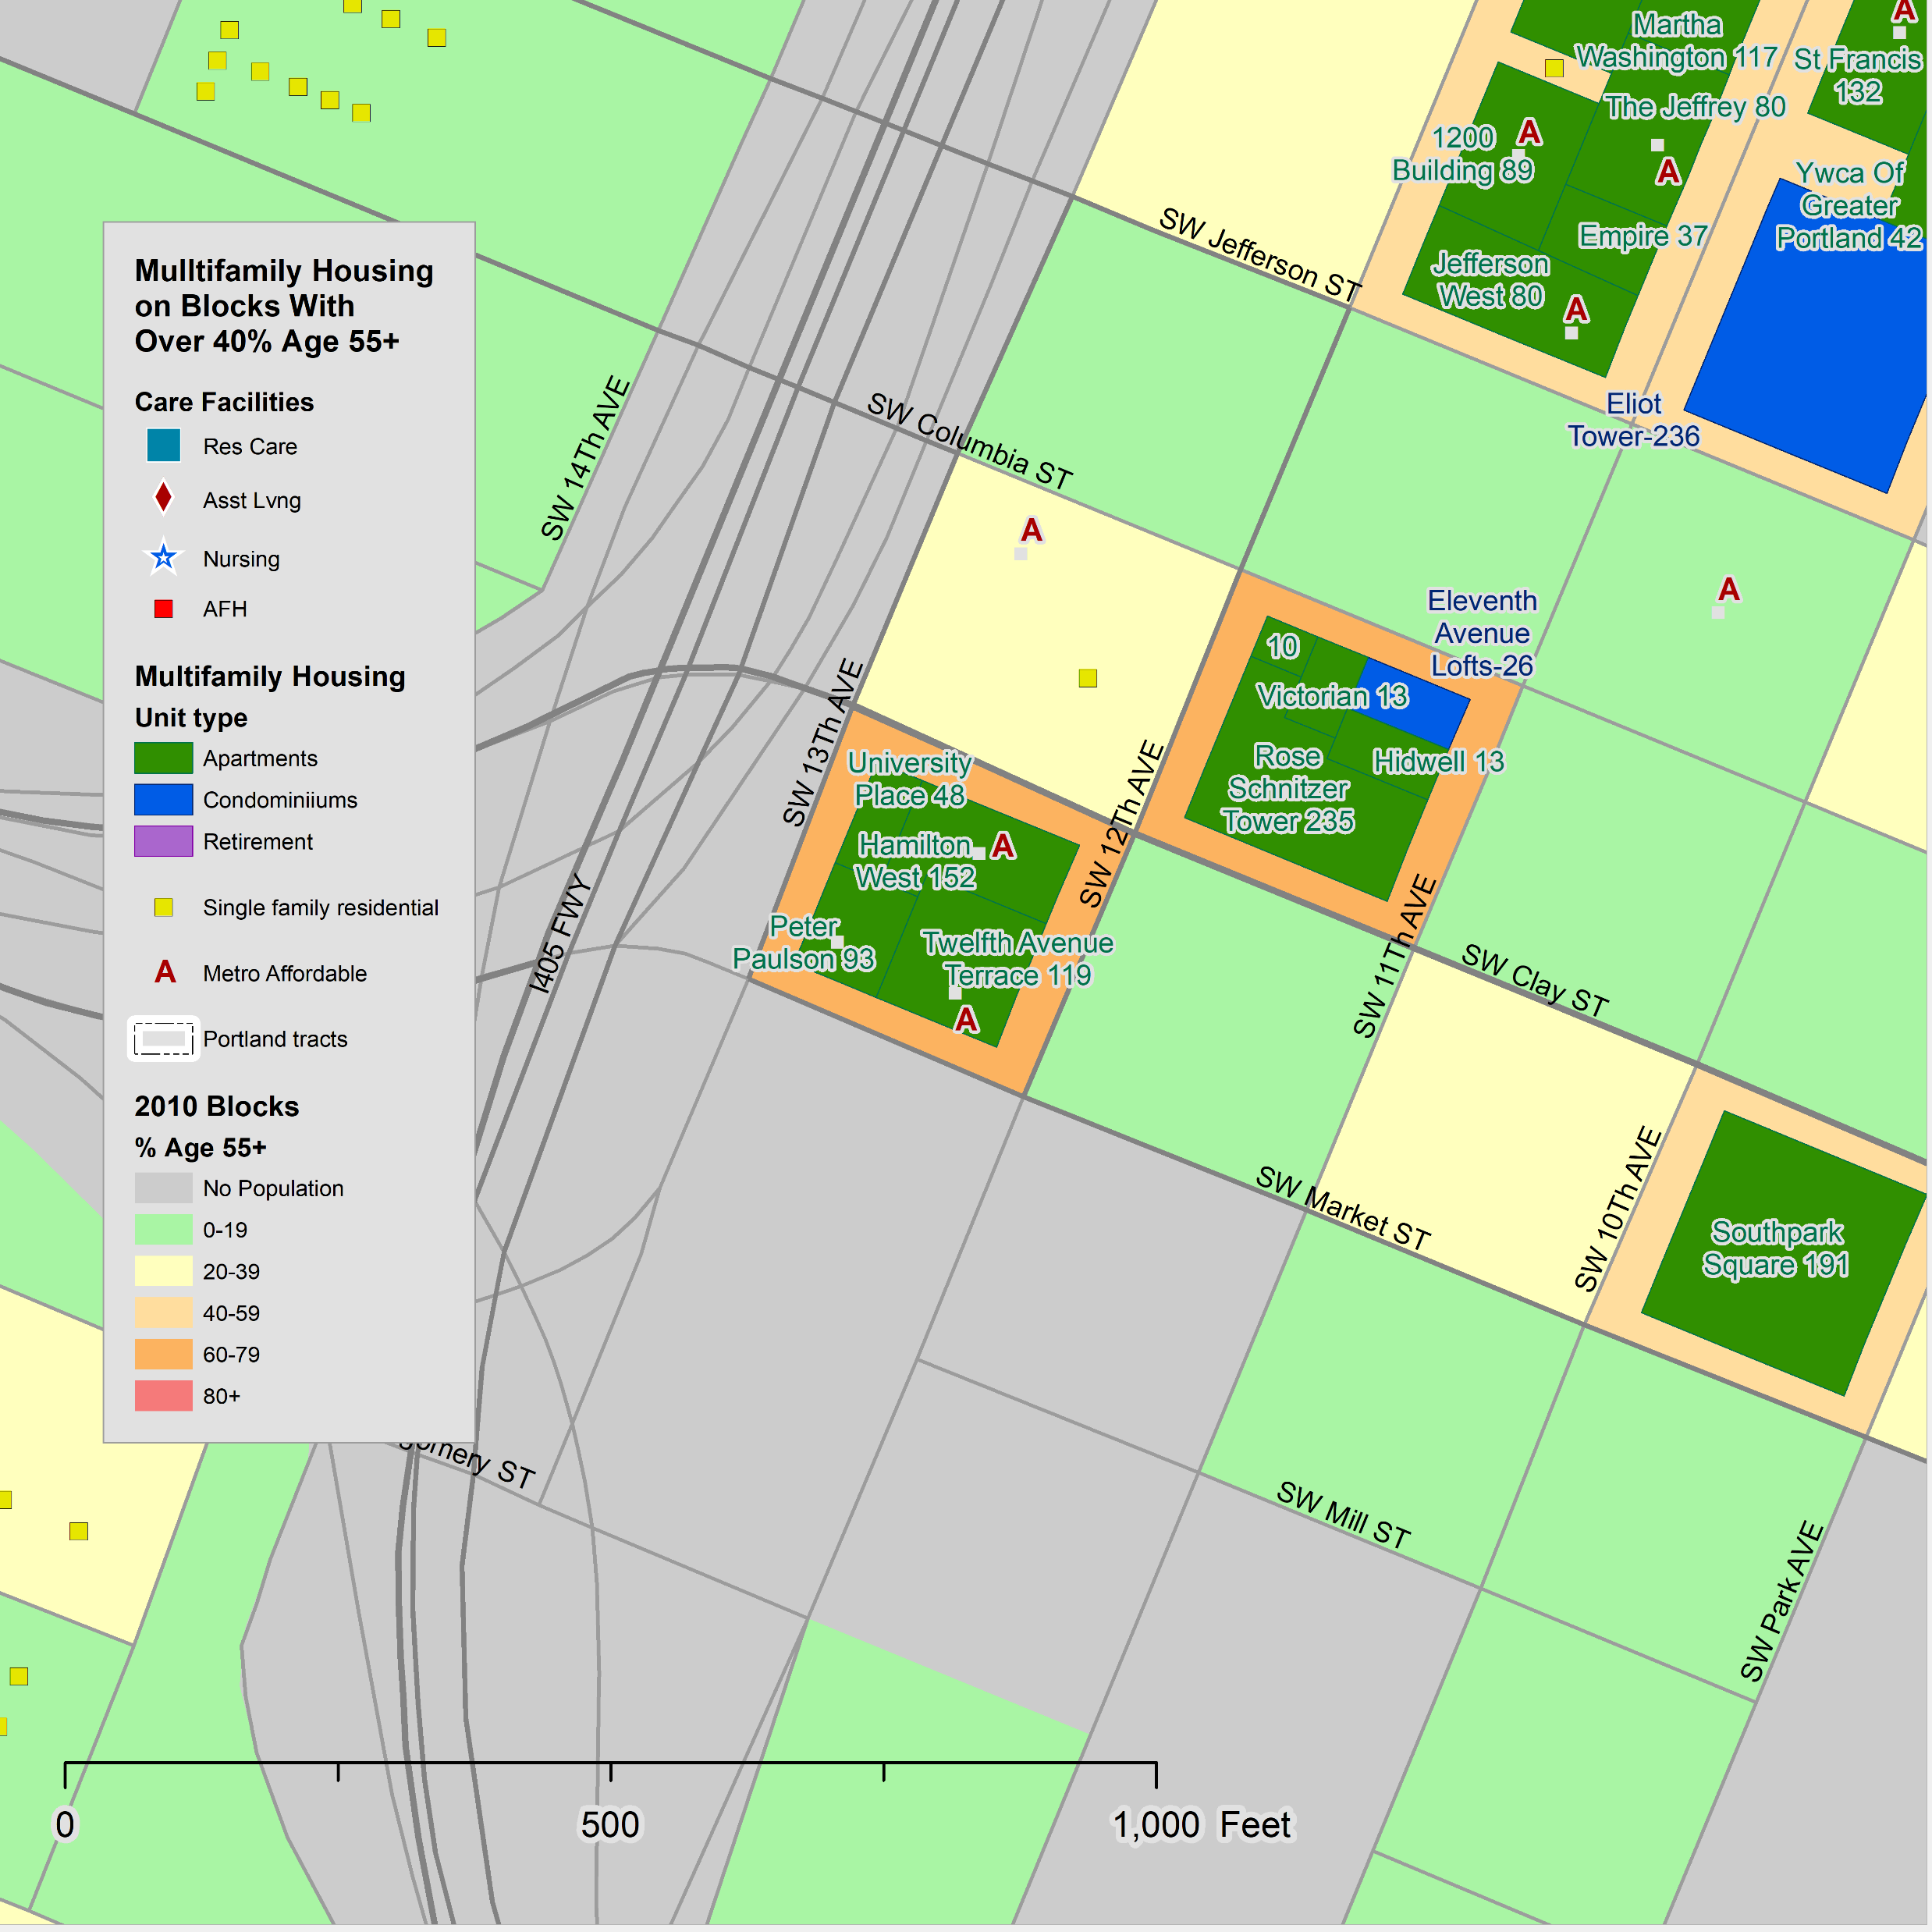
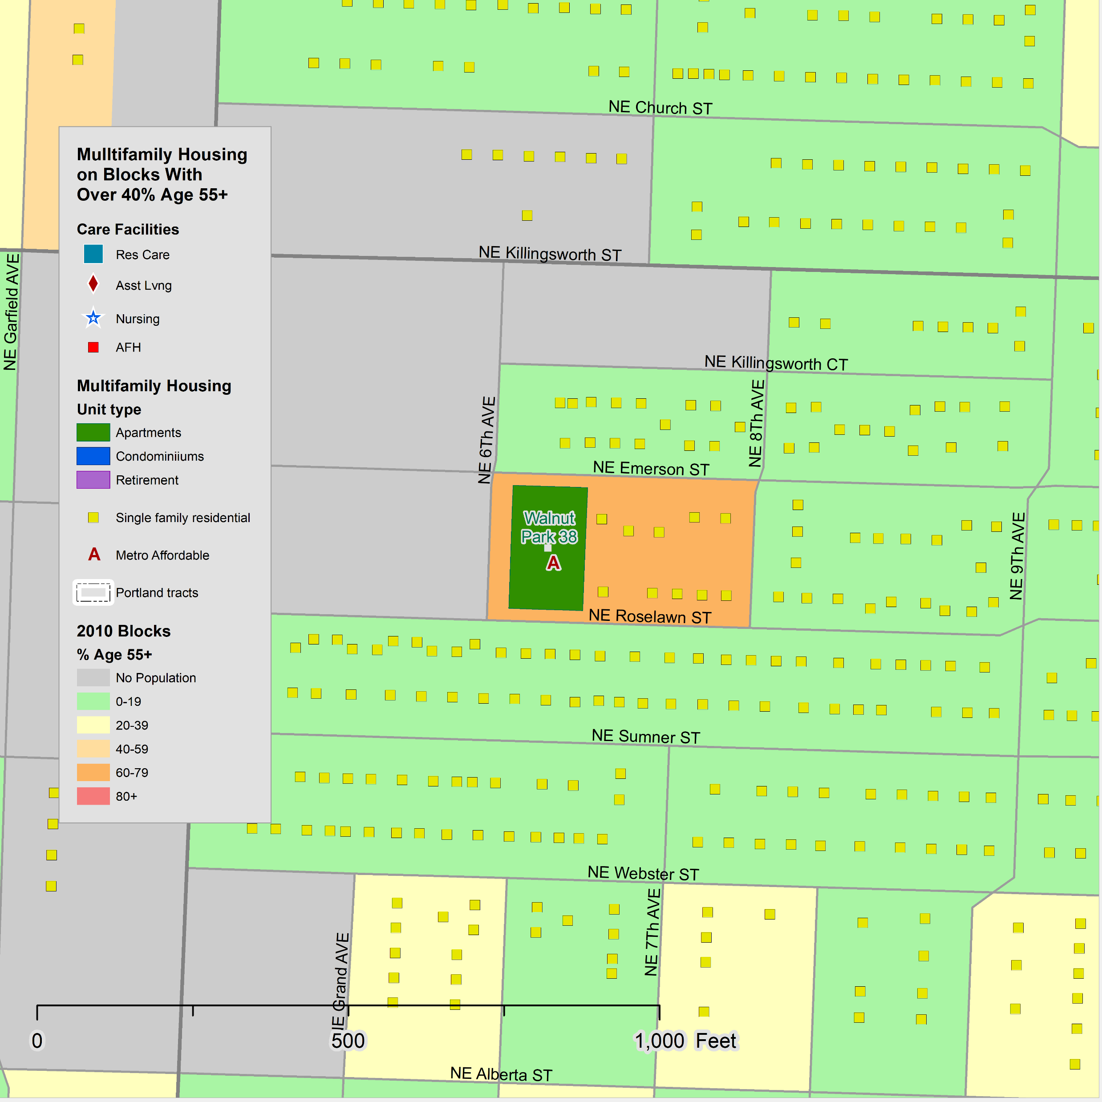
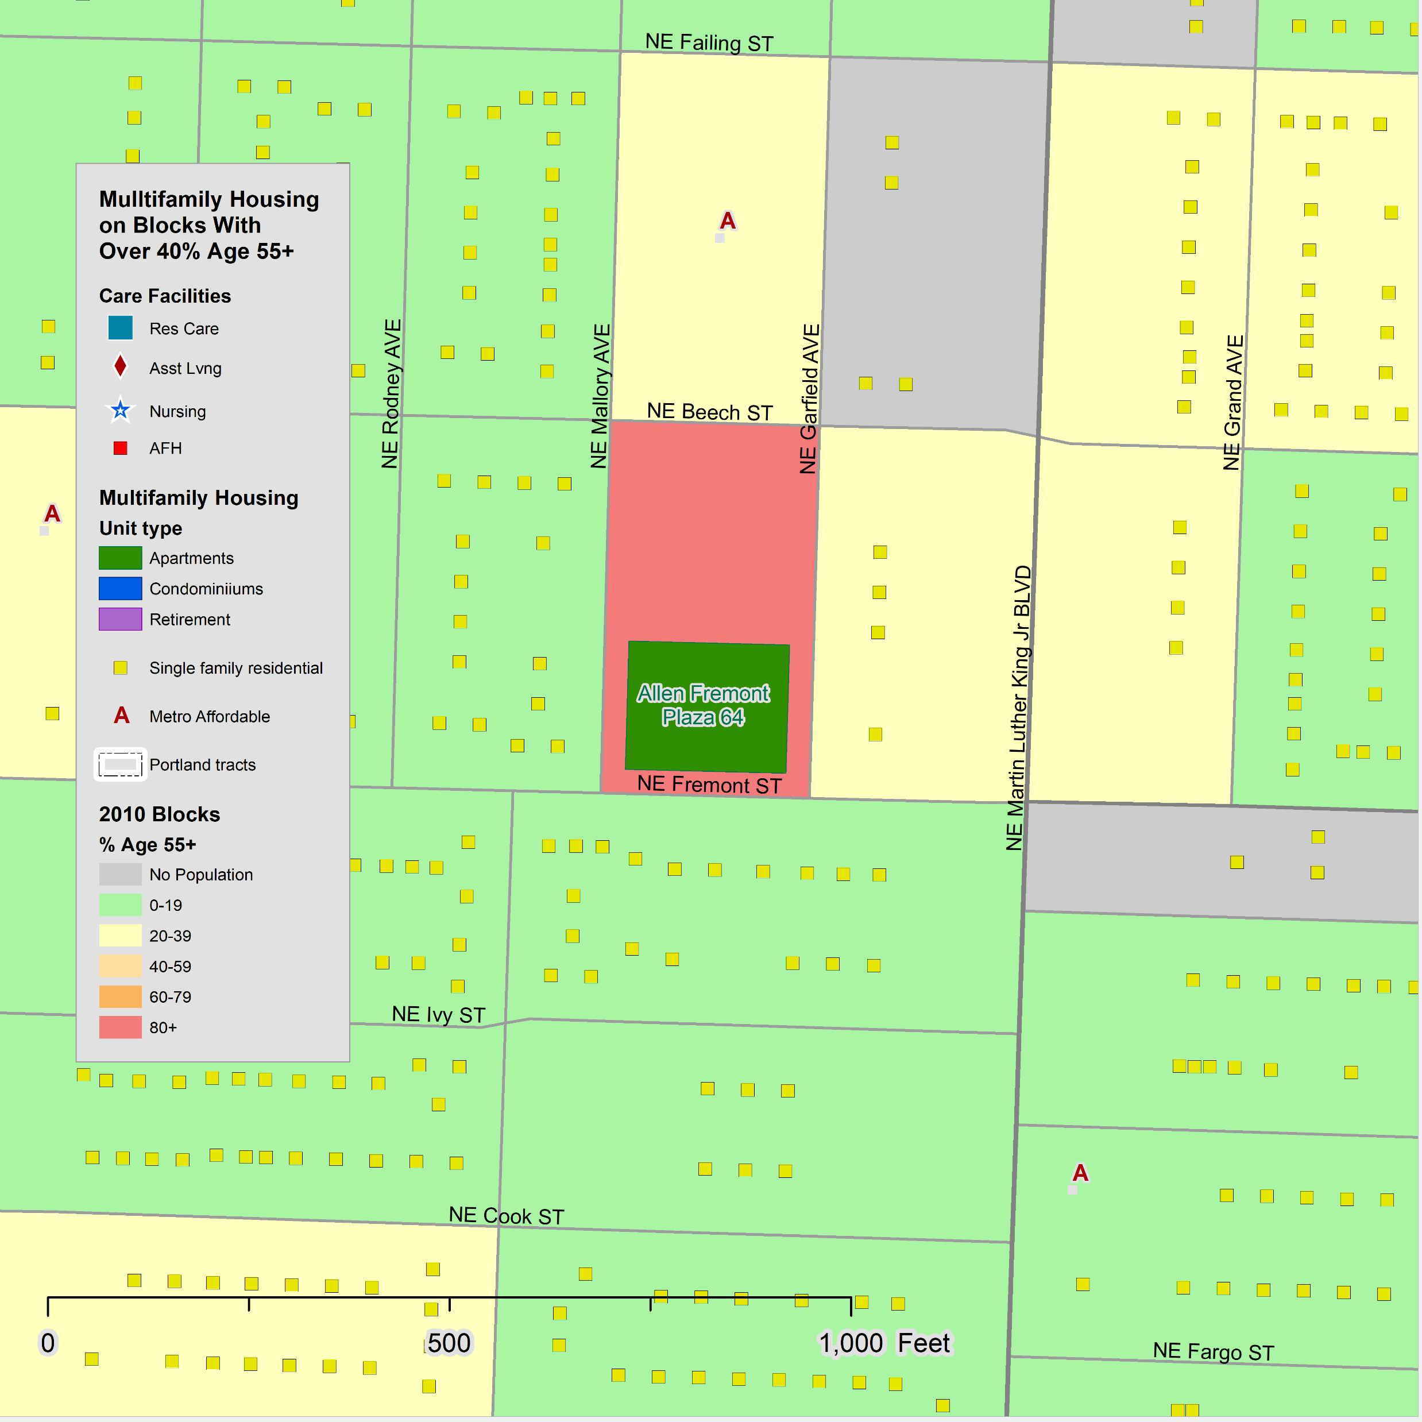
Examples, Reach CDC
10
Reach is a non-profit that provides affordable housing in the Portland Metropolitan Area, 23 of which are in the City of Portland.
Four of the developments are age restricted for those age 62+, or age 55+.
  Admiral and Park Tower – Two affordable housing developments on block, one sponsored by Reach and the other by Cedar Sinai Park. Many residents under age 65.
  Station Place Tower – Studio, one-, and two-bedroom units. 76 of the 176 units are subsidized.
  Twelfth Avenue Terrace and Hamilton West – There are four apartment developments on this block, two affordable and two market rate. There are more males than females in the four developments.
  Walnut Park – The 50 and under population likely reflects the residents of the ten single family units on the block. Almost half of the residents are Black.
  Allen Fremont Plaza – Reach indicates the building is reserved for seniors but does not state an age limit. It has a predominately Black population.
O

Slide 11
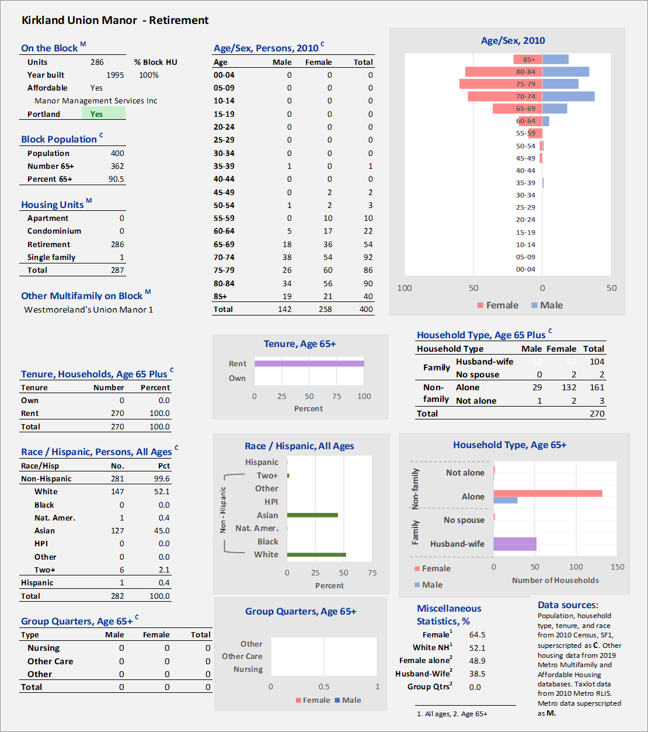
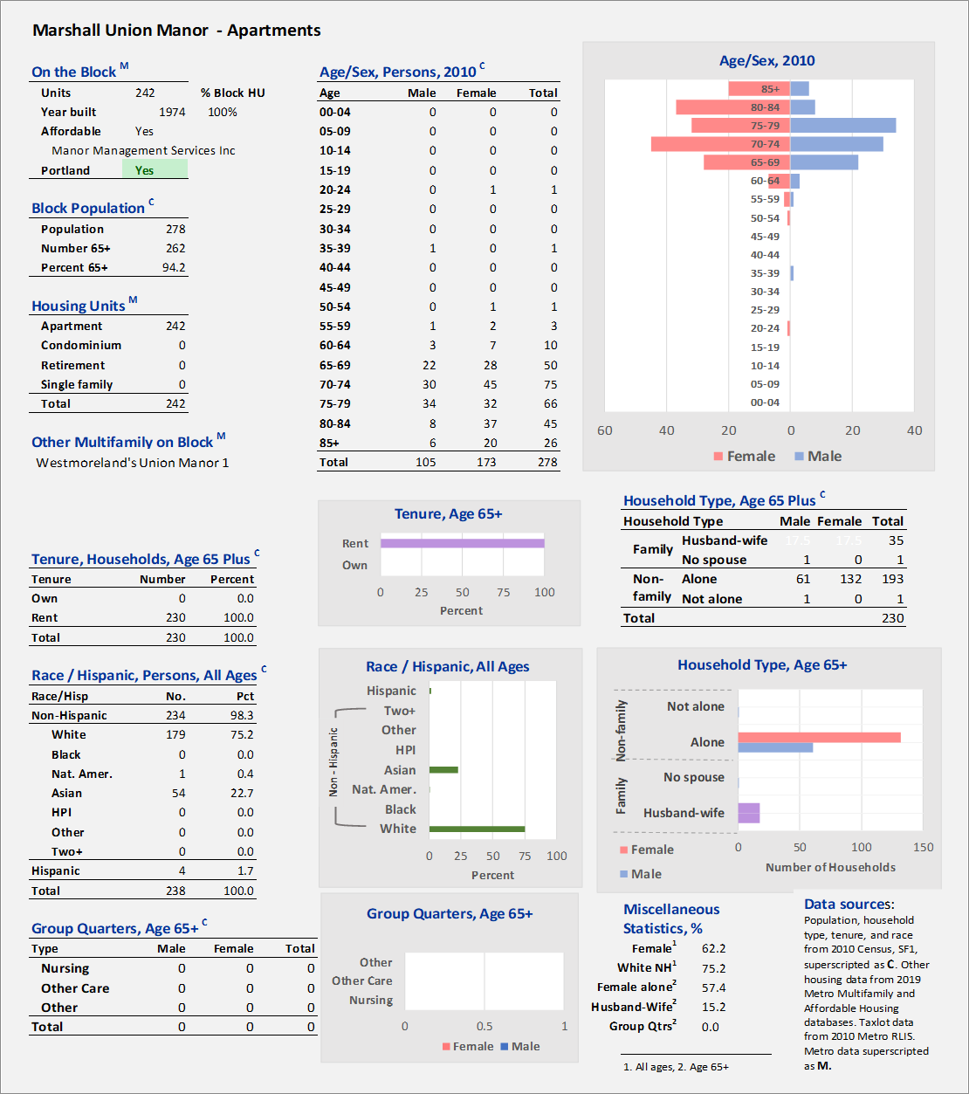
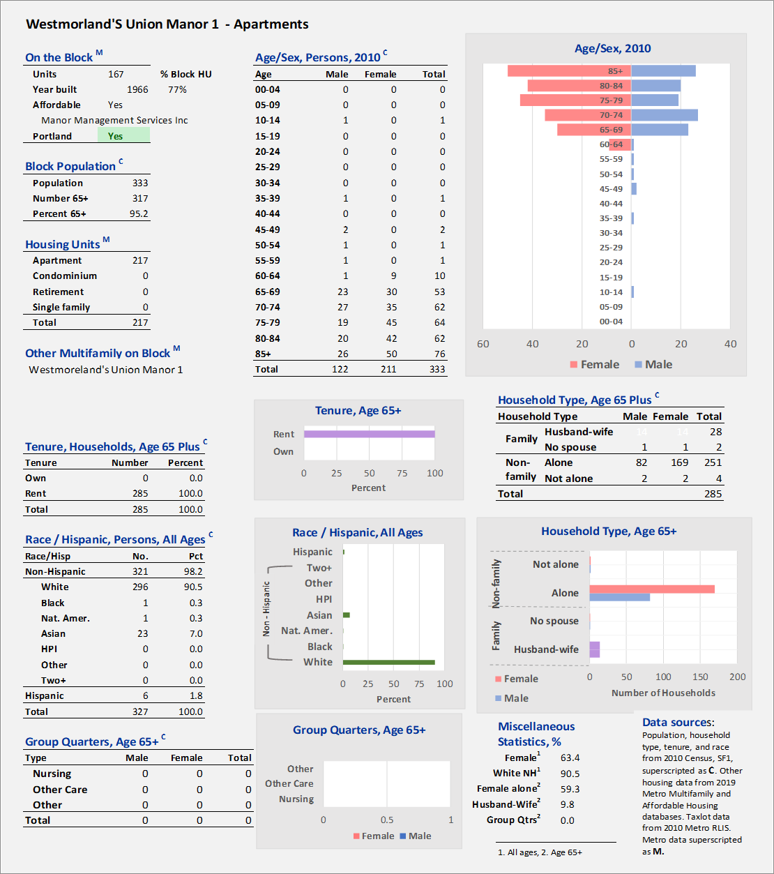

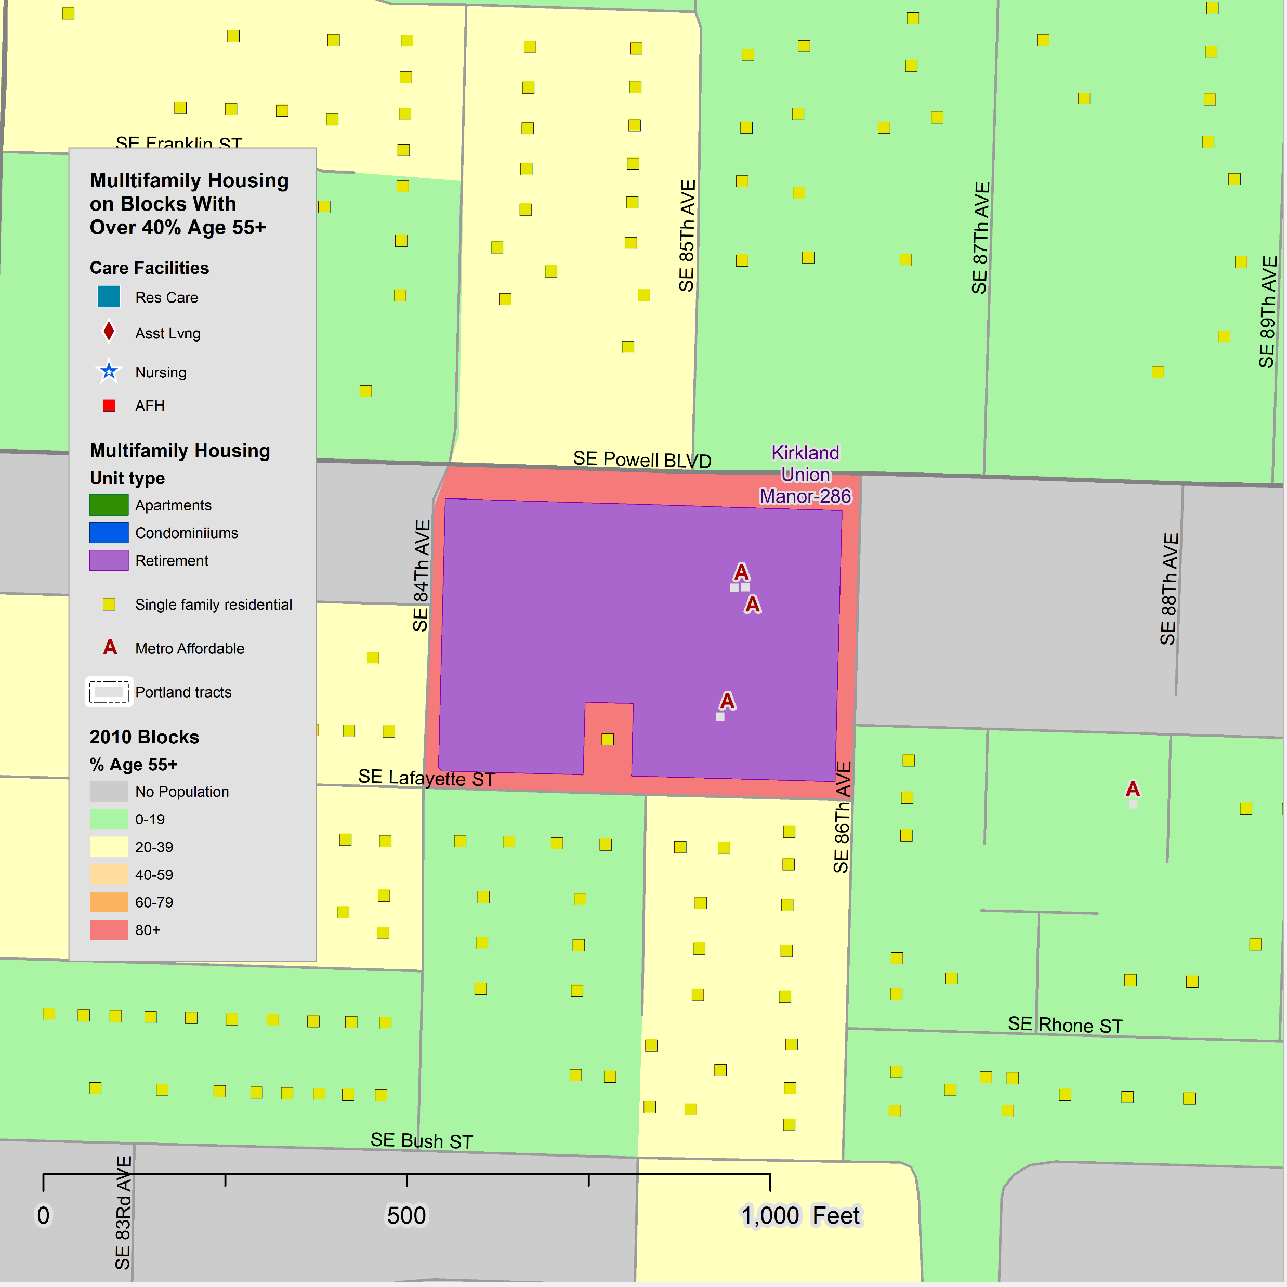
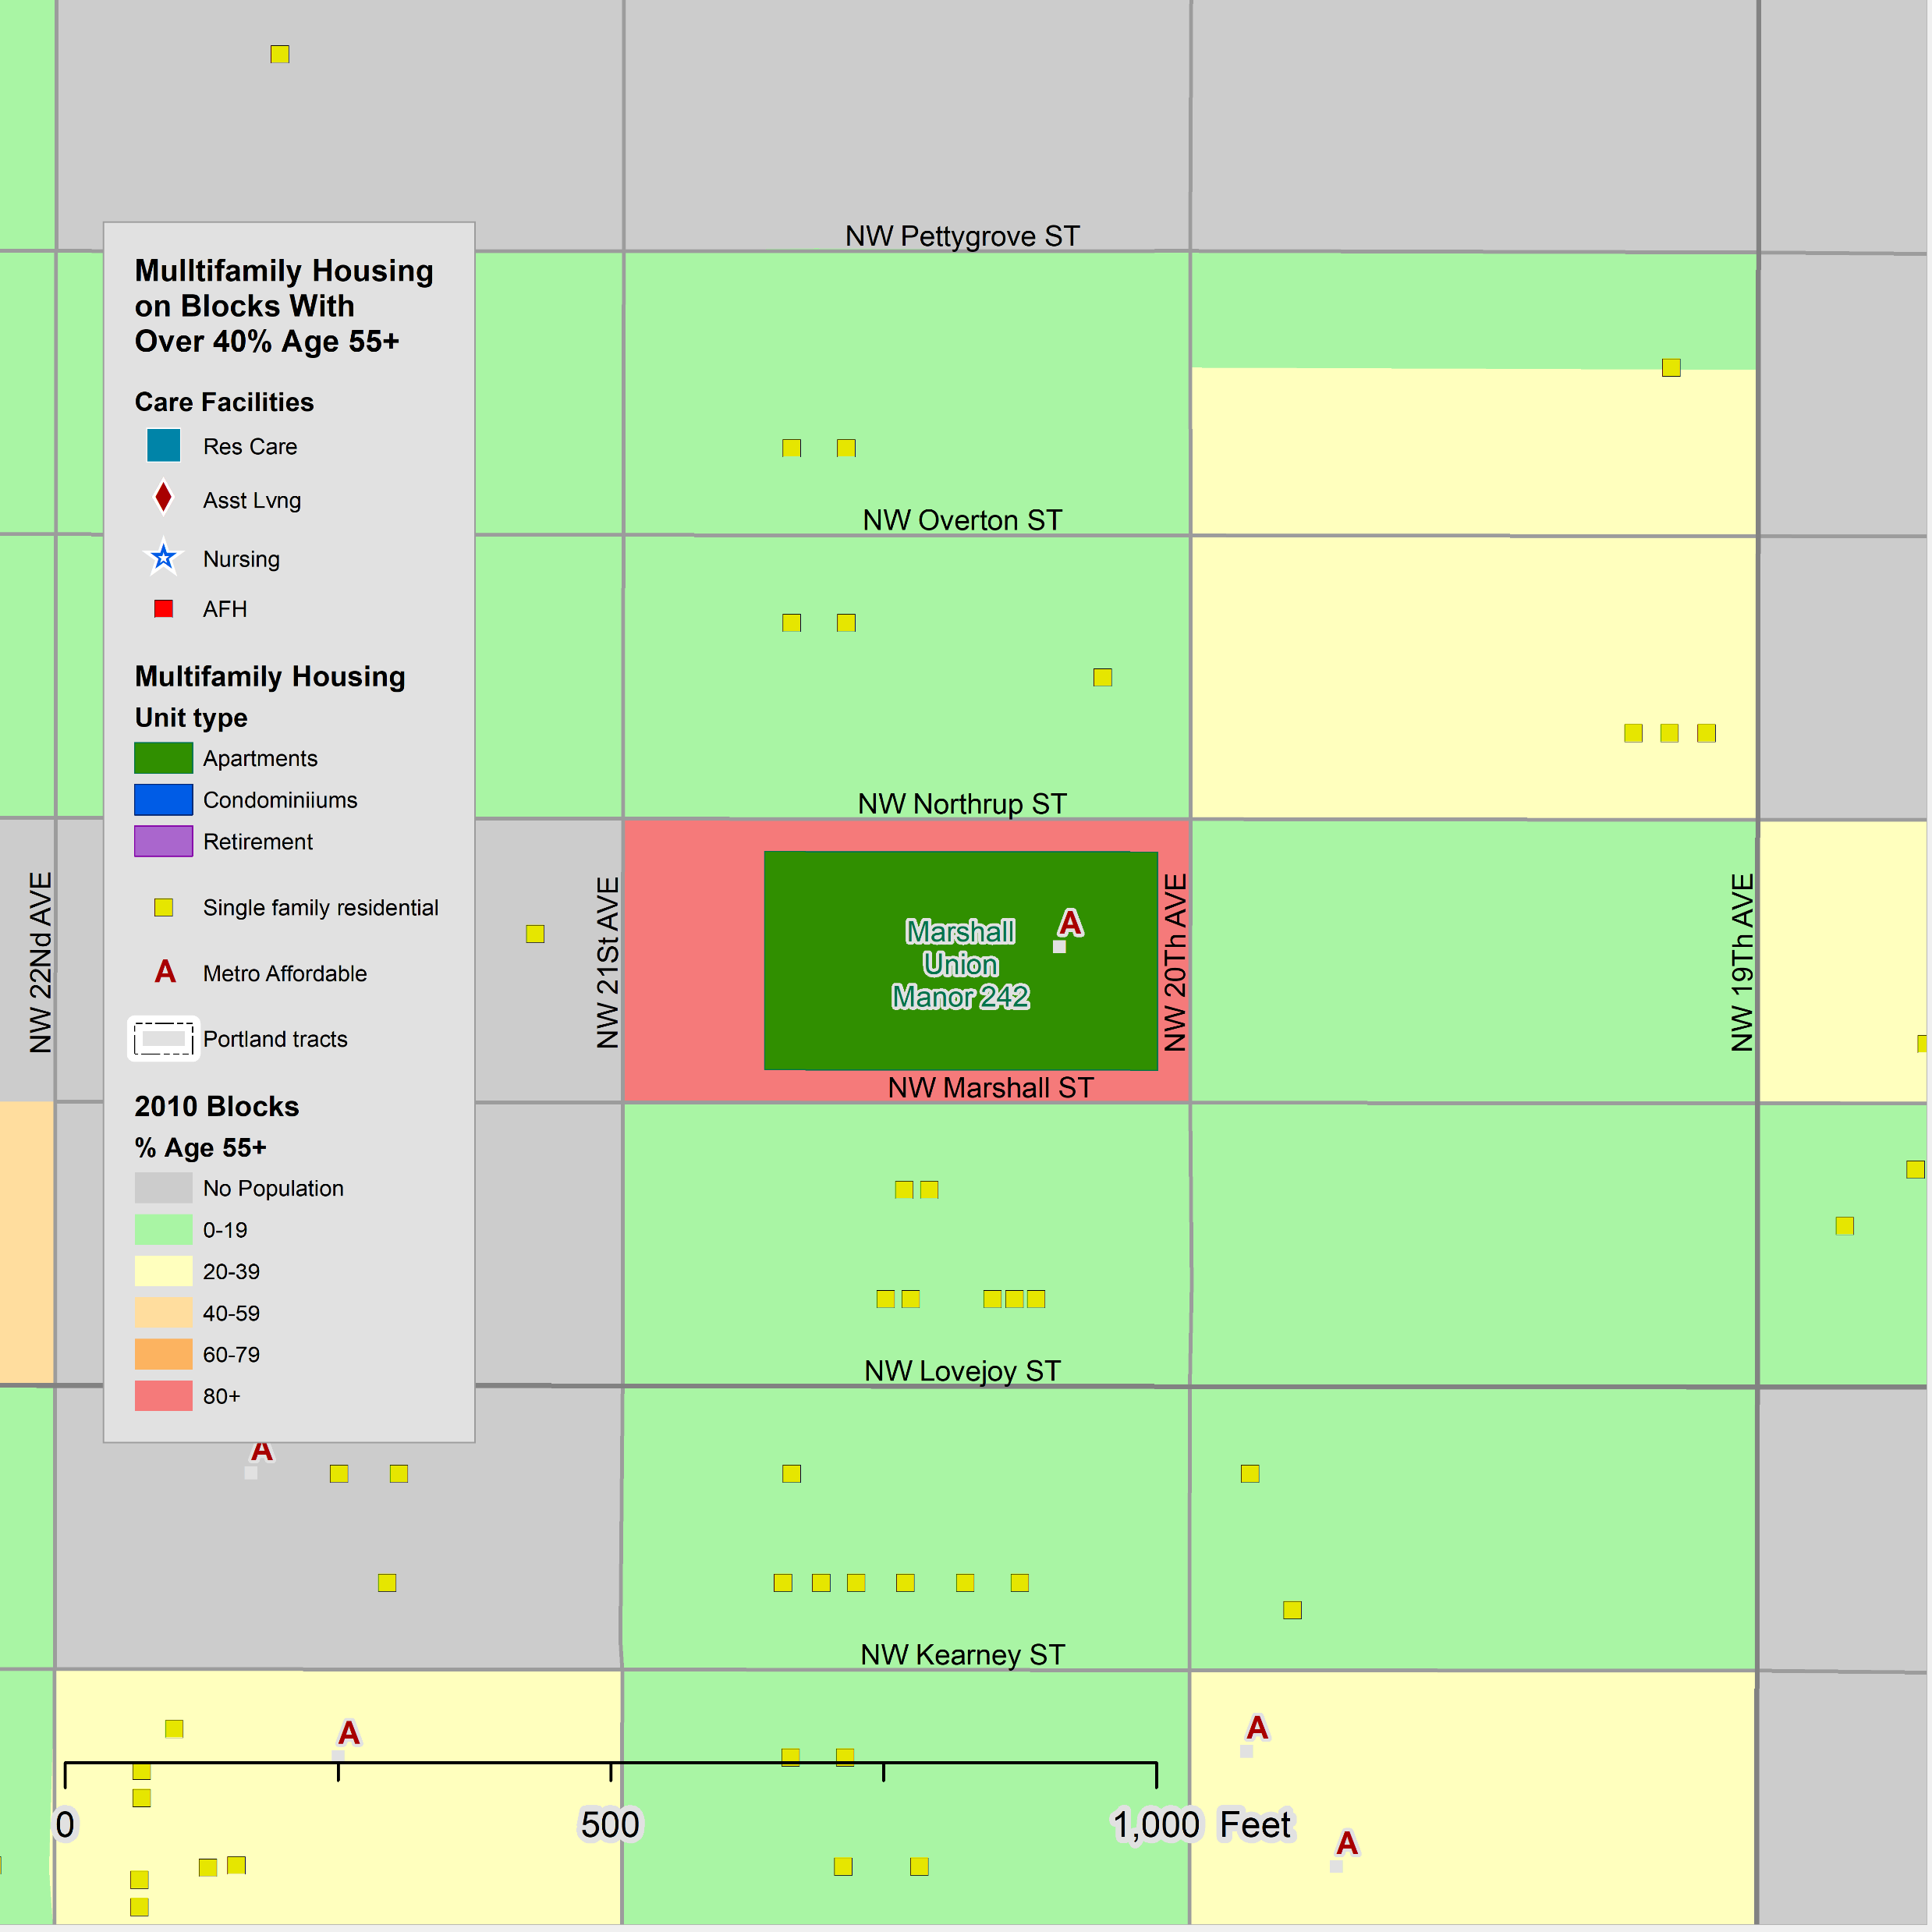
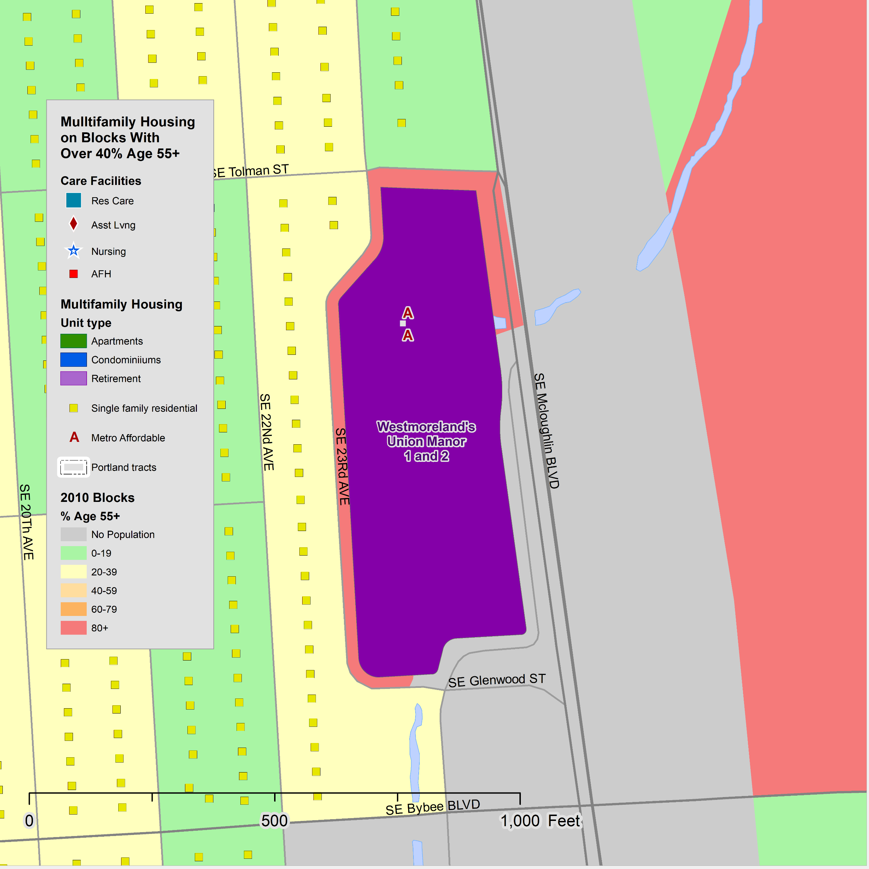
Examples – The Union Manors
11
The Union Manors consist of four developments managed by Manor Management Services. All are mid rise buildings built between 1966 and 1995.
Applicants must be age 62 or older.
All four developments offer studio and one-bedroom units and advertise affordable rent.
  Kirkland Union Manor
  Marshall Union Manor
  Westmoreland Union Manor 1
  Westmoreland Union Manor 2
The four developments have a similar age/sex composition:
  There are few residents under age 65.
  The numbers increase through those in their 80’s, suggesting that many move in after age 62.
  The gender mix is relatively even for a senior residence until their 80’s, after which females predominate.
  There are more husband-wife households than in most retirement developments. Some of the residents are surviving spouses.
  The residents are mainly White non-Hispanic, with some Asian residents.
O

Slide 12
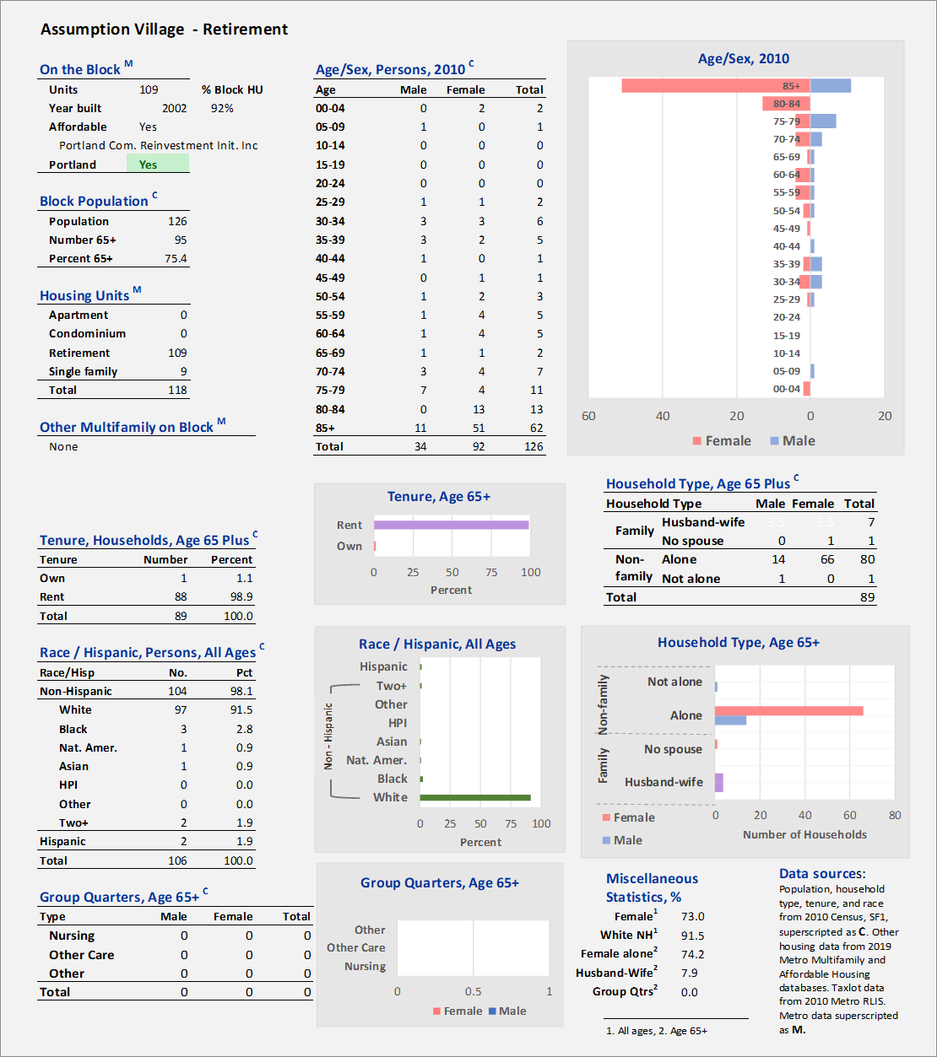
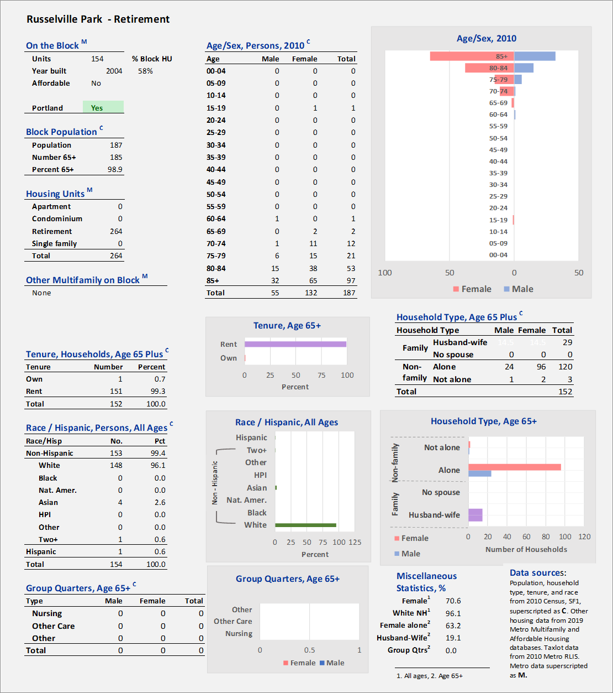
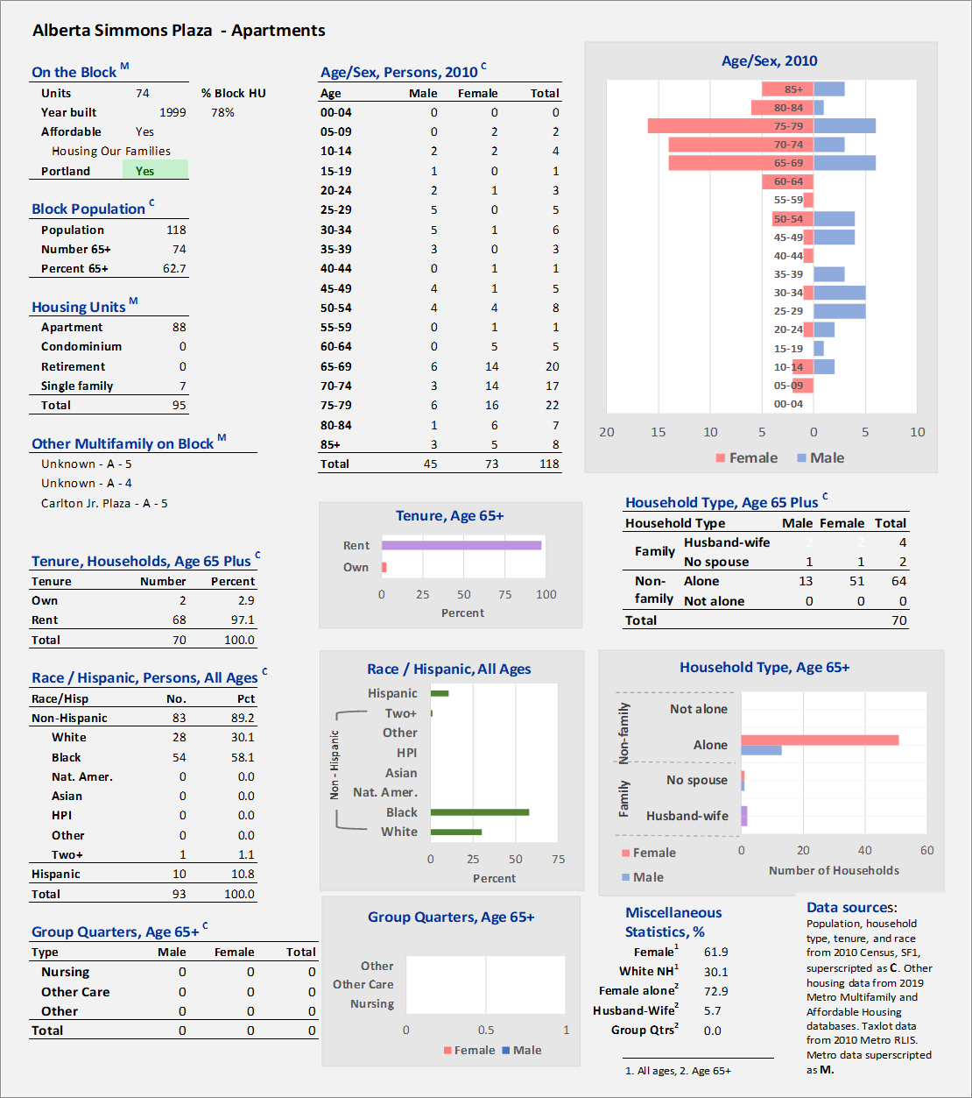
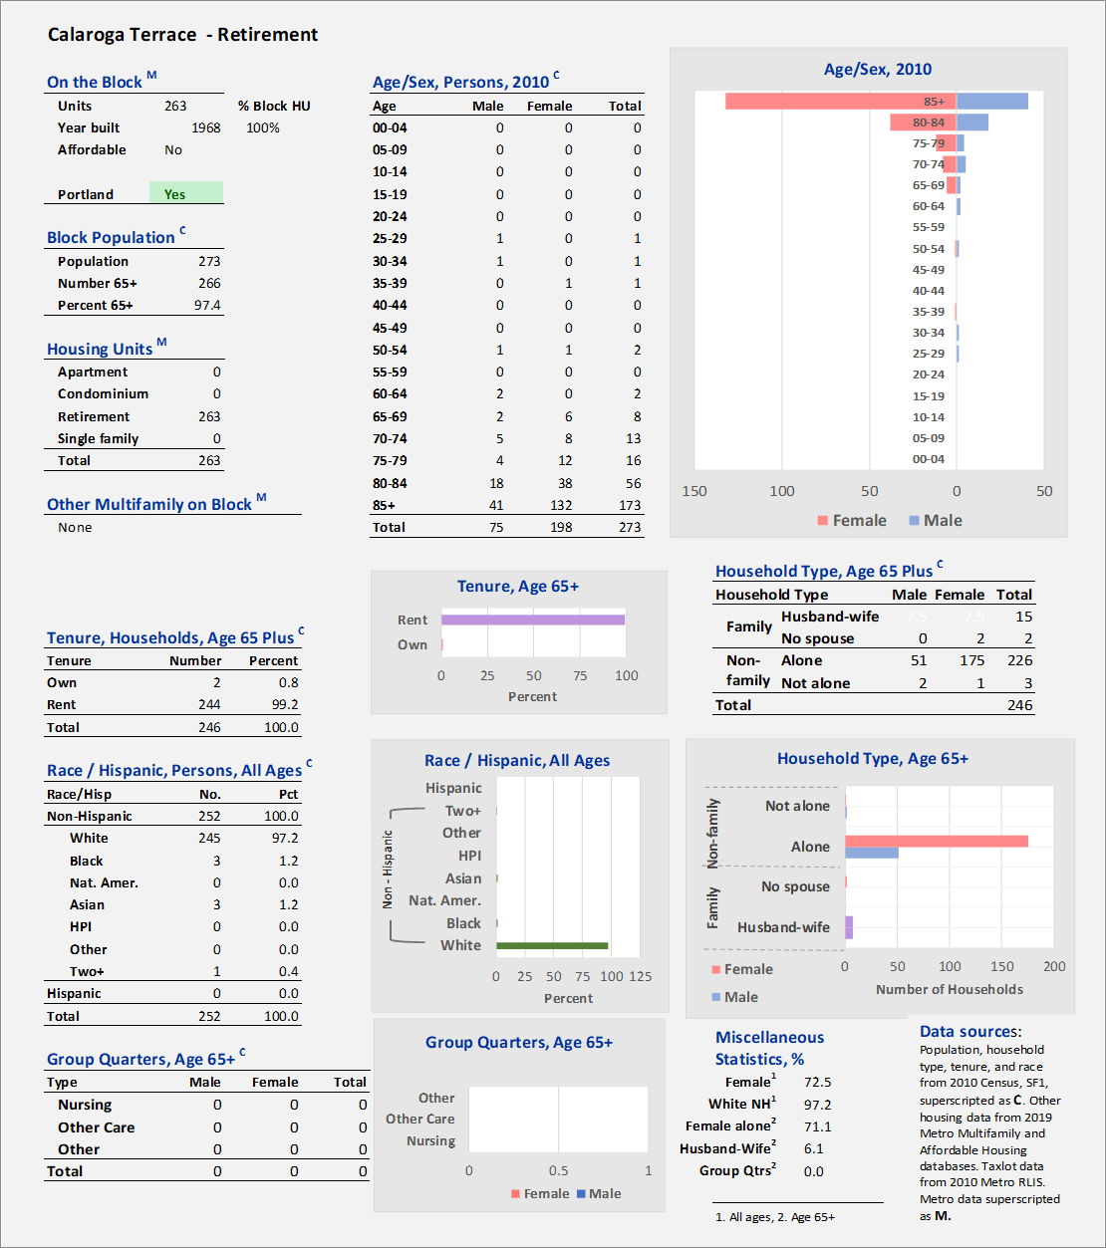
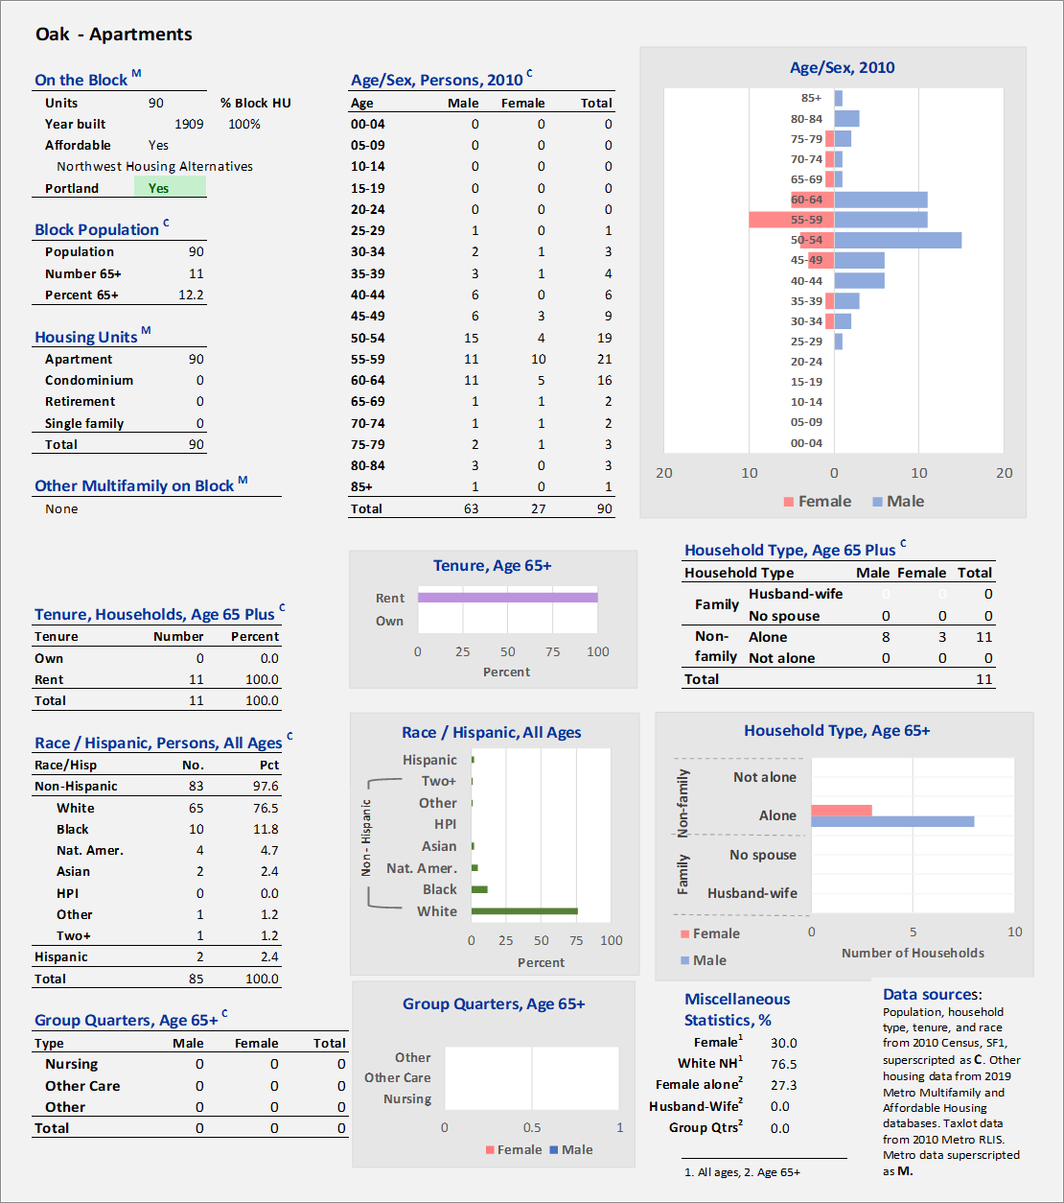





Additional Examples
12
Here are three more affordable senior housing developments and for contrast, two market rate senior housing developments.
Affordable housing:
  Assumption – includes assisted living
  Oak – mostly aged in their 50’s and 60’s
  Alberta Simons Plaza – many residents of color
Market rate housing:
  Calaroga Terrace – an independent living and assisted living community offering comfortable housing, personalized care, and views in Portland, Oregon.
  Russelville Park - an upscale and urban senior living community offering independent living, assisted living, and memory care services.
Residents in market rate, independent, and assisted living tend to be older that those in affordable housing developments and are more likely to be White non-Hispanic.
O

Slide 13
Types of Affordable Housing for Seniors
13
Beginning
Overview: Maps and tables
Examples: profiles of selected developments
A classification of senior housing types
The types of affordable housing developments for seniors vary considerably.
Since most of the households are small, mainly one person, most of the housing consists of studio and one-bedroom units.
Most of the affordable housing units are independent living, not providing the level of care like that in licensed assisted living developments.
The age/sex composition of the various affordable senior developments varies considerably. Some have a population that includes many persons age 85 and older, but most do not. Some have an older population that is the resulted of aging in place having moved in their 40’s and 50’s based on income and disability status. Others have a population that starts at the age minimum of age 55 or 62.
The following pages show a classification of senior housing for older persons based on their age/sex pyramids.
The Census group quarters population of nursing homes, residential care facilities, and adult family homes are not covered here.
O

Slide 14




Development Types by Age and Sex
14
The numbers in each five-year age group from 55 to 85+ were converted to proportions by dividing by the number age 55+. The proportions were transformed using an arc sine transformation to compress extreme values.
The transformed data for age groups were correlated.
The age 70+ groups were highly positively correlated among themselves (red) and negatively correlated (blue) to the 55-69 age groups. On blocks where you found many age 85+ you also tended to find others age 70+.
The transformed proportions by age group were correlated and principal factors extracted. Two factors explain most of the variance as shown in the plot of the eigenvalues.
The chart for this table shows that the numbers in the age 55-69 age groups are somewhat independent of each other; by contrast the age 70+ age groups are highly correlated.
Eigenvalues are the sum of the squares of the component weightings.
O
Source: 20000 and 2010 Decennial Censuses, SF1, table P12.
Learn about the Decennial Census

Slide 15



Classification of Affordable Housing for Older Adults
15
The age data for each block can be weighted by the two factors to provide an estimate for each block, known as a factor score.
The area of each sphere is proportional to the number of units in the development.
Here are the data labeled.
On this chart the percent of the age 65+ population that is male is shown by a color shading.
A helpful way to view the graph is as a continuum rotating counterclockwise from right to left, younger to older.
And from the center with age structure less defined or sharply defined.
Developments that are close to each other will tend to have similar age structures as in the case of those circled.
Younger
Older
O

Slide 16




Older
16
Four of the developments lie at the far right of the factor score chart.
In all four of the developments, residents must be age 62+ and a substantial proportion of residents are age 80+.
The three Union Manors are operated by the Union Labor Retirement Association and the Silvercrest Residence is operated by the Salvation Army.
All are high-rise or mid-rise developments with elevators.
The developments are about 41% male, ranging from 33-43%, reflecting the numbers of older, longer- living females.
Older
O

Slide 17





Mid Older
17
Mid Older
The group of five developments in the red ellipse have more persons in their 50’s and fewer in their 80’s that the Older group.
Chaucer Park is managed by the Union Labor Retirement Association, Station Place and the Admiral Apartments by Reach, Irvington Village by Providence Health Systems, Park Tower by Harsch Investments.
Chaucer Park and Park Tower do not state a minimum age. The Admiral states age 62 and Station Place age 55. Irvington Village does not state a minimum age and includes health services.
For the five developments, 53% of the residents are male, ranging from 45-66%.
O

Slide 18




Mid Younger
18
Mid Younger
This group of four developments has more in the 55-59 age group and, except for 12th Avenue Terrace, is fairly balanced with respect to gender, but leans female.
Dahlke Manor and Holgate House are managed by Home Forward and applicants must be age 55+ or have a disability. 12th Avenue Terrace is managed by Reach CDC and applicants must be at least age 55. The Watershed at Hillsdale is managed by Community Partners for Affordable Housing and includes housing for homeless veterans.
51% of the residents in these developments are male, ranging from 25% in Holgate House to 71% in 12th Avenue Terrace.
O

Slide 19




Younger
19
Because the classification scheme was based on those age 65+, these developments were identified because the largest age groups were 55- 65 which may be younger persons that aged into these age groups.
New Columbia is unique as it has 851 units in the entire Hope VI development; 556 affordable rental units are managed by Home Forward, but most do not have an age criteria; Trenton Terrace is not within the 556 Home Forward units, it has an age 62+ requirement, and is managed by NW Housing Alternatives.
The Commons requires residents to be age 55+. Center Commons is a mixed market rate subsidized housing development with units for seniors. McCoy Village has units ranging from 1 to 4 bedrooms.
For the four developments the age 65+ population was 43% male, but there were few persons age 65+.
Younger
O

Slide 20




Mixed Age
20
Northwest Tower, Medallion Apartments, and Gallagher Plaza all are managed by Home Forward and give a preference to seniors and persons with disabilities. Unthank Plaza also is managed by Home forward and applicants are required to be age 62+ or have a disability.
All have a broad age range residing in the developments including persons who may have moved in as seniors or aged in place.
The age 65+ population of these four developments is 55% male, ranging from 69% in Northwest Tower to 33% at Gallagher Plaza; the numbers of age 65+ are few.
Mixed
O

Slide 21





Recap
21
Pyramids for aggregated age/sex data, in percent:
  Older – Mainly age 65+, many 85+, more females.
  Mid Older – As young as 50’s but mainly 60’s, some 85+, gender mix even.
  Mid Younger – Many younger than 50, 60-64 largest group, more males younger, females older.
  Younger – A few 55+ but mainly younger persons.
  Mixed – A mix of younger families and older persons, few 70+.
O

Slide 22

Gender and
Age Class
22
The initial assumption was that affordable housing developments with more older persons would skew toward more females because there were more older persons and females live longer.
The results were more complex.
The 18 developments to the right of the vertical axis (red) had more females but did not progress in a regular way to the left as expected.
For the 30 developments to the left of the vertical axis (blue) the proportion of male residents grew from center to left.
However, the standard deviations for the developments to the left, blue box, are large, indicating that some were predominately male and other predominately female.
Younger
Older
We present these results because we were looking for patterns in the gender mix, but the results are inconclusive.
O

Slide 23
End of Section on Affordable Housing
Developments for Seniors
23
Beginning
Overview: Maps and tables
Examples: profiles of selected developments
A classification of senior housing types
O
Source: Final_PPT_Links\R7_1_Affordable_Housing_7.5.21_drl_4_akd3.pptx

Slide 24
The State of Aging in Portland
Information on Data Sources
and Geographies
Background for study
The Decennial Census
The American Community Survey (ACS)
Supertracts
The American Housing Survey (AHS)
20 Comparison cities
Geography issues
Portland’s Inner and outer suburbs
The ACS Public Use Microsample
Nomenclature for race and ethnicity
Census group quarters
O

Slide 25

About The State of Aging in Portland Report and Navigating the Findings
O
O
O
O
O
O
O
O
O
O
O
O
O
O
O
O
O
O
This presentation includes seven sections developed as part of a study for the City of Portland by the Institute on Aging at Portland State University (PSU), Portland, Ore. The study, titled The State of Aging in Portland, was undertaken to provide guidance to local government and members of the broad and informal “aging network” of service providers, advocates, and others in Portland and the region so that that they can better understand, and address trends related to Portland and the region’s population aging.
Funding source: The City of Portland, Community Health and Access program.
Project staff included:
  Alan DeLaTorre, PhD, Adjunct Faculty, Institute on Aging, PSU; team leader and analytical perspectives; aland@pdx.edu (he now serves as the City of Portland’s Age-friendly City program manager and can be contacted at Alan.DeLaTorre@portlandoregon.gov)
  D. Richard Lycan, PhD, Professor Emeritus and Senior Research Associate, Institute on Aging, PSU; volunteer, analyst of demographic data, mapping, and creator of PowerPoints; lycand@pdx.edu
  Margaret B. Neal, PhD, Professor Emerita of Urban Studies and Planning and former Director of the Institute on Aging (2003-2017); analyzed age-related differences and similarities in responses to the City’s survey on livability, the 2019 Portland Insights Survey; nealm@pdx.edu
  Paula Carder, PhD, Director of the Institute on Aging; project oversight; carderp@pdx.edu.
Additional support was received from faculty at PSU’s Institute on Aging and Population Research Center, and staff from the City of Portland, Metro, Multnomah County, and Home Forward.
We encourage viewers to make full use of our work, including maps and charts, in their research. Content is best viewed using the web-based iSpring modules (see navigation tips below). Content, such as maps and charts, may be best accessed from downloaded PowerPoint files as they will have the highest resolution for viewing and reuse.
Individual pages of this report may be cited as:
  DeLaTorre, A., Lycan, D. R., & Neal, M. B. (2021). State of Aging in Portland. Institute on Aging, Portland State University, slide no. #. Retrieved from: https://soaportland.cupa.pdx.edu/.
Software used in this study:
  From Office 365 Excel for analysis and building tables and charts and PowerPoint for slide creation.
  From Environmental Research Institute ArcMap 10.4 for geospatial analysis and mapping.
  From iSpring eLearning Software iSpring Converter Pro 10 to transform PowerPoint to HTML5.
  From IBM SPSS statistics for data analysis
Menu

Slide 26
The Decennial Census
O
O
Variables
2010 Census
  Household: Household size, home ownership, families
  Demographic: Age, race, Hispanic origin, gender, marital status
2000 and earlier: Above, plus additional socioeconomic variables.
Issues with Census data
  The latest 2010 data are 10 years old. Results of the 2020 census should be available in September 2021.
  The tables in the State of Aging report should be updated when the 2020 data become available.
  Only the data listed under Household and Demographic are available but there are hundreds of cross-tabulation tables.
How Census was Used for this Study
  At the census block level to determine age and race of seniors housing and to assess demographic changes.
  At the census tract level to map age, race, and group quarters residents.
  For the city of Portland to get exact counts by age, race, housing type, and group quarters residents.
Access the Census data at: https://data.census.gov/cedsci/
U.S. Census Bureau: https://www.census.gov/programs-surveys/decennial-census.html
Frequency of Data
Collection: Every 10 years
Release: Data Release Schedule
Geographic Levels
Nation, State, County, City, Census Tract and Census Block
Description
The U.S. Census counts every resident in the United States at 10-year intervals, as mandated by the Constitution. It provides a snapshot of each person living in the country on April 1 of the year in which the Census is conducted.
The data collected by the decennial census affect the number of seats a state has in the U.S. House of Representatives and are used to distribute funding and allocate resources across localities and communities.
The 2010 Census reported data on age and sex distributions, race, Hispanic or Latino origin, household relationship and type, the group quarters population, and housing occupancy and tenure (whether the housing occupant owns or rents).
O
O
O
O
O
O
O
O
O
O
O
O
O
O
O
O
Source: Demographic Research Group, Weldon Cooper Center for Public Service,
University of Virginia:
https://demographics.coopercenter.org/guide-to-publicly-available-demographic-data
Menu

Slide 27
The American Community Survey (ACS), Summary Tables
27
O
O
U.S. Census Bureau, www.census.gov/programs-surveys/acs/
Frequency of Data
Collection: ongoing
Release: Data Release Schedule
Geographic Levels
Nation, State, County, City, Census Tract and Census Block Group
Description
The American Community Survey (ACS) is an ongoing survey that covers a sample of nearly 3.5 million addresses across the U.S. The data are released at 1- or 5- year intervals (the 3-year data product has been discontinued).
The survey provides current data and allows a choice between single-year and multi-year estimates, depending on research needs with respect to currency, reliability and level of geography. The data help local agencies and individuals – in both government, business, non-profits etc. – to better understand their communities and the workforce. The ACS provides information on a variety of subjects, including demographics, economics, housing and social situations/
Variables
Demographic: Age, sex, group quarters population, race, Hispanic or Latino Origin, race, relationship, total population
Economic: Class of worker, commuting to work, employment status, Supplemental Nutrition Assistance Program (SNAP), health insurance coverage, income and earnings, industry and occupation, poverty, work status
Housing: Computer ownership & internet access, house heating fuel, occupancy/vacancy status, occupants per room, owner monthly costs, plumbing facilities, rent statistics, rooms, bedrooms, telephone service available, tenure, units in structure, value of home, vehicles available, year householder moved into unit, year structure built
Social: Ancestry, citizenship status, disability status, educational attainment, fertility, field of degree, grandparents as caregivers, language, marital history, marital status, place of birth, school enrollment, residence one year ago/migration, veterans, year of entry.
Issues with Use of ACS
Substantial sampling error, especially for small geographies such as census tracts
Sample size approximately 2.4% per year, about 12% for five-year data
How ACS was Used for this Study
Socioeconomic data about the city of Portland
Census tract data for analysis and mapping
Aggregation of tract data to supertracts (see next slide)
Access the ACS data at: https://data.census.gov/cedsci/
Back to Housing
O
O
O
O
O
O
O
O
O
O
O
O
O
O
O
O
Source: Demographic Research Group, Weldon Cooper Center for Public Service, University of Virginia:
https://demographics.coopercenter.org/guide-to-publicly-available-demographic-data
Menu

Slide 28



Supertracts
O
O
Supertracts (see red brown) are were created by aggregating 6-8 adjacent census tracts (see grey boundaries).
The supertracts emulated the city of Portland’s 20-minute neighborhoods extended to the seven-county Portland Metropolitan Area.
Portland’s 20-minute neighborhoods were designed to have access to commercial services and amenities as a pedestrian, cyclist, or on transit.
The supertracts also reduced the amount of sampling variability in the data from the American Community Survey. For example, The Lake Oswego supertract (see purple) is the aggregation of 8 census tracts.
The ACS table for the Lake Oswego tracts shows the Estimate (EST) and Measure of Error (MOE) for the number of persons with an ambulatory difficulty. The MOE is the +/- value for the 90% confidence level.
The coefficient of variation (CV) is the ratio of MOE/EST. Values from 0.00 to 0.12 can be considered as good reliability, from .12 to.40 as fair, and over .40 as poor reliable.
All of the tract CV values are greater than 0.40 (poor reliability) but aggregated to supertracts the CV is 0.259 (fair reliability).
In addition, supertracts have recognizable neighborhood names and help to link the data to the viewer’s knowledge of the City.
.
O
O
O
O
O
O
O
O
O
O
O
O
O
O
O
O
8
Menu

Slide 29
The American Housing Survey (AHS)
O
O
The American Housing Survey (AHS) is sponsored by the Department of Housing and Urban Development (HUD) and conducted by the U.S. Census Bureau. The survey has been the most comprehensive national housing survey in the United States since its inception in 1973.
The AHS is a longitudinal housing unit survey conducted biennially in odd-numbered years, with samples redrawn in 1985 and 2015.
It provides up-to-date information about the size, composition, quality and cost of housing in the United States and major metropolitan areas and measures changes in our housing stock as it ages.
Returning to the same housing units every other year to gather data until a new sample of housing units is drawn, the AHS allows users the unique opportunity to analyze housing and household changes over time.
The survey’s principal coverage is of the 15 largest metropolitan areas in the United States. Portland is not one of the top 15 but data are available for 2019, 2015, and 2011.
The AHS has a relatively small sample size, 117,422 units for the nation and only about 3,000 per metropolitan area. Many of the fields for the Portland data are suppressed due to insufficient sample size.
The wide range of core housing topics covered in the ACS include but are not limited to the following:
  size and composition of the nation's housing inventory
  vacancies
  owners and renters
  physical conditions of housing units
  equipment breakdowns
  characteristics of occupants
  housing and neighborhood quality
  mortgages and other housing costs
  fuel usage
  home improvements
  persons eligible for and beneficiaries of assisted housing
  characteristics of recent movers
  home values.
How AHS was Used
  We mainly used the national data from the AHS, as much of the Portland data were suppressed due to small sample size.
Access the AHS: Data available as a public use sample or created using the ACS Table Maker.
Back to Housing
O
O
O
O
O
O
O
O
O
O
O
O
O
O
Menu

Slide 30






Comparison Cities
30
O
O
When we discuss our city, Portland, we often speculate about how it is similar or differs from our neighbor to the north, Seattle. We decided to extend the comparison of Portland with other cities about the same size.
However, members of the team also wanted to include Austin, Oakland, and Minneapolis, cities that readers might be familiar with, or cities often compared to Portland.
Here is a list of the 20 comparison cities, 10 larger and 10 smaller, ordered by their population.
As an example of how we used the comparisons, here is a chart that shows, for each of the comparison cities and Portland, the city’s proportion of the metropolitan area population.
Portland is in the middle of the pack, compared to the Portland – Vancouver – Hillsboro Metropolitan Statistical Area (MSA).
By comparison, El Paso contains over 80% of the population in the El Paso MSA and Oakland only about 10% of the San Francisco – Oakland – Berkeley MSA.21
O
O
O
O
O
O
O
O
O
O
O
O
O
O
O
O
Menu
Use to go back to the page you were reading or to go to the table of contents for Population.

Slide 31





Geography Issues
31
O
O
O
O
O
O
O
O
O
O
O
O
O
O
O
O
O
O
Data in the Census and the American Community Survey are reported for the city of Portland, outlined by the dashed dark red line.
We also use data for the 143 census tracts that approximate the city of Portland, referred to in the study as Portland Tracts.
The Portland Tracts are a reasonably good match to the City boundary. The red dots are in the City but outside of the Portland tracts, and the green dots are in the Portland tracts but outside of the City.
Overall, the Portland Tracts undercount the total population by 1% and overcount the age 65+ population by 0.2%.
One of the cases where we use the Portland Tracts definition of the city is in comparing the city to its inner and outer suburbs.
Here the city boundary is in red, the Portland Tracts in dark brown, the inner suburbs in light brown, and the outer suburbs in yellow.
The city and its inner and outer suburbs each have approximately 1/3 of the Portland-Hillsboro-Vancouver MSA population.
See the “About” report on City, Inner, Outer for more details.
Menu

Slide 32



The City and its Inner and Outer Suburbs
O
O
O
O
O
O
O
O
O
O
O
O
O
O
O
O
O
O
We created inner (see light brown) and outer (see yellow) suburbs zones around the city of Portland (see dark brown), with approximately the same population in each of the three zones.
In the case of this three-region geography, the city of Portland is defined as the collection of 143 census tracts that approximate the City.
One of the reason for this delineation is that much of the detail reported in the Census and the American Community Survey is for census tracts.
However, when we use supertract data, the delineation between the inner and outer suburbs is slightly different.
  The tracts marked in a blue X are included in the inner suburbs, and those with the red X are excluded.
  The city is the same for tracts and supertracts, but the inner and outer definitions are different.
There is a similar problem when we attempt to aggregate Public Use Microsample Areas (PUMAs) into city, inner, and outer suburbs.
  The city of Portland is composed of five PUMAs, and these five PUMAs comprise the 143 census tracts.
  However, the inner suburbs have a slightly different delineation with supertracts.
The lavender blue PUMAs are excluded from the outer suburbs, as they extend well beyond the Portland MSA. PUMA 4100500 includes Clatsop and Lincoln Counties.
We use the Public Use Microsample to create a number of custom tables and need to use the PUMA base regions.
4
3
1
5
2
Menu

Slide 33

ACS Public Use Microdata
O
O
The Census Bureau’s American Community Survey (ACS) Public Use Microdata Sample (PUMS) files enable data users to create custom estimates and tables, free of charge, that are not available through ACS pre-tabulated data products. The ACS PUMS files are a set of records from individual people or housing units, with disclosure protection enabled so that individuals or housing units cannot be identified.
The Census Bureau produces ACS 1-year and 5-year PUMS files. These files are accessible using the microdata access tool on data.census.gov and the Census Bureau's FTP site.
Another good source of PUMS data and ideas for using them is IPUMS USA at the University of Minnesota.
Only selected geographic areas are identified in the ACS PUMS, including Region, Division, State, and Public Use Microdata Areas (PUMAs). Of these, PUMAs are the most detailed geographic areas available.
Four PUMAs (red outline) approximate the city of Portland (black dashed line).
How we used the ACS/PUMs data.
  We used the ACS/PUMs data for the seven county Portland MSA to create many custom tables that were not published as ACS summary tables.
  Data for the five PUMAs shown in yellow on the map were used to create custom tables for the city of Portland.
O
O
O
O
O
O
O
O
O
O
O
O
O
O
O
O
Menu

Slide 34
Nomenclature for State of Aging in Portland Section on Race
34
O
O
O
O
The researchers working on the State of Aging in Portland project recognize the complicated, evolving nature of language that pertains to race, ethnicity, and Hispanic origin.
The source data for most of this section come from the United States Census Bureau which has led to the creation of many graphs, charts, and labels that use the conventions adopted in the Decennial Censuses and the American Community Survey, including the use of:
  Blacks, rather than African Americans
  Hispanics, rather than Latino, Latina, Latinx, or Latine persons
  Asians, Hawaiians, and Pacific Islanders, rather than Asians and Pacific Islanders
We have diverted from U.S. Census Bureau conventions for the following:
  We use Native Americans, rather than America Indians, but do refer to American Indian and Alaska Native tribes on a single slide produced from census data.
  We capitalize White, rather than leaving it as a lowercase “w” in following the lead of the National Association of Black Journalist (NABJ; Reference: NABJ Style guide). NABJ recommended that “whenever a color is used to appropriately describe race then it should be capitalized, including White and Brown.”
O
O
O
O
O
O
O
O
O
O
O
O
O
O
O
O
Menu

Slide 35
Group Quarters
O
O
Group quarters in this study
The main types of group quarters for older persons as referenced in this report are:
  Adult family homes
  Nursing homes
  Residential care facilities
All of the above are licensed by the State of Oregon, and we make use of licensing data to generate statistics and maps.
Housing for older persons that are not group quarters
Assisted living units are classified as housing units as they provide for privacy and access to the outside as noted under housing unit to the left.
Independent living facilities are classified by the Census as housing units, not group quarters.
O
O
O
O
O
O
O
O
O
O
O
O
O
O
O
O
Housing Units
Planners generally use the Census Bureau’s definitions of housing units, households, and population in households.
A housing unit is any single-family residential structure (like a house or a manufactured home) or any distinct unit in a multi-unit building where the unit provides privacy for the occupants, and the unit has access to the outside, and occupants can come-and-go as they wish (not a custodial facility), and occupancy is independent of any institutional affiliation.
A household is a set of people living together in a housing unit. A nice feature of this definition is that the number of households always equals the number of occupied housing units.
Group Quarters
There are residential situations that do not meet all of the four criteria listed above for housing units. The Census Bureau refers to these other residential situations as group quarters.
A group quarters facility is one that houses multiple, unrelated people, where occupants do not have privacy, or there is controlled access to entering/leaving, or it’s a facility that houses only an institutional or service-receiving population.
In the decennial census, group quarters statistics also include makeshift shelters, or places without shelter, where homeless people are found to sleep.
Source for above, Local Planning Handbook, Metropolitan Council, St. Paul, MN.
Census Bureau on Group Quarters.
Menu

Slide 36
End of Section on Data Sources and Geographies
36

